Slide 1
Supporting student Retention & Success
Day 2, Session 3: Nursing Expansion Institute

Slide 2

Session Facilitator
Darcee Simon
  TA Consultant & H-1B Coach
    AIR
      dsimon@air.org

Slide 3
Session Agenda
Session Objectives and Guiding Questions
Mapping Learning Journeys
Evidence-based Student Advising Strategies
Supportive Services for Student Retention
  Grantee Panel: ASU & 1199 SEIU
Wrap-up

Slide 4
Session Objectives & Guiding Questions
Session Objectives
  Share resources and strategies for supporting students through the training/education learning process within the context of the Participant Lifecycle framework.
  Discuss strategies for supporting participant success.
Guiding Questions
  What are some potential loss points during this stage of the participant journey?
  What are some strategies you can use to ensure participants in training maintain the momentum?
  What are some evidence-based strategies for advising training participants?

Slide 5
Mapping Learning Journeys

Slide 6
Participant Lifecycle
Outreach & Recruitment | Intake, On-ramps, & Enrollment | Training/ Education Progress | Completion & Certification | Placement | On-the-Job Retention
*Training/Education Progress is likely the longest part of the participant's journey.

Slide 7

Learning Journey Map
Choose one participant pathway or learning journey from your grant.
Using the notebook in your folder, create a visual representation that starts with the 1st day of training and ends with program completion. (Example visuals might include a map, a mountain range, a roller coaster, etc.)

Slide 8
Considerations for Mapping
How long is the training program? Are there logical sequencing sections to include in your map (program semesters, phases, etc.)
Indicate significant milestones (i.e. testing, certification requirements, work-based learning experiences, etc.)
Note shifts in time/effort commitment? For example, if your learner changes from going in-person to traditional courses to a remote learning environment or on-site for work experience.

Slide 9

Example Learning Journey Map
Second Semester
Third Semester
First Semester
NCLEX Exam

Slide 10


Loss Points & Momentum Strategies
Second Semester
 | Loss Points
 | Momentum Strategies
Third Semester
First Semester
NCLEX Exam

Slide 11
Evidence-based Student Advising Strategies

Slide 12
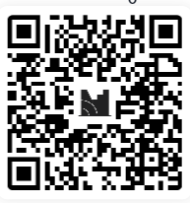
Poll Question
Which student advising strategies are most widely used to support college completion? (select all that apply)
Which strategies have high evidence of effectiveness in supporting college completion? (select all that apply)
Go to www.menti.com and enter code 5294 3091 or scan the QR code

Slide 13
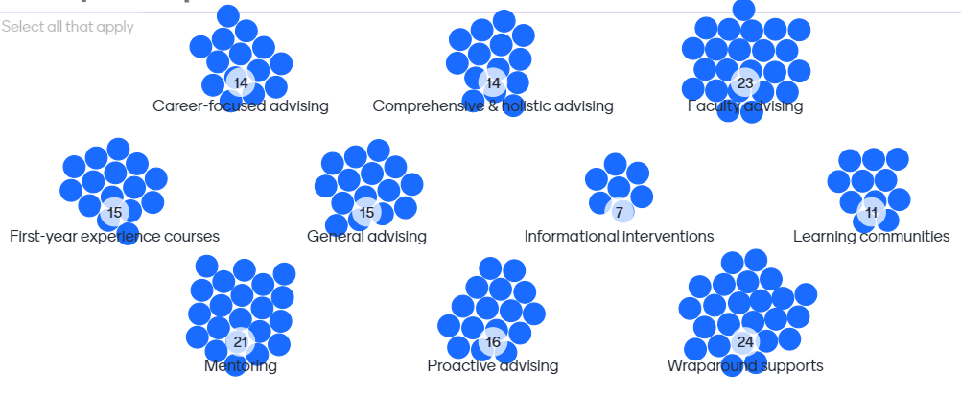
Which student advising strategies are most widely used to support college completion? (Survey Results)
Choices | Votes
Career-focused advising | 14
Comprehensive & holistic advising | 14
Faculty advising | 23
First-year experience courses | 15
General advising | 15
Informational interventions | 7
Learning communities | 11
Mentoring | 21
Proactive advising | 16
Wraparound supports | 24

Slide 14
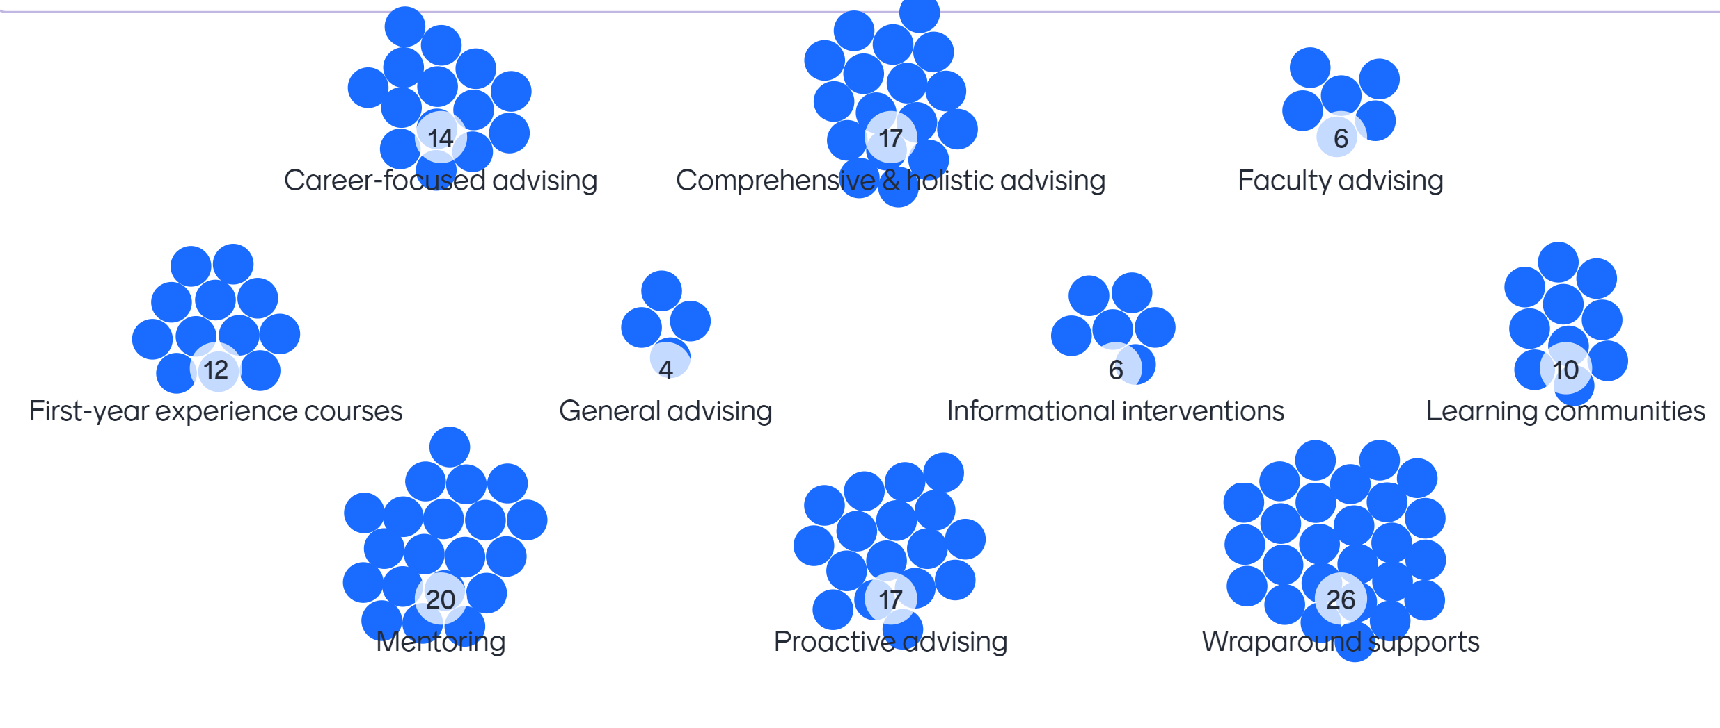
Which strategies have high evidence of effectiveness in supporting college completion? (Survey Results)
Choices | Votes
Career-focused advising | 14
Comprehensive & holistic advising | 17
Faculty advising | 6
First-year experience courses | 12
General advising | 4
Informational interventions | 6
Learning communities | 10
Mentoring | 20
Proactive advising | 17
Wraparound supports | 26

Slide 15
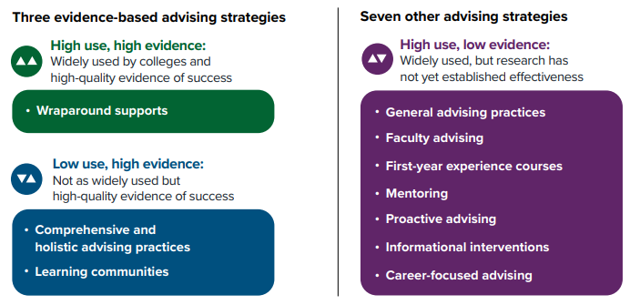
Evidence-based Advising Strategies
Source: Three Evidence-Based Advising Strategies to Support College Completion (College Completion Network)

Slide 16
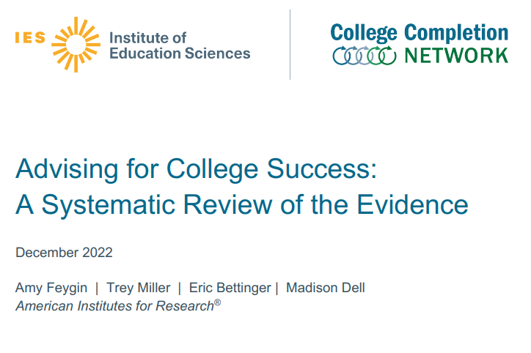
Key Findings on Advising for College Success
Student outcomes improve when we use:
  Holistic and comprehensive interventions that combine multiple components to meet student needs
  Proactive communication with sustained follow-up that spans a student’s trajectory through college
  A robust set of nonacademic supports through comprehensive case management

Slide 17
Supporting Student Retention & Success in Practice

Slide 18

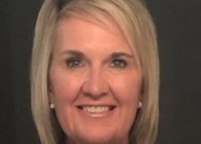
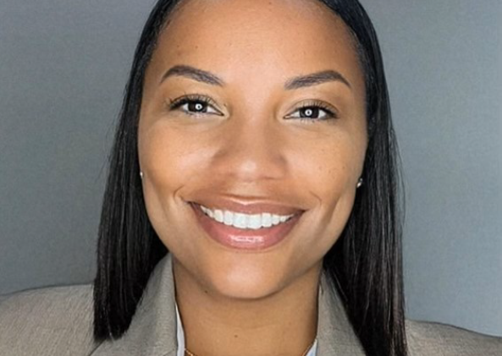
Presenters
Heidi Sanborn, DNP, RN, CNE
  Clinical Associate Professor
  Sr. Director, Post-licensure Programs
  Edson College of Nursing and Health Innovation
  Arizona State University
Lynn Harris, M.Ed.
  Program Coordinator Post-Licensure, DOL Grant Coordinator
    Arizona State University
Nikki Coleman
  Workforce Development Specialist
    1199SEIU Training and Employment Funds

Slide 19
Student Support at Arizona State University
Financial & Academic Help
Admission
1:1 meetings
Partnership Agreements
Ongoing
Student Training & Immersions
Advisory Committee
Graduation
Job Fairs
Practicums
Direct Care (hospitals)
Role-focused (RN programs)
Incentives
Orientation; Supportive Services Screen; Stipends;
Data
Stipends;
Screening; Advising, Tutoring & Success Coaching
Stipends;
Screening; Advising, Tutoring & Success Coaching
Stipends;
Incentives;
Recruiting;
Post-graduation surveys
Competency Development

Slide 20
Panel Questions
How do you identify the needs of your participants during their training/education program?
What tools/processes have you developed for making support services available during training/education program?
What barriers have you found in providing support services to your participants? How are you troubleshooting them?

Slide 21

Q&A

Slide 22
Wrap-up

Slide 23
Session Resources
AIR’s College Completion Network resources
Understanding the Student Experience: Loss and Momentum Framework (Completion by Design)
Basic Needs Center Toolkit (California Community Colleges)
H-1B Ready to Work Internship and Paid Work Experience Toolkit
Individual Career Plan for Advancement
Practitioner’s Playbook for Applying Behavioral Insights to Labor Programs
Communication Tools: Tools to track progress and increase engagement

Slide 24

Thank you!
The American Institutes for Research® (AIR), completed this project with federal funds, under contract number 1605C2-23-Q-00074 Nursing Expansion Grant TA, from the U.S. Department of Labor, Employment and Training Administration. The contents of this publication do not necessarily reflect the views or policies of the Department of Labor, nor does mention of trade names, commercial products, or organizations imply endorsement by the U.S. Government. AIR is a nonpartisan, not-for-profit organization that conducts behavioral and social science research and delivers technical assistance to solve some of the most urgent challenges in the U.S. and around the world.

