Slide 1
Eligible Training Provider
Performance Data Collection
Module 17
2019 WIOA National Performance Training
U.S. Department of Labor
Employment and Training Administration

Slide 2
Today’s Objectives
Eligible Training Provider Reporting: A flash review
Answer Frequently Asked Questions
Discuss ETP reporting in practice

Slide 3

Quick Review of ETP Performance Reporting Requirements

Slide 4
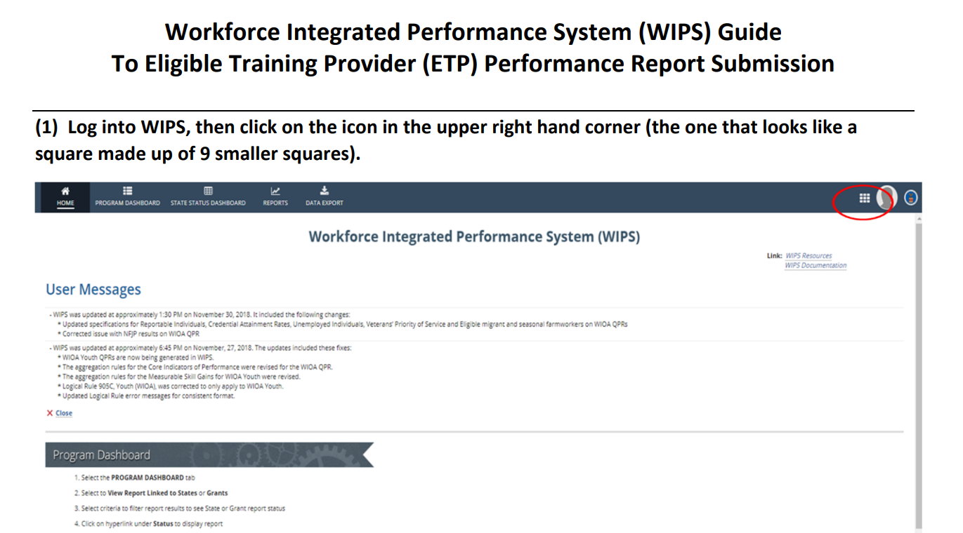
Reviewing ETP Reporting Requirements
All states (including those with “all students” waiver) must submit ETA-9171, according to requirements in TEGL 03-18
Submit Reports in WIPS
  ETP-WIPS
  Submission Guide

Slide 5
Frequently Asked Questions: ETP Reporting
My state requested a waiver of the requirement to report on all students, what am I still required to report?
Do I have to report the past 3 years of data?
Am I able to test my ETP submission in WIPS?
What are the reporting cohorts for the elements?
What if a provider/program has multiple physical locations?
Notes:
The next slides will go over each question.

Slide 6

My state requested a waiver of the requirement to report on all students, what am I still required to report?
Everything except the “All Students” elements in the ETA-9171. For those elements, just fill in the corresponding WIOA participant numbers (to clear the edit checks)

Slide 7

Am I able to test my ETP submission in WIPS?
Yes! The ETP report submission is live.

Slide 8

Do I have to report the past 3 years of data?
You do not have to report retroactive data. For individual programs, and this report as a whole, the requirement to report multiple years is accumulated moving forward.

Slide 9
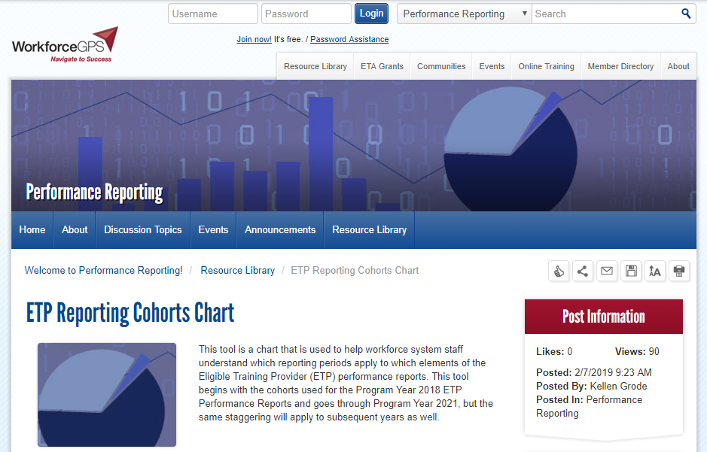
What are the reporting cohorts for the elements?
The cohorts are aligned to the WIOA cohorts. ETA has a tool on WorkforceGPS:
https://performancereporting.workforcegps.org/resources/2019/02/06/22/21/ETP-Reporting-Cohorts-Chart

Slide 10

What if a provider/program has multiple physical locations?
Right now, you can only report the main location for the provider (unless each location is approved as a separate program on the ETP list). In the future, ETA may consider adding the option to report multiple locations for a single provider/program.

Slide 11
Check-in with States: How ready are you to submit ETP reports to ETA?
Where are you with your reporting preparations?
What feedback have you received from your vendors/those developing your reports?
  What are the most challenging elements to collect/report?
If your state has the “all students” waiver for ETP reporting:
  How are you managing continued eligibility requirements?

Slide 12
Any Questions?

Slide 13

Resources
Eligible Training Provider Reporting Guidance
  TEGL 03-18
    https://wdr.doleta.gov/directives/corr_doc.cfm?DOCN=3527
ETP-WIPS Report Submission Guide
    https://performancereporting.workforcegps.org/resources/2018/12/04/14/27/WIPS-ETP-Report-Submission-Guide
ETP Reporting Cohorts Chart
  Resource on Performance CoP
    https://performancereporting.workforcegps.org/resources/2019/02/06/22/21/ETP-Reporting-Cohorts-Chart

Slide 14
Contact
      ETAPerforms@dol.gov

Slide 15
Please complete your evaluations.

