Slide 1

RESEA State Plans:
Tips on Completing Element 22: Evidence-Based Standards and Evaluation Requirements
Last Updated May 2026

Slide 2
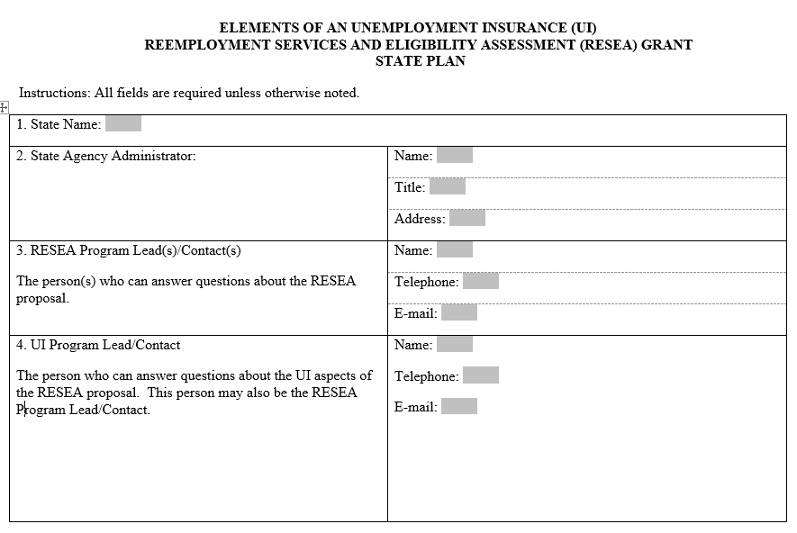
Overview
The purpose of this plain language tool is to assist states in completing Elements 22a to 22g of the RESEA state plan template.
Screenshot from RESEA State Plan Template, Page 1
Helpful links to evaluation technical assistance and related resources are included on the last page of this document.
For more help with your RESEA state plan, please contact your Employment and Training Administration (ETA) Regional Office.

Slide 3
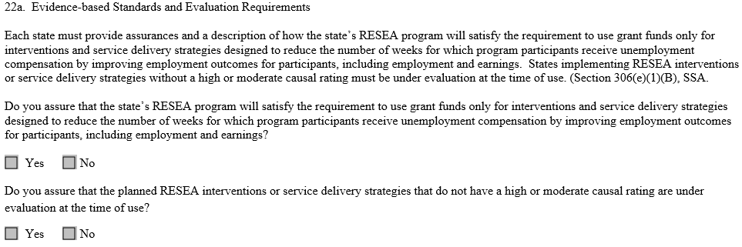
Element 22a (Updated for FY26)
22a. Evidence-based Standards and Evaluation Requirements
If “No” to the first question, please include a short explanation of the reason.
Answer “Yes” to the second question if there is any ongoing evaluation of the RESEA program; otherwise answer “No”.
Screenshot from RESEA State Plan Template,
Element 22a
Consider whether your state is:
Evaluating the RESEA program as a whole
Evaluating one or more component(s) of the RESEA program
Conducting any other type of RESEA program evaluation
If 1, 2, or 3 is true, then check “Yes” on the second question and describe the evaluation efforts in 22e.
A response is required. If you have questions on how to respond, reach out to OUI.RESEA@dol.gov.

Slide 4
Element 22b
22b. Is your state using interventions that have received a ‘High’ or ‘Moderate’ RESEA causal evidence intervention ratings in CLEAR?
- Most states will respond “Yes” and describe the intervention(s) and corresponding evidence in 22c and 22d.
- If “No”, then please note all parts of the state’s RESEA program must be currently under evaluation. Please describe the evaluation plans in 22e.
Screenshot from RESEA State Plan Template,
Element 22b
Resources for completing 22b:
For a current list of categories of RESEA interventions and their intervention causal evidence rating, visit CLEAR’s RESEA Program tab. (See Slide 5 for tips on using CLEAR to identify studies). As of May 2026, three interventions have received ‘High’ or ‘Moderate’ intervention ratings (Reemployment Eligibility Assessments, Job Search Assistance, and Profiling) .
For more information, refer to UIPL 01-20 and TEGL 6-19, or the CLEAR Causal Evidence Ratings Tool available on WorkforceGPS.org.
The CLEAR website is undergoing changes to improve functionality and ease of accessing content. While it may have a new look, all the information is available at https://clear.dol.gov/. Reach out to the RESEA helpline (RESEA@abtglobal.com) or CEO inbox (ChiefEvaluationOffice@dol.gov) for assistance navigating the site.

Slide 5
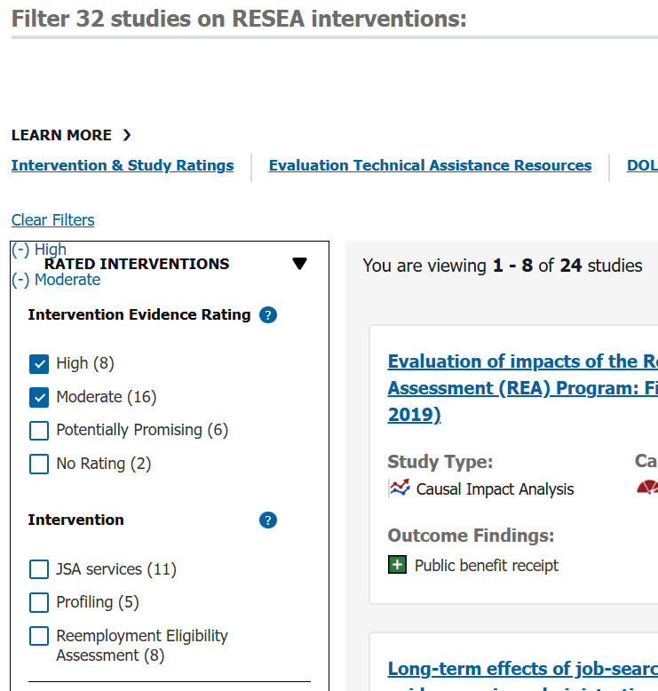
Elements 22a and 22b, continued
Tips for using CLEAR’s RESEA Program Tab to identify interventions related to RESEA with High or Moderate causal evidence:
Screenshot from CLEAR’s RESEA Program tab
1. Click checkboxes for “High” and “Moderate” to filter for studies on rated interventions
3. After filtering on intervention evidence rating and on intervention, review relevant studies on which the ratings are based.
2. Once filtered on “High” and “Moderate”, only interventions with these ratings remain; use checkboxes to filter for studies specific to a particular intervention
The CLEAR website is undergoing changes to improve functionality and ease of accessing content. While it may have a new look, all the information is available at https://clear.dol.gov/. Reach out to the RESEA helpline (RESEA@abtglobal.com) or CEO inbox (ChiefEvaluationOffice@dol.gov) for assistance navigating the site.

Slide 6
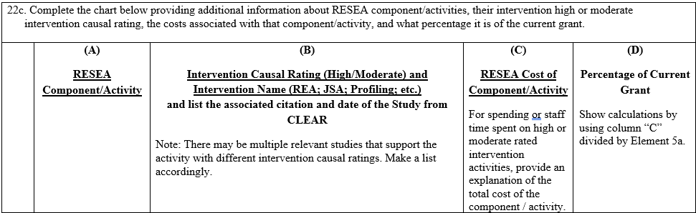
Element 22c (Updated for FY26)
22c. Complete the chart (see Slide 7 for notes on completing Columns A & B, or Slide 8 for notes on completing Columns C & D).
This table is for citing intervention(s) and RESEA program activities your state is using to inform its RESEA program design. The interventions must have a ‘High’ or ‘Moderate’ RESEA intervention rating in CLEAR.
Screenshot from RESEA State Plan Template,
Element 22c
Resources for completing 22c:
Use the CLEAR's RESEA Program tab (see Slide 5) to identify and review research studies relevant for RESEA. Filter on High or Moderate intervention rating to identify studies that provide evidence about the effectiveness of interventions described in the state plan.
Review Considerations for Assessing the Applicability of Evaluation Evidence from RESEA Evaluation and Evidence Resources available on the RESEA section in WorkforceGPS.org.
The CLEAR website is undergoing changes to improve functionality and ease of accessing content. While it may have a new look, all the information is available at https://clear.dol.gov/. Reach out to the RESEA helpline (RESEA@abtglobal.com) or CEO inbox (ChiefEvaluationOffice@dol.gov) for assistance navigating the site.

Slide 7
Element 22c, continued
Column (A): “RESEA Component/Activity”
  List the specific intervention your state implements.
  Then, describe the intervention(s) your state is using, providing enough detail so that it is clear how the intervention compares with any corresponding evidence cited in Column (B). More than one intervention may be listed.
  Two activities have been pre-filled. At a minimum, every state must complete the chart for “Required Initial RESEA Meeting Activity” listed in the chart as activity 1a. Add any notes about unique aspects of the state’s implementation of the Initial RESEA in 1b. For states that offer subsequent RESEA meetings, complete 2a and 2b. Any additional RESEA activities can be listed below 2b.
Column (B): Intervention Causal Rating (High/Moderate) and Intervention Name
  List which High or Moderate rated intervention best corresponds to the intervention or program activity listed in Column (A).
  Indicate the current rating (i.e., high or moderate) and at least one title of a study and the study publication date that is associated with the rated intervention. More than one study may be listed to support the stated intervention. A list of studies that were reviewed in developing ratings for RESEA interventions can be found on CLEAR’s RESEA Program tab. (See Slide 5 for tips on finding studies).
The CLEAR website is undergoing changes to improve functionality and ease of accessing content. While it may have a new look, all the information is available at https://clear.dol.gov/. Reach out to the RESEA helpline (RESEA@abtglobal.com) or CEO inbox (ChiefEvaluationOffice@dol.gov) for assistance navigating the site.

Slide 8
Element 22c, continued
Column (C): RESEA Cost of Component/Activity
  List the planned costs for implementing each activity listed in Column (A).
  Show calculations. For example, list the estimated cost to complete the activity once, multiplied by the expected number of times the activity will be completed, to arrive at the total estimated cost.
Column (D): Percentage of Current Grant
  For FY26, states must devote at least 40 percent and starting in FY27, states must devote at least 50 percent of their RESEA funding to evidence-based components with a high or moderate causal rating that show a demonstrated capacity to improve employment and earnings outcomes for program participants. This table is used to assess that requirement.
  Please show calculations by dividing the corresponding cost from Column (C) by the total requested funds listed in Element 5a.
In the final row, list the total cost for all High and Moderate rated interventions, and the total percent this represents out of the total amount of requested funds.

Slide 9
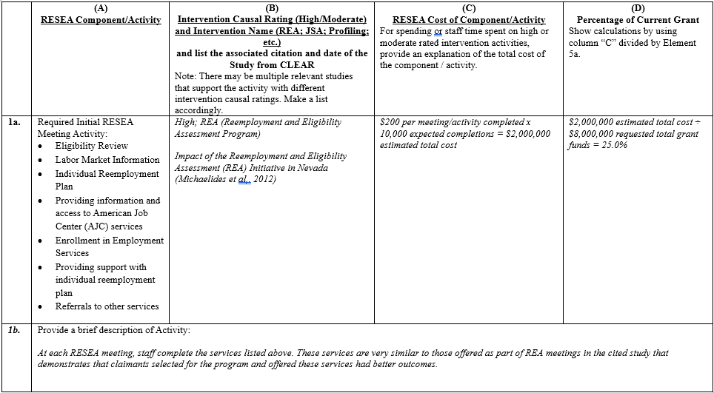
Element 22c, example
Hypothetical Example of Completing Table for Element 22c (for Initial RESEA Meetings)

Slide 10
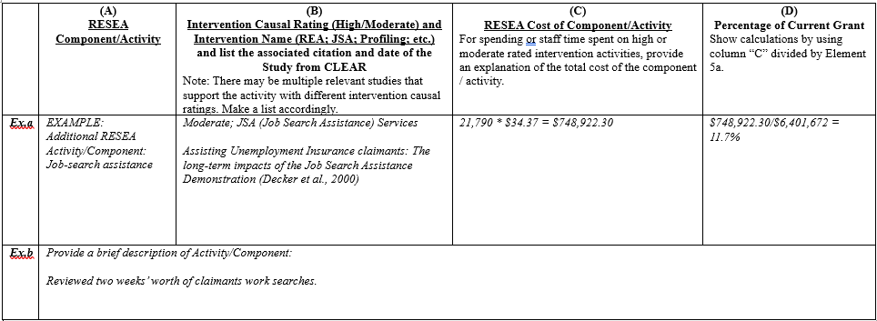
Element 22c, example
Hypothetical Example of Completing Table for Element 22c (for Additional RESEA Activities)

Slide 11
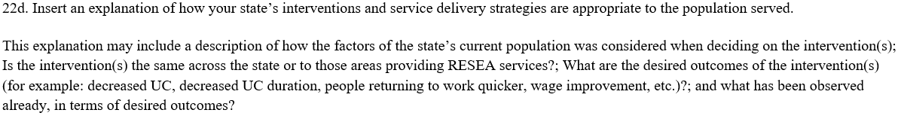
Element 22d
22d. Explain how your state’s RESEA interventions and service delivery strategies are appropriate to the population served.
In a few sentences, describe the claimants your RESEA program is serving and how the interventions or strategies listed in 22c are designed to improve outcomes for that population.
Screenshot from RESEA State Plan Template, Element 22d
Tips for completing 22d:
The narrative for 22d could address the following:
Describe whether and how any specific characteristics of the population were considered when deciding on the intervention(s).
Say whether the intervention(s) are implemented in the same way across geographic areas, or whether they differ.
Describe what are the desired measurable outcomes from the intervention(s) – what are you hoping to have an impact on? (for example: decreased UC dollars paid, decreased UC duration in weeks, people returning to work quicker, wage improvement, etc.)?
What has been observed already, in terms of desired outcomes?

Slide 12
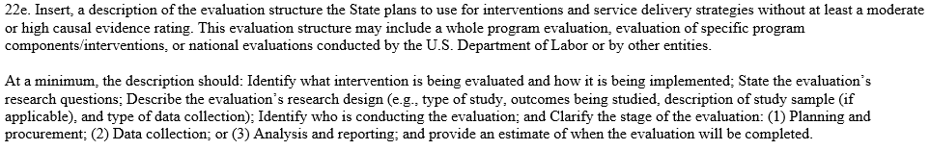
Element 22e
22e. Describe the State’s RESEA evaluation plans for the upcoming year.
This may include plans for a whole program evaluation, or evaluation of specific program components, interventions, or strategies. States may run their own evaluations, work with an outside evaluator, or participate in evaluations conducted by the USDOL.
Screenshot from RESEA State Plan Template, Element 22e
Resources for completing 22e:
For more information about expectations for states’ evaluation plans, refer to UIPL 08-24 Attachment VI, UIPL 01-20 and TEGL 6-19.
For help understanding different types of evaluations, refer to the RESEA Evaluation TA webinar series on WorkforceGPS.org, especially: What Evaluation Designs are Right for My State.
Use the CLEAR's RESEA Program tab (see Slide 5) to learn about interventions that have a growing evidence base (tip: unselect ‘High’ and ‘Moderate’ to see all interventions with emerging evidence).
The CLEAR website is undergoing changes to improve functionality and ease of accessing content. While it may have a new look, all the information is available at https://clear.dol.gov/. Reach out to the RESEA helpline (RESEA@abtglobal.com) or CEO inbox (ChiefEvaluationOffice@dol.gov) for assistance navigating the site.

Slide 13

Element 22f
22f. Total funds that will be set aside to conduct or cause to be conducted evaluations of interventions used in carrying out the RESEA Program.
Indicate how much money of this fiscal year’s budget your state will use for your evaluation. States may set aside up to 10 percent of their total requested grant award to conduct evaluations.
Screenshot from RESEA State Plan Template, Element 22f
Tips for completing 22f:
Refer to Element 5a for the total requested funds.
The amount listed in 22f should not be over 10 percent of the total requested funds. Do not round the dollar figure as this may make the amount greater than 10 percent.
Do not include any previous years’ evaluation costs.
Resources for completing 22f:
For help with evaluation planning, refer to the RESEA Evaluation TA webinar series on WorkforceGPS.org and see additional resources listed on Slide 16 .

Slide 14
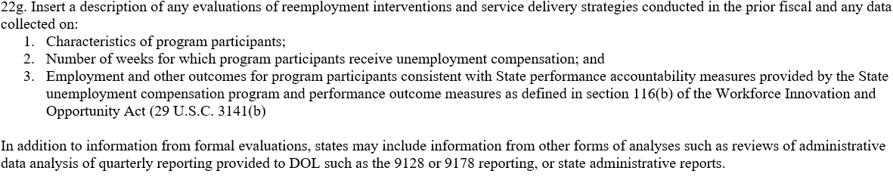
Element 22g
22g. Describe evaluations of reemployment interventions that were conducted or completed in the prior fiscal year.
States may also describe any data collection or analyses that occurred outside of formal evaluations.
Screenshot from RESEA State Plan Template, Element 22g
Tips for completing 22g
Summarize any evaluation or evaluation planning activities carried out in the prior fiscal year. Include an update and status on progress of the evaluation
Describe the types of data that were collected as part of evaluation activities in the prior fiscal year (e.g., data regarding the characteristics of program participants, or the number of weeks program participants received unemployment compensation)
Provide summary statistics for evaluation data elements collected to-date (e.g., mean, median, frequencies, etc.)
Provide relevant statistics from the quarterly reports submitted to DOL to describe the RESEA caseload (ETA 9128, 9129, 9130, 9178, etc.)
If evaluation data are not available or ready for preliminary analysis, please indicate when results are expected.
For help thinking about using data in evaluations, refer to the RESEA Evaluation and Evidence Resources on WorkforceGPS.org.

Slide 15
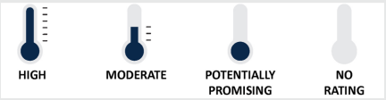

Additional Resources
UIPL 1-20 and TEGL 6-19, Expectations for States Implementing the Reemployment Service and Eligibility Assessment (RESEA) Program Requirements for Conducting Evaluations and Building Program Evidence.
  Related webinar on RESEA: Overview of Evaluation and Evidence Requirements
CLEAR’s RESEA Program tab. Identifies:
  RESEA interventions that have received ‘High,’ ‘Moderate,’ ‘Potentially Promising,’ or ‘No Rating’ intervention causal evidence ratings to-date. RESEA intervention ratings are indicated with a thermometer icon.
  Relevant research, summaries of specific studies, and syntheses of reemployment literature to-date
CLEAR’s causal evidence guidelines, which outline the standards by which impact studies using different designs can receive ‘High,’ ‘Moderate,’ or ‘Low’ causal evidence ratings by CLEAR. Impact study ratings are indicated with a gas gauge icon.
RESEA Intervention Ratings
CLEAR Study Ratings
The CLEAR website is undergoing changes to improve functionality and ease of accessing content. While it may have a new look, all the information is available at https://clear.dol.gov/. Reach out to the RESEA helpline (RESEA@abtglobal.com) or CEO inbox (ChiefEvaluationOffice@dol.gov) for assistance navigating the site.

Slide 16
Additional Resources, continued
The RESEA Evaluation and Evidence Resources landing page on WorkforceGPS.org provides evaluation resources and TA materials, such as:
  RESEA Evaluation Toolkit: This toolkit provides a basic overview of evaluation elements for program management purposes. It also provides information about other generally accepted and available evaluation resources that may be useful for state RESEA programs.
  Webinars and videos with information and tips for conducting studies about RESEA:
    Evaluating RESEA: How Does it Help My State and Where Do We Start
    Three Considerations for Designing and Implementing an RESEA Evaluation
    RESEA Evaluation Virtual Learning Series: An Overview
  Tipsheets with information on finding and submitting evidence on RESEA:
    Using the Clearinghouse for Labor Evaluation and Research (CLEAR) to Build Evidence on RESEA Programs
    Why and How to Submit an RESEA Evaluation Report for CLEAR Review
    Considerations for Assessing the Applicability of Evaluation Evidence
The CLEAR website is undergoing changes to improve functionality and ease of accessing content. While it may have a new look, all the information is available at https://clear.dol.gov/. Reach out to the RESEA helpline (RESEA@abtglobal.com) or CEO inbox (ChiefEvaluationOffice@dol.gov) for assistance navigating the site.

