Slide 1
A Focus on Strategic vs. Tactical Action for Boards
April 20, 2016
Strategic Boards Tool Kit

Slide 2

The WIOA Vision TEGL #19-14
The WIOA Vision TEGL #19-14 states that the “revitalized workforce system will be characterized by three critical hallmarks of excellence:
  The needs of business and workers drive workforce solutions;
  One-Stop Centers (or American Job Centers) provide excellent customer service to jobseekers and employers and focus on continuous improvement; and
  The workforce system supports strong regional economies and
  plays an active role in community and workforce development.”
Both Strategic and Tactical Action are required for a Board to reach necessary outcomes, and to fulfill the promise of WIOA Vision
So how do we differentiate between Strategic and Tactical Action?

Slide 3
Strategic v. Tactical
Tactical | Strategic | What this Means within a WIOA Context
Asks How? | Asks Why and What? | Not just interested in how individual programs may serve customers, but focuses on the bigger picture of modernizing the workforce system and ensuring it operates as a comprehensive, integrated and streamlined system for all workers and businesses
Reviews Real Time Analytics | Connects Activities to Vision, Mission, and projected future need | Goes beyond simply looking at workforce and occupational data, but uses data to set future goals, create strategic plans, performance improvements, and ensure system excellence
Focuses on current conditions | Focuses on emerging economic trends and labor market patterns | Understands and allocates resources to respond to current workforce skill needs while simultaneously planning for projected future industry needs. Has strong industry sector partnerships in place informing board decisions
Manages processes | Guides system development by defining goals and supporting transformational partnerships | Moves away from managing day to day processes and more toward capacity building, emphasizing lasting connections between core programs and relationships with industry
Determines “success” by reviewing outcomes relative to short-term performance measures | Evaluates system performance using board defined measures and targets that are reflective of local and regionally defined needs | Emphasizes regional planning and alignment with economic development strategy, creation of career pathways, and development of work-based learning for the long-term success of the workforce.

Slide 4
Strategic Boards…
Serve as the keeper of a guiding vision, and engages funders, partners, employers, and community members around that vision
Are committed to identify employer centric solutions through strategic regional partnerships and collaborative service
Have an effective structure and measurement process including assessing, reporting and seeking to improve program outcomes

Slide 5
WIOA Vision
WIOA drives a vision for more strategic action by Workforce Boards, with particular focus on a unified vision for workforce development shared by all levels of Boards within a state, more extensive collaboration with partners and employers, and expanded accountability and transparency.
In the realm of strategic activities, Boards will want to consider items such as:
  The impact of common
  performance measures,
  New employer measures,
  Career pathways for adult
  and youth populations,
  Sector strategies,
Today, we will select Sector Strategies as an example category, and walk through the process of delineating and planning for both Strategic and Tactical Action
  The re-envisioning of American Job Centers (AJC),
  Staff capacity building,
  One Stop / AJC procurement, cost sharing, and certification, along with many other issues.

Slide 6
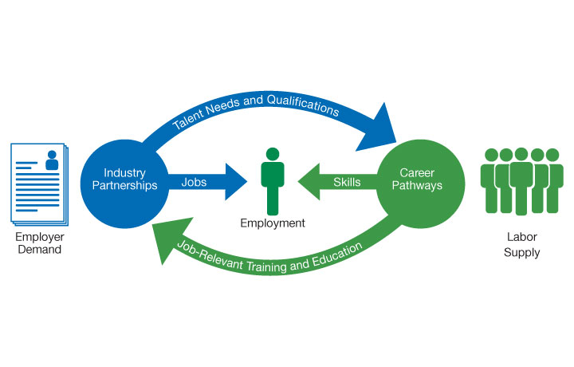
From Policy to Practice

Slide 7
Sector Strategies…
An Employer Centric Solution
A comprehensive approach to identifying and responding to the broad workforce needs of an industry sector within a State or Region
Looks to planning long term strategies for the economic growth and development of an industry within an area over time
Consists of goals, plans of action, policies, and service delivery strategies developed and continuously re-examined to meet the needs of employers
Proven framework for addressing skill gaps and engaging industry in education and training
Required element of regional planning in alignment with local labor market needs for identified in-demand sectors and occupations.

Slide 8
Sector Partnerships
Focused, active partnerships among businesses in a target industry sector
Critical partners include workforce development organizations, educators, training providers, labor unions, community organizations, and other key stakeholders
Activities improve access to quality training and good jobs that increase job quality in ways that also strengthen that industry’s workforce

Slide 9
Table Top Exercise
Sector Strategies Approach to Employer Engagement and Career Pathways
Does the Board have a role to play?
If so, what is their role?
What things would you look for if reviewing the Board?

Slide 10

Report Out

Slide 11
Examples of a Strategic
Approach to Sectors
Target sectors are identified using the most currently available regional labor market data.
Clearly reflected in goals and actions of the strategic plan and is in alignment with the seven critical factors for sector partnerships.
Industry partnerships include key sector employers who are driving the initiative forward.
Gives clear direction to the career center operator regarding industry sectors to be targeted, including quantified expectations and targeted service and training resources.
Coordinates with education providers, human service partners, and industry associations in the design and delivery of career pathways aligned to skill needs identified sector strategy efforts.
Engages in a collaborative, demand-driven approach to respond to employers’ immediate needs in partnership with economic development entities and service providers.
Develops linkages with employers to encourage employers using the system and to support American Job Center local talent development needs.

Slide 12

Other Thoughts and Ideas

Slide 13

Maher & Maher completed this project, with Federal funds from the U.S. Department of Labor, Employment and Training Administration under Contract Number DOLQ131A22098.

