Slide 1
USING DATA TO MEASURE SUCCESS AND ACCELERATE PROGRESS (track 1)
Day 3, Session 1a: Nursing Expansion Institute

Slide 2



Presenters
Kristen Milstead
  Nursing Expansion Program Lead
    U.S. Department of Labor/Employment and Training Administration
Dani Abdullah
  Nursing Expansion Program Support
    U.S. Department of Labor/Employment and Training Administration
Tessa St. John
  Grants Management & Performance Lead
    Social Policy Research Associates

Slide 3
Agenda
Session Objectives & Guiding Questions
Nursing Expansion First Year Data
Connecting Your Data to the Big Picture
Introduction to the Quarterly Scorecard
Q&A

Slide 4
Session objectives
Session Objectives
  Understand how Nursing Expansion grantees are performing overall after the first year
  Learn how to use your data to monitor progress and target areas for change
  Receive an introduction to the Quarterly Scorecard tool

Slide 5
Guiding Questions
Guiding Questions
  How is the Nursing Expansion grant program doing? How are we doing compared to the grant program overall?
    NOTE: Grantee data will be shown in this presentation anonymously.
  Why spend time focusing on data and reporting?
  How can I incorporate reporting and data into my project planning?

Slide 6
Participant reporting temperature check
What word comes to mind when you consider your first experience reporting participant data in WIPS?

Slide 7
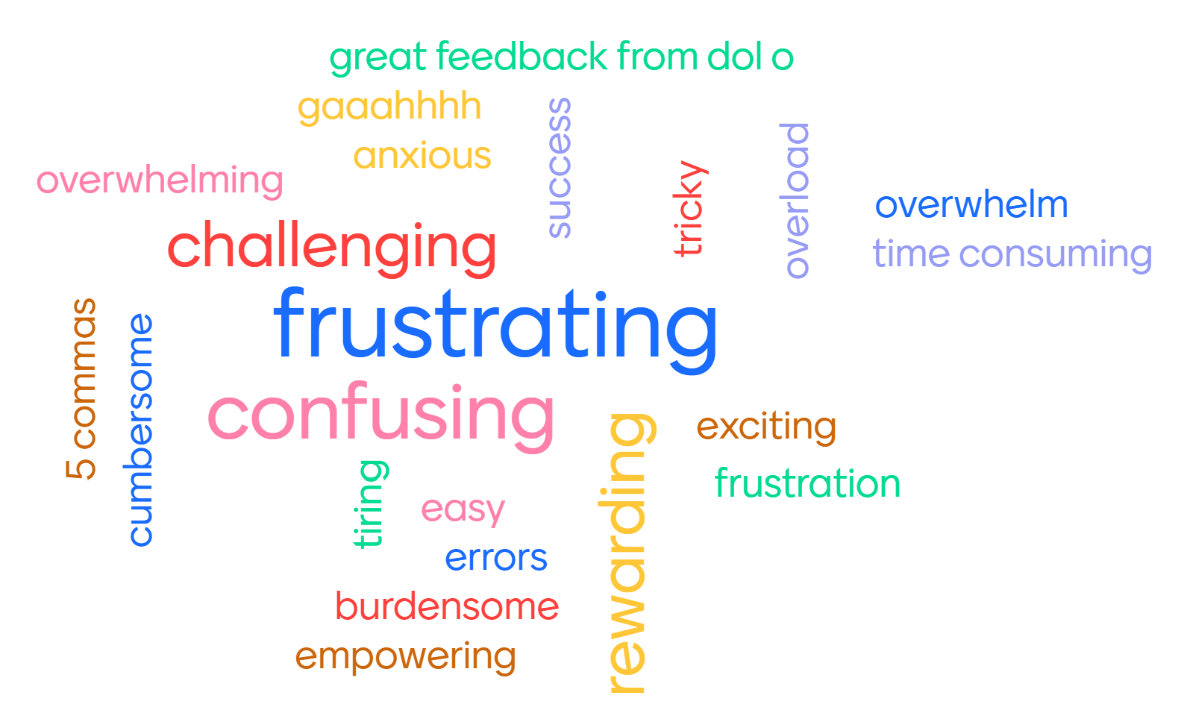
What word comes to mind when you consider your first experience reporting participant data in WIPS?
Responses
Overwhelm
easy frustrating
Burdensome
Gaaahhhh
Frustration
5_commas
Confusing Overwhelming Errors
Anxious Frustrating Tricky
Cumbersome Frustrating
Time_consuming Confusing Great_feedback_from_DOL_o
Frustrating Overload
Challenging Exciting Success
Confusing
Challenging Tiring Rewarding
Empowering
rewarding

Slide 8
What the data show
Nursing expansion grant program: One year in

Slide 9
Real-time performance outcome measures
Track 1
Total number of participants served
01
Total number of participants who began receiving education/job training activities
02
Total number of participants who began receiving education/job training activities and achieved a measurable skills gain
03
Total number of participants who completed education/job training program activities
04
Total number of participants who completed education/job training program activities and obtained a credential
05
Total number of participants who completed education/job training program activities and either entered unsubsidized employment or advanced into a new position
06

Slide 10
Nursing Expansion Participants
Race and gender demographics

Slide 11
Nursing expansion participants education status at participation

Slide 12
Nursing expansion other populations served

Slide 13
Nursing Expansion
Employment Status at Participation

Slide 14
Track 1 Demographics
Quarter Ending 6/30/2024
Race/Ethnicity
146
11
Male
135
Female
Participants Served
29
Youth (17–29)
9
55 and Older
Other Demographics
Education

Slide 15
Nursing Expansion
Total Outcomes

Slide 16
Participants Served
Quarter ending 6/30/2024: 1,089
20 grantees have started serving participants
Grant program is 15% to target
Average – 18%
Median 14%
Track 1 – Green
Track 2 – Blue

Slide 17
Participants Enrolled in Training
Quarter ending 6/30/2024: 952
17 grantees have started training participants
Grant program is 13% to target
Average 16%
Median 14%
87% of participants served have started training

Slide 18
Completed Training
Quarter ending 6/30/2024: 223
9 grantees have participants who have completed
No Track 1 grantees have participants who have completed
Grant program is 4% to target
Average – 7%
Median – 4%
Of those who have started training, 23% have completed

Slide 19
Completion and obtained a credential
Quarter ending 6/30/2024: 185
8 grantees have participants who have completed and obtained a credential
Grant program is 3% to target
Average – 8 %
Median – 4%
Of those who have completed, 83% have obtained a credential
426 total credentials – includes credentials obtained pre-completion

Slide 20
Entered employment or advanced to new position
Quarter ending 6/30/2024: 78
5 grantees have participants who have either entered employment or advanced to a new position
Grant is 2% to target
Average – 4%
Median – 4%
Of those who have completed training, 35% have either entered employment or advanced to new position

Slide 21
Measurable Skills gains
This outcome does not appear on the QPR and progress towards the target will be provided to grantees periodically from DOL.
Data Elements Used for this Outcome
PIRL 1809 Date of Most Recent Measurable Skills Gain (Training Milestones)
PIRL 1810 Date of Most Recent Measurable Skills Gain (Skills Progression)
or
Track 1 total progress-to-date for MSG not yet available.

Slide 22
Data validation as a strategy for success
Connecting your data to the big picture

Slide 23

Celebrate your successes

Slide 24

Why is DATA important?
Minimum objective
  Meeting performance targets = success
Measurable Outcomes
  Impact on community
Decision-Making
  Program adjustments
Accountability
  Federal grant continuation

Slide 25
A DATA-DRIVEN MODEL FOR SUCCESS
1.
Collect/ Track Info on Participant Activity
2.
Report Participant Activity
3.
Review Report Output
4.
Make Report Corrections
5.
Analyze Program Impact
6.
Make Program Adjustments

Slide 26
TWO major QUESTIONS YOUR DATA can HELP ANSWER
Does my report represent my program’s achievement on the outcomes?
  Ask: Is this data accurate?
Is my program on track to achieve outcome targets?
  Or, is my program effective at doing what I expect it to do?
  Ask: Are participants progressing through my program and getting jobs?

Slide 27
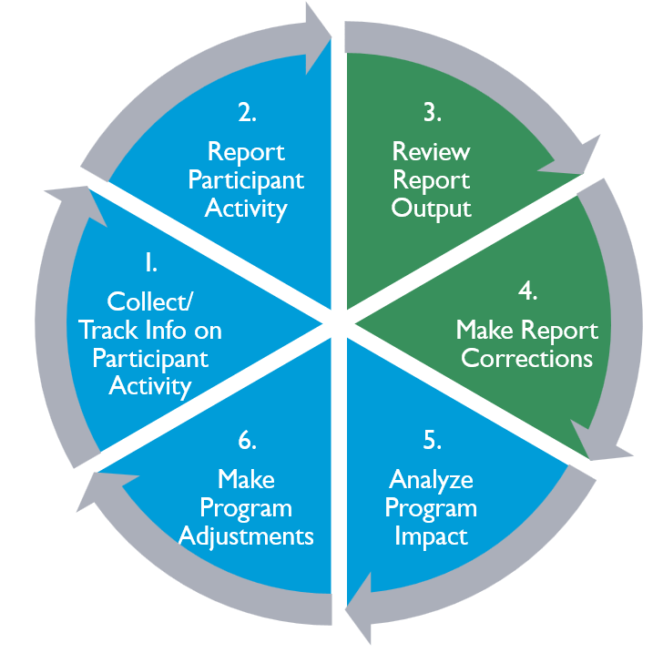
Assessing Data accuracy
Does my report represent my program’s achievement on the outcomes?
  Review
  Correct

Slide 28
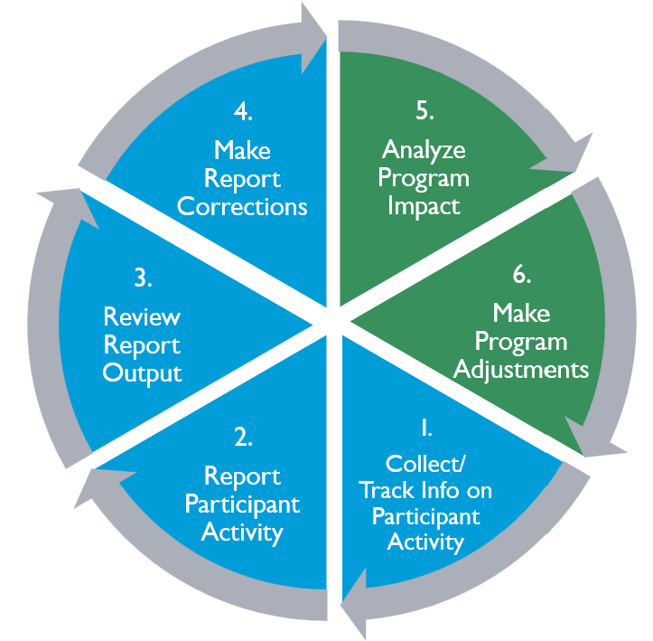
Assessing Program effectiveness
Is my program on track to achieve outcome targets?
  Analyze
  Adjust

Slide 29
HOW to assess accuracy and effectiveness
Data Assessment:
Review and Correct
Understand how to interpret outcomes
Know which data from your data file generate outcomes
Program Assessment: Analyze and Adjust
Memorize targets
Build target progress review into meetings
Compare gaps in achievement with participant lifecycle stages

Slide 30
Review and correct: understand how to interpret outcomes
Ensure you know what the number on your QPR actually means
  Understand the official DOL definition for each outcome:
    Nursing Expansion FOA
    Performance Reporting Handbook
    Performance Reporting Orientation 202
Your data collection/tracking process must gather data that represents the definition.
    Not what you think the outcome means (or think it should mean).

Slide 31
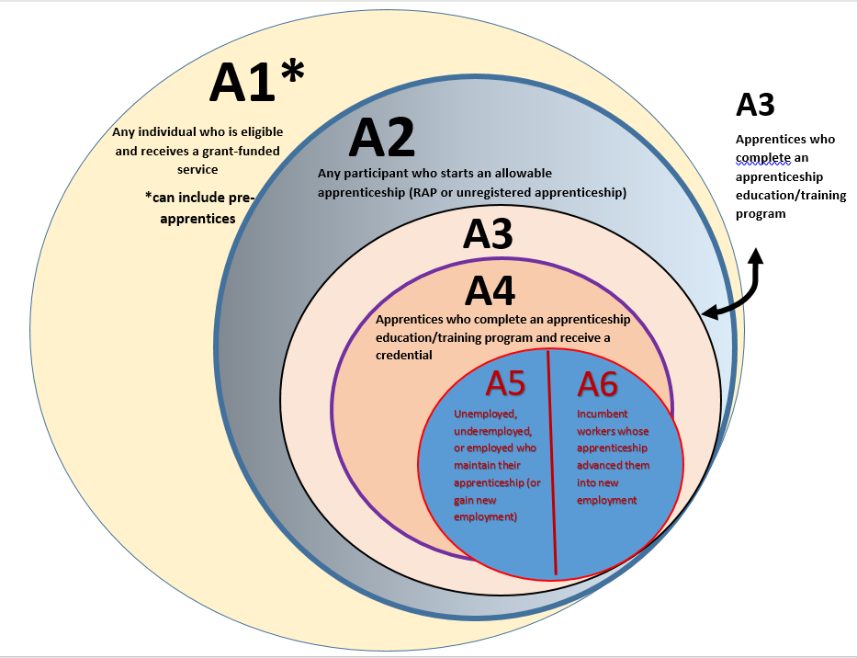
Track 1 Real-time Outcomes
¹
2
Participants who enroll in education/training activities
3
Any individual who is eligible
and receives a grant-funded
service
3
Participants who achieve a measurable skills gain
4
Participants who complete a program
5
6
5
…complete a program and receive credential
…complete a program and enter employment or advance to a new position

Slide 32
Review and correct: know which data from your data file generate outcomes
Ensure you understand which data elements WIPS uses to count participants in an outcome.
  Learn the aggregation rules for each outcome:
    H-1B PIRL 2021 v. 1.1, Tab 7
A participant must have data in these corresponding data elements to show up in an outcome.

Slide 33
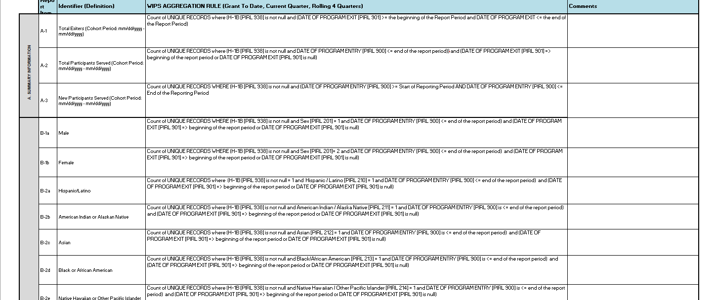
Aggregation rules look like formulas
Count of UNIQUE RECORDS where (H-1B [PIRL 938] is not null and DATE OF PROGRAM ENTRY [PIRL 900] <= end of the report period)) and (DATE OF PROGRAM EXIT [PIRL 901] => beginning of the report period or DATE OF PROGRAM EXIT [PIRL 901] is null)

Slide 34
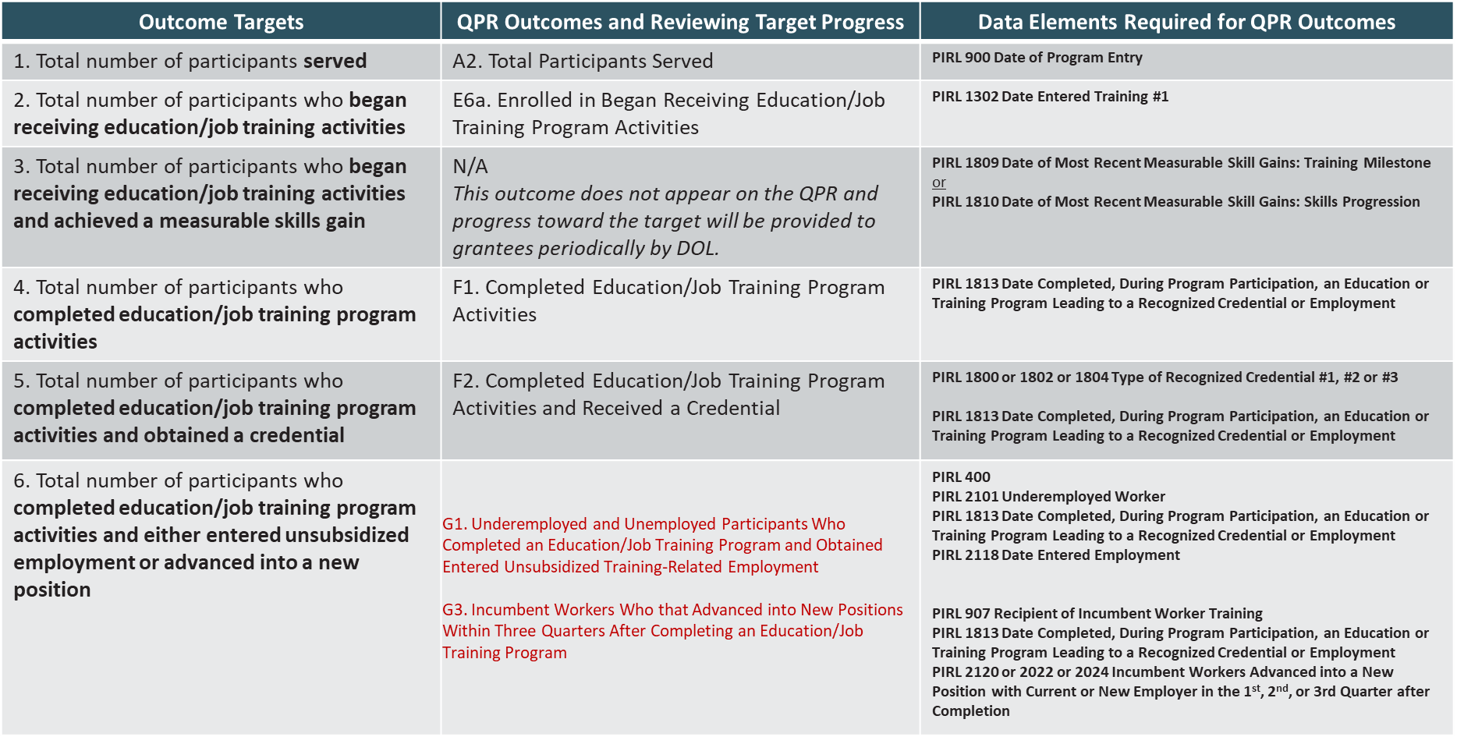
Crosswalk of real-time Outcomes and pirl data elements

Slide 35
WHY data can be “official” but inaccurate
Inaccurate understanding of the who, what, when, and why of an outcome
Forgetting to report a participant’s activity
Not capturing the right information
Lacking a process for reliably capturing required information

Slide 36
EXAMPLE
Outcome #6
Total number of participants who completed education/ job training program activities and either entered unsubsidized employment or advanced into a new position
G1. Entered Unsubsidized Employment
G3. Incumbent Workers that Advanced into New Positions Within Three Quarters After Completing an Education/Job Training Program
PIRL 400 Employment Status at Entry = 0
PIRL 2101 Underemployed Worker = 1
PIRL 1813 Date Completed, During Program Participation, an Education or Training Program Leading to a Recognized Postsecondary Credential or Employment
PIRL 907 Recipient of Incumbent Worker Training = 4
PIRL 1813 Date Completed, During Program Participation, an Education or Training Program Leading to a Recognized Postsecondary Credential or Employment
PIRL 2120 Incumbent Workers Advanced into a New Position with Current or New Employer in the 1st Quarter After Program Completion or
PIRL 2122 Incumbent Workers Advanced into a New Position with Current or New Employer in the 2nd Quarter After Program Completion or
PIRL 2124 Incumbent Workers Advanced into a New Position with Current or New Employer in the 3rd Quarter After Program Completion (one of PIRL 2120/2122/2124 must = 1)

Slide 37
What *not* to do if your data seems wrong or causes errors
Ignore it
Add, change, or take out information in your data file until an error “goes away”
Tell yourself you’ll figure out where the inaccuracy is next quarter
Assume it’s a glitch in WIPS
Write an email to your FPO or the Program Office about how annoying the reporting process is

Slide 38
Tips for correcting inaccuracies
Establish clear, consistent processes for collecting, track, and reporting accurately
  Highlight the data elements that matter
  Determine the procedure for capturing each one
  Ensure all staff with any role in data management know those procedures
  Review procedures occasionally to learn whether its effective
  Before submitting, look at the QPR and note discrepancies
  Review your data file for potential “undercounts”

Slide 39
Program level: analyze and adjust
Memorize your targets
Regularly review your progress toward targets
Compare gaps in progress with stages in the participant support lifecycle

Slide 40
Track 1 quarterly performance scorecard
ACCELERATING PROGRESS TOWARDS PERFORMANCE TARGETS

Slide 41

What is the quarterly performance scorecard?
A tool for assessing progress towards targets
  Provided quarterly
    First scorecard in September 2024
  Data from quarterly reports
  Use in conjunction with PSL Tool

Slide 42
Quarterly Performance scorecard
Grantee: [Grantee Name]
Quarter Ending: [xx/xx/xxxx] Percent of Grant Elapsed: 15%
Performance Outcome Measure | Actual 6.30.24 | Total Target | Number Remaining to Target | Percentage of Total Target Achieved | Percentage Achieving Outcomes at Participant Lifecycle Stages
Participants served | 137 | 440 | 303 | 31% | N/A
Participants enrolled in education/training activities | 137 | 440 | 303 | 31% | Percent of those served who enrolled: 100%
Participants who achieved a Measurable Skills Gain (MSG) | 100 | 440 | 340 | 23% | Percent of enrollees who achieved an MSG: 73%
Participants who completed education/training activities | 68 | 341 | 273 | 20% | Percent of enrollees who completed training: 50%
Participants who completed education/training activities AND received a credential | 20 | 341 | 321 | 6% | Percent of completers who received credential: 29%
Participants who completed education/training activities and either entered employment or advanced into a new position | 15 | 81 | 66 | 19% | Percent of completers who entered employment or advanced to a new position: 22%

Slide 43
Use the scorecard to evaluate your program
Understand & validate data
Identify gaps in meeting goals
Break grant targets into quarterly targets
Develop an action plan to achieve results
Discuss grant amendments with your FPO
Establish ongoing reviews for continuous improvement

Slide 44
1. Understand and validate your data
Crosswalk of Performance Outcome Measures for Track 1
Official Performance Outcome Measure | Scorecard Performance Outcome Measure | QPR Outcomes Used for Reviewing Target Progress | Data Elements Required for QPR Outcomes
1. Total number of participants served | Participants served | A2. Total Participants Served | PIRL 900 Date of Program Entry
2. Total number of participants who began receiving education/job training activities | Participants enrolled in education/training activities | E6a. Began Receiving Education/Job Training Program Activities | PIRL 1302 Date Entered Training #1
Scorecard
QPR
PIRL

Slide 45
2. Identify gaps in meeting goals
Percent of Grant Elapsed: 62%
Performance Outcome Measure | Actual 6.30.26 | Total Target | Number Remaining to Target | Percentage of Total Target Achieved | Percentage Achieving Outcomes at Participant Lifecycle Stages
Participants who completed education/training activities | 50 | 150 | 100 | 33% | Percent of enrollees who completed training: 50%
Compare Percent of Grant Elapsed to Percentage of Total Target Achieved
  Is there an issue?
  What considerations might apply?

Slide 46
3. Break grant targets into quarterly targets
Develop short-term goals
  Determine participants needed
  Divide by the quarters left
Consider timing of training for quarterly goals
  Set targets based on training start and end dates
REMINDER: No new participants after the 4th year
  Final 12 months is to complete training
  Enrollment goal must be met in the 16th quarter

Slide 47
4. Develop an action plan to achieve results
Use the PSL Tool as a guide
  Where are the gap areas?
  What changes will impact performance targets?
Link participant success to performance outcomes
Consider what is working!
  Can these be replicated?

Slide 48
5. Discuss grant amendments with your fpo
Did you identify necessary adjustments?
  Add a new training program
  Budget realignment
  Changing performance targets is not an allowable amendment
Discuss options with your FPO
  See Section 4 of the ETA Grantee Handbook

Slide 49

6. Establish ongoing reviews for continuous improvement
Monitor progress
Make adjustments
Involve your team
  Regular meetings
  Include partners
Increase accountability
Learn and improve

Slide 50
Putting it all together
Aligning the scorecard and psl tool for program success

Slide 51
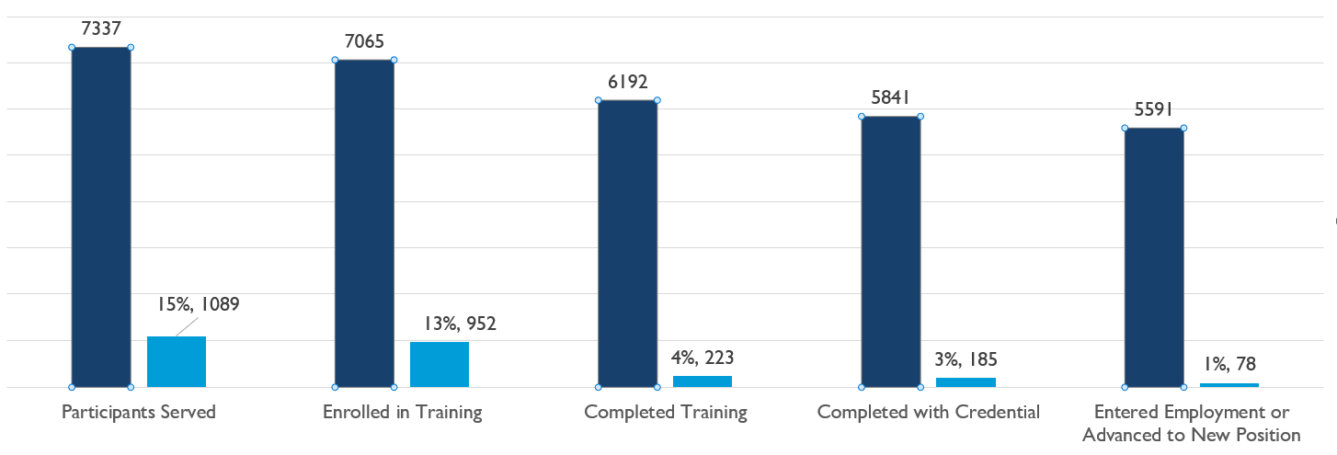
Scorecard vs. PSL Tool outcome analysis: what’s the difference?
PSL outcome analysis compares progress on outcomes
  Shows participant loss points
  Help explain why progress toward target is not being met
Scorecard shows progress toward targets

Slide 52
USING THE SCORECARD AND PSL TOOLS
3.
Review Report Output
4.
Make Report Corrections
5.
Analyze Program Impact
6.
Make Program Adjustments
1.
Collect/ Track Info on Participant Activity
2.
Report Participant Activity
PSL Tool
Scorecard

Slide 53
TRACK I
Outreach & Recruitment N/A | Intake, On-ramps, & Enrollment Receiving Services | Training/ Education Progress Starting Training Achieving a Measurable Skills Gain | Completion & Certification Completing a Program Earning a Credential | Placement Entering Employment Advancing to New Employment | On-the-Job Retention N/A

Slide 54


ALIGNING PSL PHASES WITH OUTCOME MEASURES
QPR Performance Outcome | Participant Support Lifecycle Phase | What it Can Tell You
-- Recruitment data is not reported in the PIRL to DOL | Outreach and Recruitment | Use to determine how well your outreach efforts are working to bring people into your program
Participants Served | Intake, Onramps, & Enrollment | Base QPR number
Participants Enrolled in Education/Training Programs | Training/Education Progress | Loss point between receiving services to starting training
Participants who achieved a Measurable Skills Gain | Training/Education Progress | Loss point between starting training to achieving an MSG
Participants who completed education/training activities | Completion & Certification | Loss point between starting training to completing training

Slide 55

ALIGNING PSL PHASES WITH OUTCOME MEASURES CONT.
QPR Performance Outcome | Participant Support Lifecycle Phase | What it Can Tell You
Participants who completed education/training activities AND received a credential | Completion & Certification | Loss point between completing training to receiving a credential
Participants who completed education/training activities AND entered employed or advanced into a new position | Placement | Loss point between completing a program and entering employment or advancing into a new position (look at both together)
-- Job retention information is being phased out of the PIRL for H-1B grants. | On the Job Retention | Use to determine how well your program prepares participants and is meeting the needs of employers

Slide 56


the Participant’s Journey
Time sequence of all possible major participant activities that you report to DOL:
  Becoming a grant participant
    Receiving services
    Training activities
  Earning credentials
  Completing a training program
  Entering employment or advancing to a new position of employment
Exiting the grant program

Slide 57

Questions?

Slide 58
Resources
H-1B Grants Performance Reporting and WIPS Guidance Handbook
    Nursing Expansion Track 1 Grants PDF File
Nursing Expansion – ETA and H-1B Reporting Guidance
    H-1B 2021 PIRL v 1.1 Excel File
Nursing Expansion – Data Collection & Tracking TA Resources
    Sample Case Management Excel file
Nursing Expansion – Data Reporting TA Resources
    H-1B WIPS Tip Sheet
Nursing Expansion - Performance Reporting Orientation Series
    Performance Reporting Orientation 101
    Performance Reporting Orientation 201
    Performance Reporting Orientation 202 – Track 1
    Performance Reporting Orientation 301
Case Management and Intake
    Slide deck
    Recording
    Data Collection and Tracking Toolkit
Lessons Learned: Using Excel to Manage Data and Track Participants
    Slide deck
    Recording
    Tip Sheet
ETA Grantee Handbook

Slide 59
Contact Us for reporting assistance!
NursingExpansion@dol.gov
Important: Don’t forget to copy your FPO!

Slide 60

Thank you!
The American Institutes for Research® (AIR), completed this project with federal funds, under contract number 1605C2-23-Q-00074 Nursing Expansion Grant TA, from the U.S. Department of Labor, Employment and Training Administration. The contents of this publication do not necessarily reflect the views or policies of the Department of Labor, nor does mention of trade names, commercial products, or organizations imply endorsement by the U.S. Government. AIR is a nonpartisan, not-for-profit organization that conducts behavioral and social science research and delivers technical assistance to solve some of the most urgent challenges in the U.S. and around the world.

