Slide 1
From outreach and recruitment to enrollment
Day 2, Session 2: Nursing Expansion Institute

Slide 2
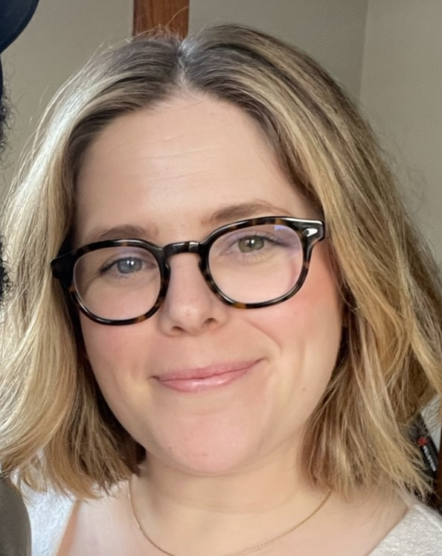
Facilitator
Kara Conroy
  Senior Researcher
    Mathematica
      kconroy@mathematica-mpr.com
        734-205-3105

Slide 3
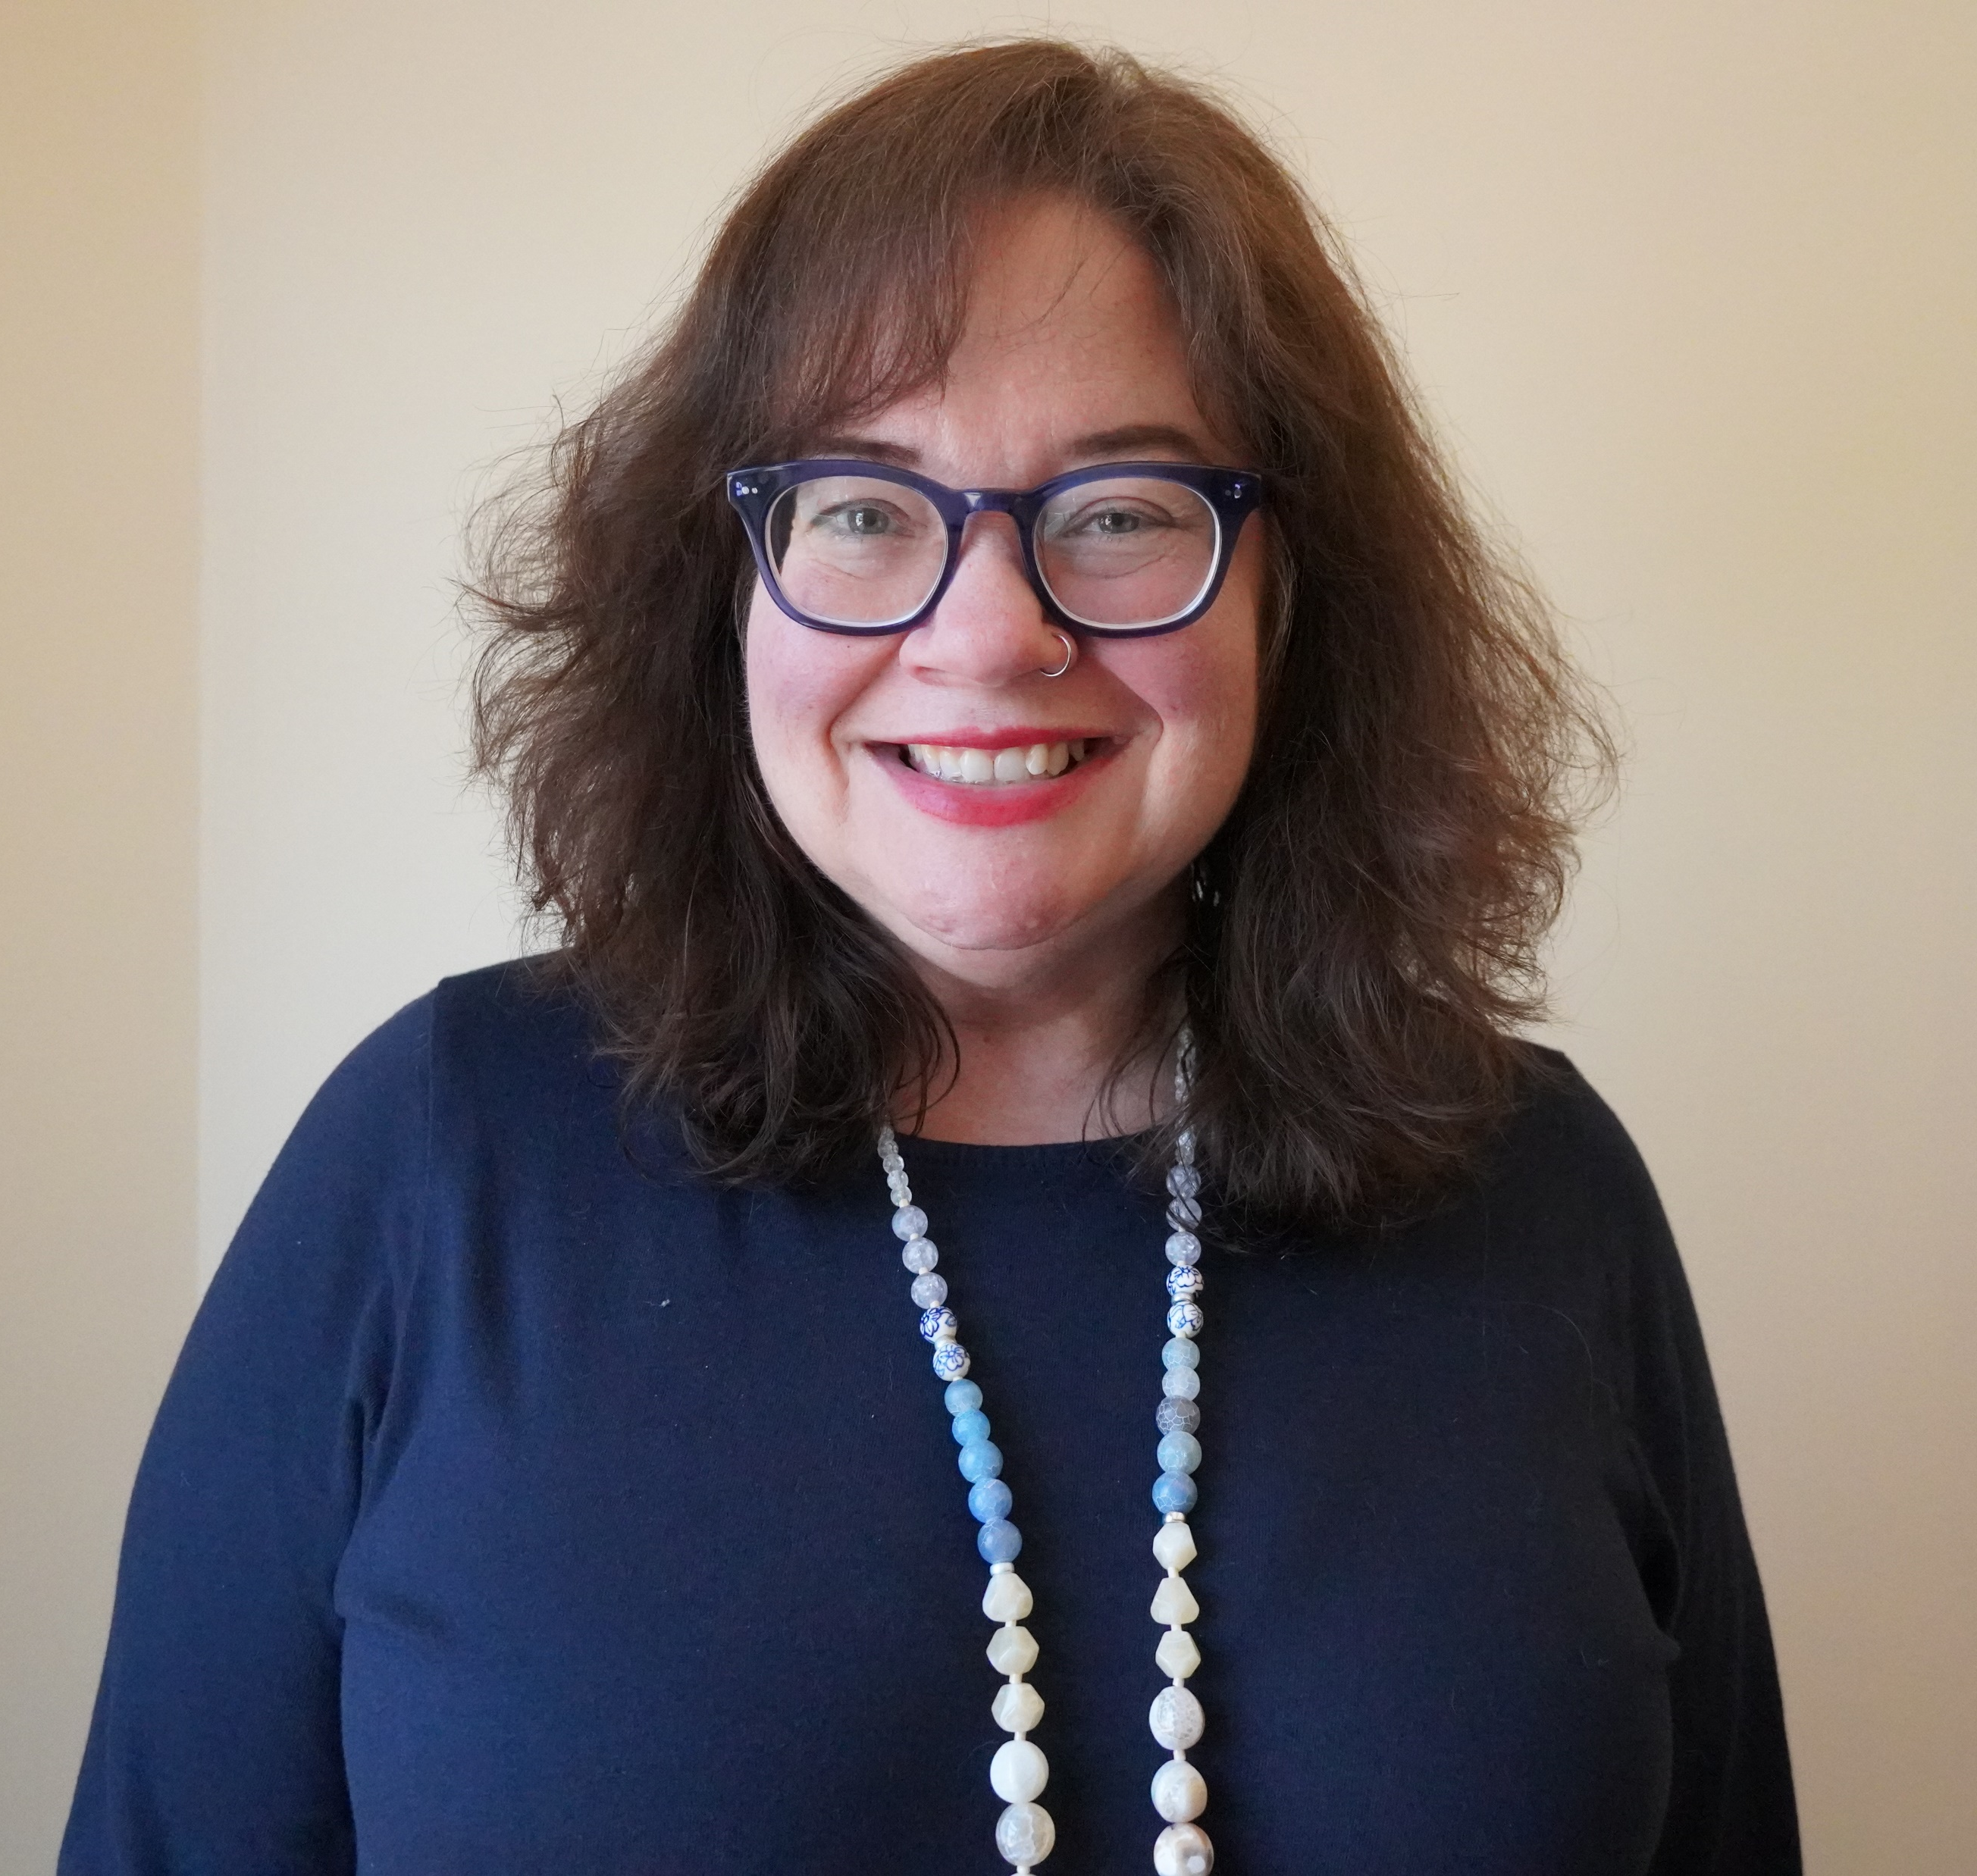
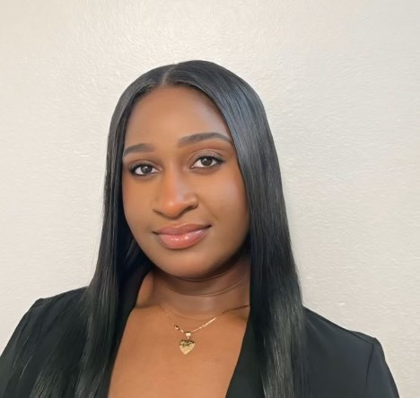
Presenters
Kimberly Huettl
  Program Specialist
    Employ Milwaukee
Dyranesia Cooper
  Vocational Counselor
    Asian American Drug Abuse Program, Inc.

Slide 4
agenda
Session objective and guiding questions
Outreach and recruitment strategies
Intake, onramps, and enrollment strategies
Grantee promising practices
  Employ Milwaukee
  AADAP
Identifying and reaching your target population
  Empathy mapping
Small group activity
  Promising practices, roadblocks, and untapped opportunities with outreach/recruitment enrollment

Slide 5
Session objectives
Session objectives
  Share resources and strategies for effective outreach and recruitment of target populations, as well as intake, onramps, and enrollment.
  Discuss strategies for recruitment and enrollment and identify untapped opportunities.

Slide 6
guiding questions
Guiding questions
  Who is a target population you have had trouble reaching or enrolling? Or a target population you named in your grant, but you have not reached out to yet?
  What strategies are effective in recruiting and enrolling your target populations? How will you engage (or have you engaged) partners in this process?
  How can you tailor and improve your outreach and enrollment process to reach your target populations?

Slide 7
Outreach & Recruitment Strategies
Outreach & Recruitment | Intake, On-ramps, & Enrollment | Training/ Education Progress | Completion & Certification | Placement | On-the-Job Retention

Slide 8
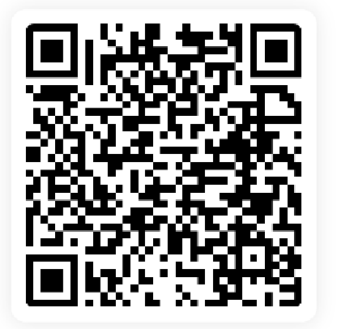
Outreach and recruitment strategies
Use multiple recruitment methods, including word of mouth from graduates and highlighting their success stories
Hire dedicated recruitment staff
Market the benefits of earning stackable credentials in a healthcare career
Utilize reverse referrals from employer and educational partners
Develop robust partnerships, especially with AJCs and community partners
Conduct information sessions at partner sites (e.g. healthcare facilities, colleges or community colleges) to reach your target population
Partner with local high schools and plant the seed with graduating students that healthcare careers could be a good fit for them
Develop a robust online presence; use social media
Keep an organized list of individuals identified during outreach to keep track of their eligibility; automate follow-up
Join at Menti.com
Code: 2733 7538

Slide 9
What other outreach and recruitment strategies have been successful for your grant?
TikTok
Partner referrals
Radio interview
Using partnerships.
Visiting rural sites
Reached out to local groups that have historically marginalized individuals
Webinar
"Bringing groups on campus for a tour and interaction, Facebook"
Establish an advisory committee of our grant partners that we use to help recruit their incumbent workers.
Connecting with hr departments
Instagram
Facebook
Networking within our employer groups
Partners
"Targeted Information Sessions, Neighborhood organization outreach workshops-meeting folks where they are"
Virtual reality simulations, job fairs, internships, externships, tik tok, radio, billboards, tv ads
"Social media Posting positions on IndeedPartner with job service"
Information sessions
Meetings with institutional partners
Pre-nursing and nursing instructors who champion the program
Partnering with local TV stations

Slide 10
What other outreach and recruitment strategies have been successful for your grant? Cont…
In person
Connecting with school advisors to recruit current students who are struggling or are incoming.
Student story videos
"College prerequisite classes Other non profit organizations"
Facebook posts
Referrals from community partners
Rural sites
Employer Partner Relationships
Healthcare partners recommend staff to upskill
Professional orgs who represent historically underrepresented groups and do community outreach
Education health fairs
Employer Agency Partners
Tabling events
Ask professional organization to share opportunities with members.
Connecting to American Job Centers
"Hiring 2 outreach specialist. Grassroot efforts Church outreach"
Planning to use our employer partners (hospitals) to help refer people to our training programs. Also social media and college marketing.

Slide 11
Intake, Onramps, and Enrollment
Outreach & Recruitment | Intake, On-ramps, & Enrollment | Training/ Education Progress | Completion & Certification | Placement | On-the-Job Retention

Slide 12
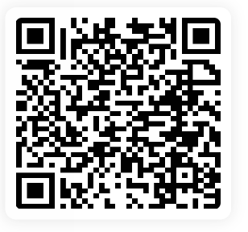
Intake, onramps, and enrollment Strategies
Determine eligibility
Discuss career interests, goals, and barriers and whether one of your NE training program(s) (or a different opportunity) is a good fit
Address any challenges in passing entrance exams or meeting prerequisites
Assess opportunities to use credit for prior learning
Coach, guide, motivate, and support individuals through the many steps and forms that can be required for enrollment
Identify supportive services they might need to participate in training
Join at Menti.com
Code: 2733 7538

Slide 13
What other intake, onramp, and enrollment strategies have been successful for your grant?
Small group orientation sessions before classes start
Working with key faculty in the training programs
Meeting 1:1 with potential participants to explain program
Zoom Interviews with Participants
FERPA releases
1:1 follow up
One on one or group meetings with interested participants
Personal connection / personal approach
"Dedicated nursing pathway coordinator to work with students prior to entering Interactive onboarding for students"
Individualized academic guidance
Orientation, meeting with HR, one on one
Working with academic partner to curate package of prereq courses for those who aren’t quite ready
"Thorough assessment Personal interview outside of intake and assessment"
Orientation packets
Surveys to gather pertinent information
I take questionnaires
Interviews to assess interest and understanding of commitment
Partnering with college, in person program orientation, success stories from program alumni, training church volunteers on program services
Meeting participants where they are at in order to provide supportive guidance.
Reaching out to students who have completed the prerequisite nursing courses and are on track to take the LPN or ADN-RN training.
Incumbent worker on our internal webpages

Slide 14
Using empathy mapping to develop tailored outreach & enrollment strategies
People are not a monolith!
Different target populations (and certainly individuals within those populations) bring unique assets and needs
  They may respond to different outreach messages and modes and enrollment supports
Empathy mapping is an exercise rooted in design thinking that can help you try to understand the mindset of the individuals you are trying to reach
  We recommend asking them directly, too!
Find out more about empathy mapping

Slide 15
Empathy map EXAMPLE: OUt-of-school youth
Says
Thinks
Does
Feels
Unsure if the training will be worth it
I don’t have transportation to attend training.
Will I be able to
keep up with the classwork?
Spends a lot of time online.

Slide 16


Grantee spotlights
Employ Milwaukee & AADAP

Slide 17
Employ Milwaukee – outreach and recruitment
Our Latino community is the fastest growing and youngest population in the county
Highest percentage of people in the labor force at 67.4%
Earn nearly 20K less in average household income compared to white counterparts
Represent16.4% of the county’s population but 5% of registered nurses

Slide 18
Empathy map Employ Milwaukee: Latino Population
Differentiated social media strategy by age group to reach the WHOLE family;
Social media campaigns place a STRONG emphasis on personal efficacy and bilingual communication;
“See yourself here!”
Says
It’s not for me.
I don’t have time.
Thinks
I won’t fit in.
I can’t make this work.
Does
Surfs but doesn’t commit. Might apply but not enroll.
Feels
Panic
Fear
Imposter syndrome

Slide 19
Aadap – intake, onramps, and enrollment strategies
Young Adults (18-29) are facing financial pressure, debt, ageism, housing, transportation, etc.
They are looking for career pathways and employment that will help them establish their independence
Transitioning into adulthood is not easy and requires motivation, guidance, and lots of support
Some young adults are parents themselves

Slide 20
Empathy map AADAP: Young Adults [Age 18-29]
Focus on rapport building in initial contact;
Holistic approach based on transparency, determination, and commitment from the participant
Targeted outreach, clear presentations, strong partnerships, professionalism, and diversity
Says
Thinks
How will I pay and/or support myself during training?
Does
Spends a lot of time thinking about debt
Feels
Unsure whether to pursue training because of financial difficulty
I have little to no income to pay for training

Slide 21
Many different target populations among The Nursing expansion Grants
Underemployed workers
Unemployed workers
Incumbent workers
Veterans and eligible spouses of veterans
Individuals who are Latino, Black, Indigenous, and People of Color
Women
Historically marginalized and underrepresented individuals
Justice-impacted individuals
Individuals with disabilities
First generation college students
Non-traditional adult learners or adult learners with employment barriers
Individuals with low-incomes
Male nurses

Slide 22
Small group activity

Slide 23

Your turn!
Each of you has your own blank empathy map worksheet
Working on your own, reflect on your grants’ target population(s) and pick one population that your organization has had difficulty reaching or enrolling OR who you have not focused on yet
  Example: Your target populations include underemployed and unemployed workers, individuals with low-incomes, and Veterans, but you have not yet focused your outreach and recruitment efforts on Veterans
After you identified one target population, begin filling in your empathy map
We will share among our tables in a few minutes
5-minutes on your own

Slide 24
Complete your Empathy map for:
Says
Thinks
Does
Feels
Tailored strategy

Slide 25
Small group activity
Round robin among your table
Share your empathy map, any roadblocks you have faced, tailored strategies you might try, and untapped opportunities you suspect
Pause for questions and invite others at your table to share if/how their understanding is different, and strategies that have worked well for them in reaching that same population
Ask questions of each other!
Coaches report out 1-2 interesting takeaways
Coaches collect a few example empathy maps (will return them at end of day)
15-minutes in small groups

Slide 26

Questions?

Slide 27

Thank you!
The American Institutes for Research® (AIR), completed this project with federal funds, under contract number 1605C2-23-Q-00074 Nursing Expansion Grant TA, from the U.S. Department of Labor, Employment and Training Administration. The contents of this publication do not necessarily reflect the views or policies of the Department of Labor, nor does mention of trade names, commercial products, or organizations imply endorsement by the U.S. Government. AIR is a nonpartisan, not-for-profit organization that conducts behavioral and social science research and delivers technical assistance to solve some of the most urgent challenges in the U.S. and around the world.

