Slide 1

Department of labor (DOL) policy on preceptorship
Nursing expansion grant program

Slide 2
Policy on Recording and transcribing DOL events
It is the policy of the Department of Labor (DOL) to conduct electronic communications sent or received by DOL or other parties representing it with complete candor. We will always inform you if a DOL-sponsored event is being recorded. The DOL does not endorse or support the unauthorized recording or transcription of its sponsored events, including this event, without consent. Bots are also not permitted in DOL-sponsored events. If you need accommodations to participate in our events, please let us know by sending an email to NursingExpansion@dol.gov.
Please be aware that DOL cannot fully monitor recording activities by external parties. If you are concerned about your privacy, you may opt for audio-only participation by disabling your video.

Slide 3






Inclusive Meeting Guidelines
Hosting and Participating in Meetings
ENGAGE EVERYONE
BE HEARD AND SEEN
ACKNOWLEDGE SPEAKER
MAXIMIZE MICROPHONES
MINIMIZE NOISE
MAXIMIZE VISUAL DISPLAYS
These guidelines are intended to improve the meeting experience for virtual participants, as well as people with hearing loss, visual impairment, and those for whom English is an additional language.

Slide 4
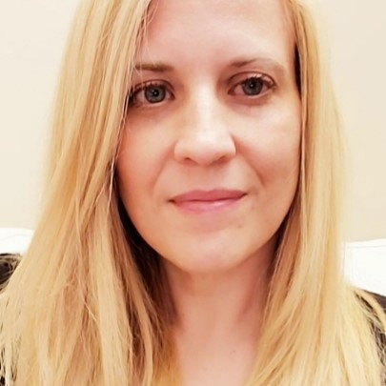
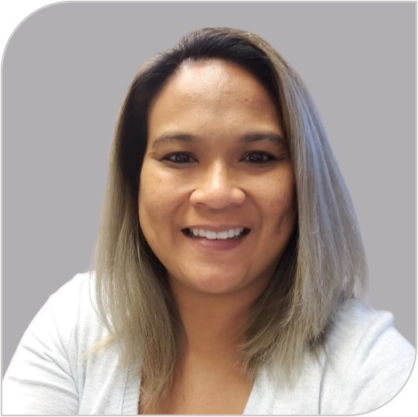
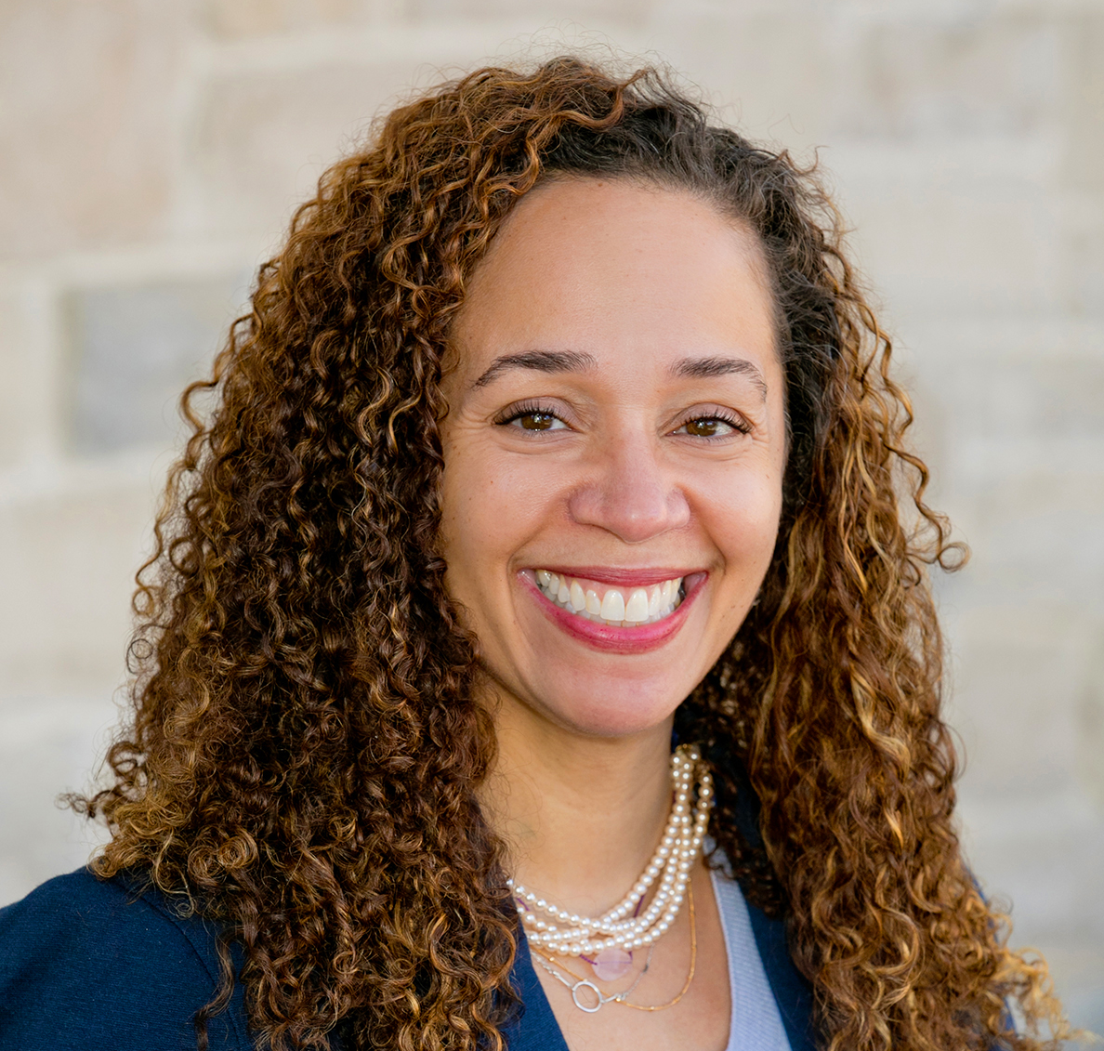
presenters
Kristen Milstead
  Nursing Expansion Program Lead
    Department of Labor/Employment and Training Administration
Dani Abdullah
  Nursing Expansion Program Support
    Department of Labor/Employment and Training Administration
Tondeleyo Gonzalez
  Project Director
    Colorado Center for Nursing Excellence
    Rural Healthcare grantee

Slide 5
New resource available
DOL Nursing Expansion Tip Sheet: Understanding Allowable Preceptor Activity
  Guidance on packing DOL’s policy
  Identification of allowable preceptor activities
    Examples

Slide 6
DOL preceptorship policy
“To achieve the FOA’s goal to expand the pipeline of nursing professionals, applicants [for Track 2] must describe the strategy to support the increased uptake of experienced nursing professionals who will become preceptors to mentor and prepare a new generation of nurses. This track requires applicants to address this issue as part of their workforce development strategy by using partnership agreements with their employer partners to ensure reduced administrative barriers, time carved out of the regular schedule for the preceptor work, and incentives or additional pay for taking on the preceptor role.”
DOL Nursing Expansion Funding Opportunity Announcement (FOA), p. 3

Slide 7
Dol preceptorship policy continued
Track 2 grantees are required to incorporate preceptors into their projects.
Track 1 grantees may optionally incorporate approved strategies for preceptorship from the Statements of Work (SOW)
  These activities must adhere to the policies on preceptorship allowability

Slide 8
Purpose of the PRECEPTOR ACTIVITIES
Purpose of the Nursing Expansion grant is to “expand and diversify the pipeline of qualified nursing professionals who can fill quality jobs in healthcare”
Preceptor activity:
  Supports the purpose of the Nursing Expansion grant funds to increase the number of new nurses
  Can be paid for with grant funds when it aligns with the overall purpose to increase the number of nurses
  Is considered a capacity building activity that supports the grant purpose
Training or orientation programs for preceptors paid for with grant funds does not meet the intent of the grant.

Slide 9
Allowable preceptor activities
“[Track 2 grantees] will propose outreach and recruitment strategies, innovative partnership agreements, and leverage employer-funded financial incentives or other types of non-monetary incentives provided by the employer to address the critical shortage of nursing preceptors.”
DOL Nursing Expansion FOA, p. 3

Slide 10
UNallowable preceptor activities continued
grant/match funds cannot pay for these activities
Providing standalone preceptorship training to nurses that does not lead to a recognized postsecondary credential
Paying wages to nurses to perform preceptor duties when they are currently enrolled in allowable grant or match-funded training
Paying incentives to nurses to become preceptors
Offering scholarships to pay for preceptor training

Slide 11
allowable preceptor activities continued
grant/match funds can pay for these activities
Proposing outreach and recruitment strategies for nurses to become preceptors
Proposing innovative partnership agreements with employer partners
Leveraging employer-funded incentives (monetary or non-monetary)

Slide 12
EXAMPLES OF ALLOWABLE PRECEPTOR ACTIVITIES
Paying nurses a stipend to take on the preceptor role and perform preceptor duties
  Only when the nurses are not current participants in the grant
Developing partnership agreements with employers to provide paid release time, bonuses, and other monetary support
Encouraging employers to pay any preceptor training costs necessary as an investment in their employees
  If the training is allowable under the grant, the costs paid can be considered match
  Otherwise, this cost is counted as a leveraged
Providing preceptorship preparation as one component of a larger, allowable nurse training program
  Allowable: leads to a recognized postsecondary credential

Slide 13
Can I train preceptors?
Preceptor training programs must lead to a recognized postsecondary credential
DOL does not anticipate that most preceptor preparing/training activities meet this requirement
Training preceptors or developing credentialed preceptor training does not meet the intent of the FOA
  May be allowable in some circumstances
  Consult with your FPO

Slide 14
How do I report preceptor activity?
Track 2:
  Outcome #7: Total number of experienced nursing professionals who were placed into a preceptor role
  Reported quarterly in the Quarterly Narrative Report (QNR)
  Review the H-1B Grants Performance Reporting & WIPS Guidance Handbook for Track 2, p. 41-21 and 61-62)
Track 1:
  No reporting requirement
  May optionally report in the QNR

Slide 15
Questions?

Slide 16
Additional guidance from DOL
Questions about:
  Whether a preceptor activity is allowable
  Whether you should count preceptors as participants
  Whether you should count employer-funded preceptor activity as match or leveraged funds
  Consult with your Federal Project Officer (FPO), who will collaborate with the National Office to provide guidance on your situation, as appropriate
Important: Speak with your FPO before implementing a strategy that is not currently in your SOW or in your approved responses to your grant Conditions of Award. Your FPO will provide guidance about a possible grant amendment.

Slide 17

Rural healthcare Using Preceptors
Rural Healthcare Grantee and the utilization of preceptors:
  Tondeleyo Gonzalez, Project Director
    Colorado Center for Nursing Excellence
Q&A

Slide 18
Upcoming event
Performance Reporting Orientation 301
    June 13 – 3:00-4:30 PM EST (2PM CST/1PM MST/12PM PST)
    Final performance reporting orientation event
    Topics: How to submit a data file on your participants and pass the edit checks; how to write a quality Quarterly Narrative Report (QNR)

Slide 19
Contact us
NursingExpansion@dol.gov
    Don’t forget to copy your FPO!

Slide 20

Thank you!
The American Institutes for Research® (AIR), completed this project with federal funds, under contract number 1605C2-23-Q-00074 Nursing Expansion Grant TA, from the U.S. Department of Labor, Employment and Training Administration. The contents of this publication do not necessarily reflect the views or policies of the Department of Labor, nor does mention of trade names, commercial products, or organizations imply endorsement by the U.S. Government. AIR is a nonpartisan, not-for-profit organization that conducts behavioral and social science research and delivers technical assistance to solve some of the most urgent challenges in the U.S. and around the world.

