Slide 1

Maximizing WIOA and non-WIOA Performance Data Cohort
Module 9
2019 WIOA National Performance Training
U.S. Department of Labor
Employment and Training Administration

Slide 2

What You Will Need For Module 8
Data Max Cohort State Action Plans
Performance Data Self-Assessment Tool
Table Teams

Slide 3
Session Overview
Maximizing WIOA and non-WIOA Performance Data Cohort
Cohort Purpose/Goals
Participating States
Cohort Outcomes - Maximizing Performance Data Development Model
Self – Assessment Tool
Tools & Resources
Session Activity
Review Self-Assessment Tool
Feedback
State Action Plans
Notes:
NOTE TO PRESENTERS:
The slide deck is structured so the charts come first, followed by the key takeaways. Ideally, the presenters will cover the key takeaways while the chart slide is still up and the subsequent slide is only there to document the key points for those that did not attend the training or need to refer to it afterward. For each chart slide I will provide the necessary context and key points that should be discussed while the chart slide is up.

Slide 4
Maximizing WIOA and non-WIOA Performance Data Cohort (2)
Cohort Overview
Participating States
Cohort Purpose/Goals
Notes:
Notes:

Slide 5

Why the Cohort was Born
Notes:
Notes:

Slide 6
Cohort Purpose & Goals
Strengthen state interagency partnerships and infrastructure
Identify and explore approaches to using WIOA and non-WIOA performance data to tell a state’s story
Develop a national resource that will assist states in using their performance data to demonstrate programmatic outcomes (capstone project)
Advance a state-specific action plan

Slide 7
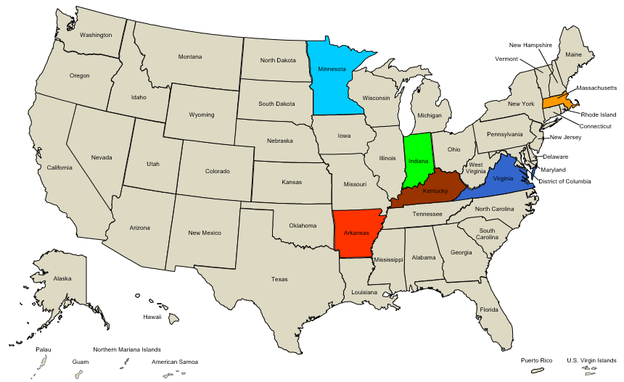
Cohort State Teams
Arkansas
Indiana
Kentucky
Massachusetts
Minnesota
Virginia

Slide 8
Cohort Outcomes
Maximizing Performance Data Development Model
Tools & Resources
Self – Assessment Tool
Notes:
Notes:

Slide 9
Cohort Capstone
Opportunity for participants, working together as one team, to identify and develop a tool or resource to help national, state, and local colleagues address an identified challenge.
Cohort challenge:
Using WIOA and non-WIOA performance data to effectively demonstrate programmatic achievements, challenges, and return on investment.

Slide 10
Effective Capstone Characteristics
Examples of criteria to consider when developing an effective capstone product:
The product addresses a need prioritized by a number of states
The audience for and purpose of the capstone product is clearly defined
The product builds off of existing models or is a unique approach to addressing a shared need
It can be adapted to meet the needs of different types of states
Implementation of the product results in defined outcomes

Slide 11
Maximizing Performance Data Development Model
Resource to help states:
  “Diagnose” where they are as organizations in using performance data to demonstrate programmatic achievements, challenges, and stakeholder return-on-investment (Self-Assessment Tool); and
  Determine next steps for making progress in using performance data to demonstrate achievements, challenges, and ROI, drawing from targeted resources and tools (Resources and Tools).

Slide 12
Maximizing Performance Data Self-Assessment Tool
Four multiple-choice questions focused on:
  Leadership and Partners
  Using and Integrating Data
  Resource Needs
  Data Governance
Set of five answer options corresponding to five levels

Slide 13
Maximizing Performance Data Resources and Tools
Direction to states on next steps, including relevant Resources and Tools
Provides opportunity for states to develop a concrete improvement plan

Slide 14
Self-Assessment Tool Group Activity
Session Activity
Feedback
Review Self-Assessment Tool

Slide 15
Maximizing Performance Data Self-Assessment Tool (2)
Review the Self-Assessment Tool Handout
Take a few minutes to answer the four questions to the best of your ability from your perspective for your state
Take 10 minutes to discuss your answers amongst your table
  Discuss your answers, including which level(s) you selected and why

Slide 16
Feedback
Would this model help your state identify its current level in using performance data to tell its story and, ultimately, advance?
  Please take a moment to reflect, and provide any ideas for improving the Maximizing Performance Data Development Model on the sticky-notes on your table

Slide 17
State Action Plans
Notes:
Notes:

Slide 18
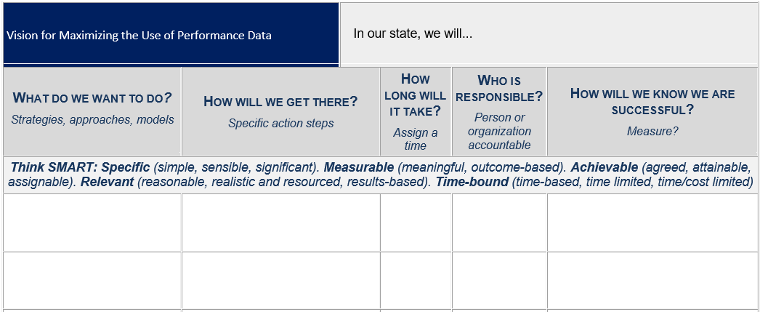
State Action Plan Template
Notes:
Notes:

Slide 19
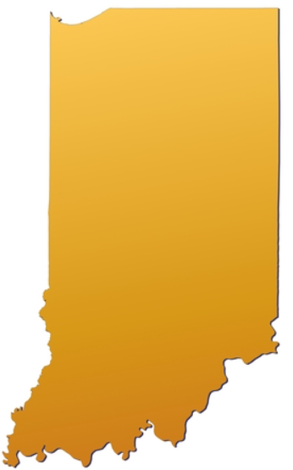
State Action Plan – Indiana
Optimized Data Analysis Systems
Visualization Optimization and Automation
Longitudinal Data Analysis (interagency data sharing)
Real(er) Time Data
Single case management system for all workforce programs

Slide 20
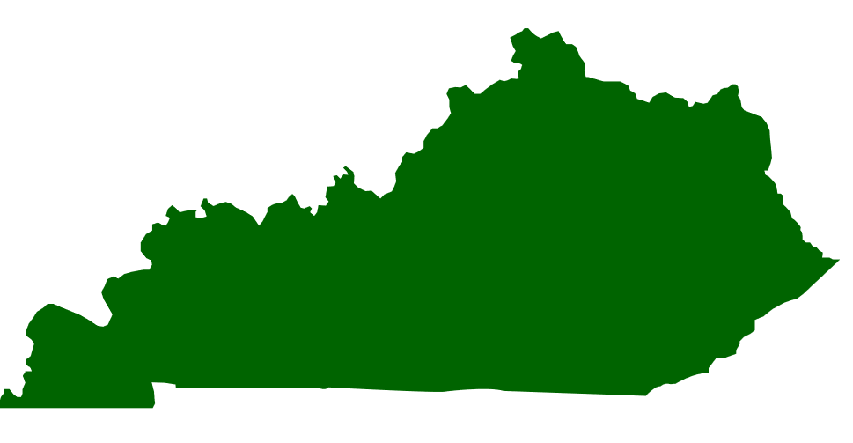
State Action Plan – Kentucky
Team building: Build the concept that the four Core partners are in the same “family” and share the same broad goals.
Data synthesis: Create more reports and dashboards using partners’ combined data
Regular examination of data by Core stakeholders (and other required partners as available)

Slide 21

State Action Plan – Virginia
Integrate the referral process among the four WIOA Titles – Three contractors have been selected to:
  Develop systems assessments and use case development
  Establish a Virginia Workforce Data Trust for Data Governance
  Create a linked, anonymized data set for use in analytics and dashboarding
  Create a new user experience web application, optimized for mobile use
  Develop a Referral Engine
  Determine user preferences and barriers from the user-experience data
  Design and develop the Analytical Visualizations based on the use cases

Slide 22
Any Questions?

Slide 23
Please complete your evaluations.

