Slide 1
Welcome to Day 2 – Diving in!
Please sit with different folks today!
Day 2, Session 1: Nursing Expansion Institute

Slide 2
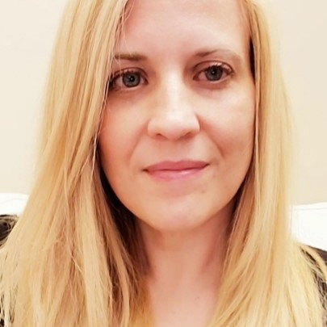
Welcome!
Kristen Milstead, Ph.D.
  Workforce Analyst, Nursing Expansion Program Lead
    Office of Workforce Investment, U.S. Department of Labor
      milstead.kristen@dol.gov

Slide 3

Day 2 Challenge – ongoing connection
Continue moving tables between sessions!
Connect with 5 new people during sessions and breaks during the day.
Create connections for later today, or for after the Institute
Add questions to post-it notes for future consideration

Slide 4

Event Information
Event Information Reminders
Building Entry/Re-Entry
Restrooms
Using Outlets to Charge
Snacks and Beverages
  Water, coffee
Accessibility Needs
  Elevators
Emergency Exits
Feedback
Social Media
  #NursingExpansion2024
  Instagram: @airinforms and @usdol
  LinkedIn: American Institutes for Research and U.S. Department of Labor

Slide 5
Day Two Agenda
Time | Session Title
8:30 a.m. | Welcome to Day 2
9:00 a.m. | Outreach & Recruitment: Intake Ramps and Enrollment Strategies
10:00 a.m. | Break
10:15 a.m. | Training & Education Program Progress Strategies
10:55 a.m. | Completion & Certification Strategies
11:35 a.m. | Placement Strategies
Time | Session Title
12:15 p.m. | Lunch (on your own)
1:30 p.m. | Effective Partnership Strategies
2:30 p.m. | Break
2:45 p.m. | Sustainability
3:45 p.m. | Break
4:00 p.m. | Coach Meet and Greet

Slide 6
Talks with TA Coaches

Slide 7

Table Talks with TA Coaches
Introductions
Day 1 Reflections
Day 2 Expectations

Slide 8

Thank you!
The American Institutes for Research® (AIR), completed this project with federal funds, under contract number 1605C2-23-Q-00074 Nursing Expansion Grant TA, from the U.S. Department of Labor, Employment and Training Administration. The contents of this publication do not necessarily reflect the views or policies of the Department of Labor, nor does mention of trade names, commercial products, or organizations imply endorsement by the U.S. Government. AIR is a nonpartisan, not-for-profit organization that conducts behavioral and social science research and delivers technical assistance to solve some of the most urgent challenges in the U.S. and around the world.

