Slide 1

Impactful Partner Communication:
Principles and Techniques
November 16, 2021

Slide 2
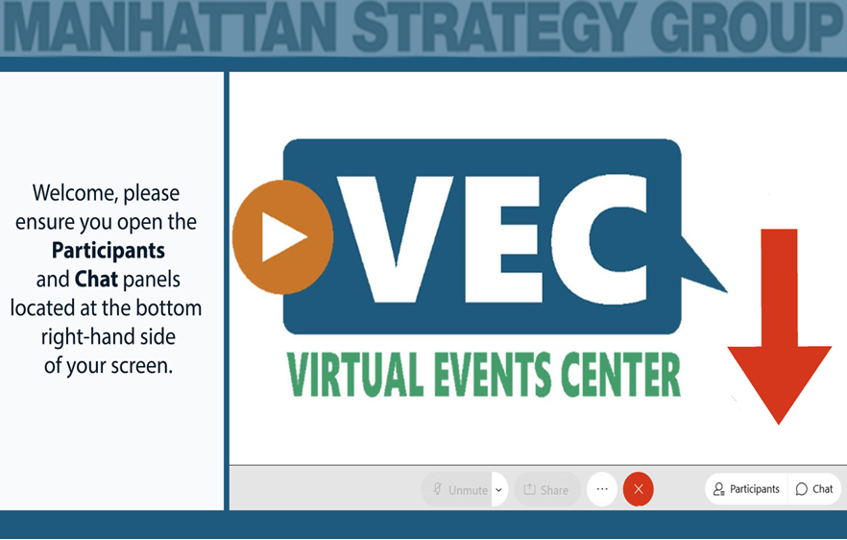
Notes:
Connor

Slide 3
Webinar Housekeeping
Move any electronic handheld devices away from your computer and speakers.
1
Close all file sharing applications and streaming music or video.
2
Check your settings in the audio pane if you are experiencing audio problems.
3
Type questions via the chat box. We will address those during the presentation.
4
Please mute yourself when not speaking.
5
Notes:
Connor

Slide 4


Speakers
Mary Roberto
TA Coach
Apryl McDonough
TA Coach
Notes:
Mary to start. Each speaker will introduce themself and a little about their background

Slide 5
Session Objectives
Hear from your SA grantee peers about their communication initiatives and techniques.
Learn about six basic principles for effective communication.
Review seven communication techniques and how they are applied to grantee SA activities and operations.
Discover how to apply communication strategies to create an emotional and motivational connection to your SA grant partners.
Notes:
The importance of effective communication really hit home with the pandemic. We’ve all found ourselves in venues that are not face-to-face and can’t rely on many of the non-verbals – the body language we’ve grown accustomed to. For community college system, you all are relying on more technology than ever to teach and communicate with students and partners. With all of the changes and evolving circumstances we’ve been exposed to, the SA TA team with DOL thought it might be a good time to revisit this topic of communication in a webinar – an engaging webinar where we are going to outline some basics, that may still seem basic, but use practical examples of their application within and around the Scaling Apprenticeship arena. We’ve heard from many grantees that communication is a challenge, especially with so many different partners with different ideas. So, today we want to help you to learn about six very basic principles and how they are applied in various aspects of the project and help you to recall seven techniques and how they are and can be applied to grantee activities and operations to help you all reach your goals. Toward the end of the webinar we will talk about your next steps in communication strategy.

Slide 6
Session Agenda and Norms
Agenda
Why are we here? Overarching communication challenges in SA programs Six principles for effective communication Seven communication techniques SA grantee sharing Q/A
Be present
Embrace vulnerability
Participate in the dialogue
Share your experience
Notes:
Mary
This is what our time together today will look like (briefly go through agenda).
And I hope you will join us in honoring the following norms for our conversation. As much as you can, please try to remain present in our discussion.
Throughout this presentation, you will have an opportunity to offer ideas and ask questions through the Q&A box in the bottom right-hand corner of your screen or you can
Also, we are aware that you are all probably webinar’d out. Some of us are looking forward to more in person interaction, but since we are not quite there yet, we promise to make this as interactive as we can. We DO value your participation and input invite you to take out some paper and a pencil and begin to jot down your thoughts, ideas and other information as we walk through the presentation. We find that adult learners process information for recall better when they can write or draw as they hear information.

Slide 7

Introduction
One Communication Opportunity
Enter in the Chat
Your Name
SA Project Site
One communication opportunity you’ve identified or addressed in your role with the SA grant.
Notes:
Mary: We are going to do an exercise in the chat so you feel comfortable using it. We’d like you to yourself in the chat, state your name and the SA grantee program site, and one communication opportunity you have identified or addressed in your SA program. For example, if you identified that student engagement is an issue, you might have identified an opportunity to encourage engagement through a motivational texting campaign through using behavioral insights and prompts.
We will give you a few minutes.

Slide 8
Six Principles of Effective Communication
Accessible
Actionable
Credible
Understandable
Timely
Relevant
Notes:
Mary: Now we are going to review these six principles of effective communication. You all have probably been exposed to these before or principles that are similar
These principles mirror those that the World Health Organization uses as a foundation for all of their communications. Now, while I think the WHO has a mission that might be slightly different than yours, I think you will still find value in how these are applied.
Understandable – SA grantees communicate with many diverse individuals with varied backgrounds. Some have backgrounds in business, education and technology for example. It is helpful for grantees to use plain language, tell real stories, be cognizant of acronyms, make it visual and use more than one language.
Accessible - Identify effective and appropriate channels • Make information available online • Ensure people with disabilities can find and use information they need
Actionable – Understanding the knowledge levels, attitudes, and current behaviors helps with messaging and moves audience to action and promotes behavior change,
Credible – technical accuracy, transparent, coordinated with partners, speaks as one voice
Relevant- To be relevant, the communications must help audiences understand the value, advice or guidance as applicable to them, their families, or others they care about. Messages must be tailored.
Timely – SA audiences have the information, advice and guidance when they need them to make decisions. Timeliness builds credibility and aligns with relevance.

Slide 9

Which Principles?
Understandable
Credible
Timely
Actionable
Relevant
Accessible
Notes:
Mary
So in thinking about the principles we just reviewed, we are going to show you a short video and ask that you think about what principle you believe is most critical in this scenario. Then, how many of us truly get to the place the bunny did here?

Slide 10
Seven Techniques to Effective and Impactful Communication
Be Present to Win!
Lead with purpose, engage in meaningful conversations, and really hear what others are saying.
Build Trust through Authenticity
Setting goals for learning helps us to experiment with our identities – so we don’t need to get everything right from the start. We really don’t know everything ☺
Ensure Equity of Voice
Diverse teams, cognitive differences, and equity of voice yields amazing outcomes.
Show me, don’t tell me
Discover the work of Dave Holston. Explore 7 exercises to solve strategic communication problems.
Drawings, words, images, mapping, role-playing, stories, and more
Notes:
Mary: Okay, enough of that fun. We are going to move into a review of seven techniques for effective and impactful communication. We will do a spin through these and then we will hear from some of the SA grantees about how they’ve actually applied some of these techniques in their SA programs.
Brene’ Brown – Fan - #2
Equity of Voice – Strategic Doing
Handoff to Apryl.

Slide 11
Seven Techniques to Effective and Impactful Communication
Ask A Beautiful Question
Use Social Media
Spread partner engagement workload among multiple people, a particularly useful strategy considering the 24/seven nature of the internet.
David Cooperider tells us about people moving in the direction of their conversations, both for good and for ill. Move away from a pull to the negative using appreciative inquiry
Coordinate and Communicate in “One Voice”
It is critical to SA grant success that programs are speaking from a “single voice” - that doesn’t mean a single person – it means presenting a consistent message.
Notes:
Mary: Mary will review seven techniques to effective and impactful communications. Handoff to Apryl.

Slide 12

PRESENTATIONS​
Dallas
SUNY
Morris
Lorain

Slide 13


Slide 14




Dallas College
Presenter: Amy Mackenroth
Communication Technique or Strategy: Be Present to Win!
Contact Information: Amy.Mackenroth@dcccd.edu

Slide 15
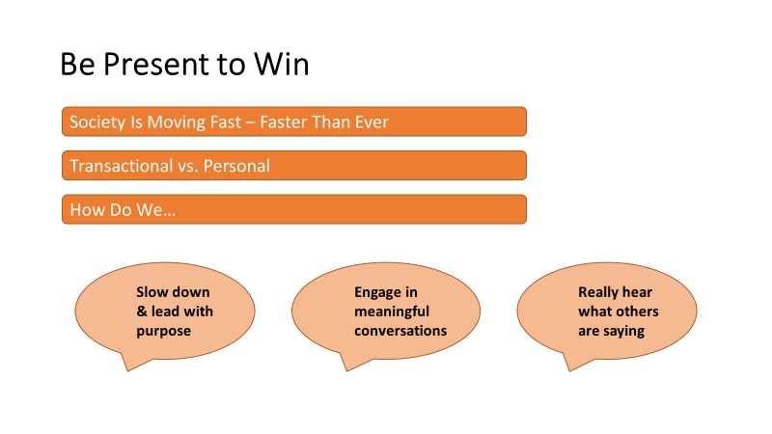

Slide 16
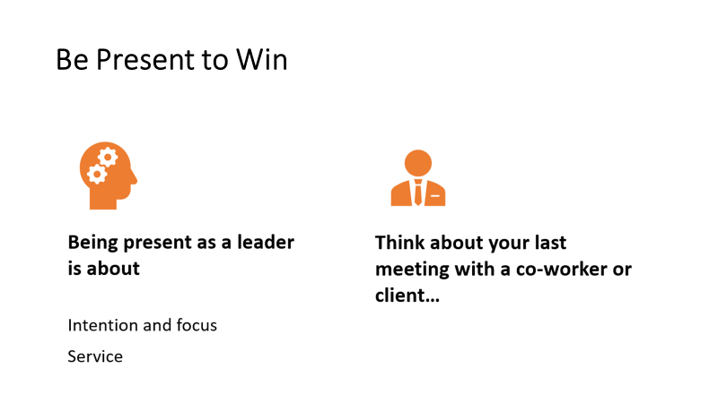

Slide 17
Related to this technique, which communication principle(s) are most important to you and why?
Understandable
Accessible
Credible
Timely
Relevant
Actionable
Type your questions for Amy in the chat.

Slide 18
Communicating with “One Voice”
SUNY
Mary Kohan
18

Slide 19
The State University of New York
Presenter: Mary Kohan
Communication Technique or Strategy: “One Voice”
Contact Information: Mary.Kohan@suny.edu
19

Slide 20
Strategies SUNY Uses in Marketing Apprenticeship to Employers
Market the “What’s In It for Me”
  Highly skilled workforce
  Pipeline of qualified applicants
  Increased efficiency and productivity
  Train workers without losing valuable production time
  Flexible, customizable, structured employer-driven training
  Increase employee retention and attendance
  Improve employer/employee relationships
  High-quality employment and training opportunities

Slide 21
Strategies SUNY Uses in Marketing Apprenticeship to Employers
Highlight the Return on Investment (ROI)
  Cost of Related Instruction subsidized: Up to $5,000 per apprentice (SUNY)
  Upskill potential apprentices: Up to $500 per pre-apprentice (SUNY)
  On-the-job training reimbursement if 50 employees or less (SUNY through WDB)
  Empire State Apprenticeship Tax Credit (NYS)
  Apprenticeship Expansion Grant 2 (NYS): Up to $10,000 per apprentice
  Dollar for dollar, no workforce training method packs as much punch as apprenticeship. On average, employers realize an average return on investment of $1.47 for every $1 invested. Additionally, every $1 invested in apprenticeships leads to a public return of approximately $28 in benefits. (https://nationalapprenticeship.org/roi)

Slide 22
Strategies SUNY Uses in Marketing Apprenticeship to Employers
Strengthen Your Sales Pitch to Employers with Data
  Proven approach with over 150,000 businesses have integrated the apprenticeship model into their talent development strategy across NYS.
  Studies show the average retention for apprentices completing programs is 91%.
  Nationally there are over 550,000 apprentices.
  NYS has 920 programs, 608 sponsors, and 18,216 apprentices.
  Not just for skilled trades - advanced manufacturing, healthcare, energy, information technology, transportation.
  Solutions for Industry Fact Sheet USDOL

Slide 23
Consistently Track Employer Marketing and Interactions with Employer Outreach Tool
FORM: Form
SPREADSHEET: Spreadsheet
  At least weekly
  Complete the SUNY’s employer outreach spreadsheet and review entries of other partners.

Slide 24
SUNY System Apprenticeship Team
Denise Zieske, Director of Workforce Development
Office of Community Colleges and the Education Pipeline
^{Denise.zieske@suny.edu}
Mary Kohan, Project Manager, NYCAN
^{Mary.kohan@suny.edu}
Jan Hennessy, Project Coordinator, NYCAN
^{Jan.hennessy@suny.edu}
apprenticeship@suny.edu www.suny.edu/apprenticeship

Slide 25
Presentation Questions
Related to this technique, which communication principle(s) are most important to you and why?
Understandable
Accessible
Credible
Timely
Relevant
Actionable
Type your questions for Mary in the chat.

Slide 26
Social Media Strategies
County College of Morris
Kimberly Whelan

Slide 27
County College of Morris
Presenter: Kimberly Whelan
Communication Technique or Strategy: Social Media Strategies
Contact Information: Kwhelan@ccm.edu
27
27

Slide 28

Participant Outreach and Recruitment Strategy
Virtual Information sessions for students
On-Campus Student Tours
Engagement of local partners helped gain traction (One Stop, Non-Profits, County Jails, & High Schools ) Campaign mirrors outreach to employers
Social Media (Instagram, Twitter Facebook, LinkedIn)

Slide 29
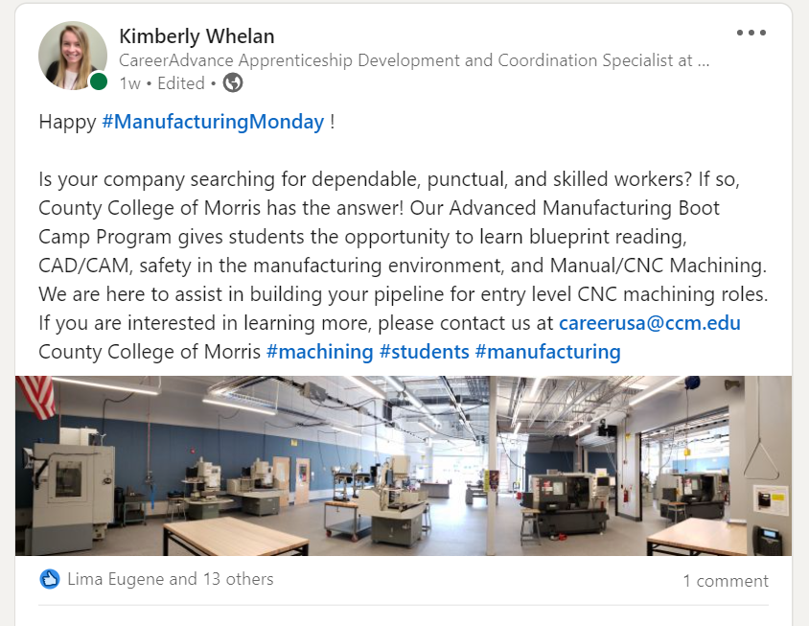
Utilizing LinkedIn to Promote your Program
Once connected with employers on LinkedIn, share your program updates such as information sessions, virtual open houses, virtual program overview, etc.
The more connections you make the better!
Be a voice not only for your community college but also for your program!

Slide 30
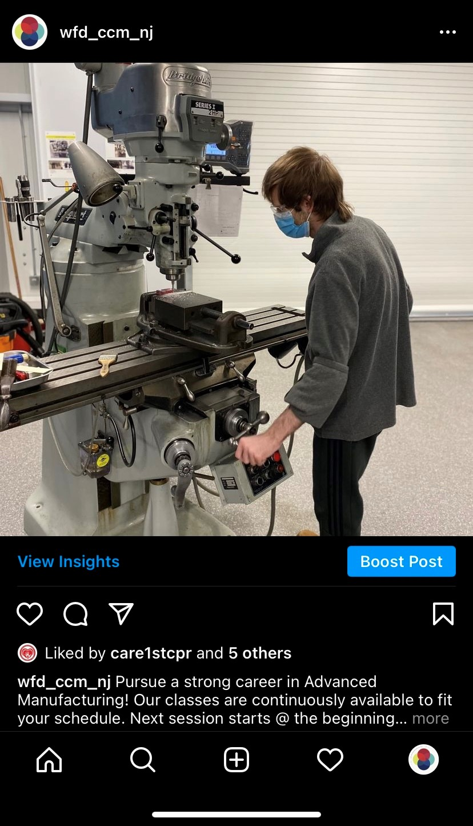
Utilizing Instagram to Promote your Program
Marketing on Instagram
  Create a weekly social media schedule.
  Posts include event promotion such as upcoming virtual open houses, program information, and statistics about advanced manufacturing.
  Add posts to stories’ tab to gain more traction and awareness.
  Use story highlights to make previous stories viewable.

Slide 31
Resources:
CareerAdvance USA Website
  https://www.ccm.edu/apprenticeships/
CareerAdvance USA Facebook
  https://www.facebook.com/workforce.ccm/
CareerAdvance USA Instagram
  https://www.instagram.com/wfd_ccm_nj/
CareerAdvance USA LinkedIn
  https://www.linkedin.com/school/county-college-of-morris/
Notes:
[

Slide 32
Related to this technique, which communication principle(s) are most important to you and why?
Understandable
Accessible
Credible
Timely
Relevant
Actionable
Type your questions for Kim in the chat.

Slide 33


Communicating with “One Voice”
Ohio Manufacturing Workforce Partnership​

Slide 34
Lorain County Community College
Presenters:
Sara Tracey & Bernie Gosky
Communication Technique or Strategy: “One Voice”
Contact Information:
stracey@ohiomfg.com
bgosky@loraincc.edu
34
34
34

Slide 35


Ohio Manufacturing Workforce Partnership
Communication Technique or Strategy
PRESENTERS
Sara Tracey
Managing Director, Workforce Services
Ohio Manufacturers’ Association
stracey@ohiomfg.com
(614) 557-0937
Ohio TechNet and Ohio Manufacturers’ Association partner to co-lead the Ohio Manufacturing Workforce Partnership and to communicate with “one voice” for consistent messaging on statewide initiatives and within our learning community which include a strategy committee, state agencies, industry sector partnerships, and education partners.
Bernie Gosky
Ohio TechNet Project Manager
Lorain County Community College
bgosky@lorainccc.edu
440-554-8238

Slide 36
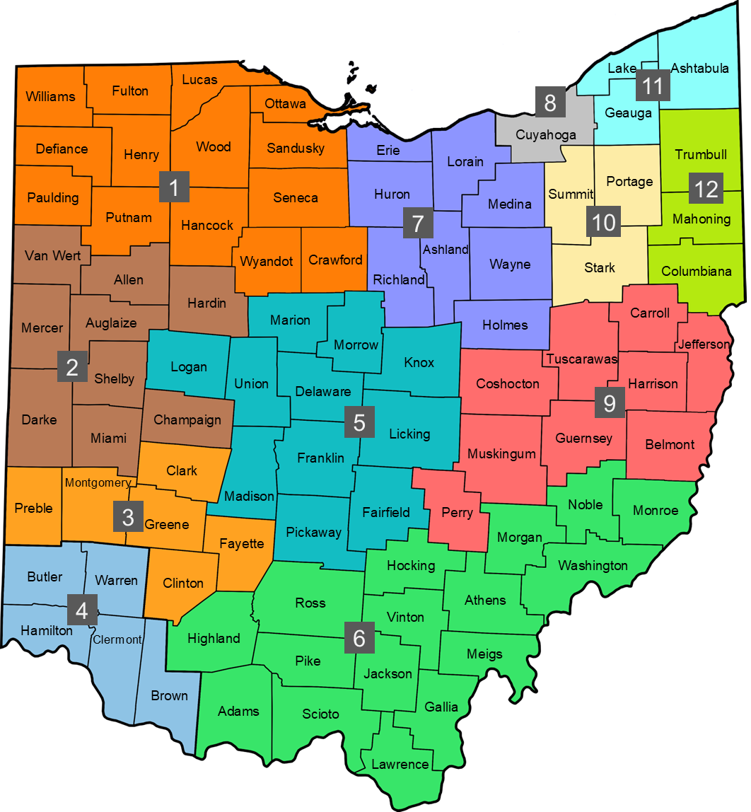
Ohio Manufacturing Workforce Partnership
Regions Map
Region 1
Region 2
Region 3
Dayton Regional MFG Workforce Partnership
Region 4
Region 5
Rhodes State College (on behalf of West Central Ohio MFG Partnership)
TechSolve
Region 6
Region 7
Building Bridges to Careers, Shawnee State University, Appalachian Ohio Manufacturing Coalition
Region 8
Lorain County Community College (LCCC) in partnership with regional sector partnerships
Region 9
MAGNET (on behalf of Workforce Connect Manufacturing Sector Partnership)
Building Bridges to Careers
Region 11
ConxusNEO
Manufacturing Works
(on behalf of Alliance for Working Together)
Mahoning Valley Manufacturers Coalition
Northwest State CC (on behalf of NW Ohio MFG Alliance)
Columbus State CC
(on behalf of Central Ohio MFG Partnership)
Region 10
Region 12
Note: Colleges identified are fiscal agents for listed regions. Each region may engage multiple education partners as they utilize funds budgeted for educational innovation.

Slide 37
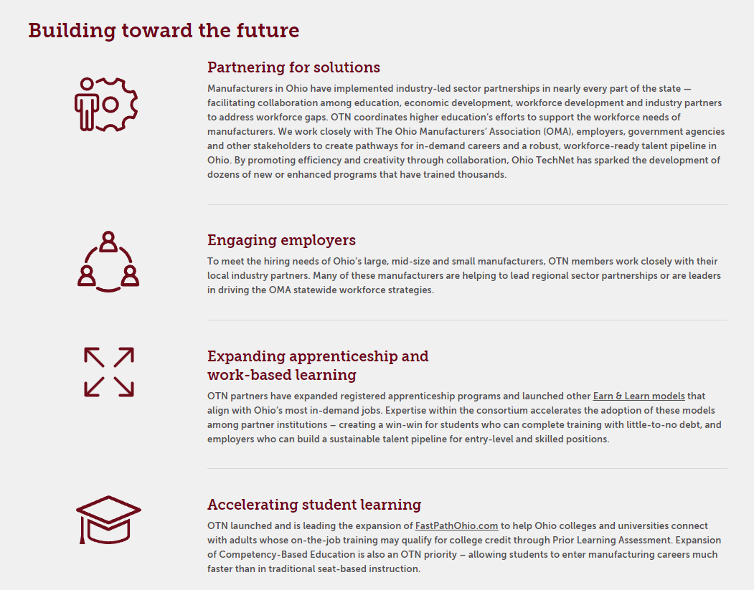
Ohio Tech Net

Slide 38
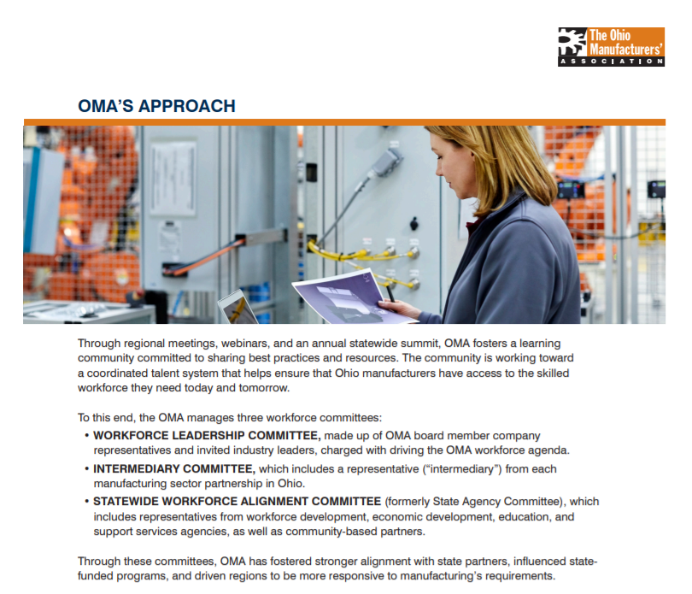
Ohio Manufacturing

Slide 39
Presentation Questions
Related to this technique, which communication principle(s) are most important to you and why?
Understandable
Accessible
Credible
Timely
Relevant
Actionable
Type your questions for Sara and Bernie in the chat.

Slide 40


Slide 41
Next Steps – Communication Planning
Given the information and presentations today, consider the following question:
What principles or techniques will you be concentrating on in the next 30 days to make your communication strategies more:
Understandable
Accessible
Timely
Actionable
Relevant
Credible

