Slide 1
Designing and Running a Strategic Board Meeting
DATE
Strategic Board Tool Kit

Slide 2
Strategic Boards Toolkit
This presentation is part of the strategic boards toolkit which can be found on Workforce GPS at http://bit.ly/293WHmh
The resources are intended to assist boards in becoming more strategic and effective. The resources will help boards at the early stages of planning, as well as those that have already implemented important WIOA-related changes and are seeking to adapt specific promising practices.
All of the material is adapted from promising practices from workforce boards in the field.
The toolkit was guided by an ETA task force of national and regional workforce system stakeholders.
Notes:
This is designed as a primer for new board members, and potentially as a training module for states or regions to use with their local board leadership, whether staff or board chairs.
This PPT begins with a brief presentation, and some thoughts for consideration. The presentation should take 15-20 minutes.
Then the audience is encouraged to break into small groups, and move to an exercise, where they can get involved planning for your next year’s worth of strategic meetings. (see additional document in the SBTK series for exercise handout).
Then there will be time to close with report outs, thoughts and observations from the exercise.

Slide 3
For Your Consideration
Is your board consistently practicing the founding principles of Strategic meetings?
Are your meetings designed to connect the tactical work of the board to its vision and mission for Workforce?
Do you achieve what you need to achieve in the course of the year’s meetings?
Notes:
Knowing how to run strategic meetings, and meeting that ideal goal in practice, are sometimes two different things. The questions here are designed to address this quandary. These are key questions that you should ask yourself about your responsibilities.
It is likely safe to assume that the majority of the audience will have a strong base knowledge of how to run a meeting – this presentation does not address invitations, or seating, or Roberts Rules of Order – we are focusing on how to drive OUTCOMES from our meetings. And although many of us are experienced meeting leaders, and most of us have all attended and run successful board meetings, we have also seen some that have run off the rails, for one reason or another.
There can be a number of obstacles that get in our way – changes in leadership, changes in board membership, challenging or dominating personalities on the board, shifting priorities of our partner agencies, last minute controversial topics that are raised
But the more clear we are about the structure and expectations we have for our meetings, and for our members, the more planning we can complete in advance, and the more strategic we can be about our choices in advance of the meeting, the better chance we have of successfully navigating the turbulent waters of the board meeting

Slide 4
Connect to Vision and Mission
Key agenda Items may be selected for each quarter at an annual planning retreat / meeting prior to the start of the year.
As you plan each individual meeting, ensure you are able to connect each agenda item to the vision and mission of the board- ( and what is happening in your workforce area).
Plan to explain to board members “How” and “Why” each item for the meeting contributes to the goals of the board.
Notes:
One of our first steps to success, is to ensure that the work of the board, in the limited time we have in meetings, is as directly connected to organizational vision and mission as possible, and is as focused on Strategic Decisions, rather than day to day operations, as possible.
If Vision and Mission is not a concern for your board leaders, you may want to skip this slide and move on to slide 5.
Otherwise, consider: – if something on your agenda doesn’t contribute to your Board’s vision and mission, why is it a part of your Agenda? We are working to make the best use of the time of Board members. They are there in a decision making capacity. The more they understand the import of their engagement, the more likely they are to keep coming back

Slide 5
Set the Agenda Early
Begin agenda planning during your previous board meeting:
  Takeaways and action items from the last meeting
  Board member questions, and recommendations for next agenda
  Next steps
Ensure sub committees or task forces understand the tasks required prior to the next meeting.
Begin looking for guest speakers immediately.
Create a balance between strategic discussions the members need to have, and tactical decisions / work that needs to be completed.
Prioritize items on the agenda, so that the most critical action items or votes are handled first. Leave any presentations to the end of the time.
Try to keep meetings to 1.5 – 2 hours at most.
Start meetings at least after mid-morning, so regardless of traffic your members have time to make it to the meeting without delaying important action.
Based on RSVP’s from members, determine whether you will have a quorum at the meeting at least 1 week in advance, so you will know if you are able to conduct a vote.
Notes:
Setting the right agenda is one of the most crucial things staff can do.
Many of your audience members already do most of this, but it is a good reminder for them to share with their private sectors board members – hopefully they are also thinking about what needs to be covered in the next board meeting – also a good way for them to stay engaged, and coming back next time.
Some of these are basic, but we don’t always remember to do all of these things at every meeting. You will want to review this list, and highlight just the things that you think your board may be missing. Perhaps limit this to 2-3 good takeaways for your audience.

Slide 6
Engage Board Members Wisely
Provide new board members with an introductory training, or provide a guidebook.
Speak with each board member prior to their joining the board, or annually, to identify what they would like to achieve for the year. This can be an informal conversation before or after a meeting, or a formal check-in or call with each member.
Help board members identify where their interests lie, and connect them directly to a sub-committee.
Board member feedback session/survey at the end of the year for improvements next year.
Notes:
Sometimes there is a standardized procedure for this, sometimes it is ad hoc, but with the implementation of WIOA, it is important that your audience thinks about revising whatever materials they have, if they have not done so already
Engaging, and retaining, business as leadership for the board, and getting them involved as champions, will require work. Their time is limited, and a valuable resource. A focus on how best to do this should be part of a plan for the success of the board.
You may want to refer to the Strategic Boards Tool Kit Primer for a link to a promising practice for guidebooks (Texas).

Slide 7
Transform Committees to Task Forces
Ensure that all sub-committees of the board have appropriate member participation.
If specific expertise is required, you may need to recruit members that are not board members to assist.
Ensure each sub-committee has a strong leader capable of setting the agenda, encouraging participation, and driving results.
Ensure that sub-committees are meeting on a regular basis, and providing minutes from their meetings to the board staff to share with the board.
Sub-committees should have a clear understanding of how their work connects to the vision, mission, and goals of the board.
Make it time limited to keep board members engaged
Notes:
Strategic boards are moving away from long-term committees and to shorter-term task forces in order to ensure that action is taken, and outcomes are achieved.
Again, your boards may be doing most of these on a regular basis. Review the list, and select two or three areas where you think the group might have an opportunity to improve the functioning of their committees.

Slide 8
Providing Content – The meeting before the meeting
Provide any “updates” to the members in an email prior to the meeting. The meeting should be for discussions, not updates.
Provide any reports, documents, PowerPoints, or links to materials at least 1-2 weeks prior to the meeting. This should include one stop budgets, financial reports, outcome reports, etc., so members can review them prior to the discussion to be held during the meeting.
Include a copy of the minutes of the last meeting.
Ensure sub-committee meetings occur.
Meet with any presenters, or members that will be reporting out to the group, at least 2 weeks prior to the meeting, to go over what they will be presenting, when, in what format, and discuss with them how what they are presenting connects to the board’s vision, mission, and goals.
Notes:
Anyone who has sat through a long meeting can tell you that the fastest way to get people to disengage is to give them a pile of reports or updates in a meeting that they could have read before hand. Board members’ time in meetings should be for discussion and decision making, rather than reading reports and listening to updates.
You have them right in front of you – make the best use of their minds. For example, if a budget discussion is on the Agenda for a meeting you want your member’s time spent asking clarification questions about a budget they already reviewed, or discussing priorities with each other, not in actually reading a budget.
Again, select two or three of these as an area of focus for your audience, wherever there is room for growth.

Slide 9

Respect Your Board Members
Schedule meetings in your member’s calendars a year in advance if possible.
Avoid rescheduling meetings whenever possible.
Ensure meetings begin and end on time.
Always follow up on members questions or requests.

Slide 10
Board Chair Leadership
Board chairs should lead and own the agenda, once it is agreed upon by executive committee
Conduct a formal call or in-person meeting with the board chair at least 1 week prior to the meeting to go over the agenda, discuss goals and desired outcomes for the meeting, and ensure that the chair and the staff are on the same page.
Keep the conversation focused on purpose.
Ensure the meeting runs smoothly:
  It is important that every member feel that they are able to contribute, that their voice is heard – encourage everyone to talk.
  Eliminate minutia and conflict - It is important that conversations do not verge off into the weeds, or extreme tangents, or that members speak for more than 3-5 minutes at a time, unless they are presenting. Do not allow a handful of people to dominate the discussion.
Notes:
This is a note for Staff Directors – and likely already occurring, but sometimes our calendars get away from us – so it may be helpful to deliver a reminder about these areas.
Possible questions to ask: why are we dong what we are doing in the meeting, why are we doing it now, and what are the outcomes we have to have for sub committees, task forces, and staff to move forward before the next meeting?

Slide 11
Take Action
Ensure that the staff is engaging actively with board members before and after the meeting, and understanding or responding to whatever questions or concerns they may have. This is an opportunity to gather intelligence for action outside of the meeting. Make sure to schedule a staff team debrief immediately following the meeting.
Identify on the meeting agenda where action needs to be taken in the meeting.
  If there needs to be a vote on a topic, ensure members know ahead of time and are prepared to weigh in on the topic.
After each item discussed, make sure the chair or executive director notes what action needs to be taken from that item.
At the end of the meeting, the chair should summarize all of the action items discussed, and note whom is responsible for taking the action. Make sure it is concrete, that there is a deadline for action, and that there will be a report back to the board on process or outcomes.
After the meeting, update your strategic action plan with information regarding board actions taken.
Notes:
This is your intelligence gathering opportunity, where you can talk about the interests of the board members, what committees they are interested in, how their committee work is going - I find that I tend to learn more interesting things before or after the meeting, than what might be shared during the meeting.
This is a great opportunity to also discuss some more difficult topics in a smaller setting – such as sector strategies, the support and development of career pathways, and the integration of apprenticeship or work based learning strategies for not only the local area, but how that feeds into regional and state level strategies.

Slide 12
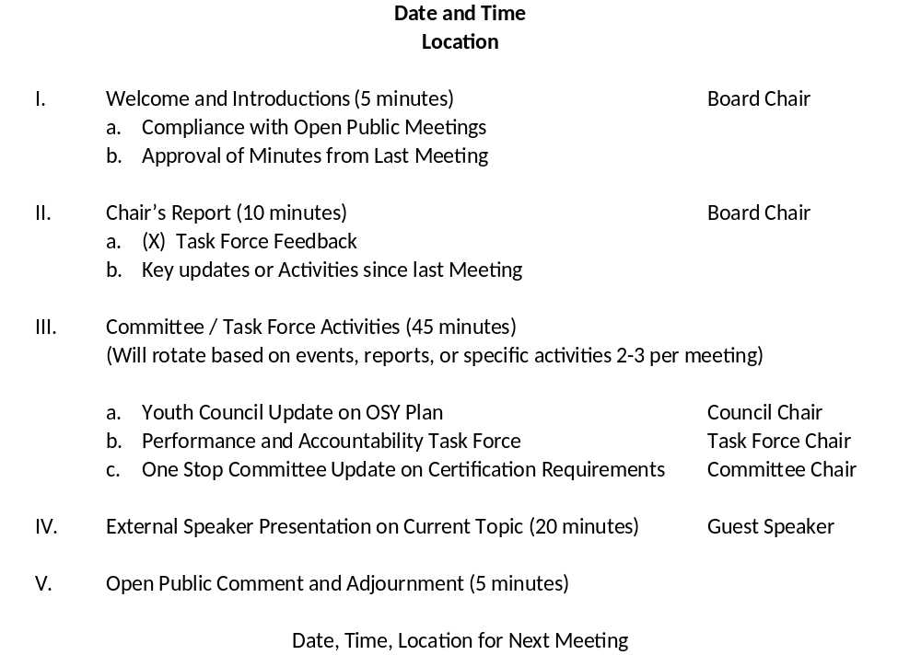

Sample Agenda
Notes:
Here you will want to pass out handouts for the exercise, as you present what is happening in the next section.
The sample agenda is here for your reference purposes. What is displayed here is timing for the sections to show where emphasis is placed, to demonstrate that the focus of the meeting should be on discussion rather than presentation, but to allow time for one presentation in a meeting. You will want to reiterate that the Board’s time should be spent providing insight, engaging in active discussion and decision making, rather than listening to reports.
As a reminder to the audience, you may want to mention that they do not have to have a committee update from every committee at every meeting. Committee updates should be sent in email form before the meeting – the meeting is a time for presentations of content, discussion, and decision making. This sample agenda is really just to help guide your thinking in the exercise.
Before you switch gears, ask the audience for any questions or concerns, or thoughts they might like to share.

Slide 13
Sample Agenda
Please refer to sample agenda handout
Additional thoughts for consideration:
  Are all board members clear on how each agenda item relates to the vision, mission, goals, and objectives of the board?
  Can you connect the agenda items to a specific strategic or tactical goal?

Slide 14
Exercise
Please form small groups of 3-5 people, ideally grouped by region
You will be provided with a handout, and given 15 minutes to discuss and complete the task
Please choose one person from the group to report out on what you learned
Notes:
Using the exercise template, the goal of this exercise is to engage the audience in planning out key discussions and decision points over the course of the year, prioritizing topics, and identifying where they might need to develop or retool a committee or task force to address an issue. They will also need to identify the topics that each task force or committee needs to tackle.
This also requires them to identify how the topics on their agendas relate to the organizational mission and vision for the board. If it does not fit, they need to ask whether it should continue to be included.
Ultimately, the expected outcome of this exercise is to help the audience member understand the importance of agenda planning, the strategic linkages between their board’s individual vision, planning, and implementation, identify potential areas of needed support, and help them to develop a plan for helping the board to reach its goals through the course of the year. If this is used as a statewide training for boards, it can also be used to start a discussion around common agenda planning for the region over the course of the next year.

Slide 15

Discussion
Notes:
Now is the opportunity for the audience to report out on what they have discussed. Think about encouraging your audience to come up with 2-3 immediate commitments to action, or steps they will take with their boards, based on this presentation.

Slide 16
Thank you!
Maher & Maher completed this project with federal funds, under contract number DOLQ131A22098 DOL-ETA-14-U-00011, from the U.S. Department of Labor, Employment and Training Administration. The contents of this publication do not necessarily reflect the views or policies of the Department of Labor, nor does mention of trade names, commercial products, or organizations imply endorsement by the U.S. Government.

