Slide 1

Monitoring reviews

Slide 2






Inclusive Meeting Guidelines
Hosting & Participating in Meetings
ENGAGE EVERYONE
BE HEARD & SEEN
ACKNOWLEDGE SPEAKER
MAXIMIZE MICROPHONES
MINIMIZE NOISE
MAXIMIZE VISUAL DISPLAYS
These guidelines are intended to improve the meeting experience for virtual participants, as well as people with hearing loss, visual impairment, & those for whom English is an additional language.

Slide 3

Facilitator
Dallas Oberlee
  Senior Associate, Coach
    Social Policy Research Associates
      Dallas_Oberlee@spra.com

Slide 4
presenters
Almendra Garcia
  Federal Project Officer
    U.S. DOL, Employment & Training Administration
      garcia.almendra@dol.gov
Elina Mnatsakanova
  Federal Project Officer
    U.S. DOL, Employment & Training Administration
      mnatsakanova.elina@dol.gov

Slide 5
agenda
Overview of Monitoring Reviews
Core Monitoring Guide
Grant Management Resources

Slide 6
Overview of Monitoring Reviews

Slide 7
Overview of Monitoring reviews – Topics
Monitoring Overview
Methods of Monitoring
Post-Monitoring Process
Tips for Managing Your Grant Early

Slide 8
Monitoring overview
Purpose of Monitoring
  Measure progress
  Identify areas of compliance & non-compliance
  Provide targeted technical assistance
  Ensure Federal funds are used responsibly
Monitoring Process
  Conducted by FPO &/or fiscal staff (Division of Financial Management & Administrative Services)
  On-site or remotely via Enhanced Desk Monitoring Reviews (EDMR)
  Mid-point of grants period of performance, lasts 3-5 days (sometimes longer)

Slide 9
Monitoring overview cont.
Scheduling Monitoring
  Work with the FPO to schedule the monitoring dates. Ensure grant staff are available during the week of the monitoring.
  1-2 months before monitoring grantee receives:
    a formal review notification/scheduling letter, copy of the Core Monitoring Guide, Document Request List
    Additional documents may be provided with the scheduling letter

Slide 10
Monitoring Overview: tips to prepare
Tips for preparing for the Monitoring
  Preparation starts at the beginning of the period of performance. Please ensure compliance with the Uniform Administrative Requirements at 2 CFR 200, FOA, other applicable regulations/TEGLs referenced in the Grant Terms & Conditions, establish necessary internal controls, & implement the grant according to the SOW & approved Budget for the achievement of planned performance goals.
  Send all requested documents to the FPO prior to the start of the monitoring. (No PII please)

Slide 11
Monitoring overview: tips cont.
Tips for preparing for the Monitoring
  Ensure that grant documents are organized & easily accessible to grant staff for easy referencing during the review. (Ex. program & financial management policies, procedures, manuals, tools/forms, participant manuals/materials/folders, performance/financial management tools, MOUs, contracts, subrecipient agreements etc.).
  Prior to the start of the monitoring, identify challenge areas that you would like the FPO to provide technical assistance on during the monitoring.
  Prior to the start of the monitoring, assess if there is an evidence-based promising practice that could be replicated or adapted by other grantees that you would like to bring to the attention of the FPO during the monitoring.

Slide 12
Monitoring overview: role of grantee
Make available grant staff for interviews/discussions.
Make available all requested documents for review.
Be prepared to discuss details regarding internal controls, organizational structure, grant operations, service delivery, tools used in grant implementation, case management system, partnerships, employer engagement, contracts, subaward agreements, MOUs, grant performance, etc.
If applicable, share challenge areas so that the FPO can identify, provide, or facilitate TA.
If applicable, be prepared to share evidence-based details regarding possible promising practices.
Be open to technical assistance.

Slide 13
Methods of monitoring: differences
On-Site Monitoring Review
Enhanced Desk Monitoring Review (EDMR)
Structured, limited to one week
In-person interviews
Review materials electronically &/or on-site
Observe activities/services
May be longer (depending on region)
Video/telephone interviews
Review materials electronically

Slide 14
Methods of monitoring: similarities
Primary review tool: DOL ETA Core Monitoring Guide
Led by the Federal Project Officer (FPO); may include DOL accounting staff
Generally, takes place once during period of performance
Interviews of grantee staff, participants, partners
Results in monitoring report outlining the findings
All findings must be resolved by the end of the period of performance

Slide 15
Post-Monitoring process
Exit Conference
Monitoring Report issued within 45 days after Exit Conference
  Background information about monitoring
  Detailed descriptions of compliance findings & required corrective actions
Grantee’s response due within 30 days after receipt of Monitoring Report
  Provide documentation required to close findings
  Corrective Action Plan (CAP) & due dates for open findings
All findings must be resolved by the end of performance period to ensure successful closeout of the grant
  90% of findings expected to be closed within the first year after review

Slide 16
Tips for successfully managing your ne grant
Communicate with your FPO
Review the Grantee Handbook
Review the Core Monitoring Guide
Complete the SMART 4.0 Training
Identify & address issues early
  Recruitment, Financial, & Reporting
Track & manage progress
Document successes & challenges
  Don’t be afraid to ask for help!
Work with your partners

Slide 17
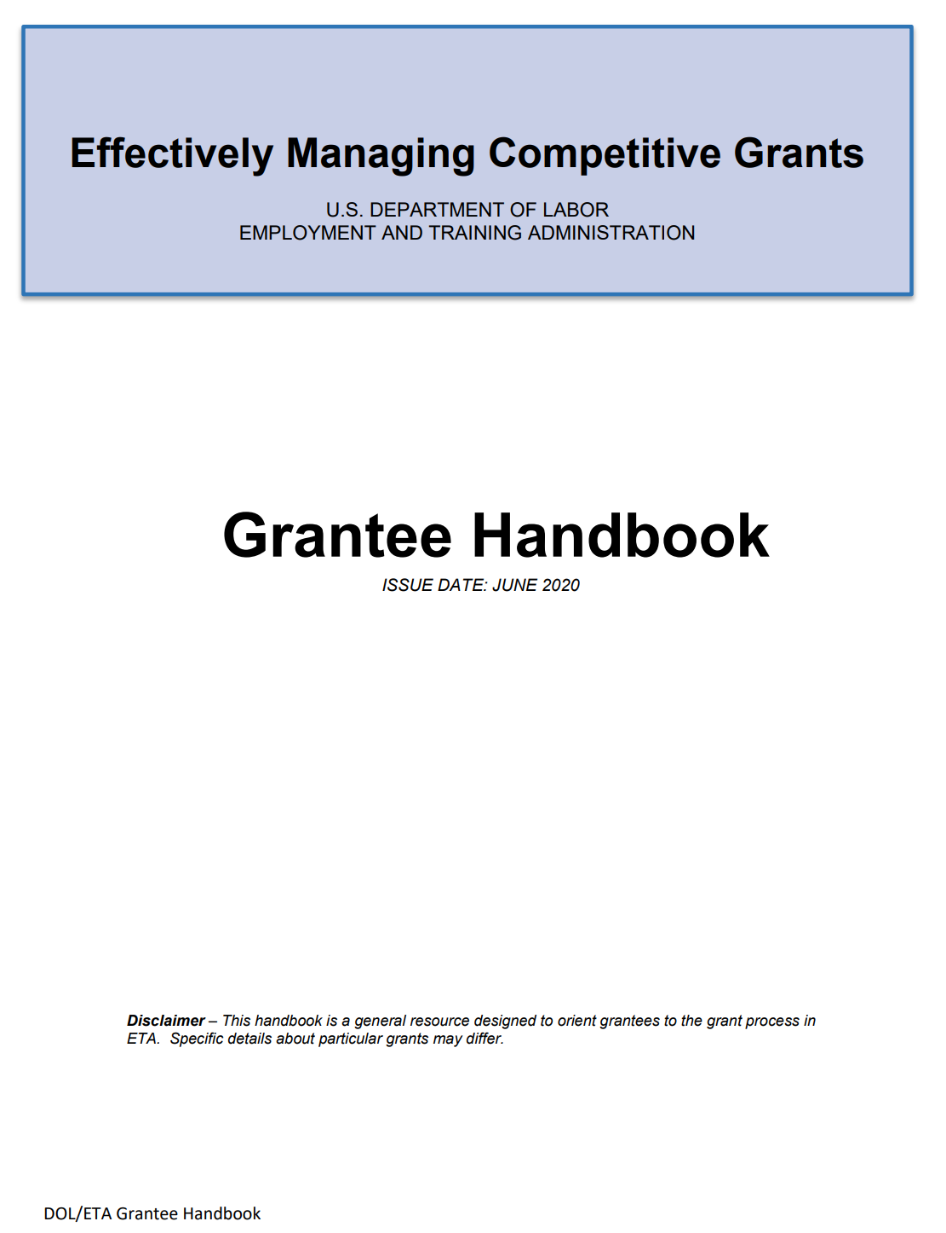
ETA GRANTEE Handbook
ETA’s Team Approach to Grant Management
An Overview of Award Documents, Grantee Obligations, & Regulatory Requirements
How to Manage Your Period of Performance
Grant Amendments
Evaluation: What You Need to Know
Audit Phase
Closeout Phase
General Parameters Governing Use of ETA Grant
Funds

Slide 18

Monitoring Overview Questions?

Slide 19
CORE MONITORING GUIDE
SECTIONS OF THE CORE MONITORING GUIDE
POLICIES & PROCEDURES CHECKLIST

Slide 20
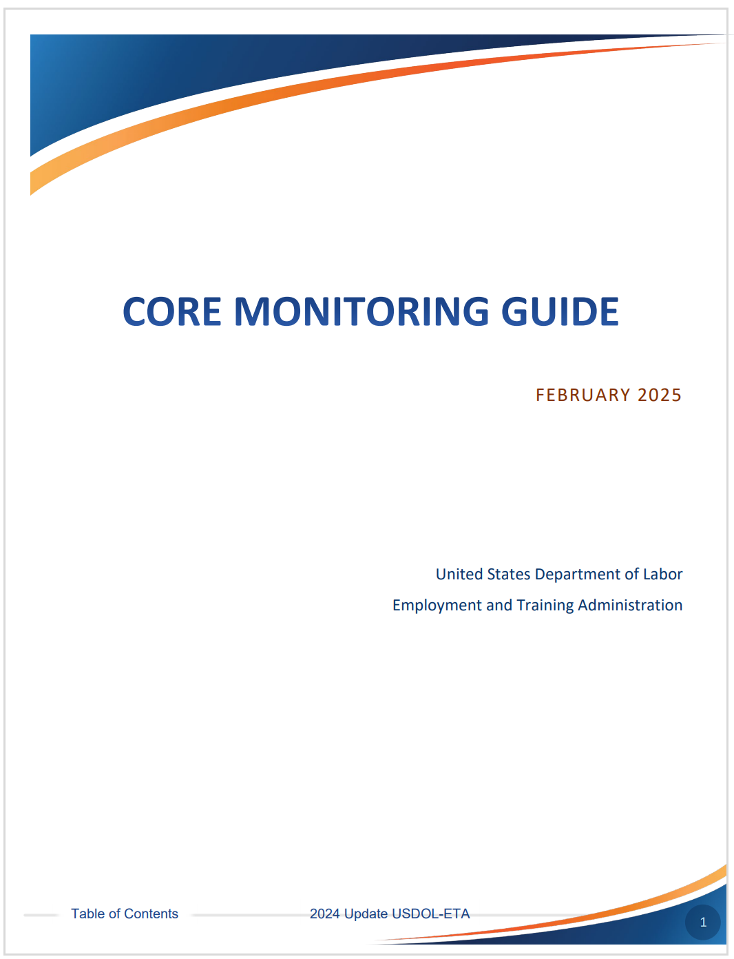
Core monitoring guide: the Primary review tool
Provides a consistent framework for assessing compliance with grant agreement, Federal regulations, & Uniform Guidance
Core Monitoring Guide
  Core Activity 1: Service Design & Delivery
  Core Activity 2: Grant Operations
  Core Activity 3: Financial Management
  Appendix: Resources & Tools

Slide 21
Core activity 1: Service design & delivery
Objective 1.a: Planning & Program Design
  The grantee has conducted all planning activities related to service design & delivery to accomplish all grant activities and goals.
Objective 1.b: Implementation
  The grantee has implemented service design & delivery activities to accomplish all grant activities & goals.
Objective 1.c: Products & Deliverables
  The grantee has documented and/or developed the products or deliverables outlined in the SOW, PIP, or State Plan or as required in applicable Federal guidance.
Objective 1.d: Business Services & Employer Engagement
  The grantee has documented & performed all service delivery activities outlined in the SOW, PIP, or State Plan related to serving businesses & engaging employer partners to ensure accomplishment of the grant/project goals.

Slide 22
CORE ACTIVITY 1: Service design & delivery cont.
Objective 1.e: Participant Services
The grantee is implementing the required service delivery strategy outlined in its award & is providing all required services to participants.
Common Findings
  Participant service policies are not in place: eligibility/enrollment, priority of service, assessment, supportive services, training services, placement, follow-up services
  Not all participant services stipulated in the SOW are provided
  Priority of service to veterans is not provided

Slide 23
Core activity 2: grant operations
Objective 2.a: Project Management
Objective 2.b: Budget
The grantee has an adequate system in place to manage the grant/project, including any specific award conditions, prior approval of project amendments, & closeout requirements.
Common Findings
  The grantee does not have a clear understanding of the amendment process
  There are no written policies & procedures for amending the grant, grant closeout
The grantee has a financial management system or budget control mechanism in place to monitor spending, determine allowability of costs, compare & reconcile the budget to actual expenditures. The system has triggers for budget amendments when necessary.
Common Findings
  Actual vs. planned budget analysis is not performed
  Actual vs. planned budget analysis is not based on budget form SF-424A categories
  The grantee is not operating within approved budget

Slide 24
Core activity 2: grant operations cont.
Objective 2.c: Property management
The grantee maintains a property management system in accordance with all prior approval requirements, terms & conditions of the award, & written programmatic policies & procedures.
Common Findings
  Lack of written policies & procedures for purchase & disposition of equipment, supplies, & intangible property developed with grant funds
  Equipment is purchased without prior Grant Officer’s approval

Slide 25
Core activity 2: grant operations cont. 2
Objective 2.d: Procurement & Contract Administration
The grantee maintains an adequate procurement/purchasing system that includes written procedures & ensures that all contracting or procurement actions are performed in a manner that provides for full & open competition.
Common Findings
  Lack of written policies & procedures for procurement
  Required contract provisions are not included in the contractual agreements
  Procurement is not conducted with full & open competition
  Cost or price analysis for all procurement actions in excess of Simplified Acquisition Threshold is not performed

Slide 26
Core activity 2: grant operations cont. 3
Objective 2.e: Performance Management
Objective 2.f: Subrecipient Management & Oversight
The grantee maintains a performance management system to manage, track, & measure performance & operating goals, indicators, milestones, expected outcomes that comply with the terms & conditions of the award.
Common Findings
  Lack of process to identify, collect, validate, and report the required performance data
  Lack of a performance monitoring tool measuring grant progress to ensure that desired outcomes are achieved by the end of the period of performance
The grantee manages all its subrecipients & tracks their performance & compliance in meeting the terms & conditions of the subaward.
Common Findings
  The grantee does not understand distinctions between subrecipients and contractors
  Pre-award risk assessment of subrecipients has not been conducted
  There is not a process (tool) to perform subrecipient monitoring and resolve resulting findings. Subrecipient monitoring has not been conducted
  Subrecipients’ quarterly performance and financial reports are not required/received

Slide 27
Core activity 2: grant operations cont.
Objective 2.g: Records Management
Objective 2.h: Personnel
The grantee maintains a system & implements procedures to manage & secure all financial records, supporting documents, statistical records, & all other records pertinent to the Federal award.
Common Findings
  Lack of policies & procedures for retention of records
  Policies & procedures for records retention are not in compliance with the Uniform Guidance
  Required accessibility clause granting DOL, the DOL Inspector General, the Comptroller General of US, the Pass-Through Entity & any of its authorized representatives access to grant-related records is not included in the policies & procedures
  Measures for protecting Personally Identifiable Information (PII) are not in place
The grantee’s management & staffing are aligned with the SOW, State Plan, or project plan & designed to assure responsible & ethical management of the grant/project.
Common Findings
  Salary & bonus limitation requirement is not observed
  Lack of polices & procedures related to personnel/hiring

Slide 28
Core activity 2: grant operations Cont. 4
Objective 2.j: Civil Rights, Complaints, Grievances & Incident Reporting
The grantee has a system in place to ensure the Federal Civil Rights complaints, program complaints, grievances, & incidents are handled properly & in accordance with Federal requirements.
Common Findings
  Lack of written discrimination complaint procedures
  Required wording (29 CFR 38.34) stating that the program or activity in question is an “equal opportunity employer/program” & that “auxiliary aids are available upon request to individuals with disabilities” is not included on publications
  The required “Equal Opportunity is the Law” notice (29 CFR 38.35) is not posted in reasonable numbers & places & is not made a part of grant participants’ files
  The “Equal Opportunity is the Law” notice/poster does not include all non-discrimination bases, and/or does not include other required information, or not the correct one
  Lack of process and/or policies & procedures for incident reporting – fraud, waste, abuse, mismanagement of funds, etc.

Slide 29
Core activity 3: financial management
Objective 3.a: Internal Controls
Objective 3.b: Accounting System & Reporting
Effective control, integrity, & accountability are maintained for achievement of the grant’s objectives in operational effectiveness & efficiency, reliable financial reporting, & compliance with laws, regulations, & policies.
Common Finding
  Lack of internal controls in place to prevent unauthorized purchases & disbursements of grant funds & safeguards of assets, so no single person controls the order, receipt, payment, reconciliation, management, & disposition of an asset
An accounting system is in place that allows the grantee to maintain accurate & complete disclosure of the grant’s financial results & those of its subrecipients.
Common Findings
  Lack of written policy to ensure that accounts are reported on an accrual basis
  Accrued expenditures are not tracked
  Quarterly financial reports are not submitted on accrual basis
  Subrecipients’ financial reports are not required/submitted

Slide 30
Core activity 3: financial management cont.
Objective 3.c: Payments & Cash Management
Objective 3.d: Cost-Sharing (match) & Leveraged Resources
Effective control, integrity, & accountability are maintained for achievement of the grant’s objectives in operational effectiveness & efficiency, reliable financial reporting, & compliance with laws, regulations, & policies.
Common Finding
  Lack of cash management policies & procedures; improper payments
Written policies & procedures to record & support any required match or leveraged resources committed or identified in the award or program regulations.
Common Findings
  Lack of written policies & procedures for match/leveraged requirements, including identifying, valuating, tracking, & reporting
  There is no system for tracking contributed match/leveraged resources
  Match/leveraged resources are not reported on the quarterly ETA-9130 financial reports
  Not on track to meet the match requirement

Slide 31
Core activity 3: financial management cont.
Objective 3.e: Program Income
Objective 3.f: Allowable Costs & Cost Classification
Written policies & procedures in place to accurately record & expend the program income in compliance with applicable Federal statutes, implementing regulations, the terms & conditions of the grant award.
System/procedures in place to ensure that it is incurring necessary, reasonable & allowable costs & that such costs are accurately classified in the accounting system. The grantee monitors the costs incurred by its contractors & subrecipients to ensure allowability & accurate cost classification.
Common Findings
  Lack of written policies & procedures ensuring that the grant is incurring necessary, reasonable, & allowable costs, based on the Uniform Guidance Subpart E - Cost Principles

Slide 32
Core activity 3: financial management cont. 3
Objective 3.g: Cost Allocation/Indirect Costs
Objective 3.h: Audits & Audit Resolution
The grantee allocates costs including indirect costs to the benefitting cost objectives based on relative benefits received & treats allocated costs consistently within its accounting system.
Common Findings
  Not keeping accurate timesheets, allocating time based on formula & not on actual hours spent on the grant
  Charging indirect costs without a current Negotiated Indirect Cost Rate Agreement (NICRA) in place
The grantee adheres to the single or program-specific audit requirements & has an audit resolution process in place including debt collection for its subrecipients.
Common Findings
  The required Single Audit has not been performed
  The grantee does not have a system in place to ensure that subrecipients’ audits are conducted & resolved

Slide 33
Grant Management Resources

Slide 34
Core monitoring guide: resources & tools (selected)
Resources
Tools
A: Acronyms
C: Record Retention Requirements
D: Items Requiring Prior Approval
E: Performance Reports & Systems
G: Single Audit Report Framework
B: Documents, Policies, & Procedures for Request & Review
F: MOU & IFA Worksheet
I: Procurement Standards Checklist
K: Contract or Agreement Checklist
O: Cost-Sharing (Match) Evaluation Worksheet
P: Transaction Testing

Slide 35
Policies & procedures checklist
Accounting Systems
Allowable Costs
Audits: Completion, Tracking & Resolution
Budget Controls & Amendments
Cash Management: Petty Cash, Bank Reconciliations
Closeout: Grants & Contracts
Compensation & Fringe Benefits
Complaints &/or Grievances (participants & staff)
Conflict of Interest, including Board members
Debt Collection
Disaster & Recovery Plan
EEO – Resolutions, Appeals, & Hearings
Eligibility & Enrollment
Exit & Follow-up
Fringe Benefits Package, Vacation & Leave, Pension, Severance Package (if any)
Incentives/ Stipends
Incident Reporting, Grievances, & Complaints
Indirect Costs: NICRA, CAP
Meals (staff, Board, participants)
Monitoring: Resolution, Appeals & Hearings
Participant/Program Services
Payroll & Time Distribution
Procurement/Purchasing
Program Income, Match, & Leveraged Resources
Property Management
Receivables & Payables
Record Retention
Reporting: Federal & Subrecipient
Salary & Bonus Limits (when applicable)
Supportive Services
Training (OJL, ITA, Refunds, etc.)
Travel
Written Code of Conduct

Slide 36
Smart 4.0 training series
ETA Grant Management Overview
Internal Controls
Budget Management & Grant Modifications
Payments & Cash Management
Cost Principles & Cost Classification
Match & Leveraged Resources
Cost Allocation & Indirect Costs
Advanced Cost Allocation
Property Management
Real Property & Leases
Subrecipient Management
How to Write an Effective Monitoring Report
Monitoring & Oversight
Financial Reporting
Personnel & Fringe Benefits
Complaints, Grievances, & Incident Reporting
Procurement Standards & Methods
Procurement & Contract Administration
Audit & Audit Resolution
Records Management
Closeout & Post Closeout

Slide 37
Questions?

Slide 38
resources
SMART 4.0 Grants Management Training
Core Monitoring Guide
Grantee Handbook
Participant Data Collection and Tracking Toolkit
Policy Checklist

Slide 39
June event
Grants Management: Match/Cost-Sharing and Leveraged Resources
  June 24, 2025 from 3-4:00(ET) / 12-1:00(PT)
  Presented by Chanel Castañeda from the Office of Grants Management
  Review the SMART 4.0 training session on Match and Leveraged Resources BEFORE the event!

Slide 40
THANK YOU
NursingExpansion@dol.gov

