Slide 1
Closing Plenary: Imagining the future – dol’s vision for the nursing expansion grants
Session 3.5: Nursing Expansion Institute

Slide 2
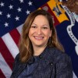
Moderator
Jenn Smith
  Division Chief
    Department of Labor

Slide 3
SESSION AGENDA
Closing Plenary overview
Remarks from ETA Assistant Secretary
Facilitated panel discussion with evaluators
Q&A

Slide 4
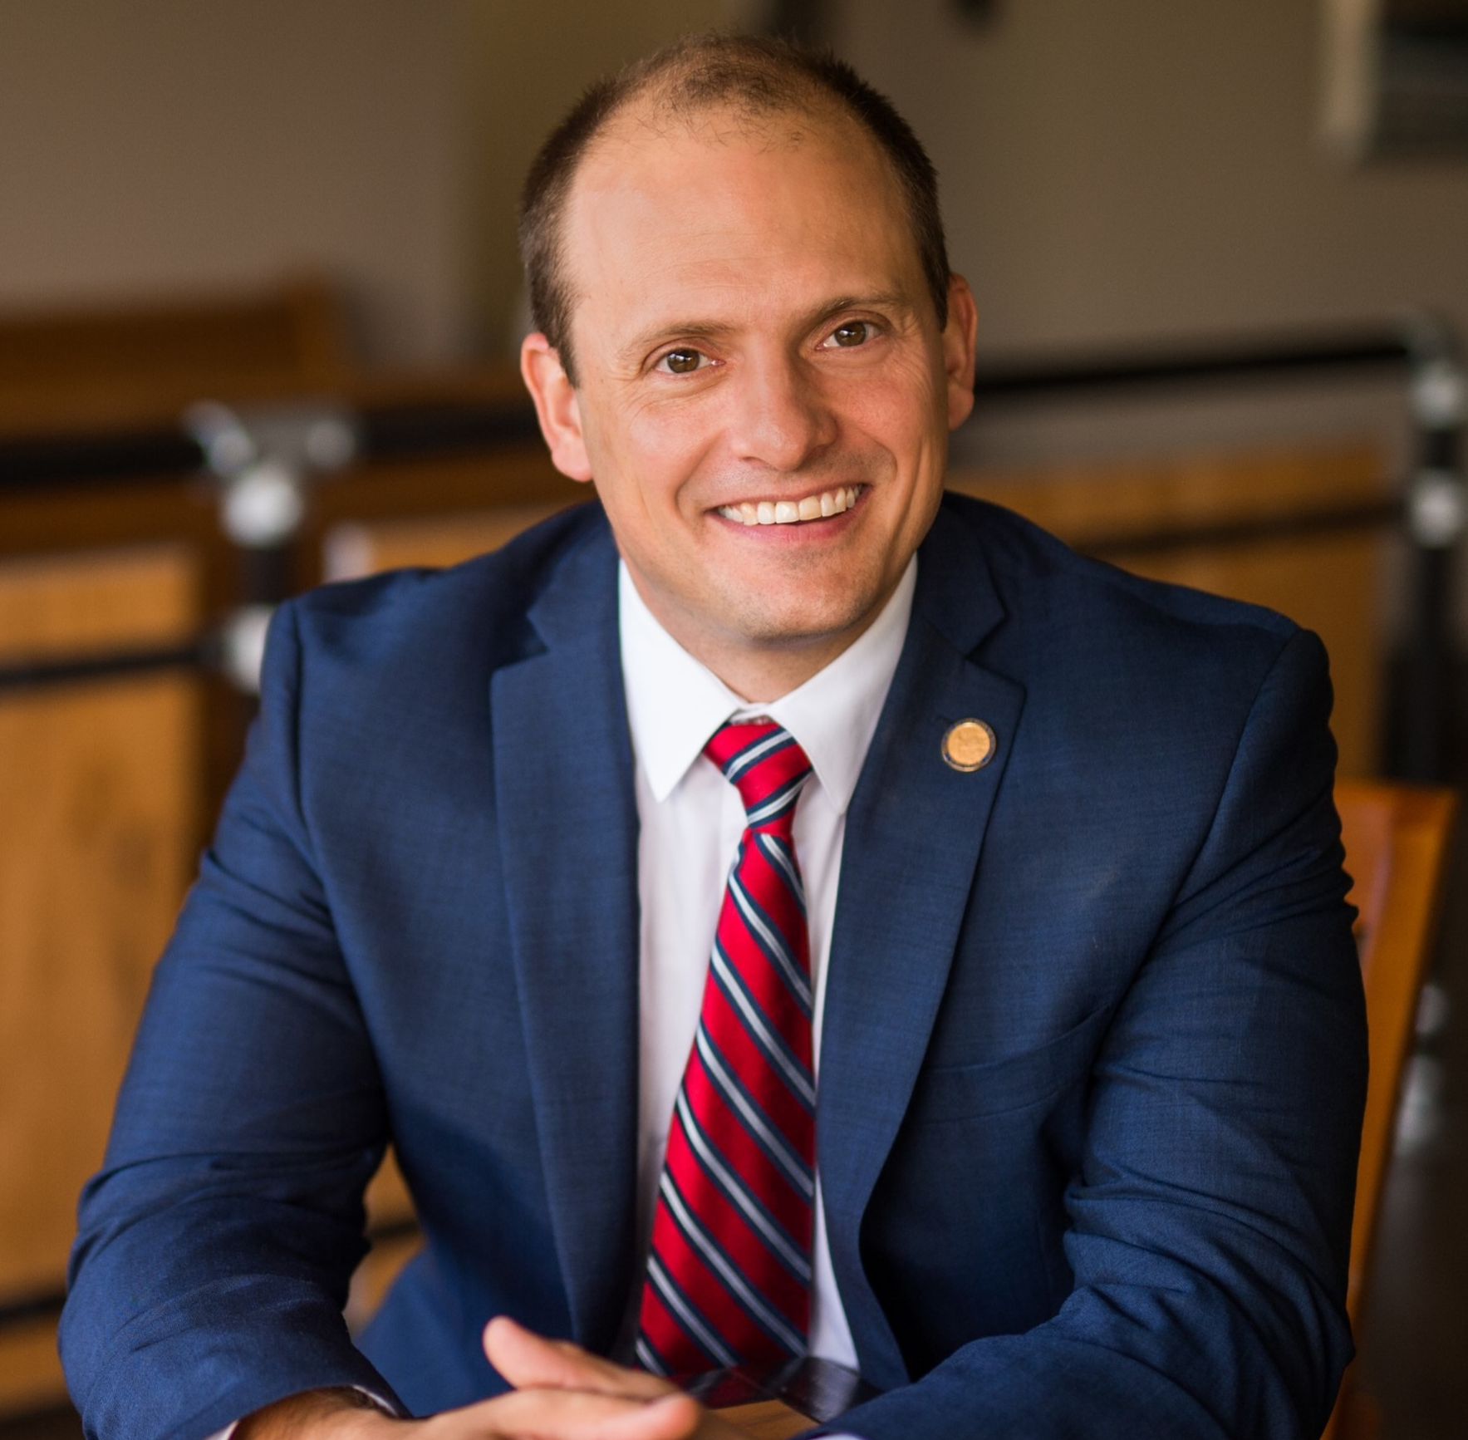
Presenter
José Javier Rodríguez
  Assistant Secretary, ETA
  Department of Labor

Slide 5
Eta assistant secretary remarks

Slide 6
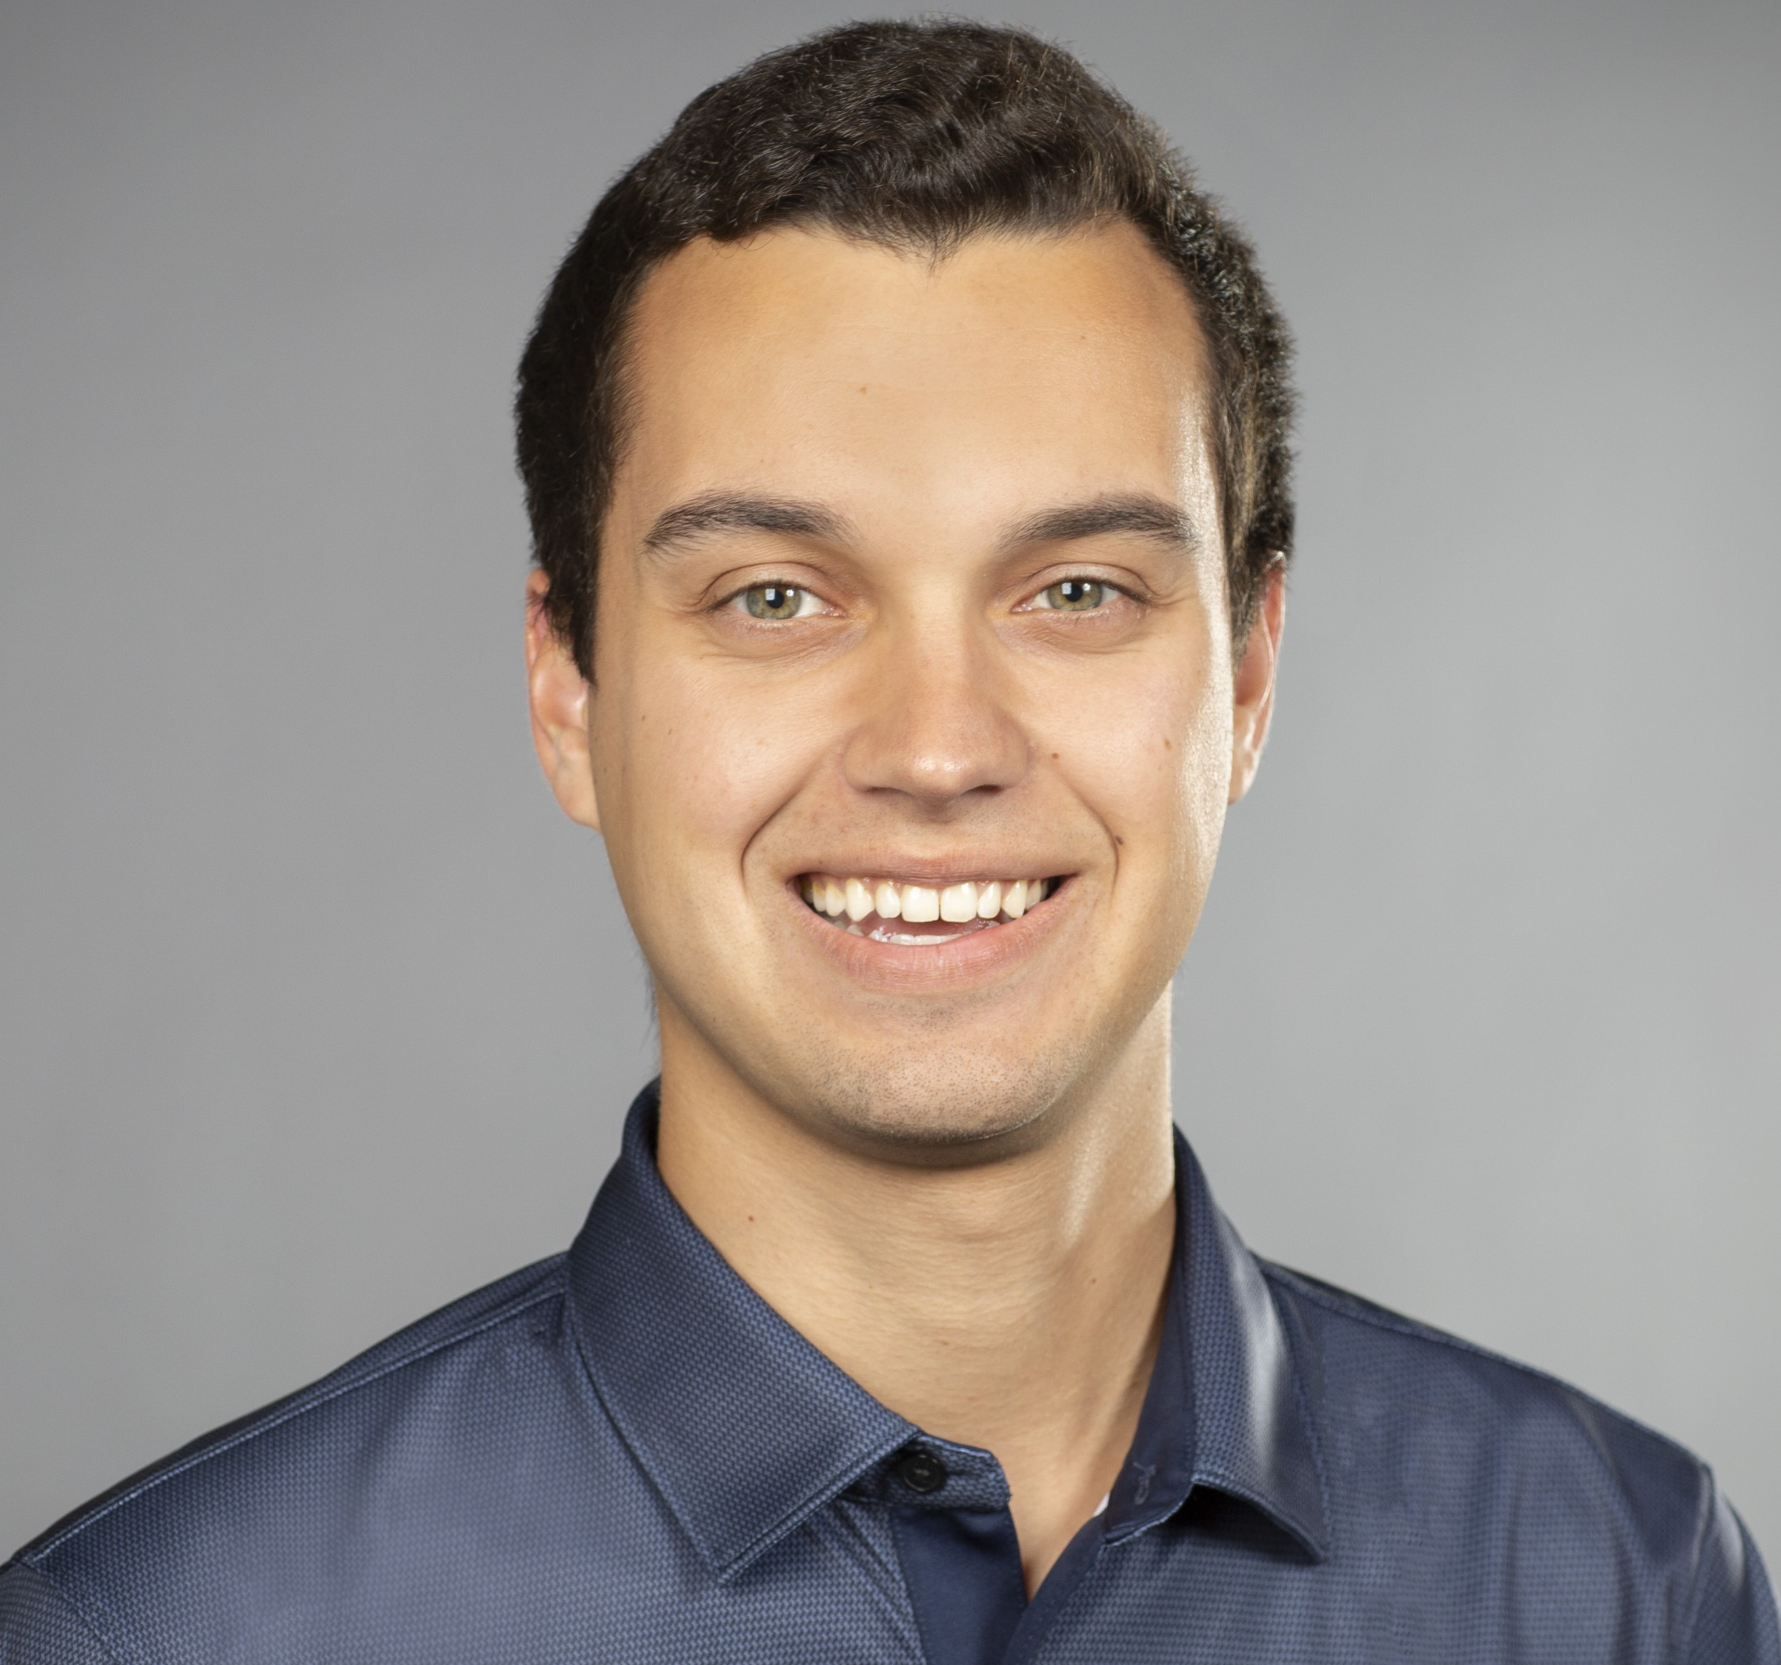
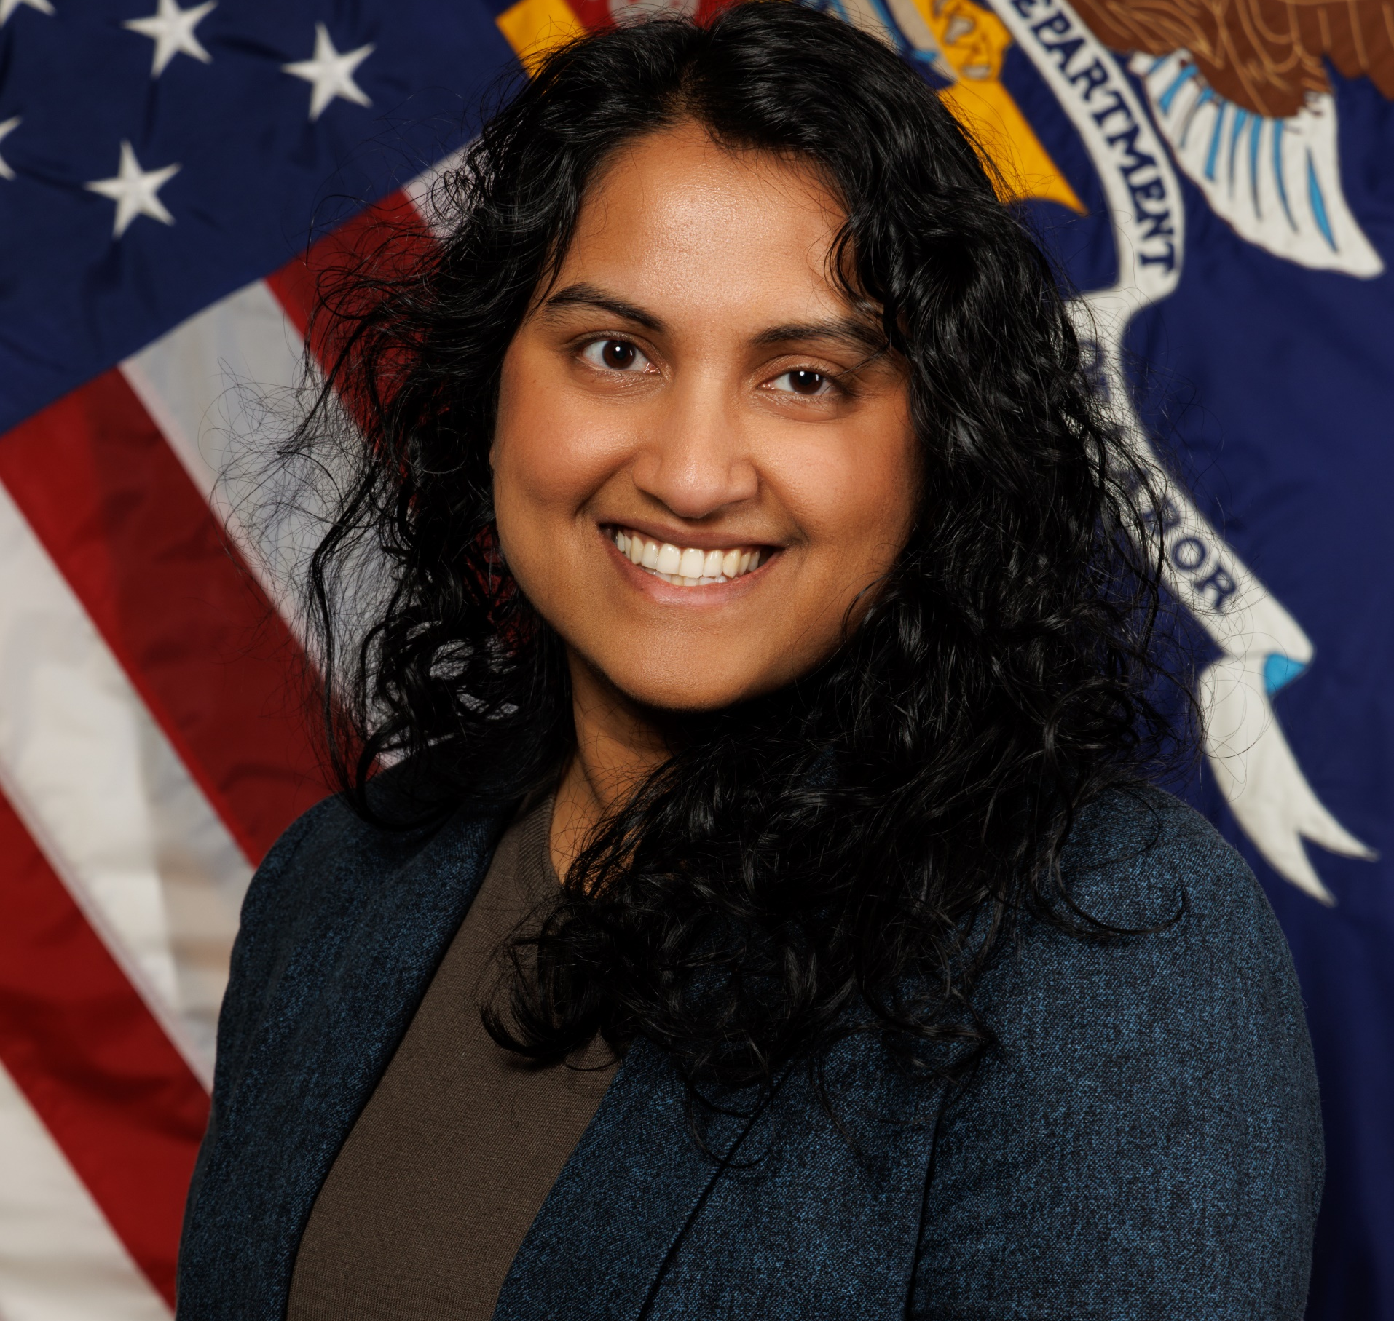
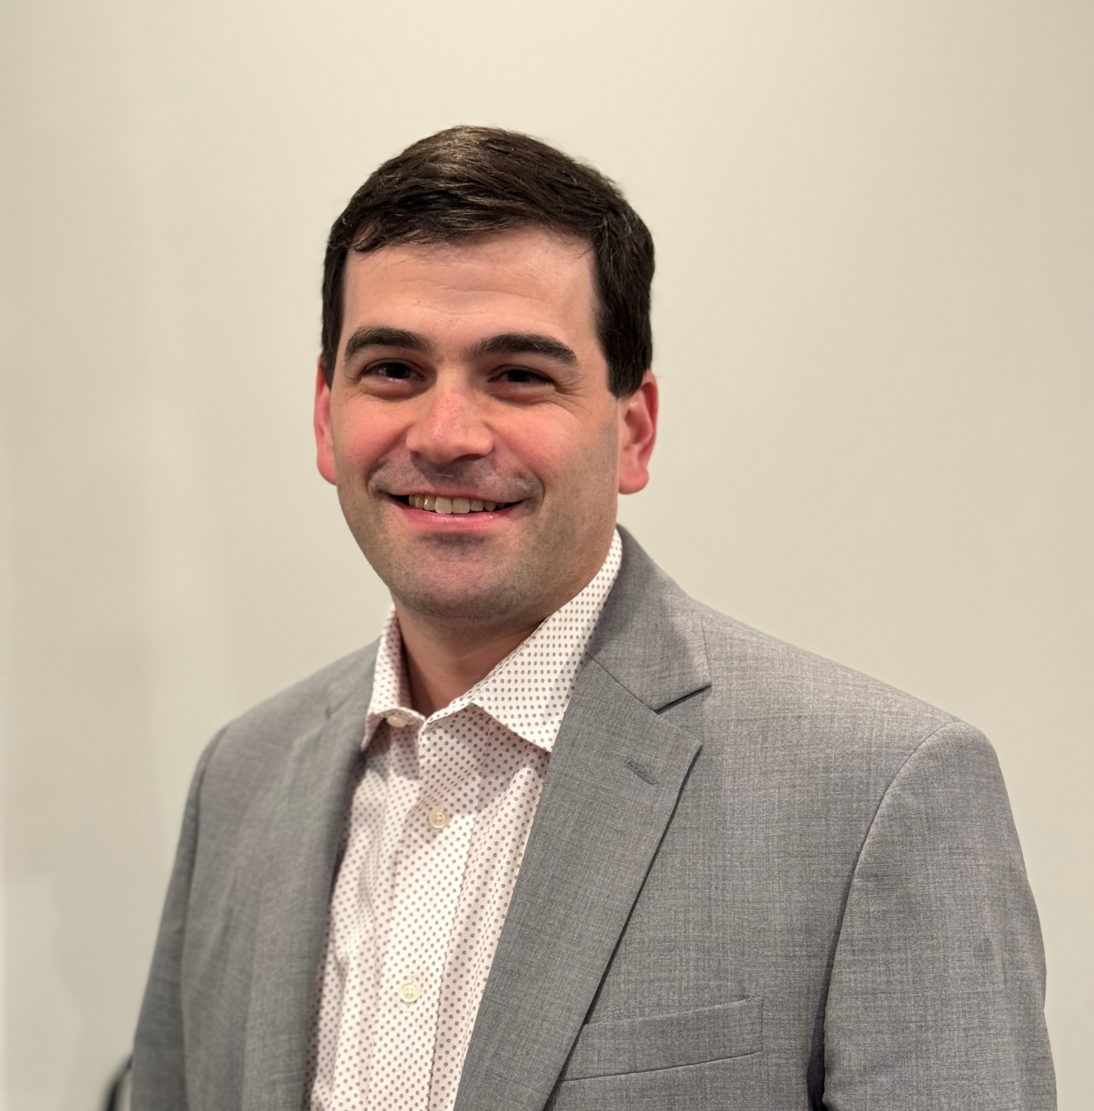
Presenters
Dr. Evan Murphy
  Evaluation Specialist
    Department of Labor
Dr. Suchi Akmanchi
  Economist
    Department of Labor
Dr. Daniel Litwok
  Senior Associate, co-Principal Investigator
    Abt Global

Slide 7
Panel discussion

Slide 8
Questions?

Slide 9
Wrap-up

Slide 10
Session Resources
Sectoral Strategies and Employer Engagement Portfolio (SSEEP) | U.S. Department of Labor (dol.gov)
WorkforceGPS - Nursing Expansion National Evaluation

Slide 11

Thank you!
The American Institutes for Research® (AIR), completed this project with federal funds, under contract number 1605C2-23-Q-00074 Nursing Expansion Grant TA, from the U.S. Department of Labor, Employment and Training Administration. The contents of this publication do not necessarily reflect the views or policies of the Department of Labor, nor does mention of trade names, commercial products, or organizations imply endorsement by the U.S. Government. AIR is a nonpartisan, not-for-profit organization that conducts behavioral and social science research and delivers technical assistance to solve some of the most urgent challenges in the U.S. and around the world.

