Slide 1
RESEA Outcome Payments: Eligibility Determination
April 3, 2023
Daniel Sommers
Employment and Training Administration Office of Unemployment Insurance
Notes:
This is the Methodology To Distribute the Reemployment Services and Eligibility Assessments (RESEA) Outcome Payments to States using RESEA reemployment and Duration of Benefits Measures.
My name is Daniel Sommers, and this presentation is from the Employment and Training Administration, Office of Unemployment Insurance.

Slide 2
Background
Methodology reflects RESEA’s statutory purpose
  Improve employment outcomes of individuals receiving unemployment compensation
  Reduce average duration of unemployment compensation through reemployment
Duration of Benefits Component
  States must show improvement in average duration of benefits
RESEA Reemployment Component
  States must show improvement in reemployment outcomes for RESEA participants
A state must meet or exceed both the Duration and Reemployment component to be eligible for an outcome payment
Measure uses these components to show improved employment outcomes through reduction in duration of UI benefits
Notes:
The methodology for these measures reflect RESEA's statutory purpose, which is to do two things. First, improve the employment outcomes for individuals who receive unemployment compensation and second, to reduce the average duration of receipt of Unemployment Compensation through reemployment.
It is for this reason, that the Measure is made of two components: A duration component and an RESEA Reemployment component .
For the Duration component, states must show improvement in the average duration of benefits. For the Reemployment component, States must show improvement in reemployment outcomes for RESEA participants.
A state must meet or excel both the Duration and Reemployment components to be eligible for an outcome payment
By incorporating these two components, the measure shows improved state employment outcomes through a reduction in duration of UI benefits.

Slide 3
A. Duration Component
  States must show improvement in duration of benefits
  States must demonstrate improvement in UI duration (12 month average)
  UI duration can be impacted by many variables such as; changes in economy, changes in state law, etc.
  Use a regression model to account for these differences. ETA models states’ average duration using the following:
    Total Unemployment Rate (12 month average)
    Potential Duration of Benefits (12 month average)
    UI Exhaustion Rate (12 months of UI data)
    Avg State Weekly Benefit Amount (12 months of UI Data)
    Year to Year Change in Employment (non farm payroll, 24 months)
  Model developed using historical data. Parameters refreshed each year. Currently developing a mid-year duration target preview.
Notes:
Here is a more detailed look at the Duration Component. States must show improvement in UI duration of benefits, therefore, the measure looks at a 12 month average of each state’s duration of benefits.
A state’s UI duration of benefits can be impacted by many different conditions, or variables, that are found in that particular state. Things Such as: changes in a state’s economy or changes in state law.
For this reason, a regression model is used to establish performance targets for a state’s duration of benefits. ETA’s developed model to estimate a states’ average duration uses the following variables:
A state’s Total Unemployment Rate (which is a 12 month average).
The Potential Duration of Benefits (for example, some states have a maximum duration of benefits of 26 weeks, while others have a much lower maximum
The exhaustion rate of benefits (this is a rate that claimants exhaust benefits – a 12 month rate)
The average State weekly benefit amount (12 months)
The year to year change in employment (uses 24 months of data from the Bureau of Labor statistics non-farm payroll labor force estimates for the state.
This model and these relationships to duration of benefits were developed using historical UI and labor force data. Each year, these parameters are refreshed using the most recent 3 years of data.

Slide 4
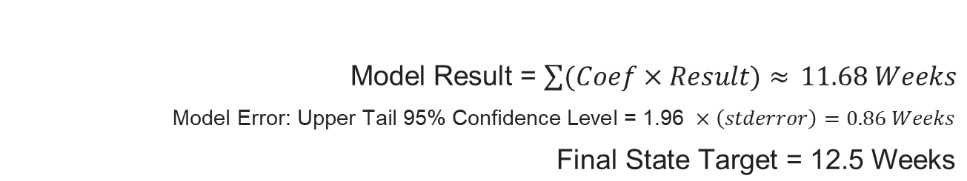
Duration Target Example 1
State Example 1
Variable | Model Coefficient | State 12 Month Result | (Coefficient × Result)
Model Intercept | -6.7 | NA | -6.7
TUR | 66.8 | 2.8% | 1.87
Exh | 13.8 | 30.3% | 4.18
Potential Duration | 0.52 | 22 Weeks | 11.44
Avg Benefit | 0.00483 | $229.33 | 1.12
Payroll Change | -17.8 | 1.3% | -0.23
Model Result = $\sum{(Coef×Result)≈ }11.68 Weeks$
$$\text{Model} \text{Error}\text{: }\text{Upper} \text{Tail}\text{ 95\% }\text{Confidence} \text{Level}\text{ = 1.96 }×\left(stderror\right)=0.86 Weeks$$
$$\text{Final} \text{State} \text{Target}\text{ = 12.5 }\text{Weeks}$$
Notes:
Here is an example of a state’s modeled duration of benefits – which is used to determine the state’s duration target. For this state’s performance year, the unemployment rate was 2.8%, with a 30.3% exhaustion rate, a potential duration of 22 weeks, and average benefit amount of around $230 and an annual percent payroll increase of 1.3%. After applying these conditions into the duration model, as well as adjusting for model error – the final state duration target is 12.5 weeks.

Slide 5
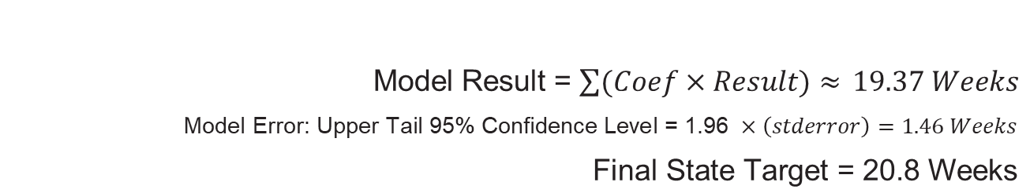
Duration Target Example 2
State Example 2
Variable | Model Coefficient | State 12 Month Result | (Coefficient × Result)
Model Intercept | -6.7 | NA | -6.7
TUR | 66.8 | 8.3% | 5.54
Exh | 13.8 | 47.3% | 6.53
Potential Duration | 0.52 | 26 Weeks | 13.52
Avg Benefit | 0.00483 | $150.11 | 0.73
Payroll Change | -17.8 | 1.4% | -0.25
Model Result = $\sum{(Coef×Result)≈ }19.37 Weeks$
$$\text{Model} \text{Error}\text{: }\text{Upper} \text{Tail}\text{ 95\% }\text{Confidence} \text{Level}\text{ = 1.96 }×\left(stderror\right)=1.46 Weeks$$
$$\text{Final} \text{State} \text{Target}\text{ = 20.8 }\text{Weeks}$$
Notes:
Here is a second example, with a state that has different conditions from the first example. Here, economic conditions are not as good, which is reflected in the unemployment rate, which is higher – at 8.3% instead of 2.8%. The exhaustion rate is also higher (47.3%), this state also has the maximum 26 weeks of potential duration, a lower benefit amount of $150, but a similar change in payroll of 1.4%.
Here we see the impact that higher unemployment rates, increased exhaustion rates, higher potential duration, as well as lower benefit amounts can have on a state’s target. When applying these conditions to the model, the state’s targeted duration is higher at 20.8 weeks.

Slide 6
B. RESEA Reemployment Component
  States must show improvement in reemployment outcomes for RESEA participants
  Requires an evaluation of state reemployment performance.
  Uses RESEA-subset data
    Collected by Employment Services (ES) program
    Reported to ETA via Workforce Integrated Performance System (WIPS)
  Reemployment Rate during 2nd Quarter after Program Exit
    RESEA participants who secure unsubsidized employment during the 2nd quarter after this same group exits the ES program
  Reemployment Targets, Interim and New, Updated Method
    Interim targets: state Wagner Peyser (WP) negotiated targets
    As more RESEA data were collected, and models refined, ETA has a new, updated method.
      RESEA-specific targets
      WP targets are discontinued
      RESEA specific model parameters (and targets) are refreshed each year
      Anticipate a mid-year RESEA target preview
Notes:
Now we look at the RESEA reemployment component.
Again, states must show improvement in reemployment outcomes for RESEA participants.
This requires an evaluation of state RESEA reemployment performance. RESEA data is a subset of the universe of UI claimant data. These data are collected by the Employment Services program which is reported to ETA through the Workforce Ingegrated performance system.
A state’s Reemployment performance is measured by calculating the Reemployement Rate for RESEA participants during the Second quarter after their program exit.
Specifically, these participants must secure unsubsidized employment during the2nd quarter after this same group exits the ES program, in order to be considered as a positive reemployment outcome.
Initially, RESEA used Wagner Peysner Negotiated Targets as interim targets. This was because, early in the program there were not enough RESEA historical reemployment data to model state specific targets.
However, As more RESEA data were collected and potential models refined, ETA established a new updated method for reemployment targets. Beginning this year an RESEA specific model has been established, and the Wagner Peynser targets discontiued. As with the duration model, the RESEA model parameters will be refreshed each year. We also anticipate making available a midyear RESEA target preview beginning with next year’s results.

Slide 7
RESEA Component Continued
  Similarly, as with UI duration, RESEA reemployment can be impacted by many variables such as; changes in economy, changes in state law, etc.
  Use a regression model to account for these differences. ETA models states’ RESEA reemployment rate using the following:
    Total Unemployment Rate (12 month average)
    UI Recipiency Rate(12 month average)
    Year to Year Percent Change in State Job Openings (BLS Business Employment Dynamics, 24 months)
    Year to Year Net Change in Gross Job Gains and Losses (BLS Business Employment Dynamics, 24 months)
    UI Duration of Benefits (12 Months of UI data)
  Model developed using historical data. Parameters refreshed each year. Currently developing a mid-year RESEA target preview.
Notes:
Here is a more detailed look at the RESEA Component and Targets. States must show improvement in Reemployment outcomes (meaning the Reemployment rate), therefore, the measure looks at a 12 month Reemployment rate for each state.
Similarly, as with UI duration, RESEA reemployment rates can be impacted by many different conditions, or variables, that are found in that particular state. Things Such as: changes in a state’s economy or changes in state law.
For this reason, a regression model is also used to establish performance targets for a state’s RESEA reemployment rate. ETA’s developed model to estimate a state’s RESEA reemployment rate uses the following variables:
A state’s Total Unemployment Rate (which is a 12 month average).
A state’s UI recipiency rate (also a 12 month average)
The Year to Year Percent Change in State Job Openings (this is sourced from BLS Business Employment Dynamics statistics, using 24 months of data)
The Year to Year Net change in Gross Job Gains and Losses (Also, from BLS Business Employment Dynamics data).
And finally, UI duration of benefits (uses 12 months of data)
This RESEA model was developed using historical RESEA outcomes, UI, and BLS labor force data. Each year, the parameters for this model are refreshed using the most recent 3 years of data.

Slide 8
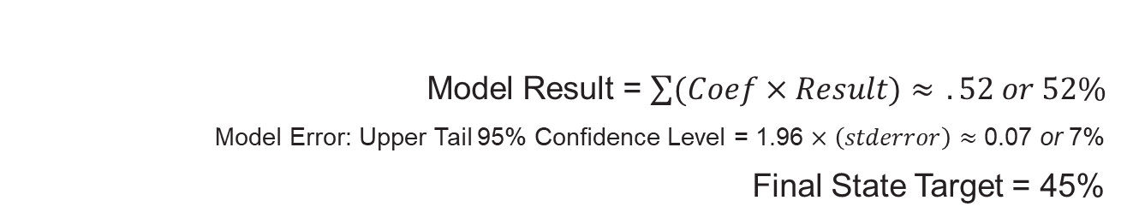
RESEA Target Example 1
State Example 1
Variable | Model Coefficient | State 12 Month Result | (Coefficient × Result)
Model Intercept | 0.775 | NA | 0.775
TUR | -0.843 | 8.2% | -0.069
Recipiency Rate | -0.109 | 35.2% | -0.038
Job Openings % Change | -0.152 | 10.6% | -0.016
Net Change Losses, Gains | 5.45x10⁻⁸ | -905,575 | -0.049
Average UI Duration | -.003 | 29 weeks | -0.0858
Model Result = $\sum{(Coef×Result)≈ }.52 or 52\%$
Model Error: Upper Tail 95% Confidence Level = 1.96 $×\left(stderror\right)≈$ 0.07 or 7%
Final State Target = 45%
Notes:
Here is an example of a state’s modeled RESEA reemployment rate – which is used to determine the state’s RESEA target. For this state’s performance year, the unemployment rate was 8.2%, with a 35.2% recipiency rate, a Year to Year percent change in Job Openings of 10.6%, A net change in Job Losses and Gains of roughly Negative 900 thousand (or in other words a net loss of 900 thousand jobs), and finally an average duration of 29 weeks. We can already see that these indicate poor economic conditions in the state. After applying the RESEA model to these conditions as well as adjusting for model error – the final state RESEA reemployment target is a 45% reemployment rate. The state’s RESEA reemployment performance must be greater than or equal to this target.
.

Slide 9
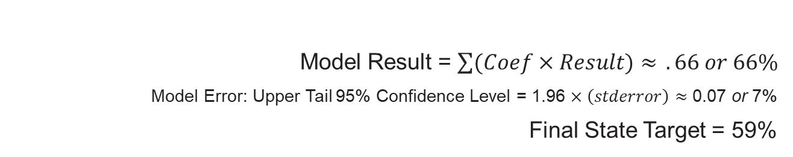
RESEA Target Example 2
State Example 2
Variable | Model Coefficient | State 12 Month Result | (Coefficient × Result)
Model Intercept | 0.775 | NA | 0.775
TUR | -0.843 | 3.9% | -0.033
Recipiency Rate | -0.109 | 19.3% | -0.021
Job Openings % Change | -0.152 | 17.1% | -0.026
Net Change Losses, Gains | 5.45x10⁻⁸ | -12,992 | -0.0001
Average UI Duration | -.003 | 13 weeks | -0.038
Model Result = $\sum{(Coef×Result)≈ }.66 or 66\%$
Model Error: Upper Tail 95% Confidence Level = 1.96 $×\left(stderror\right)≈$ 0.07 or 7%
Final State Target = 59%
Notes:
Here is a second state that has different conditions from the first example. This state’s economic conditions are better, which is reflected in the unemployment rate, which is much lower – at 3.9% instead of 8.2%. The recipiency rate is lower (19.3%), the Job Openings % change is 17.1%, the Net Change in losses and gains is still negative but not as large. And finally a UI duration of 13 weeks. No one indicator explains RESEA reemployment completely, however, together these indicators show a better economic situation from the first example and this is reflected in the higher modeled outcome target rate of 59%.
Both of these example states passed their targets. Their RESEA reemployment rates were higher than their target rate.

Slide 10
Final State Eligibility for Outcome Payments
  In order to receive outcome payments:
  States must pass both the Duration component and the RESEA component
Notes:
However, it’s important to keep in mind that in order for a state to be eligible to receive Outcome payments, States must pass both the Duration component as well as the RESEA reemployment component.

Slide 11
2021 and 2022 Outcome Results
  FY 2021: 31 out of 52 states and territories eligible
  FY 2022: 35 out of 52 states and territories eligible
  We are currently developing a midyear preview of Duration and RESEA targets along with state performance, beginning for next year’s outcome payments.
  2021, as well as future results, exclude or control for periods of very large fluctuations in data as a result of the pandemic.
  ETA’s federal notice of methodology to distribute outcome payments:
  https://www.federalregister.gov/documents/2021/10/19/2021-22704/notice-announcing-the-methodology-to-distribute-outcome-payments-to-states-for-the-unemployment
Notes:
The most recent results for Outcome payments from the 2021 and 2022 Performance Years are available. For the 2021 performance year, 31 out of 52 state or state equivalents passed the Duration and RESEA components, for 2022 35 out of 52 passed.
We are currently developing a midyear preview of both Duration and RESEA targets, along with state performance beginning for next year’s outcome payments.
An additional note for the 2021 year as well as future results, is that we exclude or control for periods of very large fluctuations in data as a result of the COVID pandemic.
For more details about the outcome payment methodology please see ETA’s federal notice of methodology to distribute outcome payments in the link below.

Slide 12
Contact
Please contact your RESEA Federal Project Officer and OUI.RESEA@dol.gov with any questions.
Notes:
Also, for further information or questions about outcome payments, please contact your RESEA Federal Project Officer and oui.resea@dol.gov

Slide 13
Thank You

