Slide 1
License Recognition for Military Spouses: What you need to Know
INSERT DATE
Notes:
Welcome
Project background

Slide 2
Presenters
INSERT PRESENTER NAME AND PHOTO
INSERT PRESENTER NAME AND PHOTO

Slide 3
Understand how states are helping military spouses receive recognition of their out-of-state occupational license
Discover tools and resources available to help military spouses take advantage of state policies
Learn tips to incorporate this information into career coaching sessions with military spouses

Slide 4
Background information

Slide 5
About License Recognition for Military Spouses
Licensing is intended to ensure that only competent and ethical individuals practice in an occupation.
To obtain a license you must demonstrate that you meet state standards for that career. Steps include completing specified training, logging a designated amount of work experience, and taking a licensure exam.
  Examples of occupations licensed in many states include teachers, land surveyors, doctors, lawyers, cosmetologists, nurses, building contractors, counselors, therapists, and electricians.

Slide 6
About License Recognition for Military Spouses
Approximately 30% of employed military spouses work in licensed occupations
Over 630,000 military spouses
Military spouses are 10 times more likely to have moved in the past year
Different procedures and requirements in each state

Slide 7

Check-In
Please check the statement that most reflects where you are now:
I feel very comfortable talking to military spouses about license recognition across states
I know a little about license recognition, but need more information to discuss it comfortably
Help – I don’t know where to begin!
7

Slide 8
License Recognition Options for Military Spouses

Slide 9

What Spouses Need to Know
The types of license recognition options they may encounter
How interstate compacts and agreements might benefit them

Slide 10
License recognition Options States are Using
Temporary licensing
Expedited application review
Licensure by endorsement

Slide 11
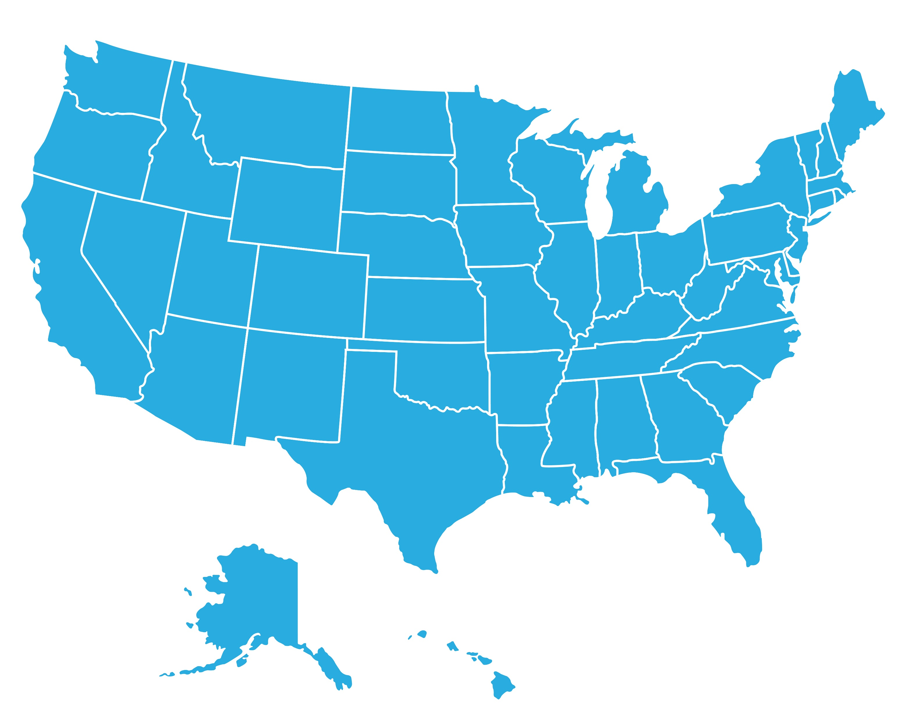
Interstate compacts and agreements
Occupations with Interstate Reciprocity Agreements include:
  Attorneys
  EMS Personnel
  Nurse Licensure Compact
  Physical Therapists
  Physicians
More information can be found at
https://www.veterans.gov/milspouses/

Slide 12
Knowledge Check
License Recognition Options for military spouses:
A) Are the same in every state
B) Are the same for every licensed occupation
C) Vary by state

Slide 13
Knowledge Check
Licensing compacts:
A) Exist only for teachers
B) Allow for expedited license recognition from state to state
C) Are multi-state agreements that allow for license recognition from states with equivalent licensure requirements
D) All of the above

Slide 14

Coaching tips
Don’t overwhelm the spouse with the details of these options – provide abbreviated definitions if needed
Instead focus on the specific options available in their new state for their occupation

Slide 15
How can spouses take advantage of License recognition options?

Slide 16
What Spouses Need to Know
Where to find license recognition information for their state
Where to find resources and tips for finding and communicating with the state licensing board

Slide 17
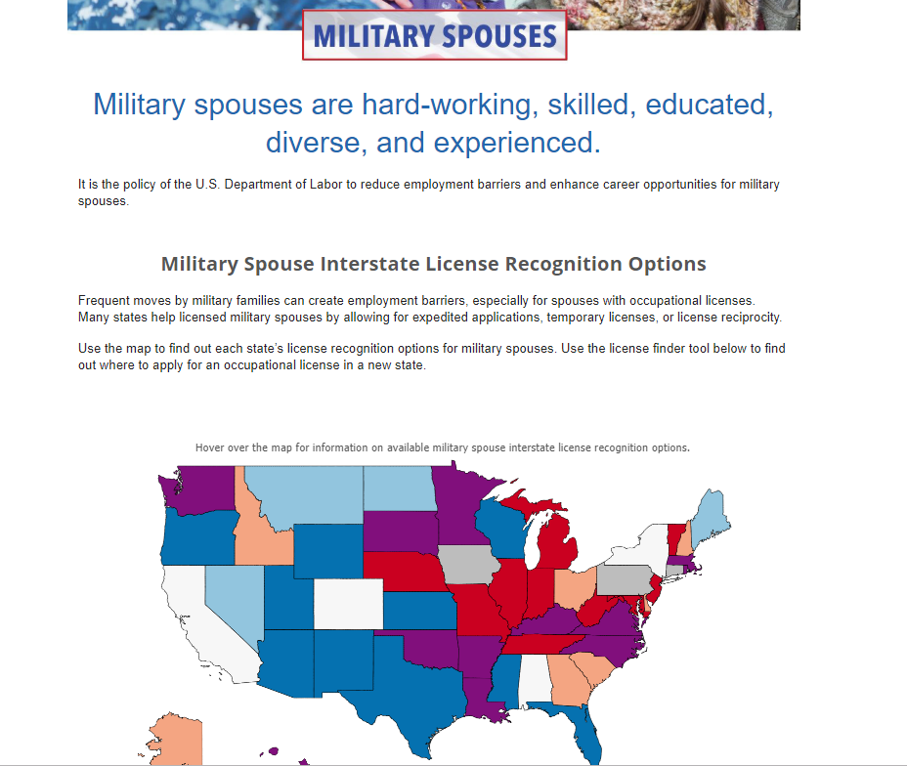
Learn about Military Spouse License Recognition Options at veterans.gov/milspouses

Slide 18
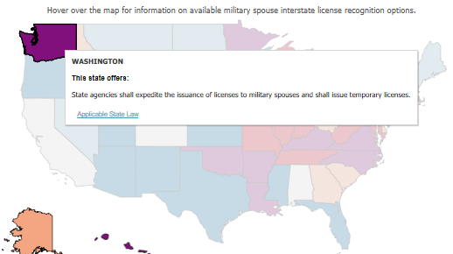
State law is provided within the map

Slide 19
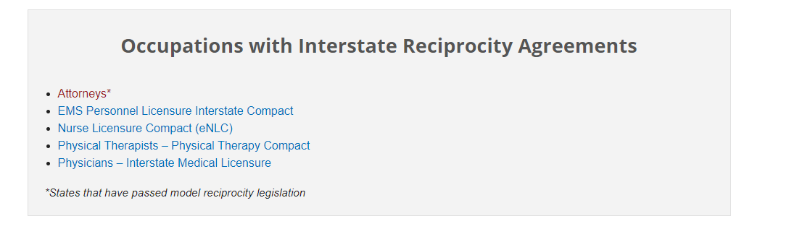
explore occupation-specific guidance
Check for occupation-specific guidance on MilitaryOneSource
For occupations that have interstate reciprocity agreements, visit http://www.veterans.gov/milspouses to see which states participate.

Slide 20
How do Spouses learn about how states are implementing the Laws?
Check the website of the licensing board for their occupation.
Check the main website of the state’s licensing agency (they may need to look under a “military” or “veterans” heading or search the site for the phrase “military spouse”).
Do a web search for their state and “military spouse occupational license.”
Talk to the licensing board.

Slide 21

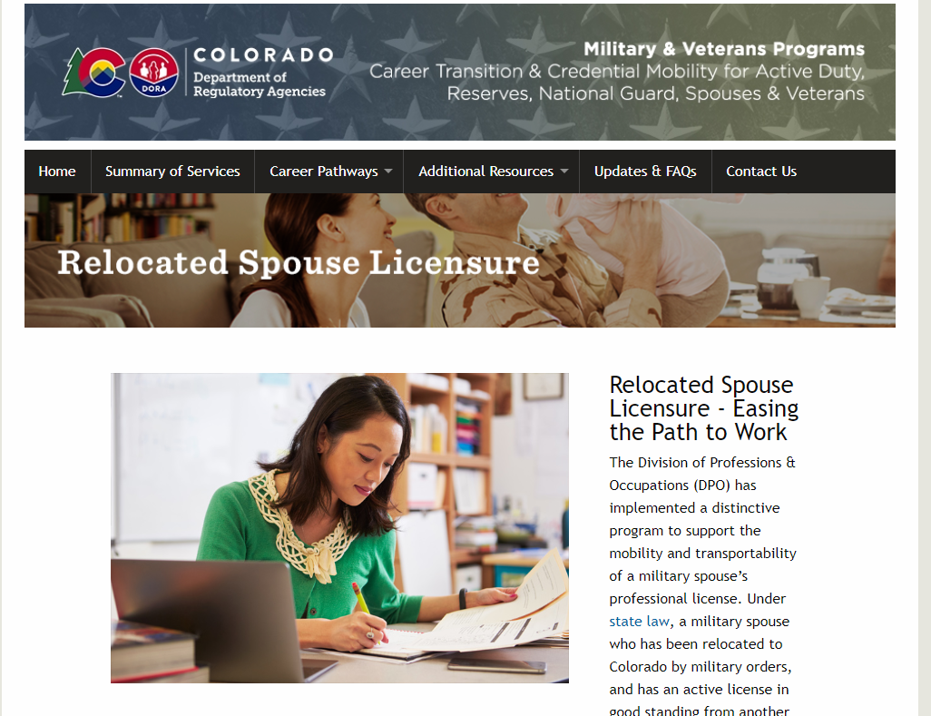
How do Spouses learn about how states are implementing the Laws?

Slide 22
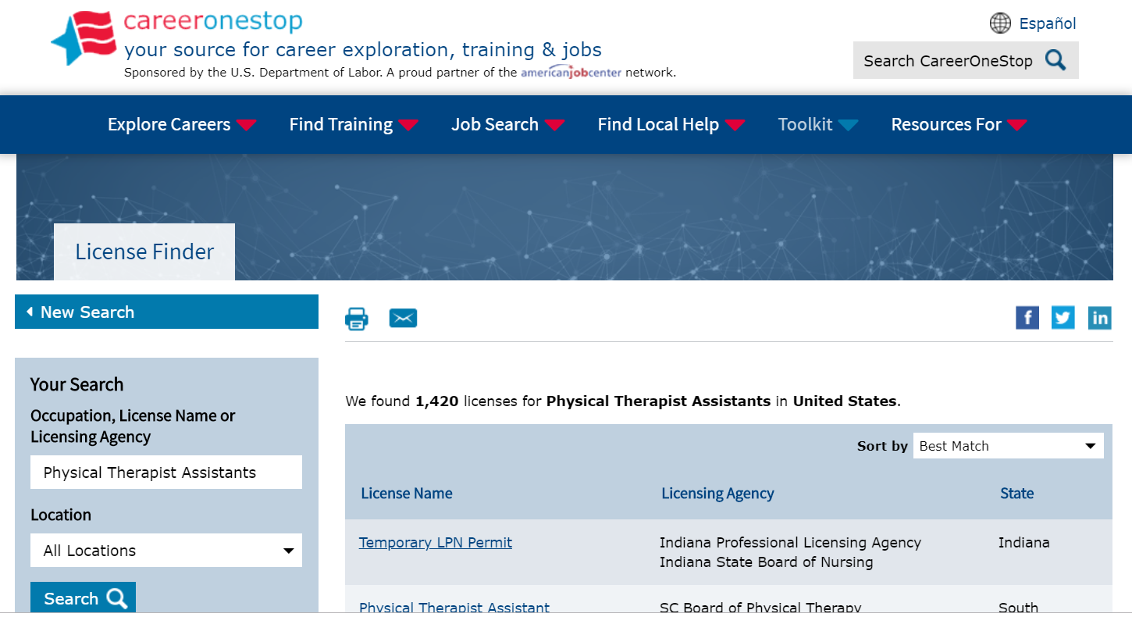
Find the licensing board
https://www.careeronestop.org/Toolkit/Training/find-licenses.aspx

Slide 23
Contact the licensing board
Know the State Law
Ask Questions
Self-identify

Slide 24

Be prepared with questions
Are there applications specifically for military spouses?
Do I meet the eligibility criteria?
What are the expected costs?
Am I eligible for any fee waivers?
How long are the various steps expected to take?
Are there specific due dates I need to meet?

Slide 25

Knowledge check
Before I talk with a spouse,
I should have all of this information
memorized?

Slide 26
Coaching tips
Give spouses a copy of the License Recognition for Military Spouses Resource Guide, which walks them through these steps
Encourage spouses to self identify their military spouse status to the licensing board so they can more quickly access the options available to them.

Slide 27
Spouse Reimbursement for the costs of license recognition
In many circumstances, military spouses who move from one state to another because of change-of-station orders are eligible for reimbursement of licensing costs through their service branch.
More information can be found at https://www.veterans.gov/milspouses/

Slide 28
A few examples

Slide 29
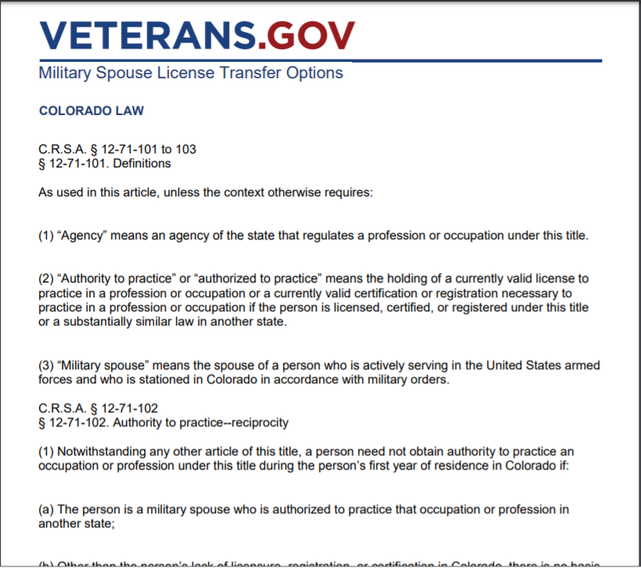

Beth: A Physical Therapist moving to Colorado
Beth found CO’s law at https://www.veterans.gov/milspouses/

Slide 30
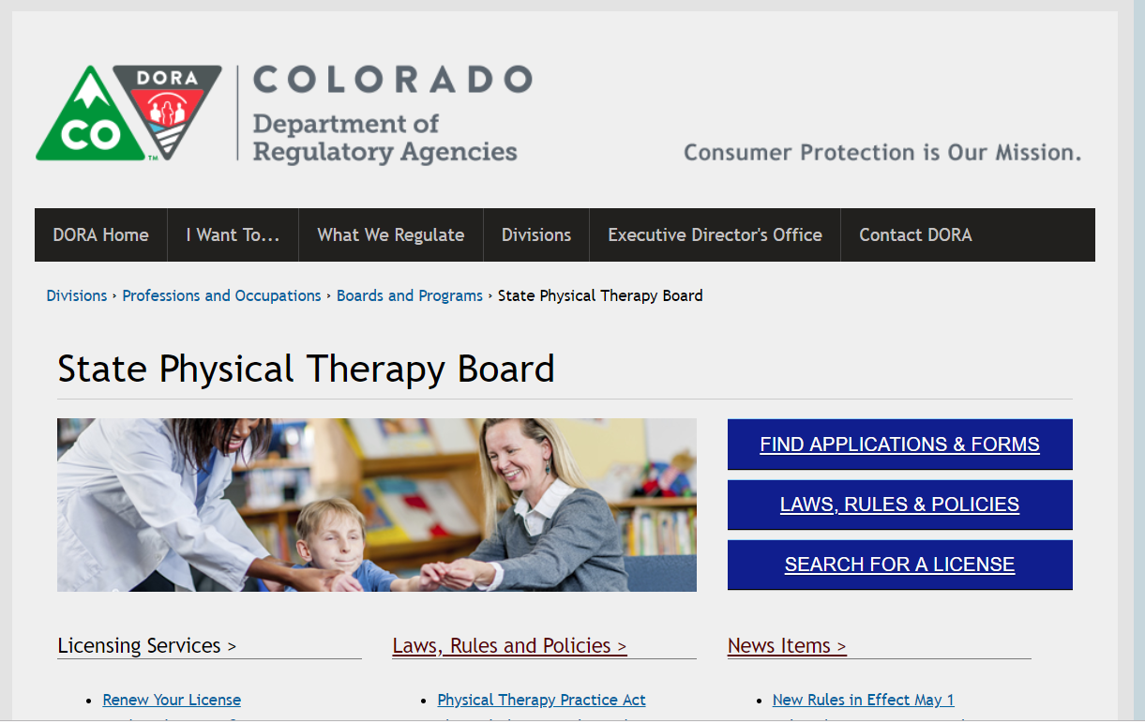
Using Career Onestop Beth found the licensing board
Colorado’s Department of Regulatory Agencies (DORA) has a page for physical therapists https://www.colorado.gov/pacific/dora/Physical_Therapy

Slide 31

Co provides specific web resources for military spouses
https://www.colorado.gov/pacific/dora-military/relocated-spouse-licensure

Slide 32
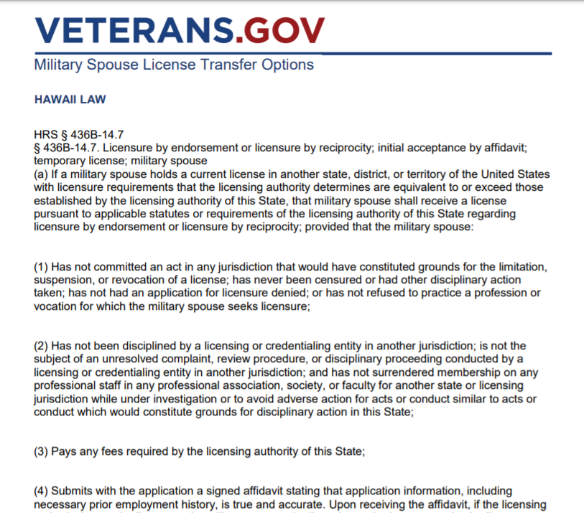

Terry: a Real Estate Agent Moving to Hawaii
Terry found HI’s law at https://www.veterans.gov/milspouses/

Slide 33

Using Career Onestop TERRY found the licensing board
Hawaii’s Department of Commerce and Consumer Affairs (DCCA) Professional & Vocational Licensing Division (PVL) on real estate at http://cca.hawaii.gov/reb/

Slide 34

Terry Needs to Talk to the Board to Learn More
Are there applications specifically for military spouses?
What are the expected costs?
Am I eligible for any fee waivers?
How long are the various steps expected to take?
Are there specific due dates I need to meet?

Slide 35
Knowledge check
If a particular state does not have a lot of information available online, I would:
1. Advise the spouse to call the licensing board
2. Suggest the spouse begin looking for alternative employment
3. Advise the spouse to work with what information was available
4. Refer the spouse to another career coach

Slide 36
A Military Spouse Perspective: [INSERT NAME of spouse]

Slide 37
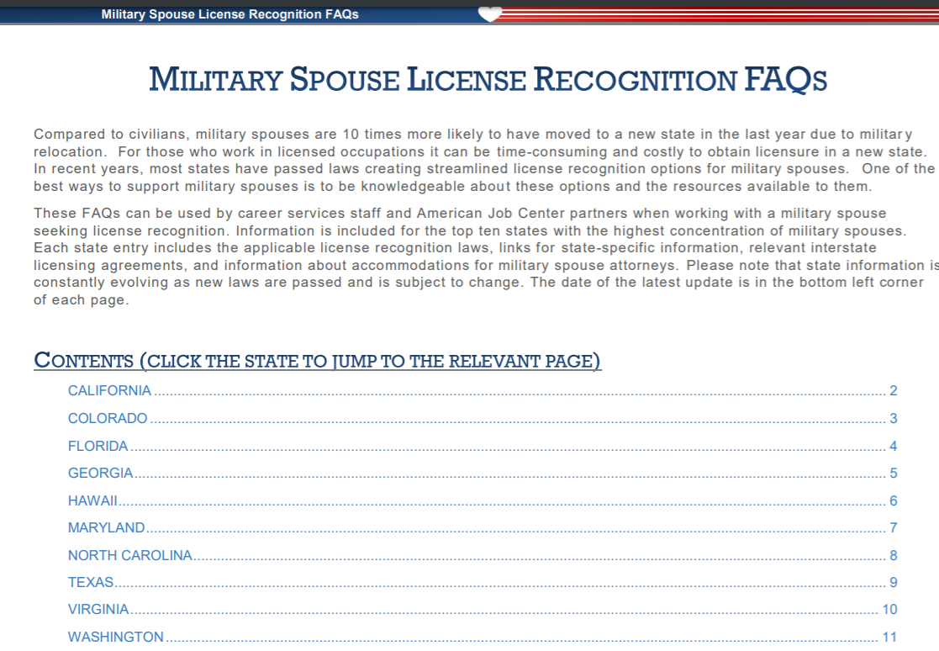
Resources available

Slide 38
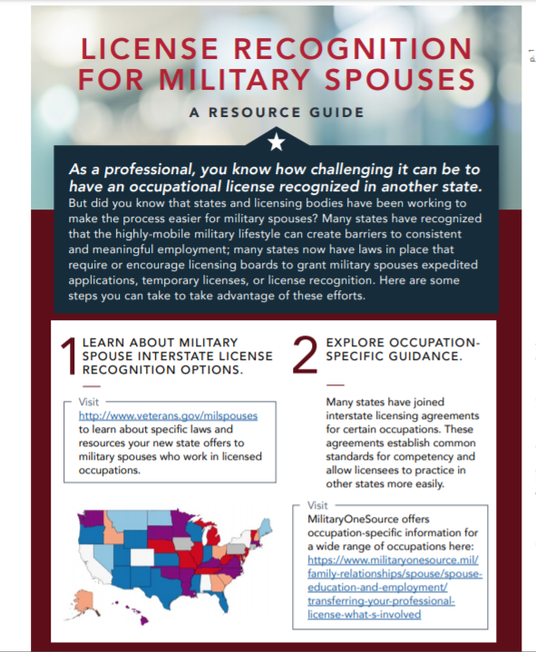
Resources available
License Recognition for Military Spouses Resource Guide

Slide 39

Lets hear from you!

Slide 40
INSERT CONTACT INFO (Name & Email)
INSERT CONTACT INFO (Name & Email)

