Slide 1
Taking Charge of your Quarterly performance report (QPR)
performance for non-performance staff
Monday, December 9, 2024
3:00 – 4:30 pm EST

Slide 2


moderators
Margaret Lamb
  One Workforce Analyst
    American Institute for Research (AIR) for U.S. Department of Labor/Employment and Training Administration
Michelle Williams
  Rural Healthcare Analyst
    American Institute for Research (AIR) for U.S. Department of Labor/Employment and Training Administration

Slide 3



Presenters
Dani Abdullah
  Rural Healthcare Program Support
    U.S. Department of Labor/Employment and Training Administration
Kristen Hefley
  Rural Healthcare Program Lead
    U.S. Department of Labor/Employment and Training Administration
Greg Scheib
  One Workforce Program Lead
    U.S. Department of Labor/Employment and Training Administration

Slide 4
RECORDING POLICY
The Program Office is committed to transparency and consent.
This event is being recorded by staff.
  If you do not consent to being recorded, please log off.
  You may choose to keep your camera off.
Notetaking bots and unauthorized recording are not allowed.

Slide 5
Agenda
Overview of QPR Data Validation
One Workforce and Rural Healthcare QPR Outcome Results
Understanding Common Data Issues
Data Validation Walkthrough
Expert Methods and Strategies for Finding and Correcting Data Issues
Practice
Troubleshooting – Q&A

Slide 6
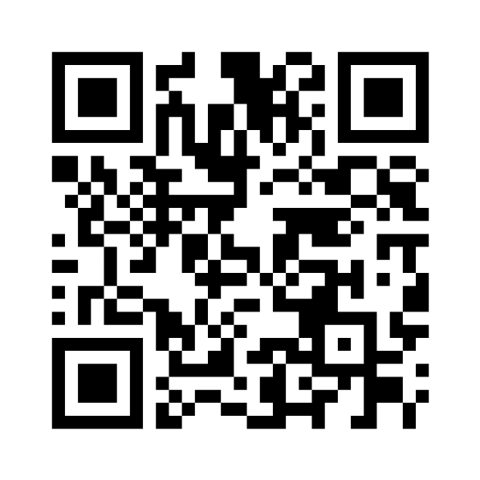
Poll question 1
In one or two words, what comes to mind when you think of “data validation?”
Scan QR code or join at menti.com & use code 8647 2111

Slide 7
Overview of QPR data validation
ADOPTING A “DATA” mindset

Slide 8
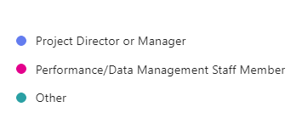
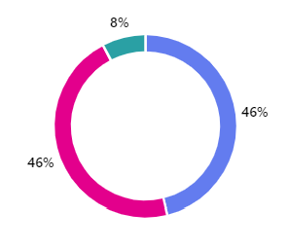
Your current role in the data reporting process
What is your role on the grant?
Involvement in Reporting by Grant Role
 | Project Director/ Manager | Performance/ Data Management Staff | Other
I have an active role in managing the data or developing the data file that generates the report | 17% | 100% | 0%
I regularly review the reports, but I don't play an active role in reporting | 67% | 0% | 0%
I sometimes review reports, but I don't play an active role in reporting | 17% | 0% | 100%

Slide 9

Why is DATA important?
Minimum objective
  Meeting performance targets = success
Measurable Outcomes
  Impact on community
Decision-Making
  Program adjustments
Accountability
  Federal grant continuation

Slide 10
A DATA-DRIVEN MODEL FOR SUCCESS
1.
Collect/ Track Info on Participant Activity
2.
Report Participant Activity
3.
Review Report Output
4.
Make Report Corrections
5.
Analyze Program Impact
6.
Make Program Adjustments

Slide 11
Assessing Program effectiveness
5.
Analyze Program Impact
6.
Make Program Adjustments
1. Collect/
Track Info on Participant Activity
2.
Report Participant Activity
3.
Review Report Output
4.
Make Report Corrections
Is my program on track to achieve outcome targets?
  Analyze
  Adjust

Slide 12
What is data validation?
The process of checking data for accuracy and quality before any action is taken using the data

Slide 13
Assessing Data accuracy
3.
Review Report Output
4.
Make Report Corrections
5.
Analyze Program Impact
6.
Make Program Adjustments
1. Collect/
Track Info on Participant Activity
2.
Report Participant Activity
Does my report represent my program’s achievement on the outcomes?
  Review
  Correct

Slide 14
Real-time performance outcome measures
Total number of participants served
“SERVED”
01
Total number of participants enrolled in education/ training activities
“ENROLLED”
02
Total number of participants who complete education/ training activities
“COMPLETED”
03
Total number of participants who complete education/ training activities and receive a degree or other type of credential
“COMPLETED WITH CREDENTIAL”
04
Total number of unemployed and underemployed participants who complete education/ training activities and obtain employment
“ENTERED EMPLOYMENT”
05
Total number of incumbent worker participants who complete training activities and that advance into a new position
“ADVANCED IN EMPLOYMENT”
06

Slide 15
MENTI Poll question
Which outcome target has been the most challenging for you to achieve?
  Served
  Enrolled
  Completed
  Completed with Credential
  Entered Employment
  Advancing in Employment
Scan QR code or join at menti.com & use code 8647 2111

Slide 16
ONE WORKFORCE AND RURAL HEALTHCARE QPR OUTCOME RESULTS
What the data show to date

Slide 17
Combined Total Outcomes
Rural Healthcare and one Workforce Grants

Slide 18
Rural Healthcare
Quarter Ending 9/30/2024
Race/Ethnicity
9,044
1,254
Male
7,668
Female
Participants Served
4,334
Youth (17–29)
456
55 and Older
Other Demographics
Education

Slide 19
One Workforce
Quarter Ending 9/30/2024
Race/Ethnicity
21,104
14,222
Male
6,688
Female
Participants Served
9,371
Youth (17–29)
1,499
55 and Older
Other Demographics
Education

Slide 20
Employment Status at Participation quarter ending 9/30/2024

Slide 21
Rural Healthcare
Total Outcomes

Slide 22
Rural Healthcare Participants Completed
Quarter ending 9/30/2024: 5,856
Grant program is 84% to target
7 grantees have met their target; most grantees are on track to achieve this target
Average – 93%
Median – 83%

Slide 23
Rural Healthcare Participants Completed with credential
Quarter ending 9/30/2024: 4596
Grant program is 71% to target
7 grantees have met their target; most grantees are on track to achieve this target
5731 credentials have been obtained regardless of completion.
Average – 94%
Median 80%

Slide 24
Rural Healthcare Participants entered employment
Quarter ending 9/30/2024: 2363
Grant program is 66% to target
4 grantees have met their target; 6 other grantees are over 50% to target
Average – 71%
Median – 60%

Slide 25
Rural Healthcare Participants advanced in employment
Quarter ending 9/30/2024: 763
Grant program is 45% to target
2 grantees have met their target
5 grantees are above 50% to target
Average – 50%
Median – 34%

Slide 26
One Workforce
Total Outcomes

Slide 27
One workforce Participants Completed with credential
Quarter ending 9/30/2024: 9,436
Grant program is 63% to target
14,012 total credentials
4 grantees have met their target
8 grantees are over 50% to target
Average – 68%
Median – 66%

Slide 28
One workforce Participants entered employment
Quarter ending 9/30/2024: 3,841
Grant program is 34% to target
2 grantees have met their target
6 grantees are over 50% to target
Average – 46%
Median – 48%

Slide 29
One workforce Participants advanced in employment Quarter ending 9/30/2024: 2,421
5 grantees did not have targets for this metric
Grant program is 83% to target
2 grantees have met their target
5 grantees are over 50% to target
Average – 56%
Median – 59%

Slide 30
MENTI Poll question
How confident are you in the accuracy of this program data on a scale of 1 to 5?
1 = low confidence 5 = high confidence
Scan QR code or join at menti.com & use code 8647 2111

Slide 31
UNDERSTANDING COMMON DATA ISSUES
Diagnosing the cause of your data issues

Slide 32
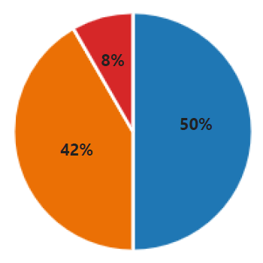
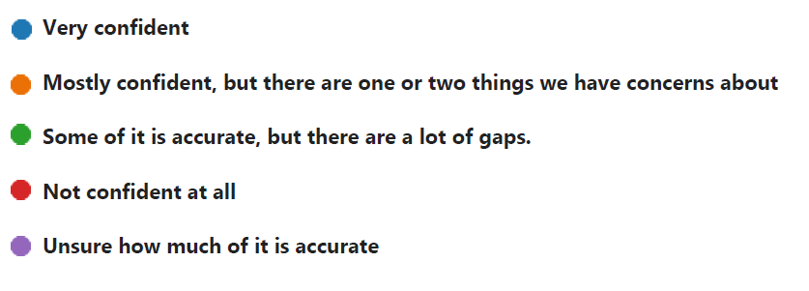
Pre-Event survey:
How confident are you that the data on your most recent QPR is accurate?

Slide 33
PRE-EVENT Survey: level of Involvement in reporting and confidence in the data
 | Very confident | Mostly confident | Not confident | TOTAL
Very involved | 17% | 33% | 0% | 50%
Highly involved | 17% | 8% | 8% | 33%
Somewhat involved | 17% | 0% | 0% | 17%
TOTAL | 50% | 42% | 8% | 100%

Slide 34
Pre-event survey:
Explain why you lack confidence; why you think mismatches with your own records exist
We have experienced difficulty merging the added H1B fields to the State's WIOA performance system. Everything has to match perfectly, or the system doesn't count it.
Sometimes the correct answer is not one of the options.
I believe the outcomes of this grant are actually higher than they look on the report, due to difficulty gathering employment and certification verification consistent with TEGL 23-19.
I am realistic that some errors may exist due to human error.
Our career coaches often fail to enter dates, employments, employment ribbon correctly.
We do not have some SSN[s] or birthdates, so we have had to just fill in something to get it accepted.
I think it’s rare, but there are possible duplication or data entry error[s].
We started with our first participants before we fully understood what data we were supposed to gather… But most participants will not answer follow up questions after they are no longer active, so there is some data we will just not be able to get.

Slide 35
three main Types of Data issues
Data is reported in your data file incorrectly.
Data is correct in the data file, but individuals aren’t showing up on the QPR.
Data is excluded from your data file.

Slide 36
TWO Common reasons WHY DATA ISSUES ARISE
Lack of knowledge about how these aspects of reporting are related to one another:
  Data elements
  Aggregation rules
  Logic rules
  QPR outcome definitions
Lack of processes or procedures that capture information in a way that aligns with the QPR outcomes.

Slide 37
DATA ISSUE AWARENESS
 | YOU catch the issue | YOU DON’T catch the issue
WIPS catches the issue | N/A | Issue #1: Data is reported in your data file incorrectly.
WIPS DOESN’T catch the issue | Issue #3: Data is correct in the data file, but individuals aren’t showing up on the QPR. | Issue #2: Data is excluded from your data file.

Slide 38
Diagnosing Issue #1: INCORRECT DATA IN YOUR DATA FILE
Data Validation Issue:
  You think the data is correct, but WIPS won’t let you submit your data file.
Impact:
  WIPS generates an error to prevent QPR overcounting.
Caused by:
  A lack of strong knowledge about the logic and aggregation rules.
Results:
  Time cost of spending extra time trying to fix the errors.

Slide 39
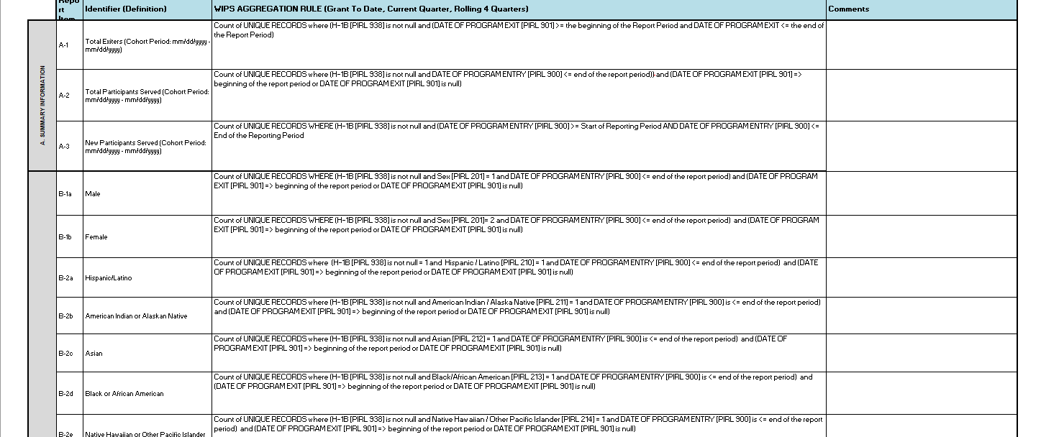
Aggregation rules look like formulas
Count of UNIQUE RECORDS where (H-1B [PIRL 938] is not null and DATE OF PROGRAM ENTRY [PIRL 900] <= end of the report period)) and (DATE OF PROGRAM EXIT [PIRL 901] => beginning of the report period or DATE OF PROGRAM EXIT [PIRL 901] is null)

Slide 40
EXAMPLE: aggregation rules interpretation
Count of UNIQUE RECORDS where (H-1B [PIRL 938] is not null, and
DATE OF PROGRAM ENTRY [PIRL 900] <= end of the report period)), and
(DATE OF PROGRAM EXIT [PIRL 901] => beginning of the report period or DATE OF PROGRAM EXIT [PIRL 901] is null)
Your grant number has been entered
The date an individual became a participant was earlier than the last day of the quarter
The individual has not exited the program or the date they exited was at least 90 days ago

Slide 41
ROLES DATA ELEMENTS PLAY IN AGGREGATING QPR OUTCOMES
Primary
  Directly used to count participants in an outcome
Secondary
  Indirectly used to count participants in an outcome
Extras
  Not used to count participants in an outcomes

Slide 42
Primary data elements
Count of UNIQUE RECORDS where (H-1B [PIRL 938] is not null, and
Date Completed an Education or Training Program* [PIRL 1813] <= end of the report period) and
(Date Completed an Education or Training Program* [PIRL 1813]] => beginning of the report period
*This data element name has been shortened.
Your grant number has been entered
The date an individual completed a program was earlier than the last day of the quarter
The date the individual completed a program was later than the first day of the grant period of performance (for cumulative totals)

Slide 43

secondary DATA ELEMENTS
Data elements used in logic rules that restrict data entry in a main character data element
PIRL 1302, 1811 → PIRL 1813 → QPR Outcome F-1

Slide 44
Data elements: extras
Most data elements play all three roles.
A few play a primary role or secondary role in most or all data elements.
  Some data elements are never “extras.”
Some data elements in the PIRL are not used to generate any QPR outcomes.
  Some data elements are always “extras.”
  Ex: Most training type data elements; most apprenticeship-related data elements

Slide 45
Diagnosing Issue #2: not showing up in qpr outcomes
Data Validation Issue:
  The QPR Outcome data doesn’t match what’s in your own records.
Impact:
  Your QPR doesn’t show your success.
Often caused by:
  A misunderstanding about how an outcome is defined
Results:
  May mean that the relevant information is not being tracked; there may be challenges with trying to collect it later

Slide 46
CROSSWALK: TARGET OUTCOMES, QPR OUTCOMES & DATA ELEMENTS
Crosswalk of Performance Outcome Measures and PIRL DATA ELEMENTS
Official Performance Outcome Measure | QPR Outcomes Used for Reviewing Target Progress | Data Elements Required for QPR Outcomes
1. Total number of participants served | A2. Total Participants Served | PIRL 900 Date of Program Entry
2. Total number of participants enrolled in education/training activities | E6a. Began Receiving Education/Job Training Program Activities | PIRL 1302 Date Entered Training #1

Slide 47
Diagnosing Issue #3: information is excluded from the qpr
Data Validation Issue:
  You have not recognized activities have been excluded from the data file.
Impact:
  Undercounting of participants in outcomes
Caused by:
  Lacking awareness of what information to track and/or a process for collecting and tracking it
Results:
  QPR does not reflect your grant’s success, and there could be challenges later with collecting the information.

Slide 48
Poll: What is your biggest reporting challenge?
Common challenges:
  WIPS errors
  Outcome definitions don’t align with my records
  Remembering to update information
  Getting responses when following up
  Generating the data file manually
  QPR and participant records mismatch
  Other?
Scan QR code or join at menti.com & use code 8647 2111

Slide 49
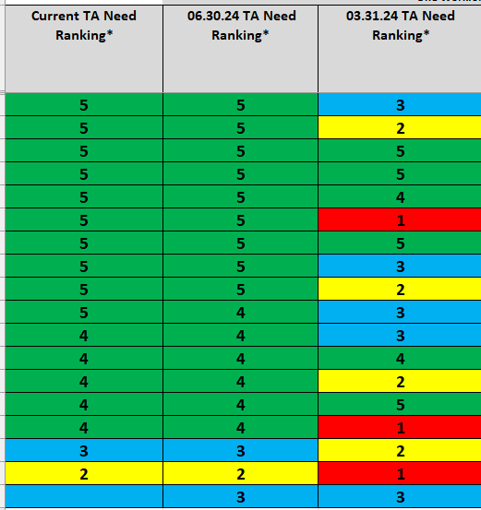
What We Look For (2)
  1 = Not meeting any targets or meeting only one target. No outcomes are green or only one outcome is green
  2 = Meeting targets for Participants Served and Participants Enrolled but behind on others. Participants Served and Participants Enrolled are green; no other outcomes are green
  3 = Meeting targets for Participants Served and Participants Enrolled, but showing signs they may fall behind on others: Three outcomes are green and three outcomes are not green; or four outcomes are green and those outcomes may include one or more employment outcomes
  4 = Meeting all targets except employment-related targets
  5 = Meeting all or almost all targets

Slide 50
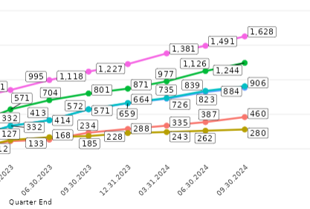
What We Look For (3)
Total Participants Served
Participants Began Education/Training
Participants Completed Training
Participants Completed Training and Earned a Credential
Entered employment
Incumbent Workers Who Advanced

Slide 51
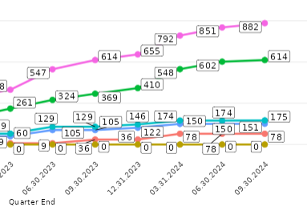
What We Look For (4)

Slide 52
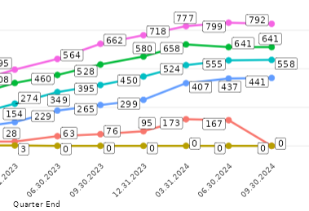
What We Look For (5)

Slide 53
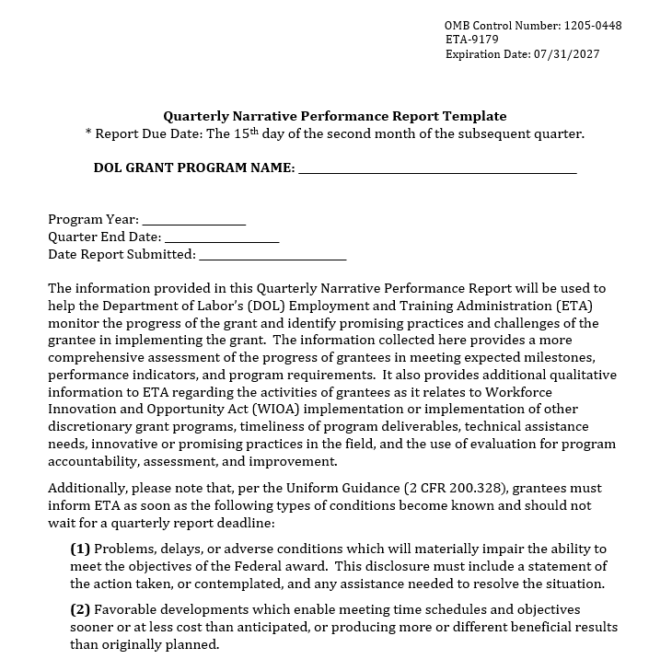
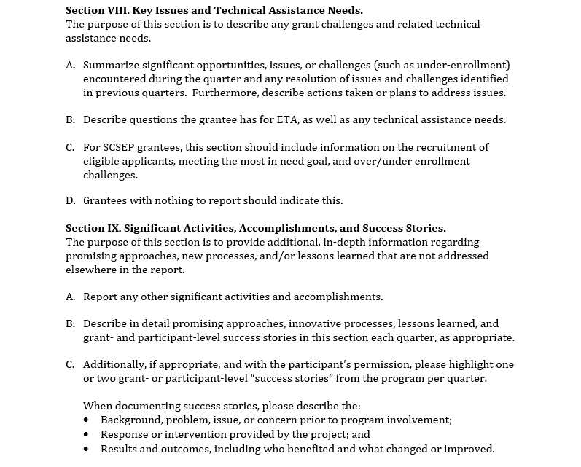
What We Look For (6)

Slide 54
Expert METHODS for Finding and CORRECTING DATA ISSUES
Data validation as a strategy for success

Slide 55
What *not* to do if you are having AN issue
Ignore it
Add, change, or take out information in your data file until an error “goes away”
Promise yourself you’ll figure it out next quarter
Assume it’s a glitch in WIPS
Assume DOL is going to fill in the gaps
Email your FPO or the Program Office about how annoying the reporting process is

Slide 56
Methods of data validation
Inductive
  Observe your data.
  Look for patterns.
  Identify the problem.
Deductive
  Start with a problem in mind.
  Review and analyze your data.
  Decide whether the problem affects your data.

Slide 57
Inductive data validation
Observe the data.
Look for patterns.
Identify the problem.
The number of incumbent workers on the QPR who advanced to a new position (Outcome #6) is low.
The number of incumbent workers who have been served on the QPR is also low.
Not serving enough incumbent workers has a negative effect on meeting the target on Outcome #6.

Slide 58
DEDUCTIVE data validation
Start with a potential problem in mind.
Review and analyze the data.
Decide whether the problem affects your data.
“Not serving enough incumbent workers has a negative effect on meeting the target on Outcome #6.”
Review the QPR number of incumbent workers; observe it’s low.
Note the QPR number reported for Outcome #6 is low; conclude that not serving enough incumbent workers is an issue

Slide 59
POLL QUESTION
Most people are either inductive or deductive thinkers.
Which one comes more naturally to you?
Scan QR code or join at menti.com & use code 8647 2111

Slide 60
Expert approach to data validation
Start with an inductive review.
  Review data and note patterns.
  Develop ideas about what the patterns mean.
Finish with a deductive review.
  See if the ideas hold up by looking at other sources:
    Other reports, such as the QNR
    QPRs from previous quarters
    Data file
    Other (i.e., data collection instrument, etc.)
Identify which ideas about the meaning of the patterns are existing problems to address.

Slide 61
VALIDATING QPR OUTCOME DATA
Practice

Slide 62
Pre-event survey: have you tried anything to ensure your data is accurate?
Reviewing participant records
Collaborating with new State team members to address these data challenges effectively
Enlisting some help from another Local Workforce Area… who understands the Geographic Solutions system and has been instrumental in helping us develop protocol that will result in correctly reported data
Only adding data to the report completed files that have a TEGL 23-19 or FPO approved verification document attached (i.e., a letter on employer letterhead, a copy of the certification)
Auditing the files in our database every quarter, with a high-level query for quality control as well as a 10% random file audit
Weekly error checking and monthly QPR checking with staff using features embedded in AGS Prime H1-B Database
Reviewing invoices - data from invoices must match our performance management system or subrecipients do not receive reimbursement until the errors are fixed
Regularly monitoring our subrecipients, including participant file review
Running reports at the end of each quarter (at a minimum) and follow up as needed
Meeting regularly with our partners to offer technical assistance
Analyze the data quarterly to look for anomalies and use a third-party software system
Using a vetted tracking system and regular monitoring

Slide 63
SCENARIO
You receive a letter from DOL indicating that your QPR shows 0 for G3. Incumbent Workers Advanced to a New Position.
You “know” that can’t be true because you’ve heard anecdotally that participants are getting new jobs.
Problem: How would you determine why your QPR indicates only 0 for this outcome?

Slide 64
Question to explore
What are some possible causes of showing 0 for an outcome on the QPR?
Scan QR code or join at menti.com & use code 8647 2111

Slide 65
Potential causes for a zero on the qpr
No one has achieved it.
Lack of awareness about which data elements populate it
Not collecting information needed
Challenges with collecting the information needed
Entering collected information improperly in the data file
Forgetting to collect or report data

Slide 66
Starting your investigation
Cause #1: No one has achieved it.
  What types of things can I do to find out whether that’s true or not?

Slide 67
Investigation results (Cause #1)
My records indicate some of the incumbent workers have advanced to a new position, but not as many as I expected.
Program staff tell me that they have heard from participants who tell them they have gotten new jobs.
What can I conclude about Cause #1?

Slide 68
INVESTIGATE ANOTHER POTENTIAL CAUSE
Cause #2: I don’t understand how the QPR counts people as having entered employment.
  What can I do to find out whether that’s true or not?

Slide 69
Investigation RESULTS (cause #2)
I realize I misunderstood that DOL was collecting that information about employment.
Now I know my grant needs to collect and report information on those data elements
  Otherwise, participants will not be counted as advancing to a new position
What should I do next?

Slide 70
Keep investigating
Causes #3 and 4: My grant isn’t collecting the information needed to report this outcome or we collect it but not very effectively.
  Results:
    When I talk to my program navigator, I learn:
      Some of our employer partners provide the information voluntarily but irregularly
      Other employer partners don’t want to release information about wages to the grant
  Since I just reviewed the data elements that populate it, I know that you don’t need data on wages for this outcome.

Slide 71
Brainstorm solutions
What would you do to improve the process of getting this employment information?
Scan QR code or join at menti.com & use code 8647 2111

Slide 72
Finish investigating
Causes #5 and 6: We’re entering data incorrectly in the data file or forgetting to collect or update data.
  I learned we have employment data from some employers, so it sounds like there could be an issue with getting it into the data file.
What actions would you take to learn more?

Slide 73
THINGS TO CHECK (Causes #5 and 6)
Generation of the data file
Employment documentation
Other incumbent worker data elements
Follow up process

Slide 74
MENTI POP QUIZ
Which of the following count as advancement to a new position?
  A new job title
  A new job description
  Increased wages as a result of training
  New job duties that incorporate skills learned during training
  All of the above
Scan QR code or join at menti.com & use code 8647 2111

Slide 75
Incumbent workers retained or advanced in employment?
Incumbent workers who meet the criteria for advancing to a new position are often incorrectly coded as retaining their positions instead
To count as having advanced, an incumbent workers must have completed the training and received one or more of the following:
  A new job title
  A new job description
  Increased wages as a result of training
  New job duties that incorporate skills learned during training

Slide 76
Results (Causes #5 and #6)
Your grant manually generates a data file each quarter
The data file shows that most of your incumbent workers have been reported as retaining their positions.
  Their employment outcomes are not being neglected

Slide 77
Investigation conclusions
Knowledge deficit
  Reading the QPR incorrectly
  Not reporting advancement to a new position
Official data collection process is not in place
Current casual data collection methods are not effective:
  Lack of response or participation
  Correct information is not sought
No one is following up with incumbent workers to see if anything has changed
There could be manual data entry error.
Unknown if programmatic issues exist

Slide 78
summary of corrective actions
Ensure data file matches your own records
Ensure you and everyone who collects, manages, or reports data truly understands the definitions and data elements.
Focus on the data elements that matter!
Have a process in place to collect the right information.
Ensure the process builds in regular, ongoing follow up and someone specific has responsibility for that task.
Ensure your process or system for generating data files accurately converts information from your records into the correct code values.
Adjust or refine processes that don’t work or show signs of being ineffective.

Slide 79
Troubleshooting and Q&A

Slide 80

Questions?

Slide 81
Thank you!
CONTACT US FOR REPORTING ASSISTANCE:
RuralHealthcare@dol.gov OneWorkforce@dol.gov
Important: Don’t forget to copy your FPO!

