Slide 1
Grant Management Overview and Readiness Assessment
SMART 3.0 Training
June 2019

Slide 2
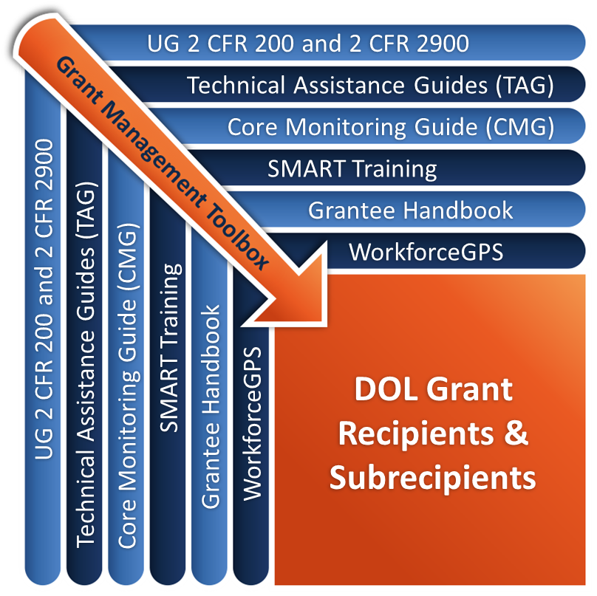
Grant Management Toolbox

Slide 3











Grant Management Toolbox References
SMART
SMART Training
Core Monitoring Guide
Technical Assistance Guides
ETA Grantee Handbook
WorkforceGPS Resources
CMG
TAG
Grantee Handbook
GPS

Slide 4
Module Overview
Grant Phases
  Pre-Award
  Post-Award
  Period of Performance
  Closeout
While reviewing each grant phase, we will look at the following:
  Risk factors
  Common mistakes → noncompliance
  Financial & administrative systems
  Oversight

Slide 5
Grant Life Cycle
Pre-Award
  Preparing application and getting systems ready
Post-Award
  Launching systems and program implementation
Period of Performance
  Complying with financial and administrative requirements
  Meeting budget and performance targets
  Adhering to cost principles
Closeout
  Completing final tasks before turning off the lights

Slide 6
Pre-Award
Grant application
Readiness preparations
Other considerations

Slide 7
Formula vs. Discretionary Awards
Formula
Discretionary
Typically to States and outlying areas
Based on prescribed methodology, or “formula”
Awarded on a recurring and/or annual basis
Plan submitted by States and outlying areas
Examples:
  Unemployment Insurance State Administration
  WIOA Title I-B
  Wagner-Peyser
  Senior Community Service Employment Program
Awarded through a competitive process
Funding Opportunity Announcement describes the grant requirements and who may apply
Applicants are self-selected
ETA makes awards based on best fit
Examples:
  YouthBuild
  Reentry Projects
  Workforce Data Quality Initiative

Slide 8
Grantee Must-Do’s
Register on SAM.gov
Register for a DUNS #
View online training modules
  Applying for ETA Competitive Grants - A Web-Based Toolkit for Prospective Applicants
  Other resources on the Grants Application and Management CoP
Prepare your systems to receive a grant
  Accounting
  Personnel/payroll
  MIS reporting

Slide 9

Grant Application
Review of applicant’s risk factors
Match and leveraged resources
Statement of work, project design, and implementation plan

Slide 10
Federal Agency Review of Risk Factors
2 CFR 200.205(c)
Financial stability
Quality of management systems and ability to meet management standards
History of performance including timely reporting, compliance, and expenditure levels
Audit or other compliance findings
Ability to implement requirements
Ability to effectively implement statutory, regulatory, or other requirements
Ability to satisfy these risk categories

Slide 11

Federal Agency Review of Risk Factors (cont.)
Review Federal systems for
  Debarment
  Suspension
  Do Not Pay list
  Otherwise excluded from doing business with the Federal government

Slide 12
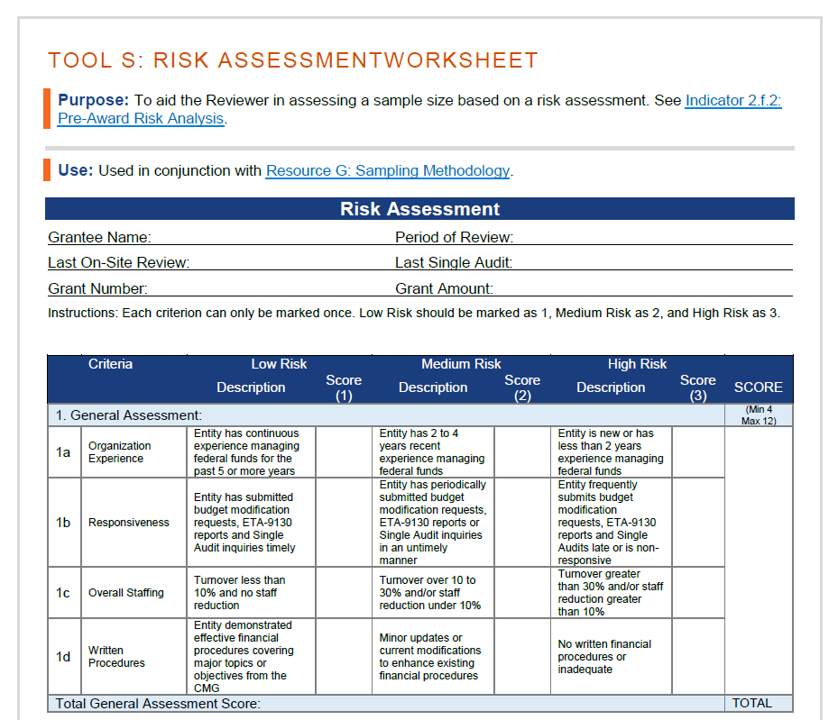
CMG Risk Assessment Worksheet
General Assessment
Legal Assessment
Monitoring/Audit Assessment
Financial Stability Assessment
CMG

Slide 13
Match and Leveraged Resources
Match – Report when expended only
Leveraged resources
Determine whether there is a match requirement
Do not promise matching funds if not required
  Held to any match commitments you make
Enter match requirement on the SF 424
Do not include in the application budget
Not a requirement
Leverage of Federal resources is reporting item
Can be penalized for commitments not met

Slide 14
Statement of Work, Project Design, and Implementation Plan
Statement of Work
Responsive to the FOA; should not conflict with Federal statutes, regulations, and Department policy
Project Design
Structured to accomplish project goals
Subrecipients
Delivery of services
Phases detailed with timelines, if appropriate
Governance structure is in place
Implementation Plan
Quick start up
Weak plan = possible failure

Slide 15

Readiness Preparations
Program design
Service delivery system
Performance accountability
Financial systems and administrative procedures

Slide 16
Program Design – Readiness Criteria
Elements of statement of work comply with FOA, Federal statutes, regulations, and DOL policy.
Project design is complete, well thought out, and effectively structured to accomplish project goals.
Governance structure is in place that can guide and track the accomplishment of project goals.
Approved indirect cost rate in place or submit application within 90 days of award.

Slide 17
Program Design – Are you ready?
  Partnership or subrecipient relationships established
  Administrative systems in place
  Essential management and staff personnel identified and trained
  Written policies and procedures
  Data collection and reporting systems
  Budget and resource allocations adequate to accomplish the project’s goals
  Procedures for tracking actual v. planned performance and financial goals

Slide 18
Service Delivery System
Capacity to provide the full range of services in the grant agreement including:
  Effective case management system
  Partner and subrecipient readiness
  System for recruiting eligible target group members
  Ability to assess participants and develop an individual service strategy

Slide 19
Performance Accountability
Implementation plan identifies specific project goals, activity levels, spending targets, and timeframes
Agreements with subrecipients contain clear, specific, and measurable budget and performance goals
System in place to periodically monitor grantee and subrecipient progress toward meeting performance goals, spending targets, and taking corrective action

Slide 20
Financial Systems/Administrative Procedures
Financial reporting system
  Permit preparation of Federal reports
  Report accruals, obligations, match, program income
Accounting records
  Fund accounting for grant revenue and expenditures
  Source documentation
  Maintained in accordance with GAAP
Internal controls
  System to protect integrity of funds
  Accountability for cash, property & other assets
    Equipment inventory and oversight procedures
  Policies and Procedures

Slide 21
Financial Systems/Administrative Procedures (2)
Budget controls
  Comparison of actual expenditures (outlays) to approved budget plan
  Compliance with line item requirements
  Administrative cost limitation
Allowable cost policy
  Only allowable costs charged
  Only allocable costs charged
Source documentation
  Costs must trace to authorizing document
Cash management
  System to control cash and other assets

Slide 22

Financial Systems/Administrative Procedures (3)
  Written Policies and Procedures
  Timekeeping or payroll system
  Employee Handbook including Conflict of Interest
  Financial Reporting
  Purchasing/Procurement
  Cash Management
  Cost Allocation Plan
  Contracting
  Equipment and supplies
  Program services and activities

Slide 23
Financial Systems/Administrative Procedures (4)
  Written Policies and Procedures
  Property Management
  Budget & Modifications
  Grievances and Complaints
  Audit & Audit Resolution
  Monitoring
  Grant or Contract Closeout
  Program Income
  Match & Leveraged resources
  Record Retention schedule

Slide 24
Other Considerations
  Equipment listed in the proposal does not constitute Grant Officer approval
  Specific written Grant Officer approval is required
  Pre-award costs
  Incurred at awardee’s own expense
  ETA does not approve these costs
  Proposal costs
  Cannot be directly charged to the grant
  Can only be charged as indirect cost and allocated in the current period to all activities of the entity

Slide 25
Knowledge Check – Questions
  True or False?
  Equipment and pre-award costs listed in the application are approved when the grant is signed.
  All financial management systems, policies, and procedures should be in place prior to the award.
  A grantee should not be expected to meet planned program and budget goals in the first quarter due to the extra time needed for start-up.
  Policies and procedures do not need to be in writing as long as they are clearly communicated to employees.

Slide 26
Knowledge Check – Answers
  Equipment and pre-award costs listed in the application are approved when the grant is signed. False
  All financial management systems, policies, and procedures should be in place prior to the award. True
  A grantee should not be expected to meet planned program and budget goals in the first quarter due to the extra time needed for start-up. False
  Policies and procedures do not need to be in writing as long as they are clearly communicated to employees. False

Slide 27
Post-Award
  Execute grant agreement
  Implement program plan
  Understand types of allowable costs
  Understand hierarchy of authorities
  Negotiate subawards as needed
  Procure contracts as needed

Slide 28
Grant Execution
  Execute grant agreement with the Grant Officer
  Cannot charge costs to grant until signed
  HHS Payment Management System
  Cannot access cash until this account is set up
  Obtain Grant Officer written approval for equipment purchases and other requests requiring prior approval
  If claiming indirect costs
  Apply to Federal Cognizant Agency for an approved rate within 90 days of grant award or
  Use 10% de minimis rate
  Comply with all grant terms and conditions

Slide 29
Implementation Plan
  Contact Federal Project Officer (FPO) to discuss SOW, project design, and implementation plan
  FPO can help avoid grant “potholes”
Initial Scope of Work from the proposal may not be specific enough
  FPO can help develop a more detailed scope of work
Project may lack a detailed implementation plan
  Grant application may not include performance schedules
  Grant Officer may have removed budget details
  Project design needs to be complete, well thought out, and effectively structured to accomplish project goals

Slide 30
Avoid Late Startup
  Be proactive in avoiding late start-up, a common cause of grant failure
  Staff in place and fully trained to implement grant Day 1
  Focus on meeting first quarter program and budget goals
  SOW, project design, and intermediate goals and milestones communicated to all staff
  Outreach and recruitment plan activated
  Operationalize financial and administrative procedures

Slide 31
Understand Types of Costs
  Direct Costs
  Readily identified with a particular cost objective
  Program or administrative
  Indirect Costs
  Not readily identifiable with a particular cost objective
  Program or administrative
  Administrative Costs
  Not same as indirect
  Based on function performed
  Administrative functions defined at 20 CFR 683.215
  Composed of direct and indirect costs
  Cap or limitation on allowable amount

Slide 32
Understand Hierarchy of Authorities (Order of Precedence)
  Program authorization legislation/statutes;
  Other applicable Federal statutes
  Applicable appropriations
  Implementing Regulations
  Executive Orders
  Office of Management Budget (OMB)
  DOL-ETA Directives
  Terms and conditions of the Federal award

Slide 33
Subawards
Grantees are pass-through entities when making subawards to partners and subrecipients
  Subawards are not procurement actions
    Unless required by statute
    Unless selected on competitive basis
  Awards to contractors are competitive procurement actions governed by the procurement rules
    Purchase of goods and services for own use or consumption
Grant agreement terms may prohibit or limit subawards

Slide 34
Pass-through Entity Requirements
2 CFR 200.331
“Pass-through” is not a “pass” on accountability
Provide funds to a subrecipient to meet the pass-through entity’s program and performance objectives
As accountable as if providing the services yourself
Uniform Guidance Requirements
  Every subaward includes the required information
  Evaluate subrecipient’s risk of noncompliance with Federal requirements and grant terms and conditions
  Impose subaward conditions if appropriate as described in 2 CFR 200.207 Specific Conditions

Slide 35

Procurement Standards & Thresholds
Micro Purchase - Under $10,000
Small Purchase - Under $250,000
Sealed Bids - Primarily for construction
Competitive Proposals - Over $250,000
Non-Competitive Proposals
Professional services
  See letter on threshold changes at: https://www.doleta.gov/grants/pdf/Grantee_Letter-Micropurchase_and_Simplified_Acqusition.pdf

Slide 36
Required Contract Clauses – Procurement
Administrative, contractual, or legal remedies for breach of contract if contract exceeds Simplified Acquisition Threshold (currently $250,000)
Termination for cause and for convenience if contract > $10,000
Equal Employment Opportunity provisions
  Must include EEO notice in recruiting materials
Davis-Bacon Act for construction contracts > $2,000
Contract work hours and safety standards for contracts > $100,000 employing mechanics or laborers

Slide 37
Grant Terms
Important terms first
Restrictions – For a specific recipient (if needed)
Formula – For WIOA/UI/ES/Trade formula awards only
Funding Restrictions – e.g. Admin Cost Limit
Administrative Requirements – Many UG-related terms
Program Requirements – Terms only applicable to a single program or initiative
Appropriations – Updated annually based Congressional approval
Public Policy – Laws and EOs that require a term
Attachments – List of certifications and other documents as needed

Slide 38
Specific Terms to Discuss – Requirement to Provide Certain Information in Public Communications
Stevens Amendment
  Currently undergoing GAO review
Pursuant to P.L. 115-141, Division H, Title V, Section 505, when issuing statements, press releases, requests for proposals, bid solicitations and other documents describing projects or programs funded in whole or in part with Federal money, all non-Federal entities receiving Federal funds shall clearly state:
1. The percentage of the total costs of the program or project which will be financed with Federal money;
2. The dollar amount of Federal funds for the project or program; and
3. The percentage and dollar amount of the total costs of the project or program that will be financed by non-governmental sources.
The requirements of this part are separate from those in the 2 CFR 200 and, when appropriate, both must be complied with.

Slide 39
Specific Terms to Discuss – Buy American
Buy American Notice Requirements
None of the funds made available under this act may be expended by an entity unless the entity agrees that in expending the funds it will comply with sections 8301 through 8303 of title 41, United States Code (commonly known as the “Buy American Act”).
Use only:
Unmanufactured articles, materials, and supplies that have been mined or produced in the US
Manufactured articles, materials, and supplies that have been manufactured in the United States substantially all from articles, materials, or supplies mined, produced, or manufactures in the US
Does not apply if:
Items for use outside of the US
US based products are unsatisfactory
Items are below the micro-purchase threshold

Slide 40
Specific Terms to Discuss – HIPPA
Violation of the Privacy Act
In short, no entity shall disclose any record contained in a system of records except pursuant to a written request by, or with the prior written consent of the individual to whom the record pertains. Certain exceptions apply.
These funds cannot be used in contravention of the 5 USC 552a or regulations implementing that section.

Slide 41
Required Contract Clauses
Right to inventions for non-profit organizations and small business firms where applicable
Clean Air Act for contracts > $150,000
Energy efficiency standards per State plan
Byrd Anti-lobbying certification for contracts > $100,000
Procurement of recovered materials
  For states and their political subdivisions
Not a contract clause, but UG prohibits use of debarred, suspended, and other excluded parties
Grant terms and conditions may identify additional requirements

Slide 42
Knowledge Check (2) – Questions
  True or False?
  To charge indirect costs to the grant, grantee must have approved IDC rate at time of application or apply for a rate within 90 days of grant award.
  Both subrecipients and contractors must be obtained by following the UG procurement requirements.
  Micro purchase procedure is option for aggregate purchases < $10,000.
  Small Purchase procedure is option for purchases < $150,000.

Slide 43
Knowledge Check (2) – Answers
  To charge indirect costs to the grant, grantee must have approved IDC rate at time of application or apply for a rate within 90 days of grant award. True
  Both subrecipients and contractors must be obtained by following the UG procurement requirements. False
  Micro purchase procedure is option for aggregate purchases < $10,000. True
  Small Purchase procedure is option for purchases < $150,000. False

Slide 44
Period of Performance
  Managing expenditures within budget limits
  Managing performance to meet performance goals
  Oversight and monitoring of subrecipients
  Reporting expenditures, performance results, and other information
  Modifying the grant when appropriate
  Meeting specific conditions, if applicable

Slide 45
Managing Expenditures
  For grant as a whole and for each subrecipient
Planned vs. actual analysis
Trend analysis over time
Overall expenditures
Is the grant “on-track”? Spending too fast/slow?
Are costs proportionate to outcomes?
Administrative expenditures
Are costs appropriately reported?
Are your costs within limitations?
Administrative expenditure rate “too fast”?

Slide 46
Managing Performance Results
  For grant as a whole and for each subrecipient
  Planned vs. actual analysis
  Trend analysis over time
  Service levels on-track to meet planned levels?
  Current enrollments
  Enrollment in training and other major activities
  Total served
  Performance results on track to meet goals?
  Training and other completions
  Job placements, earnings gain, other outcomes

Slide 47
Oversight and Monitoring
  Monitor activities of subrecipients to ensure compliance and achievement of performance goals
  Review financial and programmatic reports
  Take timely corrective action on all deficiencies
  Issue management decision on audit findings
  Use appropriate monitoring tools based on risk assessment
  Training and technical assistance
  On-site reviews
  Agreed-upon audit procedures
  Take corrective action against noncompliant subrecipients per 2 CFR 200.338

Slide 48
Emphasis on Performance Oversight
2 CFR 200.328
Pass-through entities shall monitor subrecipients to ensure that subaward performance goals are achieved
Recipients must monitor award and subaward activities to assure that performance expectations are met
  Submit performance reports comparing actual accomplishments to award objectives; unit cost computations if useful; performance trend data and analysis if informative
    Reasons for slippage if objectives not met
    Analysis of cost overruns or high unit cost

Slide 49

Reporting
General requirements
  Electronic
  Quarterly
  Timely, accurate and complete
Performance reports
  Service levels and outcomes
  Quarterly Narrative Progress Reports
Expenditure reports
  On accrued expenditure basis, accurately report obligations
  Match and leveraged Federal resources
  Program income

Slide 50
Other Information Reporting
FFATA Subaward Reporting System (FSRS)
  First-tier subrecipient subaward information for contract, grant, and loan transactions of more than $25,000
  Prime recipient and first tier subrecipients’ executive compensation
    Names and total compensation for each top 5 executives
  Must report subaward information by the end of the month following the month the subaward is obligated
  Information is accessible on www.USASpending.gov
System for Award Management (SAM)
  Register in SAM
  Log in periodically to review registration information: financial information and points of contact.
  DUN and EIN numbers must remain active until the grant award closeout process is fully completed.

Slide 51
Grant Modifications
Report deviations from budget or project scope or objective
Request prior approval for revisions 2 CFR 200.308
  Change in scope or key personnel
  Transfer of funds budgeted for participant support costs
  Subawards not identified and funded in approved award
  Change in match
  Transfers among direct cost categories
  Other terms as specified in the Grant Agreement
Inappropriate reasons for modifying grant
  Poor performance
  Not meeting budgeted expenditure goals

Slide 52
Specific Conditions Options
Requiring payments as reimbursements rather than advance payments
Withholding authority to proceed to the next phase until receipt of evidence of acceptable performance within a given period of performance
Requiring additional, more detailed financial reports
Requiring additional project monitoring
Requiring the non-Federal entity to obtain technical or management assistance
Establishing additional prior approvals

Slide 53
Knowledge Check (3) – Questions
  True or False?
  A grantee is not accountable or liable for the expenditures and performance of its subrecipients.
  Falling behind in meeting performance or budget goals can be remedied by modifying my goals lower to match current performance levels.
  One form of required oversight is to compare actual to planned results in meeting program performance and expenditure goals.
  The grantee is allowed to maintain a cash-based accounting system and to report on a cash basis.

Slide 54
Knowledge Check (3) – Answers
  A grantee is not accountable or liable for the expenditures and performance of its subrecipients. False
  Falling behind in meeting performance or budget goals can be remedied by modifying my goals lower to match current performance levels. False
  One form of required oversight is to compare actual to planned results in meeting program performance and expenditure goals. True
  The grantee is allowed to maintain a cash-based accounting system and to report on a cash basis. False

Slide 55
Closeout
  Closeout process
  Disposition of equipment
  Final expenditure report
  Closeout of subrecipients
  Match requirements, if applicable
  Leveraged resources, if applicable

Slide 56
Closeout Process
  Email notification transmitted 30 days prior to grant expiration
  Closeout package electronically transmitted to grantee
  Documentation must be submitted 90 days from expiration of grant
  Extensions may be granted
  FAQs at http://www.doleta.gov/grants/docs/GCFAQ.pdf
  Manual at http://www.doleta.gov/grants/docs/GCS.pdf

Slide 57
Closeout Process (cont.)
  Approval for disposal of equipment
  Final expenditure report
  Closeout of subrecipients
  Match requirement not met?
  Like amount of grant dollars will be unallowable
  Reduce allowable grant expenditure by amount short
  Non-compliance may result in closeout ID/FD process
  Leveraged Resources not met?
  Grant Officer will determine penalty

Slide 58
Knowledge Check (4) – Questions
  True or False?
  A PTE is responsible for the closeout and audit resolution of its subrecipients.
  There is no penalty for not meeting the match requirement in the grant.
  If the equipment has a current value of $5,000 or more, you must ask the Grant Officer for disposition instructions.

Slide 59
Knowledge Check (4) – Answers
  A PTE is responsible for the closeout and audit resolution of its subrecipients. True
  There is no penalty for not meeting the match requirement in the grant. False
  If the equipment has a current value of $5,000 or more, you must ask the Grant Officer for disposition instructions. True

Slide 60

Module Review
Reviewed the requirements and standards applicable to ETA grants by discussing each phase of the grant life cycle to ensure a successful outcome
  Pre-Award
  Post-Award
  Period of Performance
  Closeout

Slide 61
SMART Checklist
ETA Grant Management Overview
  Train staff responsible for the implement of the grant on the hierarchy of authority.
  If managing grants from different Federal agencies, ensure that staff responsible for those grants are aware of the OMB approved exceptions for that Federal agency and to ensure that DOL exceptions at 2 CFR 2900 are only applied to DOL grants.
  Periodically review SAM to ensure registration and account file is correct and updated.
  When working with subrecipients, consider developing a risk assessment tool featuring similar risk factors that the Federal agency uses for its grant applicants.
TAG

Slide 62
ETA and Uniform Guidance Resources
Core Monitoring Guide
  Tools S: Risk Assessment Worksheet
Grant & Financial Management Technical Assistance Guide
  Chapter 16: ETA Grant Management Overview
WIOA Administrative Provisions 20 CFR Part 683
  20 CFR 683.210
  20 CFR 683.215
Uniform Administrative Requirements, Cost Principles, and Audit Requirements for Federal Awards 2 CFR Part 200
  2 CFR 200.205
  2 CFR 200.308
  2 CFR 200.328
  2 CFR 200.331
  2 CFR 200.338
  2 CFR
Department of Labor Exceptions 2CFR Part 2900
  2 CFR 2900.21
  200.501
SMART
CMG
TAG
Grantee Handbook
GPS

Slide 63
Web Resources
What is the best way to find your local American Job Center (AJC)?
  See DOL’s Service Locator
Want More Information?
  DOLETA.gov/Grants
    Funding Opportunities
    How to Apply
    Manage Your Awarded Grant
    Resources and Information
      ETA Grantee Handbook
      Annual Grant Terms Template
      Core Monitoring Guide
      Technical Assistance Guides
      Uniform Guidance Quick Reference Sheet
Want More Training?
  Workforce GPS’s Grants Application and Management Community of Practice
    Financial Reporting
    Subrecipient Management and Oversight
    Indirect Cost Rates
    Policies and Procedures
    Procurement and Performance-Based Contracts
    Capital Assets and More
  WorkforceGPS
SMART
CMG
TAG
Grantee Handbook
GPS

Slide 64
Remember the Grant Management Toolbox!

Slide 65
Questions?

Slide 66
Please complete your evaluations.

