Slide 1

Reemployment Services and Eligibility Assessment (RESEA) State Plan Webinar:
June 10, 2025
A How To on filling out the RESEA State Plan
Application
EMPLOYMENT AND TRAINING ADMINISTRATION
UNITED STATES DEPARTMENT OF LABOR

Slide 2
FY 2025 RESEA State Plan
Technical Assistance Schedule
Tuesday, June 10th- Webinar
  RESEA State Plan Template and Submission Requirements
Tuesday, June 17th- Webinar
  FY 2025 RESEA Operating Guidance and Leveraging the First RESEA Evaluation
Wednesday, June 18th- Office Hours
  Will focus on first half of state plan/TA tools
Wednesday, June 25th- Office Hours
  Will focus on second half of state plan/evidence-building
If needed, additional Office Hours week of July 7th

Slide 3
RESEA State Plan Application
Complete applications consist of:
State plan with ALL fields answered
SF-424
SF-424A
NICRA/CAP if there are indirect costs
ALL information is to match on all application documents.
How to submit the application
  OUI.RESEA@dol.gov ; and
  Grants.gov
Tools available

Slide 4
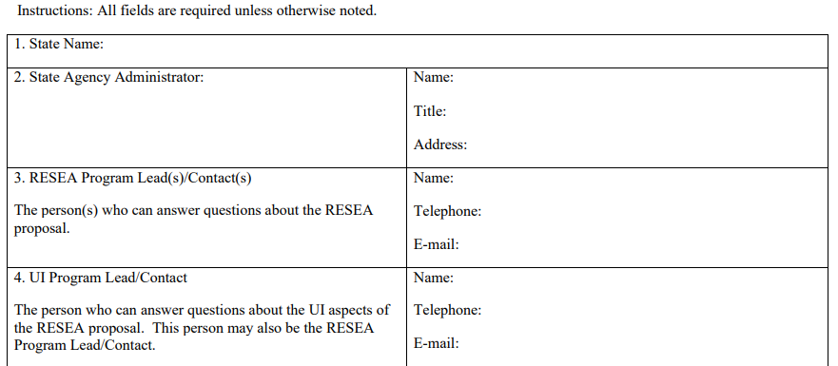
Elements 1 - 4
ALL fields of the State Plan are to be filled out and completed according to the State’s FY 2025 RESEA plans.
Notes:
Element 1. State Name.
Enter then name of your state government and workforce agency. This information must match the SF-424 Section 8. Applicant information, part a. Legal Name.
Element 2. State Agency Administrator
A. Name: This is the name of the Authorized Representative who is the authorized signatory for this grant. The information must match that of the SF-424 section 21. If your agency’s authorized representative changes during the grant cycle, the state will need to provide a new authorization identifying the new authorized signatory. It is important to keep this contact information up to date, as any official RESEA correspondence will be addressed to this person, for example, RESEA award letters.
B. Title: Enter the title of the Authorized Representative and their respective contact information in the address
C. Address: The address must match the SF-424 section 8. Applicant information, part d. address.
Element 3. RESEA Program Leads/Contacts
A. Name: Provide the names and contact information of the people who will be responsible for answering any questions regarding the RESEA state plan. It is important to keep this information up to date to prevent delays in the review and award stages of this grant.
B. Telephone: Provide the best telephone number at which the RESEA Program Leads maybe contacted.
C. Email: Provide the email addresses where the National Office should send correspondence or questions about the grant. It is important that the email address is correct.
Element 4. UI Program Lead Contact
A. Name: Provide the name of the state’s UI Program lead. Depending on how your state’s RESEA program is set up, the UI program Lead/contact may be the same as the RESEA program lead/contact or it may be another individual who works in tandem with the RESEA program lead.
B. Telephone: Provide the best telephone number at which the UI Program lead may be contacted. Current contact information is important as questions about the UI referral process arise. Particularly as it relates to the UI feedback loop and adjudication processes.
C. Email: Provide the email address where we should send correspondence or questions about the grant. It is important that the email address is correct.

Slide 5
Elements 5a. – 5b.
Elements 5a. and 5b. Total project Cost for Proposed State Plan RESEA
5a. Total Project Cost for Proposed State Plan RESEA
$
The total amount of funds requested in this grant, which may be up to the limit specified in annual RESEA operating guidance.
Requesting less than full formula allotment
5b. Element 5 Additional Space – Use this field to break out project costs. Please include a narrative describing determinations for the current year and any issues that impacted the previous year’s expenditures. Be sure to discuss what this year’s project goals, e.g. staffing up, improving program tools, etc.
ALL fields must be completed and filled out.
5a. is asking for the TOTAL FY20 25 requested whole dollar amount
5b. text box to explain how the requested amount was calculated, project cost, any issues that impacted expenditures from the previous year, and goals for the coming year.
Notes:
Element 5a. Total projected cost for proposed State Plan RESEA
Total amount of funds requested for this grant, which may be up to the limit specified on an attachment in the annual RESEA operating guidance..
For Element 5a. there are two responses: First, in the text box “$_______”: Input the total requested amount for that year’s RESEA program. This number is to match the SF-424 Section 18, Estimated Funding ($) part (a) Federal and (g) TOTAL. On the SF-424A this will match Section 1 and 5’s part (e) and (g); and Section 6 part (k). Please check the date on the SF-424 and SF-424A and ensue the document is not expired. Expired forms will not be accepted.
Next is Element 5a.’s second response, please “X” the box if your state is requesting less than the full formula allotment.
Element 5b. Additional space.
Use this field to break out project cost. Please provide a narrative describing determination for each project and the cost for the individual projects. Any issues the state may have experienced that impacted the previous year’s expenditures and this year’s project goals will be included in this space as well.
If your state is requesting less than the maximum award for the current year, explain why.

Slide 6
Elements 5a. – 5b. Self Checker
Elements 5a. And 5b. Self Checker
5a. The total amount of funds requested in this grant, which may be up to the limit specified in the annual RESEA operating guidance.
5a. Enter Total Project Cost for Proposed State Plan RESEA
$498,000.00
5b. Budget Narrative Costs
The total entered will automatically populate for Question 7a.
Expenses | Dollar Amount
Expenses 1 | $0.00
Expenses 2 | $0.00
Expenses 3 | $0.00
Expenses 4 | $0.00
Expenses 5 | $0.00
Expenses 6 | $0.00
Expenses 7 | $0.00
Expenses 8 | $0.00
Expenses 9 | $0.00
Expenses 10 | $0.00
Expenses 11 | $0.00
Expenses 12 | $0.00
Expenses 13 | $0.00
Expenses 14 | $0.00
Expenses 15 | $0.00
Expenses 16 | $0.00
Project sum will remain RED if the Budget Narrative Costs do not equal Total Project Cost
Project Sum
$0.00 (RED)
5b. Use the fields to the right to list out the different expenses. This page is to help ensure project cost equal 5a. The Total Project Cost for Proposed State Plan RESEA.
Expenses may include, but are not limited to: Evaluation Cost, Administrative Cost, Upgrading IT, IT programming, Additional staffing, Improving and/or Upgrading program tools.
Notes:
Elements 5a. – 5b. Self Checker
State Plan Self Checker is an optional tool, provided by the National Office, to assist states with verifying totals before submitting the State Plan for review. The State Plan Self Checker is not a required document and should NOT be returned with the submission of the state’s State Plan.
Using the Self Checker, enter the amount, Element 5a. Total Project Cost, in this example, $498,000. In other words, the total amount of funds requested for this grant period.
The Self Checker for Element 5b. Budget Narrative Costs, to the right, states can list out the different projects and cost associated with this year’s grant. For example: Administrative cost, IT upgrades, Evaluations, Evidence-base funding, etc.
As the project cost are entered in the cells, the sum will automatically total in the Project Sum line. This figure will remain RED until the sum of the project sum equals 5a. Total Project Cost.
This information can be copy and pasted to the State Plan and included with the narrative in Element 5b.

Slide 7
Elements 6a. – 6b.
Elements 6a. and 6b. Carry-over: Total Funds from prior RESEA Grants Projected to carry-over
2023
6a. Carry-over: Total Funds from prior RESEA Grants Projected to carry-over.
FY
$
TOTAL Dollar Amount
Projected Obligated date:
$
Please include expected date for full obligation and expenditure of these remaining funds.
Projected Expenditure date:
2024
FY
$
Projected Obligation date:
Projected Expenditure date:
6b. Element 6 Additional Space – Use the text box to provide details for each year’s carry-over funds. Please explain why there are carry-over funds for each specific FY. Additionally, include how the funds will be used and a timeline for the expenditure. If there is ‘Zero’ carry-over, please note this in the text field.
6a. -- Are there funds remaining for FY 2023? Or for FY 2024? If so, how much for each respective year.
Use box 6b. to provide details for each year’s carry-over, use of funds, and timeline for expenditure.
Notes:
Element 6a. Carry-over: Total funds from prior RESEA grants projected to carry-over.
In Element 6a. Complete the set of text boxes for each fiscal year’s carry-over amounts. This includes the “FY______ $______”, the Projected Obligation date and Projected Expenditure date.
Each FY, US DOL provides grantees a Notice of Award Agreement, referred to as a NOA. The notice includes the deadline by which a grantee must obligate that year’s funds. If your state applied for an extension or received outcome payments, there may be a different obligation date. Enter two digits for the month, day, and year (MMDDYY).
Projected Expenditure date. Just as with the obligation date, the expenditure date can be found on the more current NOA. Enter two digits for the month, day, and year (MMDDYY).
The final part of Element 6a. is the TOTAL Dollar Amount. To calculate the Total Dollar Amount, add the information listed in “FY_____ $_____” and verify the amounts by consulting the ETA-9130 Financial report, which shows a state’s unobligated carry-over amounts as of December 31st of the current fiscal year.
Please note, states can only carry over funds from the previous two years. Since this is 2025, states may only have carry-over funds from FY’s 2023, 2024.
Element 6b. Use the text box, to provide details for each year’s carry-over funds. This includes a narrative why there are carry-over funds, how the funds will be used and a timeline for the expenditure.
For example: FY 2023 carry-over ($100,000): $80,000 for evaluation of the RESEA grant. Negotiations were delayed with the vendor thus delayed in expending funds. And $20,000 for IT services. Funding expenditure is expected by 12/31/2025. FY 2024 carry-over ($900,000): $100,000 for evaluations. $40,000 for IT services. $760,000 for RESEA operating expenses, salaries, admin, and supplies. Funding expenditure is expended by 06/30/2026.

Slide 8
Element 6a. Self Checker
Example of Element 6a. Self Checker
6a. Carry-over: Total Funds from prior RESEA Grants Projected to carry-over.
The Total Dollar Amount will populate the sum of the amounts entered for FY 2023 and FY 2024
Total Dollar Amount
$1,000,000.00
Enter the Dollar Amount to be Carried-over from FY 2023
$100,000.00
Enter the Dollar Amount to be Carried-over from FY 2024
$900,000.00
EXAMPLE:
Enter the dollar amount for any carry-over for FY 2023 and/or 2024.
The Total Dollar Amount will calculate automatically.
Notes:
Element 6a. Self Checker
Element 6a Self Checker. Use the Self Checker to verify the Total Dollar Amount being carried over. Enter the carry-over amount for each FY. The total carry-over amount will calculate and provide the Total Dollar Amount being carried over.

Slide 9
Elements 7a. – 7b.
Element 7a. Total Service Delivery (Program) Cost
7a. Total Service Delivery (Program) Cost
$
Please include evaluation expenses in this element
Element 7b. Provide a breakout narrative listing the program cost, include evaluation cost
7b. Element 7 Additional Space – Provide a breakout narrative listing the program costs, including a line for evaluation costs.
7a. How much of your FY 2025 grant request will be for Program costs? Please include the FY 2025 budget for Evaluation Expenses in the total dollar amount for Service Delivery (Program) Cost.
7b. In the space provided, list the program cost, including evaluation items.
Notes:
Elements 7a. – 7b.
Complete Elements 7a and 7b based on FY 2025 requested funds.
Refer to Element 5a and determine how much of these funds will be for Element 7a.’s Total Service Delivery (Program) Cost, which includes the evaluation expenses in this element.
Element 7b.
In the space provided, please provide a breakout narrative listing the program cost, including a line for evaluation cost. For example: Contractor costs; Program costs; Other costs; and Evaluation Cost.

Slide 10
Elements 8a. – 8b.
Element 8a. Total Administrative Cost
8a. Total Administrative Costs
$
The total amount of funds requested for program administrative costs. Please include a breakout of these costs.
Note: This entry includes information technology (IT) costs
Element 8b. Use the space to elaborate on the administrative cost
8b. Element 8 Additional Space – Use the space to elaborate on the administrative costs. Please include changes to staffing, IT expansion, other significant changes, etc.
8a. How much of your FY 2025 grant request will be for Administrative costs?
8b. In the space provided, elaborate on the program administrative cost. Including IT cost, changes to staffing, and other significant changes.
Notes:
Elements 8a Total Administrative Cost.
Based on the FY 2025 requested grant funds in Element 5a, determine the administrative budget.
Enter the total amount of funds requested for program administrative cost, including both the direct and indirect cost, as well, as both personnel and non-personnel cost.
A list of covered administrative functions is found in 20 CFR Section 683 215 WIOA Title I. States must provide a breakout of these costs, including those that are IT costs.
To check your calculations, the total amount provided in Element 7a. plus the amount in Element 8a., should equal the Total Project Cost in Element 5a.
Element 8b. In the space provided, please provide a breakout narrative listing the administrative cost, including staffing changes, IT expansion or upgrades, and other significant changes.

Slide 11
Elements 7a. And 8a. Self Checker
Example of Element 7a. and 8a. Self Checker
7a. Total Service Deliver (Program) Cost and 8a. Total Administrative Costs.
DO NOT ENTER A DOLLAR AMOUNT… Total Project Cost for Proposed State Plan RESEA from question 5a.
Total Project Cost
$498,000.00 (RED)
7a. Enter the Total Service Deliver (Program) Cost
$200,000.00
8a. Enter the Total Administrative Cost
$50.00
The Total Project Cost with remain RED if the sum from 7a. And 8a. Do not equal the Total Project Cost.
Total Project Cost (figures in RED) will automatically populate the amount from question 5a., Total Project Cost.
Totals from questions 7a. and 8a. will automatically add up and alert you if the sum does not match the figure entered in question 5a., Total Project Cost.
Notes:
Elements 7a. and 8a. Self Checker
The Total Project Cost, highlighted in red, will automatically populate from Element 5a., a dollar amount does not need to be entered in this cell. The Total Project Cost, figures in RED, will remain RED until the amounts entered for Elements 7a. and 8a. equal the sum of 5a., Total Project Cost.

Slide 12
Element 9a.
Element 9a. Completed Initial RESEA Staffing and Time
9a. Completed Initial RESEA Staffing and Time
Complete chart below on how specific required initial RESEA activities are staffed, the average time needed, and estimated costs. Use Element 9’s additional space provided after the chart to explain any of the chart figures and information.
Activity | Staff (ES/WIOA/UI/ Other) | Individual/Group | In-Person, Remote, Virtual | Average Time (Minutes) | Staff Cost Per Hour (Dollars)
EXAMPLE LINE | ES | Individual | In-Person | 10 minutes | $78.96
Eligibility Review
Labor Market Information
Providing support with individual reemployment plan.
Providing information and access to American Job Center (AJC) services including career services
Referrals to other services
Other activities performed in addition to required elements. Please describe any additional activities in element 10b.
Pre-work (Preparation for RESEA)
Post-work (casework notes etc.) following RESEA
Totals
Note: Please not that all eligibility determinations and redeterminations are funded through the regular UI funding for non-monetary determination and not through the RESEA grant.
Notes:
Element 9a. Completed Initial RESEA Staffing and Time
This chart reflects the time it takes to complete the activities involved in conducting the initial RESEA meeting, including the Pre and Post work to conduct the initial RESEA meeting. If any portions are automated, please indicate this in the Individual/Group column, and enter “zero” in the Average Time (Minutes) column.
The National office is requesting Average time in minutes and total Dollar amount calculated based on minutes
Notice there is a Pre-Work (Preparation for RESEA) and a Post-Work (casework notes, etc.) category following the required RESEA activities.
Pre-work would be any work required to prepare for the RESEA meeting such as, but not limited to:
1. Room preparation; group orientation or virtual meeting
2. Phone calls or emails such as for reminders or scheduling
3. Paperwork; internal forms, reminder letters to the RESEA participant, etc
Post-work would be any work required after the RESEA meeting such as, but not limited to:
1. Documentation (case notes, paperwork)
2. Phone calls or emails such as for follow up
The Staff Cost Per Hour Column is requesting Average time in minutes and total Dollar amount calculated based on minutes
The information for this Element can be entered in the State Plan Self Checker, tab “Element 9a”, and the totals will be calculated automatically. The information can be cut and pasted from the Self Checker to the State Plan. Highlight the desired cells to be copies in the Self Checker. To copy select “control and ‘C’”. To paste in the State Plan, right click on the first open cell where you want the information to start. Under Paste Options select the Overwrite Cells option. The Total cells for Total Average Time and Staff Cost Per Hour should be copied and pasted separately from the other cells on the excel sheet.

Slide 13
Element 10a.
Element 10a. Completed Subsequent RESEA Staffing and Time
10a. Completed Subsequent RESEA Staffing and Time
Complete chart below on how specific subsequent RESEA activities are staffed, the average time needed.
Activity | Staff (ES/WIOA/UI/ Other) | Individual/Group | In-Person, Remote, Virtual | Average Time (Minutes) | Staff Cost Per Hour (Dollars)
EXAMPLE LINE | ES | Individual | In-Person | 10 minutes | $78.96
Eligibility Review
Labor Market Information
Providing support with individual reemployment plan.
Providing information and access to American Job Center (AJC) services including career services
Referrals to other services
Other activities performed in addition to required elements. Please describe any additional activities in element 10b.
Pre-work (Preparation for RESEA)
Post-work (casework notes etc.) following RESEA
Totals
Note: Please not that all eligibility determinations and redeterminations are funded through the regular UI funding for non-monetary determination and not through the RESEA grant.
Notes:
Element 10a. Completed Initial RESEA staffing and time
Similar to the chart in Element 9a., complete all fields in Element 10a.
If there are no subsequent RESEAs in the program design, then indicate with a “$0” in the Staff Cost Per Hour column. In Element 10b. state “No Subsequent”. In addition, if your state is considering implementing subsequent RESEAs, please indicate as such in addition to your statement of “No Subsequent. For example: “State X currently does not conduct subsequent RESEA meetings. However, the subsequent RESEA meeting may be added later in the FY year.” Please remember to notify your FPO of any changes or adjustments and provide them with an updated State Plan.
The definitions Pre-work and Post-work for Element 10a are the same as Element 9a.
Follow the same process as Element 9a. To report Staff Cost Per Hour.
The information for this Element can be entered in the State Plan Self Checker, tab “Element 10a”, and the totals will be calculated automatically. The information can be cut and pasted from the Self Checker to the State Plan. Highlight the desired cells to be copies in the Self Checker. To copy select “control and ‘C’”. To paste in the State Plan, right click on the first open cell where you want the information to start. Under Paste Options select the Overwrite Cells option. The Total cells for Total Average Time and Staff Cost Per Hour should be copied and pasted separately from the other cells on the excel sheet.

Slide 14
Elements 9b. and 10b.
Element 9b. and 10b. Additional space to explain any notable changes from the previous year
9b. Element 9a. Additional Space to explain any notable changes from the previous year, automated services that have expenses, “zeros”, efforts to prevent fraud or chart information that may need an explanation.
10b. Element 10a. Additional Space- Use the text field for any fields requiring additional
explanation.
9b. and 10b. In the space provided, elaborate on any notable changes from the previous year.
9b. and 10b. Provide narrative for any services that may be automated.
Notes:
Elements 9b. and 10b. Additional Space
Elements 9b. and 10b. are provided for a breakout narrative to explain any area notable differences from previous years’ activities, as well as, automated or zeros within the chart.
For example: If your pre-work (Preparation for RESEA) is completed both by a person and automated. A narrative should break down what is automated and done in person. Generally, the average time and expense should not include any of the work that is automated as it is “zero.” However, if there is a time and cost associated with automated services, please explain in the space provided.
Examples of automated services are, but not limited to the following: emails, phone calls, letters, text messaging. Include in the narrative any noticeable differences since implementing the automated portions.
Lastly, the extra space in Elements 9b. and 10b. is to explain notable differences from the previous years’ time or costs to carry out respective RESEA activities.

Slide 15
Elements 11a., 12a., and 13a.
Element 11a., 12a., and 13a. Total Number of RESEAs Projected to be Scheduled, Completed, and Fail to Report
11a. Total Number of RESEAs Projected to be Scheduled
Initial to be Scheduled
Subsequent to be Scheduled
12a. Total Number of RESEAs Projected to be Completed
Initial to be Completed
Subsequent to be
Completed
13a. Total Number of RESEAs Projected for which the Claimant will fail to report
Subsequent Fail to Report
Initial Fail to Report
11a – 13a are interconnected.
11a., 12a., and 13a. If noticeable increase, decrease, or no change from the previous year, provide an explanation how target was determined.
Notes:
Element 11a., 12a., and 13a. Total Number of RESEAs Projected to be Scheduled, Completed, and Fail to Report
Elements 11a – 13a are interconnected. The Total Number of RESEAs Projected to be Scheduled must be a total from Elements 12a. and 13a. In other words, 12a. Initial completed plus 13a. Initial Fail to Report must equal 11a. Initial to be Scheduled. The same is true for Subsequent cells.
Element 11a. Total Number of RESEAs Projected to be Scheduled is the total number of initial RESEAs for which an official notice is sent to the claimant.
If there is a notable increase, decrease, or no change from the previous year, please provide an explanation in Element 11b. how the target number was determined.
Element 12a. Total Number of RESEAs Projected to be Completed is the total number of RESEAs the state will schedule during the grant period for which the claimant will report and participate in a RESEA.
The Total Number of RESEAs Projected to be Completed should equal the difference from Projected Initial to be Scheduled minus Initial Fail to Report. Apply the same calculation for Subsequent, using the subsequent numbers.
Please provide an explanation in Element 12b. how the target number was determined if there is a notable increase, decrease, or no change from the previous year.
Element 13a. Total Number of RESEAs Projected for which the Claimant will Fail to Report is the number of claimants who will fail to report and will not participate in a RESEA. The Total Projected Claimants to Fail to Report should equal the Projected Initial Scheduled minus Initial to be completed. Use the Subsequent numbers to calculate the Subsequent Fail to Report. If there is a notable increase, decrease, or no change, please provide a narrative in Element 13b. how the target number was determined.
These figures can be checked prior to submitting the State Plan in the State Plan Self Checker on tab Elements 11a., 12a., and 13a. Enter the totals for Projected Initial Scheduled and Projected Subsequent Scheduled. These figures will remain RED until the sums from Projected Initial/Subsequent Completed and Projected Initial/Subsequent Fail to Report equal the total in Element 11a.

Slide 16
Elements 11b., 12b., and 13b. Examples
Element 11b. Please provide an explanation how the targeted number was determined. Including any significant changes from the previous years.
EXAMPLE:
Growth; Increased #’s | Unchanged | Reduced; Lower #’s
Updated language in notification letter to clear and simple language, listing benefits, requirements, and consequences. | State X continues to use the profile model from 2022, which was last updated in 2019. Our data shows claimants most in need of reemployment services are being selected and completing successfully. | State X over projected numbers for 2022, due to the extremely low unemployment rate our state is experiencing.
Elements 11b., 12b., and 13b. require narratives explaining how targeted numbers were determined.
Notes:
Elements 11b., 12b., and 13b. Examples
The additional space for Element 11b., 12b., and 13b., are to explain how each target number was determined and is to include an analysis for any significant changes from the previous years.
For example, Element 11b.’s response will either demonstrate Growth, Unchanged, or Reduced RESEAs projected to be scheduled and will include a brief narrative explaining any significant changes from previous years.
Moreover, if your state is projecting growth, an increase in projected RESEAs scheduled, you will want to provide an explanation as why, .e.g., the state updated letters, used additional reminders, automatic scheduling, additional staff, etc.
If your state target numbers are unchanged, explain if the targets are similar numbers to previous years, or if the funding request is the same, or there were no system or personnel changes, or the state is in the process of updating IT and personnel to increase scheduling numbers, etc.
If the target is a reduced number of RESEAs scheduled, provide a narrative that explains why. Is it a low unemployment rate? Significant changes in staffing? Reduced locations where RESEA is provided, etc.?
Elements 12b. and 13b. ask for similar brief narratives explaining why the state is projecting Growth, Unchanged, or Reduced numbers for each element. Please be sure to include any significant changes from previous years that may have caused any changes.
In summary, The narrative needs to included:
How the state determined the targeted number;
Addressed why there is a difference or not; and
The actions the state is taking to improve upon previous year.

Slide 17
Element 14
Element 14. Actions taken to reduce number of claimants failing to report
14. Actions taken to reduce number of claimants failing to report.
Provide a brief narrative that discusses any actions in the past year(s) and/or plans to carry out any activities under the proposed RESEA program to reduce the number of claimants failing to report, please identify and provide an analysis about the efforts.
Provide details about actions taken/planned with a timeline
Actions must demonstrate that aid in reducing fail to report rates
Note any obstacles/challenges encountered
Highlight any potential promising practices
Notes:
Element 14. Actions taken to reduce number of claimants failing to report
Please provide a brief narrative on all actions taken this year or in past years to reduce the number of fail to report. Give a narrative with additional details about the taken or planned actions. Please be sure to include a timeline of the activities implementation and any obstacles/challenges creating the failure to report rate.
The actions provided in this section must demonstrate activities that aid in reducing the fail to report rating. And these narratives will be evaluated and inventoried as potentially promising interventions for future studies, inc
In summary, narratives should include:
An explanation about the fail to report;
Specific actions to improve the FTR rate;
Anticipated timeline for new actions or planned improved practices;
Challenges the state is facing;
Address any specific improvements mentioned in the previous state plan that were not implemented; and
Highlight any best practices your state attributes to lowering the FTR.

Slide 18
Elements 15a. – 15d.
Element 15a. – 15d. Is RESEA statewide Yes/No and Locations
15a. Is RESEA statewide Yes/No Check box
Yes
No
If ‘Yes,’ then proceed to Element 16.
Note: RESEAs are considered statewide if operating in at least one location in each Workforce Innovation and Opportunity Act [WIOA] workforce development area.
15b. Total number of RESEA Sites The total number of sites where RESEAs will be conducted. If RESEAs are provided at limited sites, list the towns/cities or local workforce development areas where RESEA activities will be conducted. If RESEA is not available statewide, Worker Profiling and Reemployment Services (WPRS) must be provided in areas where RESEA is not available.
Number of sites providing RESEAs:
Number of sites providing WPRS:
15c. List RESEA locations if RESEA activities are not statewide:
15d. List WRPS locations if RESEA activities are not statewide:
Notes:
Elements 15a. – 15d. Is RESEA statewide YES/NO and Locations
Element 15a. Is RESEA statewide Yes or No Check box.
A state is considered to be operating RESEA statewide if RESEA services are available in each WIOA-designated local workforce development area.
If you select “Yes”, then proceed to Element 16, no additional information is needed from your state for Element 15.
If you select “No,” then proceed to Element 15b., 15c., and 15d., Total number of RESEA sites.
Element 15b. The total number of sites where RESEAs will be conducted. Enter the total number of locations in the state that provide REESEA services in the text box titled “Number of sites providing RESEAs”. In the text box titled “Number of sites providing WPRS”, provide the total number of sites providing WPRS services.
Element 15c. List RESEA locations if RESEA activities are not statewide.List each location, towns/cities, or local workforce development areas, where RESEA activities will be conducted.
Element 15d. List WPRS locations if RESEA activities are not statewide.List each location, towns/cities, or local workforce development areas, where WPRS activities will be conducted.

Slide 19
Element 16
Element 16. Role of UI Staff
16. Role of UI Staff
Briefly describe the role played by UI staff in program management.
Note: At a minimum, UI Staff must be involved with the following activities: Participating in the planning, administration, and oversight of RESEA program; Training – Providing all appropriate staff training on unemployment compensation (UC) eligibility requirements; Reports – Ensuring accurate data are provided in the RESEA-required reports; and Conducting eligibility determinations and redeterminations resulting from issues identified through RESEA participation.
  Narratives must contain:
    UI’s role in planning, decision, implementation, training, and program management for the RESEA program;
    Are RESEA and ES staff trained on how to detect UI eligibility issues (indicate with “Yes” or “No” and provide narrative);
    How often is UI updating the training to RESEA and ES staff; and
    Is UI involved with verifying the RESEA reports for accuracy (indicate with “Yes” or “No” and provide narrative).
  This element is not inquiring about the UI Feedback Loop and Adjudication. Elements 20a. and 20b. collect this information.
Notes:
Element 16 Role of UI Staff
Briefly describe the role played by UI staff in program management.
What role UI plays in the planning, decision making, implementation, training, and program management for the RESEA program.
Staff providing RESEA services are NOT required to be merit-staff. However, staff providing RESEA services must receive sufficient training from UI staff and include how to provide “meaningful assistance.” Determinations and adjudication outcomes are to be completed by UI merit staff.
“Meaningful assistance” means having staff that are well-trained in UI claims filing and claimant rights and responsibilities, if requested or if the individual is identified as needing services due to barriers such as limited English proficiency, disabilities, or other barriers. The level and timeliness of remote services should be comparable to assistance the individual would receive if staff were assisting such individual in person in the American Job Center, UIPL 14-18.
For more information, please refer to WIOA Section 134(c)(A) and WIOA 20 CFR 678.430(a)(10) and UIPL No. 14-18 Section (4)(A). Links included in the PowerPoint.
Please provide detailed narrative regarding the following:
1.What is the UI staff role in the RESEA program management?
• Give examples how UI is involved in the program management of RESEA.
2. Are the RESEA and Employee Services (ES) staff trained on how to detect UI eligibility issues?
• Are UI staff training ES staff on how to identify ineligibility issues? “Yes” or “No”
• How often is UI updating the training to staff providing RESEA services?
• Please note: Staff providing RESEA services must receive sufficient training from UI staff.
• Please refer to WIOA Section 134(c)(A) and WIOA 20 CFR 678.430(a)(10). See UIPL No. 14-18
3. Does UI staff ensure accurate data being entered on the RESEA required reports?
• Provide an answer of “Yes” or “No”.
• If “Yes”, please describe the process.
• If “No”, please provide a brief narrative how the data entered on the RESEA reports is verified for accuracy.
• If it is not currently being verified for accuracy, please provide a brief narrative, including date, when the state projects UI staff will begin to verify the accuracy of the information on required

Slide 20
Element 17
Element 17. Selection of RESEA Participants
17. Selection of RESEA Participants
Please describe the state’s methodology for selecting claimants to participate in the RESEA program and at what point in the claim series selections are made. If a profiling or statistical model is used, please describe the model including factors used and when the model was last updated/will be updated.
At what point in the claim series are selections made?
Are profiling or Statistical models used?
  If so, describe the model, including factors used, when the model was last updated and/or will be updated
How is the targeted population determined?
Notes:
Element 17. Selection of RESEA Participants
Please provide narrative at what point in the claim series are selections made and if a profile or statistical models are used. If the state is using a profile or statistical models to select RESEA participants, provide a brief description of the model, including factors used, when the model was last updated or will be updated. If the current model was last updated more than two years ago, please indicate when the state plans to update their profile model.
For states that are not using a profiling or statistical model to select RESEA participants, please provide the actual selection process of participants. If the selection process is automated, please include a description how the selection process works, e.g., assessment, anyone still working after a certain number of UC payments, etc.
Please provide narrative describing:
At what point in the claim series are selections made;
Time frame the claimant has for scheduling the initial RESEA meeting from when selected;
Time frame the claimant has for attending the initial RESEA meeting from when selected; and
Indicate if a profile or statistical model is being used.
This includes:
Providing a description of the model and factors used; and
When the model was last updated or will be updated;
If the current model was last updated more than two years ago, please indicate when the state plans to update their profile model.
For states that are not using a profiling or statistical model to select RESEA participants.
Narratives need to include:
Indicate if the selection process is automated;
Describe the actual selection process of participants;
For example, Your state uses an assessment or the selection of anyone after a certain number of unemployment compensation payments, etc.
How the state identified the targeted population; and
If the model has changed from the previous state plan, describing the changes.
provide a statement about the state’s targeted population and how it was determined. If the model has changed, please provide a narrative describing the changes.

Slide 21
Element 18a. – 18c.
Elements 18a., 18b., and 18c. Proper Notification
18a. Proper Notification - Please attach a copy of the template notification letter
All states participating in the RESEA program must provide both an assurance that, and description of how individuals selected to participate in RESEA will receive proper notifications regarding the program’s eligibility conditions, requirements, and benefits. Proper notifications must be m clear and simple language and include warnings to ensure selected individuals are fully aware of the consequences of noncompliance with the state’s policies related to non-attendance and/or nonfulfillment of UI wort search requirements. (Section 306(e)(l)(A)(i), Social Security Act (SSA).
18b. Do you assure that proper notification as described in Element (18a) will be provided?
Yes
No
18c. Insert description of notification process and attach template used for notifications.
Attach a copy of the notification letter
Provide information on notification process
Discuss mitigating instances of an RESEA participant failing to report, e.g., what type and how often reminders are sent
If “No” to proper notification, explain
Notes:
Elements 18a. – 18c. Proper Notification
Element 18a. Proper Notification
Please attach the template notification letter sent to those who have been selected to participate in RESEA.
The notification letter should provide the claimant with:
program’s eligibility conditions,
requirements, and benefits, including the issuance of warnings and simple clear notifications to ensure that participating individuals are fully aware of the consequence of noncompliance with the state’s policies related to non-attendance and/or nonfulfillment of UI work search requirements.
Lastly, the notification letter should provide reasonable scheduling accommodations to maximize participation for eligible individuals.
The notification letter is to be in clear and simple language. Provide a narrative if the state is in the process or plans to revamp/update the notification letter. Please include a projected date when the revamped/updated notification letter will be complete and replace the current notification letter.
When returning the state plan by email, the state should also include an email attachment of the state’s notification letter.
Element 18b. Do you assure that proper notification, as described in Element 18a will be provided?
This element only requires you to check “Yes” or “No”.
Element 18c. Insert a description of the notification process and attach the template used for notifications.
Please provide a narrative on how the notification process works. This should include both automated and manual actions during the notification process such as: Letters, emails, text, phone calls (initial and/or follow-up), etc. If the state is in the process or plans to update or add to the notification system, this should also include a projected implementation date.

Slide 22
Elements 19a. – 19b.
Elements 19a. and 19b. Reasonable Scheduling Accommodations
19a. Reasonable Scheduling Accommodations
To maximize participation in the RESEA program, the state must provide assurance that, and a description of how reasonable scheduling accommodations are made available to individuals selected for RESEA (Section 306(e)(l)(A)(ii), SSA).
Do you assure that reasonable scheduling accommodations are available to RESEA participants?
Yes
No
19b. Insert a description of the reasonable scheduling accommodations provided. Please describe your rescheduling policies, procedures, and limitations for rescheduling. Be sure to identify which items have been automated versus in-person.
Provide a description of reasonable scheduling accommodations:
  Rescheduling process, policies, and procedures;
  How many times a claimant can reschedule;
  Timeline for appointments, e.g., how far out appointments are scheduled;
  Is there a scheduling process in place for subsequent RESEA?
If “No” to reasonable scheduling accommodations are available, explain
Links: Statue Section 306(e)(1)(A)(ii),
Notes:
Elements 19a.– 19b. Reasonable scheduling accommodations
Element 19a. Reasonable Scheduling Accommodations requires only a “Yes” or “No.”
Marking “Yes,” the state is stating it assures reasonable scheduling accommodations are available to RESEA participants.
Element 19b. Please describe the reasonable scheduling accommodations provided, rescheduling policies and procedures, and limitations for rescheduling.
The narrative should identify which of these processes are automated versus in-person.
The description of the reasonable scheduling accommodations provided should include the following:
1. Details about the rescheduling process and procedures;
2. How many times a claimant can reschedule. This includes how the state ensures a claimant is prevented from excessive rescheduling that could substantially delay or allow the claimant to circumvent participation in RESEA activities;
3. A timeline for appointments, e.g., window of time for the claimant to schedule and window of time the claimant must complete the appointment;
4. Is there a scheduling process in place for subsequent RESEA?; and
5. If the state is currently working on changes or updates to the rescheduling process and when the state projects the changes or updates will be implemented.
Please refer to Section 306(e)(1)(A)(ii), SSA and annual RESEA operating guidance.

Slide 23
Elements 20a. – 20b.
Elements 20a. and 20b. UI Feedback Loop and Adjudication
20a. UI Feedback Loop and Adjudication.
Once selected for an initial or subsequent RESEA, claimants are required to participate in all components of the RESEA. Failure to report or participate in any aspect of the RESEA must result in referral to the UI agency for adjudication under the applicable state law. States must include a description of the UI feedback loop and adjudication process. As described in Unemployment Insurance Program Letter (UIPL) No. 14-18: Unemployment Insurance and the Workforce Innovation and Opportunity Act, an effective feedback loop: advises UI staff whether the claimant reported as directed and participated in the eligibility assessment and/or services, as appropriate: is in place for all reemployment service activities in which UI claimants are required to participate: and includes a process for referral to UI adjudication any eligibility issues identified in an eligibility review.
Insert a brief description regarding the feedback loop from the RESEA provider to the UI system on whether the claimants reported and participated in required activities as directed.
20b. Insert a brief description of the feedback loop established to refer any UI eligibility issues identified during the RESEA for adjudication.
Part 1 - provide information on RESEA to UI System:
  Feedback process and are there follow ups;
  Staff involved and roles/responsibilities;
  What happens when claimant fails to report and or never reschedules?
Part 2 - provide information on UI eligibility issues:
  How are claimant eligibility issues referred? When non-UI staff?;
  How long does the issue remain open with the claimant?
Notes:
Elements 20a.– 20b. UI Feedback Loop and Adjudication
In Element 20a. provide a brief description regarding the feedback loop from the RESEA provider to the UI system on whether the claimants reported and participated in required activities as directed. State’s must provide the following information:
1. What is the feedback process and is there a feedback process for Subsequent?;
2. Which staff are involved in the Feedback process and what are their roles and responsibilities; and
3. What happens if a person never reschedules?
4. What systems are being used to support the feedback loop? E.g., case management, Excel, Email, Separate Data Base, etc.
Element 20b. A brief description of the feedback loop established to refer any UI eligibility issues identified during the RESEA for adjudication.
States are to provide a detailed description of the feedback loop to refer any UI eligibility issues are identified during the RESEA for adjudication. Specific details to include in your response:
1. How are claimant eligibility issues referred?
2. How long does the issue remain open with the claimant?
3. Does the communication loop support two-way communication?
Additional Guidance:
Include a brief narrative about the communication loop supporting two-way communication between the RESEA providers and UI.

Slide 24
Elements 21a. – 21b.
Elements 21., 21a., and 21b. Activities Supporting RESEA’s Statutory Purpose
21. Activities Supporting RESEA’s Statutory Purposes
Each state must provide assurance that, and description of how, the planned RESEA program will conform to the four statutory purposes identified below (Section 306(e)(1)(B), SSA).
21a. Purpose 1: To improve employment outcomes of individuals that receive unemployment compensation and to reduce the average duration of receipt of such compensation through unemployment.
Do you assure that the proposed RESEA program design and planned activities conform to purpose 1 as described in Element 21a?
Yes
No
21b. Insert brief description of specific RESEA program elements and/or activities that support purpose 1.
Responses are to provide specific information to assure the planned activities.
  1) fulfill each purpose and
  2) support each of the other purposes.
Notes:
Elements 21a. – 21b. Activities Supporting RESEA’s Statutory Purposes
The four statutory purposes are identified in Section 306(e)(1)(B) of the SSA.
Each state will be asked to check “yes” or “no” if the state assures the purposed RESEA program design and planned activities conform to the specific purpose.
For each purpose, states will also provide narrative containing the full range of current and planned activities associated with each purpose.
Element 21a and 21b, Purpose 1: To improve employment outcomes of individuals that receive unemployment compensation and to reduce the average duration of receipt of such compensation through unemployment.
Narratives will include:
How the services improve employment outcomes;
How the state verifies the employment outcomes are improving;
What reemployment services/career services are offered;
What assistance is provided with the reemployment plan and how is the reemployment plan used;
How often is the reemployment plan revised or updated while the claimant is participating in RESEA;
What WIOA services are RESEA participants referred to; and
Anything else the RESEA program is doing to support Purpose 1.

Slide 25
Elements 21c. – 21d.
Elements 21c. and 21d. Activities Supporting RESEA’s Statutory Purpose
21c. Purpose 2: To strengthen program integrity and reduced improper payments of unemployment compensation by states through
the detection and prevention of such payments to individuals who are not eligible for such compensation.
Do you assure that the proposed RESEA program design and planned activities conform to purpose 2 as described in Element 21c.?
Yes
No
21d. Insert brief description of specific RESEA program elements and/or activities that support purpose 2.
Responses are to provide specific information to assure the planned activities
  1) fulfill each purpose and
  2) support each of the other purposes.
Notes:
Element 21c.– 21d. Activities Supporting RESEA’s Statutory Purpose
Purpose 2: To strengthen program integrity and reduce improper payments of unemployment compensation by states through the detection and prevention of such payments to individuals who are not eligible for such compensation.
The narrative will explain how the activity is supporting program integrity and will include:
How the feedback loop is used to ensure integrity and supports communication between UI and the RESEA service provider;
How is UI and RESEA service providers ensuring eligibility issues are identified and reported to UI (looking for internal controls); and
Other actions that are being used to support Purpose 1.

Slide 26
Elements 21e. – 21f.
Elements 21e. and 21f. Activities Supporting RESEA’s Statutory Purpose
21e. Purpose 3: To promote alignment with the broader vision of the Workforce Innovation and Opportunity Act (WIOA) (29 U.S.C. 3101 et seq.) of increased program integration and service delivery for job seekers, including claimants for unemployment compensation. (Note: Additional information about the vision of WIOA is provided in Training and Employment Guidance Letter No. 19-14, Vision for the Workforce System and Initial Implementation of the Workforce Innovation and Opportunity Act and additional information specific State UI programs is provided in Unemployment Insurance Letter No. 14-18, Unemployment Insurance and the Workforce Innovation and Opportunity Act).
Do you assure that the proposed RESEA program design and planned activities conform to purpose 3 as described in Element 21e?
Yes
No
21f. Insert brief description of specific RESEA program elements and/or activities that support purpose 3 including information about how RESEA has been integrated into the State’s workforce system and network of AJCs.
Responses are to provide specific information to assure the planned activities
  1) fulfill each purpose and
  2) support each of the other purposes.
Notes:
Elements 21e. – 21f. Activities Supporting RESEA’s Statutory Purpose
Purpose 3: To promote alignment with the broader vision of the Workforce Innovation and Opportunity (WIOA) Act of increased program integration and service delivery for job seekers, including claimants for unemployment compensation.
Additional information about the vision of WIOA is provided in Training and Employment Guidance Letter (TEGL) No. 19-94.
Additional information specific to UI programs, is provided in Unemployment Insurance Program Letter (UIPL) No. 14-18.
Explain how RESEA is integrated into the states workforce system:
How is RESEA being integrated with WPRS and Wagner-Peyser services; and
Please include intake procedures for the Wagner-Peyser services; and
Staff training
Are the RESEA staff trained on other workforce system partner program requirements and is RESEA staff training other workforce system partners on RESEA (please include frequency of these trainings).
Anything else the RESEA program is doing to support Purpose 3.

Slide 27
Elements 21g. – 21h.
Elements 21g. and 21h. Activities Supporting RESEA’s Statutory Purpose
21g. Purpose 4: To establish reemployment service and eligibility assessment as an entry point for individuals receiving unemployment compensation into other workforce system partner programs.
Do you assure that the proposed RESEA program design and planned activities conform to purpose 4 as described in Element 21g?
Yes
No
21h. Insert brief description of specific RESEA program elements and/or activities that support purpose 4.
Responses are to provide specific information to assure the planned activities
  1) fulfill each purpose and
  2) support each of the other purposes.
Notes:
Elements 21g. – 21h. Activities Supporting RESEA’s Statutory Purpose
Purpose 4: To establish RESEA as an entry point for individuals receiving unemployment compensation into other workforce system partner programs.
The narrative will provide specific RESEA program elements and activities that support purpose 4. Narratives will include:
Strategies used to connect RESEA participants to referrals; such as:
Warm introduction (person-to-person); or
Electronic introduction (email or other digital means);
Expectation on completing referrals (does RESEA policy require the completion of a referral?
If applicable: Example of how RESEA is working with WIOA Dislocated Workers; and
Other actions that are being used to support Purpose 4.

Slide 28
Element 22a.
Element 22a. Evidence-based Standards and Evaluation Requirements
22a. Evidence-based Standards and Evaluation Requirements
Each state must provide assurances and a description of how the state’s RESEA program will satisfy the requirement to use grant funds only for interventions and service delivery strategies designed to reduce the number of weeks for which program participants receive unemployment compensation by improving employment outcomes for participants, including employment and earnings. States implementing RESEA interventions or service delivery strategies without a high or moderate causal rating must be under
evaluation at the time of use. (Section 306(e)(1)(B), SSA.
Do you assure that the state’s RESEA program will satisfy the requirement to use grant funds only for interventions and service delivery strategies designed to reduce the number of weeks for which program participants receive unemployment compensation by improving employment outcomes for participants, including employment and earnings?
Yes
No
If “No,” please include a short explanation of the reason.
Notes:
Element 22a. Evidence-based standards and Evaluation Requirements
Each state must provide assurances and a description of how the state’s RESEA program will satisfy the requirement to use grant funds only for interventions and service delivery strategies designed to reduce the number of weeks for which program participants receive unemployment compensation by improving employment outcomes for participants, including employment and earnings. States implementing RESEA interventions or service delivery strategies without a high or moderate causal rating must be under evaluation at the time of use.
Element 22a. answer “Yes” or “No” to the question about you assuring the state’s RESEA program will satisfy the requirement to use grant funds only for interventions and service delivery strategies to reduce the number of weeks for which program participants receive unemployment compensation by improving employment outcomes for participants, including employment and earnings.

Slide 29
Element 22b.
Element 22b. Is your state using ‘High’ or ‘Moderate’ RESEA interventions
22b. Is your state using interventions that have received a ‘High’ or ‘Moderate’ RESEA causal rating in the Clearinghouse for
Labor Education and Research (CLEAR)?
Yes
No
If “Yes,” complete 22(c) and 22(d).
If “No,” the state’s RESEA program must be under evaluation.
Notes:
Element 22b. Is your state using ‘High’ or ‘Moderate’ RESEA interventions
Resources for completing 22b:
For a current list of categories of RESEA interventions and their intervention causal evidence rating, visit CLEAR’s RESEA Program tab.
As of March 2025, three interventions have received ‘High’ or ‘Moderate’ intervention ratings (Reemployment Eligibility Assessments, Job Search Assistance, and Profiling) .
For more information, refer to UIPL 01-20 and TEGL 6-19, or the CLEAR Causal Evidence Ratings Tool available on WorkforceGPS.org.

Slide 30
Element 22c.
Insert a description of the evidence-based interventions and service delivery…
Element 22c. Evidence-based Standards and Evaluation Requirements
This table is to cite intervention(s) that has received ‘High’ or ‘Moderate’ RESEA intervention ratings in CLEAR, which your state is using to inform its RESEA program design.
22c. Insert a description of the evidence-based interventions and service delivery strategies the State plans to use to speed reemployment including specific references to the evidence relied upon.
Describe which interventions your state is using that have received ‘High’ or ‘Moderate ratings in CLEAR. Be sure to cite the specific name of the study of an intervention and when the report was published.
Description of Intervention | High/Moderate Rating in CLEAR | Name of Study | Study published (MM/YYYY)
Notes:
Element 22c. Insert a description of the evidence-based interventions…
Resources for completing 22c:
Use the CLEAR's RESEA Program tab to identify and review research studies relevant for RESEA. Filter on High or Moderate intervention rating to identify studies that provide evidence about the effectiveness of interventions described in the state plan.
Review Considerations for Assessing the Applicability of Evaluation Evidence from RESEA Evaluation and Evidence Resources available on WorkforceGPS.org.
To complete the table for Element 22c in the State Plan:
“Description of Intervention” – Provide the specific intervention your state implements. Then describe the intervention(s) your state is using that have “High” or “Moderate” intervention rating on CLEAR. More than one intervention may be listed, and more than one study can support each intervention.
“High/Moderate Rating in CLEAR” – indicate the rating (i.e., high or moderate).
“Name of Study” – indicate the title of a study that is associated with the rated intervention. More than one study may be listed to support the stated interventions. A list of studies that were reviewed in developing ratings for RESEA interventions can be found on CLEAR’s RESEA Program tab.
“Study published” – Record the date of that study in the fourth column.
See next slide for an example table.
NOTE: The interventions listed in 22c should be consistent with the description in 22i. For example, if a state describes job search assistance in 22i, then 22c should also reference a study associated with the job search assistance intervention.

Slide 31
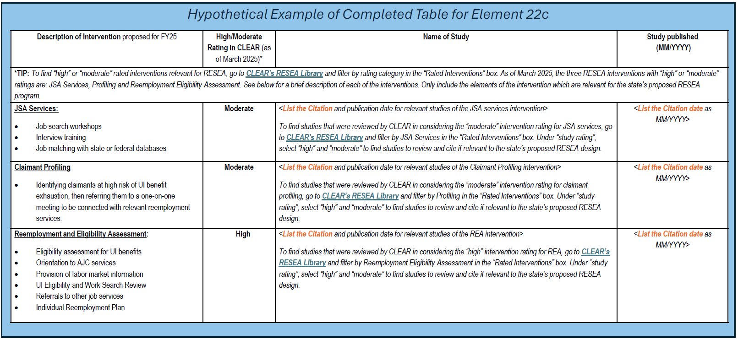
Element 22c. Example
This table is to cite intervention(s) that has received ‘High’ or ‘Moderate’ RESEA intervention ratings in CLEAR, which your state is using to inform its RESEA program design.

Slide 32
Element 22d.
Element 22b.- 22d. Evidence-based Standards and Evaluation Requirements
22d. Insert an explanation of how such interventions and service delivery strategies are appropriate to the population served.
Briefly describe how the interventions listed in 22c are appropriate for the population your RESEA program is serving, and give a general description of how the interventions are proven to be effective for UI claimants.
Tips for completing 22d:
The narrative description provided for 22d could address the following:
Describe how the factors of the state’s current population was considered when deciding on the intervention(s)
Is the intervention(s) the same across the state or to those areas providing RESEA services?
What are the desired outcomes of the intervention(s) (for example: decreased UC, decreased UC duration, people returning to work quicker, wage improvement, etc.)?
What has been observed already, in terms of desired outcomes?
Notes:
Element 22d. Insert an explanation of how such interventions and service delivery strategies are appropriate to the population served.
Briefly describe how the interventions identified above are appropriate for the population your RESEA program is serving.
Are the interventions/services the same across the state or to those areas providing RESEA services?
Follow the tips listed on the slide.

Slide 33
Element 22e. – 22f.
Element 22e. and 22f. Evidence-based Standards and Evaluation Requirements
22e. Do you assure that the planned RESEA interventions or service delivery strategies that do not have a high or moderate causal rating are under evaluation at the time of use?
Yes
No
Not Applicable (all interventions have a high or moderate causal rating)
If “Not Applicable” please advance to 22g NOT an option. Must be Yes or No.
22f. Insert, a description of the evaluation structure the State plans to use for interventions and service delivery strategies without at least a moderate or high causal evidence rating. This evaluation structure may include a whole program evaluation, evaluation of specific program components/interventions, or national evaluations conducted by the U.S. Department of Labor or by other entities.
Explain what the intervention that your state is planning to evaluate, and how it is being implemented within the RESEA program.
Describe the type of evaluation being planned by your state, e.g., impact study using random assignment or quasi-experimental design.
22f requires a response and must be answered.
Notes:
Element 22e.– 22f. Evidence-based Standards and Evaluation Requirements
Element 22e. Do you assure that the planned RESEA interventions or service delivery strategies that do not have a high or moderate causal rating are under evaluation at the time of use?
Your state must assure that the RESEA interventions or service delivery strategies used to implement the program without a high or moderate causal rating are under evaluation at the time of use by checking “Yes“ or “No.”
At this time, states can only select “Yes” or “No.”
Check “Yes” if ANY interventions or service delivery strategies, the state is currently using or proposing to use, that do not have a high or moderate causal rating are or will be under evaluation at the time of use.
Check “No” if ANY interventions or service delivery strategies, the state is currently using or proposing to use, that do not have a high or moderate causal rating and are not or will not be under evaluation.
Element 22f. Insert, a description of the evaluation structure the state plans to use for interventions and service delivery strategies without at least a moderate or high causal evidence rating. This evaluation structure may include a whole program evaluation, evaluation of specific program components/interventions, or national evaluations conducted by the U.S. Department of Labor or by other entities.
In other words, describe if your state is planning to evaluate the whole or a component of the RESEA program.
• Explain what the intervention that your state is planning to evaluate, and how it is being implemented within the RESEA program. Please include any interventions or service delivery strategies that do not have a high or moderate causal rating and are or will be under evaluation. Provide narrative for any interventions or service delivery strategies, the state is currently using or proposing to use, that do not have a high or moderate causal rating and will not be under evaluation.
• Describe the type of evaluation being planned by your state, e.g., impact study using random assignment or quasi-experimental design.
• (Note: common responses include: (1) an impact study using the most rigorous and appropriate design feasible, (2) an impact study using random assignment, or (3) an impact study using a quasi-experimental design)
Tips for completing 22f:
At a minimum, the description should:
Identify what intervention is being evaluated;
State the evaluation’s research questions;
Describe the evaluation’s research design (e.g., type of study, outcomes being studied, description of study sample (if applicable), and type of data collection);
Identify who is conducting the evaluation; and
Clarify the stage of the evaluation: (1) Planning and procurement; (2) Data collection; or (3) Analysis and reporting

Slide 34
Element 22g. – 22h.
Element 22g. and 22h. Evidence-based Standards and Evaluation Requirements
22g. Total funds that will be set aside to conduct or cause to be conducted evaluations of interventions used in carrying out the RESEA Program. This amount is limited to 10 percent of grant award (Section 306(d)(2), SSA).
$
22h. Insert a description of any evaluations of reemployment interventions and service delivery strategies conducted in the prior fiscal and any data collected on:
Characteristics of program participants;
Number of weeks for which program participants receive unemployment compensation; and
Employment and other outcomes for program participants consistent with State performance accountability measures provided by the State unemployment compensation program and performance outcome measures as defined in section 116(b) of the workforce Innovation and Opportunity Act (29 U.S.C. 3141(b)
Examples: In addition to information from formal evaluations, states may include information from other forms of analyses such as reviews of administrative data or analysis of quarterly reporting provided to DOL.
22g -- Enter total dollar amount and DO NOT round as it may be greater than 10 percent.
22h – Summarize any prior fiscal year(s) evaluations or interventions and service delivery strategies
Notes:
Element 22g.– 22h. Evidence-based Standards and Evaluation Requirements
Element 22g. Total funds that will be set aside using FY25 funds to conduct evaluations of interventions used in carrying out the RESEA program.
This amount is limited to 10 percent of FY25 grant award (Section 306(d)(2), SSA)
Indicate how much money your state will use for the RESEA evaluation in the space “$______” Please enter the total dollar amount set aside for evaluations.
DO NOT round the dollar figure as this may make the amount greater than 10 percent.
Element 22h. Insert a description of any evaluations or reemployment interventions and service delivery strategies conducted in the prior fiscal and any data collected on:
1. Characteristics of program participants;
2. Number of weeks for which program participants receive unemployment compensation; and
3. Employment and other outcomes for program participants consistent with state performance accountability measures provided by the state unemployment compensation program and performance outcome measures as defined in section 116(b) of the Workforce Innovation and Opportunity Act (29 U.S.C. 314(b).
Tips for completing 22h:
Summarize any evaluation or evaluation planning activities carried out in the prior fiscal year. Include an update and status on progress of the evaluation
Describe the types of data that were collected as part of evaluation activities in the prior fiscal year (e.g., data regarding the characteristics of program participants, or the number of weeks program participants received unemployment compensation)
Provide summary statistics for evaluation data elements collected to-date (e.g., mean, median, frequencies, etc.)
Provide relevant statistics from the quarterly reports submitted to DOL to describe the RESEA caseload (ETA 9128, 9129, 9130, 9178, etc)
If evaluation data are not available or ready for preliminary analysis, please indicate when results are expected.
For help thinking about using data in evaluations, refer to the RESEA Evaluation TA webinar series on WorkforceGPS.org.

Slide 35
Element 22i.
Element 22i. Complete below chart providing additional information about RESEA component/activities, their casual rating, the costs associated with that component/activity, and what percentage it is of the current grant.
22i. Complete below chart providing additional information about RESEA component/activities, their causal rating, the costs associated with that component/activity, and what percentage it is of the current grant.
EVIDENCE BASED FUNDING
 | RESEA Component/Activity (a) | Causal Rating (Moderate; High) (b) | RESEA Cost of Component/Activity (c) | Percentage of Current Grant (d)
1. |  |  | $
2. |  |  | $
3. |  |  | $
4. |  |  | $
5. |  |  | $
11. | Totals |  | $ | %
FY2025, states must devote at least 40 percent of their RESEA funding to evidence-based components with a high or moderate causal rating.
Notes:
Element 22i
Element 22i. Complete below chart providing additional information about RESEA component/activities, their causal rating, the costs associated with that component/activity, and what percentage it is of the current grant.
Enter the component/activity in column (a). No descriptions are needed. These components/activities should be described in elements 21b., 21d, 21f, and 21h.
Column (b), enter the causal rating, high or moderate, that can be located on the CLEAR website. Please enter “None” if the component or activity does not have a causal rating on the CLEAR website. No narrative is needed, as this should be addressed in element 22f.
The total cost of the RESEA component or activity will be entered in column (c). No additional information is needed in this column.
Please be sure to enter a total for columns (c) and (d) in row 11 before submitting your State Plan to the National Office. This information can be entered in the State Plan Self Checker to help with accuracy. Look for the tab titled Element 22i. on the State Plan Self Checker.

Slide 36
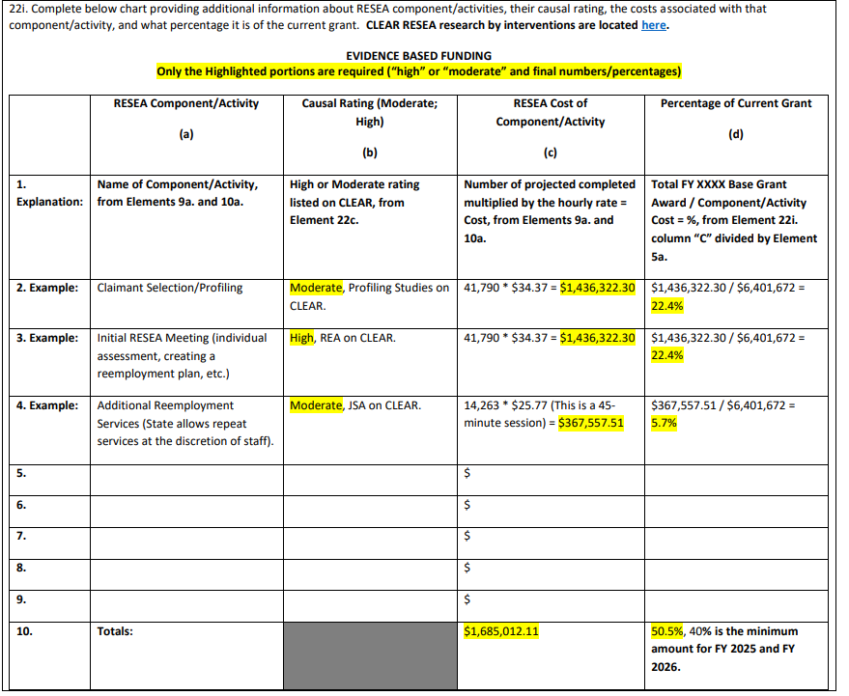
Example of 22i

Slide 37




Resources
These resources are related to assisting states with operations, performance reporting, and guidance and tools related to the evidence-based requirements of the RESEA program. Pages are updated as new resources become available.
RESEA Operations:
RESEA State Plan Self Checker
RESEA Pre-Checklist
SF-424 Instructions
SF-424A Instructions
Element 22i Example
Select RESEA Evaluation and Evidence Resources for additional tools and resources to assist with topics from evidence building to why and how to submit the RESEA evaluation report to CLEAR for review.
EMPLOYMENT AND TRAINING ADMINISTRATION
UNITED STATES DEPARTMENT OF LABOR

Slide 38
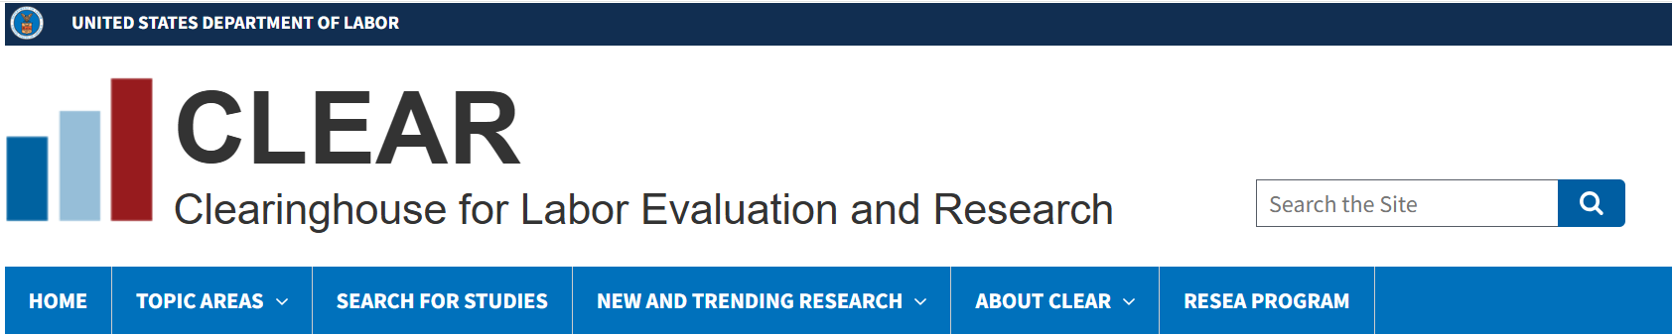
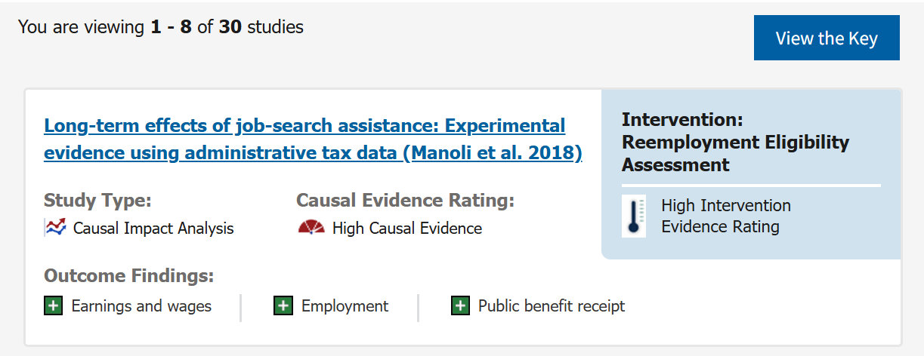
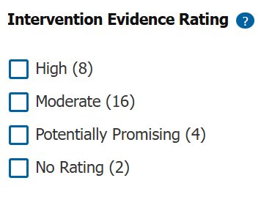
Resources
Here you can find which interventions have received high or moderate ratings, based on findings from rigorous causal impact studies. You can also delve into summaries of individual studies of interventions that you are interested in.
EMPLOYMENT AND TRAINING ADMINISTRATION
UNITED STATES DEPARTMENT OF LABOR

Slide 39
Thank You!
EMPLOYMENT AND TRAINING ADMINISTRATION
UNITED STATES DEPARTMENT OF LABOR

