Slide 1
PY 2017 WIOA National Performance Data
Module 2
2019 WIOA National Performance Training
U.S. Department of Labor
Employment and Training Administration

Slide 2
Module Objectives
Review National Performance for Each Indicator
Review State Performance for Each Indicator
Discuss Ongoing Challenges
Notes:
NOTE TO PRESENTERS:
The slide deck is structured so the charts come first, followed by the key takeaways. Ideally, the presenters will cover the key takeaways while the chart slide is still up and the subsequent slide is only there to document the key points for those that did not attend the training or need to refer to it afterward. For each chart slide I will provide the necessary context and key points that should be discussed while the chart slide is up.

Slide 3
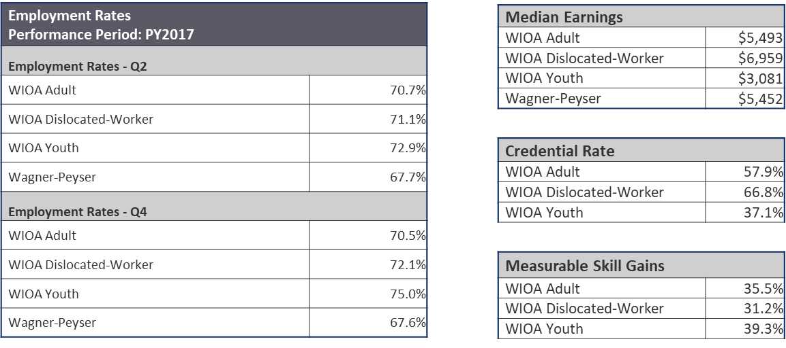
National Performance by Indicator and Program – Charts
Source: PY 2017 Q4 WIOA Performance Individual Record Data
Only 2 quarters of data are available for Employment 4th Quarter and Credential Attainment. Full reporting is expected for the PY 2018 Annual Report.
Notes:
This is the first full program year of results for Employment Rate in the 2nd Quarter after Exit and Median Earnings. Full reporting for the Employment Rate in the 4th Quarter after Exit and Credential Attainment Rate are expected in the PY 2018 Annual Reports.
National results are in line with our expectations from previous projections and simulations based on WIA performance record data.

Slide 4
National Performance by Indicator and Program
First full program year of results for Employment Rate in 2nd Quarter after Exit and Median Earnings
Full reporting for Employment Rate in the 4th Quarter after Exit and Credential Attainment Rate expected in PY 2018 Annual Reports
National results are in line with expectations from previous projections and simulations based on WIA performance record data

Slide 5
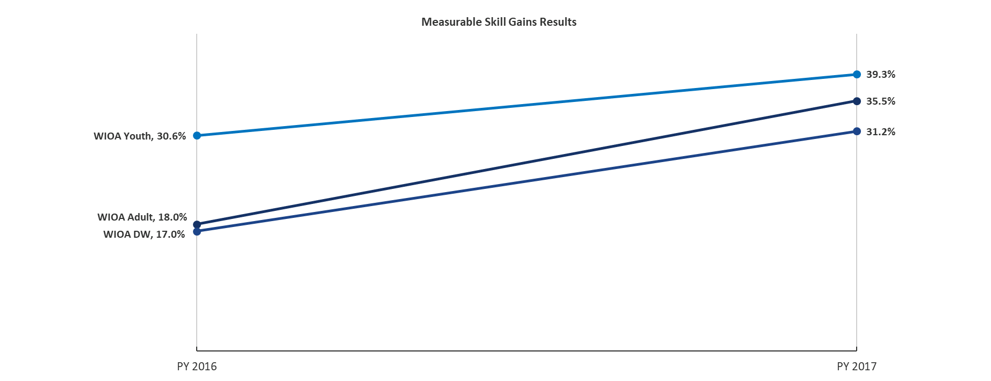
National Performance Results
Measurable Skill Gains (MSG)*
*Source: PY 2017 Q4 WIOA Performance Individual Record Data
Notes:
Second full program year of MSG results
Improved results from all WIOA title I programs
Likely driven by state and federal technical assistance and improved data collection
Expect performance to continue to improve with the ICR changes made for PY 2018

Slide 6
Measurable Skill Gains
Second full program year of MSG results
Improved results from all WIOA title I programs
  Likely driven by state and federal technical assistance and improved data collection
Expect performance to continue to improve with the ICR changes made for PY 2018

Slide 7
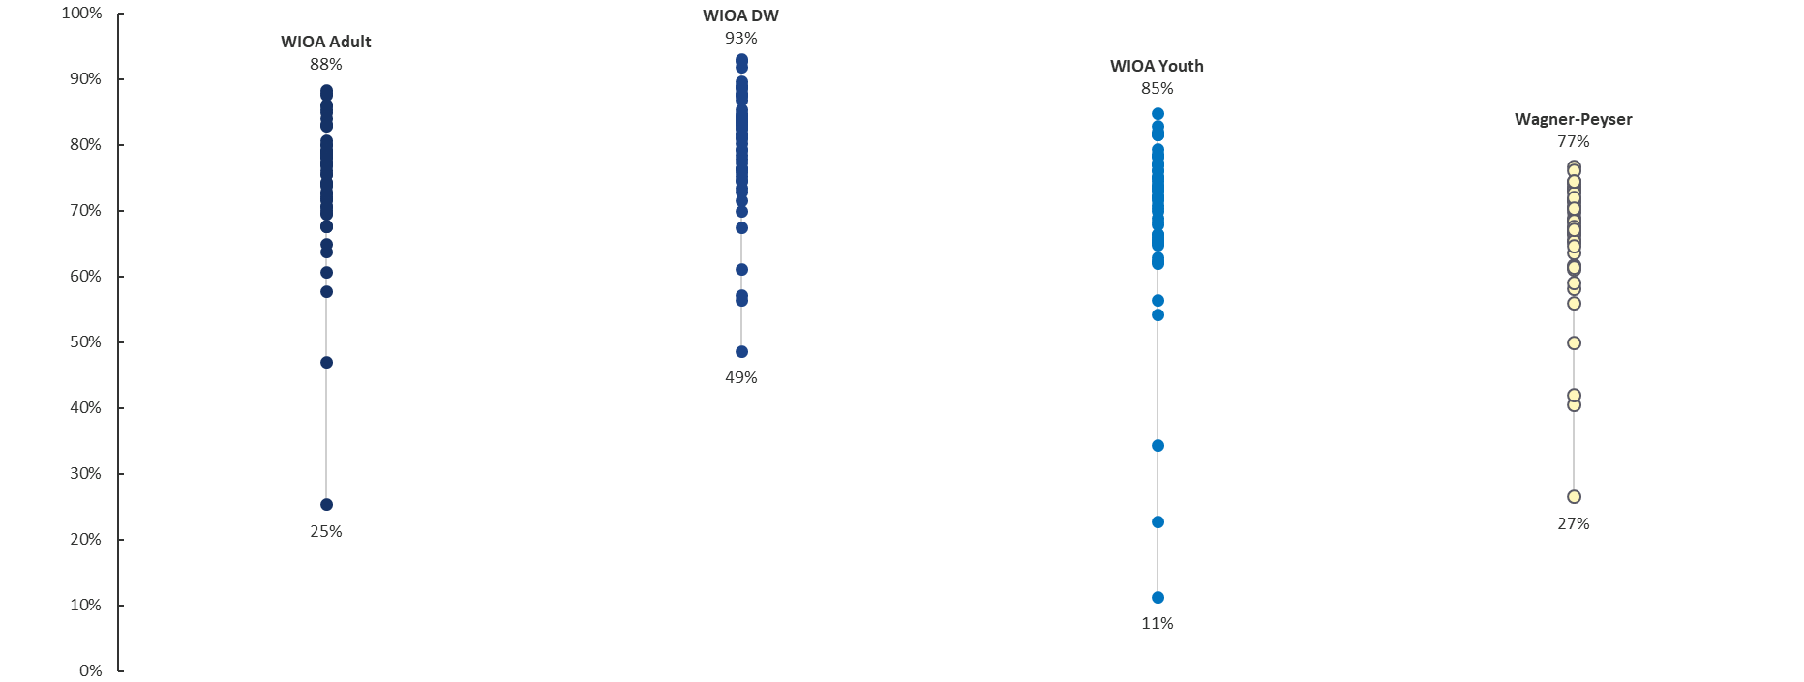
State Performance
Employment Rate 2nd Quarter
Source: PY 2017 Q4 State Quarterly Reports
Notes:
These are commonly referred to as technical dot plots. We’re using them to better understand and compare the range of state performance across programs. Each dot represents a state’s performance level and for context we’ve called out the highest and lowest values for each set.
With the exception of a few understandable outliers, we have neat, tight ranges for the employment and wage indicators.
This makes sense, since these measures rely on data state workforce agencies have been collecting for a long time. We’ll see how this changes when we look at other indicators like Measurable Skill Gains. We did not produce dot plots for 4th Quarter Employment and Credential Attainment since those indicators are not complete yet.
Of course we have to mention here that state performance assessment is dependent on the statistical adjustment model and negotiated levels of performance. Still, reviewing raw performance levels in this way can be informative. These values are in no way meant to offend, they are meant to be illustrative.

Slide 8
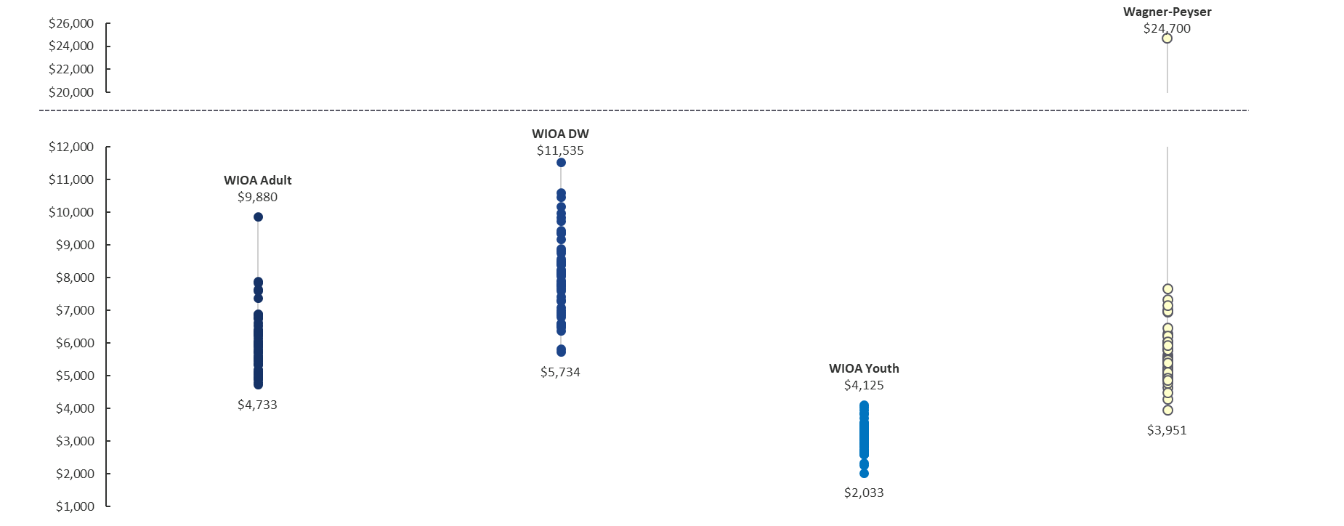
State Performance
Median Earnings
Source: PY 2017 Q4 State Quarterly Reports
Notes:
Same notes as before, fairly tight ranges for Median Earnings, with the exception of Guam. Visuals like this help DOL and states identify issues that wouldn’t normally jump off of a report with tons of numbers on it. We will be following up with Guam, and others, individually on a few of these outlier observations.

Slide 9
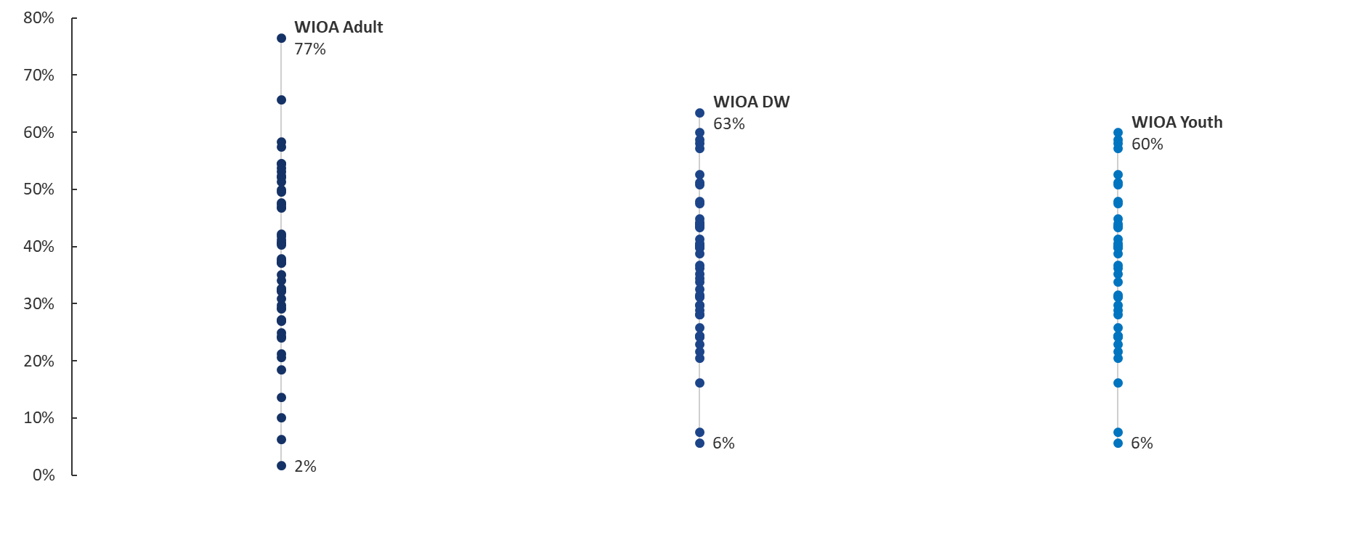
State Performance
Measurable Skills Gain Rate
Source: PY 2017 Q4 State Quarterly Reports
Notes:
Note the wide range of results for MSG. This is why we’re dedicating significant technical assistance efforts towards MSG. We understand the indicator is new, but we’re going to help you collect the information and report it as accurately as possible.

Slide 10
State Performance
Using technical dot plots to understand and compare range of state performance across programs
  Called out the highest and lowest values for each set
With the exception of a few outliers, employment and wage indicators have neat, tight ranges
  This makes sense, since these measures rely on data state workforce agencies have been collecting for a long time
  This changes when we look at other indicators like Measurable Skill Gains
  Did not produce dot plots for 4th Quarter Employment and Credential Attainment since those indicators are not complete yet

Slide 11
State Performance (cont.)
Visuals like this help DOL and states identify data quality or performance issues
  Will follow up with Guam, and others, individually on outlier observations
Wide range of results for MSG
  Dedicating significant technical assistance efforts towards MSG
  The indicator is new, it will take time for reporting to mature

Slide 12
Ongoing Challenge
Measurable Skill Gains indicator has new specifications for PY 2018 and beyond
  This is a challenge for future modeling (will be discussed in detail in Module 11)
  Range of state performance indicates everyone is not on the same page and more technical assistance is necessary

Slide 13
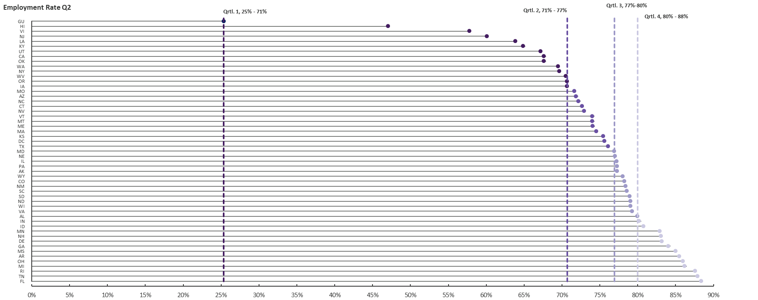
State Performance Quartiles by Indicator and Program – WIOA Adult, Employment Rate Q2*
Source: PY 2017 Q4 State Quarterly Reports
Notes:
We don’t have to review each of the next set of visuals. They get repetitive, but we want states to understand and feel comfortable seeing results displayed in quartiles.
Kevin will provide an overview of what a quartile range is if necessary and how to interpret them.
This is an approach to continuous improvement used by Adult Education. We’re considering incorporating this type of analysis in the negotiations tool for the 2020-2021 negotiations. They use it as a measure of continuous improvement when a state’s performance moves to a higher quartile. If a state is already in the 4th quartile then they’ll need to use some other measure of continuous improvement. This isn’t meant to be the only metric, but it gives us another tool in negotiations. For example, if your state is in the 2nd quartile, setting a target that puts you in the 3rd quartile *regardless of the percentage point change* could be considered continuous improvement.
We’d like a discussion and feedback. How do states see this working out in practice?

Slide 14
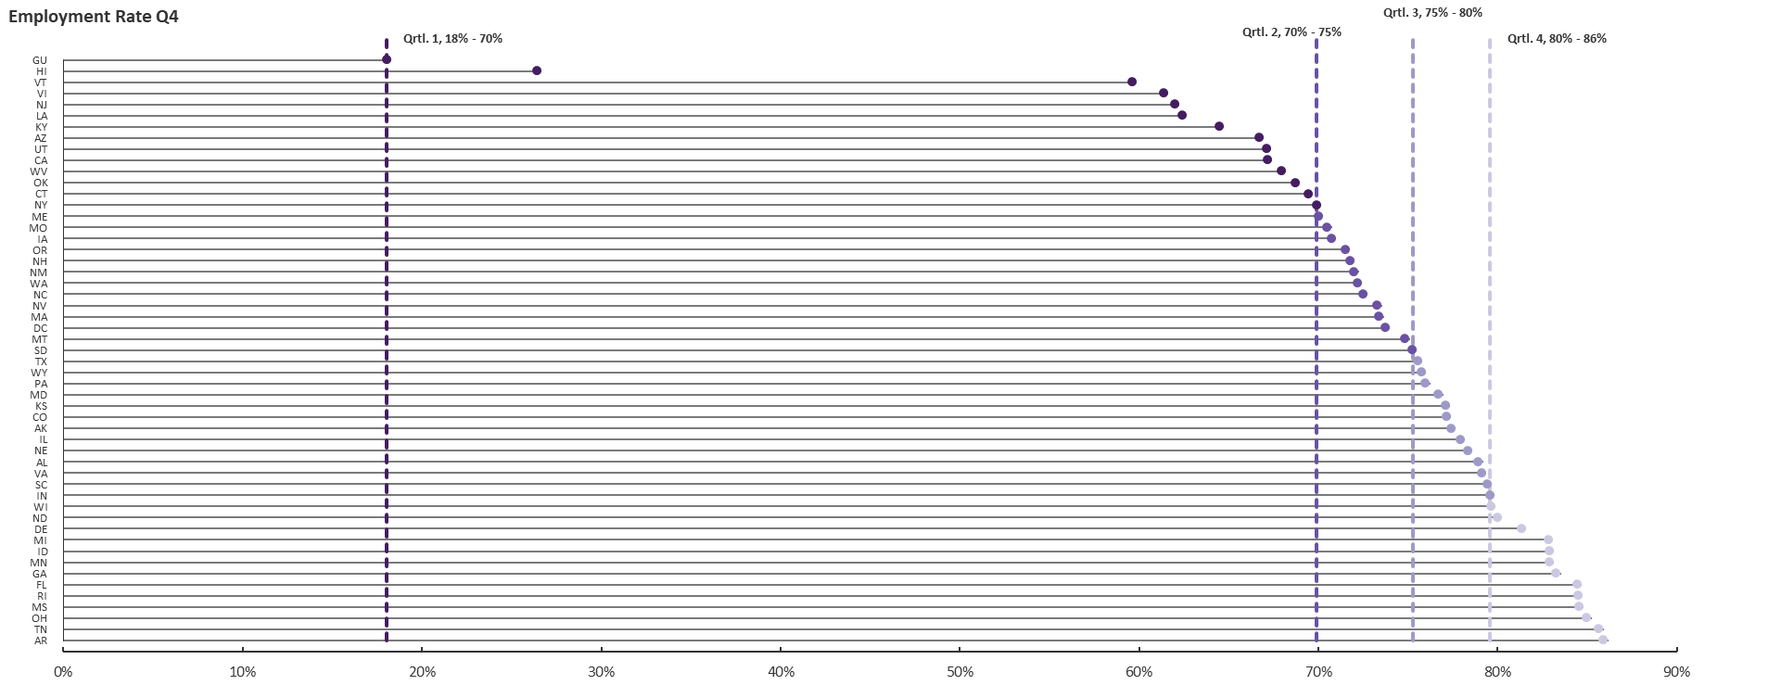
State Performance Quartiles by Indicator and Program – WIOA Adult, Employment Rate Q4*
*Source: PY 2017 Q4 State Quarterly Reports

Slide 15
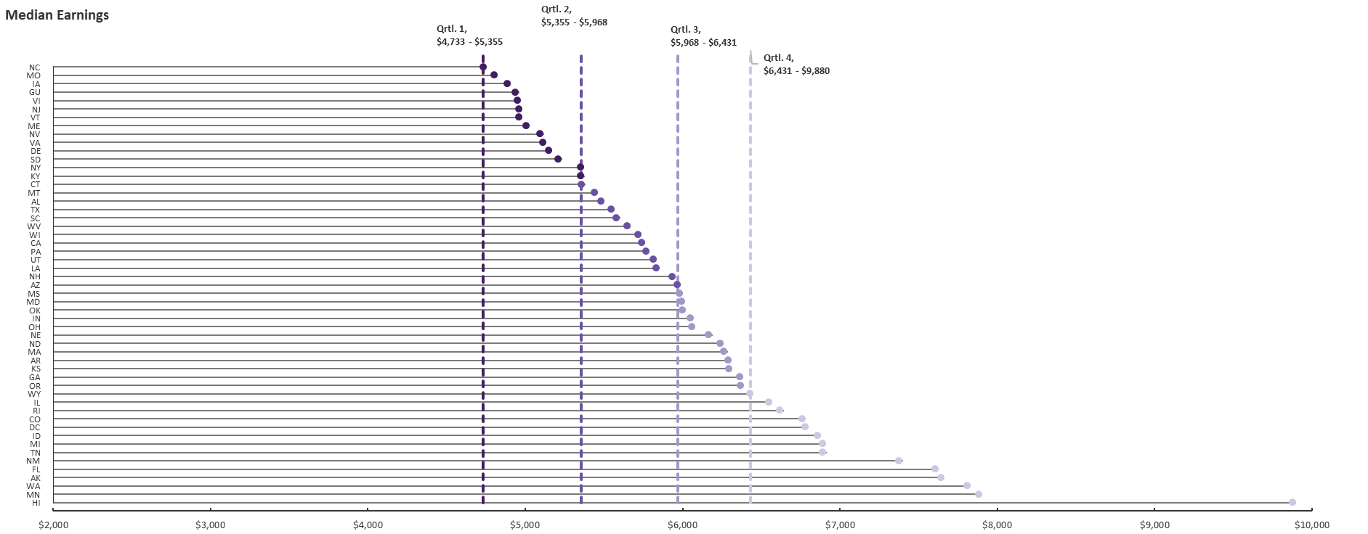
State Performance Quartiles by Indicator and Program – WIOA Adult, Median Earnings*
*Source: PY 2017 Q4 State Quarterly Reports

Slide 16
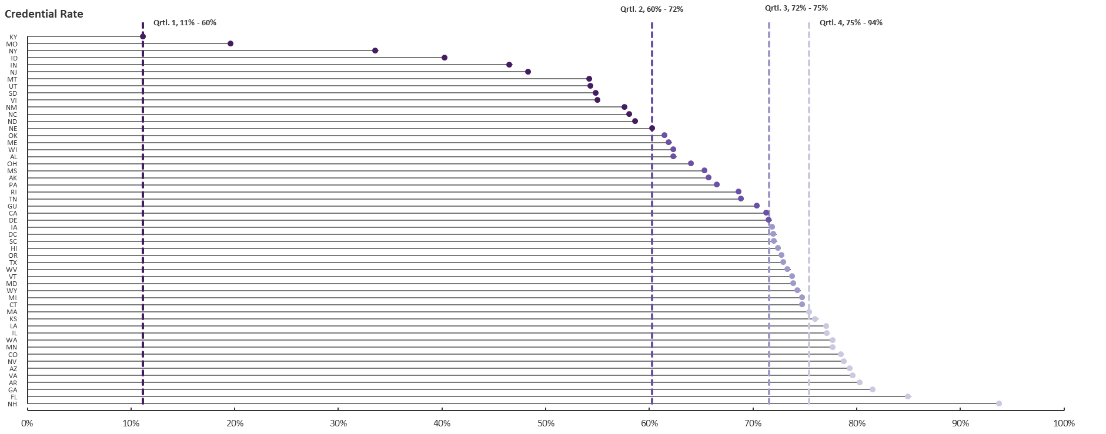
State Performance Quartiles by Indicator and Program – WIOA Adult, Credential Rate*
*Source: PY 2017 Q4 State Quarterly Reports

Slide 17
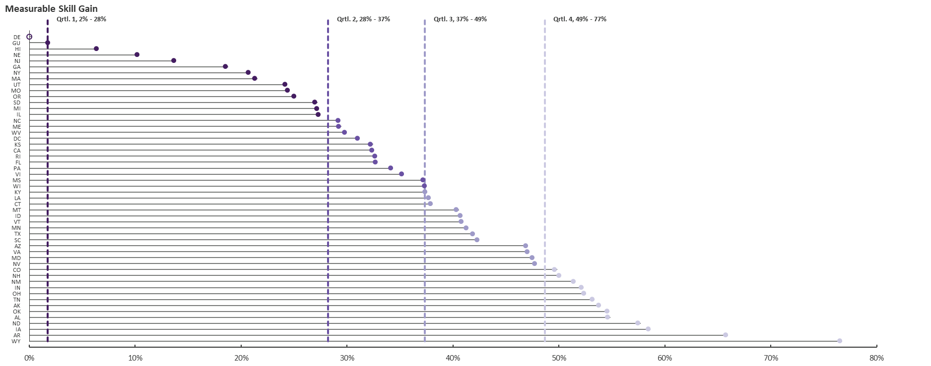
State Performance Quartiles by Indicator and Program – WIOA Adult, Measurable Skill Gain*
*Source: PY 2017 Q4 State Quarterly Reports

Slide 18
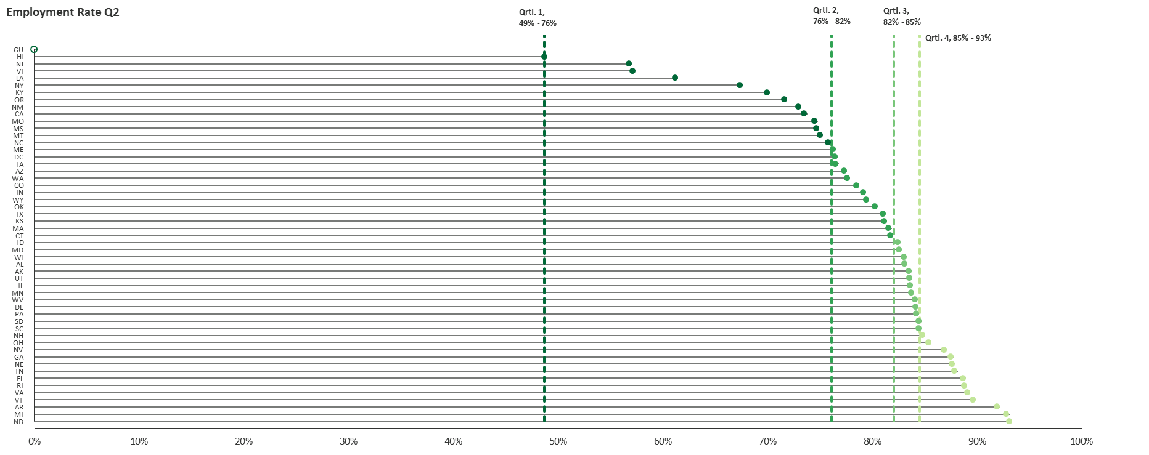
State Performance Quartiles by Indicator and Program – Dislocated Worker, Employment Rate Q2*
*Source: PY 2017 Q4 State Quarterly Reports

Slide 19
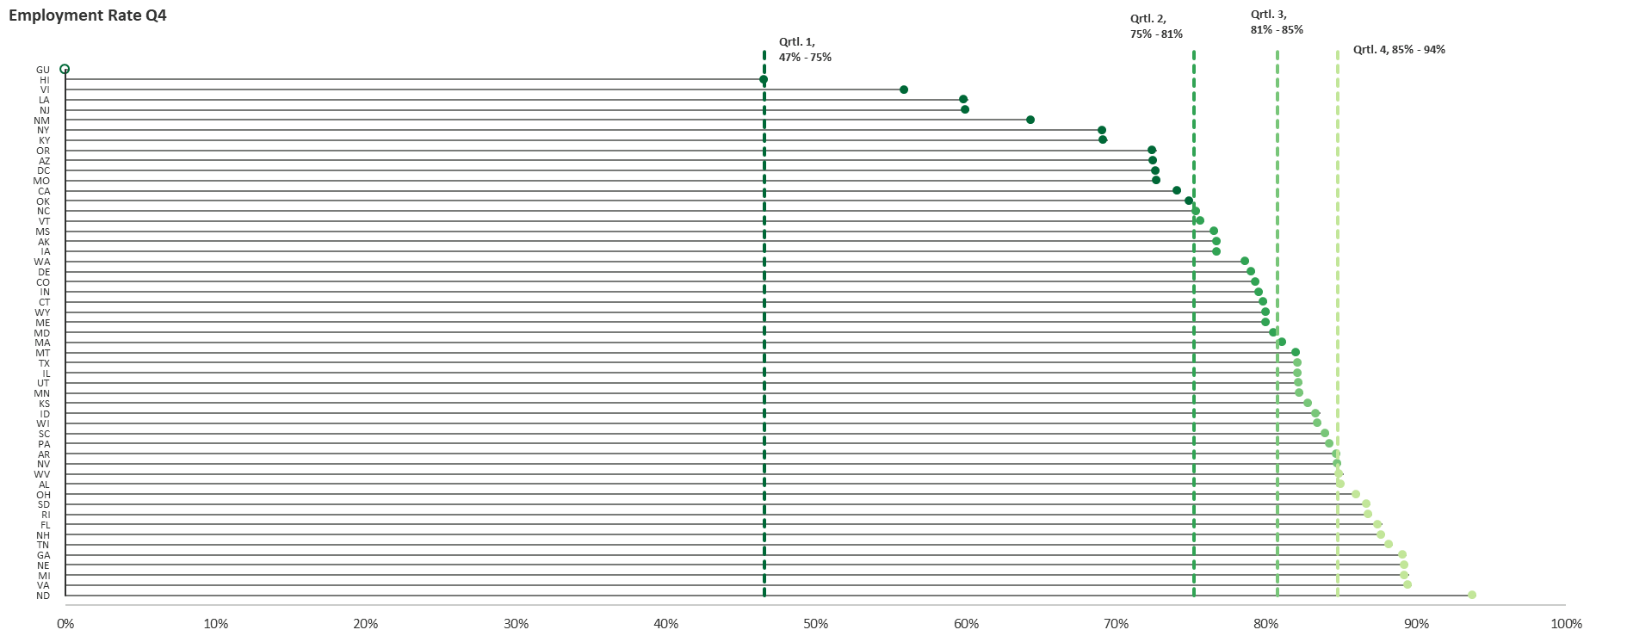
State Performance Quartiles by Indicator and Program – Dislocated Worker, Employment Rate Q4*
*Source: PY 2017 Q4 State Quarterly Reports

Slide 20
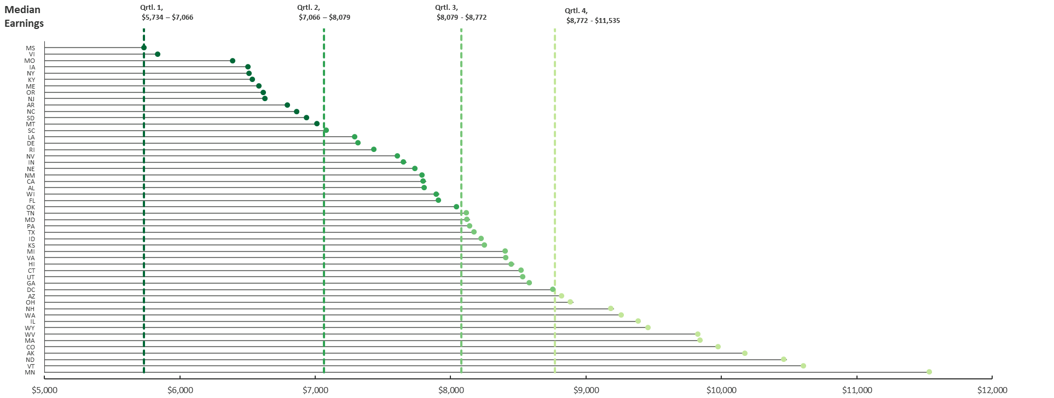
State Performance Quartiles by Indicator and Program – Dislocated Worker, Median Earnings*
*Source: PY 2017 Q4 State Quarterly Reports

Slide 21
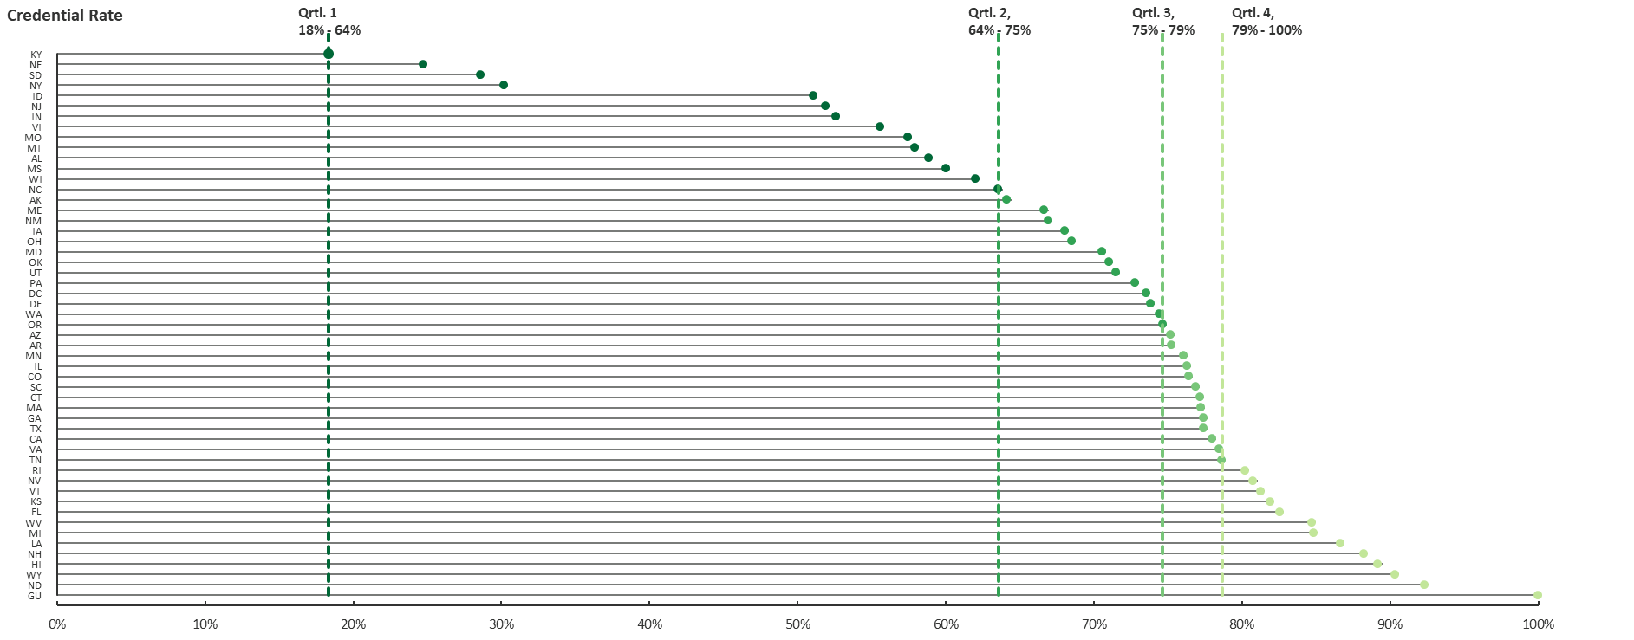
State Performance Quartiles by Indicator and Program* (cont.)
*Source: PY 2017 Q4 State Quarterly Reports

Slide 22
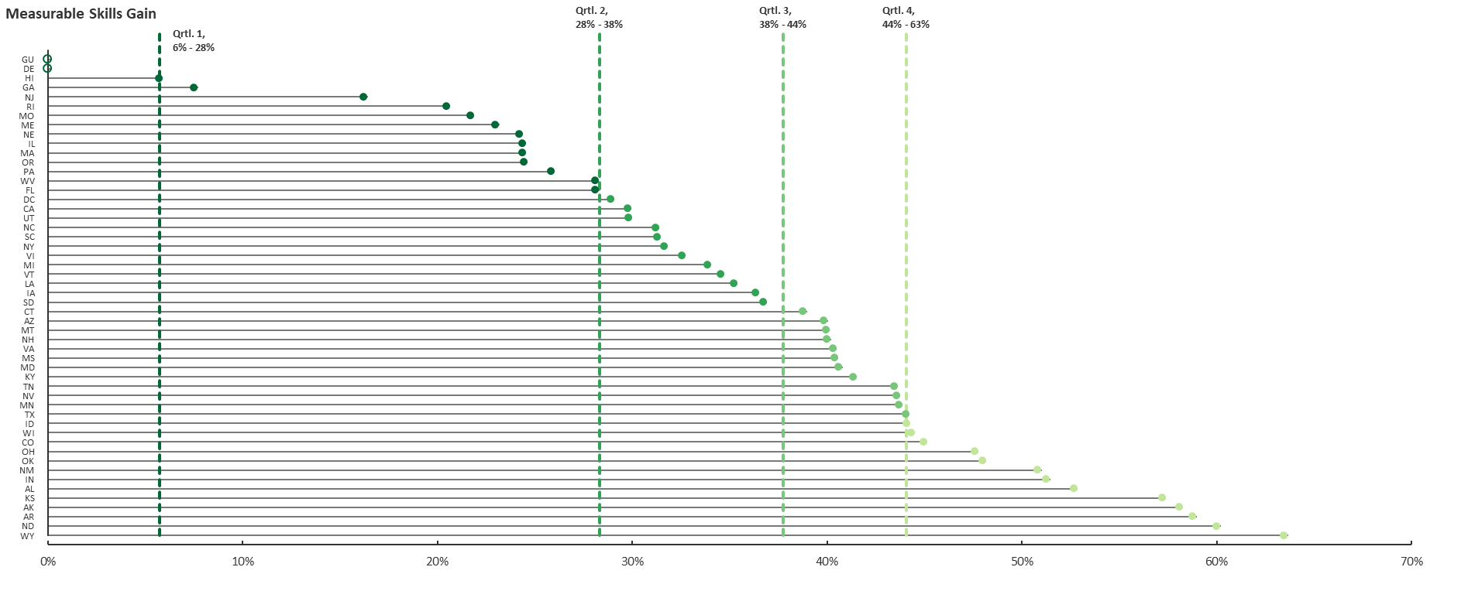
State Performance Quartiles by Indicator and Program – Dislocated Worker, Measurable Skill Gains*
*Source: PY 2017 Q4 State Quarterly Reports

Slide 23
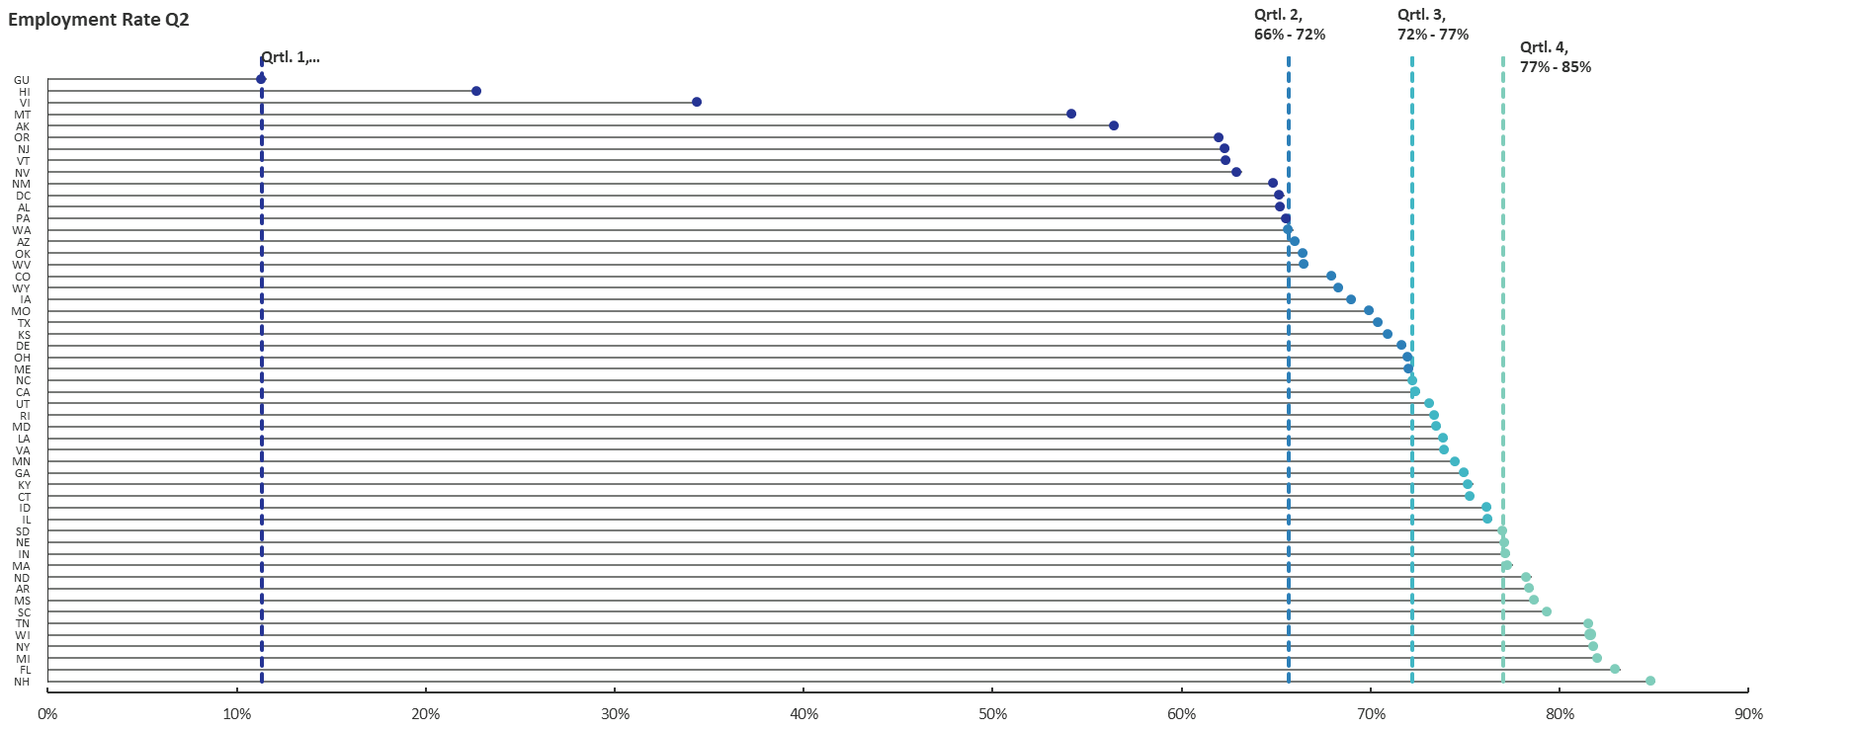
State Performance Quartiles by Indicator and Program – WIOA Youth, Employment Rate Q2*
*Source: PY 2017 Q4 State Quarterly Reports

Slide 24
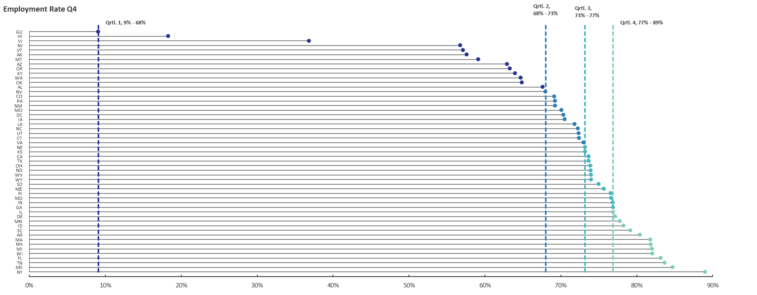
State Performance Quartiles by Indicator and Program – WIOA Youth, Employment Rate Q4*
*Source: PY 2017 Q4 State Quarterly Reports

Slide 25
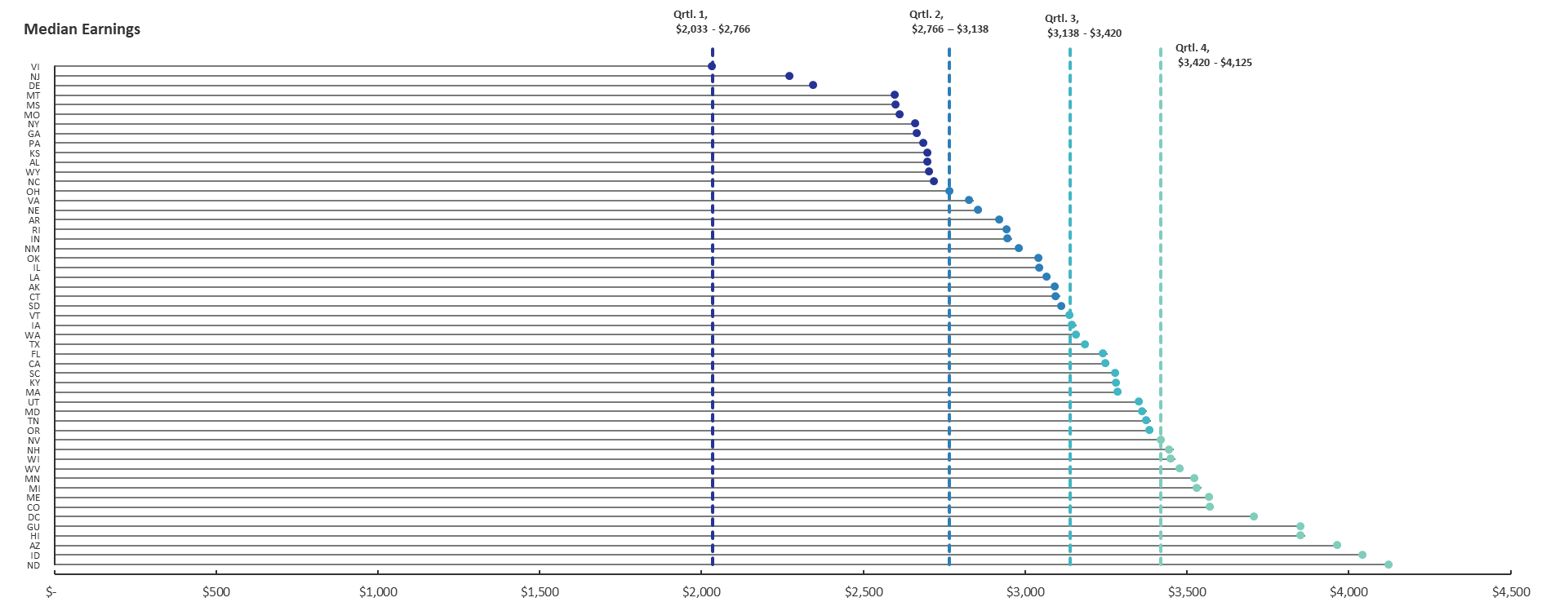
State Performance Quartiles by Indicator and – WIOA Youth, Median Earnings*
*Source: PY 2017 Q4 State Quarterly Reports

Slide 26
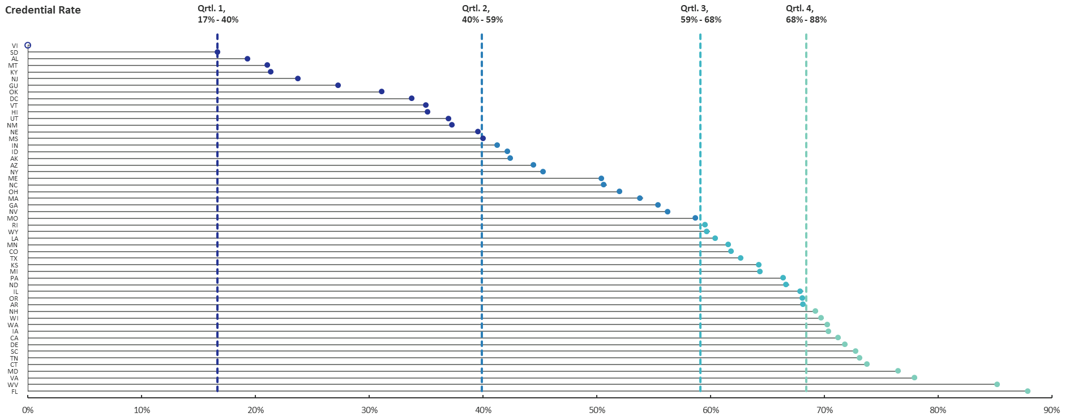
State Performance Quartiles by Indicator and Program – WIOA Youth, Credential Rate*
*Source: PY 2017 Q4 State Quarterly Reports

Slide 27
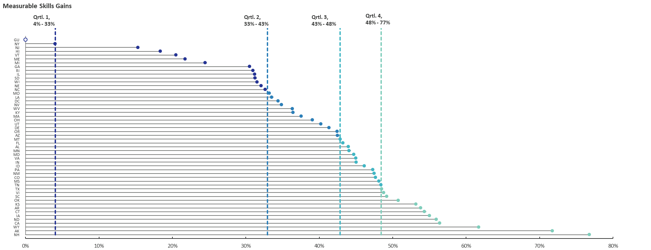
State Performance Quartiles by Indicator and Program – WIOA Youth, Measurable Skill Gains*
*Source: PY 2017 Q4 State Quarterly Reports

Slide 28
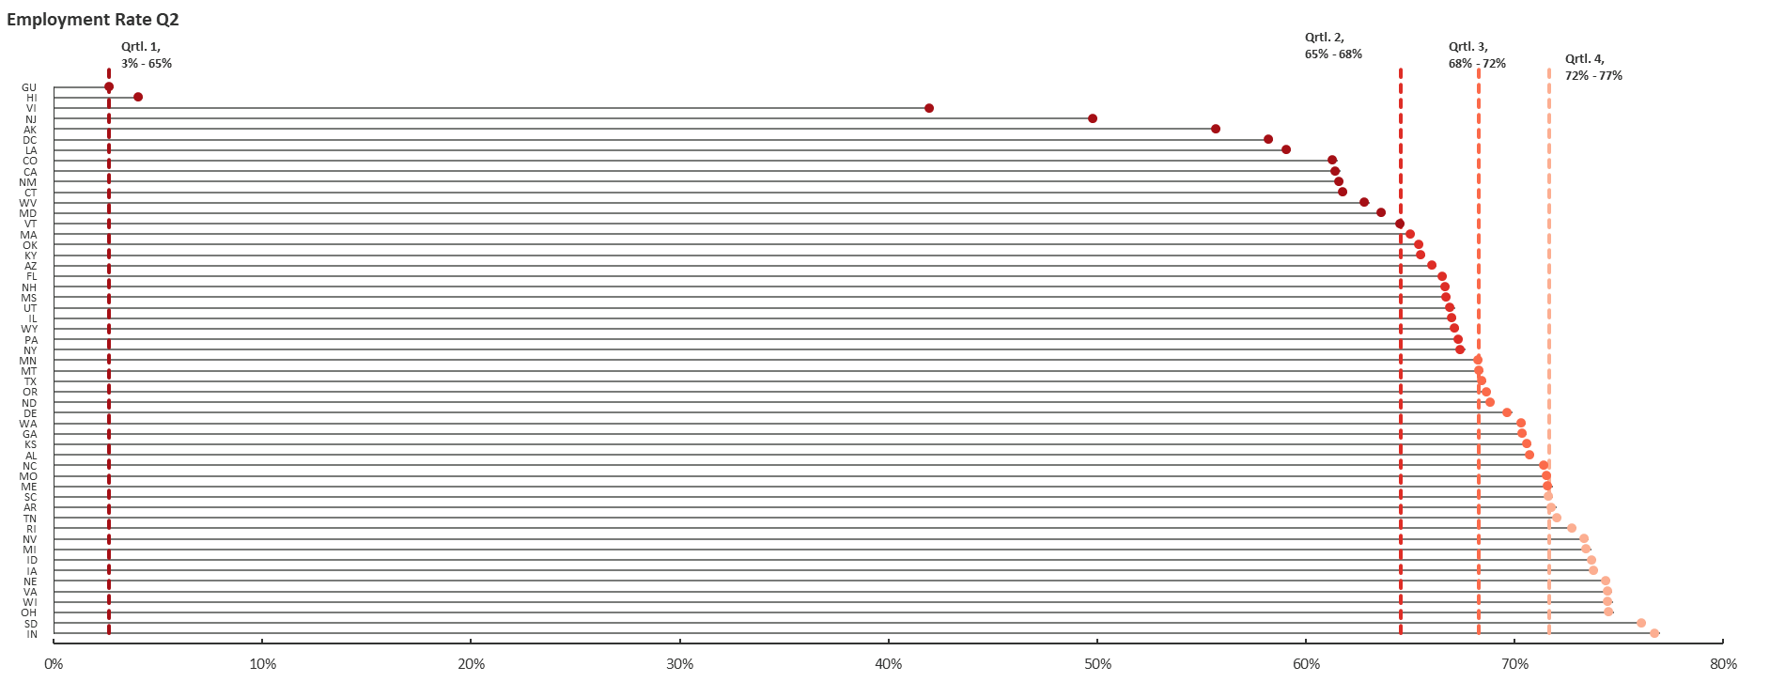
State Performance Quartiles by Indicator and Program – Wagner-Peyser, Employment Rate Q2*
*Source: PY 2017 Q4 State Quarterly Reports

Slide 29
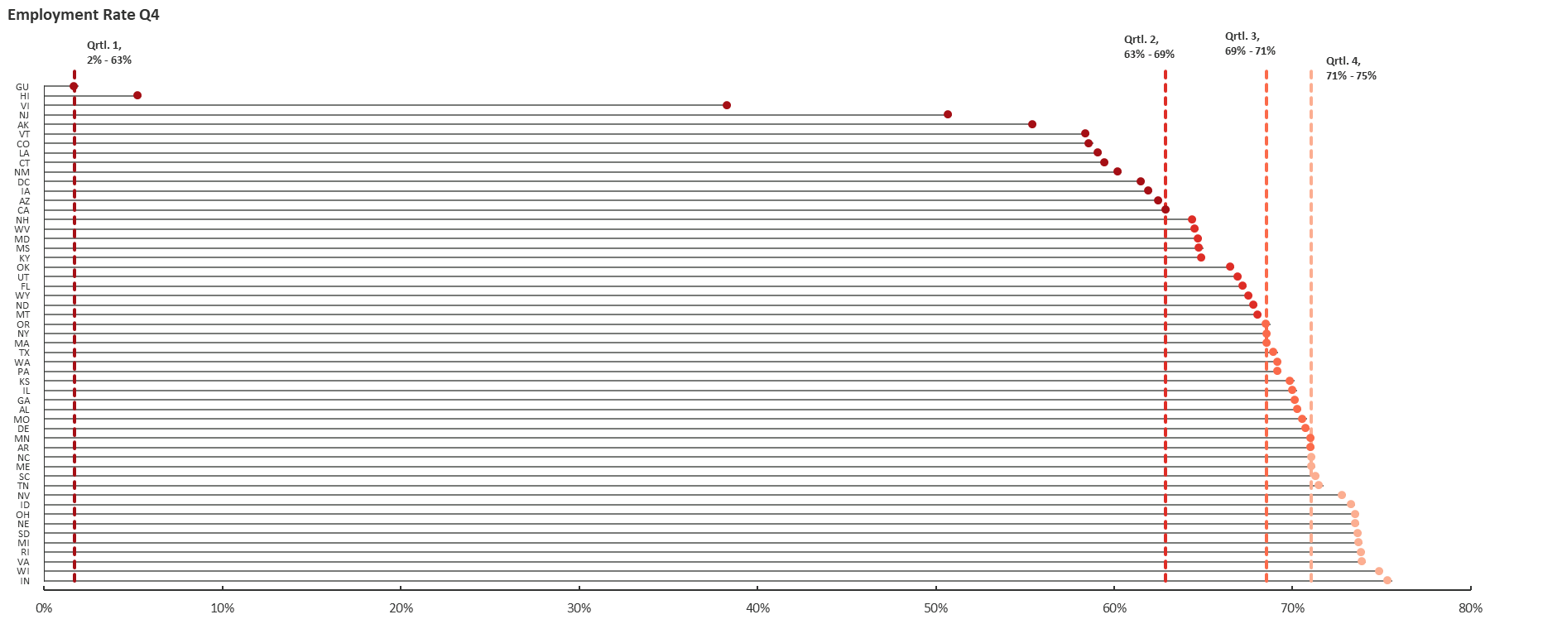
State Performance Quartiles by Indicator and Program Wagner-Peyser, Employment Rate Q4*
*Source: PY 2017 Q4 State Quarterly Reports

Slide 30
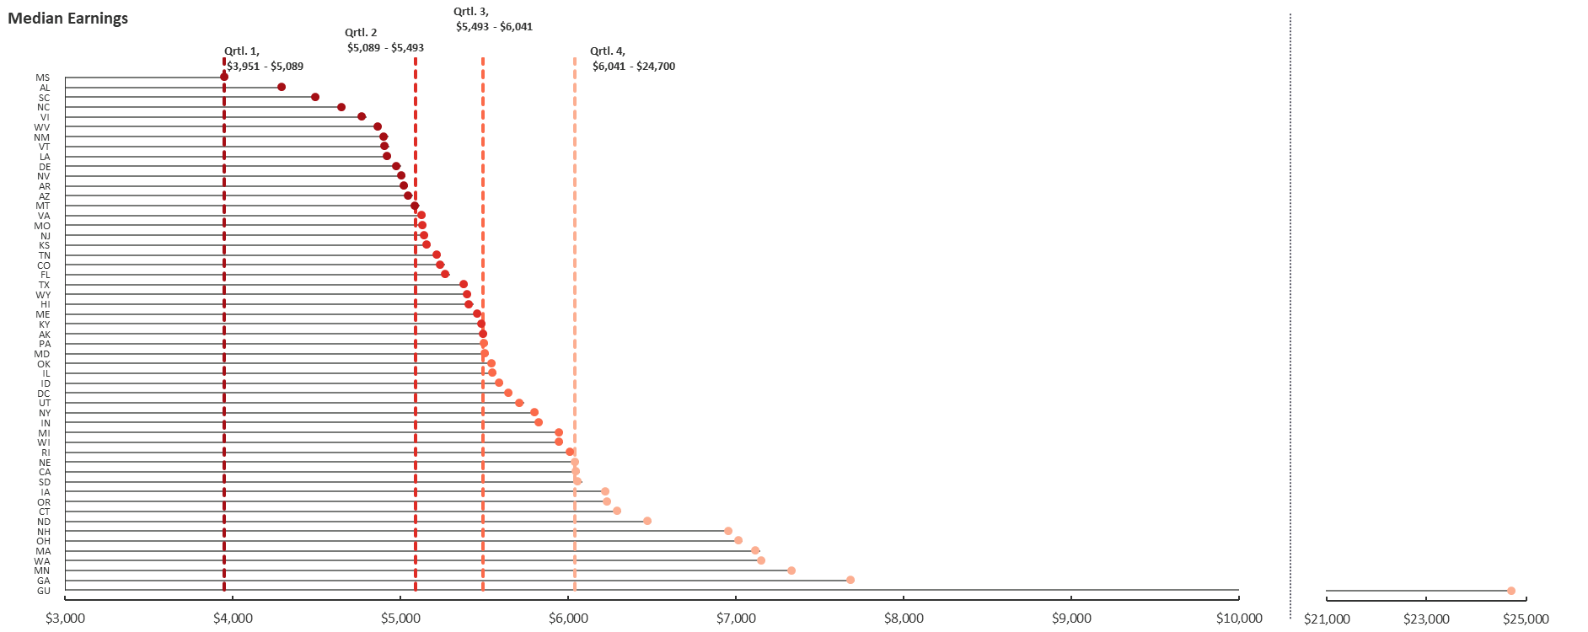
State Performance Quartiles by Indicator and Program – Wagner-Peyser, Median Earnings*
*Source: PY 2017 Q4 State Quarterly Reports

Slide 31
Any Questions?

Slide 32
Contact
 ETAPerforms@dol.gov

Slide 33
Please complete your evaluations.

