Slide 1
Statistical Adjustment Model – Measurable Skill Gains (MSG)
Module 11
2019 WIOA National Performance Training
U.S. Department of Labor
Employment and Training Administration

Slide 2
Today’s Objectives
How the MSG model is the same
How the MSG model is different
Data challenges and their implications for the MSG model
Future plans

Slide 3
How is the Measurable Skill Gains Model the Same as the Other Models?
Same framework and functional form
  MSG = PC₁ + PC₂ + … + EC₁ + EC₂ +… + S₁ + S₂ + … + b
Similar variables (see handout)
    Participant Characteristics
    Economic Conditions
    State Fixed Effects

Slide 4
How is the Measurable Skill Gains Model Different than the Other Models?
Possible variable differences
Data Challenges
  The MSG indicator is different—It is NOT exit based
  MSG data has been collected since PY2016, however, since it is a new data element it has taken some time for the reported data to better reflect actual skill gains of participants
  There is no historical data for this performance indicator

Slide 5
Challenges with Determining the MSG Denominator for Quarters
Remember, the MSG indicator is a PY rate
  (Participation in training or education program with at least 1 of the 5 measurable skill gains in PY) / (Participation in education or training program in PY)
How can we convert this rate to a quarter rate?
  Rolling 4 quarters (i.e., reference period + prior 3 quarters)
  Quarters treated as a PY (i.e., any gains in only that quarter)
  Other ideas?
Ultimately, there is a balance between determining which method results in quarter MSG rates that are comparable to PY rates without impacting model estimates.

Slide 6
Measurable Skill Gains Model Development – Data Challenges
Data quantity
  Currently only have 9 quarters of total data (PY 2016 Q1 – PY 2018 Q1)
  For a sufficient number of observations, PY data needs to be converted to state data by quarter. (Which is problematic as previously discussed.)

Slide 7
Measurable Skill Gains Model Development – Data Challenges (2)
Data quality
  Much of the early data (i.e., PY 2016) is unusable
  The dependent variable of the model (i.e., the MSG rate) has an upward trend due to improvements in data collection and reporting
  Lack of data reliability makes it difficult to assess the estimated effects of the model variables

Slide 8
MSG Model Data Challenges - An Example (1)
What is the expected relationship between gaining a measurable skill gain (the dependent variable in this model) and the unemployment rate (one of the independent variables or this model)?
What does the data look like?
  MSG rate trends since PY 2016?
  Unemployment rate trends since 2016?

Slide 9
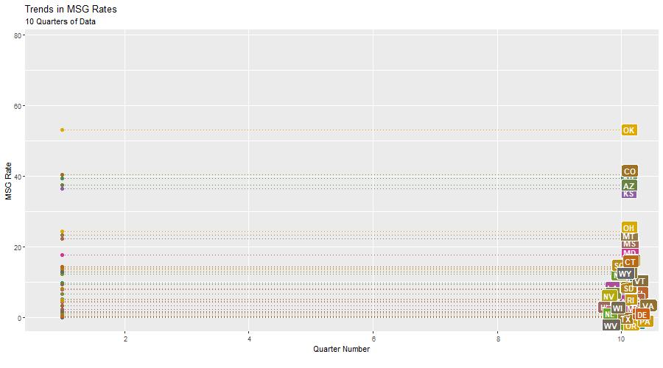
MSG Model Data Challenges - An Example (2)
Source: PY 2016 Q4, PY 2017 Q4, and PY 2018 Q2 WIOA Performance Individual Record Data

Slide 10
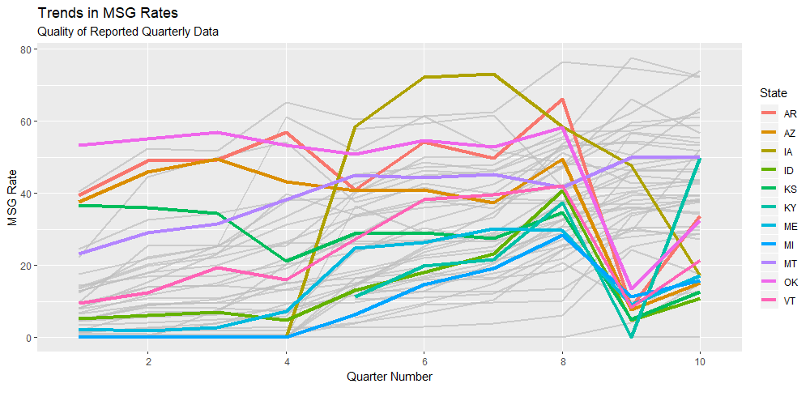
MSG Model Data Challenges - An Example (3)
Source: PY 2016 Q4, PY 2017 Q4, and PY 2018 Q2 WIOA Performance Individual Record Data

Slide 11
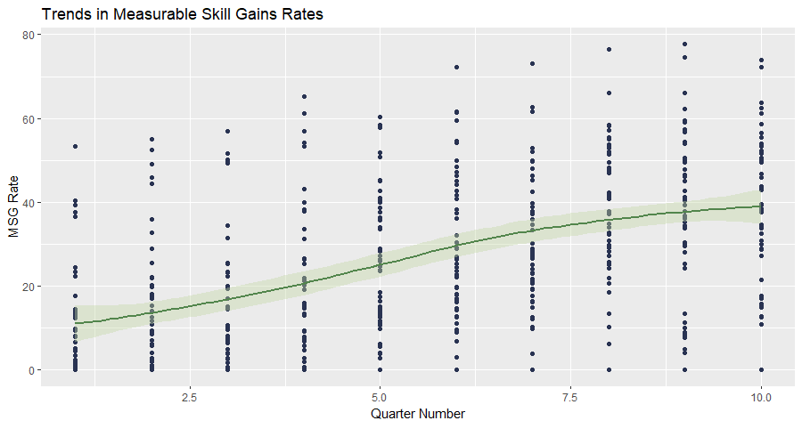
MSG Model Data Challenges - An Example (4)
Source: PY 2016 Q4, PY 2017 Q4, and PY 2018 Q2 WIOA Performance Individual Record Data

Slide 12
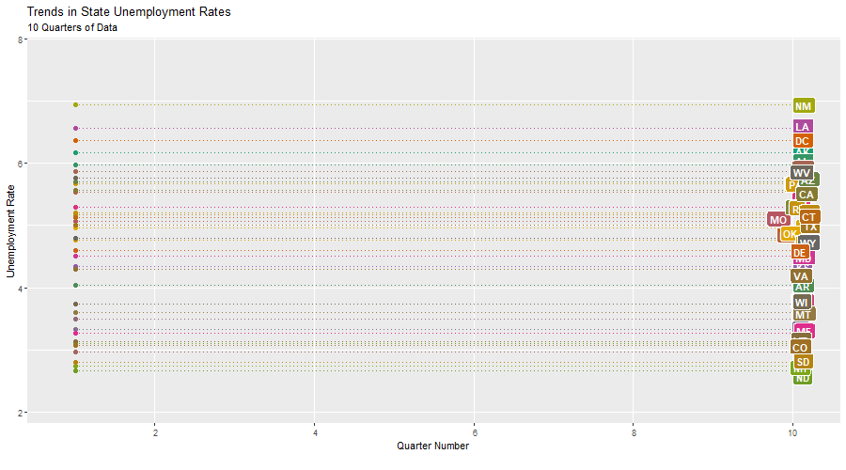
MSG Model Data Challenges - An Example (5)
Source: PY 2016 Q4, PY 2017 Q4, and PY 2018 Q2 WIOA Performance Individual Record Data

Slide 13
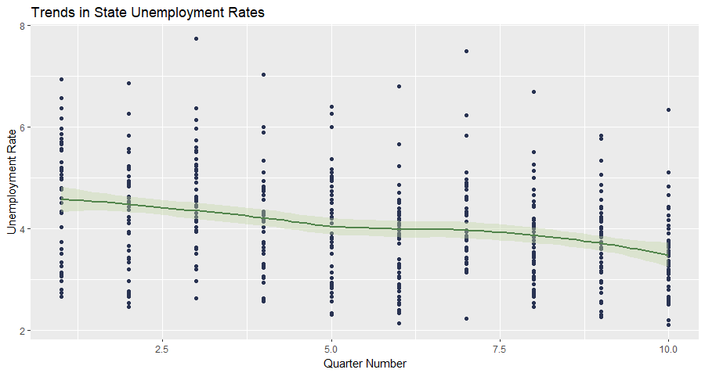
MSG Model Data Challenges - An Example (6)
Source: PY2016 Q4, PY2017 Q4, and PY 2018 Q2 WIOA Performance Individual Record Data
Source: PY 2016 Q4, PY 2017 Q4, and PY 2018 Q2 WIOA Performance Individual Record Data

Slide 14
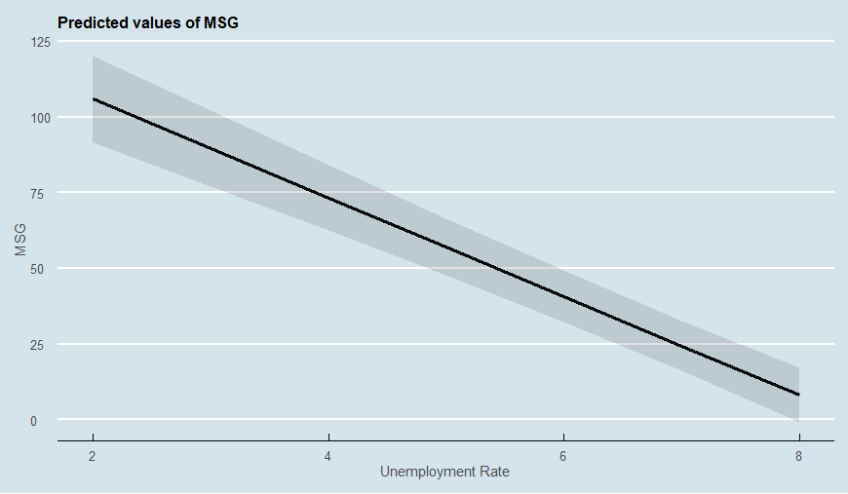
MSG Model Data Challenges - An Example (7)
Resulting UR Coefficient for Fixed Effects Model
-16.28

Slide 15
MSG Model Data Challenges - An Example (8)
This example shows how both the data quantity and quality challenges affect the development of the model
  Quantity challenge – the short timeframe doesn’t allow for much variation in the unemployment rate variable
  Quality challenge – consistent upward trend as reported data on MSG indicator improve
What other variables might be a problem?
  With the unemployment rate data we at least have reliability in the quality of the data

Slide 16
Future Steps
Test on PY 2018
Q2 & Q3
Data
Finalize MSG Statistical Model’s Specifications
Planned TA in late 2019

Slide 17
Any Questions?

Slide 18
Contact
Kevin Reuss
  Economist
    Employment and Training Administration
    U.S. Department of Labor
      Reuss.kevin.l@dol.gov

Slide 19
Please complete your evaluations.

