Slide 1
PIRL Data Elements:
Data Collection and Submission
Module 14
2019 WIOA National Performance Training
U.S. Department of Labor
Employment and Training Administration

Slide 2
Topics for this Session
Exit date data element analysis
Common Exit
Measurable Skill Gains and Credential Attainment denominator data element analysis
Common questions regarding determining the correct date to enter

Slide 3
Exit Date Data Element Analysis – Part 1
Exit Date Patterns
Link to additional visualizations:
https://public.tableau.com/profile/scott8222#!/vizhome/PY16_PY17_Exitsv_PY18Q2/ExitDateData

Slide 4
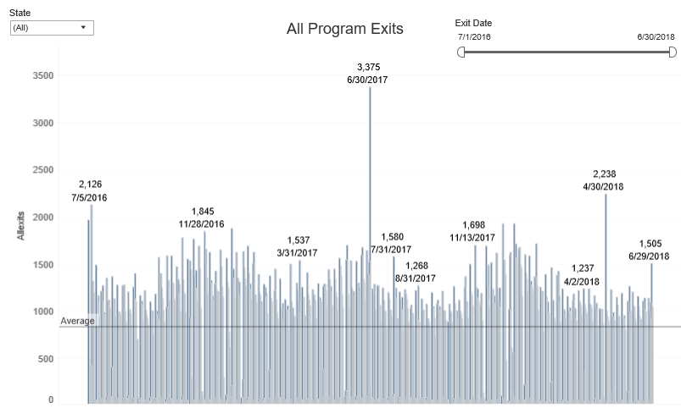
Exit Date Data Analysis – All Program Exits
*Source: PY 2018 Q2 WIOA Performance Individual Record Data

Slide 5
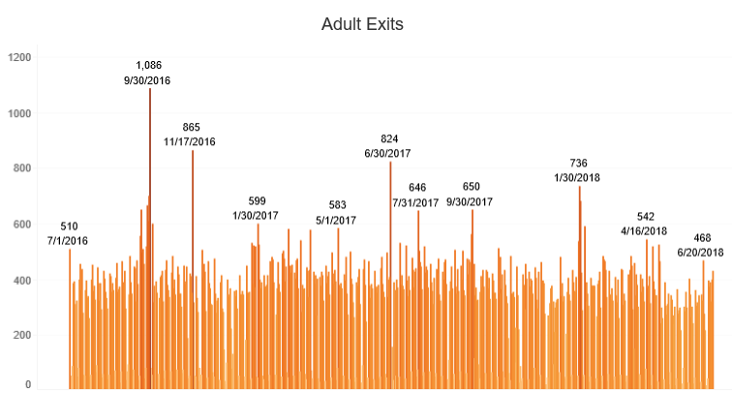
Exit Date Data Analysis – Adult Exits
*Source: PY 2018 Q2 WIOA Performance Individual Record Data

Slide 6
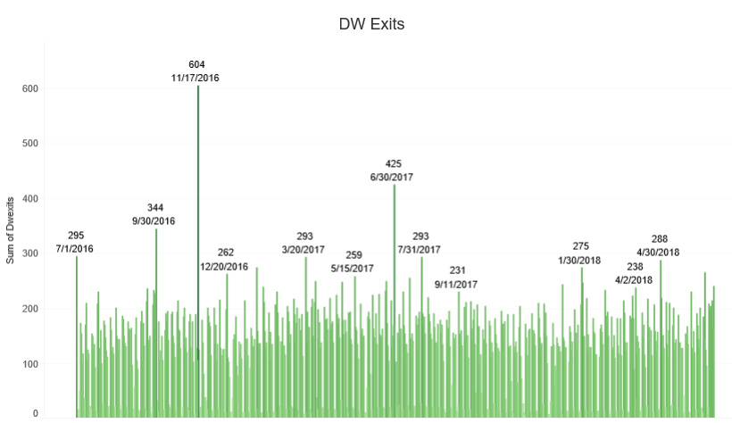
Exit Date Data Analysis – DW Exits
*Source: PY 2018 Q2 WIOA Performance Individual Record Data

Slide 7
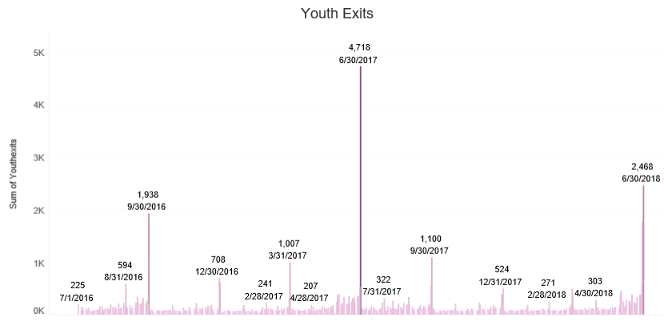
Exit Date Data Analysis – Youth Exits
*Source: PY 2018 Q2 WIOA Performance Individual Record Data

Slide 8
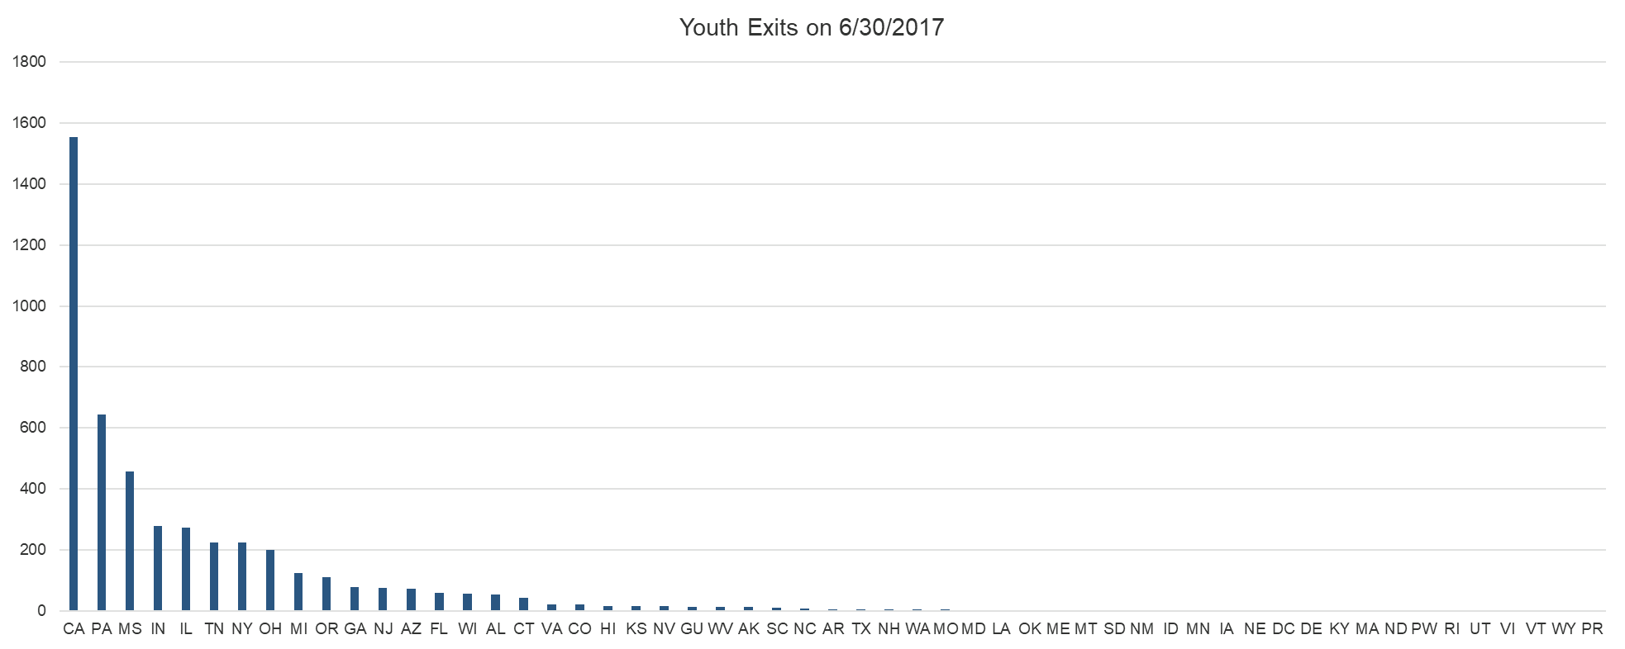
What happened in the Youth Program on 6/30/17 (Number Exits)?
*Source: PY 2018 Q2 WIOA Performance Individual Record Data

Slide 9
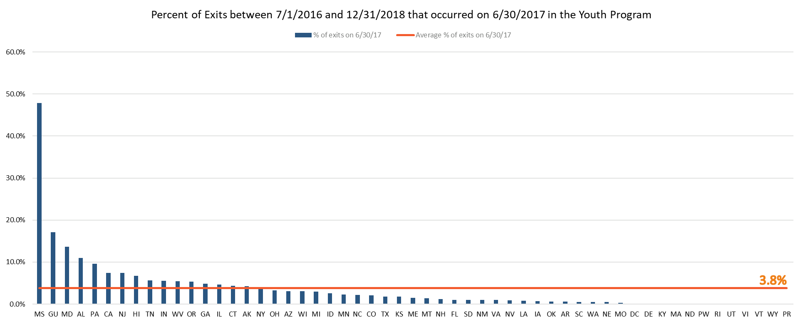
What happened in the Youth Program on 6/30/17 (Percent Exits)?
*Source: PY 2018 Q2 WIOA Performance Individual Record Data

Slide 10
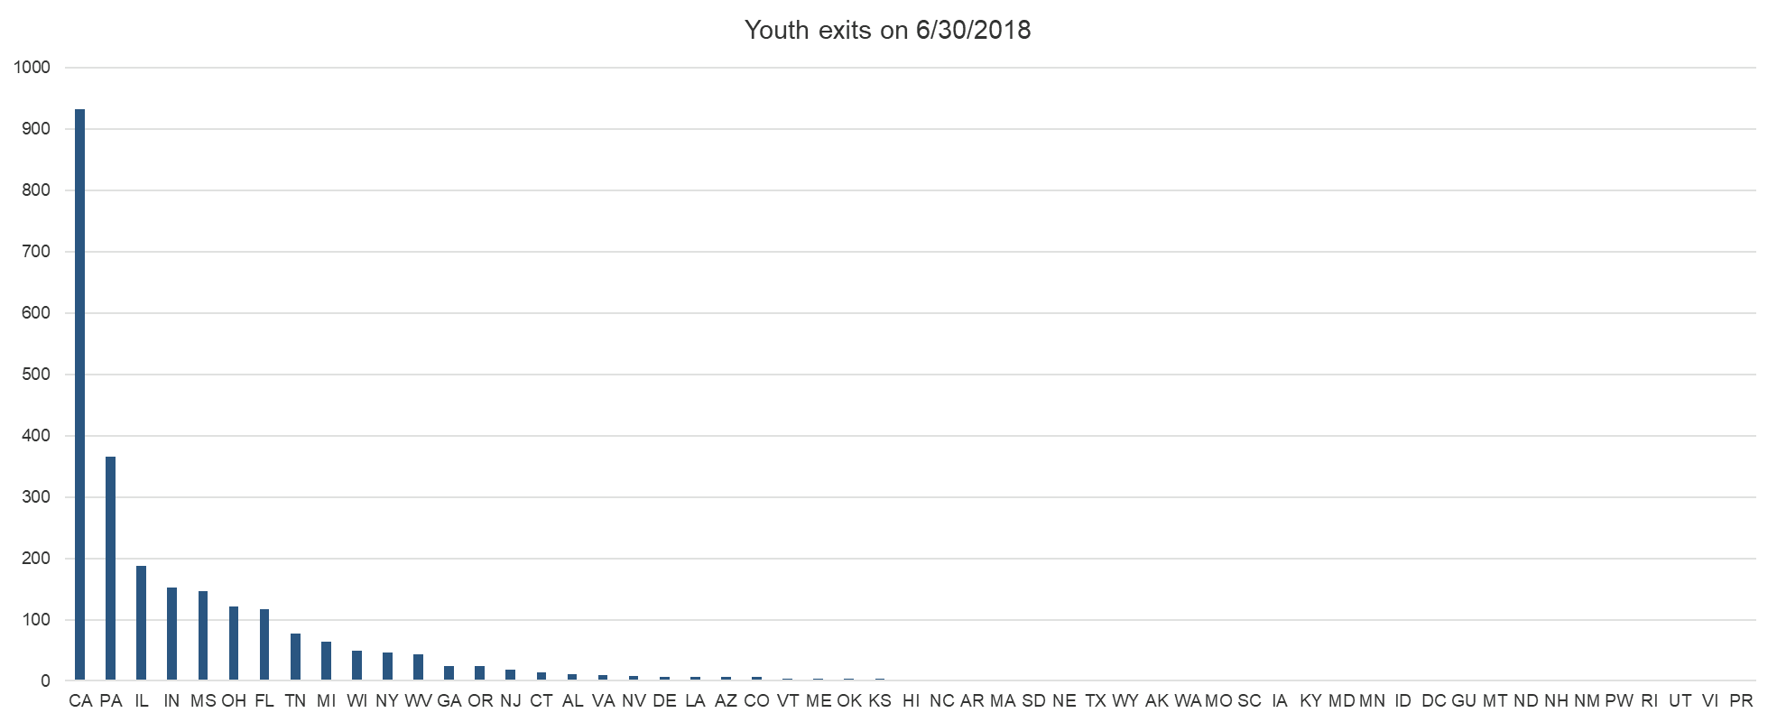
What happened in the Youth Program on 6/30/18 (Number Exits)?
*Source: PY 2018 Q2 WIOA Performance Individual Record Data

Slide 11
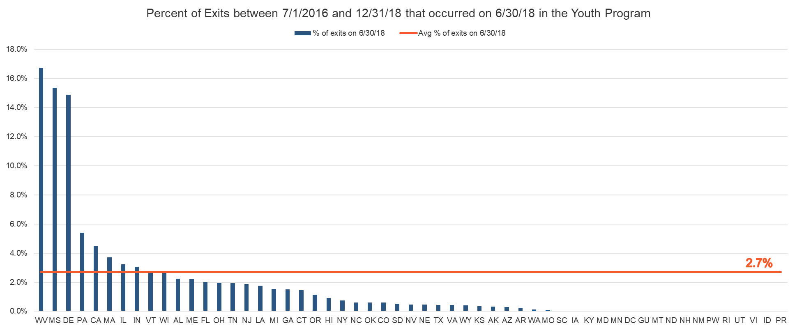
What happened in the Youth Program on 6/30/18 (Percent Exit)?
*Source: PY 2018 Q2 WIOA Performance Individual Record Data

Slide 12
Exit Date Data Element Analysis – Part 2
“Unsubstantiated” Exit Percentage (percent of exit dates without a corresponding service date)

Slide 13
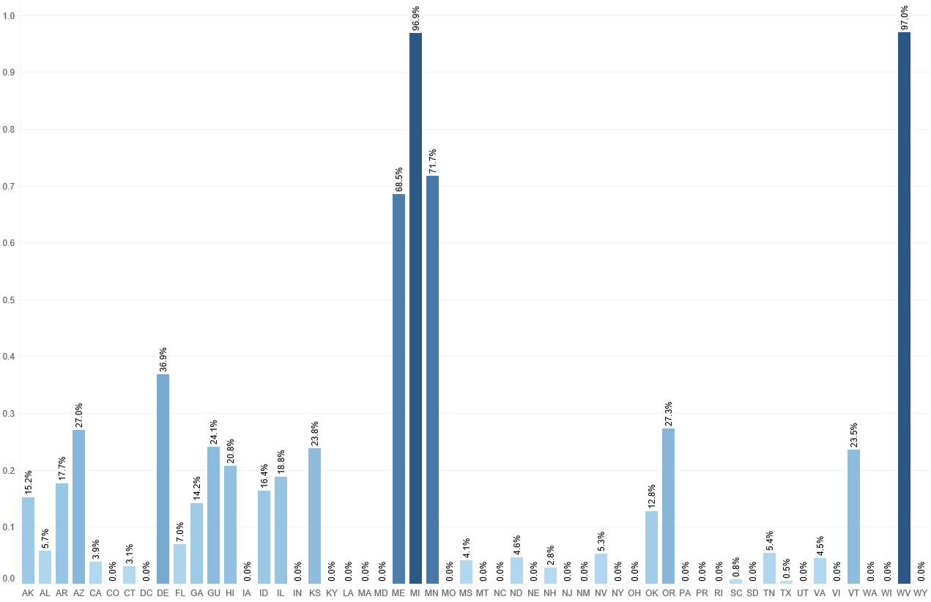
Unsubstantiated Exit Dates (Title I) (Rolling 4 quarters)
*Source: PY 2018 Q2 WIOA Performance Individual Record Data

Slide 14
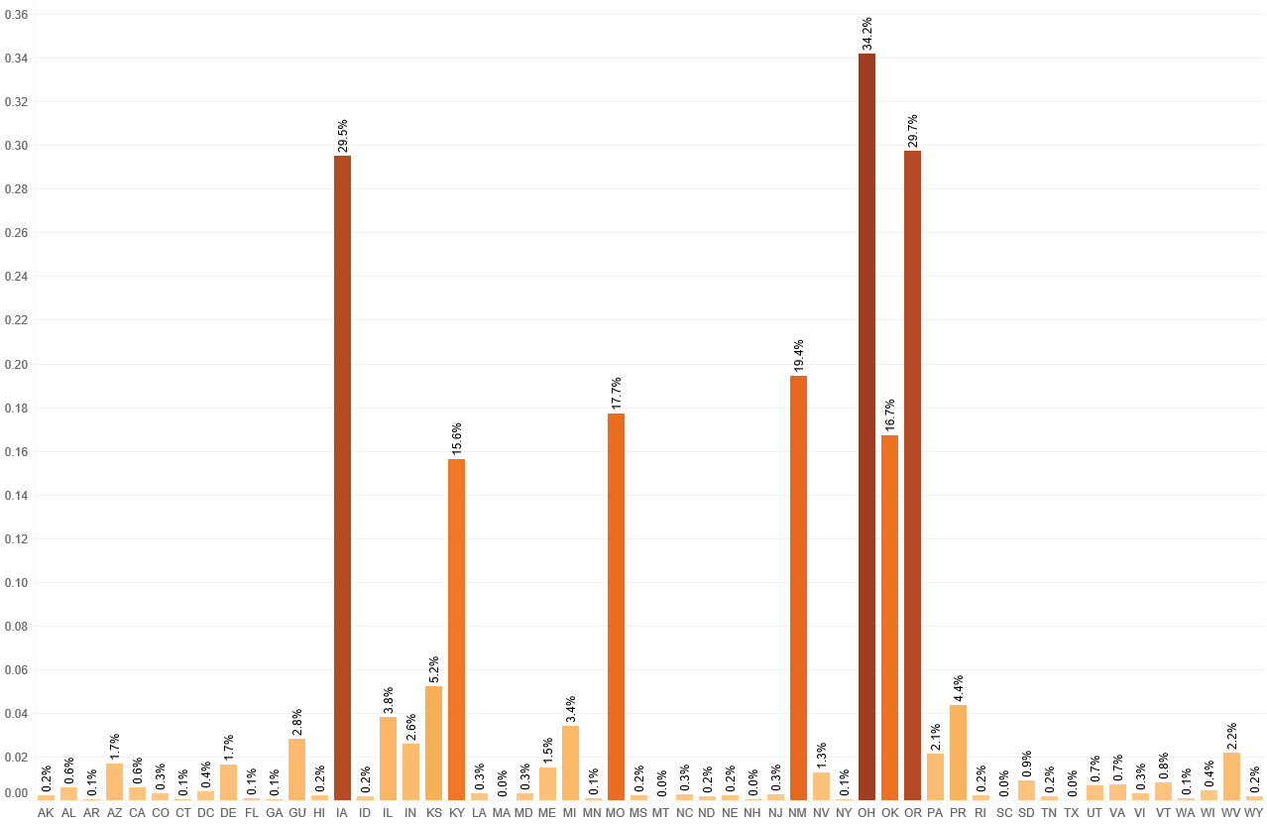
Unsubstantiated Exit Dates (Adult) (Rolling 4 quarters)
*Source: PY 2018 Q2 WIOA Performance Individual Record Data

Slide 15
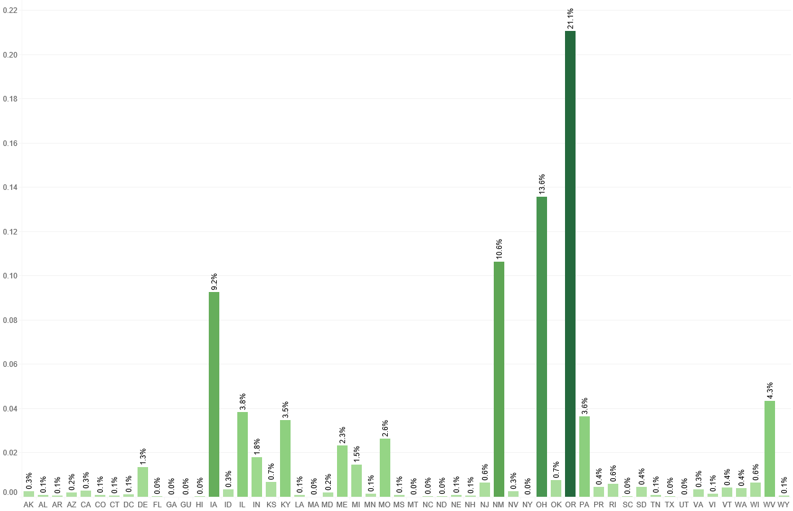
Unsubstantiated Exit Dates (DW) (Rolling 4 quarters)
*Source: PY 2018 Q2 WIOA Performance Individual Record Data

Slide 16
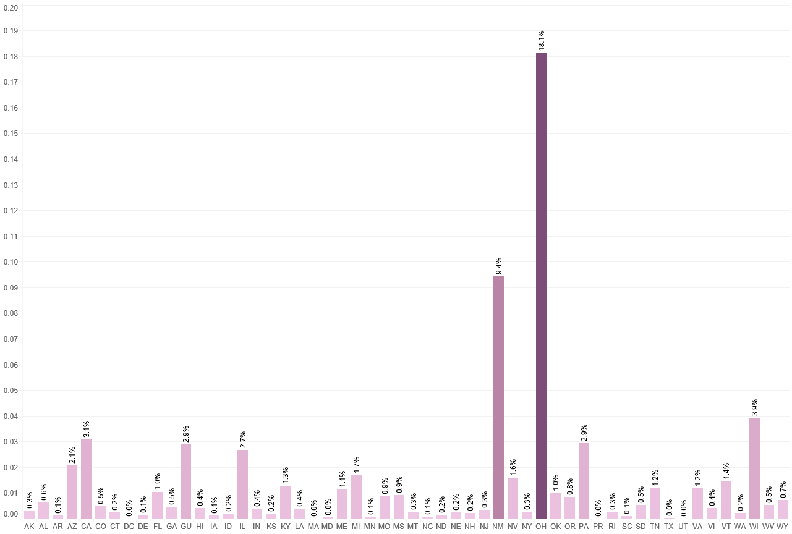
Unsubstantiated Exit Dates (Youth) (Rolling 4 quarters)
*Source: PY 2018 Q2 WIOA Performance Individual Record Data

Slide 17

Discussion of Exit Date Data
Since this is an update of data from a previous discussion on PY17 Q4 data, do you see any improvement from your state?
  If yes, what changes/actions do you think account for these improvements?
  If no, what challenges is your state still working to resolve?
Are there any surprises about this data?

Slide 18
Common Exit Data Analysis

Slide 19
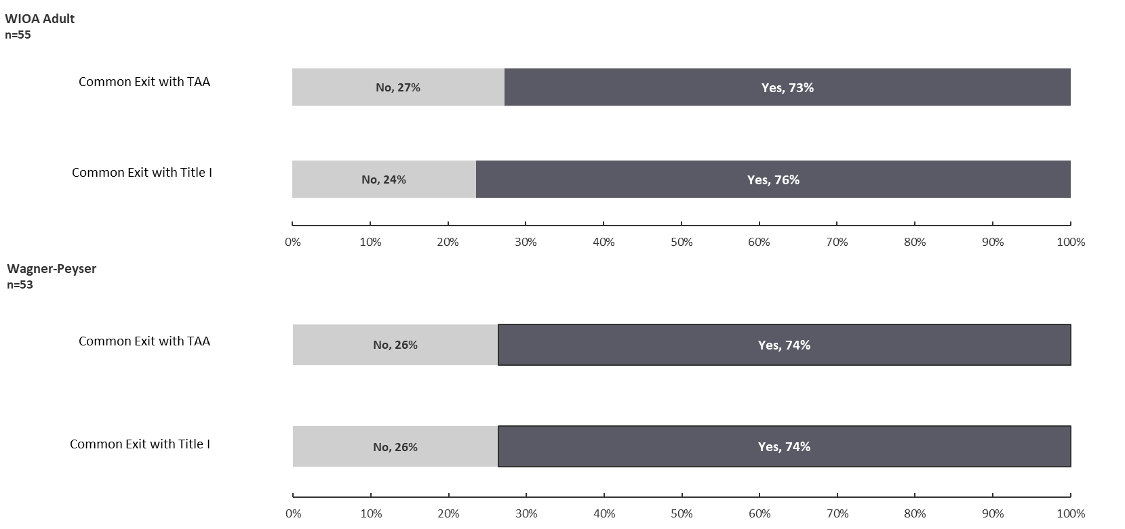
Common Exit Data Analysis (WIOA Adult and Wagner-Peyser)
*Source: PY 2018 Q2 State Quarterly Performance Reports. See handout for full State-by-State list

Slide 20

Discussion of Common Exit Data
Does the data in the handout accurately reflect your state’s policies on common exit?
Are there any challenges to accurately reporting common exit policies in your state?
What are the challenges/opportunities of common exit policies?

Slide 21
Credential Attainment and Measurable Skill Gains Denominator Data Analysis
Visuals link:
https://public.tableau.com/profile/scott8222#!/vizhome/MeasurableSkillGainsCY18Outcomes_PY18Q2PIRL/CY18_MSG

Slide 22
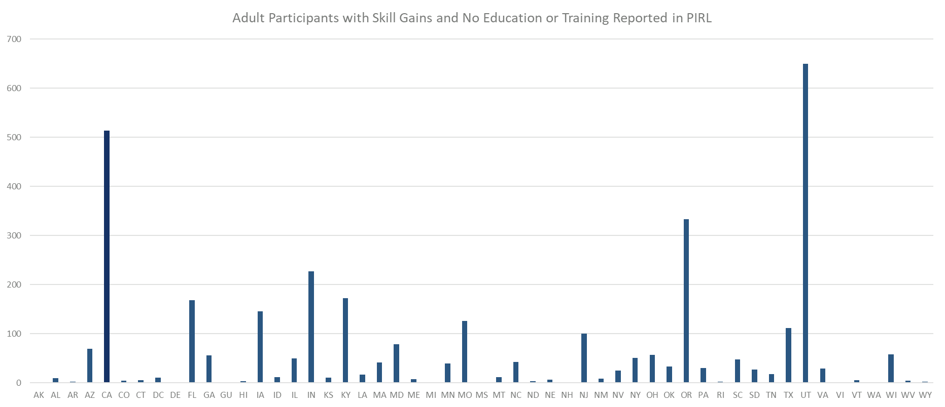
Measurable Skill Gains Reported without Education or Training Adult (Rolling 4 quarters)
*Source: PY 2018 Q2 WIOA Performance Individual Record Data

Slide 23
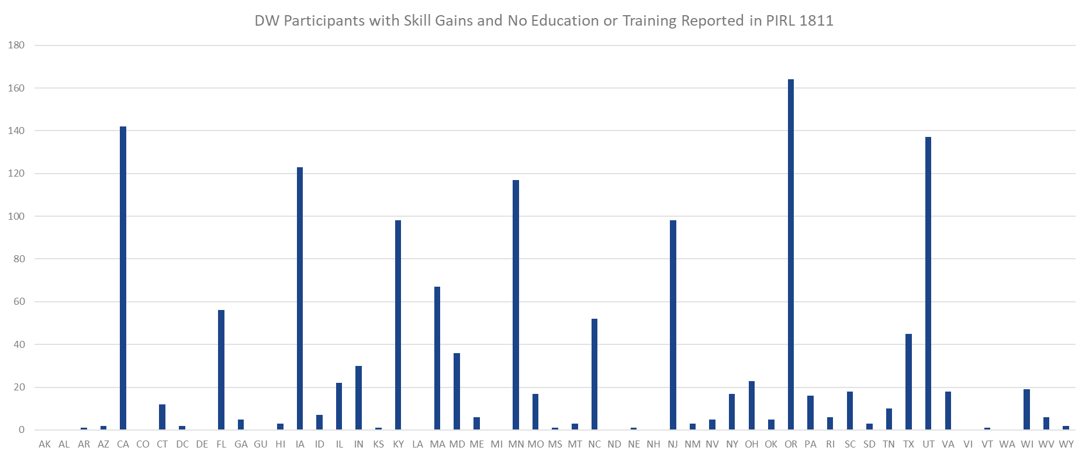
Measurable Skill Gains Reported without Education or Training
Dislocated Workers (Rolling 4 quarters)
*Source: PY 2018 Q2 WIOA Performance Individual Record Data

Slide 24
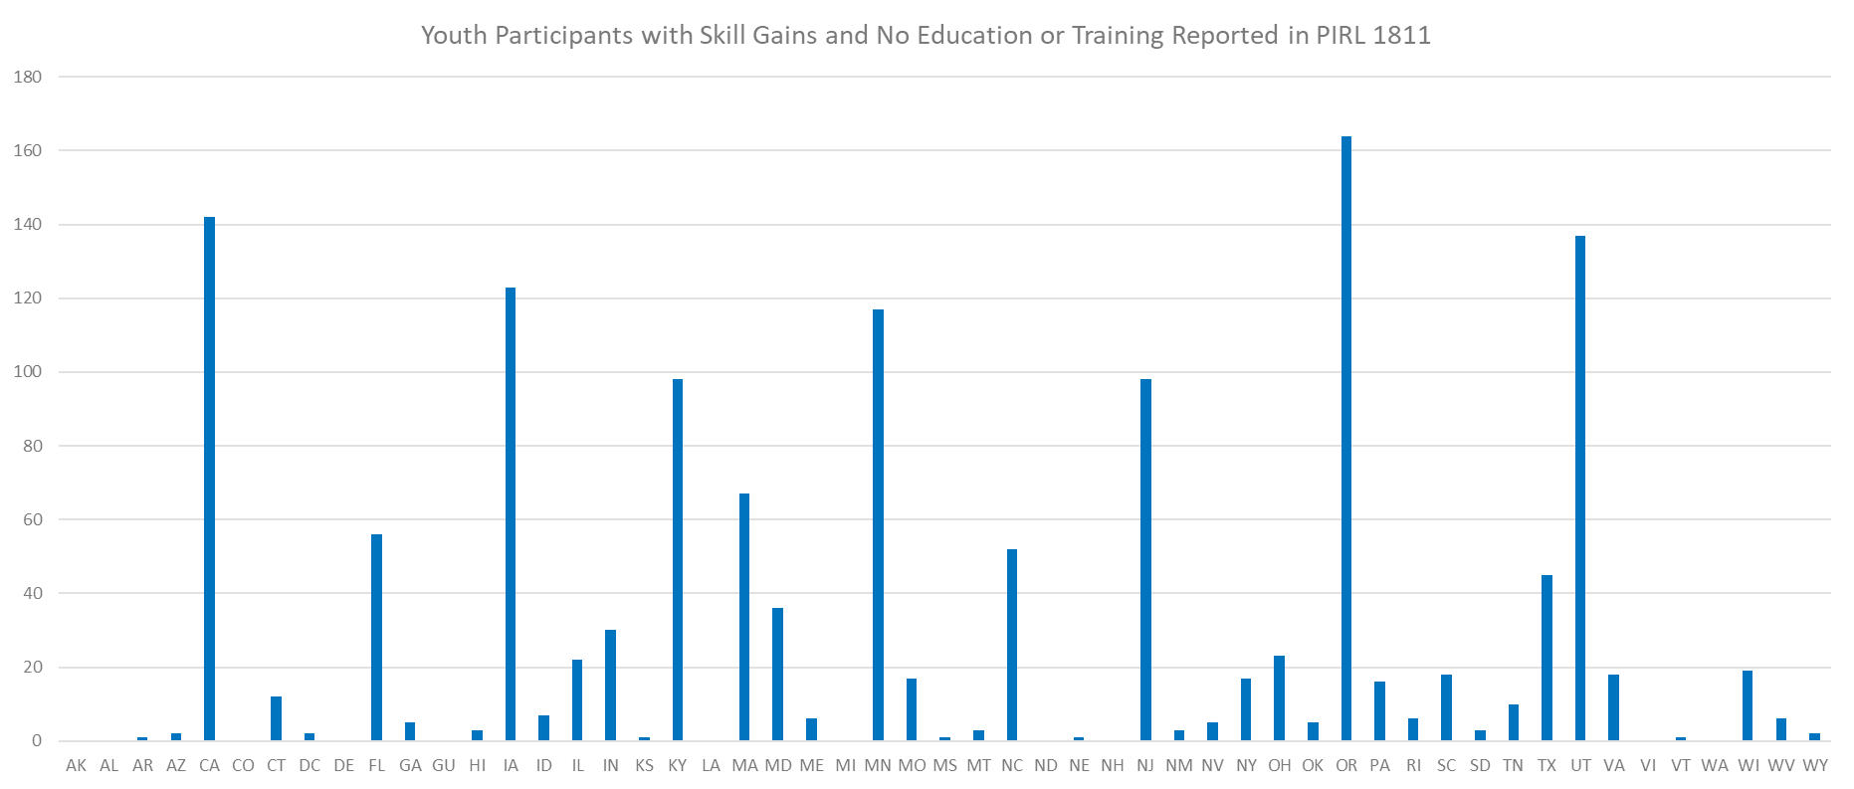
Measurable Skill Gains Reported without Education or Training Youth (Rolling 4 quarters)
*Source: PY 2018 Q2 WIOA Performance Individual Record Data

Slide 25
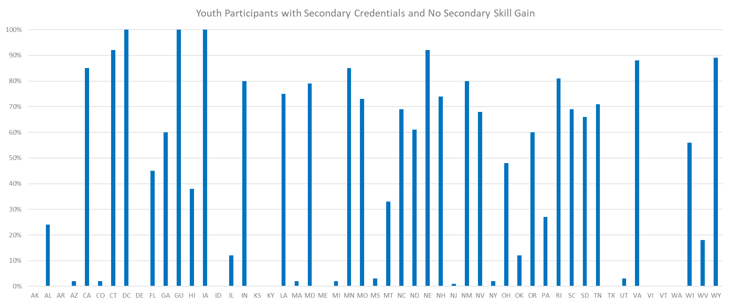
Credentials without Corresponding Skill Gain
Youth (Rolling 4 quarters)
*Source: PY 2018 Q2 WIOA Performance Individual Record Data

Slide 26
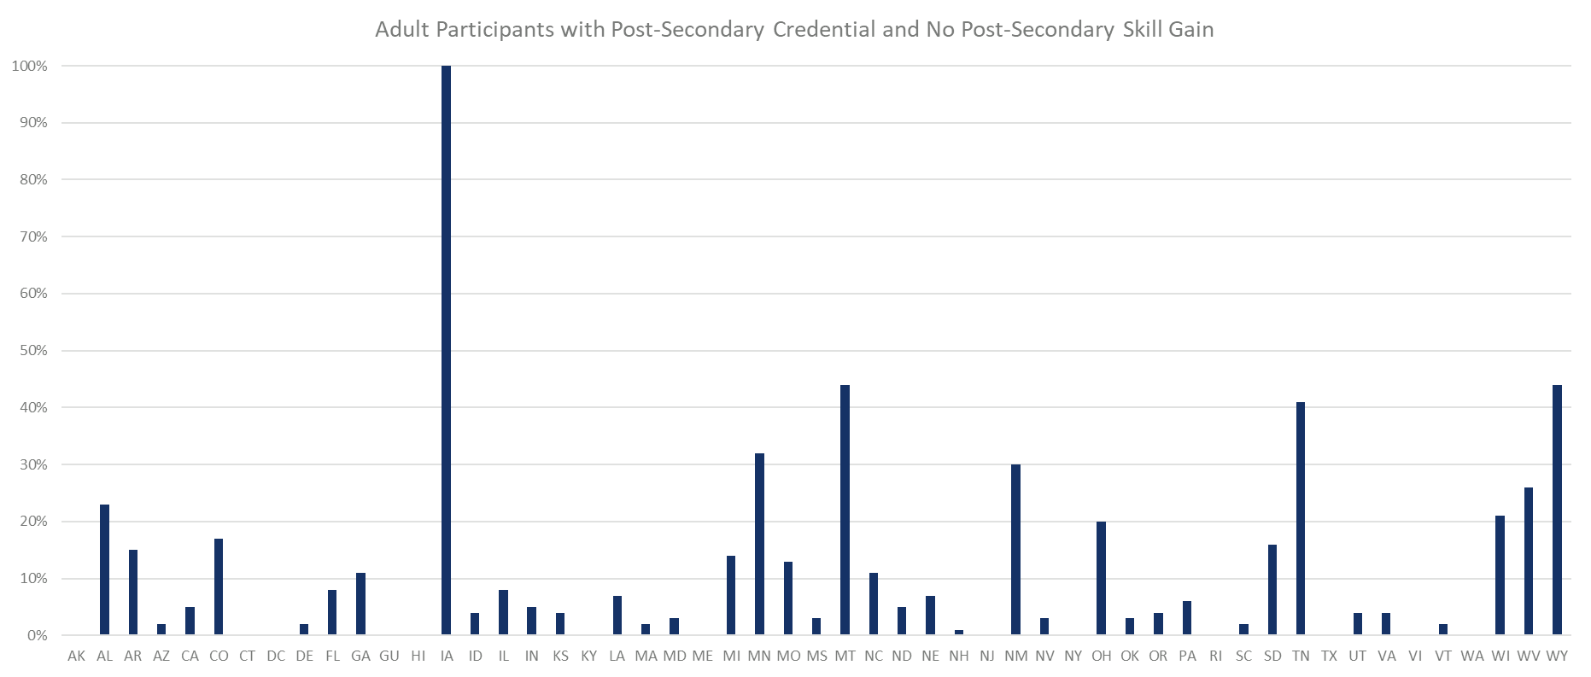
Credentials without Corresponding Skill Gain
Adult (Rolling 4 quarters)
*Source: PY 2018 Q2 WIOA Performance Individual Record Data

Slide 27
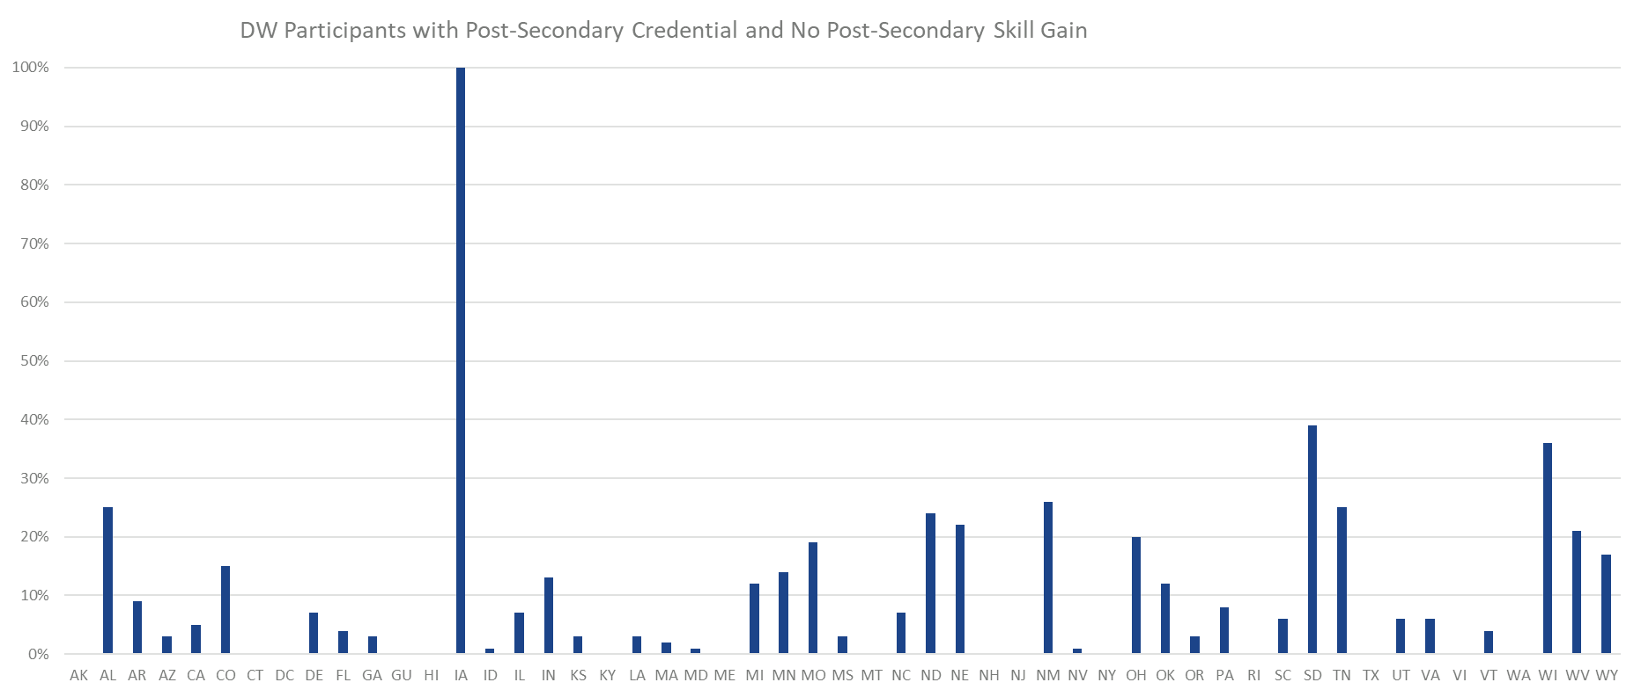
Credentials without Corresponding Skill Gain
DW (Rolling 4 quarters)
*Source: PY 2018 Q2 WIOA Performance Individual Record Data

Slide 28

Discussion of CA and MSG PIRL Elements
Since this is an update of data from a previous discussion on PY17 Q4 data, do you see any improvement from your state?
  If yes, what changes/actions do you think account for these improvements?
  If no, what challenges is your state still working to resolve?
Are there any surprises about this data?

Slide 29
Common Questions:
Regarding Determining the Correct Date to Enter

Slide 30
Common Questions:
Determining the Correct Date to Enter (1)
PIRL 1332 and 1406: If a participant begins training/education during participation and continues after exit, what dates should be reported in each?
  PIRL 1332 – Should be reported as a “1” if the participant was in the training or education at any time during participation, regardless of when the program started or ended.
  PIRL 1406 – In this scenario, enter the first day after the date of exit into PIRL 1406 in order to demonstrate the post-exit continuation of education/training.

Slide 31
Common Questions:
Determining the Correct Date to Enter (2)
PIRL 1308, 1313, 1318: If a test takes place on a date after the classroom training is done, which date should be reported?
  If the test is paid for as a part of the training program, the test date should be the date reported. Otherwise, the last date of the actual training should be reported.
PIRL 1811: What date is someone considered “enrolled” in training or education?
  Once the registration for the training or education program has occurred, a participant is considered enrolled. Simply putting the training or education program on a participant’s IEP is not sufficient to be considered enrolled.

Slide 32
Common Questions:
Determining the Correct Date to Enter (3)
PIRL 1801, 1803, 1805-1810: If a participant completed high school in June, but the ceremony or certificate was not issued until July, which date should be entered?
  Provided there is data validation documentation to support it: Enter the date(s) that the credential attainment or skill gain occurred, not the date that documentation was distributed or collected.

Slide 33
Any Questions?

Slide 34
Contact
 ETAPerforms@dol.gov

Slide 35
Please complete your evaluations.

