Slide 1
Data on Participants with Barriers to Employment
Module 5
2019 WIOA National Performance Training
U.S. Department of Labor
Employment and Training Administration

Slide 2
Session Highlights
Barriers to Employment
Youth Barriers to Employment
WIOA Adult Priority Populations
Veteran’s Priority

Slide 3
WIOA Participants with Barriers to Employment

Slide 4
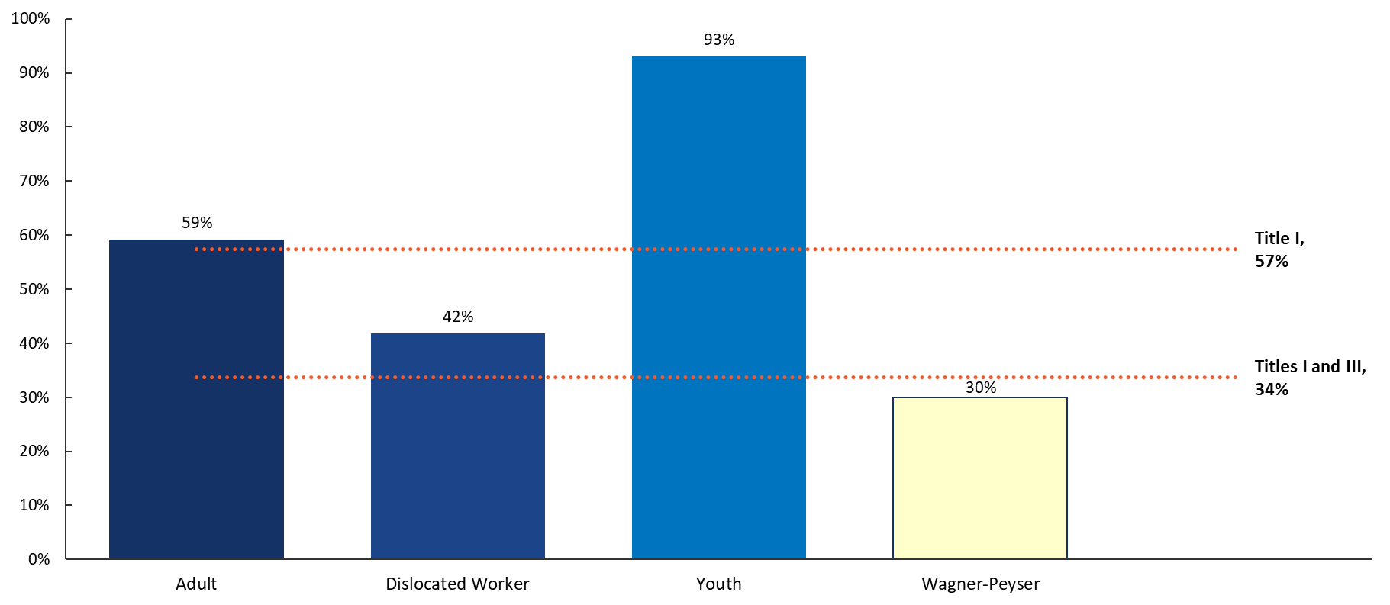
WIOA Participants with Barriers to Employment:
Percent of Participants
Source: PY 2017 Q4 WIOA Performance Individual Record Data (Note: this is a different source than is used on slide 9)

Slide 5
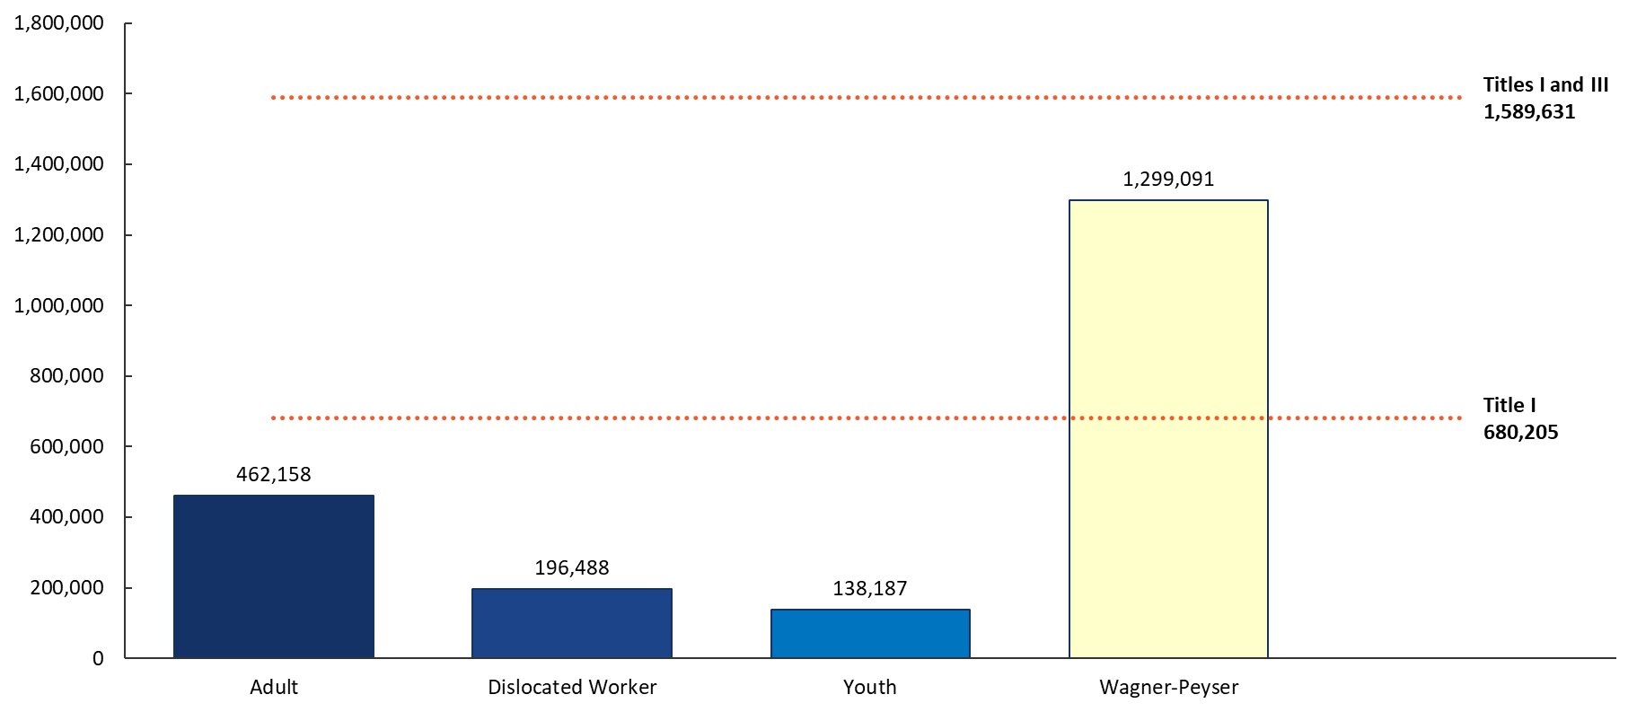
WIOA Participants with Barriers to Employment:
Number of Participants
Source: PY 2017 Q4 WIOA Performance Individual Record Data (Note: this is a different source than is used on slide 9)

Slide 6

Discussion on Barriers to Employment Data
Are any of these numbers surprising and if so, why?
What barriers are the biggest challenge to collect?
What steps is your state taking to improve the collection of data on barriers to employment?

Slide 7
WIOA Youth Barriers to Employment

Slide 8
WIOA Youth Barriers to Employment (Percent of All Youth)
Source: PY 2018 Q1 WIOA Performance Individual Records (results for PY 2017 reporting period) (Note: this is a different source than slides 5 and 6)

Slide 9

Discussion on Youth Barriers to Employment Data
Are any of these numbers surprising and if so, why?
What barriers are the biggest challenge to collect?
What steps is your state taking to improve the collection of data on barriers to employment?

Slide 10
WIOA Adult Priority Populations
Including Veteran’s Priority of Service

Slide 11
Providing Priority of Service
Priority of Service in the Adult program is provided in the following order:
  Veterans and eligible spouses who also are included in WIOA Adult Priority groups.
    This means that veterans and eligible spouses who also are recipients of public assistance, low-income individuals, or individuals who are basic skills deficient would receive first priority for services provided with WIOA adult formula funds.
  Individuals who are not veterans or eligible spouses but who are included in the groups given priority for the WIOA Adult program.
  Veterans and eligible spouses who are not included in WIOA’s priority groups.

Slide 12
Providing Priority of Service (cont.)
Priority of Service in the Adult program is provided in the following order:
  Any other populations identified by the Governor or Local Workforce Development Board for priority.
  Individuals who are not veterans or eligible spouses and who are not included in the groups given priority for the WIOA Adult program.
WIOA Priority Populations Desk Reference
  https://ion.workforcegps.org/resources/2017/10/05/14/01/WIOA-Desk-Reference

Slide 13
WIOA Adult Priority Populations: Adults Receiving Individual Career Services or Training
*Source: PY 2018 Q1 WIOA Performance Individual Records (results for PY 2017 reporting period)

Slide 14

Discussion on Adult Priority Data
Does the data align to your expectations?
For states that have higher than average percentages in priority groups, what is your state doing to implement priority/ensure that locals implement?

Slide 15
Any Questions?

Slide 16
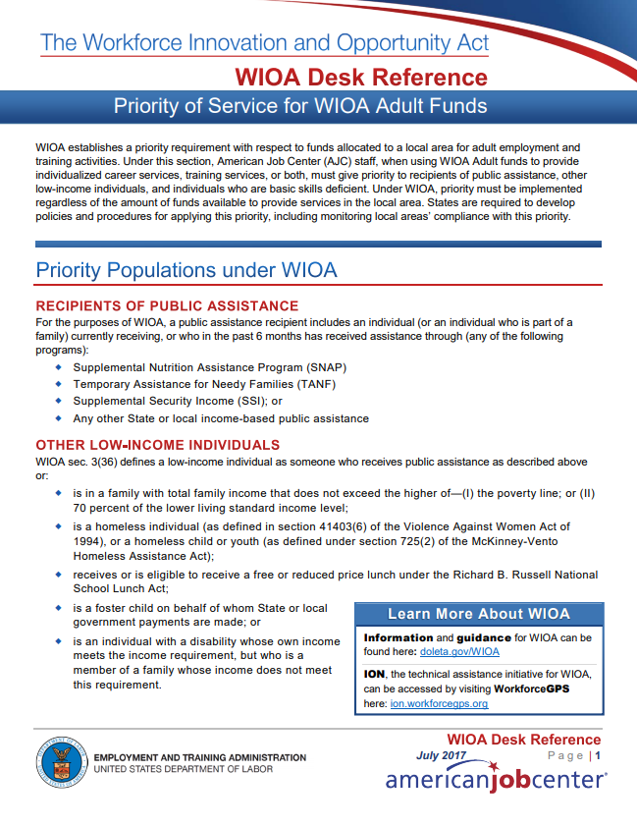
Resources
WIOA Priority Populations Desk Reference
  Resource Info
    https://ion.workforcegps.org/resources/2017/10/05/14/01/WIOA-Desk-Reference

Slide 17
Contact
 ETAPerforms@dol.gov

Slide 18
Please complete your evaluations.

