Slide 1
Sustainability: Planning for the future of your grant
Day 2, Session 7 Nursing Expansion Institute

Slide 2

Moderator/Presenter
Dallas Oberlee
  Senior Associate
    Social Policy Research Associates
      Dallas_Oberlee@spra.com
        510-988-0190

Slide 3
Agenda
Session Objectives & Guiding Questions
Poll: Stages of Planning for Sustainability
Planning for Sustainability
  Key Strategies
Promising Practice: Peer Sharing
Grantee Sustainability Plans
Wrap up and Close

Slide 4
Session Objectives
Session Objectives
  Define sustainability and examine key areas of sustainability planning, including evaluating program effectiveness and developing continuity plans for staff, customers, and partnerships.

Slide 5
Guiding Questions
Guiding Questions
  What actions can we take now to plan for sustainability?
  How do we keep sustainability in mind throughout the project?
  What are some successful sustainability strategies?

Slide 6
Sustainability

Slide 7
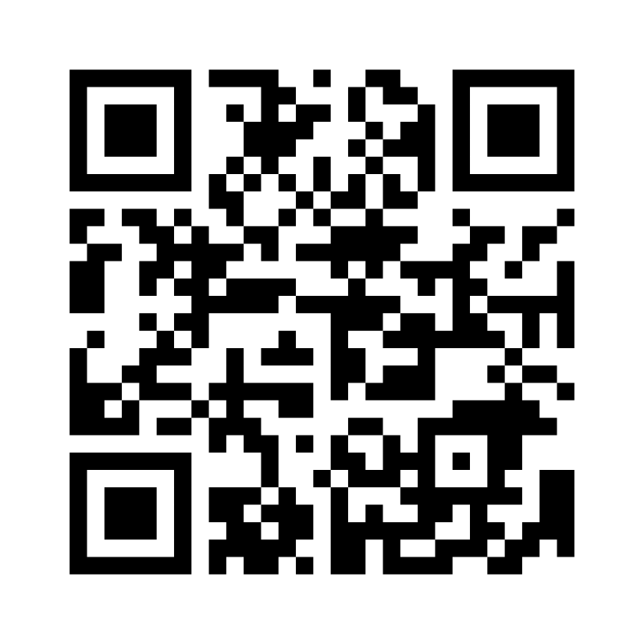
Poll question!
Go to www.menti.com and enter code 8510 3391
Or scan the QR code
You may utilize your phone or laptop

Slide 8
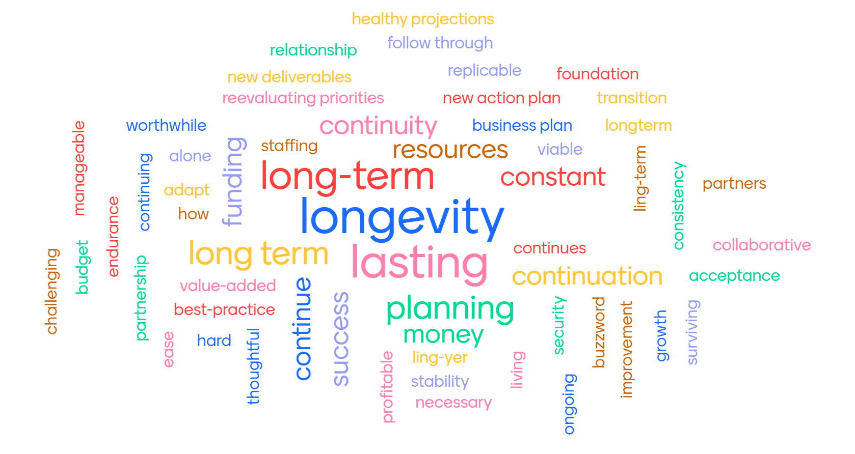
Poll Question 1: What is one word that comes to mind when you hear “sustainability”?

Slide 9
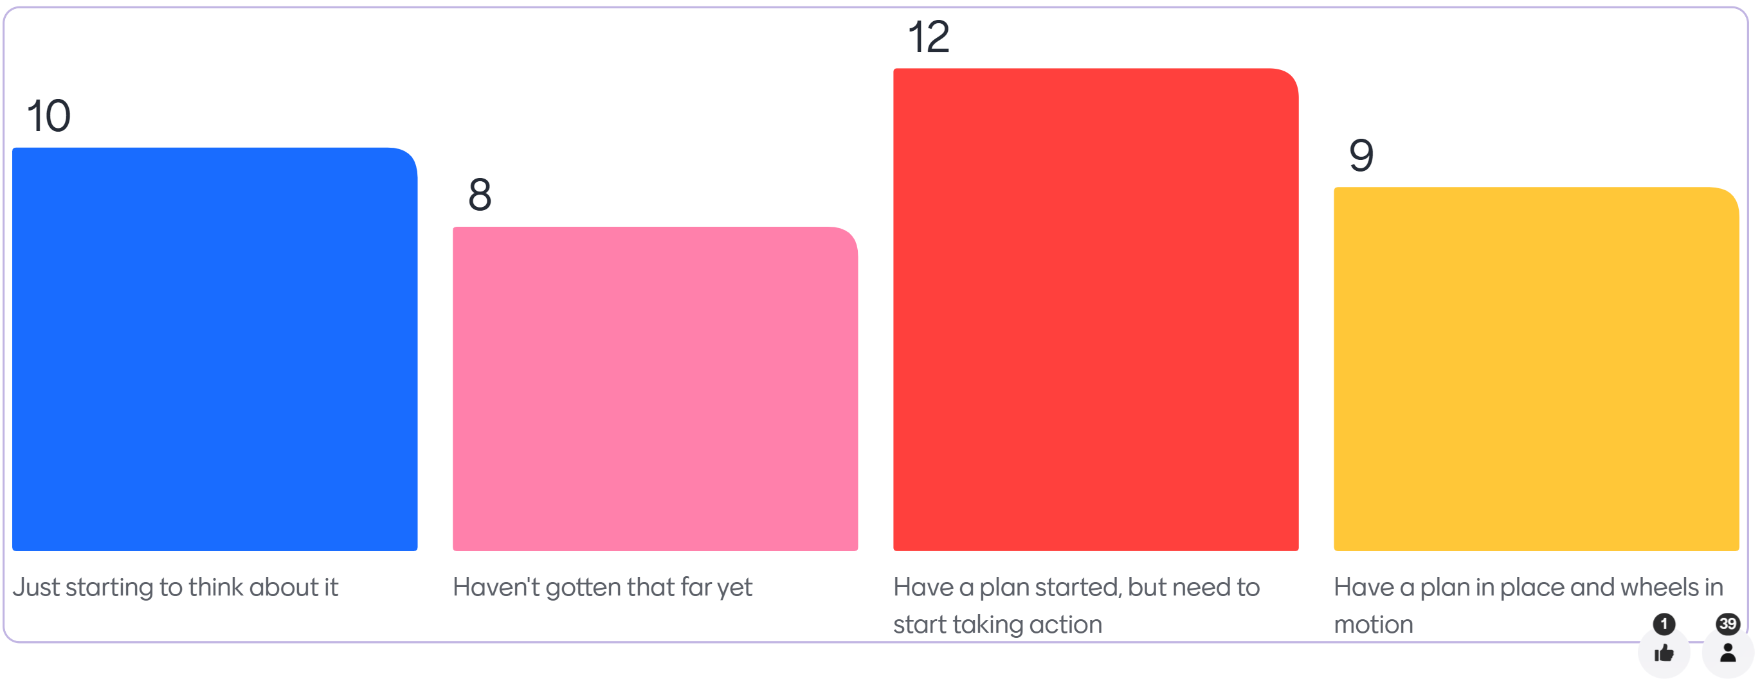
Poll question 2: Where are you at in planning for sustainability?
Choices | Votes
Just starting to think about it | 10
Haven't gotten that far yet | 8
Have a plan started, but need to start taking action | 12
Have a plan in place and wheels in motion | 9

Slide 10
Planning for sustainability
Key strategies

Slide 11
WHAT IS SUSTAINABILITY AND WHY DOES IT MATTER?
Sustainability refers to the continuation of a project’s goals, principles, and efforts to achieve desired outcomes.
  Planning for sustainability requires appropriate decisions be made at each stage of program development.
  It ensures your program’s longevity and its ability to adapt to changing circumstances while maintaining the program’s impact and services beyond the initial grant funding period.

Slide 12
KEY AREAS OF SUSTAINABILITY
Program Assessment and Evaluation
Leadership and Staffing Succession
Building and Maintaining Partnerships
Continued Participant Engagement
Financial and Resource Stability

Slide 13

PROGRAM ASSESSMENT AND EVALUATION
Identify and assess activities undertaken through the grant and determine which ones have yielded or are yielding your successful outcomes.
Identify ways to document your success.

Slide 14

LEADERSHIP AND STAFFING Succession
Develop a plan for leadership and staffing succession to ensure the effective transfer of knowledge and expertise, preventing disruptions due to staff turnover.

Slide 15

BUILDING AND MAINTAINING PARTNERSHIPS
Partners can play an important role in sustainability by connecting you to greater resources or expertise, providing services if your program no longer has funds available, and advocating on your behalf.

Slide 16

CONTINUED PARTICIPANT ENGAGEMENT
As you consider program initiatives and services beyond the grant period, evaluate the strategies and activities that you plan to continue and how your participants will transition into them.

Slide 17

FINANCIAL AND RESOURCE STABILITY
Seek additional funding sources to replace or complement grant funding.
Develop a funding plan to provide safeguards and ensure that key infrastructures are maintained (including an adequate number of qualified staff).

Slide 18
Promising Practice
Elliot health system

Slide 19

Presenter
Sarah Vlasich BSN, RN, CMSRN
  Workforce Development Specialist & Granite State PARTNERS Project Manager
    Elliot Health System
      sarah.vlasich@elliot-hs.org

Slide 20

Sustainability in practice
Our Vision
2036 Projection
Endowment for Health
Evaluating and Assessing Barriers
Innovation in Partnership
More Nurses – Stronger Communities

Slide 21

Elliot Hospital: Sustainability Planning
What has been going well?
Where have the roadblocks (if any) been?

Slide 22
Preparing a plan for sustainability
Essential program components

Slide 23

Core program components
When developing your sustainability plan, first evaluate which program components are essential for long-term success. This may help to:
  Clarify sustainability goals and objectives.
  Align stakeholders to the program’s purpose,
  goals, and expectations.
  Guide the planning and implementation of
  sustainability efforts.
  Guide the monitoring and evaluation of
  sustainability efforts.

Slide 24
Sustainability reflection questions
What core program components and services are integral to the program?
What is the capacity of the program to maintain its operations and services?
What is the program’s capacity to adapt to changing circumstances (e.g., changes in funding, the labor market, or policy)?
Who are the external partners and collaborators that can enhance the impact of sustainability?

Slide 25

Share Insights

Slide 26
Wrap up and close out
Key takeaways

Slide 27
Resources
Sustainability Readiness Toolkit
Sustainability Planning Checklist
Setting the Stage for Sustainability through Data Storytelling
H-1B OW/RH Grantee Virtual Convening: Planning for Sustainability

Slide 28

Questions?

Slide 29

Thank you!
The American Institutes for Research® (AIR), completed this project with federal funds, under contract number 1605C2-23-Q-00074 Nursing Expansion Grant TA, from the U.S. Department of Labor, Employment and Training Administration. The contents of this publication do not necessarily reflect the views or policies of the Department of Labor, nor does mention of trade names, commercial products, or organizations imply endorsement by the U.S. Government. AIR is a nonpartisan, not-for-profit organization that conducts behavioral and social science research and delivers technical assistance to solve some of the most urgent challenges in the U.S. and around the world.

