Slide 1
Intro Slide
Short-Time Compensation (STC) Webinar Series
Maximizing Impact: Leveraging Rapid Response to Increase STC Outreach
June 24, 2025
2:00 PM ET

Slide 2
Where Are You Joining Us From?
Please enter your location in the chat window.

Slide 3
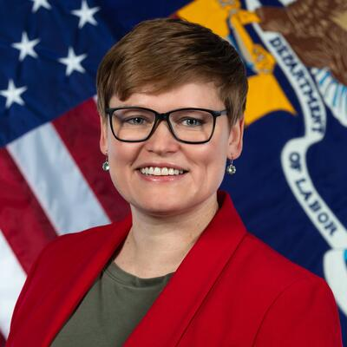
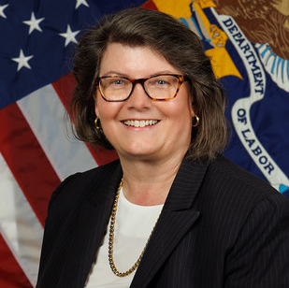
Introductory Remarks
Michelle Beebe
Robin Fernkas
Deputy Administrator (OUI)
Deputy Administrator (OWI)
U.S. DOL/ETA
U.S. DOL/ETA

Slide 4

Moderators
Amanda Poirier
Regional Director, Region 1 Boston
U.S. DOL/ETA

Slide 5
Poll Activity
Please let us know in what area do you work?
State Unemployment Insurance
State or Local Rapid Response
State or Local Business Services
ETA
Other, Please Let Us Know in the Chat

Slide 6
Agenda
Framing Today’s Conversation.
Leveraging Rapid Response for STC Outreach.
State Practices:
  Illinois
  Connecticut
Questions and Answers/Panel.
Resources and Contact Information.

Slide 7
Framing Today’s Conversation

Slide 8
Framing Today’s Conversation
Previous Session, “Building the case for why STC supports workers and employers” held on July 17, 2024. First STC webinar in the series.
Previous Session, “State Promising Practices,” focused on state promising practices held on November 6, 2024. Second STC webinar in the series. This session featured:
  Washington’s program outreach; Maine’s STC program outreach and administration, and Texas’ Administration of the STC program.
Quick Reminders!
  STC, also known as work sharing or shared-work, is an alternative to layoffs for employers experiencing a reduction in available work.
  STC preserves employees’ jobs and employers’ trained workforces during times of lowered economic activity.
  STC allows employers to reduce hours of work for employees rather than laying-off some employees while working full time.
  STC is a partnership between employers, workers, and state workforce agencies.

Slide 9
States with STC Programs (highlighted in yellow)
*available for states with conforming laws*
WA
MT
ND
ME
OR
MN
ID
SD
WI
NY
NH
WY
MI
VT
IA
PA
MA
NV
NE
OH
RI
UT
IL
IN
CA
CO
WV
CT
KS
MO
VA
KY
NJ
TN
NC
DE
AZ
NM
OK
AR
MD
SC
GA
DC
MS
AL
TX
LA
AK
FL
HI
PR
VI
GU

Slide 10
Framing Today’s Conversation
STC is a play in the Rapid Response Playbook.
It’s a business engagement strategy.
It supports business in times of contraction.
Businesses should have knowledge of the STC program at all points during the business cycle.

Slide 11
Leveraging Rapid Response for STC Outreach

Slide 12
Rapid Response’s Purpose
Provide solutions to businesses in need, across the business cycle.
Provide layoff aversion services to businesses to minimize periods of unemployment.
  Offer STC or other programs to prevent layoffs and/or to reemploy dislocated workers.
  Ongoing engagement with businesses in the community, across the business cycle, to support layoff aversion activities and reemployment of dislocated workers.
Assist employers in managing reductions in workforce:
  Assess needs and options for employers.
  Work in partnership and across the workforce system to deliver services.
  Deliver WIOA services as needed.

Slide 13
About Layoff Aversion and What’s Required
Goal of layoff aversion is to help companies make changes so that layoffs are reduced or avoided.
Focuses on prevention versus traditional layoff response.
Layoff aversion ranges from avoiding layoffs to minimizing the time a dislocated worker is out of work.
Saving jobs is the priority!
Notes:
Requires very strong partnerships and collaboration.
Relationships with employers.
Relationships within and outside the workforce system.
Requires early warning networks and data collection and analysis efforts.

Slide 14
Examples Of Layoff Aversion Globally
Ongoing Strategies of Administrative Activities
Developing a layoff aversion policy.
Gathering data and intelligence related to economic transitions trends.
Developing early warning networks using data.
Identifying sectors that need training and support.
Engaging in proactive measures like business visitation programs or layoff forecasting programs.
Connecting employers to short-term training, on-the-job training, apprenticeship, incumbent worker training.
Implementing and conducting outreach for STC programs.
Strategic Partnership.
Connecting to labor unions to help assess skills of workers.
Conducting talent transfer activities, like job fairs.

Slide 15
Examples of Layoff Aversion Globally
Prior to Potential Layoff
Work with businesses to identify the costs of running the business and assisting them in determining under-performing units.
Helping companies to support continuous improvement in processes, new products, customers and markets.
Partnering and working with Manufacturing Extension Partnerships and other business-focused organizations to assess risk.
Conducting analysis of suppliers to assess risks.
Facilitating employer loan programs for employee skill upgrading.
Working with UI to leverage STC.
Using incumbent worker training programs, as applicable.
Holding on-site job fairs with employers who have a similar skill set need.
Connecting with unions to assist in accessing skilled workers needs for employment/reemployment.

Slide 16
What are the Connections between STC and Rapid Response?
Rapid Response (and business services) should include conducting STC outreach to businesses across the business cycle to support layoff aversion.
Rapid Response should also include supporting efforts to reemploy dislocated workers as quickly as possible by connecting workers to WIOA programs to support rapid reemployment.

Slide 17

STC is One of Several Services for Employers
STC can be an initial connection for employers to the public workforce system.
Rapid Response can offer [at least] the following services to support the relationship:
  Direct services to support the employers to determine areas of growth and opportunity.
  Offer connections to business services to support the businesses’ ability to grow and sustain its workforce.
  Incumbent worker training programs and on-the-job training programs to support upgrades in the workers’ skills.
  Conduct industry and occupational analysis of STC employer/employees to see if they are “at-risk.”
Notes:
Rapid Response should conduct industry and occupational analysis to determine if the STC employers’ industry and workers’ jobs are “at-risk” more globally. If so,

Slide 18
Partnership is the Key to Layoff Aversion Success!
Partner(s) | Activities/Resources
Manufacturing Extension Partnership. | Prefeasibility Studies, lean management, Six Sigma, accessing new customers/markets.
Business community, including sector partnerships and Chambers of Commerce. | Company matching/instant labor exchange, layoff forecasting, referrals.
Small Business Development Centers. | Succession planning, loan programs.
Registered Apprenticeship. | Customized training.
Educational Institutions. | Targeted training, incumbent worker training, etc.
Local Workforce Development Boards. | Incumbent worker training, on-the-job training, etc.
State Unemployment Insurance Agency. | STC, Data Gathering/Early Warning.
Banks, Accountants, etc. | Early Warning Data, connecting to businesses.

Slide 19
Opportunities to Connect Rapid Response and STC Programs
Rapid Response funds may be used to support STC Outreach, across the business cycle.
Rapid Response staff may educate employer(s) and worker(s) about STC.
Rapid Response funds may be used to support business services and business service teams that support STC outreach.

Slide 20
Illinois Department of Commerce and Economic Opportunity & Illinois Department of Employment Security
State Practices

Slide 21
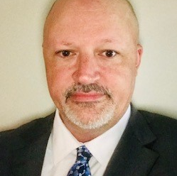

Presenters
Bryan Ellis
Todd W. Lowery
Southern Illinois Regional Workforce Manager
State Business Services Manager
Illinois Department of Commerce & Economic Opportunity
Illinois Department of Employment Security

Slide 22
Illinois Workforce Program Structure & Collaboration
Illinois differs from other states: Rapid Response and STC programs are housed in separate state agencies.
  Illinois Department of Commerce and Economic Opportunity (DCEO)
    Manages Workforce Innovation & Opportunity Act (WIOA) Title I programs, including Rapid Response.
    Also manages state-level economic and business development.
  Illinois Department of Employment Security (IDES)
    Manages STC, known as WorkShare IL.
    Manages Unemployment Insurance and WIOA Title III programs.
    Is a vital partner in Rapid Response activities.
Separate state agencies, but strong collaboration.
Illinois does not utilize Rapid Response funds to support STC outreach.
Illinois does leverage Rapid Response teams to promote the STC/WorkShare IL program.

Slide 23
DCEO Mission and Structure
The mission of the Illinois Department of Commerce and Economic Opportunity (DCEO) is to foster equitable economic opportunities across the State of Illinois. DCEO works to attract and support major job creators, invest in communities, strengthen Illinois’ workforce, foster innovation, and promote a clean energy economy.
DCEO leverages existing staff, infrastructure, and employer relationships to promote WorkShare IL.
  DCEO: Office of Employment & Training (OET)
    Maintains fiscal and programmatic oversight of the WIOA Title IB programs.
    Supports innovative workforce programs and career, training, and employment services.
    WARN and coordinates Rapid Response.
  DCEO: Office of Entrepreneurship, Innovation, and Technology (EIT)
    Supports entrepreneurs, innovators, and small businesses.
    Provides information and technical support.
    Small Business Development Centers, business advice, and management assistance.
  DCEO: Office of Regional Economic Development (RED)
    Provides information to businesses on all DCEO programs and incentives.
    Regional outreach approach.
    Provide early warning of potential layoff activity.
Notes:
Business-facing offices of DCEO that promote WorkShare IL

Slide 24
DCEO Rapid Response Support for WorkShare IL Outreach
DCEO leverages staff, employer relationships, LWIA business services teams, and Rapid Response teams to promote WorkShare IL.
Rapid Response and LWIA Business Service teams promote WorkShare IL as a layoff aversion strategy.
  Distribute WorkShare IL informational materials.
  Referrals to IDES WIOA Title III partners for detailed WorkShare information.
  WorkNet Layoff Assistance for Employers webpage.
  WorkShare information is included in annual WARN requirements mailing to Illinois employers.
Illinois Employment Business System (IEBS)
  Predictive analytics: Dun & Bradstreet and Labor Market Information data.
  DCEO Rapid Response and IDES Business Services teams utilize the data to conduct outreach to potentially “at-risk” companies.

Slide 25
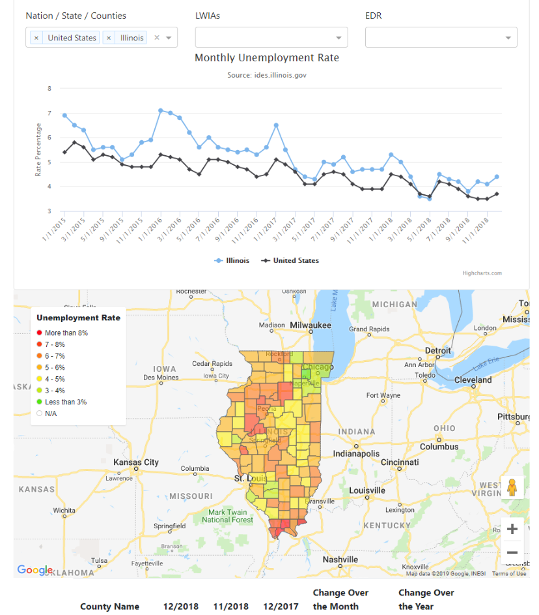
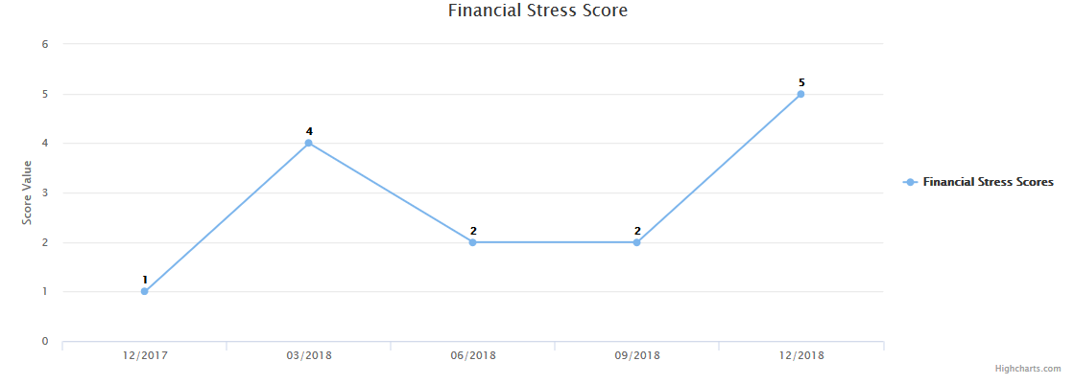

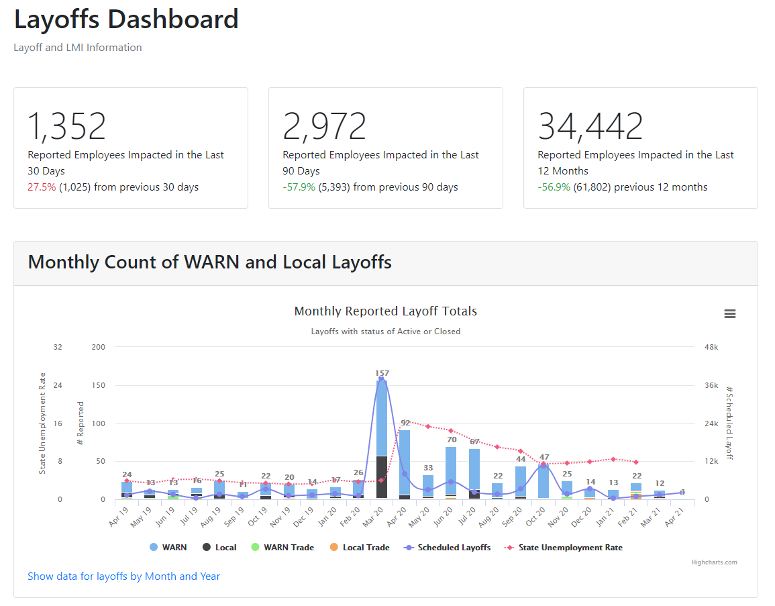
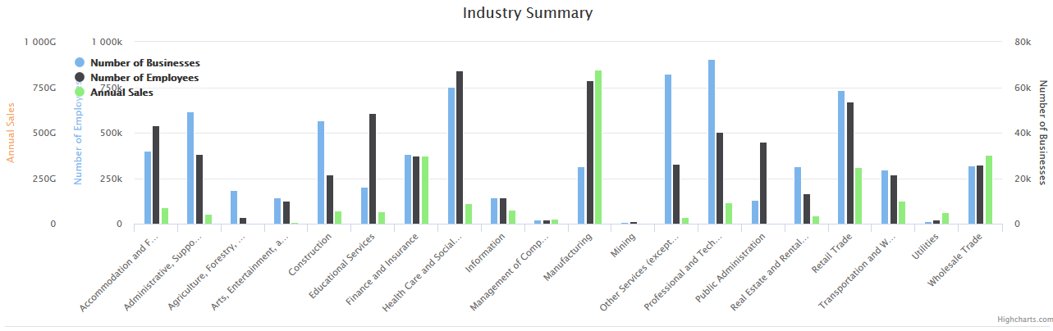

Illinois Employment Business System (IEBS)
IEBS resources, such as D&B and LMI information to identify early warnings and recognize the signs of a business facility closure or mass layoff.
Supply and Demand Data Resource Tool
Labor Market Information
Predictive Analytics & Forecasting
Layoff Tracking and Reporting Tool

Slide 26

WorkShare IL Outreach Strategy
Primary Goal: Awareness.
Developed Foundational Materials:
  Branding: Created a cohesive brand identity with a logo and consistent look.
  Collateral Materials:
    Print.
    Videos.
    Event/Trade Show Materials.
    Presentation templates.
Key Strategies
  All strategies use targeting: industry, employer size, key employer titles.
  Leverage existing business outreach and coordination on local business services teams.
  Social Media outreach: LinkedIn and Facebook.
  Exhibit/Sponsorship Opportunities at Industry Events.
  Email and Direct Mail campaigns.
  Trade publication outreach.
Notes:
Primary Goal is awareness because the program was new starting in 2021
This isn’t a typical marketing campaign because we hope that an employer does not face the conditions where they might need workshare BUT we want them to know enough about it in case they need it.
First: focused on foundational materials: Branding and several collateral materials that can be used across activities.
Specifics if you want to give examples:
Print: flyer, post card,
Videos: overview video highlighting the WorkShare IL program—on our website and used in presentations; Employer explainer on registration and WorkShare plan submission process; Employee explainer for employers to use when they implement their plan; video shorts used on social media campaigns.
Event/Trade Show Materials: banners, tablecloths, swag
Presentation templates for use with group presentations, webinars, etc
Second, we have four key promotional tools – all of which use some form of “targeting” either by industry, or by size of business, or focusing on decisionmaker titles – Executive, HR, etc
The four key strategies highlighted here: social media, industry events, email campaigns, and advertising are IN ADDITION to using our ongoing business outreach to include WorkShare
Some details if you need to mention here:
Webinars and Panel Discussion – Hosted webinars and panel discussions to promote WorkShare IL to members of the IL Manufacturing Association and IL Retail Merchant Association
Email Campaigns – Launched targeted email campaigns reaching Illinois small, mid-size, and large businesses across industries, as well as intermediaries like chambers and industry associations
Targeted Industries included manufacturing, IT, healthcare, transportation, supply chain, construction, and finance
Achieved Average Email Open Rate – 22% and Average Click Through Rate – 3%
Direct Mail Campaigns –Expanded WorkShare IL brand awareness through a direct mail campaign focused on small to mid-size businesses in the manufacturing and IT industries
Trade Publication Advertising – Ran geo-targeted ads in Illinois industry trade publications
Trade publications - Industry Dive, IL Business Journal, Springfield Business Journal, IL Business Leader Magazine for IL Chamber of Commerce
Trade publications for key associations – SHRM, IL CPA Association, IL Healthcare Association, IL Manufacturing Association, IL Landscaping Contractor Association, IL Technology & Manufacturing association, IL Fabricators & Manufacturers Association
Impressions ranging from 3,500 to 75,000+
Exhibitor and Sponsorship Engagement – Promoted WorkShare IL through exhibitor booths, sponsorships and speaking slots at conferences and annual events for IL- based trade associations
Associations covered - IL SHRM, IL CPA Association, IL Manufacturing Association (IMA), IL Healthcare Association (IHCA), IL Retail Merchant Association (IRMA), IL Health and Hospital Association (IHA), IL Municipal League (IML), IL Plumbing Heating and Cooling Contractor Association (IPHCC)
Digital Ad Campaigns –
Executed Paid Digital Ad Campaigns on Facebook and LinkedIn targeting Employer Decision Makers
Target Industries –
Healthcare, Manufacturing, IT, Tourism, Real Estate, Hospitality, Finance, Law, & others
LinkedIn Campaign –
Achieved an average Engagement Rate of 23% with an average CPC of $2.80 *
Facebook Campaign –
Achieved an average Engagement Rate of 42% with an average CPC of $0.42 **
* LinkedIn typical Engagement Rate = 0.19% and typical Cost Per Click (CPC) = $40
** Facebook typical Engagement Rate = 0.05% and typical Cost Per Click (CPC) = $4.50

Slide 27
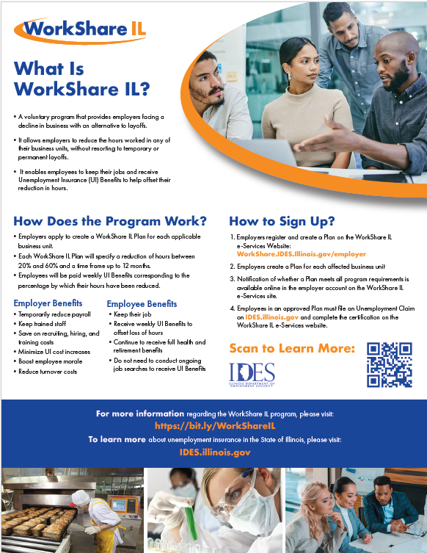
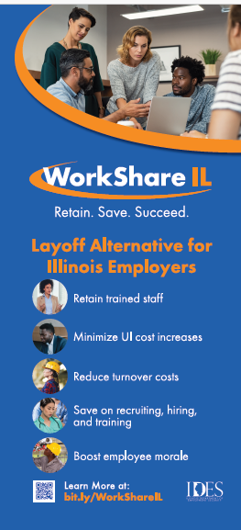

Flyer
Handout Card
Trade Show Scroll Up Signage
Notes:
Here are examples of printed collateral
The same “look and feel” are used in:
Videos
Trade show scroll up banner
Email campaigns and
Social media promo

Slide 28
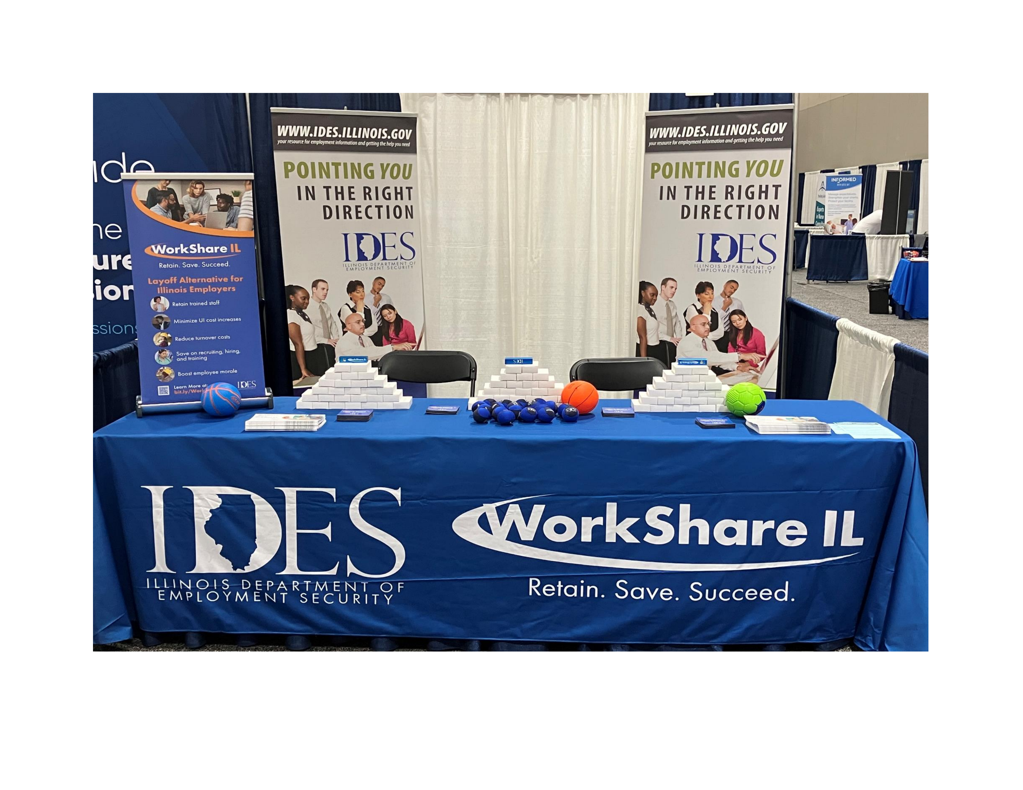
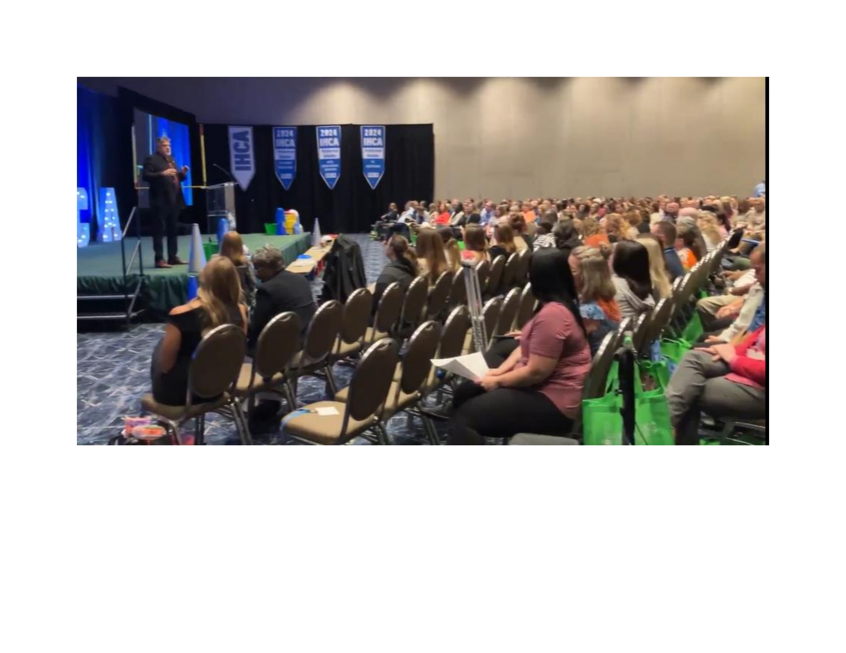


Outreach at Industry Association Events
Notes:
Talk about industry events and direct contact with employers

Slide 29

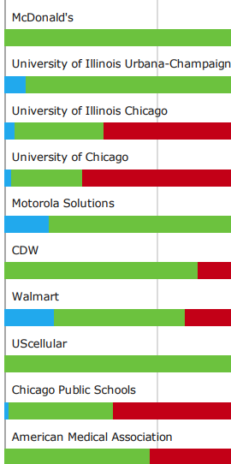
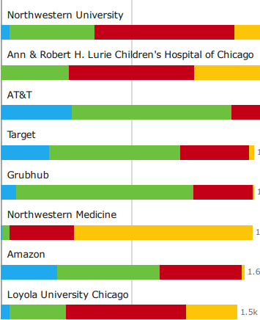


Social Media Ad Analytics -May 2023 thru Jan 2025
Targets = Employer Decision Makers in Industries such as
  Healthcare, Manufacturing, IT, Tourism, Real Estate, Hospitality, Finance, Law, & others
Some of the
Top Companies Reached
Notes:
Talk about social media as a tool
Can do a lot of targeting
By industry
By title of decision makers
Using direct ads that generate leads
We do monthly campaigns so that the targeting is changing regularly
In addition to message and visual, we also have very short featurette’s that play in the add

Slide 30
Connecticut Department of Labor
State Practices

Slide 31


Presenters
Susan Fracasso
Ashley Rivera
Rapid Response Coordinator
Program & Services Coordinator
Connecticut Department of Labor
Connecticut Department of Labor

Slide 32

Who is Eligible for Shared Work?
All Connecticut employers whose taxes/ reimbursement payments are currently up-to-date.
Any size employer that has at least 2 permanent employees participating.
Only applicable for permanent employees (part or full-time) and cannot be used to subsidize seasonal workers during the off-season.
An employee’s hours and wages cannot be reduced by less than 10% or more than 60% and employers cannot eliminate or reduce the worker’s benefits.
  If employee is part of a union, they must agree to reduction of work.
  Hourly and salaried employees can participate.

Slide 33
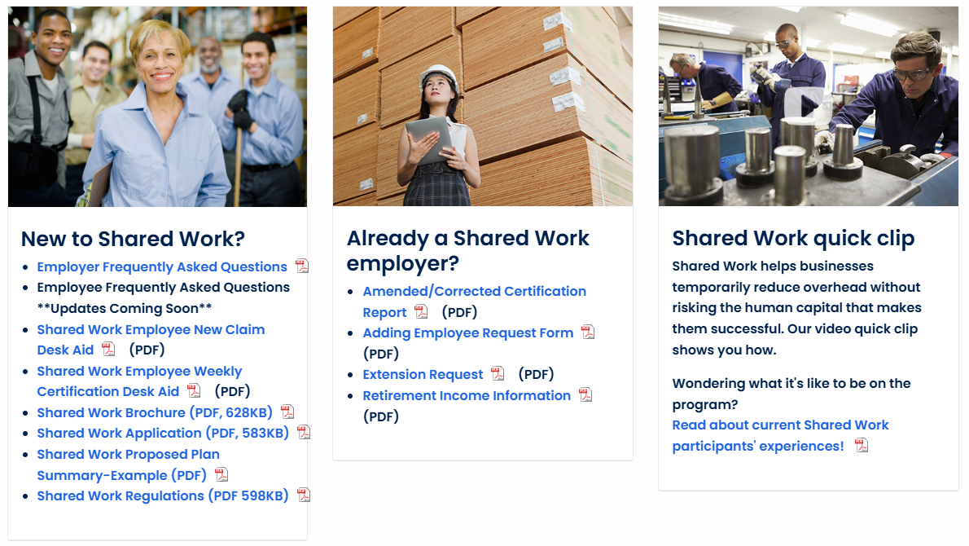
Resources on SharedWorkCT.com
Shared Work Application.
Extension Request.
Employer FAQ.
Shared Work Desk Aids.

Slide 34
Shared Work Employer Participation
Shared Work has employers from many different industries such as manufacturing, restaurants, retail, casinos, daycare, schools, and others. Even town and local government can apply to participate.
Shared Work Participation during the Pandemic:
Shared Work Participation Currently:
More than 1,700 employers participating.
34,000 employees supported by Shared Work.
About 179 employers participating.
3,000 employees supported by Shared Worker.
Pre-Pandemic Note: CTDOL had a little over 200 employers participating in Shared Work annually.

Slide 35

Rapid Response’s Role in Marketing Shared Work
Any employer who is downsizing is advised of the benefits of using Shared Work in lieu of layoffs.

Slide 36
Connecticut's Rapid Response/Shared Work Partnership and Outreach
Quarterly, Rapid Response staff accesses the Shared Work approved plans spreadsheet and contacts non-seasonal employers with five or more workers who applied three months prior.
The outreach is short and informal focusing on just three simple questions.

Slide 37
Connecticut's Rapid Response/Shared Work Partnership and Outreach
Questions for Shared Work Employers and Employees
How is the Shared Work program working for you?
What prompted you to go on the Shared Work program?
Do you see business improving?
If business is not improving, employers are asked if they would like to be connected with a Business Services representative to discuss other forms of assistance that might be available (grants, loans, etc.).

Slide 38
Connecticut's Rapid Response/Shared Work Partnership and Outreach
All employers are sent a follow-up email with a link to our Business Service dedicated website where they can explore on their own additional resources.
Any concerns regarding the Shared Work program are relayed to the Shared Work Unit for resolution.
Concerns regarding doing business in the state in general are communicated to our Commissioner to share with our legislative liaisons.

Slide 39
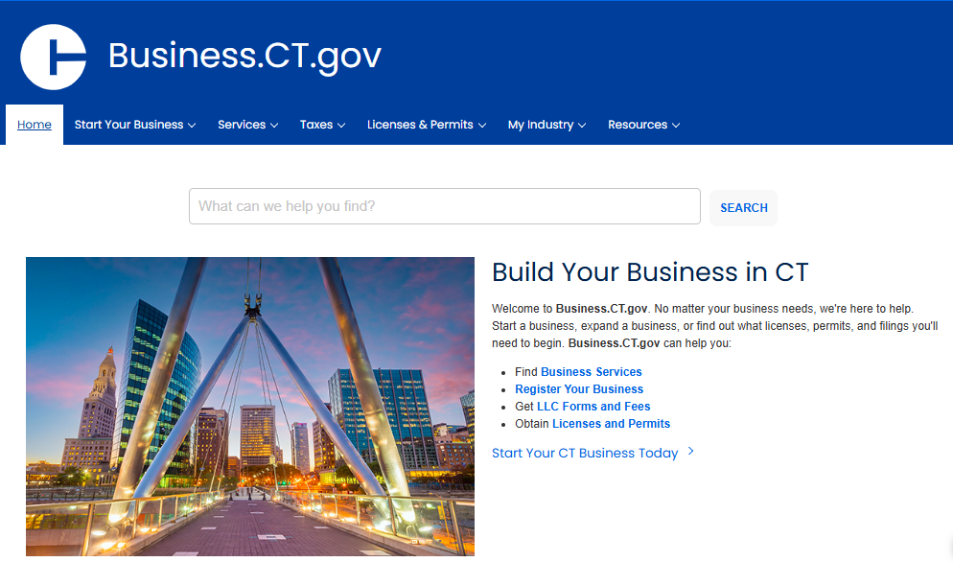
Resources
https://business.ct.gov/

Slide 40

Resources
CTDOL Employer Seminars:
  CTDOL Employer Seminars
  Join the business engagement unit each month for free employer seminars.
  Topics include CT FMLA, Drug Testing, Wage and Hour Laws, Unemployment Insurance, and more.
  Geared toward: business owners, managers, human resources professionals, supervisors, benefits managers, attorneys, and other employers who may be interested in learning from our expert speakers.

Slide 41

Additional Rapid Response Outreach for Employers
Rapid Response uses a monthly query of lack of work Unemployment claims by employer and reaches out to businesses who had five or more workers apply for unemployment.

Slide 42
Panel

Slide 43
Panel Questions
How does Rapid Response balance the potential for layoff with STC/layoff aversions?
What are some ways you suggest the partnership between Rapid Response, Business Services, the Workforce system, and UI may be improved?
If Rapid Response is unable to prevent a layoff, what occurs after to consider the cause of the layoff and what could be done differently next time?

Slide 44
Question and
Answer

Slide 45
Resources and Contact Information

Slide 46
Resources
Guidance: STC Provisions in the Middle-Class Tax Relief and Job Creation Act of 2012
  Provide an overview of the all the provisions of Subtitle D that concern STC.
    Unemployment Insurance Program Letter No. 22-12
    Unemployment Insurance Program Letter No. 22-12, Change 1
    Unemployment Insurance Program Letter No. 22-12, Change 2
Guidance: Layoff Aversion in Rapid Response
  To emphasize and support the use of layoff aversion as a strategy support workers.
    TEN 9-12: Layoff Aversion in Rapid Response Systems
UI Reports Handbook
  Includes guidance on STC reporting requirements (ETA-9050 and ETA-5159).
    Employment and Training Handbook No. 401

Slide 47
Resources
STC 101
  Provides STC resources and tools for practitioners.
    WorkforceGPS - STC 101
STC State Tools and Resources
  Includes state materials and best practices for practitioners.
    WorkforceGPS - State STC Tools & Resources
STC One-Stop Shop
  Provides STC resources and tools for practitioners.
    WorkforceGPS - Welcome to STC
STC Webinar Series: Building a Case for Why STC Supports Workers and Employers.
  This webinar explores STC as a tool to support workers and employers by averting layoffs and maintaining talent.
    WorkforceGPS - Short-Time Compensation Webinar Series: Building the Case for Why STC Supports Workers and Employers
STC Webinar Series: State Promising Practices.
  This webinar features presentations on promising administrative and promotional practices from state STC programs from Washington, Texas, and Maine.
    WorkforceGPS - Short-Time Compensation Webinar Series: State Promising Practices

Slide 48
Contact Us
Amanda Poirier
Regional Director
U.S. DOL/ETA
Email: poirier.amanda@dol.gov
Phone: (617) 788-0124
David King
Unemployment Insurance Program Supervisor
U.S. DOL/ETA National Office
Email: king.david.h@dol.gov
Phone: (202) 693-2698
Nicole R. Roberson
State Conformity & Compliance Team (Regions 1 & 6)
Division of Legislation, OUI/ETA, US DOL
Email: Roberson.Nicole@dol.gov
Phone: (202) 693-2688

Slide 49
Contact Us
Susan Fracasso
Rapid Response Coordinator
Connecticut Department of Labor
Email: Susan.fracasso@ct.gov
Phone: (860) 263-6589
Ashley Rivera
Program & Services Coordinator
Connecticut Department of Labor
Email: ashley.rivera@ct.gov
Phone: (860) 263-6642
Bryan Ellis
Southern Illinois Regional Workforce Manager
Illinois Department of Commerce & Economic Opportunity
Email: Bryan.Ellis@illinois.gov
Phone: (618) 363-2417
Todd W. Lowery
State Business Services Manager
Illinois Department of Employment Security
Email: Todd.Lowery@Illinois.gov
Phone: (217) 782-0160

Slide 50
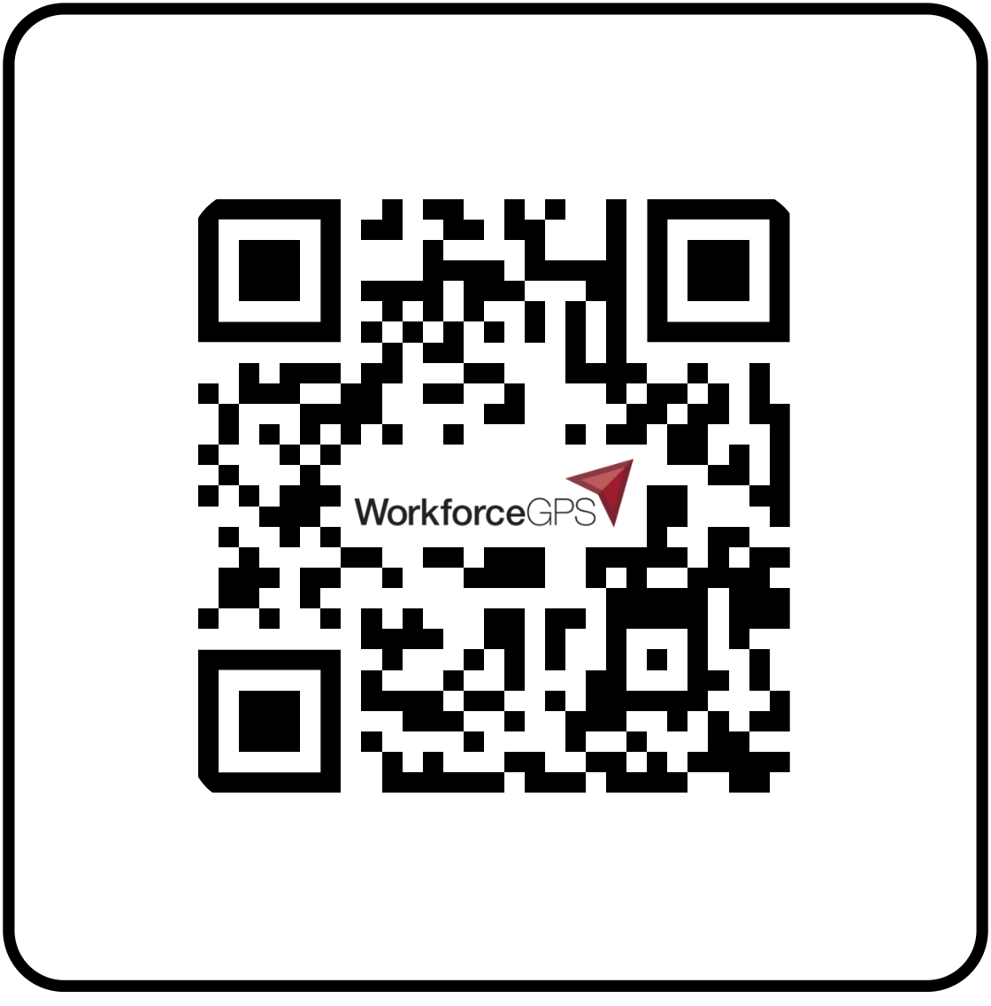
Thank You!
We look forward to seeing you on WorkforceGPS.
Need Help? Email: Support@WorkforceGPS.org

