Slide 1
Financial Reporting
SMART 4.0
Hosted by the Office of Grants Management
Division of Compliance Assistance and Policy
Employment and Training Administration
U.S. Department of Labor

Slide 2

SMART 4.0 Training Series
The training modules are focused on: Strategies for sound grant management that includes Monitoring, Accountability, Risk mitigation and Transparency.
4.0 focuses on Risks Identification and SMART Practices!

Slide 3
Disclaimer
SMART 4.0 is part of the catalog of SMART grant management tools. This conference and its materials should be viewed primarily as a support resource. It is not intended to be comprehensive, but rather to provide an understanding of 2 CFR 200, 2 CFR 2900, and the management of ETA grants. The use of these SMART 4.0 modules does not ensure compliance. Any omission of an applicable Federal requirement does not waive a grant recipient or subrecipient’s responsibility to comply with that requirement.
If, in any instance, there appears to be a conflict with the program statute, Federal regulations or OMB guidance, such conflict must be resolved in favor of the statute, Federal regulations, or OMB guidance. All the information contained in the SMART 4.0 modules may not be reproduced or distributed for a fee or profit.

Slide 4
Today’s Speakers
Glarion Webb
  Grants/Financial Management Specialist
    Dallas Region IV
Chanel Castañeda
  Supervisor and Grants Management Specialist
    Division of Compliance, Assistance, and Policy

Slide 5

Module Overview
Basic Requirements.
ETA-9130 Reporting Elements.
Risks and SMART Practices.

Slide 6
Basic Requirements

Slide 7

The Need for Financial Data
DOL uses data to report to Congress and other stakeholders.
  Can influence future funding.
Track program performance against financial spending.
  Identify potential technical assistance.
Helps avoid returning grant funds back to DOL.

Slide 8
Basic Requirements.
Basis.
  Accrual.
Frequency.
  Quarterly and cumulative.
Transmission method.
  ETA online reporting system.
Due 45 calendar days after quarter end.
Quarter End Date | Financial Reports Due
March 31 | May 15
June 30 | August 15
September 30 | November 15
December 31 | February 15

Slide 9
Authorization of ETA 9130
Uniform Guidance 2 CFR Part 200.
  Financial Management 2 CFR 200.302(b)(2) requires accurate, current, complete disclosure of financial results.
  Financial Reporting 2 CFR 200.328 requires no less frequently than annually nor more frequently than quarterly per terms and conditions of Federal award, except in unusual circumstances.
DOL Exception 2 CFCR 2900.
  Financial Reporting 2 CFR 2900.14 states that recipients must develop accrual information through best estimates based on an analysis of the documentation at hand.

Slide 10
14 Versions – ETA 9130 Reports
ETA-9130 – Basic.
ETA-9130 (A) – Statewide Youth.
ETA-9130 (B) – Local Youth.
ETA-9130 (C) – Statewide Adult.
ETA-9130 (D) – Local Adult.
ETA-9130 (E) – Statewide Dislocated Workers.
ETA-9130 (F) – Local Dislocated Workers.
ETA-9130 (G) – National Dislocated Worker Grants.
ETA-9130 (H) – Statewide Rapid Response.
ETA-9130 (I) – Employment Services and Unemployment Insurance.
ETA-9130 (J) – National Farmworker Jobs Program.
ETA-9130 (K) – Senior Community Service Employment Program.
ETA-9130 (L) – Indian and Native American Program.
ETA-9130 (M) – Trade Adjustment Assistance Program.

Slide 11
ETA 9130 Report: Final vs. Closeout Reports
Final report 2 CFR 200.329(c)(1).
  Due no later than 45 calendar days after the reporting period.
    In which the grant period of performance expires, or
    All funds, Federal AND recipient share, are expended;
    WHICHEVER comes first.
Closeout report 2 CFR 200.344.
  Must be submitted no later than 120 calendar days after the expiration of the grant, regardless of whether funds are fully expended prior to the Period of Performance (POP) expiration date.

Slide 12
Reporting Periods, Due Dates, and
Cumulative Data
Each report must be complete and accurate for all levels where funds are expended through the last day of the quarterly report period.
Ensure that data is reported by subrecipients and submitted to DOL by the due date.
DOL financial reports are cumulative until the end of the life of the allotments or the period of performance for the DOL awards.
  All funds must be fully expended by the expiration of the period of performance, or they risk losing their availability.
  For WIOA, unless otherwise authorized in a grant or cooperative agreement or subsequent modification, grant recipients must expend funds with the shortest period of availability first (20 CFR 683.110(a)).

Slide 13
Expenditure Period
The Period of Performance for most DOL-ETA programs is an expenditure period (not an obligation period).
  Thus, only costs (accrued expenditures) incurred during the grant’s period of performance are allowable. No additional costs can be incurred after the end of the grant period, even if obligations were established during the grant period.
  Expiration of Expenditure Period.
    The only liquidation that can occur is a liquidation of the accruals for goods and services received during the grant period - this allows time for receipt and payment of invoices for those accrued expenditures. (2 CFR 2900.15)
  Requires a FINAL report via e-grants reporting system and a CLOSEOUT report via e-grants reporting CLOSE-OUT system.

Slide 14
Online Reporting System
Follow instructions in the Notice of Award.
Provide requested reporting contact information.
  An e-mail is sent to primary contact with password and PIN.
System is user-friendly and provides guidance to assist user in completing the ETA 9130 form.
  System edits – hard and soft.
Passwords and PINS.
  Password issued to access system and enter data.
  PIN issued to certify data.
  Instructions link provides information on how to use system.
  https://www.dol.gov/sites/dolgov/files/ETA/grants/pdfs/FSR_eform.pdf

Slide 15

Check Your Knowledge in 60 Seconds
Answer True or False
If the accounting system is on a cash basis, accrual reporting is not required.
ETA 9130 Report line 10.b, Cash Disbursements should always equal or exceed line 10.e, Federal Share of Accrued Expenditures.
Examples of accruals include salaries, goods received but invoices not paid, and goods or services received but not yet invoiced.
Program income earned on grant funds must be included on the ETA 9130 report.

Slide 16
ETA-9130 Reporting Elements

Slide 17
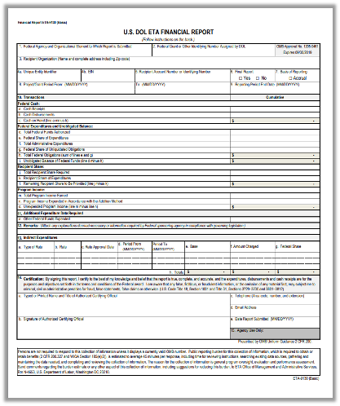
Main Sections of the
ETA 9130
Basic Information (1-9).
Federal Cash Section (10a-10c).
Federal Expenditures and Unobligated Balance (10d-10i).
Recipient Share (10j-10l).
Program Income (10m-10o).
Additional Expenditure Data Required (11).
Remarks (12).
Indirect Expenditures (13a-13g).
Certification (14).

Slide 18
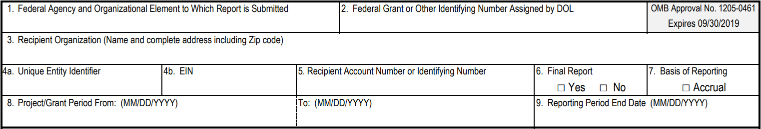
ETA-9130 Report Basic Information (Line Items 1 – 9)
Federal Agency.
Federal Grant Number.
Recipient Organization.
Unique Entity Identifier / EIN.
Recipient Account Number.
Final Report.
Basis of Reporting.
Project Grant Period.
Reporting End Date.

Slide 19
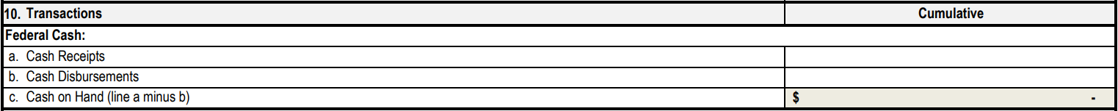
Federal Cash (Line Items 10a – 10c)
10a: Cash Receipts.
  What did you draw down from the Payment Management System (PMS) as of the report quarter end date?
  Data pre-entered for non-formula; data must be entered for WIOA formula programs.
10b: Cash Disbursements.
  What cash has been disbursed?
  Of cash drawn down from PMS, how much has been disbursed for grant activities?
10c: Cash on Hand.
  Automatic calculation.
  Excess cash requirements apply, explain in Remarks.

Slide 20
Cash: Quick Tips
REMINDER
Cash disbursements (line 10b) cannot be greater than cash receipts (line 10a).
Generally, cash disbursements (line 10b) cannot be greater than federal share of expenditures (line 10e).
What if too much cash is drawn?
  Immediate needs.
  Returning funds to PMS or after grant has closed - ETA-ARTeam@dol.gov.
Must address all issues with explanation in Section 12 Remarks.

Slide 21
Common Issues with Cash
What documentation is used to determine how much to draw down from PMS?
  Accruals beyond immediate cash needs.
  Use grant funds to pay for other activities.
Must deposit funds in an interest-bearing account unless the following apply (2 CFR 200.305(b)(8)):
  Grant recipient receives less than $250,000 in Federal awards per year.
  The best reasonably available interest-bearing account would not be expected to earn interest in excess of $500 per year on Federal cash balances.
  The depository would require an average or minimum balance so high that it would not be feasible within the expected Federal and non-Federal cash resources.
  A foreign government or banking system prohibits or precludes interest-bearing accounts.

Slide 22
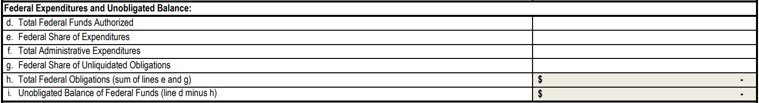
Federal Expenditures and Unobligated Balance (Line Items 10d – 10i)
10d. Federal Funds Authorized.
10e. Federal Share of Expenditures.
10f. Administrative Expenditures.
10g. Unliquidated Obligations.
10h. Total Federal Obligations.
10i. Unobligated Balance.

Slide 23
Federal Share of Expenditures (Line Item 10e)
Line 10e includes actual cash paid out plus the value of all goods/services received but not yet paid.
Cannot exceed 10d (Federal funds) – hard edit.
Will usually be greater than 10b.
Net of refunds, rebates, and credits.
If less than the prior reported cumulative amount.
  Soft edit, caution, remarks must include explanations.

Slide 24
Expenditure: Quick Tips
REMINDER
Examples of accruals:
  Salaries.
  Goods received, but invoices not paid.
  Goods or services received, but not yet invoiced.
NOT Accruals:
  Orders placed but not yet received.
  Obligations.
  Encumbrances.
Accruals can be estimations.
  If accruals for estimates are recorded in the accounting system as accruals, they must be reversed in the following reporting period to avoid over reporting of expenditures.

Slide 25
Common Issues with Expenditures
Accruals are underreported.
  Grant recipients do not include all accruals.
    Even though they may have received the goods or services.
  Pass-through entities do not collect and/or include subrecipient accruals.
Grant recipients not including expenditures for the full reporting period.

Slide 26
Administrative Expenditures (Line Item 10f)
Not every program uses the same definition.
  WIOA
  TAA
Not all grants have the same limits.
Includes direct and indirect administrative costs.

Slide 27
Federal Share Unliquidated Obligations (Line Item 10g)
Unliquidated Obligations.
  The sum/value of undelivered goods/services under a legal binding agreement.
  The amount of obligations for which an accrued expenditure (line 10e) has not yet been incurred.
NOT Unliquidated Obligations.
  Projected staff salaries.
  Future rents (except termination fee).
  Budget items not yet expended.
Need to update regularly as over-obligating can lead to returning funds to DOL.

Slide 28
Recipient Share (Line Items 10j – 10l)
10j. Total Recipient Share Required.
10k. Recipient Share of Expenditures.
10l. Remaining Recipient Share to be Provided.

Slide 29
Recipient Share: Quick Tips
REMINDER
Required Match.
  Must be reported in the period expended.
Leveraged Resources.
  Grant recipients are encouraged to report leveraged resources (amounts greater than required match if there is a match requirement).
Lack of Documentation.
  In-kind contributions need to be supported by documentation.
Stand-In Costs.
  Grant recipients cannot use stand-in costs to address disallowed costs unless they report these costs in the period in which they occur on line 10k.

Slide 30
Program Income (Line Items 10m – 10o)
10m. Total Program Income Earned.
10n. Program Income Expended.
10o. Unexpended Program Income.
Program Income must always be SPENT FIRST before requesting new grant funds from PMS.

Slide 31
Program Income: Quick Tips (1)
Often not reported correctly.
What you need to be aware of when reporting program income:
  The definition of program income is at 2 CFR 200.1.
  Direct grant recipients must include program income earned and expended by subrecipients.
Program Income examples:
  Interest from interest-bearing accounts.
  Rental of space.
Program income exceptions:
  Government revenues.
  Donations.
  Profits of commercial organizations.
  Matching funds.
  YouthBuild proceeds from the sale of buildings constructed or renovated.
  Sale of property.
  Royalties.

Slide 32
Program Income: Quick Tips (2)
Income after the period of performance (2 CFR 200.307(f)):
  There are no Federal requirements over the disposition of income earned after the end of the period of performance for the Federal award.
    Unless program regulations or the grant terms and conditions provide otherwise.
    DOL-ETA may negotiate agreements with grant recipients regarding appropriate uses of income earned after the period of performance as part of the grant closeout process.

Slide 33
Additional Expenditure Data Requirements
(Line Items 11a – 11d)
11a: Other Federal Funds Expended: Found on all reporting forms.
11b-11d: Varies between all the ETA-9130 reports, some examples:
  11b: Employment Service Expenditures.
  11c: Training Service Expenditures.
  11d: Other Program Service Expenditures.

Slide 34
Training Expenditures – ETA-9130 Reports
Must submit financial data for training for the following programs:
  WIOA Adult/Youth, and DWG
  TAA
  INA
  SCSEP
Annual or quarterly performance reports should tie out to the data reported on the 9130 reports.

Slide 35
Remarks (Line Item 12)
Enter information for Items Requiring Explanations.
Excess cash on hand.
Reduction in cumulative expenditures.
Decrease in disbursements.
Other significant expenditure adjustments (e.g., FIFO adjustments, prior period changes).

Slide 36
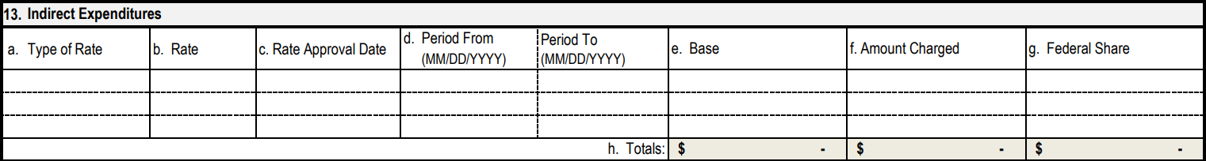
Indirect Expenditures (Line Items 13a - 13g)
13. Indirect Expenditures.
  Type of Rate
  Rate
  Rate Approval Date
  Period
  Base
  Amount Charged
  Federal Share
  Totals

Slide 37
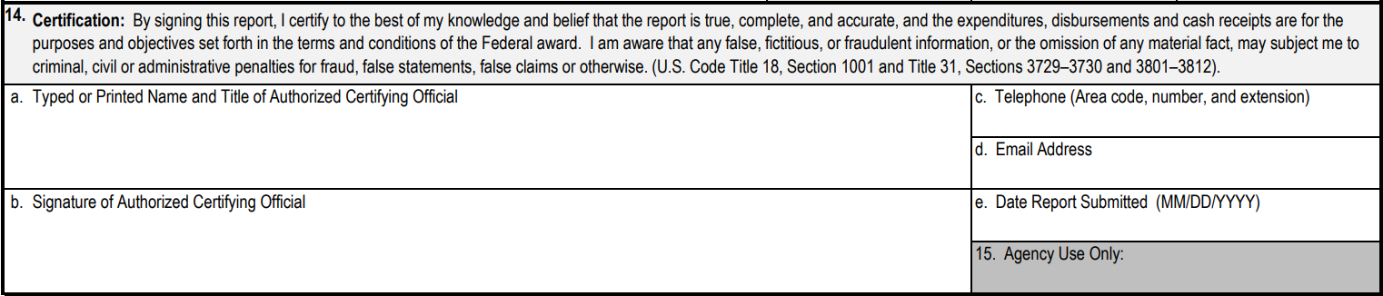
Certification (Line Items 14a – 14e)
Certification done by entering PIN.
Same as affixing a signature of authorized Certifying Official.

Slide 38
Transitioning the ETA-9130 Reporting System
Currently, ETA-9130 forms were submitted to an in-house reporting system: E-Reporting System.
Coming soon, DOL-ETA is moving to an ETA-9130 reporting system managed by HHS - Payment Management System (PMS).
  Line items are expected to stay the same.
PMS offers awarding agencies and grant recipients:
  Cash management services.
  Centralized payment services.
  Financial reporting system.
    Centralizing your cash management and financial reporting process in one system.

Slide 39
Transitioning the ETA-9130 Reporting System.
PMS has many benefits to its program, some of which include:
  Quick and easy user set-up.
  Access to account information and reporting.
  Efficient and accurate payment system.
  Secured funding request transfers.
  Variety of payment options (ACH, Fedwire, Warehouse).
  Eliminates duplicate entries across various grant financial systems by sharing reconciled data.
  Live customer support.
Expected transition – Spring 2023
  Upcoming TEN will be released.

Slide 40
Check Your Knowledge in 60 Seconds.
Answer True or False.
Recipients must submit financial reports no later than 45 days after the end of the reporting period.
In designing subrecipient reporting forms, the PTE should include the information it needs for reporting to DOL.
PTEs should consider having subrecipients report more frequently than quarterly.
Accrual reporting is required for the PTE but not for subrecipients.

Slide 41
Risks and SMART Practices

Slide 42
Common Risks
Recipients and subrecipients not reporting on accrual basis.
Cash disbursements exceed expenditures.
Inaccurate reporting at subrecipient levels, which results in inaccurate reporting by direct recipients.
Important data items not collected from subrecipients.
Administrative expenses exceeding limit.
Classifying administrative expenses as program costs.
Calculating/reporting indirect costs on basis other than that prescribed in negotiated rate agreement.
Inconsistent reporting.
Underreporting of program expenditures.
Late reporting.

Slide 43
SMART Practices
Develop and update procedures that track obligations, accrued expenditures, and disbursements to include the data elements identified at 2 CFR 200.302.
Develop a process to track accrual data in the accounting system or separately as required by DOL, including subsequent liquidation or reconciliation of accrual data.
Install a process to collect and summarize financial data from subrecipients in order to meet DOL financial reporting deadlines.
Develop or update procedures that properly track match, leverage resources, program income, and indirect costs to ensure timely collection and accurate submission on the required financial report (ETA-9130).

Slide 44

Any Questions?

Slide 45
Testing For Compliance - Core Monitoring Guide
The purpose of ETA monitoring is to assess for compliance using the Core Monitoring Guide (CMG). Here is a list of indicators that discussed during the module’s topic.
Objective 3.b: Accounting System and Financial Reporting
An accounting system is in place that allows the grant recipient to maintain accurate and complete disclosure of the grant’s financial results and those of its subrecipients.
    Indicator 3.b.1: Basis of Reporting.
    Indicator 3.b.2: Financial Reporting.
    Indicator 3.b.3: Subrecipient’s Financial Reporting.
    Indicator 3.b.4: Performance Reports.

Slide 46
ETA and Uniform Guidance Resources
Core Monitoring Guide.
Grant and Financial Management Technical Assistance Guide.
DOL Home Page Resources.
Uniform Guidance Crosswalk.
Uniform Administrative Requirements, Cost Principles, and Audit Requirements for Federal Awards 2 CFR Part 200.
Department of Labor Exceptions 2 CFR Part 2900.

Slide 47
Financial Reporting Resources
Core Monitoring Guide
  Objective 3.b: Accounting System and Financial Reporting.
Grant and Financial Management Technical Assistance Guide
  Chapter 11: Financial Reporting.
ETA 9130 Form Instructions and various forms
Uniform Administrative Requirements, Cost Principles, and Audit Requirements for Federal Awards. 2 CFR Part 200
  2 CFR 200.302
  2 CFR 200.328
  2 CFR 200.329
Department of Labor Exceptions. 2 CFR Part 2900
  2 CFR 2900.14
Uniform Guidance Crosswalk

Slide 48
Thank You!

