Slide 1

Participant Case File Maintenance:
A Q&A with Federal Project Officers

Slide 2






Inclusive Meeting Guidelines
Hosting and Participating in Meetings
ENGAGE EVERYONE
BE HEARD AND SEEN
ACKNOWLEDGE SPEAKER
MAXIMIZE MICROPHONES
MINIMIZE NOISE
MAXIMIZE VISUAL DISPLAYS
These guidelines are intended to improve the meeting experience for virtual participants, as well as people with hearing loss, visual impairment, and those for whom English is an additional language.

Slide 3

Presenter
Chris Herzog
  Principal TA Consultant
    AIR
      cherzog@air.org

Slide 4

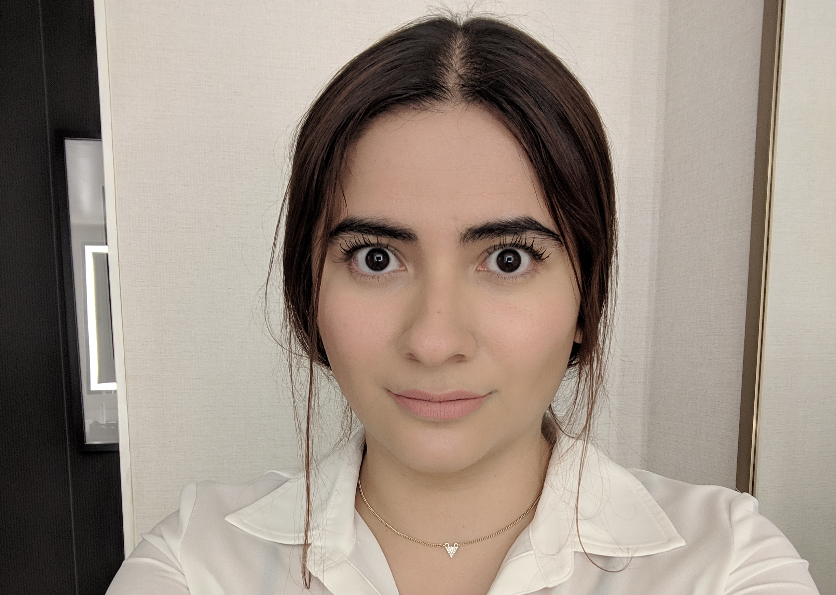
Presenters
Brie Burleson
  Federal Project Officer
    U.S. Department of Labor, Employment and Training Administration
      burleson.brie@dol.gov
Almendra Garcia
  Federal Project Officer
    U.S. Department of Labor, Employment and Training Administration
      garcia.almendra@dol.gov

Slide 5
Agenda
Welcome and Agenda (5-minutes)
Overview of the Why, How, and What of Participant File Monitoring (20-minutes)
  Best practices for case file management
  What FPO’s will be looking for in case files
  Common challenges
Facilitated Q&A (30-minutes)
Wrap-up (5-minutes)

Slide 6
Overview of the What, Why, and how of Participant Case File monitoring

Slide 7

Poll #1
How prepared do you feel for case file monitoring?
  Totally ready!
  There are some things we need to check on but feel overall prepared.
  We have some work to do.
  We have a lot of work to do.
  Completely relaxed; our monitoring is done.

Slide 8
What is the purpose of monitoring?
Measure grant progress
Identify areas of compliance and non-compliance
Provide targeted technical assistance
Ensure that federal funds are used responsibly

Slide 9
Monitoring overview
Monitoring is conducted by the Federal Project Officer (FPO)
Some reviews are conducted jointly with ETA Division of Financial Management and Administrative Services (DFMAS):
  FPO reviews project implementation
  DFMAS accountant conducts financial management review
Reviews are conducted on-site or remotely via Enhanced Desk Monitoring Reviews (EDMR)
ETA monitors grants at least once during the period of performance
  Mid-point of grants’ period of performance
  Reviews last 3-5 days

Slide 10
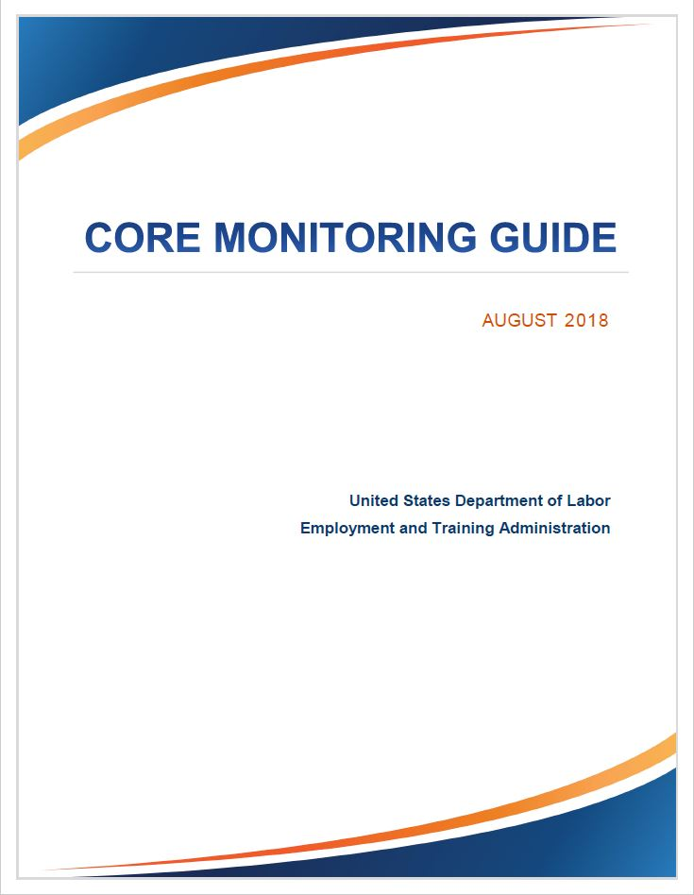
Core Monitoring Guide
ETA’s primary review tool
  Provides a consistent framework for assessing compliance with grant agreement, Federal regulations, and Uniform Guidance
Core Monitoring Guide (2018)
  Core Activity 1: Service Design and Delivery
  Core Activity 2: Grant Operations
  Core Activity 3: Financial Management
  Appendix: Resources and Tools

Slide 11
Examples of What FPO’s Look for in case files
(see TEGL 23-19, Change 2)
Eligibility verification and checklist
Needs assessment used to determine the supportive service
Contact forms
Intake assessment forms
Status verification (i.e., veteran and other status)
Applicant interview form
Case / progress notes
Documentation for measurable skill gain
Receipts for supportive services, stipends, wages, union fees, etc.
Dates of entry and types of training
Program outcomes, dates of completion, credentials
Service plan, exit and follow up plan
Employment verification

Slide 12
Common Compliance Findings #1
Lack of records related to participant’s files:
Eligibility and enrollment
Supportive services
Policy and priority of service to veterans and other priority populations
Referrals, follow up, placement notes, etc.
Common Compliance Findings

Slide 13
Example Findings
Finding #3: Non-compliance with Performance Reporting Requirements
The grantee does not have a tool to track progress toward achieving the PH3 grant performance outcomes. Additionally, The grantee did not enter participant data into the Grantee Performance Management System (GPMS).
The grantee also did not collect documentation to substantiate and validate participants' progress toward accomplishing performance indicators.
Finding #4: Non-compliance with Source Documentation Requirements
The grantee did not provide documentation to verify that participants received the full array of services outlined in the grant agreement.
Finding #5: Non-compliance with Participants Eligibility Requirements
The grantee did not provide documentation to substantiate eligibility for forty-one participants enrolled in the grant.

Slide 14
Q&A with the FPO’s
How do I set up and organize case files?
How do I decide what and how much goes into case files?
How do I document what I collect?
Should my files be both hard copy and electronic?
What level of detail should my case notes be? (i.e., 1 sentence vs. 10 pages) What is important to include, and what is not?
Are there best practices for gathering information from partners in other parts of the organization to keep participant data in one place?

Slide 15
Best Practices for Data Collection and Reporting
Understand what information to collect.
Understand the timing of when information should be collected.
Maintain effective staff roles and responsibilities for developing and maintaining files.
Continuously improve your internal case management system.
Continuously improve intake procedures that build in participant data collection.
Maintain a pre-established schedule to regularly check in with participants.
Establish methods to follow up with your participants after they leave your program.
Continuously improve your process for regularly collecting information from grant partners.
Maintain your policies for documenting, validating, and securing data.
Document your established procedures so new staff can follow them.

Slide 16
Note on Personally Identifiable Information
Grantees are required to protect PII when transmitting information but are also required to protect PII and sensitive information when collecting, storing, and/or disposing of it.
Guidance regarding their handling and protection of PII is provided at TEGL 39-11: Guidance on the Handling and Protection of Personally Identifiable Information (PII).
Region 6 uses Kiteworks to avoid PII issues when sending files for electronic review to avoid this challenge.

Slide 17
Questions from the audience?

Slide 18
Poll #2
After today’s session, how prepared do you feel for case file monitoring?
  Totally ready!
  There are some things we need to check on but feel overall prepared.
  We have some work to do.
  We have a lot of work to do.
  Completely relaxed; our monitoring is done.

Slide 19
resources
SMART 4.0 Grants Management Training
SMART 4.0 Training on Records Management
Core Monitoring Guide
Participant Data Collection and Tracking Toolkit
Policy Checklist
TEGL 23-19, Change 2

Slide 20

Thank You!
The American Institutes for Research® (AIR) and its partners Mathematica and Social Policy Research Associates, completed this project with federal funds, under contract number 1605C2-23-Q-00074 Nursing Expansion Grant TA, from the U.S. Department of Labor, Employment and Training Administration. The contents of this publication do not necessarily reflect the views or policies of the Department of Labor, nor does mention of trade names, commercial products, or organizations imply endorsement by the U.S. Government. AIR is a nonpartisan, not-for-profit organization that conducts behavioral and social science research and delivers technical assistance to solve some of the most urgent challenges in the U.S. and around the world.

