Slide 1

Reporting Mini-Refresher:
WIPS Tips
Quarter Ending March 31, 2026

Slide 2
General Announcements & Reminders
Keep using the Demo 2021 Participant Individual Record Layout (PIRL)
The Program Office has started to do data quality checks, so you may get an email from us if we see what seems to be an anomaly in your data trends.
Quarterly Performance Reports (QPRs) are cumulative quarter to quarter
Every section of the Quarterly Narrative Report (QNR) needs to be filled out
  You may optionally attach a copy of your QNR, as long as you also report the information directly into the QNR text boxes in WIPS.
  If a section is not applicable or you have nothing to report in that section, please put something to indicate that like "N/A" or "No information to report."
  Each section has a character limit of 2,000 characters.
Notes:
Data QC TPs
Please be assured that receiving a feedback letter from the WORC Program Office team is not punitive action. We provide you with letters, as needed, to help with issues that may prevent your reports from representing your grant’s success accurately. In some cases, when operational challenges appear to exist, our goal is to help you find a solution early.
If an error was made in the QPR, please make corrections to your next report. In the future, if performance data corrections cause reductions in outcomes, please include an explanation in the narrative report. This will allow us to differentiate intentional corrections from reporting errors.
PIRL TPs
We have gotten some questions about the rollout of the new 2025 Demo PIRL, which you may have heard about via other DOL grants or partners.
While the new PIRL will be available in WIPS for the upcoming reporting deadline, WORC Round 4-6 grantees will continue using the 2021 Demo PIRL until the end of their grant period of performance. When submitting your QPR, you should still choose the 2021 Demo PIRL from the dropdown options. No changes are needed in how you collect and report your data for this grant.

Slide 3
WIPS TIP #1: How to Keep Leading Zeroes
For SSNs or county codes, the number may start with a leading zero. Excel may not store that zero, which can cause errors when you submit to WIPS.
To fix, format the cell(s) as text, by highlighting relevant cells and choosing “Text” under the Formatting drop down.

Slide 4
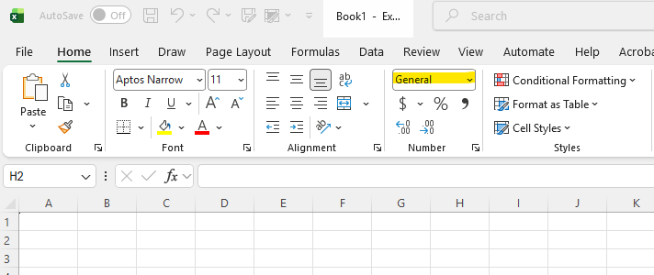
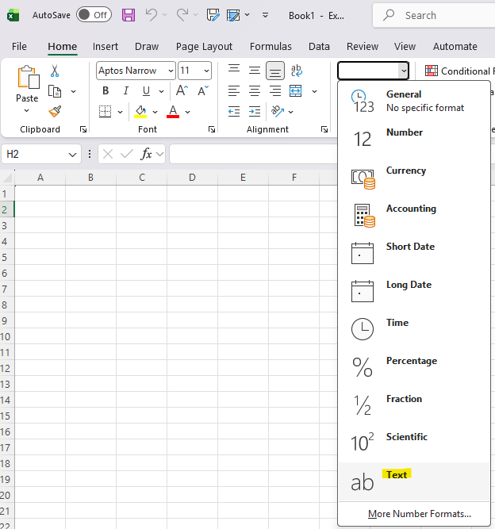
WIPS TIP #1: Screenshots
To change a column's format in Excel, click the column letter to select it, then use the dropdown menu in the "Number" group on the Home tab to select the format “Tex.”
Notes:
Demo

Slide 5
WIPS TIP #2: Column Error
The current 2021 Demo Grant PIRL has 136 data elements and requires 136 columns to be in your data file.
When one or more data elements at the end of the Demo PIRL are left blank in your data file, the empty columns may not be recognized when you convert your Excel document to a .csv or .txt file.
Your last column will be DE 2700 (Social Security Number) in Column EF.
To fix, add borders to your columns in your Excel sheet. The borders result in the recognition of blank columns when you convert your file. Do not add borders to extra rows or columns.

Slide 6
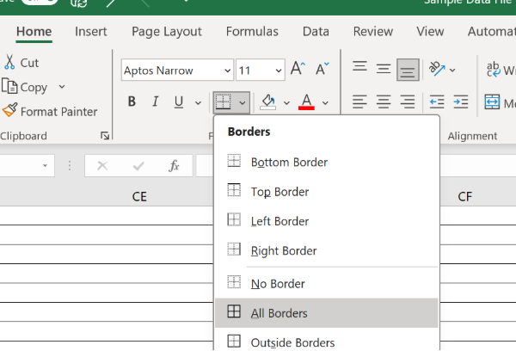
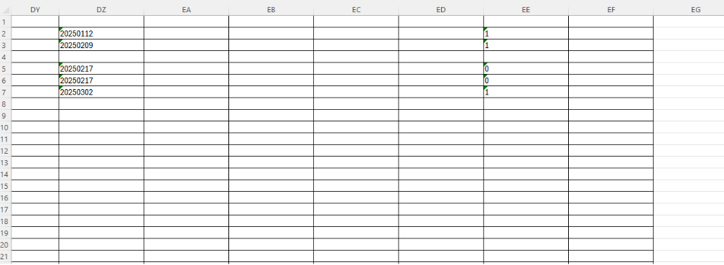
WIPS TIP #2: Screenshots
To add borders in Excel, select your cells and use the Borders dropdown in the Home tab to "All Borders".
Notes:
Demo

Slide 7
WIPS TIP #3: Program Services and Training Activity Types 1
Aggregated in QPR Section C. Program Services and Training Activities
Basic Career Services (BCS)*
  Isolated interactions that involve minimal staff time (think many AJC/One Stop services)
  Initial skill assessments, provision of information, program referrals
Individualized Career Services (ICS)
  Typically involved significant staff time
  Customized to participants’ needs
  Special assessments, individual employment plans, counseling, work experience (i.e., internships, pre-apprenticeships, or job shadowing)
  *Requires eligibility determination and assessment by a staff member of the individual's skills, education, or career objectives to count as grant-funded service to a participant
Notes:
Self-Service only BCS is aggregated into Total Reportable Individuals (which is not a WORC performance outcome)

Slide 8
WIPS TIP #3: Program Services and Training Activity Types 2
Training Services
  Includes OJT, Customized Training, Registered Apprenticeship, and others
Supportive Services
  Resources that people need to participate in career and training services
  Transportation, housing assistance, childcare, needs-related payments

Slide 9
WIPS TIP #4: Who is a participant?
Individuals are considered participants (and therefore reportable on a QPR toward outcomes) when they receive grant-funded services, beyond a determination of eligibility.
Individuals who receive services funded solely with leveraged resources (i.e. no services are provided with grant funds) are not considered grant participants. Grantees must not include individuals funded solely with leveraged resources in the data file that is uploaded to WIPS.
You are required to collect and report data on all participants.
Record date individual becomes participant in DE 900 (Date of Program Entry and exits in DE 901 (Date of Program Exit)- Participants served aggregates with DE 900/901
See 20 CFR 677.150 for more information

Slide 10
WIPS TIP #4: Who is a NOT participant?
Individuals who only use the self-service system.
Individuals who receive information-only services or activities, which provide readily available information that does not require an assessment by a staff member of the individual's skills, education, or career objectives.

Slide 11
WIPS TIP #5: When to exit participant?
Scenario 1
A participant does not officially become an exiter until 90 days have elapsed since the individual last received grant-funded services (that are not self-service, information-only, or follow up services), if no future services are scheduled for the individual.
If you know that the individual is planning on coming back for future planned training services, you could keep them enrolled.
The Demo PIRL schema allows you to report up to three individual training services for a participant with entrance and completion dates for each service.

Slide 12
WIPS TIP #5: When to exit participant?
Scenario 2
It’s possible that a participant may enter the program, go 90 days without receiving services and be exited from the program, and re-enter a training program, without the intention of doing so at the outset.
In that scenario, you would report separate entrance(s)/exit(s) that would count as separate participant outcomes, aggregated through observation numbers.

Slide 13

Reminders
  Quarterly Progress Reports for the quarter ending March 31, 2026, are due Friday, May 15, 2026.
  Grantees should utilize the Quarterly Narrative Report to:
  Report outcomes not captured in the Quarterly Performance Report.
  Explain data corrections/significant changes.
  Include supplemental attachments, as needed.
WORC Performance Reporting Resources

Slide 14
How to Contact the Program Office
WORC Mailbox
WORC@dol.gov
Hannah Jenuwine
WORC Program Lead
Jenuwine.Hannah.R@dol.gov
202-693-2845

