Slide 1

Framing preceptorship
Strategies, expectations, and Peer exchange

Slide 2






Meeting Guidelines
Hosting and Participating in Meetings
ENGAGE EVERYONE
BE HEARD AND SEEN
ACKNOWLEDGE SPEAKER
MAXIMIZE MICROPHONES
MINIMIZE NOISE
MAXIMIZE VISUAL DISPLAYS
These guidelines are intended to improve the meeting experience for virtual participants, as well as people with hearing loss, visual impairment, and those for whom English is an additional language.

Slide 3

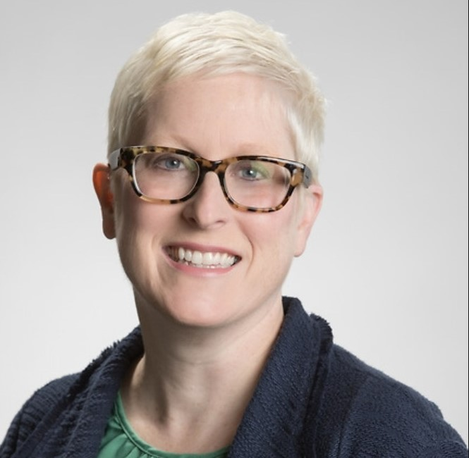
facilitators
Chris Herzog
  Principal TA Consultant
    AIR
      cherzog@air.org
Lori Collins
  Senior TA Consultant
    AIR
      lcollins@air.org

Slide 4

DOL Presenters
Kristen Hefley, Ph.D.
  Workforce Analyst, Nursing Expansion Program Lead
    Department of Labor/ETA, Office of Workforce Investment

Slide 5
agenda
Welcome and Agenda (5 minutes)
Framing Preceptorship (35 minutes)
  Preceptorship as Systems Change
  Reporting Your Preceptorship Activity
  Using Grant Funds for Preceptorship
Grantee Spotlights (25 minutes)
Q&A (20 minutes)
Next Steps and Wrap Up (5 minutes)

Slide 6
PRECEPTORSHIP AS SYSTEMS CHANGE
understanding the preceptor requirement and how to meet it

Slide 7
Review: the GRANT preceptorship requirement
“To achieve the FOA’s goal to expand the pipeline of nursing professionals, applicants [for Track 2] must describe the strategy to support the increased uptake of experienced nursing professionals who will become preceptors to mentor and prepare a new generation of nurses. This track requires applicants to address this issue as part of their workforce development strategy by using partnership agreements with their employer partners to ensure reduced administrative barriers, time carved out of the regular schedule for the preceptor work, and incentives or additional pay for taking on the preceptor role.”
DOL Nursing Expansion Funding Opportunity Announcement (FOA), p. 3

Slide 8
Breaking down the requirement
PURPOSE: to support the increased uptake of experienced nursing professionals who will become preceptors to mentor and prepare a new generation of nurses
TACTIC: as part of [grantees’] workforce development strategy by using partnership agreements with their employer partners

Slide 9
WHAT is a WORKFORCE DEVELOPMENT STRATEGy?
A good workforce development strategy identifies:
  the unmet workforce needs of employers in an industry
  the gap between the needs of employers and the current skills of workers
  training opportunities and other activities that provide the skills necessary to meet the needs of employers
Successful strategies require two-way communication with and buy-in from employers.

Slide 10
The role of the nursing expansion grant on preceptorship
Grantees should implement a workforce development strategy that:
  Solicits information on employer-specific needs and challenges
  Understands and addresses nursing job quality factors that intersect with challenges identified by employers
  Collaborates with employers (and other partners) to implement innovative strategies that increase job quality to support the uptake of preceptorship for experienced nurses

Slide 11
Having an impact
As a grantee, you will have a permanent impact on the institutionalization of new preceptorship activities in your service area.
Initiate
Motivate
Encourage
Convene
Connect
Normalize
You are the driver of systems change!

Slide 12
Building sustainable preceptorship programs
Will likely require a financial investment, such as:
  Additional wages
  Bonuses for time spent on preceptor activity
  Scholarships to pay for additional training
  Investing in activities that professionalize preceptorship and raise its status, such as quality training and/or certification
  Flexibilities such as reduced schedules or workload for nursing rounds to allow time to precept
Employers or other partners can pay these expenses, which can be reported as leverage funds toward the grant (but grant or match funds cannot be used)

Slide 13
TIPS for implementing a successful preceptor workforce development strategy
Key Steps in meeting the preceptorship requirement include:
Clarifying the requirement
Communicating with employers
Collaborating with partners
Crystallizing partnership agreements
Checking on the results

Slide 14

Clarifying the Preceptor requirement
Building preceptorship strategies into your program design is one way your grant helps increase the capacity of an organization to train nurses.
If an organization builds its capacity for preceptors, it is building nursing capacity as well!
Focus your approach:
  Engage your employers and get buy-in to implement new strategies.
  Encourage changes that last beyond the life of the grant.

Slide 15
Communicating with EMPLOYERS
Two-way communication helps get buy-in
  Listen to and understand the unique challenges of your employers.
  Create space to have solution-focused conversations that build trust.
  Explain the measurable positive impact of implementing new strategies for their organization.

Slide 16
Collaborating with partners
Part of your role is to convene organizations and connect them to resources and to one another.
Partners may be able to offer the following, where appropriate:
  Time and resources
  Information/research on successful approaches
  Leveraged training/orientation activities or curricula
  Leveraged monetary or non-monetary incentives to nurses to become preceptors
  Other activities that solve challenges with increasing preceptor capacity

Slide 17
Crystallizing partnership agreements
Roles and responsibilities should be embedded in employer and other partnership agreements
  Monetary and non-monetary incentives
  Time carved out of schedules
  Training opportunities
  Recruiting activities
  Procedural details, such as who will be offered preceptorship and how and when preceptors will be paired with nursing students
  Following up and collecting information about the impact of the preceptorship strategy(ies)
  Other roles/responsibilities
Reminder: There are limitations on paying for preceptor wages and training using grant or match funds.

Slide 18
Checking on the results
Required preceptor outcome:
  Outcome #7: Total number of experienced nursing professionals who were placed into a preceptor role
You must be able to collect this information from your employer partners
Share results with your stakeholders
Report the data to DOL

Slide 19
Reporting Your Preceptorship activity
what counts in the preceptor outcome?

Slide 20
OUTCOME #7 DEFINITION
Definition provided in the Handbook:
  Refers to experienced nursing professionals who take on a preceptor role as a result of the grant and begin actively performing preceptor duties
    Experienced nursing professionals
    As a result of the grant
    Actively performing preceptor duties

Slide 21
Breaking down the definition of outcome #7 into core components
“Experienced nursing professionals”
  Nurses with prior nursing work experience that is sufficient for them to serve as effective mentors to nursing students
“As a result of the grant”
  As a result of the preceptorship workforce development strategy(ies) you implement
“Actively performing preceptor duties”
  Begin providing mentoring activities to nursing students in the workplace
    Note that the nursing students being provided preceptorship do not necessarily have to be grant participants!

Slide 22
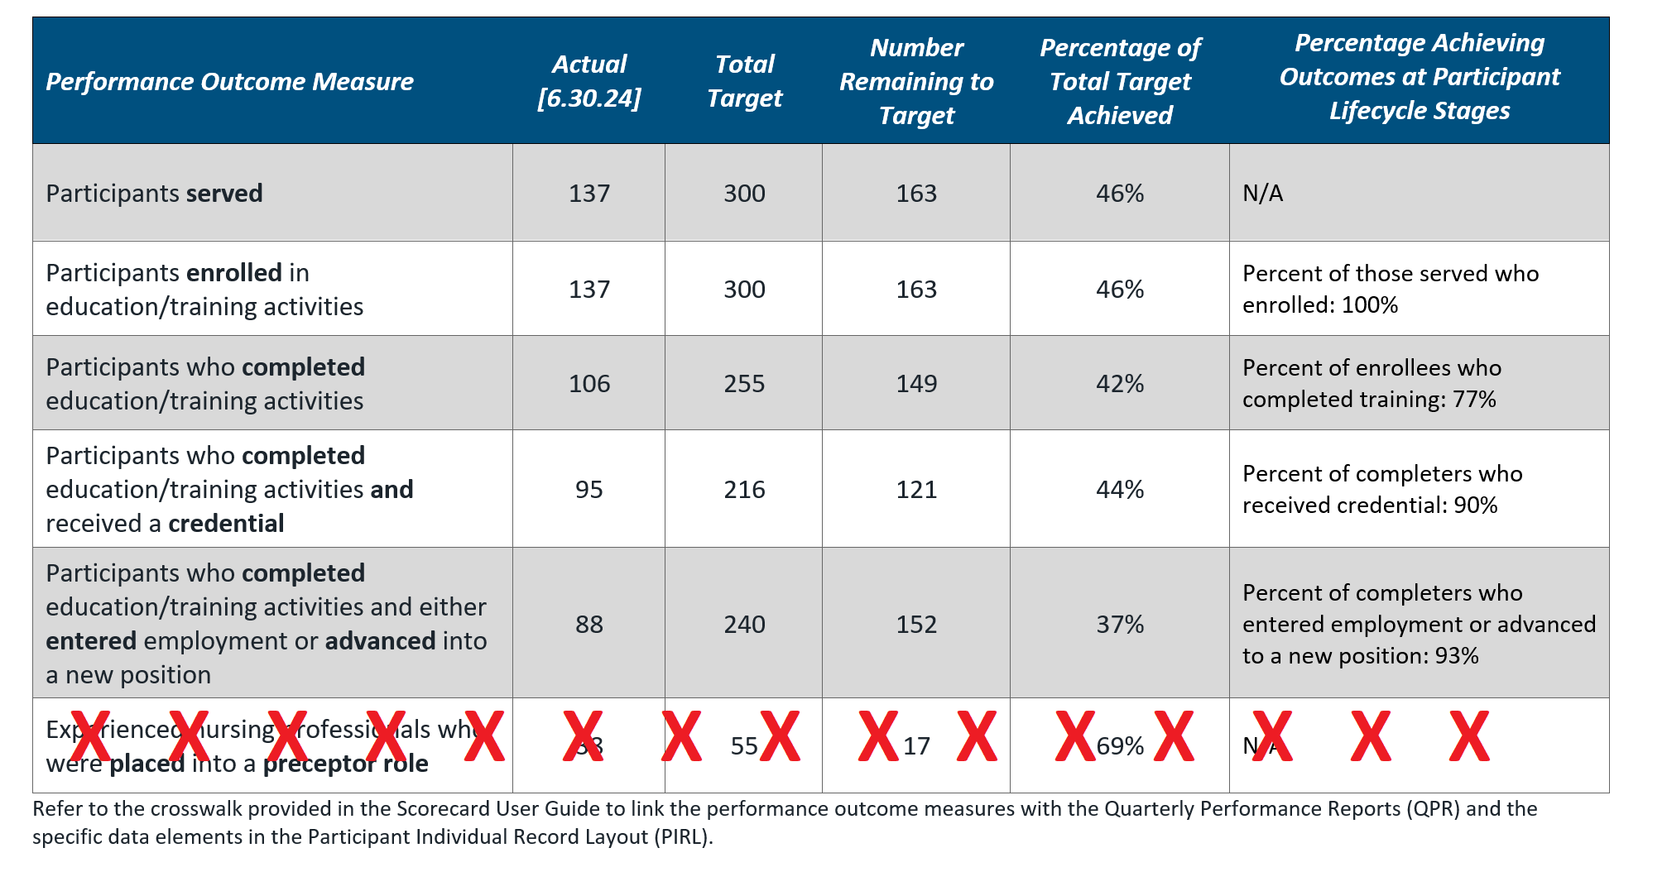
SCORECARD revision

Slide 23
Why was outcome #7 removed from the scorecard?
Participant outcomes versus capacity building outcomes
  Participant outcomes (Outcomes #1-6) show what participants are doing
  Capacity building outcomes (Outcome #7) show the impact of actions you take
Removal of Outcome #7 from the scorecard
  Distinguish it from the participant outcomes
  Emphasize DOL’s interest in building preceptor capacity over merely meeting a numerical target
Please note that removing the outcome from the scorecard does not eliminate the requirement to report on it. You will continue to report your progress on it in your QNR.

Slide 24
HOW TO REPORT OUTCOME #7
As a capacity building outcome demonstrating results of actions taken by you:
  Reported quarterly in the Quarterly Narrative Report (QNR)
  Instructions in the H-1B Grants Performance Reporting & WIPS Guidance Handbook for Track 2 (p. 41-42 and 61-62).
You must be able to collect this information from your employer partners to report it.
Notes:
.

Slide 25
Using grant funds for preceptorship
what’s allowable vs. what meets the preceptor requirement

Slide 26
Preceptors and your program design
Grantees must implement a workforce development strategy to generate new ways of building preceptor capacity.
Grantees may also be supporting their participants (i.e., nursing students) by using preceptors as part of the program design.
  This activity is not sufficient to meet the preceptor requirement and count in Outcome #7.

Slide 27
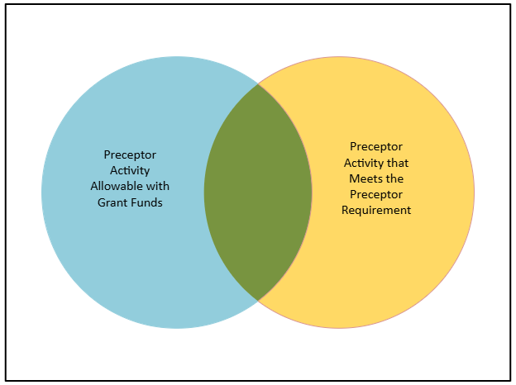
The relationship between Allowability and the preceptor requirement
Allowability = grant funds can pay for this activity
“Allowable” is not the same as “reportable in the preceptor outcome”

Slide 28
Allowable activities that meet the preceptor requirement
What do grant funds pay for in support of the preceptor requirement?
Staff time and resource costs associated with:
  communication and collaboration with employers on preceptor strategies
  convening partners and resources
  drawing up agreements
  outreach and marketing
  instituting a new preceptor model

Slide 29
Expanded definition of Outcome #7
Count in this outcome:
  The number of nurses with prior nursing work experience that is sufficient for them to serve as effective mentors to nursing students who take on a preceptor role as a result of the preceptorship workforce development strategy(ies) you implement and begin mentoring nursing students

Slide 30
Questions?

Slide 31
Grantee spotlights
Atlantic Health and University of south Dakota

Slide 32
grantee Presenters
Valerie Woodruff, MSN, RN, CCRN
  AHS PEACE Program Nurse Educator
    Atlantic Health
      Valerie.Woodruff@atlantichealth.org
Michelle Knuppe, MSN, RN
  Program Director
    University of South Dakota
      Michelle.Knuppe@usd.edu
Dawn R. Warren, MSN, BSN, RN
  Clinical Coordinator
    University of South Dakota
      Dawn.Warren@usd.edu

Slide 33
Atlantic Health System
Nursing Preceptorship Program
DOL AHS PEACE Program
Pathways to Ensure Access to Clinical Excellence in Nursing
April 2025
The Atlantic Health System PEACE Program is supported by the U.S. Department of Labor. A total of $2,785, 263 or 83 percent of the Atlantic Health System PEACE program is financed with Federal funds and $557,053 or 17 percent is funded by other sources.

Slide 34

Serving Northern New Jersey
Counties Served: Bergen, Union, Essex, Hudson, Morris, Passaic, Sussex, Warren, Monmouth

Slide 35
AHS PEACE Program Partnerships
Educational Partners
William Paterson University
Union County Project Search
Workforce and Training Partners
Goodwill Industries Inc.
Workforce Development Program Partner
Professional Organizations
Organization of Nurse Leaders of New Jersey: Nursing Workplace Environmental and Staffing Council (NWESC)
Employer Partners
Morristown Medical Center
Overlook Medical Center
Hackettstown Medical Center
Newton Medical Center
Chilton Medical Center
Atlantic Medical Group
Atlantic Visiting Nurse
CentraState Healthcare System
County College of Morris
Pequannock Township: Morris County Allied Health Academy
Workforce Development Board of Northwest NJ

Slide 36

Atlantic Health System Preceptorship Policy
9/1/2022
All new nursing employees with be assigned a qualified preceptor, who in coordination with the manager or designee, will monitor and evaluate the new employee’s competency during their clinical orientation.
This Photo by Unknown Author is licensed under CC BY

Slide 37
Ladders & Latticed Career Pathways in Nursing
Level 1
Preceptor to Students
Score >28
Level 2
Preceptor to Experienced RNs/Transitional RN
Score >32
Level 3
Preceptor to New Graduates/Hire Learners
Score >38
Web Based Preceptor Training Modules and
In-Person Course
Training update every 3 years
Annual Preceptor Evaluation Eligibility by Nurse Manager or designee (Unit Educator, ANM)
Demonstrated leadership skills
Demonstrated knowledge, skills and attitude in area of practice
Preceptor Selection Tool
Based on Score of Selection Tool – preceptor is eligible to precept on 3 levels (Max score 42)
Eligibility
Experienced RN
Minimum 1 year Experience
BSN Preferred

Slide 38
Preceptor Selection and Evaluation Tool for Leadership
The Preceptor is rated on the attributes listed below. Each attribute is worth up to three (3) points:
One (1) = Needs Improvement Two (2) = Meets Expectations Three (3) = Exceeds Expectations
Evaluation Criteria (Max Score 42 points)
Clinical competence
Nursing Process
Transformational Leadership
Collaboration/Communication Skills
Professional Development
Conflict Resolution
Commitment
Flexibility
Empowerment
Values

Slide 39

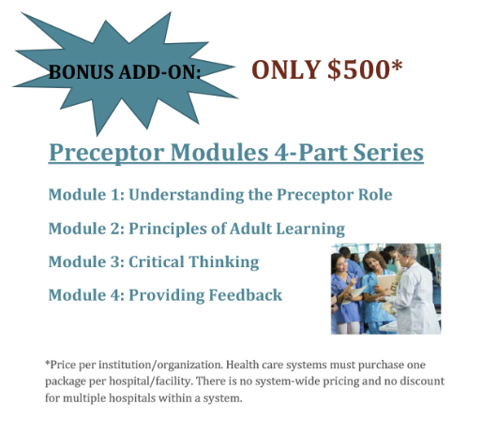
Preceptor Training
Standardized Modules purchased through The New Jersey Collaborating Center for Nursing
Classroom Training
Requirements:
Must complete on-line modules
RN Preceptor Classroom Training
Preceptor Classroom Training Update required every 3 years

Slide 40

Preceptor Compensation
Hourly Compensation: $1.60/hour
Preceptor Bonus Pay
    4 hours =$25.00
    8 hours= $50.00
    12 hours= $75.00
Note: Preceptor Compensation and Training is not funded by the DoL Grant
Atlantic Health System’s Preceptor Compensation Policy was in existence prior to the DoL Grant Period
This Photo by Unknown Author is licensed under CC BY-ND

Slide 41

Preceptor Evaluation
By Orientee following completion of clinical orientation
Annually by Nurse Manager

Slide 42

The Value of AHS Preceptorship in the words of our RN Orientees
AHS: Preceptor Evaluation Tool by Orientee (24 Questions)
My orientation experience exceeded my expectations. My preceptors were excellent - kind, caring, and gold-standard in providing patient care, and encouraging for me to learn as much as possible and take complex patient assignments
Brandon really gave me the freedom and confidence to think on my own during orientation
Andi was an excellent preceptor! She was patient with me and always answered my questions. She knew my limitations and talked me through care for my patients and always provided explanation for the things that we were doing.
He truly challenged my knowledge and pushed me out of my comfort zone to be more independent. He really stressed to me the importance of knowing as much as possible about your patient so that when questions come, I can be ready to answer without hesitation.
Overall, I am very grateful for the time and dedication my preceptors gave to help start my critical care nursing career.
Absolutely amazing, I can’t say enough good things!!!!

Slide 43
Thank you

Slide 44
South Dakota Nursing Network
A Worker-Centered Strategic Response to Nursing Shortages in South Dakota
DOL Nursing Expansion Grant
Michelle Knuppe, MSN, RN, Program Director
Dawn R. Warren, EdD, MSN, BSN, RN, Clinical Coordinator

Slide 45

Project Purpose Overview
Purpose: A worker-centered strategy group that will design programs, guide project implementation, and provide feedback to action teams.
Action Team I
Action Team II
Purpose: Improve training to engage healthcare stakeholders and education institutions in the adoption and deployment of training for high demand nursing positions.
Action Team III
Action Team IV
Purpose: Address and develop innovative strategies to solve issues with preceptor supply while leveraging current partner efforts.
Purpose: Develop good quality jobs and review current practices, policies and environmental strategies to promote employment standards for nursing.
Purpose: Support the development of a nursing workforce that is representative of the state through targeted recruitment activities.

Slide 46
Action Team III
Purpose: Address and develop innovative strategies to solve issues with preceptor supply while leveraging current partner efforts.
Overall Goal: Increase the number of experienced nursing professionals serving as preceptors across the state of S.D., with emphasis on the underserved and mental health needs.

Slide 47
How?
Determine the current preceptor supply/need.
Identify barriers that impact current preceptor supply.
Review roles (best practice) of the preceptor.
Review current preceptor education while determining what is working well and what challenges exist.
Identify what resources are currently available to preceptors.
Identify strategies for a successful preceptorship.
Discuss rewards and benefits for preceptors and students.
At least 10 students will complete a preceptorship experience that includes a mental health setting
Develop an evidence-based tool kit to increase the number of high-quality, well-prepared preceptors.
Share/disseminate plan across the state of S.D.

Slide 48
Preceptor Survey Fall 2024
Two questions provided the most valuable information to advance the work of Action Team III
What reservations do you have when considering being a preceptor for a nursing student?
    Self doubt related to ability to be a preceptor
    Concerns about the time commitment
What actions could your employer or USD Nursing take to increase your willingness to be a preceptor?
    About half responded nothing
    The remaining responses focused on incentives
      Financial
      Additional education
      Recognition

Slide 49
Preceptor Spring 2025
Did a pre- and post- survey
Added questions
  What do you enjoy most about being a preceptor
  What are your reservations about being a preceptor
  What are the challenges of being a preceptor

Slide 50
General Conclusions
Preceptors enjoy being preceptors!
Being a preceptor allows them to advocate for their area of nursing
Scheduling and time are a constant barrier
  Slows down the care the preceptor provides
  Challenge to provide quality education
  Not all moments are teachable moments
  Not always time to act on potential teachable moments

Slide 51
Future Strategies
Develop a preceptor toolkit
Revise the preceptor handbook
Preceptor recognition and awards
Exploring unique preceptorship experiences

Slide 52
Thank you!
Michelle.Knuppe@usd.edu
Dawn.warren@usd.edu

Slide 53
Questions? 2

Slide 54
Next steps and wrap-up

Slide 55
Thank you! END

