Slide 1
WIOA & Data Validation
Module 16
2019 WIOA National Performance Training
U.S. Department of Labor
Employment and Training Administration

Slide 2
WIOA & Data Validation - Definition
WIOA section 116(d)(5) requires the Departments to establish data validation guidelines to ensure the information contained in program reports is valid and reliable.

Slide 3

Today’s Objectives
Review Joint Data Validation Requirements
Identify where States are in achieving the framework
Discuss feedback for DOL only guidance, best practices, challenges

Slide 4

Quote
“Toto,
I’ve got a feeling we’re not in Kansas anymore.”
~ Dorothy Gale, The Wizard of Oz

Slide 5
WIOA Data Validation: The Next Generation
DOL, in collaboration with the Department of Education, published Training and Employment Guidance (TEGL) 7-18 DOL to provide States with a general framework for data validation
Applies to the six core programs:
  WIOA title I: Adult program, Dislocated Worker program, and Youth program,
  Title II: The Adult Education and Family Literacy Act (AEFLA) program,
  Title III: Employment Service program authorized under the Wagner-Peyser Act, as amended by WIOA title III and administered by DOL;
  Title IV: Vocational Rehabilitation (VR) program authorized under title I of the Rehabilitation Act of 1973, as amended by WIOA title IV and administered by ED.

Slide 6

WIA vs. WIOA
State agencies develop their own data validation procedures for their programs
  No specific statistical validation methodology
  No specific data validation software
  No performance report

Slide 7
Do I have to….
Develop a joint procedure with the six core programs?
Conduct data validation jointly?
Submit a report? Jointly?
Use software? Whose?
NO

Slide 8
What IS Required?
Written procedures: Process for identifying and correcting errors or missing data.
Train Staff: At least once a year.
Monitoring protocols: Ensure staff are following the written data validation procedures and take appropriate corrective action as needed.
Procedures
Training
Monitoring

Slide 9
What IS Required? (cont.)
Regularly review program data (quarterly) for errors, missing data, out-of-range values, and anomalies.
Document errors are corrected.
Regularly assess effectiveness of the data validation process (e.g., at least annually) and revise as needed.
Review
Document
Assess

Slide 10
Source Documentation
Same concept as WIA
Allows electronic, paper, or mix of options
States can customize source documentation

Slide 11
Source Documentation: A Closer Look
States must include regular data element validation through core program monitoring on 24 common data elements in the joint WIOA Participant Individual Record Layout (PIRL) which are listed in Attachment I of the guidance.
States may:
  Maintain supporting documentation for program-specific data elements not included in this joint guidance.
  Conduct additional source document validation on more data elements.
  Require additional source documentation in their procedures.
Attachment I contains instructions and definitions that ensure all programs are interpreting different types of source documentation consistently.

Slide 12
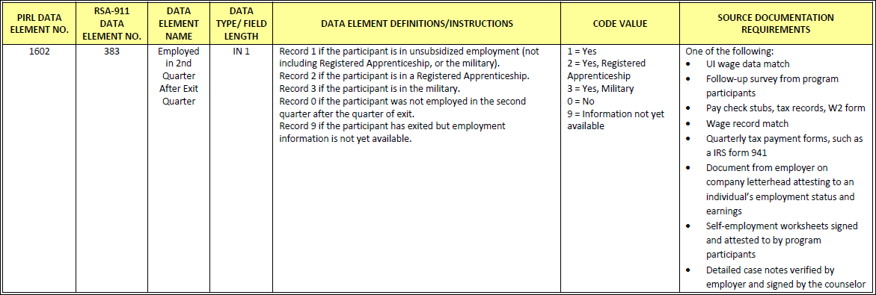
Source Documentation: A Closer Look Example
Employed in the 2nd Quarter after Exit
The State program may choose any of the source documents listed, as appropriate.

Slide 13
Coming Soon: DOL Only Guidance
ETA is drafting data validation guidance that expands upon TEGL 7-18 for titles I and III, and includes instructions for DOL-only funded grant programs to ensure that data contained in all program reports submitted to DOL is valid and reliable.
This upcoming DOL-only data validation guidance will have additional data elements where ETA prescribes source documentation.

Slide 14
Examples:
What States are Saying
  Accountability specialist who regularly monitors the local program data and provides technical assistance.
  Audits completed at eligibility.
  State uses a comprehensive monitoring tool including data elements.
  Monitors incorporating data validation quarterly monitoring visits.
  MIS monitoring is focused on data validation.
  Mandatory data validation checks on participant files during annual program monitoring.
  Electronic reviews: Reviewing data regularly for errors and outliers.
Data Validation Incorporated into Monitoring

Slide 15

Reporting
No separate data validation report
Tell us your methodology in the annual report narrative
Different Title programs are not expected to report jointly

Slide 16

Monitoring
DOL will incorporate data validation into grants management
  Check for processes
  Procedures
  Training
  Corrective action
  File review and source documentation
  Ongoing data analysis

Slide 17
Discussion Questions
To what extent have you developed data validation procedures consistent with the framework outlined in the TEGL?
    a. Develop written DV procedures?
    b. Conduct regular reviews or data?
    c. Document issues?
Have any states implemented (or plan to implement) a statistical sampling methodology?
Have any states required data element validation beyond the 24 required elements? If so, how were they chosen, and how did you develop the requirements for source documentation?
What additional guidance would be useful that could be included in the DOL only Data Validation?

Slide 18
Any Questions?

Slide 19
Contact
 ETAPerforms@dol.gov

Slide 20
Please complete your evaluations.

