Slide 1
Nursing Expansion Institute & Next Steps – Track 1
Day 3, Session 1B: Nursing Expansion Institute

Slide 2

Moderator/Presenter
Dallas Oberlee
  Senior Associate
    Social Policy Research Associates
      Dallas_Oberlee@spra.com
        510-988-0190

Slide 3
Agenda
Objective & Guiding Questions
Reflection and Open Discussion
Participant Support Lifecycle
  Review and Workspace
Strategies, Opportunities, and Solutions
Wrap up and Close

Slide 4
Session Objectives
Session Objectives
  Planning and development of each grantee’s Participant Support Lifecycle tool
  Identify key action items and next steps for each grantee.

Slide 5
Guiding Questions
Guiding Questions
  What does your Participant Lifecycle look like for your project?
  What do you want to implement in your program after this convening?
  What action do you need to take?

Slide 6

Reflection and open discussion
How are you feeling as we are nearing the end of the convening?
What areas do you feel excited about tackling when you get home?
What are your “Aha” moments from the convening?
What questions still remain?

Slide 7
Participant support lifecycle
Review and workspace

Slide 8
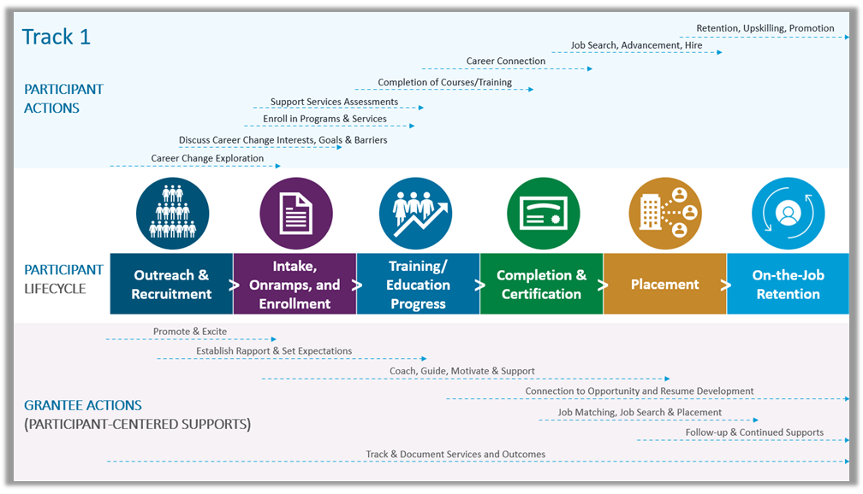
Review: Participant Support lifecycle

Slide 9
Workspace: Participant Support lifecycle tool
Using the PSL to Design Participant-Centered Supports
  Step 1: Define/Refine Key Components and Milestones
  Step 2: Align with Metrics, Identify Potential Loss Points, and Brainstorm Strategies
  Step 3: Explore Resources and Promising Practices
  Step 4: Plan for Action

Slide 10

Solutions, Strategies, and Opportunities

Slide 11
Strategies, Opportunities, and solutions
Strategies/Opportunities
What do you want to explore or implement with your program after the convening?
Solutions
What areas do you still need to develop solutions around?

Slide 12
Wrap Up and Close
Thank you!

Slide 13

Thank you!
The American Institutes for Research® (AIR), completed this project with federal funds, under contract number 1605C2-23-Q-00074 Nursing Expansion Grant TA, from the U.S. Department of Labor, Employment and Training Administration. The contents of this publication do not necessarily reflect the views or policies of the Department of Labor, nor does mention of trade names, commercial products, or organizations imply endorsement by the U.S. Government. AIR is a nonpartisan, not-for-profit organization that conducts behavioral and social science research and delivers technical assistance to solve some of the most urgent challenges in the U.S. and around the world.

