Slide 1

Strategies and Tools for Managing
Partnerships
A nursing expansion peer-to-peer event

Slide 2






Inclusive Meeting Guidelines
Hosting and Participating in Meetings
ENGAGE EVERYONE
BE HEARD AND SEEN
ACKNOWLEDGE SPEAKER
MAXIMIZE MICROPHONES
MINIMIZE NOISE
MAXIMIZE VISUAL DISPLAYS
These guidelines are intended to improve the meeting experience for virtual participants, as well as people with hearing loss, visual impairment, and those for whom English is an additional language.

Slide 3

PRESENTER
Lori Collins
  Coach and Senior TA Consultant
    AIR
      lcollins@air.org

Slide 4
AGENDA
Welcome
Reaffirming Strong Partnerships – Vision, Mission, and Management
Partner Relationship Management Tools
Q&A with Coaches
Facilitated Discussion
Wrap-Up

Slide 5
Reaffirming Strong Partnerships

Slide 6
Shared Vision and Mission
Serves as the guide for fostering ongoing collaboration, advancing initiatives, and sustaining momentum
Provides alignment of efforts toward common objectives
Ensures adaptability and resiliency
Supports development of trust over time

Slide 7









EFFECTIVE COLLABORATION STRATEGIES
Which approaches are you already using?
Clear and Frequent Communication
Shared Goals and Individual Roles
Mutual Respect
Conflict Resolution
Regular Meetings
Trust Building
Inclusive Decision-Making
Flexibility and Adaptability
Resource and Knowledge Sharing

Slide 8
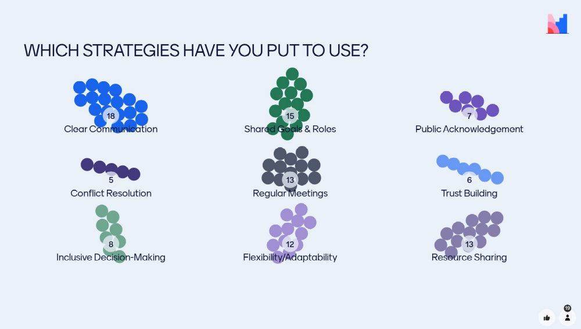
Strategies poll results
What strategies have you put to use? | Results
Clear communication | 18
Shared Goals and Individual Roles | 15
Public acknowledgement | 7
Conflict resolution | 5
Regular meetings | 13
Trust building | 6
Inclusive decision-making | 8
Flexibility/adaptability | 12
Resource sharing | 13

Slide 9
Partnership agreements
Key elements include:
Statement of commitment to the shared vision and mission
Roles and responsibilities
Expected performance outcomes, deliverables, and milestones
Timelines and deadlines
Resource contribution commitments
Administrative and reporting requirements

Slide 10
Partner relationship Management tools

Slide 11
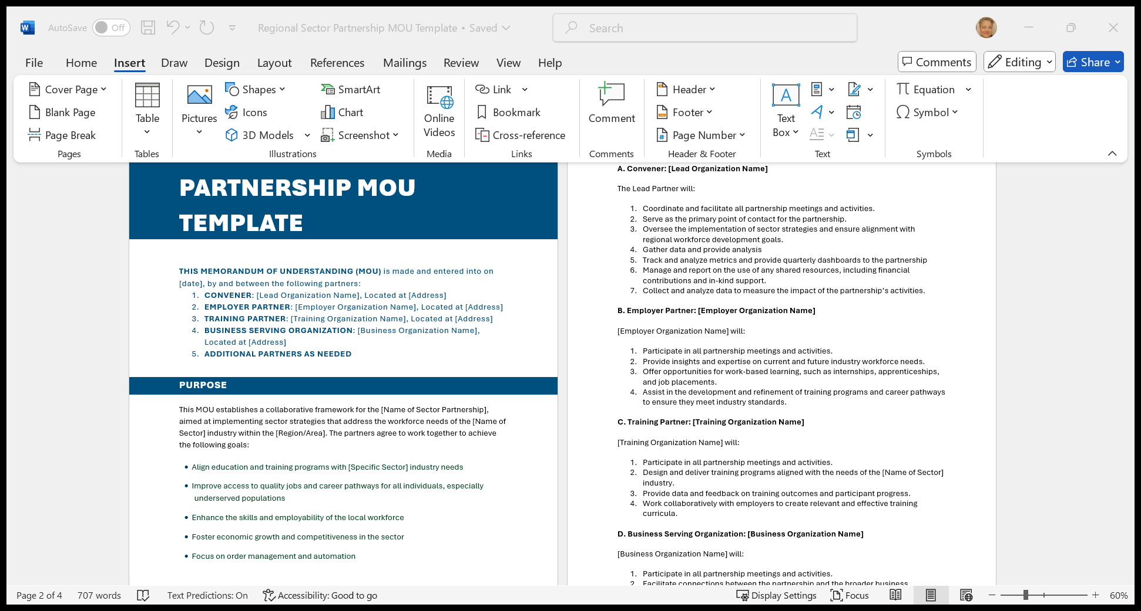
Sample Partnership agreement Tool on WorkforceGPS

Slide 12
Why Measure Partnership Impacts and Value (beyond grant metrics)?
Hold partners accountable
Determine strength of strategies
Advance continuous improvement
Tell your “story”
Attract new partners
Attract new and more diverse resources

Slide 13
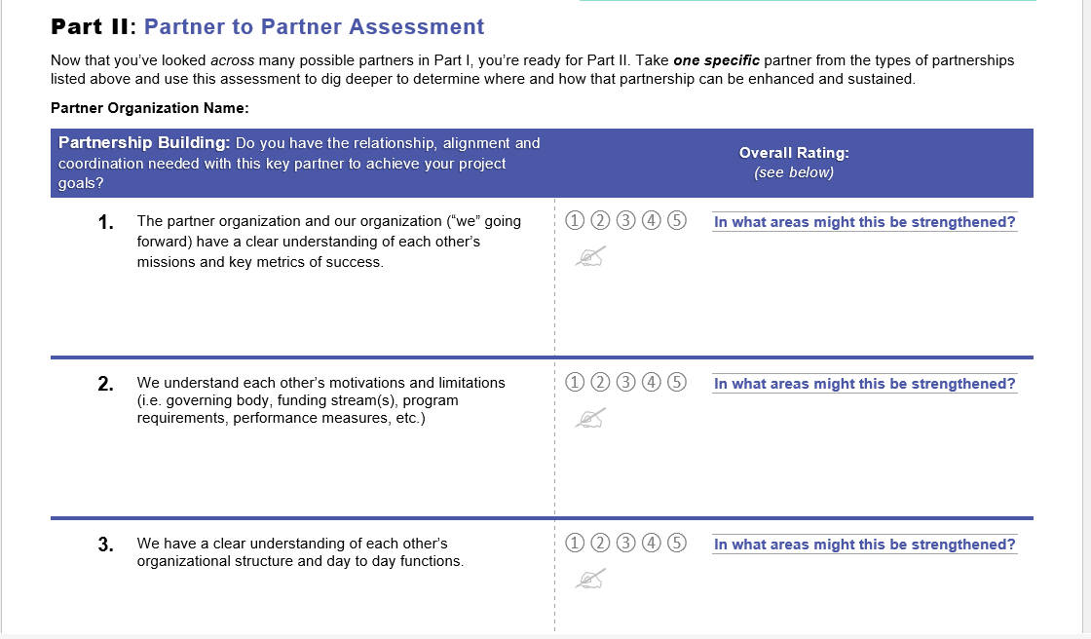
Sample Partnership measurement tool

Slide 14
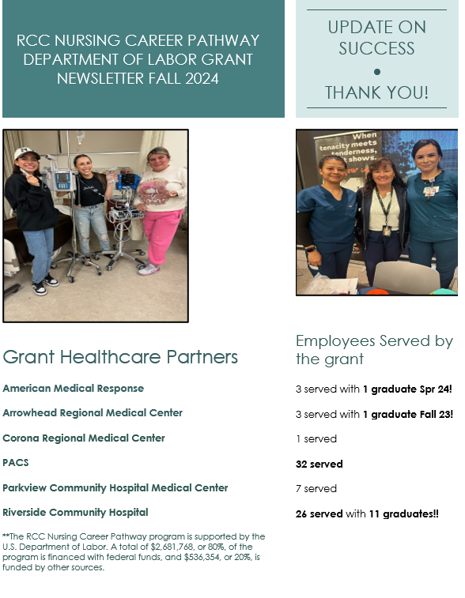
Sample Partnership newsletter
Newsletters can help to reinforce vision, attract new partners and funding, communicate successes and drive event participation
Riverside Community College Newsletter

Slide 15
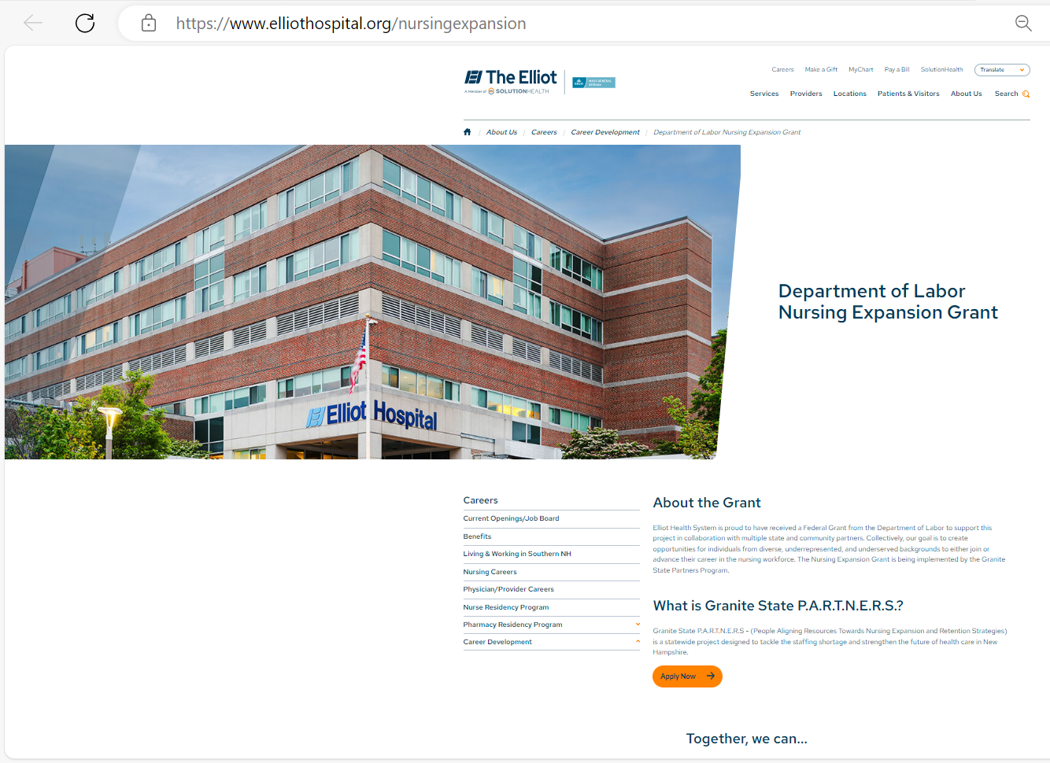
Sample Partner Website
Partner websites can be used to share information and resources with current and future partners

Slide 16
Resource links
Sample Regional Sector Partnership Agreement
Sample Sectors Self Assessment and TechHire H-1B Partnership Assessment Tool
Sector Strategies Framework Implementation Guide and Action Planning Tool

Slide 17
Questions?

Slide 18
Peer Discussion
What strategy did you try that has not yet worked?
What is working well that took awhile for you to build?
What are your current partnership challenges, and how might we think about overcoming them?
  i.e., partners solely focusing on training (failing to enter data and not following through on job placement)
  Strategies for coaching partners?

Slide 19
Thank you!

Slide 20
Contact us!
Lori Collins
  Senior TA Consultant & Nursing Expansion Coach
    AIR
      lcollins@air.org

Slide 21

Acknowledgement
The American Institutes for Research® (AIR), completed this project with federal funds, under contract number 1605C2-23-Q-00074 Nursing Expansion Grant TA, from the U.S. Department of Labor, Employment and Training Administration. The contents of this publication do not necessarily reflect the views or policies of the Department of Labor, nor does mention of trade names, commercial products, or organizations imply endorsement by the U.S. Government. AIR is a nonpartisan, not-for-profit organization that conducts behavioral and social science research and delivers technical assistance to solve some of the most urgent challenges in the U.S. and around the world.

