Slide 1
Effective PARTNERSHIP Strategies
Day 2, Session 6: Nursing Expansion Institute

Slide 2
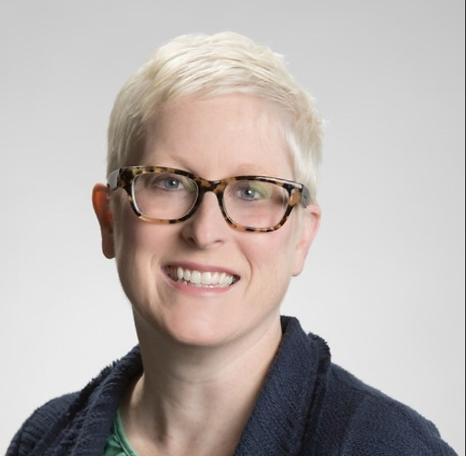
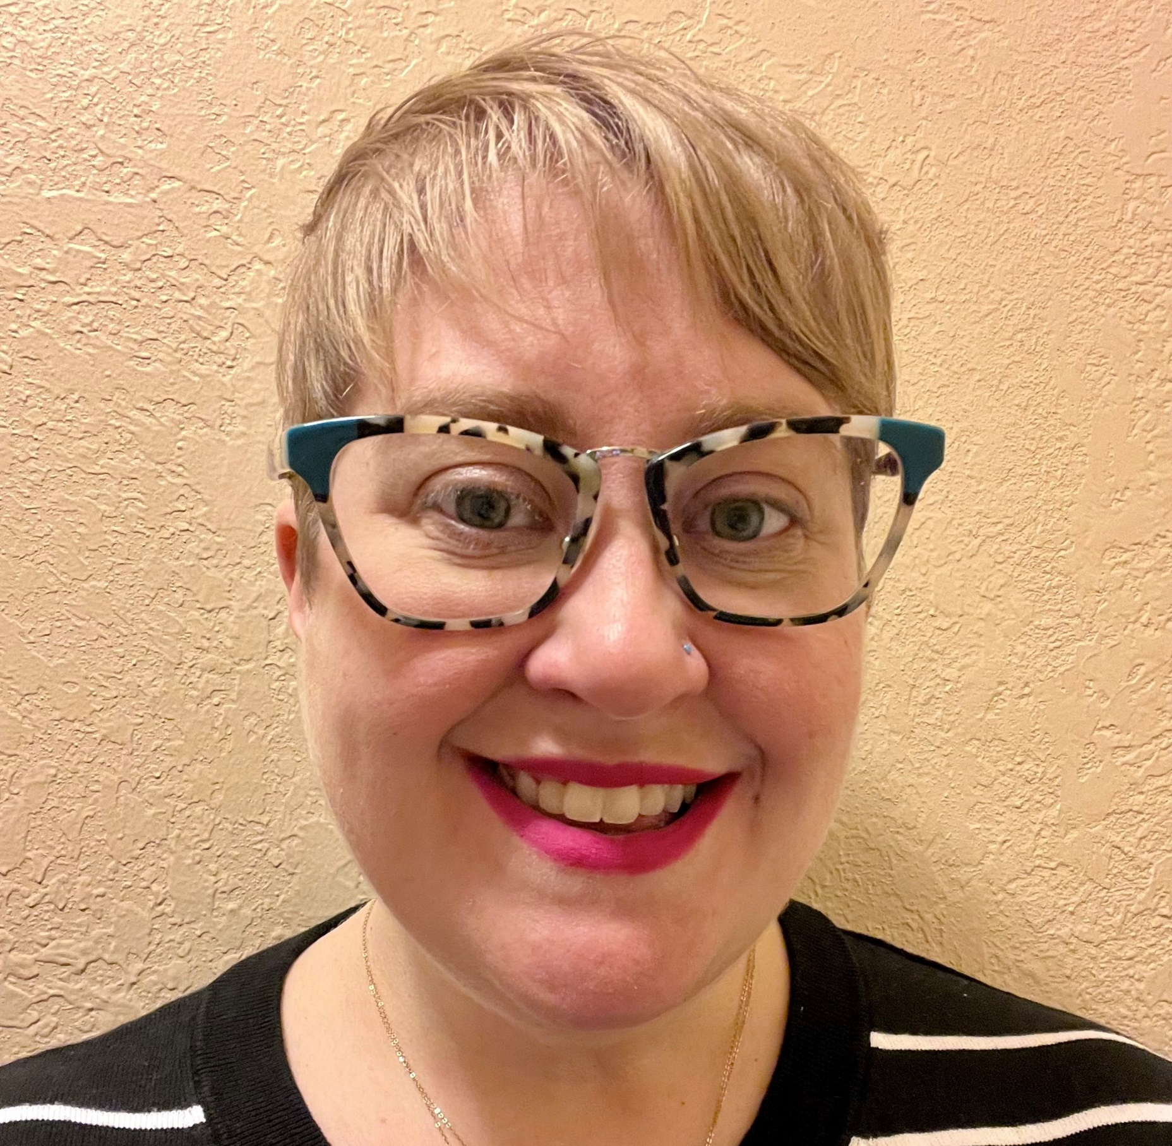
facilitators
Lori Collins
  Senior TA Consultant/Nursing Expansion Grantee Coach
    AIR
      lcollins@air.org
Darcee Simon
  TA Consultant/Nursing Expansion Grantee Coach
    AIR
      dsimon@air.org

Slide 3
Agenda
Session Objectives & Guiding Questions
Effective Partnership Strategies – PSL
Grantee Promising Practices Panel: Alluvion Health & University of Alabama
Working Through Partnership Challenges
Table Discussions
Q&A

Slide 4
Session objectives
Session Objectives
  Identify and explore key elements of effective partnerships
  Learn from two grantees on their best practices
  Discuss what to do when challenges arise

Slide 5
Guiding Questions
Guiding Questions
  Why have partnerships?
  What makes an effective partnership?
  How can we mitigate partnership issues?

Slide 6
Effective Partnership Strategies – PSL
Outreach & Recruitment | Intake, On-ramps, & Enrollment | Training/ Education Progress | Completion & Certification | Placement | On-the-Job Retention

Slide 7
Quote
If you want to go fast, go alone. If you want to go far, go together.
~African proverb

Slide 8

Why do we develop partnerships?

Slide 9
Why do we develop partnerships? (survey results)
Help with recruitment and sustainability
To help us accomplish goals
To get a grant
Shared vison
To ensure we are making the biggest impact possible.
To ensure participants have good experiences
Community engagement and broader perspective
To share the load. To braid resources
Support
Different perspectives
Helping one another to achieve a common goal
To increase pipelines
Collaborate and support the program
To grow collaboration between academia and workforce
Share resources
Braiding Participant support
Diverse strategies, perspectives, and resources to support participants
Sustainability
To enhance the outcomes
Outreach
To be able to learn and provide support
To combine resources, planning and problem solving
To accomplish together what we cannot do alone
Community buy-in
Bigger impact
We may develop partnerships to secure employment and minimize costs.
To be serve our area.
Increase positive outcomes for the participant
They will employ our participants
To invite other entities to have input and responsibility for outcomes
Braiding support
To offer more to the participants what the organization cannot
Working with people/organizations that have common goals or we have solutions for partners problems

Slide 10
Keys to effective partnership
Shared vision and mission
Communication
Roles and responsibilities
Progress checks
Trust, respect, and collaboration

Slide 11
Shared mission and vision
Establish a clear and shared vision, mission, and goals for the partnership that align with the needs and interests of both parties.
  Helps partners to
    align expectations, resources, and strategies
    communicate their value proposition and impact
Use a collaborative process to engage partners in developing that shared vision, mission, and goals

Slide 12
Communication
Communicate regularly and transparently using various methods
  Establish a communication plan that outlines the frequency, purpose, and format of communication
  Use communication tools that are accessible, reliable, and secure for all partners
  Acknowledge and appreciate the contributions of partners

Slide 13
Define roles & responsibilities
Identify the strengths, needs, and interests of each partner and how those align with the partnership goals
Create a Partnership Agreement that outlines roles, responsibilities, expectations, and benefits of each partner, and how those will be monitored and evaluated
Provide training and coaching to partners, and leverage their expertise and resources to support each other

Slide 14
Progress checks
Monitor and evaluate the progress and outcomes of the partnership, using data to inform decision-making and improvement
  Develop a logic model or theory of change that identifies inputs, activities, outputs, outcomes, and impacts.
  Collect and analyze data and evidence to measure the performance and impact of the partnership.
  Conduct regular reviews and feedback sessions with partners, and use that to continuously identify the strengths, weaknesses, opportunities and threats of the partnership.

Slide 15
Trust, respect, and collaboration
Celebrate successes
Learn together from challenges
Build rapport and relationships
Share lessons learned and best practices

Slide 16
Grantee Panel Discussion

Slide 17
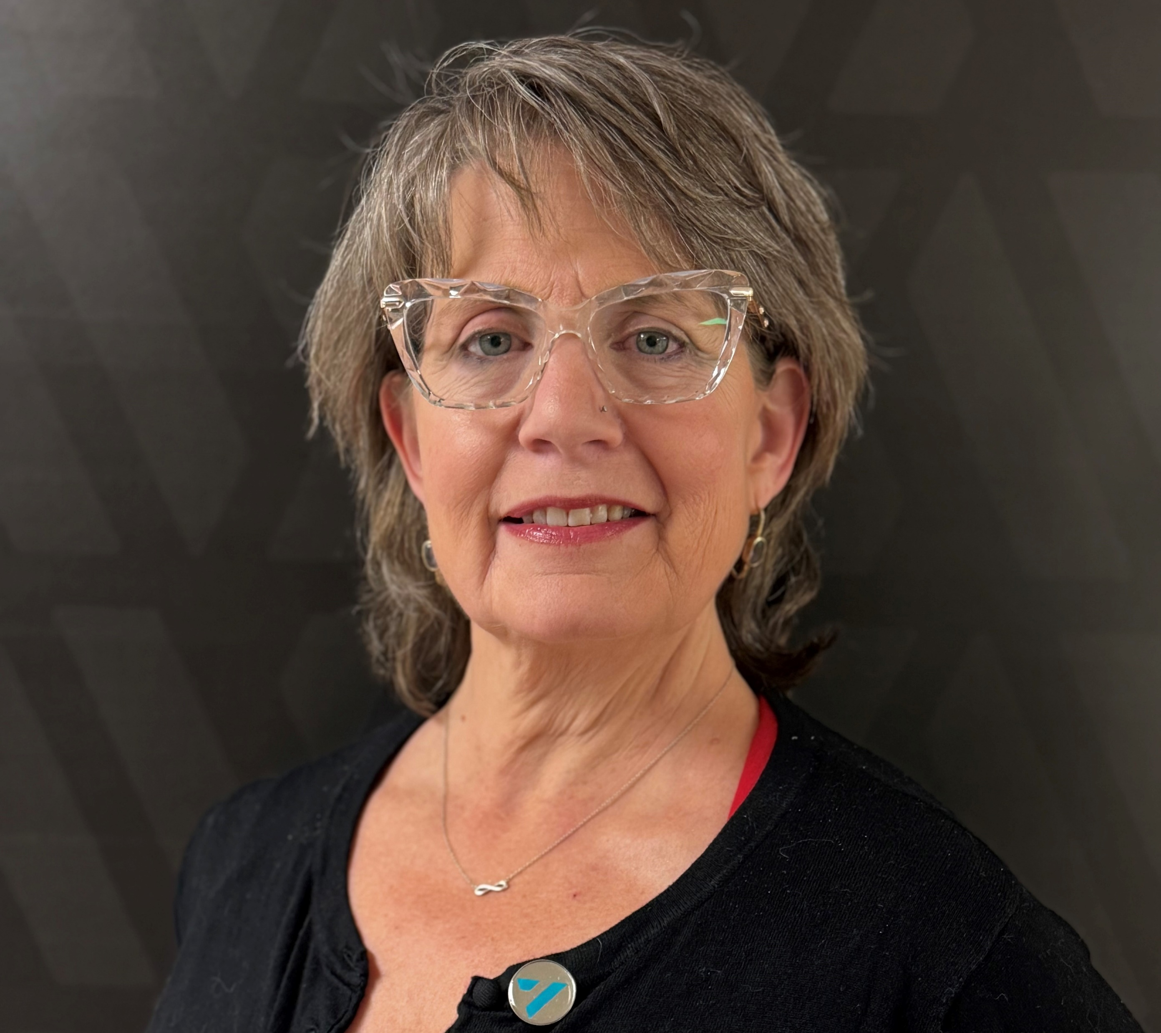
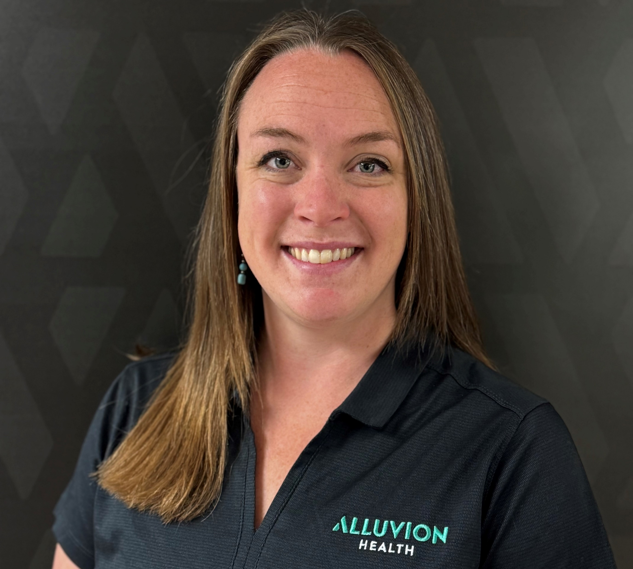

Panelists
Heather Smith, MSN, RN
  Clinical Educator
    Alluvion Health
Hannah Dieterle
  Next Nurse Program Coordinator
    Alluvion Health
Susan Welch, EdD, RN, CNE, CCRN alumnus
  Vice Dean
    University of Alabama
    Capstone College of Nursing

Slide 18
Working through Partnership challenges

Slide 19
When there are conflicts or disagreements
Engage in collaborative problem-solving and decision-making
Seek consensus and compromise
Reflect on the goals of the partnership

Slide 20
Small Group Activity
At your table, pick one of these topics for group discussion:
  What keys of an effective partnership do you think are most important, and why? Is there anything you would add to the list?
  Select a challenge a grantee at the table is having and identify a solution from each of the five keys to an effective partnership.

Slide 21

Insight exchange

Slide 22

Questions?

Slide 23

Thank you!
The American Institutes for Research® (AIR), completed this project with federal funds, under contract number 1605C2-23-Q-00074 Nursing Expansion Grant TA, from the U.S. Department of Labor, Employment and Training Administration. The contents of this publication do not necessarily reflect the views or policies of the Department of Labor, nor does mention of trade names, commercial products, or organizations imply endorsement by the U.S. Government. AIR is a nonpartisan, not-for-profit organization that conducts behavioral and social science research and delivers technical assistance to solve some of the most urgent challenges in the U.S. and around the world.

