Slide 1
Exploring Shifts in Reportable Individual Data
Module 4
2019 WIOA National Performance Training
U.S. Department of Labor
Employment and Training Administration

Slide 2
Module Objectives
Review 2018 Amended PIRL changes to Reportable Individual specifications and element definitions
Discuss shifts in data in relation to these changes
Activity: Reporting Reportable Individuals
Review available resources

Slide 3

Review
The 2018 Amendment to the PIRL changed both the specifications for calculating reportable individuals as well as the definitions for the elements for the services that comprise the reportable individual category.

Slide 4
Changes to the specifications of Reportable Individuals
Before, we attempted to calculate RI using the mix of services and date of exit.
Now, we have added RI code values for programs with RI, added PIRL 1007, and restructured/redefined existing elements to more accurate reflect the definition of RI and simplify the calculation.
NEW: Count of UNIQUE RECORDS where (Reportable Individual) and (PIRL 1002 Most Recent Date Received Basic Career Services (Self-Service) => beginning of the report period or PIRL 1007 Date of Most Recent Reportable Individual Contact >= beginning of the reporting period)
OLD: Count of UNIQUE RECORDS where ((Funding Stream) and (Date of First Basic Career Service (Self-Service) is not null and (Date of First Basic Career Service is null and Date of First Individualized Career Service is null and Received Training = 0)} and (DATE OF EXIT => beginning of the report period or DATE OF EXIT is null))

Slide 5
Changes to PIRL Reportable Individual data element definitions
1000 and 1002: Definitions tweaked to reflect that these elements are roll-ups of services in 1100, 1101, and 1103.
1007: Added to account for individuals that express interest by way of providing identifying information but do not receive services (important for WIOA Youth)
1100, 1101, 1103: Changed definitions from WIA legacy element definitions to align to WIOA categories of:
  Information-only Activities (1100)
  Self service (1101)
  Information-only Services (1103)

Slide 6
Reportable Individual Data Shifts – National
*Source: PY16 Q4-PY18 Q2 State Quarterly Reports

Slide 7
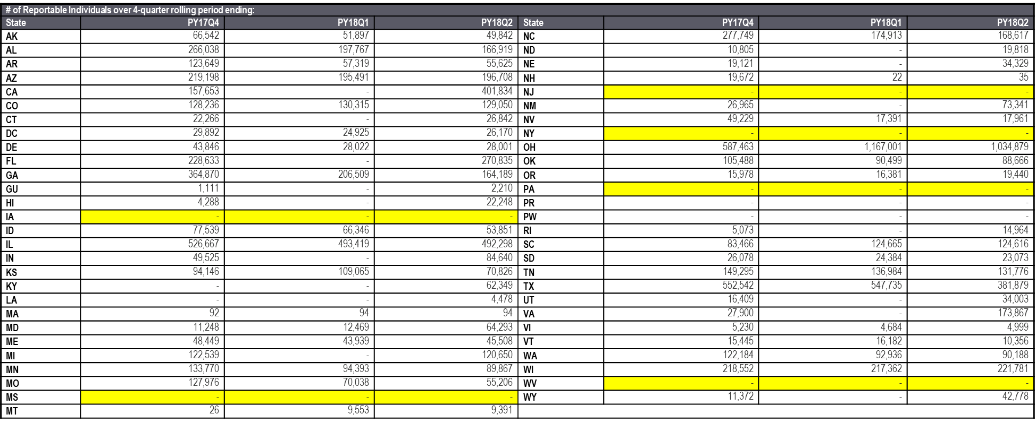
Reportable Individual Data – by State (WP)
*See handout for additional charts
Notes:
Ask about states that had drops from Q4 to Q1. Biggest percentage drops: NH (100%), NV (64%), MO (57%), GA (55%), WV (39%), NC (39%), AL (37%), DE (36%), VA (33%), MN (33%).

Slide 8
Reportable Individual Data Shifts - State
Review the handout for data specific to your state.
Discuss: What outliers stand out?
Discuss: Does this data reflect what you understand to be occurring in your state?
  Number of Reportable Individuals
  Which program is serving Reportable Individuals
Notes:
Ask about states that had drops from Q4 to Q1. Biggest percentage drops: NH (100%), NV (64%), MO (57%), GA (55%), WV (39%), NC (39%), AL (37%), DE (36%), VA (33%), MN (33%).

Slide 9
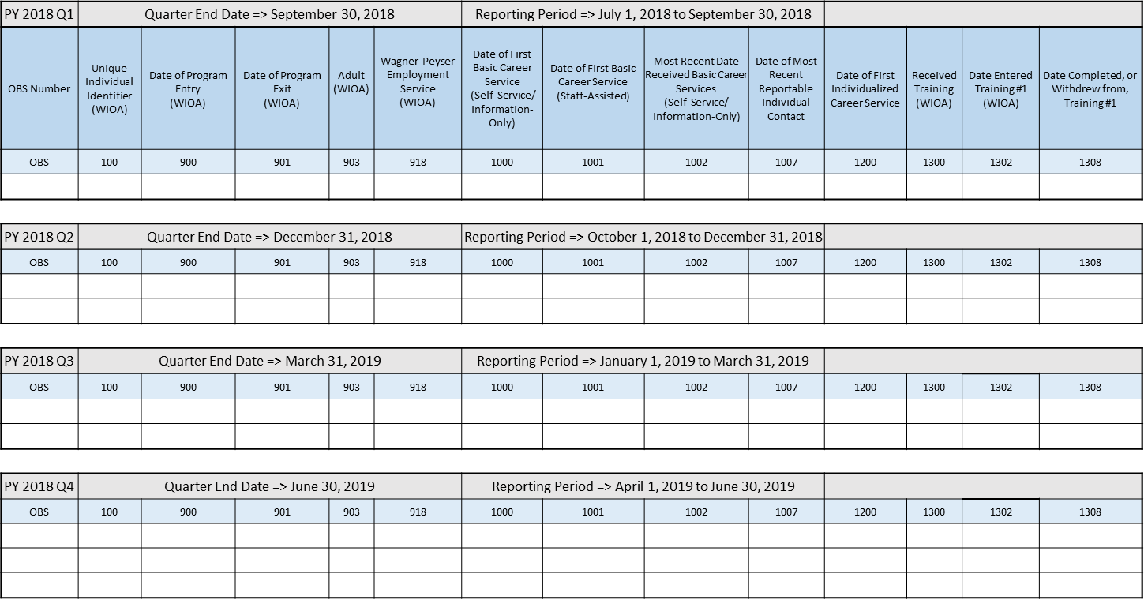
Reportable Individual Activity
Work on the activity at your table (feel free to work as a team)
Fill in the blank cells based on the scenario described in the next slide.

Slide 10
Scenario – WIOA Adult and WP Program
Joe makes first contact with the state workforce agency on 7/5/18. He comes in, provides minimal identifying information and uses a computer station to run a few job searches. While there, Joe is approached by a career counselor for further assistance. Joe says he is interested, but must leave for work and will return some other time. Joe accesses the state job board remotely 2 more times, on 7/15/18 and 7/28/18. Joe returns to the agency 12/5/18 and meets with a career counselor. He has a one-on-one counseling session, during which he works with a counselor to develop an IEP. An IEP is established later that same day and Joe is enrolled in a training program that begins 12/15/18. Joe completes his training 1/15/19. On 2/12/19 Joe returns to the career center for information on job vacancies. He later remotely accessed the state job board on 4/10/19, 5/1/19, and again on 6/2/19.
*Assume Adult/WP common exit policy

Slide 11
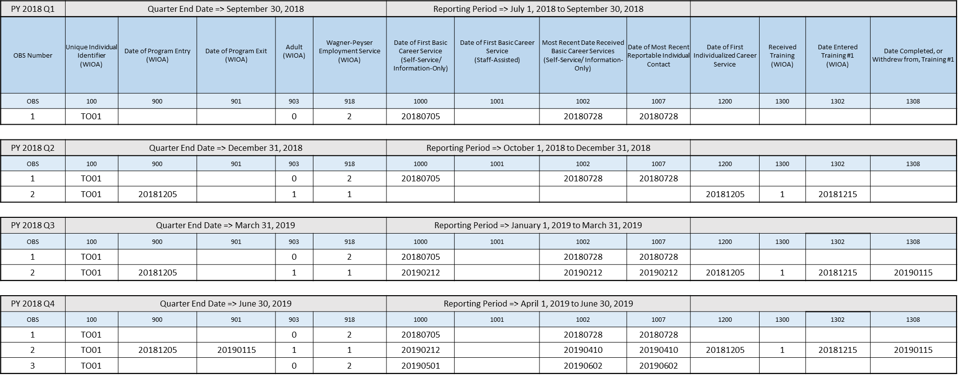
Reportable Individual Scenario Solutions
*Note that the program flags in PIRL 903 and PIRL 918 may look different depending on state co-enrollment/common exit policy.

Slide 12
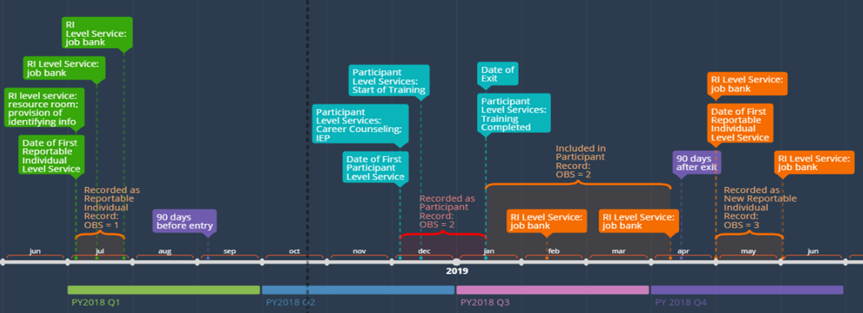
Visual Timeline of Services and Records

Slide 13
Resources
Reportable Individuals Resource Page
    https://performancereporting.workforcegps.org/resources/2018/08/27/15/30/Reportable-Individual-Resource-Page
Reportable Individuals Scenario Tool
    https://performancereporting.workforcegps.org/resources/2018/07/30/15/14/Reportable-Individuals-Scenario-Tool
Understanding Reportable Individuals and Participants for Performance: A Guide to Reporting Services
    https://performancereporting.workforcegps.org/resources/2017/08/01/09/32/Understanding-Reportable-Individuals-and-Participants-for-Performance-A-Guide-to-Reporting-Services
TEGL 14-18
  DOL performance accountability alignment guidance
    https://wdr.doleta.gov/directives/corr_doc.cfm?docn=7611

Slide 14
Contact
 ETAPerforms@dol.gov

Slide 15
Please complete your evaluations.

