Slide 1

Occupational Employment Statistics
Occupational Employment Statistics
June 2020
www.bls.gov/oes
OESinfo@bls.gov

Slide 2
Occupational Employment Statistics (OES)
What are the OES data?
Where can I find the OES data and how are they used?
Stories told by the OES data
Typical entry-level education and STEM (science, technology, engineering, and mathematics) data

Slide 3
What are the OES data?

Slide 4
Overview
Establishment-based (employer) survey
Employment and wage estimates for approximately 800 detailed occupations, as defined by the Standard Occupational Classification (SOC) system
Estimates are of the number of jobs and wages paid in certain occupations
Data published annually

Slide 5
Survey coverage
Sample of businesses from the Quarterly Census of Employment and Wages (QCEW)
  State unemployment insurance database
Survey excludes most of the agricultural sector
Also excludes military and private households
Within federal government, covers executive branch and U.S. Postal Service only

Slide 6
Classification systems
Standard Occupational Classification (SOC) system
  Used to classify jobs into occupations based on job duties
  SOC codes are assigned to individual jobs
North American Industry Classification System (NAICS)
  Used to classify establishments into industries based on primary activity (main product or service)
  NAICS code is assigned to establishment as a whole

Slide 7
How are “employees” defined by the OES survey?
Included:
All full- and part-time workers who are paid a wage or salary
Paid owners, officers, and staff of incorporated businesses
Workers on paid leave
Workers assigned temporarily to other units
Excluded:
Self-employed and owners, partners, and proprietors of unincorporated businesses
Unpaid family workers
Workers on unpaid leave
Workers not covered by unemployment insurance
Contractors and temporary help not on respondent’s payroll

Slide 8
How are “wages” defined by the OES survey?
Wages and salaries only, not total compensation costs
Straight-time, gross pay, excluding premium pay (such as overtime)
Included:
Base rate
Cost-of-living allowances
Incentive pay (commissions, production bonuses, tips)
Guaranteed pay
Hazardous-duty pay
Excluded:
Overtime
Shift differentials
Nonproduction bonuses
Tuition reimbursements
Back pay
Severance pay

Slide 9
Three-year methodology
Each set of OES estimates produced by combining data from six semiannual survey panels, collected over three years
  180,000-200,000 units per panel, for a total three-year sample of approximately 1.1 million
Wages “aged” or updated to reference date based on movements in BLS Employment Cost Index (ECI)
Employment levels benchmarked to average QCEW employment for the two most recent survey panels

Slide 10
Example of three-year methodology
May 2019 estimates are based on the following survey panels:
  May 2020
  November 2019
  May 2019
  November 2018
  May 2018
  November 2017
  May 2017
  November 2016
Each year, two oldest panels drop out, two new ones are added

Slide 11
OES and time series
OES data not designed for looking at changes through time:
  Three-year methodology
  Changes in industry, occupational, and geographic classifications
  Changes in methodology
  Relatively new program with limited historical data
Caution recommended
For more information: www.bls.gov/oes/oes_ques.htm#qf1
Potential methodology change (MB3)
  www.bls.gov/oes/oes-mb3-methods.htm

Slide 12
SOC has 4 levels of occupational groupings
Major Group
29-0000 Healthcare Practitioners and Technical Occupations
Minor Group
29-2000 Health Technologists and Technicians
Broad
Occupation
29-2050 Health Practitioner Support Technologists and Technicians
Detailed Occupations
29-2051 Dietetic Technicians
29-2052 Pharmacy Technicians
29-2053 Psychiatric Technicians
29-2055 Surgical Technologists

Slide 13
OES aggregations
For most occupations, OES publishes SOC detailed occupations
For some occupations, OES aggregates to the SOC broad occupation or to an OES-specific combination of detailed occupations
Example – the SOC broad occupation 13-1020 Buyers and purchasing agents contains three detailed occupations:
  13-1021 Buyers and purchasing agents, farm products
  13-1022 Wholesale and retail buyers, except farm products
  13-1023 Purchasing agents, except wholesale, retail, and farm products
OES publishes only the broad occupation 13-1020

Slide 14
2018 SOC implementation
OES began implementing the 2018 SOC in the May 2019 data
Because each set of OES estimates is produced from three years of survey data, can’t fully implement immediately
  Need three full years of survey data collected using the 2018 SOC
  May 2019 and May 2020 estimates based on a combination of survey data collected under the 2010 SOC and the 2018 SOC
  Use a hybrid of the two systems that includes some codes not found in either the 2010 or 2018 SOC

Slide 15
2018 SOC implementation schedule
May 2019 and May 2020 estimates will use a hybrid system
May 2021 estimates will be the first based fully on the 2018 SOC
  All three years of survey microdata collected under the new system
Reference Date | Published | Number of panels based on 2018 SOC | SOC system used
May 2019 | March 31, 2020 | 2/6 | Hybrid of 2010/2018
May 2020 | Late March/early April 2021 | 4/6 | Hybrid of 2010/2018
May 2021 | Late March/early April 2022 | 6/6 | 2018

Slide 16
Example: Public relations and fundraising managers
The 2010 SOC occupation 11-2031 Public Relations and Fundraising Managers was split into two 2018 SOC occupations:
  11-2032 Public Relations Managers
  11-2033 Fundraising Managers
For May 2019, these were combined and published as 11-2030 Public Relations and Fundraising Managers
  2018 SOC broad occupation; same content as the 2010 occupation

Slide 17
Example: Project management specialists
The new 2018 SOC occupation 13-1082 Project Management Specialists is mapped to three occupations in three different major groups
  Some of these occupations also had other breakouts
  And 13-1082 may draw from additional occupations
  Can’t combine them all to create a hybrid!
Combined with one other occupation to form 13-1799 Project Management Specialists and Business Operations Specialists, All Other
  Not directly comparable anything in the 2010 or 2018 SOCs

Slide 18
OES vs. O*NET
Occupational Information Network (O*NET)
Detailed profiles of occupational characteristics
Sponsored by Employment and Training Administration (ETA)
SOC-based system, but may add additional detail
  SOC: 47-2031 Carpenters
  O*NET: 47-2031.01 Construction Carpenters, 47-2031.02 Rough Carpenters
These subcategories are not part of the official SOC structure and OES does not have data for them
www.onetonline.org/

Slide 19
Where can I find the OES data and how are they used?

Slide 20
Data we have vs. data we don’t have
OES has:
Employment estimates
Wages (mean, percentile wages, both hourly and annual)
National industry specific
State, metropolitan, and nonmetropolitan data
Public/private ownership data
Jobs per 1000
Location quotients
OES does not have:
Unemployment estimates
Self-employed
Demographics
Educational attainment
Projections
Benefits
Wages by experience level
County data
Monthly or quarterly data

Slide 21
Where are the OES data?
Downloadable Excel files: www.bls.gov/oes/tables.htm
  Separate files for each year and each data type
HTML web pages: www.bls.gov/oes/tables.htm
  Web pages for each state, area, or industry
  Most recent years only
Query tool: www.bls.gov/oes/data.htm
  Create customized tables (most recent data only)

Slide 22
Where are the OES data?
Occupational profiles: www.bls.gov/oes/current/oes_stru.htm
  Selection of data for one occupation
  National employment and wage estimates
  Industry profile
  Geographic profile with maps

Slide 23
Other OES data products
Charts and maps: www.bls.gov/oes/charts.htm
  Overview charts—highlights from the OES news release
  Charts by occupation, state and area, or industry
  State and area maps
OES publications: www.bls.gov/oes/publications.htm
OES news release: www.bls.gov/oes/news.htm

Slide 24
BLS/DOL uses of OES data
BLS:
Employment projections
Occupational Outlook Handbook
Occupational injury and illness incidence rates
Employment Cost Index
National Compensation Survey modeled wage estimates
DOL:
Foreign Labor Certification
Service Contract Act
CareerOneStop
O*NET

Slide 25
Other users and uses of OES data
Federal government: President’s Pay Agent, Bureau of Economic Analysis
States: state employment projections, workforce and economic development, job placement and training
Private sector/individuals: Human resources professionals, students, job seekers, guidance and career counselors, academic researchers, media

Slide 26
Stories told by the OES data

Slide 27
Employment and annual mean wages for the largest occupations in hospitals, May 2019
Registered nurses made up 30 percent of hospital employment in May 2019, The Economics Daily, April 27, 2020

Slide 28
Largest occupations in nursing care facilities, May 2019
Source: U.S. Bureau of Labor Statistics, Occupational Employment Statistics.

Slide 29
Metropolitan areas with highest shares of food preparation and serving related occupations, May 2019
Source: U.S. Bureau of Labor Statistics, Occupational Employment Statistics.

Slide 30
Largest occupations in food and beverage stores, May 2019
Cashiers in food and beverage stores earned an average of $12 per hour in May 2019, The Economics Daily, June 1, 2020

Slide 31
Percentile wages—definition
Show percentage of jobs in an occupation that pay less than or equal to a given wage and the percentage that pay more than or equal to that wage
Occupation A
10 percent of jobs pay $11.00 per hour or less; the remaining 90 percent pay $11.00 per hour or more.
10% | 25% | Median | 75% | 95%
$11.00 | $15.00 | $20.00 | $24.00 | $29.00

Slide 32
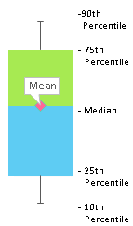
Hourly mean and percentile wages for largest occupations in food and beverage stores, May 2019
Source: U.S. Bureau of Labor Statistics, Occupational Employment Statistics.

Slide 33
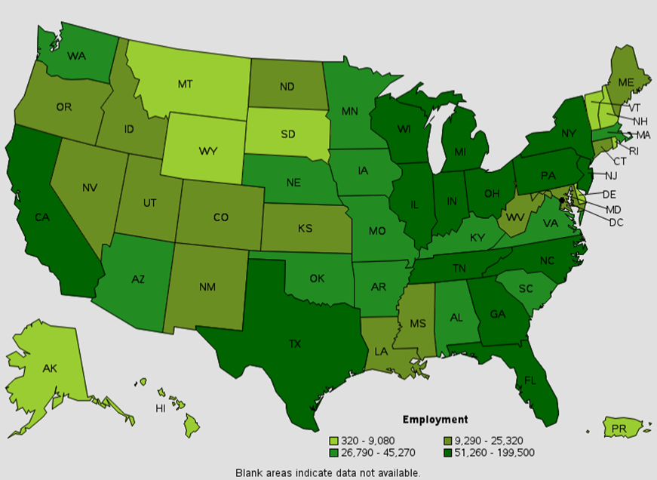
Employment of heavy and tractor-trailer truck drivers, by state, May 2019
States with highest employment were Texas, California, and Florida
States with highest concentrations included Arkansas, Nebraska, and Wyoming
Source: U.S. Bureau of Labor Statistics, Occupational Employment Statistics.

Slide 34
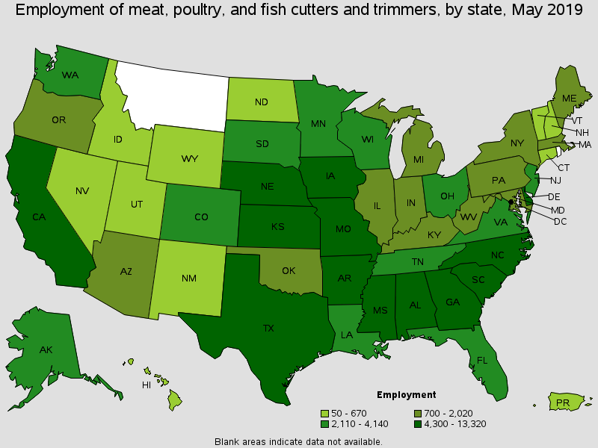
Employment of meat, poultry, and fish cutters and trimmers by state, May 2019
States with highest employment included North Carolina, Alabama, and Georgia
States with highest concentrations included Delaware, Nebraska, and Alaska
Source: U.S. Bureau of Labor Statistics, Occupational Employment Statistics.

Slide 35
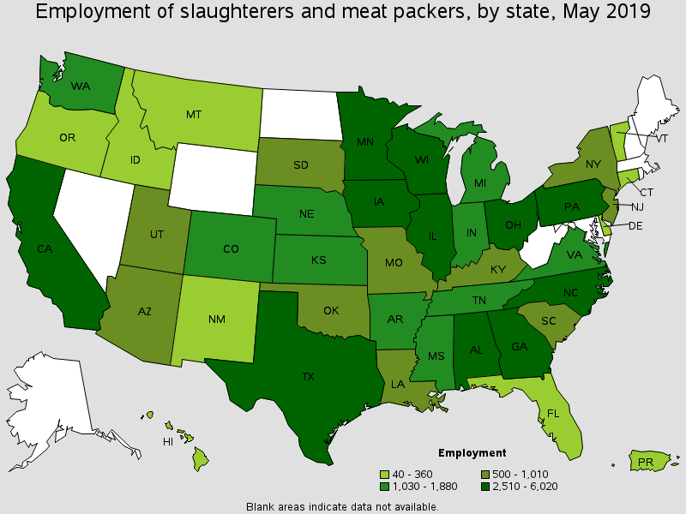
Employment of slaughterers and meat packers by state, May 2019
States with highest employment included Texas, North Carolina, and Georgia
States with highest concentrations included Iowa, South Dakota, and Nebraska
Source: U.S. Bureau of Labor Statistics, Occupational Employment Statistics.

Slide 36
Typical entry-level education and STEM data

Slide 37
Data by typical entry-level educational requirement
Based on education and training categories from the BLS Employment Projections program
  Eight education categories
  Represent typical education level required to enter occupation
  Different from educational attainment of workers in occupation
  See www.bls.gov/emp/documentation/education/tech.htm for more information
National, state, metropolitan and nonmetropolitan area, NAICS sector, and 4-digit NAICS
Available at www.bls.gov/oes/additional.htm

Slide 38
Employment by typical entry-level educational requirement, as a percentage of total employment, May 2019

Slide 39
Annual mean wages by typical entry-level educational requirement, May 2019

Slide 40
Highest paying occupations that typically require less than a bachelor's degree for entry, May 2019

Slide 41
STEM (science, technology, engineering, and mathematics) data
STEM and non-STEM aggregations
  Same breakdowns as typical entry-level education data set
  Available at www.bls.gov/oes/additional.htm
STEM aggregation contains 98 occupations
  Computer and mathematical, architecture and engineering, life and physical science; managers and postsecondary teachers in these functional areas; sales occupations requiring scientific or technical knowledge at the postsecondary level
Only one of many possible STEM definitions
  See www.bls.gov/soc/2018/#crosswalks for additional options

Slide 42
STEM employment by type of STEM occupation, May 2019

Slide 43
Highest and lowest paying STEM occupations, May 2019

Slide 44
Metropolitan areas with the highest employment shares of STEM occupations, May 2019

Slide 45
Occupational Employment Statistics
www.bls.gov/oes
OESinfo@bls.gov

