Slide 1
NURSING EXPANSION PROGRAM PROGRESS
YEAR 2 CHECK-IN
Taking Charge of your Quarterly performance report (QPR)
Tuesday, September 30, 2025
3:00 – 4:30 pm ET

Slide 2


Presenters
Kristen Hefley
  Workforce Analyst
    U.S. Department of Labor/Employment and Training Administration
Tessa St. John
  Grants Management & Performance Lead
    Social Policy Research Associates

Slide 3
Today’s agenda
Nursing Expansion Program Impact at the End of Year 2
Common Reporting Issues
Identifying Reporting Issues
Diagnosing and Correcting Reporting Issues
Practice Scenarios

Slide 4
Nursing expansion grant program IMPACT AT THE END OF YEAR 2

Slide 5
Nursing Expansion
Participant Demographics
Race/Ethnicity
3,357
399
Male
2,940
Female
Participants Served
1,739
Youth (17–29)
127
55 and Older
Other Demographics
Education

Slide 6
Nursing Expansion
Employment Status at Program Entry

Slide 7
Progress toward OUTCOME targets

Slide 8
Participants Served - Percent of Target ACHIEVED
Grantees can serve and start new participants in training through the end of the fourth year of the period of performance
Currently: 50% of that time period has elapsed
40% or Higher
Arizona State University
Asian American Drug Abuse Program, Inc.
Broward College
Community Health Care Center, Inc. (Alluvion Health)
Employ Milwaukee, Inc.
Forward Careers, Inc.
Healthcare Industry Grant Corporation (1199 Funds)
Riverside Community College District
Sanford Health
Massachusetts General Hospital-IHP
The University of South Dakota
The WorkPlace
Thomas Edison State University
University of Jamestown
Valley Initiative for Development and Advancement

Slide 9
Participants Served
Quarter ending 6/30/2025
Year 1
Total: 1,089
20 grantees served participants
Grant program is 14% to target
Average – 18%
Year 2
Total: 3,357
24 grantees served participants
Grant program is 43% to target
Average – 47%
Total Grant Target is 7,843
Track 1 – Green Track 2 – Blue

Slide 10
Participants BEGAN TRAINING - Percent of Target ACHIEVED
Grantees can serve and start new participants in training through the end of the fourth year of the period of performance
Currently: 50% of that time period has elapsed
40% or Higher
Arizona State University
Asian American Drug Abuse Program, Inc.
Broward College
Employ Milwaukee, Inc.
Forward Careers, Inc.
Healthcare Industry Grant Corporation (1199 Funds)
Montana State University Billings
Riverside Community College District
Sanford Health
The Massachusetts General Hospital - IHP
The University of South Dakota
The WorkPlace
Thomas Edison State University
University of Jamestown
Valley Initiative for Development and Advancement

Slide 11
Participants Started Training
Quarter ending 6/30/2025
Year 1
Total: 952
17 grantees have started training
Grant is 13% to target
Average 16%
87% of participants served have started training
Year 2
Total: 3,259
24 grantees have started training
Grant is 43% to target
Average 48%
97% of participants served have started training
Total Grant Target is 7,571
Track 1 – Green Track 2 – Blue

Slide 12
Completed Training
Quarter ending 6/30/2025
Year 1
Total: 223
9 grantees have participants who have completed
Grant is 4% to target
Average – 7%
Of those who have started training, 23% have completed
Year 2
Total: 1,012
20 grantees have participants who have completed
Grant is 15% to target
Average – 14%
Of those who have started training, 31% have completed
Total Grant Target is 6,585
Track 1 – Green Track 2 – Blue

Slide 13
Completed Training and obtained a credential
Quarter ending 6/30/2025
Year 1
Total: 185
8 grantees report participants who completed & obtained a credential
Grant is 3% to target
Average – 8 %
Of those who completed training, 83% have obtained a credential
Year 2
Total: 918
19 grantees report participants who completed & obtained a credential
Grant is 15% to target
Average – 13%
Of those who completed training, 91% have obtained a credential
Total Grant Target is 6,141
Track 1 – Green Track 2 – Blue

Slide 14
Entered employment or advanced to new position
Quarter ending 6/30/2025
Year 1
Total: 78
5 grantees reported participants who have entered or advanced in employment
Grant is 2% to target
Average – 4%
Of those who completed training, 35% have either entered or advanced in employment
Year 2
Total: 523
18 grantees reported participants who have entered or advanced in employment
Grant is 9% to target
Average – 9%
Of those who completed training, 52% have either entered or advanced in employment
Total Grant Target is 5,825
Track 1 – Green Track 2 – Blue

Slide 15
POLL:
How confident are you that the data on your most recent QPR is accurate?
Very confident
Mostly confident, but there are one or two things we have concerns about
Some of it is accurate, but there are a lot of gaps
Not confident at all
Unsure how much of it is accurate

Slide 16
COMMON REPORTING ISSUES AND STEPS TO Resolve THEM

Slide 17
QUESTIONS FOR DISCUSSION
What issue(s) have you encountered in your data or reports so far?
How did you know it was an issue?

Slide 18
COMMON REPORTING ISSUES
Data is inconsistent across various reports
QPR counts don’t match internal organization records
Data file contains inaccurate information
WIPS errors prevent you from reporting something you believe you should be able to report
Incomplete data due to data collection or tracking issues

Slide 19
How knowledge of data issues comes to light
PASSIVE AWARENESS
ACTIVE AWARENESS
PRO-ACTIVE AWARENESS
Anecdotal information
WIPS Errors
Quarterly feedback from DOL
Knowingly providing incorrect or incomplete data to DOL
Cross-checking QPR with grant records and noticing a mismatch

Slide 20
STEPS TO RESOLVE DATA AND REPORTING ISSUES
Review your data and identify issue(s)
Diagnose the causes of issue(s)
Correct the issue(s)
Put prevention measures in place to address the cause(s)
Each step requires a pro-active response to ensure accuracy

Slide 21

Questions?

Slide 22
IDENTIFYING REPORTING ISSUES

Slide 23
NURSING EXPANSION PERFORMANCE OUTCOMES
Outcome Measure | QPR Line | Data Elements
Total Participants Served | A2. Total Participants Served | PIRL 900, Date of Program Entry
Total Participants Enrolled in Education/Training Activities | E6. Began Receiving Education/Job Training Activities | PIRL 900, Date of Program Entry PIRL 1302, Date Entered Training #1
Total Participants Who Completed Education/Training Activities | F1. Number Completed Education/Job Training Program Activities | PIRL 900, Date of Program Entry PIRL 1302, Date Entered Training #1 PIRL 1813, Date Completed an Education or Training Program Leading to a Recognized Postsecondary Credential or Employment
Total Participants Who Completed Education/Training Activities and Received a Degree or Other Type of Credential | F2. Completed Education/Job Training Program Activities and Obtained a Credential | PIRL 900, Date of Program Entry PIRL 1302, Date Entered Training #1 PIRL 1813, Date Completed an Education or Training Program Leading to a Recognized Postsecondary Credential or Employment PIRL 1800 or PIRL 1802 or PIRL 1804, Type of Recognized Credential #1 or #2 or #3
Total Participants Who Completed Education/ Training Program Activities and Either Entered Unsubsidized Employment or Advanced into a New Position NOTE: This outcome combines Outcomes #5 and 6 for Track 2 from the Funding Opportunity Announcement | The sum of: G1. Entered Unsubsidized Employment and G3. Incumbent Workers that Advanced into New Position | PIRL 900, Date of Program Entry PIRL 1302, Date Entered Training #1 PIRL 1813, Date Completed an Education or Training Program Leading to a Recognized Postsecondary Credential or Employment PIRL 2118, Date Entered Employment (for G1) PIRL 2120, Incumbent Workers Advanced to a New Position (for G3)
Performance Outcome Crosswalks: Track 1 & Track 2

Slide 24
BECOMING A “DATA DETECTIVE”
The process of identifying data issues is both an art and a science.
Requirements:
  Deep understanding of how data “ends up” on your QPR
  Baseline knowledge of where your grant stands with performance targets
  Curiosity about changes in the data over time
Identifying issues is a process of pattern recognition.

Slide 25
TECHNIQUES FOR identifying POTENTIAL DATA ISSUES: Quarterly PERFORMANCE report (QPR)
Review current QPR data on the outcomes identified for this grant program and note significant outliers
  Very high or very low reported numbers
Compare current data with previous QPRs and note trends.
  What changed and didn’t change
Review other line items on the QPR that have a relationship to the grant outcomes for clues.

Slide 26
identifying POTENTIAL DATA ISSUES:
Quarterly performance report (QPR)
SUPPORT
CONFLICT
A low number in the QPR can be explained by reviewing descriptions of grant implementation
The QNR notes challenges that align with the QPR
Number volunteered in the QNR is different from what is on the QPR
Programmatic descriptions don’t align with the data.

Slide 27
QUESTIONS TO CONSIDER AS PART OF YOUR ANALYSIS
Are numbers in the QPR consistent with numbers mentioned in the QNR?
Is there consistency between descriptions of program implementation and outcome data on the QPR?
Are numbers trending in a direction that doesn’t make sense (i.e., going down or staying the same for multiple quarters)?
Does the QNR tell a story that can adequately explain trends or outliers?
Have anticipated changes in the program noted in the QNR resulted in changes in the data in the QPR?
Does the way outcomes are described in the QNR align with the outcome definition?
Are the same data issues or challenges persisting over time?

Slide 28
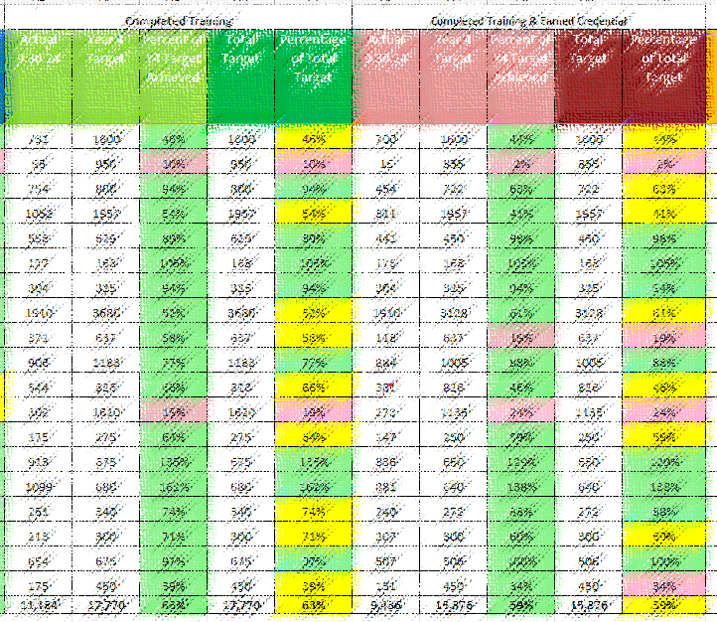
HOW DOL IDENTIFIES POTENTIAL ISSUES IN GRANTEE DATA
Grant dashboard is updated each quarter
Check your planned to actual goals and flag areas of concern
Compare your data to what you wrote in your narrative report
Compare your data over time to see how you are progressing towards target
Flag possible reporting issues

Slide 29
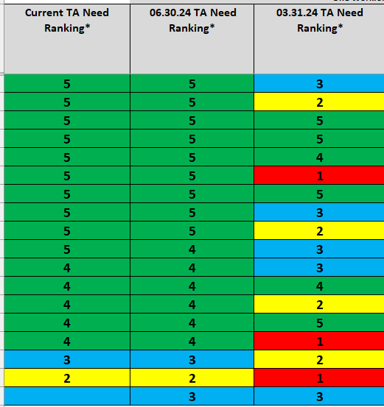
What We Look For
  1 = Not meeting any targets or meeting only one target. No outcomes are green or only one outcome is green
  2 = Meeting targets for Participants Served and Participants Enrolled but behind on others. Participants Served and Participants Enrolled are green; no other outcomes are green
  3 = Meeting targets for Participants Served and Participants Enrolled, but may fall behind on others: Three outcomes are green and three outcomes are not green; or four outcomes are green and those outcomes may include one or more employment outcomes
  4 = Meeting all targets except employment-related targets
  5 = Meeting all or almost all targets

Slide 30
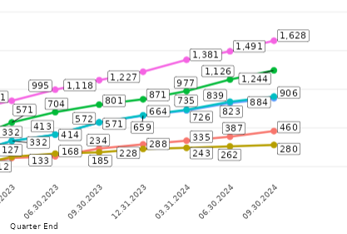
What We Look For (2)
Total Participants Served
Participants Began Education/Training
Participants Completed Training
Participants Completed Training and Earned a Credential
Entered/Advanced in employment

Slide 31
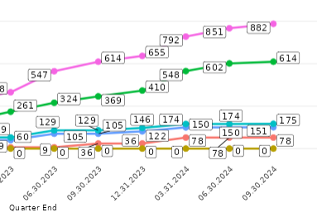
What We Look For (3)

Slide 32
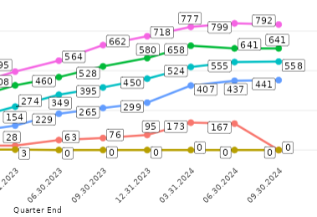
What We Look For (4)

Slide 33
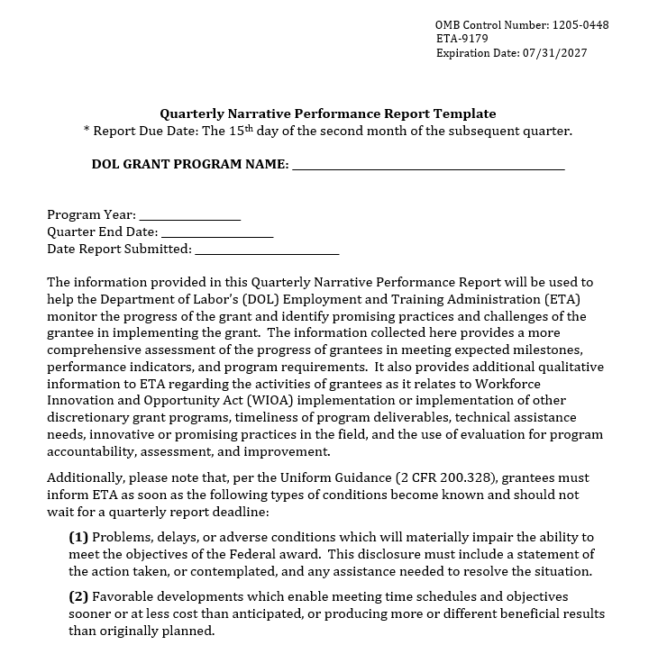
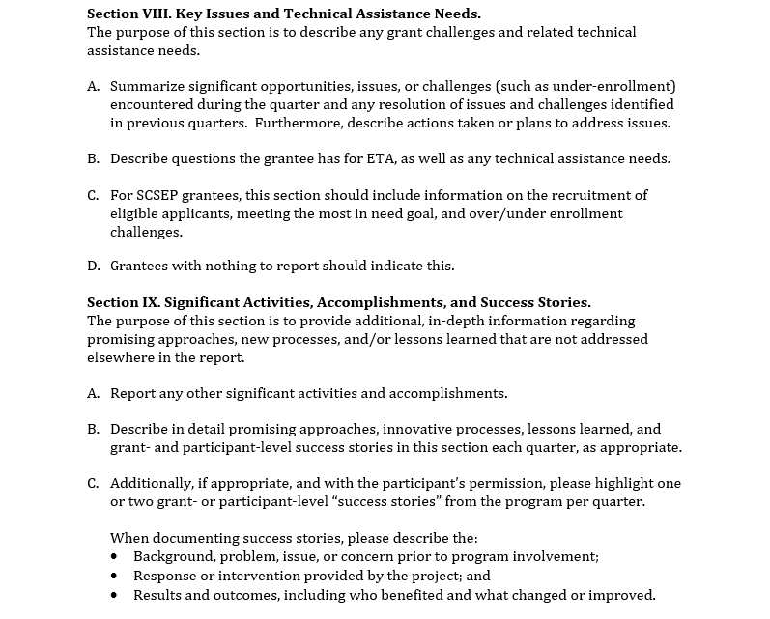
What We Look For (5)

Slide 34
Questions? 2

Slide 35
DIAGNOSING, CORRECTING, AND PREVENTING THE CAUSE OF DATA ISSUES

Slide 36
STAGES OF THE REPORTING PROCESS
Understanding what information to collect
Establishing processes to collect, track, manage, and report the information
Data collection
Tracking and follow-up
Data file preparation and submission

Slide 37
DIRECT CAUSES OF REPORTING ISSUES
Data is reported inaccurately
Data is missing in the data file
The direct cause of a reporting issue is always at the data file submission stage: code values in the data file are not accurate or complete.

Slide 38
Identifying data errors
There can be many reasons why data is reported inaccurately.
A “breakdown” in the process can occur at any stage along the way.
There might be an isolated problem in one stage, or a bigger problem that is more global that affects multiple stages.
Data is Incorrect
Data File Submission
Data Collection
Data Tracking
Participant Follow-Up
Established Data Management Procedures
PIRL and QPR
Knowledge

Slide 39
Identifying data errors: data file submission
Data is Incorrect
Data File Submission
Data Collection
Data Tracking
Participant Follow-Up
Established Data Management Procedures
PIRL and QPR
Knowledge
DATA FILE SUBMISSION CAUSE
When preparing the data file, code values were inadvertently entered incorrectly or left off.

Slide 40
Identifying data errors: participant follow-up
Data is Incorrect
Data File Submission
Data Collection
Data Tracking
Participant Follow-Up
Established Data Management Procedures
PIRL and QPR
Knowledge
PARTICIPANT FOLLOW-UP CAUSE
No process for following up with participants after they complete the program to get information about employment
There is a process in place, but it’s not working

Slide 41
Identifying data errors: data tracking
Data is Incorrect
Data File Submission
Data Collection
Data Tracking
Participant Follow-Up
Established Data Management Procedures
PIRL and QPR
Knowledge
DATA TRACKING CAUSES
No process for monitoring information that should be updated if it changes over time
There is a process in place, but it’s not working

Slide 42
Identifying data errors: data collection
Data is Incorrect
Data File Submission
Data Collection
Data Tracking
Participant Follow-Up
Established Data Management Procedures
PIRL and QPR
Knowledge
DATA COLLECTION CAUSES
No method of collecting information that must be reported
A method has been established, but it’s not comprehensive or something about it isn’t working

Slide 43
Identifying data errors: data management
Data is Incorrect
Data File Submission
Data Collection
Data Tracking
Participant Follow-Up
Established Data Management Procedures
PIRL and QPR
Knowledge
DATA MANAGEMENT CAUSES
No policies for how data will be captured, stored, and updated between reporting periods to ensure it’s comprehensive
Ineffective methods for converting the information collected into the acceptable file format for WIPS

Slide 44
Identifying data errors: reporting knowledge
Data is Incorrect
Data File Submission
Data Collection
Data Tracking
Participant Follow-Up
Established Data Management Procedures
PIRL and QPR
Knowledge
REPORTING KNOWLEDGE ISSUES
Misunderstanding how an outcome is defined
Lack of awareness of how the data elements and the QPR outcomes are connected

Slide 45
ASK WHY AT EVERY STAGE
When you learn about a reporting issue, investigate each stage separately.
Start from the direct cause then work backwards:
  Examine the data file to make sure the code values match your records.
  Review your follow-up methods to ensure they're effective and are ongoing.
  Review your tracking methods to ensure data is updated regularly.
  Review your data collection procedures to ensure everything is captured and the way it is collected is effective.
  Review your data management system
  Review the definitions of outcomes and data elements to ensure you're reporting what is required or expected.
Note: There may be multiple reasons why data is inaccurate!
Ask “why” at every stage until you find the root cause.

Slide 46
WHERE TO TURN FOR DIAGNOSIS
KNOWLEDGE
PIRL
Performance Handbook
DATA MANAGEMENT
Storage system
Handouts
Participant records
COLLECTION, TRACKING & FOLLOW UP
DATA FILE SUBMISSION & REPORTING
Internal policies and processes
Your data file
Your records
Knowledge
  PIRL
  Performance Handbook
  Handouts
Data Management
  Storage system
  Participant Records
Collection Tracking and Follow-Up
  Internal policies and processes
Data File Submission and Reporting
  Review your data file
  Review your records

Slide 47
Questions? 3

Slide 48
Practice Scenarios:
Identifying, diagnosing, AND CORRECTING REPORTING ISSUES

Slide 49
SCENARIO #1: KNOWLEDGE ISSUE
EXAMPLE:
Code values for the employment outcomes are not accurate or complete in the data file.
  Why?
We didn’t track that information.
  Why?
We didn’t realize we needed to track it.
How would you resolve this reporting issue?

Slide 50
SCENARIO #2: FOLLOW UP ISSUE
EXAMPLE:
Code values for the employment outcomes are not accurate or complete in the data file.
  Why?
Participants aren’t responding when we try to follow up.
  Why?
Our method of following up is not effective at getting the information.
How would you resolve this reporting issue?

Slide 51
SCENARIO #3: Data tracking issue
EXAMPLE:
Code values for credential attainment are not accurate or complete in the data file.
  Why?
We haven’t checked in to see if there’s anything to update.
  Why?
We forgot.
How would you resolve this reporting issue?

Slide 52
SCENARIO #4: Data COLLECTION ISSUE
EXAMPLE:
Code values for employment status at entry are not accurate or complete in the data file.
  Why?
We didn’t ask that information at intake.
  Why?
What are some of the possible reasons why a grantee didn’t ask for this information at intake?

Slide 53
SCENARIO #5: Data management issue
EXAMPLE:
I heard anecdotally that participants have entered employment, but our QPR says 0.
  Why?
Code values for employment status are not accurate or complete in the data file.
  Why?
We didn’t have a process in place to ensure that the follow-up information we received was documented in our records in a way that it could be used for reporting purposes.
How would you resolve this reporting issue?

Slide 54
SCENARIO #6: Data KNOWLEDGE ISSUE
EXAMPLE:
Code values for employment status are not accurate or complete in the data file.
  Why?
WIPS kept giving us errors, so we deleted some of the data in the data file.
  Why did WIPS return errors?
What we tried to report violated a logic rule.
  Why?
We were trying to report participants who were incumbent workers as “entering employment,” which is an invalid employment outcome for that group of participants.
How would you resolve this reporting issue?

Slide 55
PREVENTION OF DATA ISSUES
Reporting issues can be multi-causal. Ensure you’ve explored the issue to the root cause and corrected it.
Monitor the issue to see if the changes in policies or procedures are effective.
Be ready to try something new if the issue re-emerges.

Slide 56
PREVENTION OF DATA ISSUES (2)
Map every data element to a stage of the participant’s journey.
Identify the who, what, when, where, and how related to data collection.
Establish processes for data that needs to be checked.
If the first thing you try doesn’t work, pick something else. Ask for help. Talk to other grantees. Review the online Community to see if there are any resources with tips or ideas.

Slide 57
Investigation conclusions
Knowledge deficit
  Reading the QPR incorrectly
  Not reporting advancement to a new position
Official data collection process is not in place
Current casual data collection methods are not effective:
  Lack of response or participation
  Correct information is not sought
No one is following up with participants about employment outcomes
Manual data entry error
Unknown if programmatic issues exist

Slide 58
TIPS FOR RESOLVING REPORTING ISSUES
Ensure data file matches your own records.
Ensure you and everyone who collects, manages, or reports data truly understands the definitions and data elements.
Focus on the data elements that matter!
Have a process in place to collect the right information.
Ensure the process builds in regular, ongoing follow up and assign responsibility for that task.
Ensure your process or system for generating data files accurately converts information from your records into the correct code values.
Adjust or refine processes that don’t work or show signs of being ineffective.

Slide 59
Final Questions?

Slide 60
THANK YOU! Contact Us for reporting assistance!
NursingExpansion@dol.gov
Important: Don’t forget to copy your FPO!

