Slide 1
The Statistical Adjustment Model
Module 10
2019 WIOA National Performance Training
U.S. Department of Labor
Employment and Training Administration

Slide 2

What You Will Need For Modules 10 & 11
Handout – WIOA Statistical Adjustment Model Variables

Slide 3
The Objectives of this Session
Overview of Statistical Adjustment Model
How the model is used in the negotiation and performance evaluation processes
Early tests of the model’s performance using reported data from PY 2017
Example of the importance of accurately reported data
Ultimate Objective: Move up one level in your understanding of the model and how it is used

Slide 4
What do you know about the Statistical Adjustment Model?
How would you rate yourself?
Experienced | I am very familiar with what the statistical adjustment model is doing and/or how it is used and I am mainly interested in some of the more technical details.
Intermediate | I am generally familiar with the what the statistical adjustment model is doing and/or how it is used, but there are significant aspects about the model that I am not quite clear about.
Beginner | I may know that there is a statistical adjustment model and that it is a part of performance, but I don’t really understand what it is doing and/or how it is used.

Slide 5
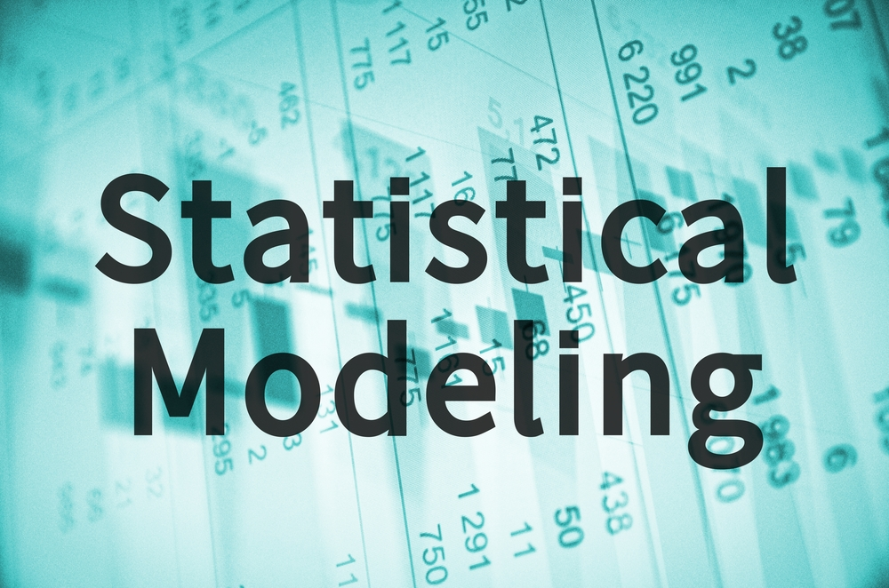
The Statistical Adjustment Model
What does the model do?
What are the general components of the model?
Why is it important to report accurate data?

Slide 6
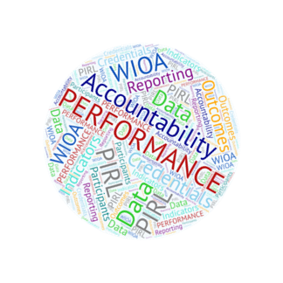
How is the model used – for negotiations?
In the negotiation process:
  The model produces an estimate of the expected performance level for each indicator
  Historic program data are used
  This estimate is a factor in agreeing on a negotiated level of performance

Slide 7
How is the model used – for evaluation?
In evaluation of performance:
  Actual participant outcomes are applied to the model estimates to create the adjustment factor
  The adjustment factor is applied to the negotiated level of performance
  State performance is measured against the adjusted level of performance

Slide 8
How the model is used in the negotiation and performance evaluation processes
Step 1:
States: Submit Expected Levels of Performance in State Plans for two program years
(PYs A & B).
DOL/ED: Produce estimated levels of performance using the statistical adjustment model.
Required State Actions
Step 2: States and DOL/ED arrive at Negotiated Levels of Performance for PYs A & B before PY A begins by considering the four factors of performance negotiation.
Step/3 Step 5: PY Concludes. DOL/ED process State data on actual outcomes & re-estimate performance levels using the actual characteristics of participants & economic conditions of PY.
The positive or negative difference between the DOL/ED estimates before and after PY are used to adjust the Negotiated Levels of Performance and calculate the Adjusted Levels of Performance.
Step 4/Step 6: DOL/ED determine States' performance success or failure by comparing Actual Results of PY to the Adjusted Levels of Performance for PY.
After PY A
During PY B

Slide 9
What are the components of the model?
The Model Framework:
  Performance Outcomes adjusted by Participant Characteristics and Economic Factors
The Model Specifications:
  Y (specific performance indicator) = PC₁ + PC₂ + … + EC₁ + EC₂ +… + S₁ + S₂ + … + b (indicator baseline)
    Participant Characteristics
    Economic Conditions
    State Fixed Effects

Slide 10
What data are important?
All PIRL data
  46 PIRL elements are currently used in the statistical adjustment model for the participant characteristic variables
  Multiple PIRL elements are used to accurately measure performance indicators
  Additional PIRL elements (in addition to those in the handout) may be important in the future
The better the data, the better the model!

Slide 11
Early Tests of the Statistical Adjustment Model
Some caveats on these model tests:
Visualizations on the performance of the model that show measures of:
The adjustment factor
The performance level score
How the adjusted level compares to the original negotiated level
The original predicted targets and corresponding variable values were estimated using WIA data (PY 2015 and earlier)
The “actual” data used is the WIOA PY 2017 reported data

Slide 12
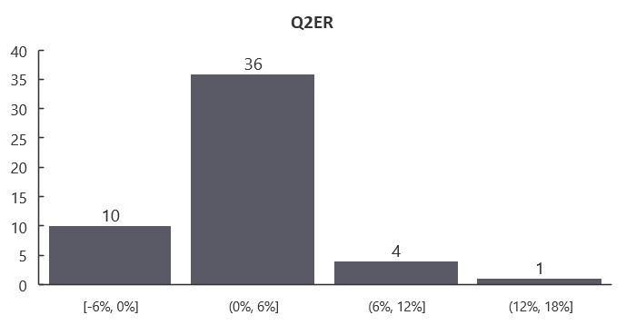
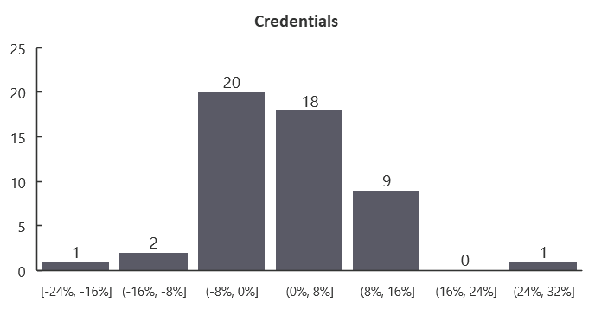
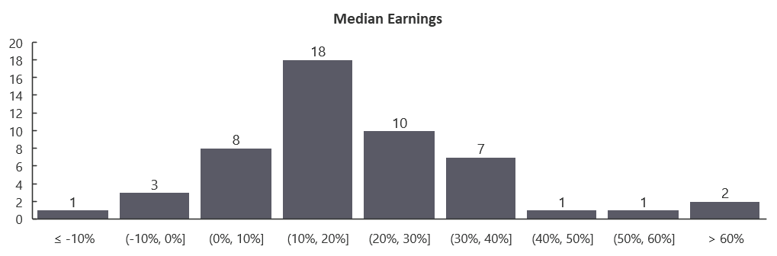
Variance of the Adjustment Factor
Test with reported PY 2017 WIOA Adult data
Source: PY 2005-15 WIASRD, PY 2017 WIOA Performance Individual Record Data

Slide 13
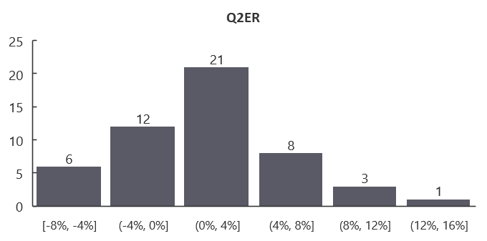
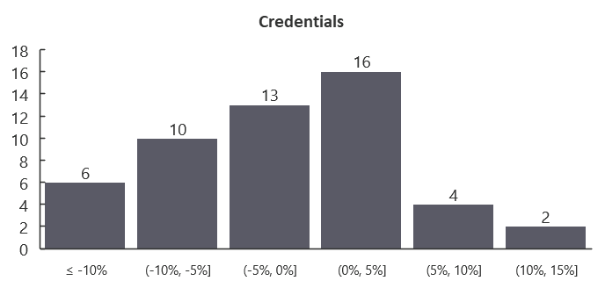
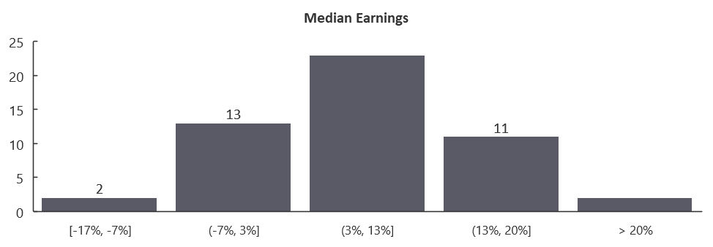
Variance of the Adjustment Factor
Test with reported PY 2017 Dislocated Worker data
Source: PY 2005-15 WIASRD, PY 2017 WIOA Performance Individual Record Data

Slide 14
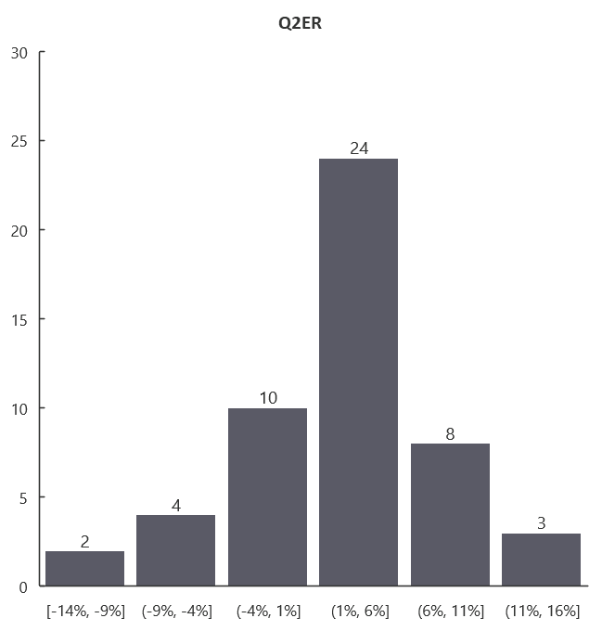
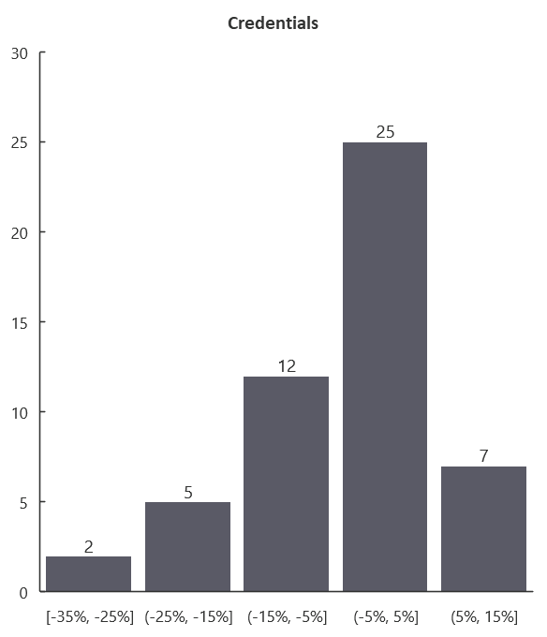
Variance of the Adjustment Factor
Test with reported PY 2017 WIOA Youth data
Source: PY 2005-15 WIASRD, PY 2017 WIOA Performance Individual Record Data

Slide 15
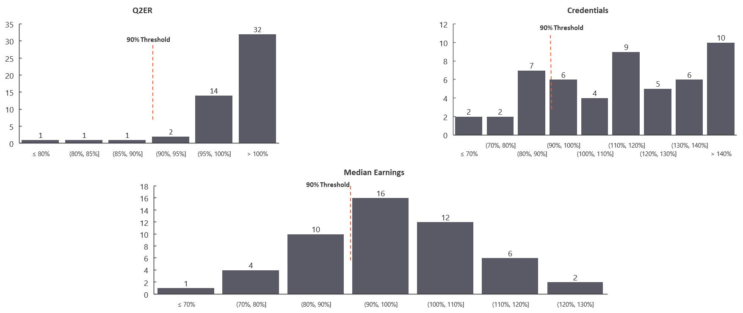
Variance of Individual Indicator Scores
Test with reported PY 2017 WIOA Adult data
Source: PY 2005-15 WIASRD, PY 2017 WIOA Performance Individual Record Data

Slide 16
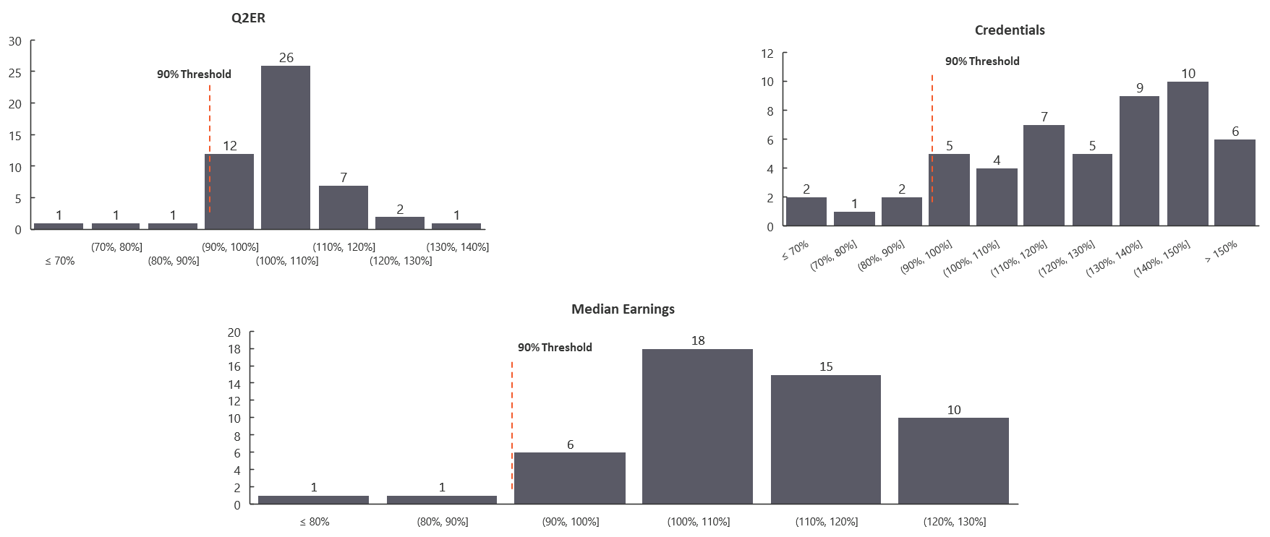
Variance of Individual Indicator Scores
Test with reported PY 2017 Dislocated Worker data
Source: PY 2005-15 WIASRD, PY 2017 WIOA Performance Individual Record Data

Slide 17
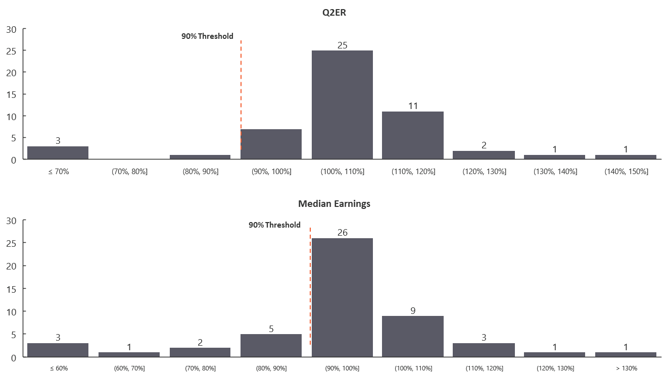
Variance of Individual Indicator Scores
Test with reported PY 2017 WIOA Youth data
Source: PY 2005-15 WIASRD, PY 2017 WIOA Performance Individual Record Data

Slide 18
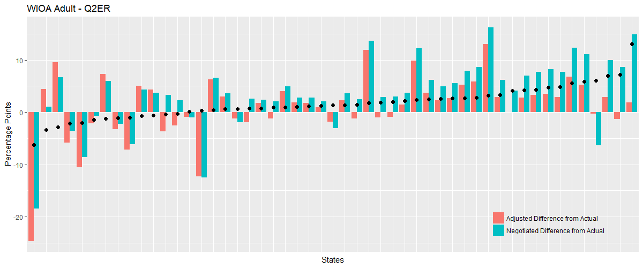
Proximity to Outcomes: Negotiated Levels vs. Adjusted Levels
Test with reported PY 2017 WIOA Adult – Q2ER data
Source: PY 2005-15 WIASRD, PY 2017 WIOA Performance Individual Record Data

Slide 19
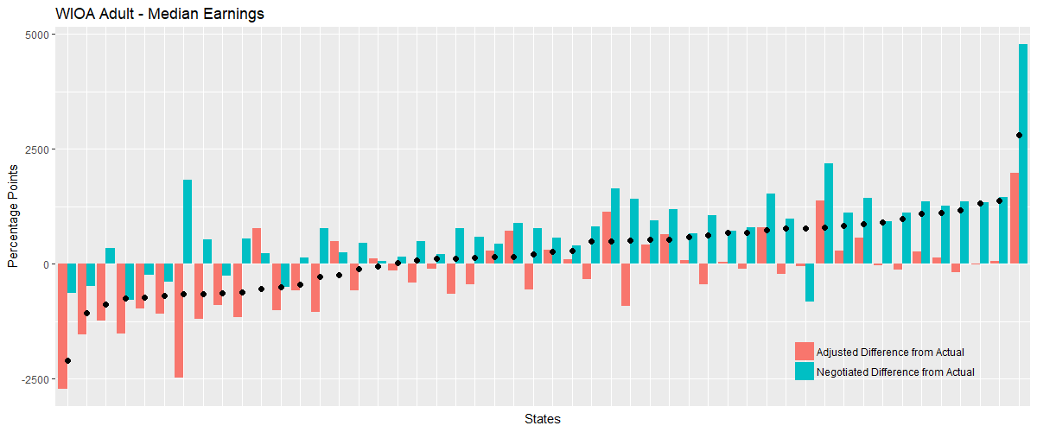
Proximity to Outcomes: Negotiated Levels vs. Adjusted Levels
Test with reported PY 2017 WIOA Adult – Median Earnings data
Source: PY 2005-15 WIASRD, PY 2017 WIOA Performance Individual Record Data

Slide 20
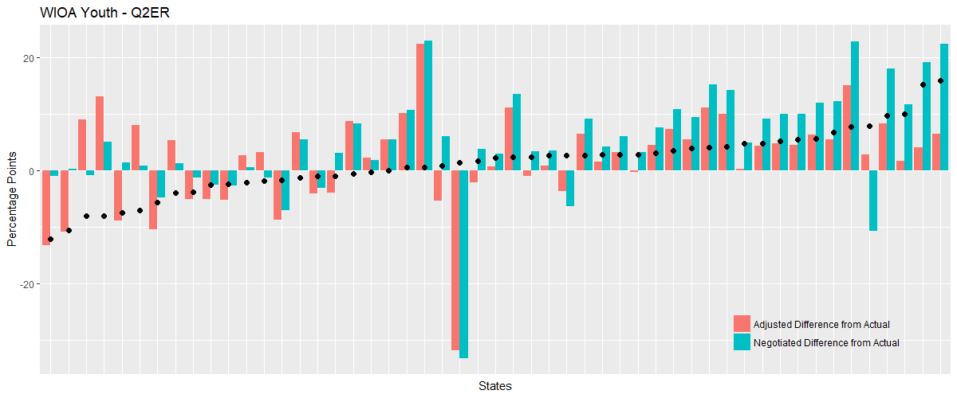
Proximity to Outcomes: Negotiated Levels vs. Adjusted Levels
Test with reported PY 2017 WIOA Youth – Q2ER data
Source: PY 2005-15 WIASRD, PY 2017 WIOA Performance Individual Record Data

Slide 21
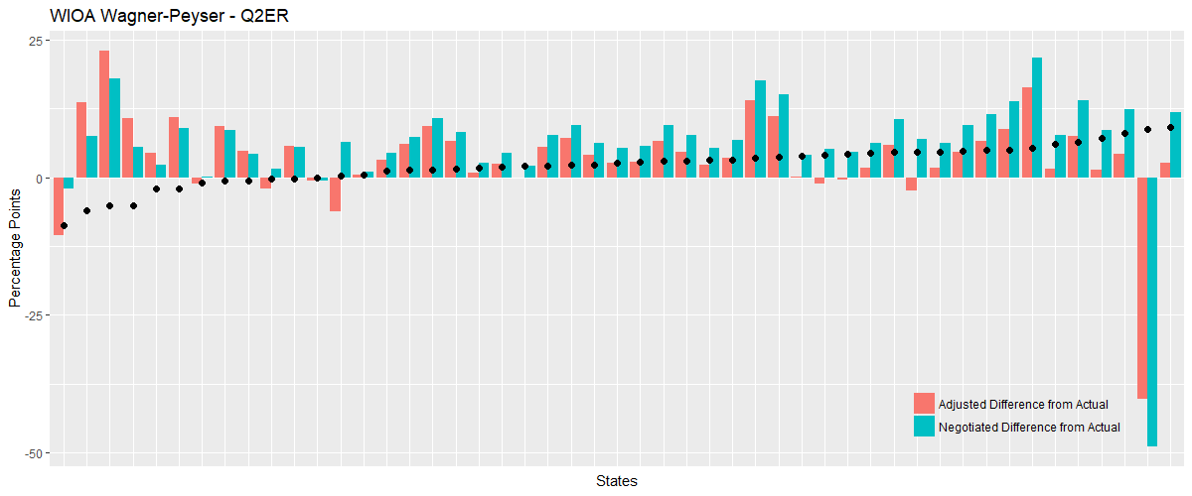
Proximity to Outcomes: Negotiated Levels vs. Adjusted Levels
Test with reported PY 2017 Wagner-Peyser – Q2ER data
Source: PY 2005-15 WIASRD, PY 2017 WIOA Performance Individual Record Data

Slide 22
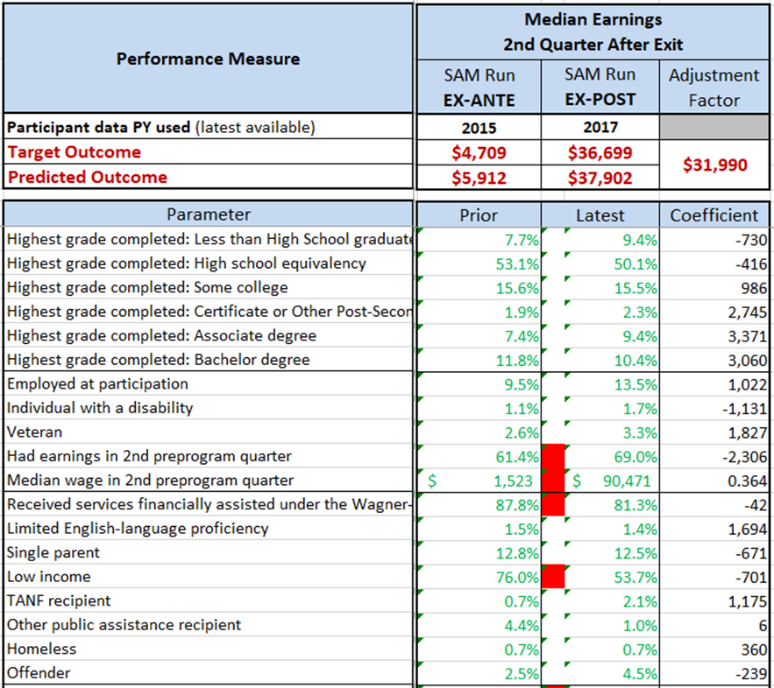
The Importance of Reporting Data Accurately
An Example

Slide 23
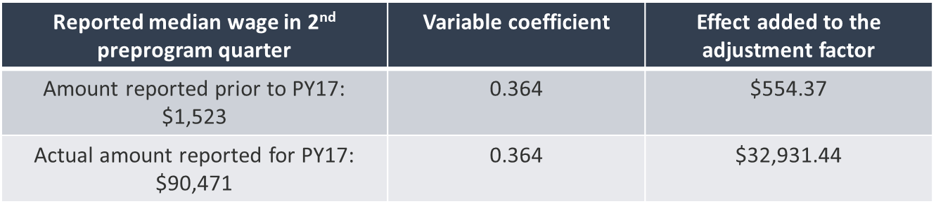
The Importance of Reporting Data Accurately
An Example (2)
What are the overall impacts:
  This variable effect is added to all the other effects and results in an overall adjustment factor of $31,990
  The original negotiated level of $4,709 was increased to $36,699

Slide 24
Any Questions?

Slide 25
Contact
 ETAPerforms@dol.gov

Slide 26
Resources
Statistical Adjustment Model Summary
    https://www.doleta.gov/performance/guidance/docs/Statistical-Model-Summary-2-16-18.docx
WIOA Statistical Model Methodology Report
    https://www.doleta.gov/performance/guidance/docs/WIOA_Statistical_Model_Methodology_Report-6-24-2016.pdf
WIOA Performance Negotiation Tool
    https://www.doleta.gov/performance/guidance/docs/PY2018-2019-WIOA-Negotiation-Tool.xlsx
    Using the Statistical Adjustment Model for Negotiation WIOA Performance Levels
    https://www.workforcegps.org/events/2018/02/16/14/00/Using-the-Statistical-Adjustment-Model-for-Negotiating-WIOA-Performance-LevelsEvent

Slide 27
Please complete your evaluations.

