Slide 1
Apprenticeship Grants
WIPS’ Office Hours
January / February 2026
Facilitated By: Shelia F. Lewis, Maria Brady, and Mary Ricchezza

Slide 2

Agenda
About WIPS’ Office Hours
Your Ideas, Suggestions, Requests
Announcements
Reporting Reminders
Reporting Checklist
Common Reporting Errors/Problems: How to Trouble-shoot and Resolve Them
Upcoming Events/Deadlines

Slide 3
About Office WIPS’ Hours (for OA-Managed Grants)…
This is your time to ask questions, run/upload test files, learn from your peers, etc. Please take advantage of this opportunity!
Submitter/Certifiers should attend (i.e., the person(s) that creates, uploads, and certifies your PIRL data files). Program directors, case managers, etc. are welcome too!
Ask your data upload questions
Use this time to upload a small test data file
Use this time to trouble-shoot file upload issues, data preparation issues, etc.
Bring data element, WIPS, performance, and reporting issues to ETA’s attention
Ask other grantees/peers questions
Unexpected QPR results? Let’s look at your data file and find out why.
Frequency - Generally, 2-3 times after the end of the reporting quarter and before the report due date

Slide 4
Transition from
PIRL v.2021 to
PIRL v.2025
Notes:
Shelia

Slide 5
REMINDER: ETA-Only Performance Reporting
Information Collection Request (ICR) (1)
What is the new version of the PIRL called? The newly revised PIRL is called “PIRL v.2025”. (The current version was PIRL v.2021.)
Will the QPR template change? Yes.
Will the Apprenticeship PIRL Schema change? Yes.
What will be the effective date for the revised QPR template and PIRL v.2025 for registered apprenticeship grants?
  The first quarter that OA grantees could use the new QPR and new AP schema is the March 31, 2026 (Q3) report quarter, due May 15, 2026. This is a change from our previous announcement of December 31, 2025 (Q2)
  Last date to begin collecting new PIRL v.2025 data elements is July 1, 2026
Notes:
Shelia
Based on what we are seeing, it is very unlikely that we will be able to meet our original plan for having the Apprenticeship the 12/31/2025 (Q2) report quarter (2/15/2026 due date). With that in mind, we intend to push those back so that the first quarter that grantees would/could use the new QPRs/schemas would be the 3/31/2026 (Q3) report quarter (5/15/2026 due date).

Slide 6
REMINDER: ETA-Only Performance Reporting
Information Collection Request (ICR) (2)
What does this mean for registered apprenticeship reporting?
  The number of data elements to be collected will change
  Some data elements will no longer need to be collected by AP grantees
  Some new data elements have been added to the PIRL
  The number of columns in the PIRL data file will change from 102 to 107
  The QPR template has been revised
  There is no longer a separate youth QPR template
The revised Apprenticeship Reporting Resource Document is published on WorkforceGPS.
All ETA changes are published on Reporting Requirements | U.S. Department of Labor
Notes:
Shelia

Slide 7

REPORTING
REMINDERS

Slide 8
Reporting Reminders: Important Dates (1)
All grantees should submit and certify the data/information uploaded for QPRs and QNRs into WIPS by 11:59pm EST on Sunday, February 15, 2026.
Grantees may begin uploading PIRL data files and QNR information into WIPS anytime after the last day of the reporting quarter. For example, grantees could have began uploading data files on January 1, 2026, for the reporting period that ended December 31, 2025.
Grantees were not able to upload PIRL data files for the quarter ending December 31, 2025 before January 1, 2026.

Slide 9



Reporting Reminders: PIRL Data Files (2)
Data files containing participant information of any kind should never be attached to or embedded into the Quarterly Narrative Report (QNR), to a WIPS help desk ticket, or to an email message.

Slide 10

Reporting Reminders: Begin Early (3)
Begin the reporting process EARLY! Remember - reporting begins with data collection!

Slide 11

Reporting Reminders: Ask for Help (4)
Ask for help early and ask often as needed!

Slide 12
Reporting Reminders: Help Us Help You (5)
Contact the WIPS’ help desk using this link:
WIPS Technical Assistance Request.
Do not upload your PIRL data file into the help desk ticket or using any other method such as email.
Provide the file ID for the data file that you uploaded. Doing so enables the WIPS team to access your data file.
Provide a clear description of the error that you are experiencing.
Expect errors—especially if you are new to uploading PIRL data files! Expect several series or levels of errors. Resolving one set of errors may reveal errors related to another set of PIRL data elements.

Slide 13

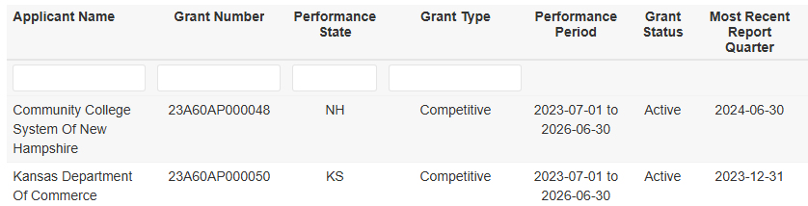
Reporting Reminders: You Must Report! (6)
DOL is required to publish grantee aggregated performance data. This information is published here: Apprenticeship Grants Performance Dashboard | Apprenticeship.gov. Without your quarterly certified PIRL data files, DOL will not be able to meet this requirement and your grant’s name will be published without performance data.
For more information, please refer to Bulletin 2025-35 on the announcement of the OA Grant Performance Dashboard.
Notes:
Shelia
Not only do grant recipients have reporting requirements, but DOL also has reporting requirements from Congress
Summary – The Office of Apprenticeship created the Registered Apprenticeship Grant Performance Dashboard to meet a requirement under the Senate Report accompanying Fiscal Year (FY) 24 Appropriations to publicly disclose on its website grantees receiving funding, the number of registered apprentices attributable to each grantee, and the respective employment and earning outcomes of program participants as required under section 116(b)(2)(A)(i) of WIOA.
The dashboard allows users to view Apprenticeship Grantee data currently collected by the Department of Labor’s (the Department) OA. The dashboard covers the following grants and cooperative agreement:
Apprenticeship Building America Round 1 (ABA1);
State Apprenticeship Expansion Formula (SAEF1); and
Scaling Apprenticeship Readiness Across the Building Trades Initiative (Cooperative Agreement with TradesFutures)
The dashboard aggregates data reported by grantees in their quarterly performance reports (QPR) from the Workforce Integrated Performance System (WIPS). Categories of grant information presented include grants that are Participant Serving (i.e., grants that provide participant services to pre-apprentices and registered apprentices) and Capacity Building (i.e., grants that are not providing participant services). Further, for SAEF1, grant information is presented by Funding Option (i.e., base formula and competitive).
Background – OA prioritizes the growth and expansion of Registered Apprenticeships across industry sectors and all populations as continuing goals for the National Apprenticeship System. To facilitate this ongoing growth and expansion in support of the Department’s efforts, OA has awarded several funding opportunities to grantees across the nation. The Registered Apprenticeship Grant Performance Dashboard provides the most complete grant performance information for active grants within Program Year (PY) 2023 (i.e., July 1, 2023 – June 30, 2024) that reported data for the quarter ending June 30, 2024. Grantees that do not appear in the dashboard may not have had participant activities to report for this quarter or OA may be in the process of providing technical assistance to grantees to verify and validate any potential data discrepancies. Annual updates to the data will be made to ensure the dissemination of accurate and timely grant performance metrics. For more information about OA grants, please visit https://www.apprenticeship.gov/investments-tax-credits-and-tuition-support.

Slide 14

REPORTING
CHECKLIST

Slide 15
Quarterly Reporting Checklist (1)
Obtain access for submitter/certifiers at least 4 weeks prior to the report deadline.
Are you using the correct version of the Apprenticeship Reporting Resources Spreadsheet?
Are you reporting ALL active participants each quarter? This includes all participants enrolled during the reporting quarter AND those previously enrolled who are still active (carryover).
Be sure that ALL reportable individuals are reported each quarter. Reportable individuals from previous reporting quarters should not be deleted from the PIRL data file.

Slide 16
Quarterly Reporting Checklist (2)
Make sure every row in your file has the PIRL 2914 (Apprenticeship Grants Program Status) and the PIRL 2920 (Grant Number) completed.
Be sure you are using the correct Grant Number for PIRL 2920 (Grant Number).
Be sure submitter/certifiers are not uploading the .csv file/PIRL data in the QNR section of WIPS.
.csv or .txt data files for the QPR should be uploaded in the File Upload section of WIPS.
QNRs and corresponding attachments like the Indicator Table should be uploaded under the My Reports section of WIPS where it says, “Quarterly Narrative Reports”.
No participant data or PII should be included in the QNR.

Slide 17
Quarterly Reporting Checklist (3)
Report all credentials and measurable skill gains?
Certify your PIRL data file! No certification means no report submission. Do not be concerned about the QPR results if you are certain that your data file is complete and accurate to the best of your knowledge.
Respond to all questions, as applicable, on your Quarterly Narrative Report.
Certify your Quarterly Narrative Report!
If the grant has closed/sunset/ended, no reporting is required beyond the last quarter of performance!

Slide 18

COMMON REPORTING ERRORS:
How To Trouble-shoot and Resolve Them

Slide 19
QPR Does Produce Expected Results – (e.g., Pre-apprenticeship status: enrolled (AKA: Number of enrolled pre-apprentices during the reporting quarter) (QPR Field F-1a-a)
Begin by reviewing/reading the QPR specification on Tab 9 (Adult QPR Aggregation Rules) of the Performance Reporting Resources spreadsheet:
Go to your PIRL data file and verify each data element and code value correspond with the aggregation rule. Adding filters to the PIRL file may help with this step:
Count of UNIQUE RECORDS where (APPRENTICESHIP GRANT NUMBER [PIRL 2920] is not null) AND (APPRENTICESHIP GRANTS PROGRAM STATUS [PIRL 2914] = 1) AND ((PRE-APPRENTICESHIP PROGRAM STATUS [PIRL 2901] = 1) AND (DATE ENROLLED IN PRE-APPRENTICESHIP [PIRL 2902] is not null) AND (DATE ENROLLED IN PRE-APPRENTICESHIP [PIRL 2902] is within the report period) AND (DATE OF PROGRAM ENTRY [PIRL 900] is not null AND DATE OF PROGRAM ENTRY [PIRL 900] is within the report period))
Count of UNIQUE RECORDS where (APPRENTICESHIP GRANT NUMBER [PIRL 2920] is not null) AND (APPRENTICESHIP GRANTS PROGRAM STATUS [PIRL 2914] = 1) AND ((PRE-APPRENTICESHIP PROGRAM STATUS [PIRL 2901] = 1) AND (DATE ENROLLED IN PRE-APPRENTICESHIP [PIRL 2902] is not null) AND (DATE ENROLLED IN PRE-APPRENTICESHIP [PIRL 2902] is within the report period) AND (DATE OF PROGRAM ENTRY [PIRL 900] is not null AND DATE OF PROGRAM ENTRY [PIRL 900] is within the report period))

Slide 20
WIPS Column Number Error
The data file uploaded for your Apprenticeship grant must have all columns indicated in the most recent Apprenticeship schema. PIRL data files must have exactly 102 columns for the current Apprenticeship Schema (i.e., PIRL v2021).
Check that all column and row headers have been removed.
Check that extra rows and footers have been removed from your PIRL data file.
Check the file for odd formatting, stray characters (i.e., punctuation, spaces, etc.).
Copy/paste the file into NotePad or NotePad++ (preferred). Doing so, usually reveals the source of the error. Once identified, you may save the file as a .txt and upload it into WIPS.

Slide 21

UPCOMING EVENTS

Slide 22


Thank You For Joining Us Today!
Let’s continue to explore ideas
to grow Registered Apprenticeships
Any Questions?
The Office of Apprenticeship is here to help!
Contact us at:
SAEEI.Grant@dol.gov ​
ABA.Grant@dol.gov
ABA2.Grant@dol.gov
​SAEF.Grant@dol.gov

Slide 23

Appendices:
WIPS’ Tips
Archived Topics
Qs and As
Resources

Slide 24

APPENDIX :
WIPS’ TIPS

Slide 25
WIPS’ Tips (1)
Columns that have leading zeros should be formatted as text. If you save your file as a .csv (comma separated value) file, every time you open the file Excel will remove the leading zeros, so you must reformat it before closing out the file again.
The data file uploaded for your Apprenticeship grant must have all columns indicated in the most recent Apprenticeship schema. (Schema is short for ‘schematic’, or the combination of PIRL data elements for Apprenticeship.)
CSV files must have exactly 102 columns for the current Apprenticeship Schema (i.e., PIRL v2021).
Column headers and extra rows or footers must be removed prior to uploading data files in WIPS.
WIPS will accept .txt, .csv or .gzip files. We recommend utilizing the .csv format whenever possible.
When testing your PIRL file, instead of uploading all participant records, try a smaller number like 5 – 10 records.

Slide 26
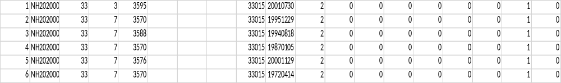
WIPS’ Tips (2)
Converting Participant Records into a .csv File
Converting participant-level data entered into an Excel spreadsheet or case management system to be saved into a table structured format that WIPS will be able to read
Those who use an Excel file to input their participant level data will save their Excel files as a .csv file prior to uploading the file into WIPS

Slide 27
APPENDIX :
ARCHIVED TOPICS

Slide 28
Collecting Social Security Numbers (SSNs) (1)
The collection and reporting of SSNs is essential for the wage and employment data after an individual has exited the program (i.e., completed their pre-apprenticeship or RAP)
Non-State grantees and state grantees not affiliated with a state workforce agencies are expected to collect and report SSNs from participants.
However, while OA grantees are required to request participants’ SSNs, participants cannot be denied services if they choose to not disclose their SSN. Grantees should also ensure that when they are collecting this information from participants, they inform the participants of the reason for requesting SSNs, in accordance with the American Competitiveness and Workforce Improvement Act.
Use disclaimer statements on intake documents telling participants why their SSNs are requested.
Notes:
Shelia

Slide 29
Collecting Social Security Numbers (SSNs) (2)
Congress requires OA to report performance outcomes by grantee name on public-facing websites such as apprenticeship.gov. When SSNs are not reported; this may lead to rows of blanks instead of wage and employment outcomes to be published on websites. When this happens grantee stakeholders (i.e., Congress, governors, etc.) often have questions. To avoid this situation, grantees should collect and report SSNs.
Additionally, the publication of blanks could “raise questions in Congress about the success of a grantee and whether grants funds are being spent in an appropriate manner. Not being able to tell your story accurately is likely to be noticed through quarterly roll-up reports from the Department of Labor to Congress.
Notes:
Shelia

Slide 30

Reportable Individuals
Reportable Individuals enter a RAP that was developed with grant funds, but they do not receive a direct, grant-funded service; therefore, they are not considered “participants” – Refer to TA Aid on Reportable Individuals located at WorkforceGPS Performance Reporting. Reportable Individuals are NOT participants under
To track and report reportable individuals, grantees must indicate the OBS number and the following PIRL data elements:
  OBS Number
  PIRL 100 – Unique individual identifier
  PIRL 1007 – Date of most recent reportable individual contact (Date individual registers in an apprenticeship program)
  PIRL 2914 – Apprenticeship grants program status (funding stream identifier). All reportable individuals should be coded as "2" for Data Element 2914.
  PIRL 2920 – Apprenticeship grant number
  Note: Reportable Individuals should not be removed/deleted from grantee PIRL data files. Grantees do not receive
  credit for any reportable individual removed/deleted from PIRL data files. That is, when reportable individuals are
  removed/deleted, WIPS is not able to calculate the cumulative number from the beginning of the grant’s period of
  performance on the Quarterly Performance Report (QPR).

Slide 31
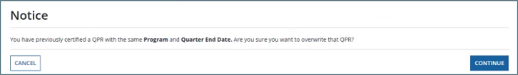
Overwriting PIRL Data Files (Quarterly Performance Reports)
When attempting to certify QPR data for the same reporting period that has a certified QPR data file, a warning message appears about overwriting the original file (see above).
Clicking CONTINUE certifies the updated report and shows a Certification Overwritten status for the older version.
  Note: Only one PIRL data file per selected program within the same quarter may be certified and reported.

Slide 32
Updated Logic Rule
Grantees can use either code value “1” or “0” for data element PIRL 1300 (Received Training) for apprentices.
Prior to this update, if the code value for data element PIRL 2907(Apprenticeship Program Status) equaled “1”, then PIRL 1300 also had to equal “1”.
This way if grantees have participants who are co-enrolled in more than one Apprenticeship Grant, they are not forced to use code value “1” for both programs.
Please note that all Registered Apprenticeship Programs should have a training aspect. All apprentices should be enrolled in training, and that should be recorded in the grantee’s data file.

Slide 33
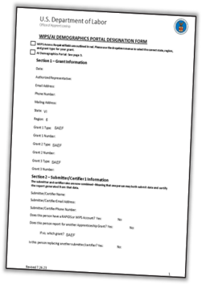
Obtaining Access to WIPS (1)
OA-managed grants require grantees to submit a WIPS Technical Assistance Request with the WIPS AI Demographic Portal Designation form attached for system access.
This process must be completed for each assigned apprenticeship grant.
Each OA-managed grant can have (3) submitter/certifiers.
Individuals needing WIPS’ access should submit their work-related email address (i.e., no Gmail, Hotmail, etc. email addresses)
Please request WIPS access at least four weeks prior to the report due date.
WIPS’ access will expire if there is no activity for 90 days. Set a reminder to login at least once/month to remain active.

Slide 34
Obtaining Access to WIPS (2)
Go to the following link: WIPS Technical Assistance Request | U.S. Department of Labor (dol.gov)
Complete the fields labeled Name, WIPS Email Address, WIPS User Role, and Program Related to this WIPS Inquiry (check the Registered Apprenticeship box).
Once you check Registered Apprenticeship, you will be required to fill out the Registered Apprenticeship Grant # field. Also, a new field labeled Signed WIPS/AI Demographic Portal Designation Form will appear with an icon next to it.
If you click on the icon, you’ll see the following message, “Office of Apprenticeship grantees must also complete and upload a signed WIPS/AI Demographic Portal Designation Form, found on the Apprenticeship Grants Performance Reporting WorkforceGPS page to request WIPS access.”
Click on the WorkforceGPS - Performance Reporting hyperlink to go to the WorkforceGPS page and then download the form labeled WIPS/AI Demographics Portal Designation Form on the page.
Fill out the form accordingly and list staff who need access to the RAPIDS Apprenticeship Information (AI) Demographic Portal as well. NOTE: Access to the portal does not grant access to RAPIDS.
Have your Authorized Representative sign the form.
Upload the completed and signed form under the field labeled Signed WIPS/AI Demographic Portal Designation Form.
Click the submit button at the bottom.

Slide 35
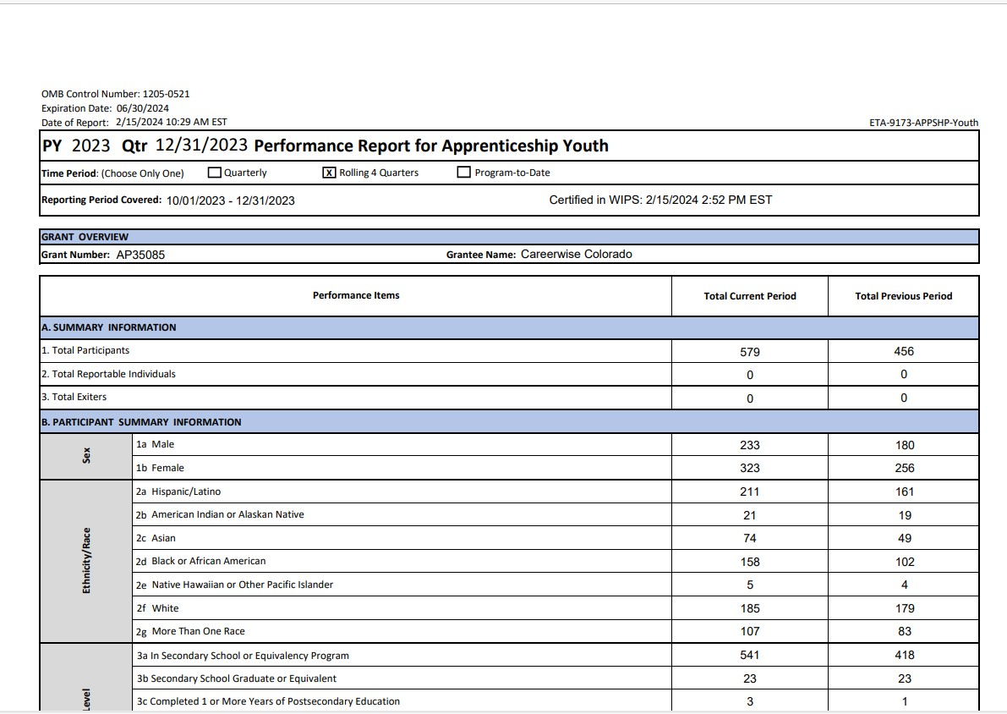
Reading/Interpreting the QPR (1)
In the Time Period section select the Quarterly “view”.
Problem: An Apprenticeship Grantee was facing issues with the following:
Total Participants
Total Exiters
Demographic categories (i.e., sex, race, and ethnicity)

Slide 36
Reading/Interpreting the QPR (2)
Sections of the QPR are not aggregated in the same manner:
  Section A (Summary Information) counts Total Participants to include newly enrolled during the reporting quarter + participants who were enrolled in prior quarters AND who are still actively receiving services (carryover).
  Section A (Summary Information) counts Total Exiters to include participants who exited prior to the current reporting quarter.
  Section F2 (Registered Apprenticeship Program Status) counts apprentices who started or exited their RAPs within the reporting period.
  Section F3 (Type of Registered Apprenticeship Program Training Approach) of the QPR count all apprentices who are still in the program (i.e. those who were enrolled during previous reporting periods (carryover) and those who were enrolled during the current reporting period).

Slide 37
Data Elements Used for Pre-Apprentices (1)
OBS Number
PIRL 100 | PIRL 211 | PIRL 407 | PIRL 2901
PIRL 101 | PIRL 212 | PIRL 408 | PIRL 2902
PIRL 102 | PIRL 213 | PIRL 409 | PIRL 2903
PIRL 103 | PIRL 214 | PIRL 900 | PIRL 2904
PIRL 200 | PIRL 215 | PIRL 901 | PIRL 2905
PIRL 201 | PIRL 300 | PIRL 907 | PIRL 2913
PIRL 202 | PIRL 400 | PIRL 923 | PIRL 2914
PIRL 210 | PIRL 402 | PIRL 2700 | PIRL 2920

Slide 38
Data Elements Used for Pre-Apprentices (2)
These data elements no longer apply the quarter after a pre-apprentice has transitioned to a registered apprenticeship | These data elements apply to individuals who are participants in a registered apprenticeship program
Data ​Element​ | Data Element | Also Used for ​Pre-Apprenticeship​
PIRL 2901 | PIRL 2900​ | ​
PIRL 2902 | PIRL 2907​ | ​
PIRL 2903 | PIRL 2908​ | ​
PIRL 2904 | PIRL 2909​ | ​
PIRL 2905 | PIRL 2910
 | PIRL 2911
 | PIRL 2912​ | ​
 | PIRL 2913​ | ​
 | PIRL 2914​ | X​
 | PIRL 2917
 | PIRL 2918​ | ​
 | PIRL 2920​ | X​

Slide 39
Pre-Apprentice Reporting Scenarios (1)
Scenario | PIRL Data Elements
If the pre-apprentice is enrolled in a pre-apprenticeship | PIRL 900 = MUST BE COMPLETED PIRL 2901 = 1 PIRL 2902 = MUST BE COMPLETED PIRL 2903 = MUST BE COMPLETED PIRL 2907 = LEAVE BLANK PIRL 2914 = 1
If the pre-apprentice has cancelled or withdrawn from a pre-apprenticeship | PIRL 900 = MUST BE COMPLETED PIRL 901 = MUST BE COMPLETED PIRL 2901 = 2 PIRL 2902 = MUST BE COMPLETED PIRL 2905 = LEAVE BLANK PIRL 2907 = LEAVE BLANK PIRL 2914 = 1
If the pre-apprentice has completed their pre-apprenticeship program but has NOT transitioned into a registered apprenticeship yet | PIRL 900 = MUST BE COMPLETED PIRL 901 = MUST NOT BE BLANK IF THEY HAVE COMPLETED THEIR PRE-APPRENTICESHP PIRL 2901= 3 PIRL 2902 = MUST BE COMPLETED PIRL 2905 = MUST BE COMPLETED PIRL 2907 = LEAVE BLANK PIRL 2914 = 1

Slide 40
Pre-Apprentice Reporting Scenarios (2)
Scenario | PIRL Data Elements
If the pre-apprentice has completed their pre-apprenticeship program AND transitioned into a registered apprenticeship MANAGED BY THE SAME GRANTEE | PIRL 900 = MUST BE COMPLETED PIRL 901 = LEAVE BLANK PIRL 2901 = 4 PIRL 2902 = MUST BE COMPLETED PIRL 2905 = MUST BE COMPLETED PIRL 2907 = 1 PIRL 2908 = MUST BE COMPLETED PIRL 2914 = 1 PIRL 1300 = 1 PIRL 1302 = enter date received training PIRL 1303 = 09 (registered apprenticeship) PIRL 1306 = enter O*Net code PIRL 1307 = leave blank PIRL 1610 = leave blank PIRL 1703 = leave blank PIRL 1704 = leave blank PIRL 1705 = leave blank PIRL 1706 = leave blank

Slide 41
PIRL Data Elements Used for Apprenticeship Entry and Exit
Scenario | PIRL Data Elements
If the pre-apprentice has completed their pre-apprenticeship AND transitioned into a registered apprenticeship program NOT MANAGED BY THE GRANTEE | PIRL 900 = MUST BE COMPLETED PIRL 901 = MUST BE COMPLETED PIRL 2901 = 3 PIRL 2902 = MUST BE COMPLETED PIRL 2905 = MUST BE COMPLETED PIRL 2907 = LEAVE BLANK PIRL 2914 = 1
If the registered apprentice is enrolled into a registered apprenticeship program | PIRL 900 = MUST BE COMPLETED PIRL 2907 = 1 PIRL 2908 = MUST BE COMPLETED PIRL 2914 = 1
If the registered apprentice has cancelled or withdrawn from a registered apprenticeship program | PIRL 900 = MUST BE COMPLETED PIRL 901 = MUST BE COMPLETED PIRL 2907 = 2 PIRL 2908 = MUST BE COMPLETED PIRL 2914 = 1
If the registered apprentice has completed a registered apprenticeship program | PIRL 900 = MUST BE COMPLETED PIRL 901 = MUST BE COMPLETED PIRL 2907 = 3 PIRL 2908 = MUST BE COMPLETED PIRL 2914 = 1
Note: THESE ARE NOT UPDATED LOGIC RULES. This is guidance on how to fill out the required data elements based on current logic rules in the Apprenticeship (AP) Schema.

Slide 42
APPENDIX :
Questions and Answers

Slide 43
Final QPRs and QNRs at the End of the POP.
Answer:
Final QPRs and QNRs are due on August 15, 2025, for grants whose period of performance ends on June 30*. No additional reporting is required. This includes reporting for participants who are employed after the grant’s POP. The following OA-managed grants are no longer active and no longer require QPRs or QNRs. All grant numbers associated with these grants should no longer be used/uploaded in grantee PIRL data files.
ASE – Apprenticeship State Expansion Grant
SAE16 – State Apprenticeship Expansion 2016 Grant
SAE2020 – State Apprenticeship Expansion 2020 Grant
YARG – Youth Apprenticeship Readiness Grant
*The reporting quarter for the SAEEI grant is April 1 – June 30, 2025. The final QPR and QNR are due on August 15, 2025. After the PIRL data file and the QNR have been certified in WIPS, no additional reporting is required.
Question:
When is the final QNR and QPR due for grants that have reached the end of their period of performance (POP)?

Slide 44
QPR/QNR Quarterly Submission Process
Question:
Is the QPR/QNR quarterly submission process changing from WIPS to another system?
Answer:
WIPS is the official performance reporting system for OA quarterly performance reports. All apprenticeship grantees should upload and certify their data utilizing WIPS.

Slide 45
Direct, Grant-Funded Services
Question:
What are direct, grant-funded services for registered apprenticeship grants?
Answer:
Direct, grant-funded services for OA-managed grants include:
On-the-Job Learning (OJL) – AKA On-the-Job Training (OJT) – paid OJL/OJT under the supervision of experienced professionals
Related Instruction (RI) – instruction which complements OJL/OJT, provides registered apprentices with theoretical knowledge and skills
Supportive Services (SS) – range of services designed to help apprentices succeed, both in their training and in their personal lives (e.g., childcare assistance, transportation assistance, uniforms, tools, etc.)

Slide 46
Post-Exit Data Elements
Question:
How should grants complete post-exit data elements (PIRL 1600 - 1607 and PIRL 1703 - 1706)?
Answer:
Once PIRL 901 (Program Exit Date) is filled out, you must fill out the post-exit PIRL data elements.
If the value you input for 1600: Employed in 1st Quarter After Exit Quarter (WIOA) is “0”, then you must input “0” for 1601:Type of Employment Match 1st Quarter After Exit Quarter (WIOA).
If the value you input for 1600: Employed in 1st Quarter After Exit Quarter (WIOA) is “9”, then you must input “5” for 1601:Type of Employment Match 1st Quarter After Exit Quarter (WIOA).
“0” represents “No” for data elements 1600, 1602, 1604, and 1606 and “Not employed” for data elements 1601, 1603, 1605, and 1607.
While “9” represents “Information not available yet” for data elements 1600, 1602, 1604, “5” represents this for data elements 1601, 1603, 1605, and 1607.
Please note that after a certain number of quarters, you MUST put “0” for PIRL 1600-1607. WIPS will not accept “5” or “9”.
For data elements PIRL 1703-1706 (Wages x Quarter After Exit), leave blank!
Note: For grantees that do not intend to collect and report supplemental employment and earnings information, DOL strongly recommends always leave these data elements blank.

Slide 47
QPR Time Period Views
Question:
Why is the “quarterly” QPR view the same as the “program-to-date” QPR view in WIPS?
Answer:
When you toggle between different views of the QPR in WIPS (e.g., Quarterly and Program to Date), it's not going to change because it isn't looking at a database where all the previous quarters' data is stored.
Instead, it's simply looking at the data from the single file that you have uploaded. This decision was made by the WIPS team awhile back.

Slide 48
Certifying QPRs in WIPS
Question:
Do grantees have to certify their QPRs in WIPS?
Answer:
Grantees certify that their data are complete, true, and accurate. Apprenticeship grantees should click on the certify button regardless of whether the QPR results are what is expected.
This step is important so that grantee data is transferred into the WIPS data warehouse. When data is transferred into the data warehouse, it becomes available for:
Evaluation studies;
Data analysis;
WIPS’ QPR testing; and
Apprenticeship grants online data dashboard

Slide 49
Uploading PIRL Data Files for Previous Quarters
Question:
Can I upload PIRL data files for previous reporting quarters into WIPS?
Answer:
In most cases, yes. However, there is an exception. Since the PIRL was last updated effective July 1, 2021, grantees are not able to upload PIRL data files from reporting periods before the quarter ending September 30, 2021. Therefore, any PIRL data files for reporting periods prior to September 30, 2021, will not be accepted by WIPS.
Also, the earliest reports that are available in WIPS for apprenticeship grants are from the quarter ending December 31, 2020.

Slide 50
PIRL Apprenticeship (AP) Schema
Question:
Should grantees report on all required data elements in the Apprenticeship Schema?
Answer:
Apprenticeship grantees should report on the required (“R”) Data Elements under the Apprenticeship column (column W) as shown in Tab 1 ETA-9172 (Full PIRL). Tab 2 AP Schema shows the PIRL Data Elements collected by Apprenticeship Grants using WIPS for reporting. Tab 2 is a subset of Tab 1 and represents the apprenticeship schema. Grantees should collect each data element in the apprenticeship schema, as applicable to each participant/individual*. In other words, every data element may not apply to each participant. Therefore, grantees should follow the instructions for each data element.
*Both reportable individuals and pre-apprentices have specific data elements that must be completed for each.

Slide 51
Full PIRL Apprenticeship Section
Question:
Should grantees complete Section E.10 – Registered Apprenticeship of the Full PIRL Schema?
Answer:
Data elements required to be collected by Apprenticeship grantees are indicated by an ‘R’ in the Apprenticeship column (column W) of the Full PIRL Schema. The PIRL data elements listed in Section E.10 are all selected with an ‘R’ in column W; therefore, they are required to be collected by Apprenticeship grantees, as applicable to each individual enrolled.

Slide 52
File Format Error
Question:
Why am I getting a file format error in WIPS when my PIRL data file only has 102 columns?
Answer:
Sometimes certain cells are formatted to have wrap-around text. Please make sure you do the following to avoid getting a column error in WIPS:
Remove headers from your file
Delete/clear anything after the 102nd column in your file
Highlight your rows and columns and de-select the Text Wrap formatting in Excel
If the preceding steps do not clear the column number error, copy/paste your .csv file into NotePad or NotePad++

Slide 53
DOL Data File Requests
Question:
If DOL asks grantees to submit the data file by email, how should PII be protected?
Answer:
DOL will not ask grantees to submit raw data files (i.e., .csv) via email. Electronic mail systems do not support the secure transmission of PII.
Grantees should submit their data files only through WIPS. The WIPS Help Desk exists on an email platform, so data files should not be transmitted when seeking assistance from the Help Desk. If Grantees are not able to certify their QPR in WIPS, they should seek technical assistance from ETA.
Data files should never be transmitted via email and should never be attached to the Quarterly Narrative Report (QNR)!

Slide 54
Reporting Participant Information
Question:
Should grantees update all participant information and add new participants each quarter during the grant’s period of performance?
Answer:
Yes. Grantees should report on ALL participants—new and existing—every quarter until individuals are no longer enrolled in the program. Each quarter, individual records for each participant are updated with new information, as appropriate. PII is not likely to change, but information on services received is likely to change from one quarter to the next, as the participant progresses through the program.
In summary, each data file should contain both new enrollees AND existing participants from previous quarters. Participants who were enrolled in a previous reporting quarter AND who are also still enrolled in the current reporting quarter are also known as “carryover”.

Slide 55
Grantee Reporting Staff Responsibilities
Question:
What are the responsibilities of grantee reporting staff?
Answer:
All organizations/grantees are different and often manage more than one grant. ETA is not able to provide a job description for their reporting staff. ETA supports many different reporting/performance professionals—many with different responsibilities and job descriptions, which literally run the gamut! This question would be best answered by other grantees that have a similar organizational structure.

Slide 56
“No Program Flag” Error
Question:
Why am I receiving a “No Program Flag” error in WIPS when I try to upload my PIRL data file?
Answer:
This error means that PIRL 2914 (Apprenticeship Grant Program Status) is not filled out in the file you’re trying to upload. For example, if you’re attempting to upload a .csv file and none of the rows have anything for data element 2914, then WIPS will trigger the No Program Flag error.
Please remember to use code value 1 for participants (pre-apprentices and registered apprentices) and code value 2 for reportable individuals for PIRL 2914.

Slide 57
Reporting on Reportable Individuals
Question:
Should reportable Individuals be reported on the Quarterly Performance Report (QPR) or via the Quarterly Narrative Report (QNR)?
Answer:
Grantees should report reportable Individuals every quarter on the QPR. In other words, once a reportable individual is reported on a PIRL data file, they should not be removed from subsequent PIRL data files. Since reportable individuals are registered apprentices who do not receive direct, grant funded services, grantees should only report the OBS number, and the four (4) data elements listed below in their PIRL data file:
  OBS Number
  PIRL 100 (Unique Individual Identifier)
  PIRL 1007 (Date of Most Recent Reportable Individual Contact)
  PIRL 2914 (Apprenticeship Grant Program Status)
  PIRL 2920 (Apprenticeship Grant Number)
Resources:
Performance Reporting TA – Interpretation/Application of Reportable Individuals Across Apprenticeship Grants
Performance Reporting TA – Types of Individuals

Slide 58
APPENDIX :
Resources

Slide 59


Office of Apprenticeship
Performance Reporting Resource Guide
U. S. Department of Labor
Reporting Resources for Office of Apprenticeship-Managed Grants
July 2025

Slide 60


CSG Technical Assistance
The Council for State Governments (CSG) provides one-on-one assistance to apprenticeship grantee with:
    Creating data files
    Uploading data files
    Troubleshooting data files
Contact CSG – Apprenticeship Data Alignment and Performance Technical Assistance Center
Grantees should forward their invitation for technical assistance to their federal project officer (FPO)
Click here to set up an appointment with CSG.
Notes:
Grantees should forward their calendar invitation from CSG to their federal project officer (FPO).

