Slide 1
ICF ABA2 Orientation
August 28, 2024

Slide 2
Agenda
Welcome and Coaches’ Introduction
ICF TA Resources
  Community of Practice
  Coaching Overview
  Quarterly Reporting
  Webinars and Peer-to-Peer Exchanges
  ABA Content Specific Resources
Other OA Investments
Other Apprenticeship Resources
TA Evaluation
Questions

Slide 3
Welcome and Introductions

Slide 4
TA Resources

Slide 5
Community of practice
Community of Practice (COP): Provides an on-line collection of apprenticeship information, tools, resources, and best practices.
  Tip Sheet
  Fact Sheets
  White Papers
  Guides
  Manual
  Toolkits
https://aba.workforcegps.org/

Slide 6
Technical assistance and coaching support
Subject matter expertise and customized technical assistance
One-on one coaching by a dedicated TA coach who will provide grantees with personalized support to address challenges
Individual or small-group conversations with experts in the field designed to inform strategy and address challenges
Intensive TA provided on-site or virtually by coaches and subject matter experts
Support in submitting quarterly reports

Slide 7
QUARTERLY REPORT DUE DATES
Each grantee must submit the quarterly reports required.
  They are due no later than the report due dates listed below:
Report Activities Occurring Between | Quarter End Date | Report Due Date
July 1 – September 30 | September 30 | November 15
October 1 – December 31 | December 31 | February 15
January 1 – March 31 | March 31 | May 15
April 1 – June 30 | June 30 | August 15
Your 1st reports are due no later than 11:59 pm EDT, November 15, 2024
This report will cover activities from July 1 thru September 30, 2024.
Notes:
Shelia

Slide 8
QNR Tips
Clarity and Conciseness:
Answer all questions and not unnecessary jargon.
Structured Format:
The report follows a structured format, with distinct sections for different topics. This makes it easier to navigate the report and find information – their format is actually optimal as they respond by section, rather than one large summary narrative.
Detailed Information: Provide detailed information about their activities, such as their proactive communication efforts and partnership development.
Focus on Key Issues:
Highlight key issues, such as the need for guidance from DOL and the impact on their project progress.
Use of Data: Where applicable, the report uses data to support their points, which adds credibility to their statements and helps to provide a more objective view of their performance.

Slide 9
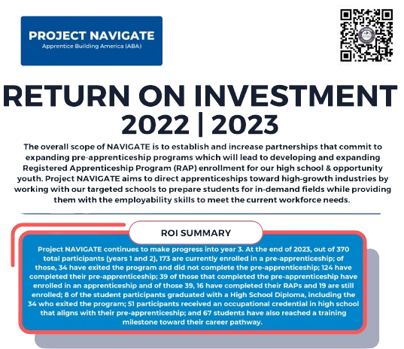
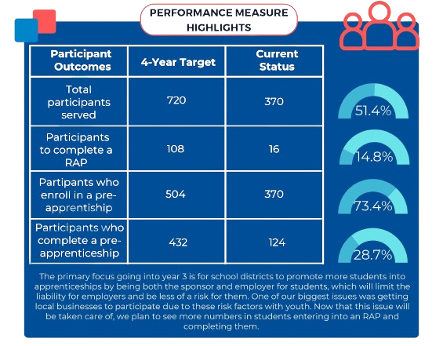
Using qnrs to tell a story

Slide 10
ABA2 Grantees 1 & 2
ABA2 PERFORMANCE MEASURES for CATEGORIES 1 & 2 |  |  |  | Quarter ending:
[Grant number] |  | [Grantee name]
 | Program Outputs | Targets (Cumulative 4-year total) | Previous Quarter's "Cumulative (Program-to-Date)" | Current Quarter | Cumulative (Program-to-Date)
1 | Total number of RAPs developed |  |  |  | 0
2 | Total number of RAPs expanded |  |  |  | 0
3 | Total number of pre-apprenticeships developed (as applicable) |  |  |  | 0
4 | Total number of pre-apprenticeships expanded (as applicable) |  |  |  | 0

Slide 11
Category 3 performance measures
ABA2 PERFORMANCE MEASURES FOR REGISTERED APPRENTICESHIP HUBS (CATEGORY 3) |  |  |  |  | Quarter ending:
[Grant number] |  | [Grantee name]
 | Program Outputs | Targets (Cumulative 4-year total) |  | Previous Quarter's "Cumulative (Program-to-Date)" |  | Current Quarter |  | Cumulative (Program-to-Date)
1 | Total number of RAPs developed |  |  |  |  |  |  | 0
2 | Total number of RAPs expanded |  |  |  |  |  |  | 0
3 | Total number of pre-apprenticeships developed (as applicable) |  |  |  |  |  |  | 0
4 | Total number of pre-apprenticeships expanded (as applicable) |  |  |  |  |  |  | 0
5 | Total number of stakeholder's engaged |  |  |  |  |  |  | 0
6 | Total number of employers receiving incentive funding, including total amount of funds to be awarded in incentive funding | # Employers: |  | # Employers: |  | # Employers: |  | # Employers: | 0
 |  | Total Funds: |  | Total Funds: |  | Total Funds: |  | Total Funds: | 0
7 | Total number of technical assistance resources created |  |  |  |  |  |  | 0
8 | Total number of new sponsors |  |  |  |  |  |  | 0
9 | Total number of individuals enrolled in a RAP that was developed using ABA grant funds (i.e., Reportable Individuals) |  |  | The "Total number of individuals enrolled in a RAP that was developed using ABA2 grant funds" will be reported into WIPS using four required PIRL data elements for reportable individuals: PIRL 100 (Unique Individual Identifier), PIRL 1007 (Date of Most Recent Reportable Individual Contact), PIRL 2914 (Apprenticeship Grant Program Status), and PIRL 2920 (Apprenticeship Grant Number).
10 | Total number of individuals enrolled in a pre-apprenticeship that was developed using ABA grant funds |  |  |  |  |  |  | 0

Slide 12
QpR tips
Every quarter, double-check the ABA Performance Reporting site for the latest schema and edit checks: https://ase.workforcegps.org/Performance-Reporting
Always edit and upload your PIRL to WIPS in .csv format to avoid data reformatting, Excel will reformat your data and remove leading zeros*.
  For experienced users, there are methods to use Excel without reformatting data: https://spreadsheetweb.com/how-to-avoid-formatting-change-in-csv-files-in-excel/
The PIRL is cumulative, so previously submitted records will need to be updated with every quarterly submission.
  The PIRL contains up to 16 rolling quarters. Remove records only if they have not had any activity for over 16 quarters.

Slide 13
QpR tips
The number of required PIRL elements that must contain data depends on the type of service provided. Regardless of the type of record, your PIRL file will always have 102 columns. The AP Schema contains handy column filters to choose from:
  Reportable Individuals: 5 required elements
  Pre-Apprenticeships: 49 required elements
  Apprenticeships: 102 required elements
Feel free to contact Scott Wheeler with any of your data/reporting questions.

Slide 14
Coaches’ next steps
First 6 Months:
  Set up cadence for coaches’ meetings
  Review workplan for project including strategies to meet grant performance metrics
  Provide on-going guidance, support, encouragement, solutioning

Slide 15
Additional Resources
Monthly Newsletter: Provides shared resources, best practices, grants management tools, and announces upcoming events.
Webinars/Peer to Peer:
Provides peer-to-peer opportunities to address questions impacting a number of grantees.
Site Visits and Multi-Site Convenings:
To support grantees in learning from one another on innovations, and promising.
Annual National Convening:
To share resources and discuss activities and findings.
Additional Questions: ABA.Grant@icf.com

Slide 16
OA Investments

Slide 17
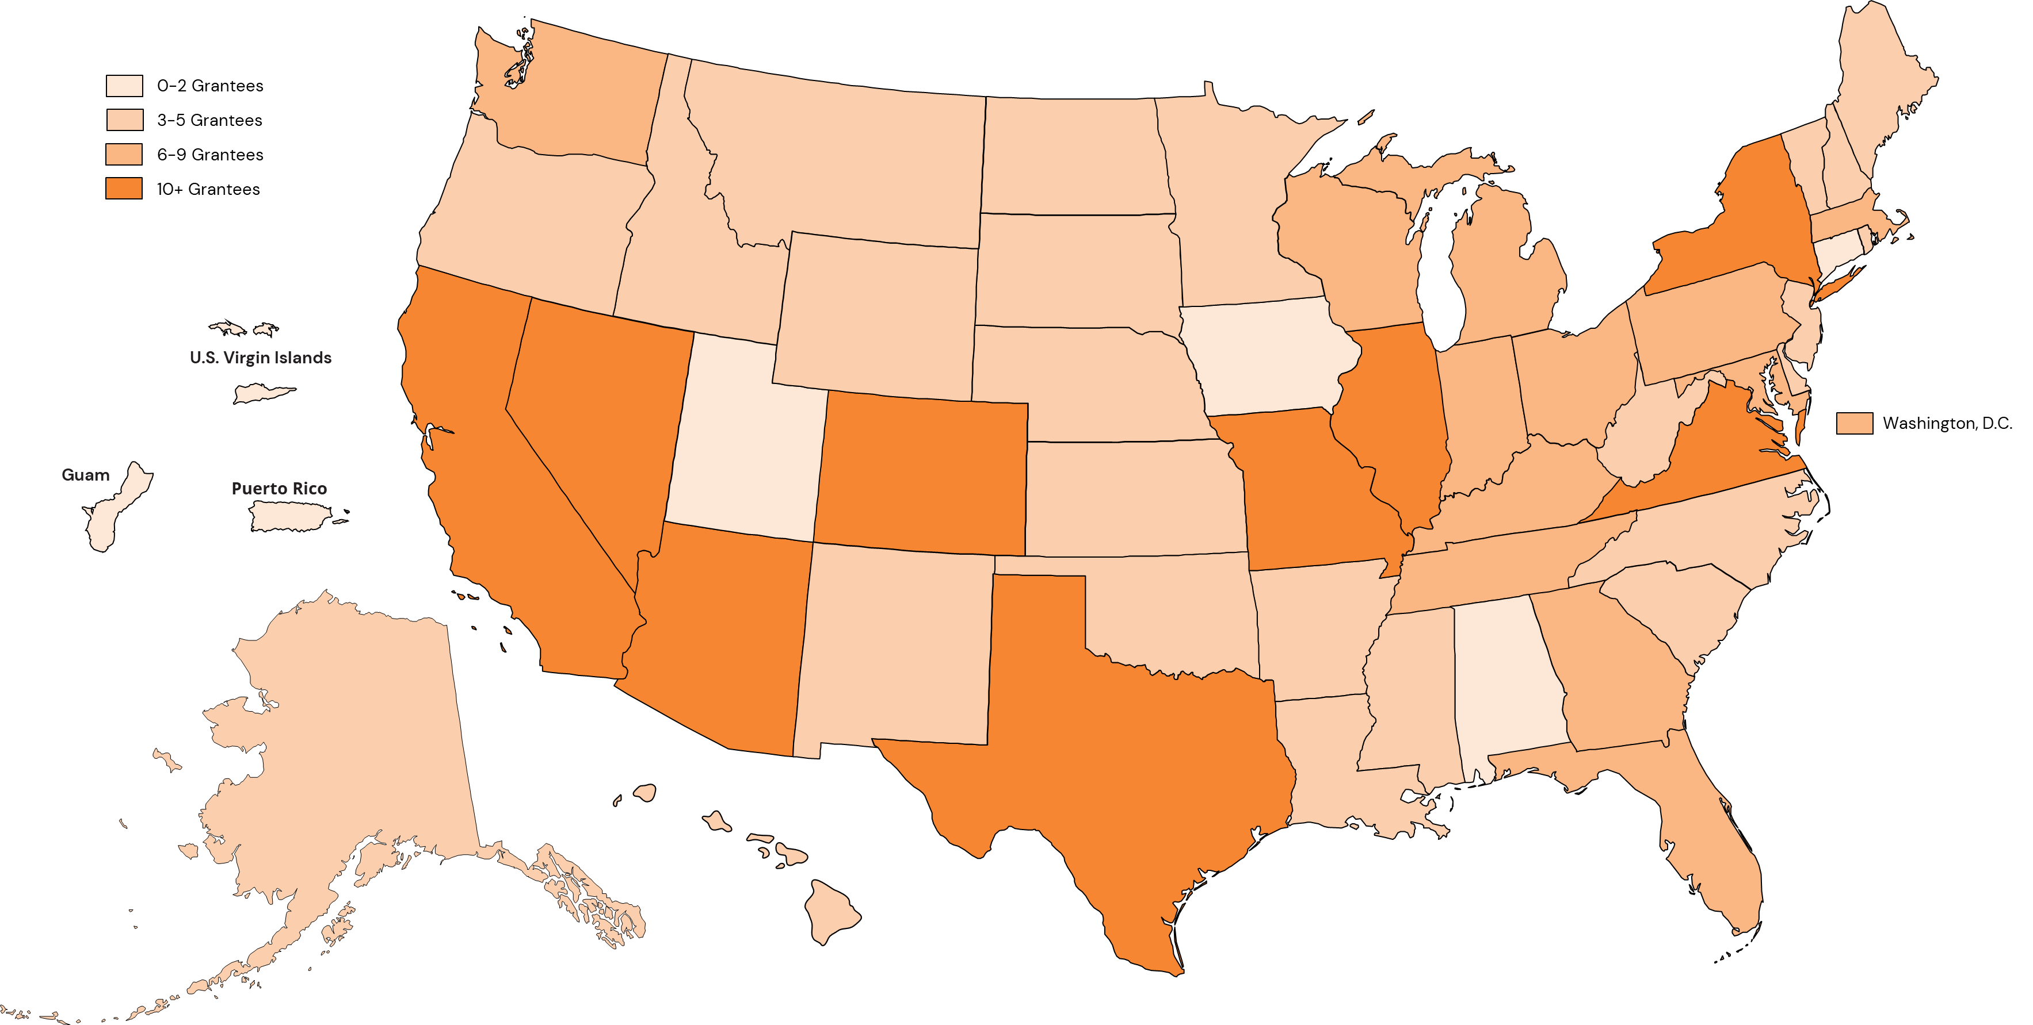
DOL Investment

Slide 18
Additional Intermediary Funds – National or Regional in Focus
Apprenticeship Expansion and Modernization Fund
  3 Grantees
Industry Intermediaries (2 Rounds)
  16 Grantees

Slide 19
Additional resources

Slide 20


WorkforceGPS
Host Community of Practice
DOL Webinars on a number of topics
Youth Connections Community of Practice
Resources and Publications
Future Webinars
Notes:
Call out on WorkforceGPS
RA101 – whole series

Slide 21

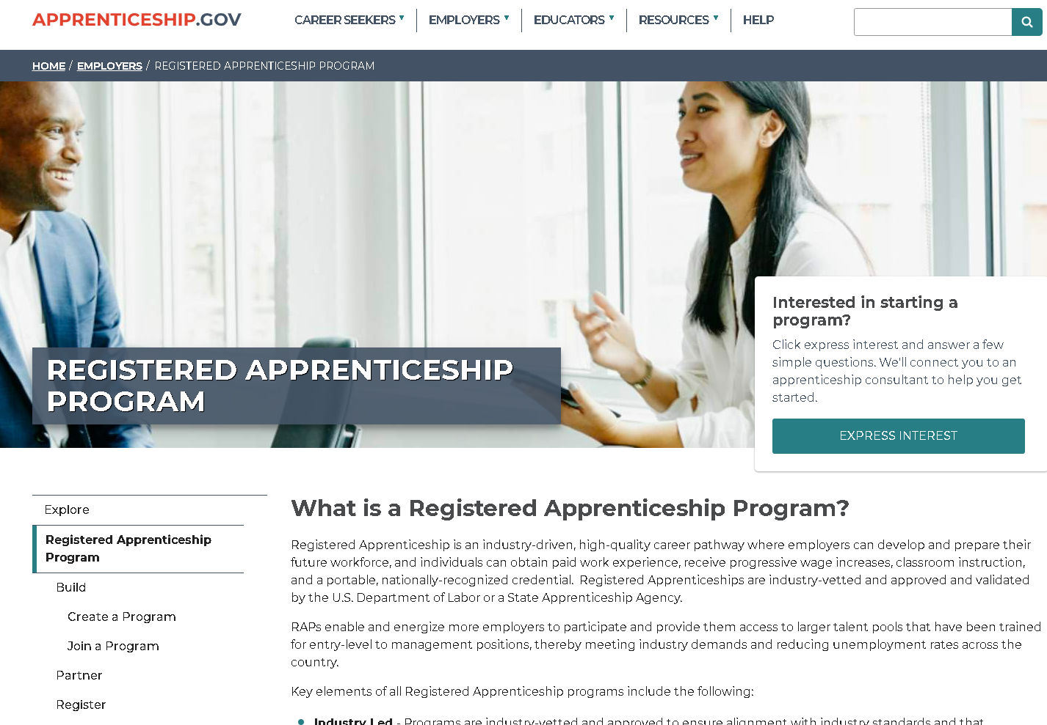
Apprenticeship.gov
One-stop shop
Resources for employers
Resources for sponsors
Resources for career seekers
Fact sheets, tools
News and Updates
Notes:
Call out like EEO resources

Slide 22
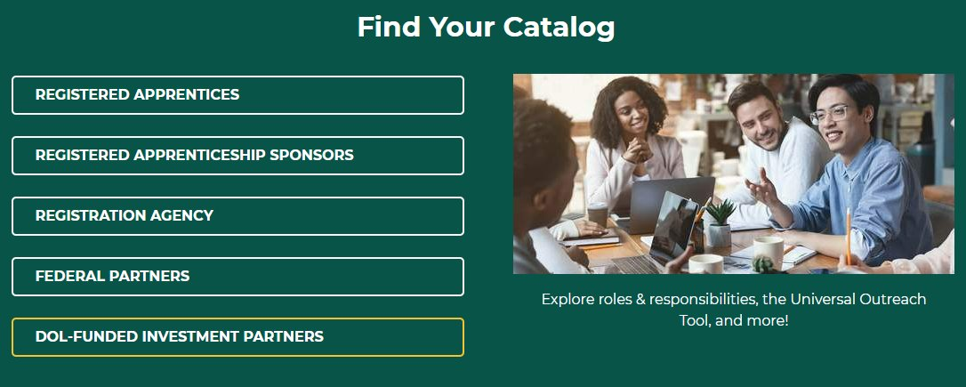

Registered apprenticeship academy
Grantees fall under the DOL-Funded Investment Partners catalog on the Registered Apprenticeship Academy. Resources include registered apprenticeship overview, program administration, EEO, outreach and recruitment and more!

Slide 23
RA TA Centers Program Overview
Strategic Partnerships and System Alignment Center
Data and Performance and Best Practices Center
Diversity and Inclusion Center
Apprenticeship Occupations and Standards Center

Slide 24
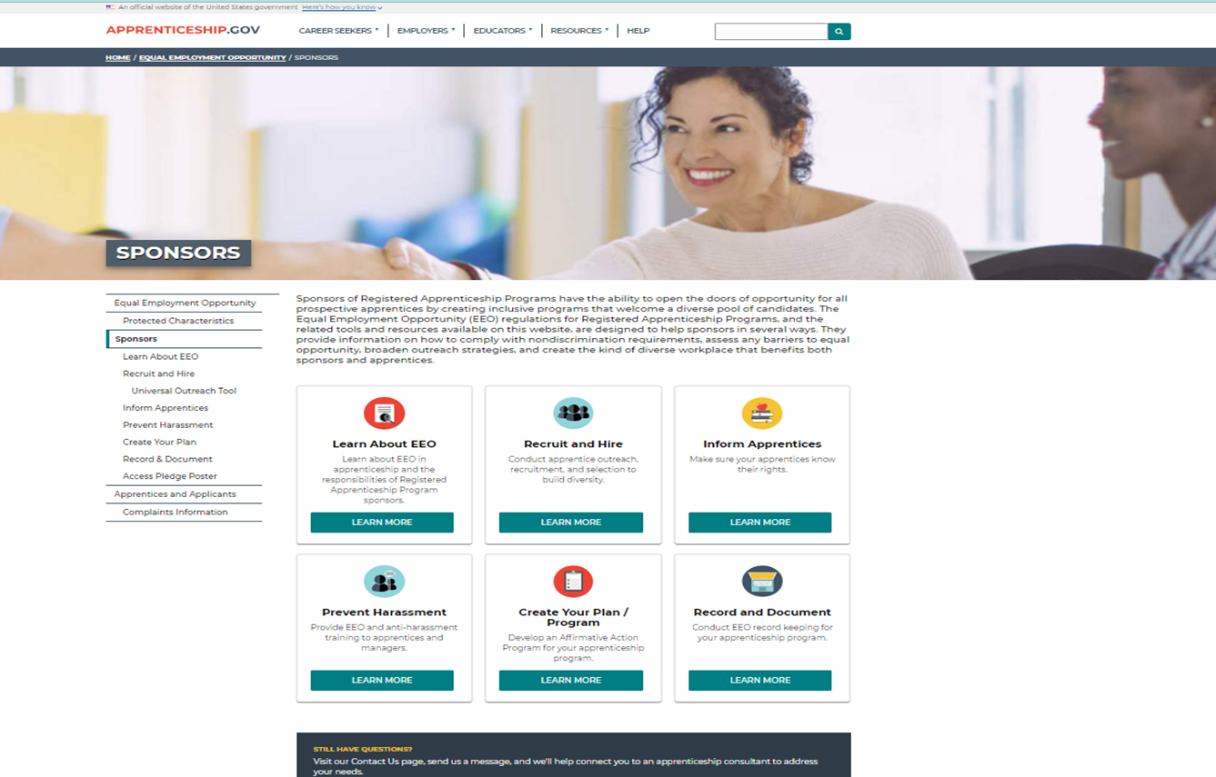
EEO Resources
www.apprenticeship.gov/eeo/sponsors
EEO Pledge
Anti-Harassment Training
Complaints Filing
Information and Form
Quick Reference Guides (e.g., reporting)
FAQs
Webinars

Slide 25
Additional Resources:
Written Materials
EEO in Registered Apprenticeship
    https://www.apprenticeship.gov/eeo
EEO Regulations for RAPs
    https://www.apprenticeship.gov/sites/default/files/29_cf_30_regs_only.pdf
    Sponsor Quick Reference Guides
    https://www.apprenticeship.gov/eeo/sponsors/learn-about-eeo
Recordkeeping Reference Guide
    https://www.apprenticeship.gov/sites/default/files/sponsor-quick-reference-guide-record-keeping.pdf
RA Academy Training
Disability Inclusion Starts with You
https://www.dol.gov/agencies/ofccp/compliance-assistance/self-id-forms-video
Meeting EEO Requirements through Affirmative Action Programs
https://rise.articulate.com/share/qSfP0cjuu9PTvAxqjcYARK1tF_hb_oIw#/
EEO Requirements for Registered Apprenticeship Programs with Five or More Apprentices
https://rise.articulate.com/share/rMO3lm66XDUsv4-rEI8WmMgkLxLsic6E#/

Slide 26
DEIA Resources
Please visit the DEIA homepage and resource page on apprenticeship.gov for more information on DEIA in Registered Apprenticeship
An Untapped Opportunity: Registered Apprenticeship at Minority Serving Institutions - This report highlights the current state of registered apprenticeship across Minority Serving Institutions. It highlights institutions that have robust registered apprenticeship programs so that readers can better understand the strengths and challenges of RA at MSIs.
Apprenticeship Shaped My Post-Prison Life - Partnerships between employers and prison industries are a win for companies, the economy, and aspiring workers after incarceration.
We Go Where They Need Us to Be: The Power of Community Colleges to Support Learners in Reentry - What it looks like when community colleges embrace postsecondary education in corrections and reentry programs as a core part of their mission.
Moving Beyond the Box: When Fair Chance Hiring Means Advancement Not Just Employment - Leaders in corporate policy share three key strategies for building growth and economic advancement for people with records.
WTIA Diversity, Equity, and Inclusion 2023-2024 Insights Report – The WTIA DEI Center of Excellence engaged approximately 70 technology companies in a mixed-methods study of DEI practices in their organizations to glean insights and best practices.

Slide 27
TA Evaluation

Slide 28
TA Evaluations Methods
Domain | Activity | Metrics | Instrument
Awareness (Reaction) Satisfaction Engagement Relevance | Webinars Conference/Peer to Peer Exchange Engagements | Number of registrants and participants Post-activity feedback survey results Number of session attendees Post- feedback survey results | Tracking spreadsheet Webinar poll Survey
Consideration (Learning) Knowledge Skills Attitude Confidence Commitment | Coach Feedback Grantee Feedback | Improvement in status Meeting Goals Knowledge gains in the Grant requirements, RAs, Employer engagement, etc. Satisfaction with effectiveness of Coach and TA Alignment of grantee and coach expectations and perceptions | Coach Feedback Form Grantee Survey
Conversion (Behavior) Application | Performance Measures | Total number of RAPs developed/expanded Total number of pre-apprenticeships developed/expanded (as applicable) | ABA Quarterly Narrative Report and Quarterly Performance Report Coach Feedback Form
Connection (Results) Improvement in KPIs | Coach Feedback Changes in Grantee Performance (at risk/low, medium, or high) | Improvement in KPIs and Grantee Tier status Changes in performance from baseline to follow-on | Baseline Assessment Grantee Tier Assessment Coach Feedback Form
Notes:
ICF utilized a multi-stage TA assessment process that measure the impact of TA across four key learning stages: awareness, consideration, conversation, and connection.
Awareness – extent to which recipients participate in TA, value it and find it relevant
Consideration – extent to which recipients develop new knowledge and skills and know how to apply it.
Conversion – extent to which grantees change their work styles and adopt new, evidence-informed practices based on TA received.
Connection – Measures the extent to which key outcomes are achieved for job seekers and businesses who receive services provided by TA recipients
The metrics are customized to each strategy to illuminate areas for continuous improvement. Data collection activities are conducted on a continuous basis.
The Grantee satisfaction survey was sent to all 39 ABA grantees by their coach and 26 grantees completed the survey yielding a 67% response rate. The Coach feedback form mimicked the grantee satisfaction survey and provided input from the coaches on their assessment of grantees engagement, satisfaction, application and improvement since beginning their TA efforts. 38 of 39 coaches completed the feedback forms yielding a 97% response rate. The next several slides detail the findings of the first iteration of this semi-annual survey.

Slide 29
Questions/discussion

Slide 30

National Apprenticeship Week 2024

Slide 31
Thank you

