Slide 1



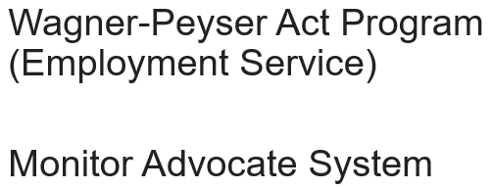

January 2022
Labor Trafficking in U.S. Agriculture:
Information to Help Employment Service Staff Respond to Potential Trafficking
Notes:
Timmy Dudley: Hello, The United States Department of Labor, Employment and Training Administration (ETA) presents this webcast in collaboration with Polaris, which is a Non-Governmental Organization that receives funding from the U.S. Department of Health and Human Services to operate the U.S. National Human Trafficking Hotline. This webcast is for State Workforce Agency staff, including State Monitor Advocates, outreach staff, and other Employment Service staff. Through this webcast, Polaris will present information on labor trafficking, which is intended to help staff identify and respond to trafficking indicators and to understand their role in referring potential trafficking to enforcement agencies.
This webcast will help State Workforce Agency Employment Service staff, including American Job Center staff, migrant and seasonal farmworker (MSFW) outreach staff, and State Monitor Advocates identify potential signs of labor trafficking, which they must document as either Apparent Violations or, if applicable, as complaints filed through the Employment Service and Employment-Related Law Complaint System. For specific guidance on how to document and refer Apparent Violations and Complaints, please consult your state’s State Monitor Advocate or your ETA Regional Monitor Advocate. Contact information for those individuals is provided at the end of this presentation.
I am Timmy Dudley, speaking for the ETA National Monitor Advocate team, and I would like to introduce Ted Lynch from Polaris, who will present information for the remainder of this webcast.

Slide 2


Labor Trafficking in U.S. Agriculture
Ted Lynch
Strategic Initiative on Labor Trafficking
The views, figures and contents of this presentation represent the position of Polaris, a non-governmental organization, not necessarily those of the U.S. Department of Labor or the U.S. Government.
Notes:
For over a decade, Polaris has assisted more than sixty thousand victims and survivors through the US National Human Trafficking Hotline, and built the largest known US data set on the crime that illuminates how human trafficking works, in real time, and turns knowledge into targeted systems-level strategies to disrupt and prevent human trafficking. Polaris has a wealth of information on trafficking in agriculture and today, we will share resources that the hotline provides, statistics on trafficking in agriculture, and tips for outreach staff to use if they encounter possible situations and victims of trafficking while conducting outreach.
The figures, views and information presented here, unless otherwise cited or sourced, do not represent the views or positions of the U.S. DOL.

Slide 3
You play a critical role in identifying and preventing labor trafficking!
Workforce development professionals such as State Monitor Advocates (SMA) and Employment Service outreach staff come into contact with hundreds of thousands farmworkers every year while conducting outreach, field visits, and field checks. Outreach staff observe the working and living conditions of MSFWs and, upon observation or upon receipt of information regarding a suspected violation of Federal or State employment-related law, including labor trafficking, they are responsible for logging the incident and referring these cases to enforcement agencies as appropriate.
Additionally, educational engagement is a critical preventive measure, and SMAs and outreach staff are able to educate and help agricultural employers with compliance and understand the risks of trafficking and exploitation in their supply chains.
Notes:
State Monitor Advocates (SMA) and Employment Service outreach staff come into contact with hundreds of thousands of migrant and seasonal farmworkers every year in the course of their duties. During this time, SMAs and outreach staff should be alert to observe the working and living conditions of farmworkers. If there are signs of trafficking, staff should log and refer these cases to the appropriate enforcement agencies.
Educational engagement with agricultural employers and growers are also a critical preventative measure to help employers and growers get into compliance and understand the risks of trafficking and exploitation in their supply chains if they don’t have strong checks and processes in place. Polaris values your collaboration in the fight against labor trafficking and appreciates your participation in this webcast.

Slide 4
Overview
Polaris and the National Human Trafficking Hotline
Human Trafficking 101
Hotline Data on Labor Trafficking in Agriculture
Tips for Outreach Staff
Notes:
During this webcast we will introduce Polaris and talk about the National Human Trafficking Hotline before moving to a broad overview of Human Trafficking including definitions of the criminal law. Then we will go over some relevant hotline data on labor trafficking in agriculture.
We will finish up by discussing some tips for any staff in direct contact with farm workers on how to assess for labor trafficking.

Slide 5


Strategic Initiatives
Labor Trafficking
Sex Trafficking
Financial Systems
Learning, Innovations & Data Systems
Survivor Engagement
Government Policy & Strategic Advocacy
U.S. National Human Trafficking Hotline
Notes:
Polaris is an anti-trafficking organization founded in 2002. We are pioneers in the use of technology to address trafficking in the U.S. and through the National Human Trafficking Hotline have built the largest known U.S. data set on actual trafficking experiences.
Many of you may be familiar with the National Human Trafficking Hotline, but we also have three strategic initiatives that focus on preventative strategies.
One team focusing on sex trafficking working with cities, another focused on engaging with financial institutions and the financial industry to develop red flags and ways to identify links between money laundering and proceeds from trafficking, and then the Labor Trafficking Strategic Initiative, which I am a part of. Our team is primarily focused on labor trafficking in Agriculture at this time, and in our work in the US, the H-2A visa program.
Additionally we have a Government Policy and Strategic Advocacy team that works with Congress advocate for the reauthorizations of the TVPA, the field’s defining legislation, but also looks at other legislations and state initiatives that might affect vulnerabilities or advance protections for survivors and vulnerable populations.

Slide 6
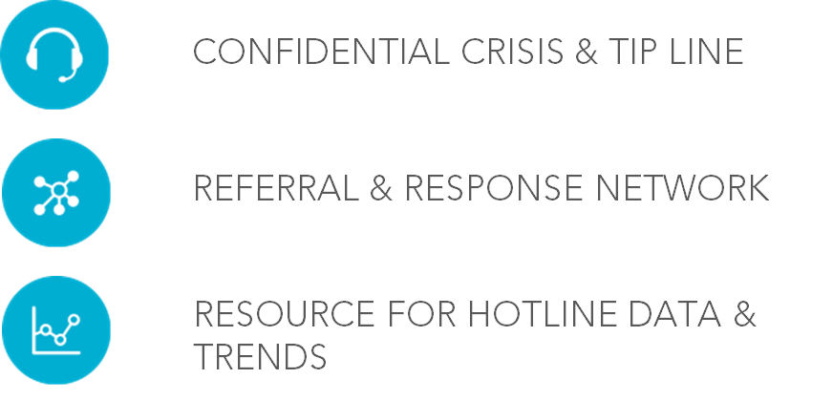
HT Hotline main Functions
Notes:
The National Hotline serves three key functions:
It is a confidential crisis and tip line where victims, survivors, or their family and friends can call in and be connected to resources depending on their wishes and needs
It is a robust national referral and response network, which includes an avenue for reporting human trafficking situations to specially trained and trusted law enforcement contacts across the country.
Lastly it is also a resource for hotline data and trends
The advantages of having one single national hotline instead of statewide or local hotlines are:
It is a center for national coordination of cases across states.
Second, it has financial stability and law enforcement recognition & credibility due to government funding, but also has NGO independence which is important for victims and survivors that don’t want to have to interact with law enforcement to access services.
It is one easily memorable number which is also the best way to not duplicate efforts in promotion.
And lastly it’s a data hub on the right scale to draw some broader conclusions at the regional and national level.

Slide 7
Human Trafficking 101
Notes:
Now we will get into what human trafficking is as defined by federal law, and how Polaris thinks about the different components of the crime.

Slide 8
The Trafficking Victims Protection Act of 2000 and subsequent re-authorizations define human trafficking:
a) Sex trafficking in which a commercial sex act is induced by force, fraud, or coercion, or in which the person induced to perform such act has not attained 18 years of age; or
b) The recruitment, harboring, transportation, provision, or obtaining of a person for labor or services, through the use of force, fraud, or coercion for the purpose of subjection to involuntary servitude, peonage, debt bondage, or slavery. (22 U.S.C. § 7102(9)).
Notes:
Sex trafficking is when a commercial sex act is induced by force, fraud, or coercion, or in which the person induced to perform such act has not yet turned 18 years of age. What this means is that for sex trafficking it is not necessary to prove Force, Fraud or Coercion for someone under the age of 18- a minor.
Labor trafficking is defined as the recruitment, harboring, transportation, provision, or obtaining of a person for labor or services, through the use of force, fraud or coercion for the purpose of subjection to involuntary servitude, peonage, debt bondage, or slavery.
We’ll be focusing here on labor trafficking, specifically labor trafficking in agriculture.

Slide 9
A-M-P Model
Action*
Means**
Purpose
Recruits
Harbors
Transports
Provides
Obtains (or so attempts)
Force (Physical assault, sexual assault, confinement)
Fraud (False promises about work/living conditions, withholding wages)
Coercion (Threats of harm or deportation, debt bondage, psychological manipulation, confiscation of documents)
Commercial sex act(s)
Forced labor or services
*Additional actions that constitute sex trafficking, but not labor trafficking, include patronizes, solicits, and knowingly advertises.
**Neither force, nor fraud, nor coercion are required to be shown for minors under the age of 18 induced into commercial sex acts.
Notes:
The Hotline operates off of the federal definition of human trafficking, which is represented here by the A-M-P Model, which helps hotline advocates through the assessment process on calls.
To fit the federal definition of trafficking, the situation must have an action: recruit, harbor, transport, provide, or obtain. A means which can be a form of Force, Fraud, or Coercion, and be for the purpose of either commercial sex acts or forced labor or services.
The Means which needs to include at least one element of either force, fraud or coercion differenciates a situation of labor trafficking vs a labor exploitation situation.

Slide 10
Some facts about HT
The trafficker is usually already known to workers before the exploitation starts.
Trafficking does not requires state or international
border crossing.
Many do not immediately identify as victims of trafficking and may not be ready to leave their situation at a point of intervention.
Labor Trafficking frequently includes fraud, nonviolent coercion, threats, and debt bondage.
Notes:
When we begin talking about human trafficking, there are always myths and misconceptions that are disseminated or widely held. A few myths include the following:
One is that trafficking victims are complete strangers that target unknown people, This is False, many times the trafficker is already known to the victim or worker whether that be a family member, community member, recruiter or employer that has learned about the vulnerabilities that a worker might have.
Another is that trafficking requires state or international border crossing- This is also False, that is a description of human smuggling, which can be a part of some trafficking situations but is not actually a requirement, victims can be trafficked in their hometowns and even their own homes. Many labor trafficking situation involving foreign nationals have an aspect of traveling and entering the US but that part isn’t a defining part of the trafficking situation, although it can be a risk factor.
Trafficking victims will always leave the situation when offered help or when they come into contact with someone outside the situation.. This is also False- many victims do not immediately identify as victims of trafficking and may not be ready to leave their situation at the point of an unexpected intervention or access point if they haven’t thought through what their next steps might look like. This is especially true in labor trafficking in agriculture.
Another Myth is that Trafficking victims must be kidnapped or physically restrained. This is not required and Polaris sees and documents a lot of nonviolent coercion such as debt bondage, fraud, threats and document confiscation. Unfortunately this prevents a lot of labor trafficking cases from being identified or investigated because it might not fit someone’s idea of what trafficking is ‘supposed to look like’

Slide 11
Labor Trafficking vs Exploitation
Freedom to move
Freedom to leave WITHOUT serious harm/ repercussions
Force, Fraud, or Coercion
Limited freedom
to move
Cannot leave without serious harm/ repercussions
Unfair
Wages
&
Poor living and working conditions
Notes:
It's important to remember that many aspects of labor trafficking and labor exploitation are similar and both involve exploitative working conditions. The main difference between labor trafficking and labor exploitation is that, in trafficking situations, there are elements of force, fraud and coercion and limited freedom of movement. It can be a little more difficult to tell if someone can really leave in many visa sponsored situations because the visa is typically tied to one employer and workers do not have the option to seek other employment. Traffickers can exploit that vulnerability further if they choose. The Hotline provides different legal referrals for labor trafficking and labor exploitation situations and may offer to report a labor trafficking situation to our law enforcement contacts for investigative consideration. Labor exploitation cases also receive legal assistance referrals and referrals to the applicable labor agency like WHD, OSHA or EEOC.

Slide 12

The Typology: 25 Types
Data Source: Polaris, ‘The Typology of Modern Slavery: Defining Sex ad Labor Trafficking in the United States https://polarisproject.org/resources/the-typology-of-modern-slavery-defining-sex-and-labor-trafficking-in-the-united-states/
2007-2017 analysis of hotline case data
Notes:
In 2017 Polaris conducted an analysis of 10 years worth of hotline cases with high and moderate likelihood of trafficking to classify cases by business-type and industry. Before these distinctions we really only had the distinctions between sex and labor trafficking. However, someone working in domestic work for a diplomat is likely facing something very different from someone picking oranges who also has a different situation from a victim in construction.
The typology looked at what matters most to traffickers, their money and business models to better understand what interventions might work against them. In this report over 400 cases of labor trafficking in Agriculture were analyzed.
If we analyze the nationalities and backgrounds of potential victims identified by the NHTH in agriculture, and labor trafficking typologies more broadly, the majority of victims are from or have backgrounds from Latin America and the Caribbean countries. More about this can be found in Polaris’s report titled The Latino Face of Human Trafficking

Slide 13
Human Trafficking Data
Notes:
Polaris holds the largest known data set on human trafficking in North America, which grew out of more than a decade of operating the U.S. National Human Trafficking Hotline. Internally, we scour the data for patterns and other information that form the underpinning of our pilot programs, policy decisions and long-term strategies. Every year, Polaris publishes data based on calls, text messages, webforms, emails and webchats with the U.S. National Human Trafficking Hotline. This data, while limited and self-selecting, offers important insights into patterns of sex and labor trafficking in North America, and has lead Polaris to target programming on labor trafficking in agriculture, among other focuses.

Slide 14
2020 Labor Trafficking Highlights
Top 3 Industries by Case:
Domestic Work (184)
Agriculture and Animal Husbandry (79)
Construction (63)
Top 3 Industries by Number of Victims Identified
Agriculture and Animal Husbandry (1094)
Domestic Work (297)
Construction (242)
Data Source: Polaris, National Human Trafficking Hotline
Notes:
Just considering labor trafficking in 2020, agriculture had the 2nd most cases of all the labor trafficking industries we track, after domestic work.
When looking at number of victims identified in those cases, we see that many more victims were identified in agriculture than any other venues of labor trafficking.
The hotline defines the venue of Agriculture/Farms/Animal Husbandry A farming business primarily engaged in growing crops, cultivating soil, or rearing animals for their byproducts.
Within Agriculture we also track sub-venues or sub- industries- a few include:
Cattle
Hogs/Pigs
Honey/Beekeeping/Apiculture
Onions
Oranges
Poultry/Eggs
Sheep/Goats
Strawberries
Tobacco
Tomatoes

Slide 15
2020 Labor Trafficking Highlights
Top Risk and Vulnerability Factors:
Recent Migration or Relocation
Economic Hardship (self reported)
Unstable Housing
Substance Concern
Top forms of Force Fraud and Coercion:
Withholding Pay/Earnings
Excess Working Hours
Threats to Report to Immigration
Withholds/Denies Needs
Verbal Abuse/Manipulation
Data Source: Polaris, National Human Trafficking Hotline
Notes:
We see that the top risk and vulnerability factors for Labor trafficking are recent migration or relocation, economic hardship which can cover many different forms such as debt or just lack of economic opportunity, unstable housing situations and substance dependence or abuse.
Looking at the most common forms of force, fraud and coercion, we have withholding pay or wage theft, which unfortunately is very common outside of trafficking situations too, but can also be a factor in trafficking situations if it plays a factor in someone’s ability to physically leave a situation or keeps them working longer because they still think they will eventually see that money.
Next, excessive working hours, when this is used as a form of FFC, means workers are being required to do mandatory, non-voluntary overtime or face retaliation or other punishment.
Threats to report to immigration authorities or threats to deport workers are also commonly used. WIthholds/denies needs could be related to access to food and water or workers ability to access financial services to send home money, even access to phones.
And finally verbal abuse and manipulation can take many forms and have racist, sexist and homophobic undertones meant to belittle and break down workers and usually accompanies threats.

Slide 16
Data Source: Polaris/National Human Trafficking Hotline
Notes:
As mentioned before, the hotline’s main purpose isn’t to gather data, but to connect victims and survivors with the services they need at that moment, because of this, as well as due to fear, many victims of labor trafficking in agriculture are not always asked about their status or are not comfortable disclosing this information, which is also fine and contributes to the large percentage or workers and victims with unknown status. Over 60% of potential victims were identified as working in the US through temporary visa programs. It is possible that larger numbers of individuals working on temporary visa programs contact Polaris, compared to individuals who identify themselves as US citizens or undocumented workers, because the US Department of State provides a pamphlet that educates workers employed through temporary visa programs about their rights before they enter the US. This may result in greater awareness about their rights, including that they may contact the hotline to seek help. This indicates that proactive education and outreach regarding trafficking may result in potential victims seeking help more frequently. It is important that other agricultural worker populations also know about their rights, so they may receive help as well. State Workforce Agency outreach workers can be important resources to educate farmworkers in this way, in addition to identifying trafficking indicators in the field."

Slide 17
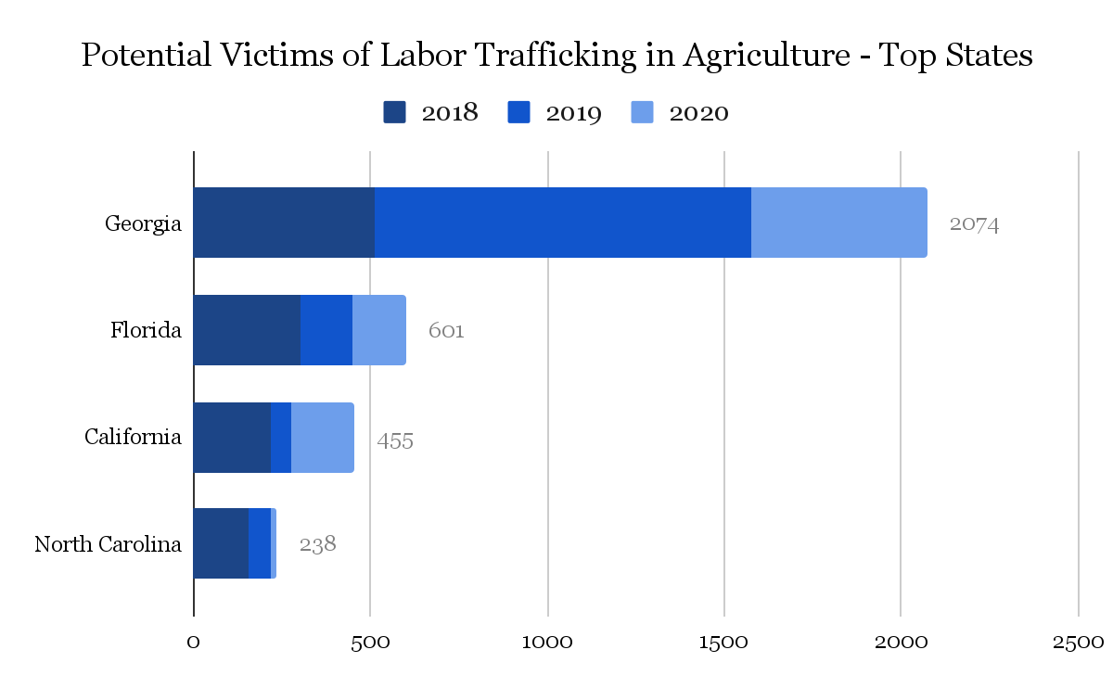
Data is of Potential Victims of Labor Trafficking in Agriculture for top states, 2018-2020
Data Source: Polaris/National Human Trafficking Hotline
Notes:
Here are the top potential victim totals by state, and unsurprisingly, these totals mirror the states with high levels of agricultural activity. While we certainly hear about labor trafficking in ranching, shepherding, animal husbandry and other agricultural activities like dairy and eggs, most of the victims we identify in agriculture are working in a vegetable, fruit and produce harvesting.
Looking at this, someone might think that if we just concentrated on Georgia we could address a lot of trafficking, and that might be true, but also this is an example of where a lot of the caveats to our data are demonstrated. Georgie adopted E-Verify across the board in the agriculture sector before many other states. This means that employers were pushed to move to the a temporary visa program to comply, and the use of FLCs, foreign labor contractors is also widespread.
Temporary visa workers are more likely to know about the National Human Trafficking Hotline and feel comfortable calling in about a variety of issues vs undocumented and even US citizen workers that don’t have the same engagement or access opportunities due to the Know Your Rights Pamphlet given to visa holders and other outreach efforts.
Hotline data does not show prevalence of human trafficking- it is an estimate that depends on a local community’s awareness of how to identify human trafficking along with awareness of the National Human Trafficking Hotline as a resource. Paradoxically, areas around the country that are doing more to combat human trafficking may appear to have higher rates of trafficking or call volume if hotline statistics are misrepresented and used as a measure of prevalence of trafficking.
Additionally, the hotline is operated with the primary priority of assisting victims and survivors with their immediate needs when they contact the hotline. This means that collecting data, is a secondary priority.
Polaris and the anti-trafficking movement have also been able to engage with certain victim populations better then others, leading to uneven representation in hotline data as well based on victims likely identifying at different rates. When citing or referencing data from the National Human Trafficking Hotline it is important to explain exactly what is being represented.

Slide 18
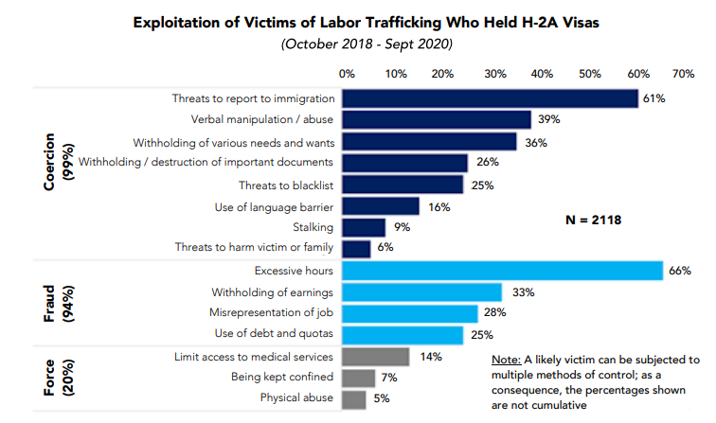
Source: Polaris, Labor Exploitation and Trafficking of Agricultural Workers During the Pandemic
Notes:
Apart from collecting data on location and victim status, the National Human Trafficking Hotline collects and analyzes data on the different types of Force, Fraud and Coercion. Many victims likely face a mix of the various types of coercion, fraud and some even experience direct force. When the general public thinks about human trafficking, even if they are thinking about labor trafficking, chances are they are imagining situations that have strong aspects of force, but as we can see many of the situations the hotline analyzed involving victims in agriculture in the past two years did not have aspects of physical abuse, physical confinement such as locking workers in their housing, or other types of force. However, the majority had aspects of Fraud and Coercion, 54% experienced excessive working hours and 55% threats to report to immigration authorities. To learn more read our analysis entitled Labor Exploitation and Trafficking of Agricultural Workers During the Pandemic

Slide 19
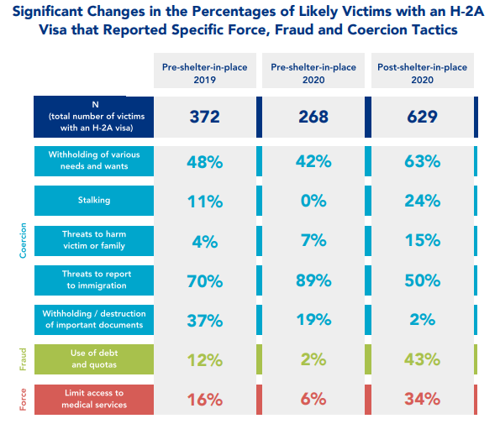
Source: Polaris Labor Exploitation and Trafficking of Agricultural Workers During the Pandemic
Notes:
In the same analysis we looked at two time periods immediately before the pandemic (April 1st, 2019-Sept30th 2019), (Oct 1st 2019-March 31st 2020) and one period during the first year of the pandemic (April 1st 2020-Sept 30th 2020) to try and see if the types of force, fraud and coercion that workers reported facing changed during the COVID-19 pandemic.
Some takeaways were that we saw an increase in the percentage of victims that reported experiencing having their needs withheld. Many employers also put in more rules and controls on their workers movements to try and prevent the spread of the virus which could have also contributed to this.
Stalking and threats to harm victim or family members slightly increased as well.
Threats to report to immigration decreased from 70 and 89% before the pandemic to 50% during the pandemic, and withholding or destruction of documents also decreased.
Despite being declared essential, the use of debt and limiting access to medical attention also increased for agricultural workers during the period analyzed.

Slide 20
Best Practices While Assessing for Labor Trafficking
Notes:
Now that we’ve gone through what human trafficking is, and some data on labor trafficking in agriculture, we’ll talk about some of the best practices that Polaris uses for assessing for human trafficking that may be relevant for interactions SMAs and Employment Staff outreach teams have with agricultural workers.

Slide 21
Labor Trafficking Assessments General Steps On Calls to the National Human Trafficking Hotline
Safety Check/ Communication Planning
Presenting Issue
Working Conditions, Pay, Housing Conditions, Recruitment Process
Explaining options and walking through possible next steps
1
2
3
4
Notes:
Polaris staff are trained on the following procedures when receiving calls on the National Human Trafficking Hotline. It may be helpful for staff to ask similar questions to determine whether individuals may be victims of trafficking and to document key information to make appropriate referrals.
Make sure to do a safety assessment and planning for future communication such as a callback number, who else has access or uses the phone and when the best time to call might be. Safety planning about anyone that might be around to overhear also gets at the level of monitoring and force, fraud or coercion right off the bat.
Typically if someone is calling into a line, then the presenting issue will come right out- the reason that the caller is calling. This could be a wage and hour issue, or a contract violation. Trafficking victims typically don’t identify a whole trafficking situation off the bat nor identify as a victim of anything. Sometimes a worker will call in simply seeking to transfer their visa to a new employer without offering much of a reason for why. It is important to focus in on the ‘why’ they want to leave their job, and start by asking questions related to that, while reassuring workers that they won’t get into any trouble by providing this information.
The third part is going over the working conditions, pay, housing conditions, recruitment process, all the details to figure out whether any FFC is being implemented. We ask about housing, pay, possible debts to try and get a better understanding of whether the employer or a supervisor has created an environment of dependence for their workers and then also continue on to ask about more explicit methods of control like document confiscation, explicit threats and physical abuse.
Rounding out the call we usually explain any options and next steps that will be taken by the worker and the hotline and repeating this so both entities are on the same side about what to expect. This may include the worker reaching out directly to other local referrals, setting up a time to facilitate a warm transfer, or discussing what interacting with law enforcement might look like and how the worker would want to interact with them, if they want to be anonymous or have their information passed along.

Slide 22
Signs of Labor Exploitation In the Field
Observations:
  Surveillance cameras
  Exterior locks, bars on windows, restraints
  Denied access to specific areas
  Poor or unhealthy living arrangements
  Access to water
  Weapons
Keep in Mind:
  Note workers willingness to engage or talk
  Workers may be concerned about being seen speaking with outsiders
  They may be concerned about their fellow workers reporting on them to management
  Proactively offer materials so workers don’t feel like they need to opt-in to receive them
Assessing for Trafficking:
  Absent a presenting issue, start with lower risk questions around Force, Fraud & Coercion
  Ask about housing, food, if their work hours, and pay is adequate, if they are paying off debt or covering their costs, & whether they can send money home.
  If anyone has gotten hurt and what happened (did they get medical attention), why did they get hurt
Assessment for Trafficking
  If workers are still open then you can escalate the questioning to threats around blacklisting, police or immigration involvement, physical abuse, retaliation and document confiscation or destruction
  It’s important to wrap up questioning when it becomes clear that conversation is no longer productive.
  When possible leave information for workers to reach out later
Notes:
While doing outreach in the field you have the opportunity to witness and document many signs of labor exploitation that may also factor into a labor trafficking situation. It is unlikely that you would be able to witness, without speaking with anyone, enough signs of force, fraud or coercion to make a strong trafficking determination unless you witnessed severe physical abuse or workers housed in prison-like conditions, which any savvy trafficker would avoid or conceal. It is also important to remember that your presence may make workers or victims feel nervous if they have been coached about interacting with you or any outsiders and think they may face retaliation if they speak up or are seen speaking with you. Workers may also not speak up in small groups due to fear that one of their fellow workers may report back on them and we have even seen situations where the main exploiter doesn’t actually have a supervisory role but is another worker.
In the field or at housing sites you want to document any issues or irregularities in housing, access to water, bathrooms, kitchens, that you normally would. In suspected trafficking situations, it is also helpful to observe whether there are surveillance cameras, locks on the outside of doors or bars on windows that would indicate monitoring and surveillance over normal security.
If you are able to speak with one or more workers that are comfortable speaking with you, you can ask similar questions to the on-call labor assessment to try and figure out if any force, fraud and coercion is present by asking about their journey to the farm. This may include:
if they received their reimbursements and if they are still working off the investment they made to get here -to try and get at whether there is a debt bondage or debt manipulation situation.
If they have a written contract and whether the work is in line with what the contract stated.
Their workload: whether they are getting enough or too many hours, whether they are getting paid what was promised in the contract and if they get breaks.
Whether anyone has gotten seriously hurt and needed to get medical attention? If so did it happen in a timely manner?
If the workers still seem comfortable answering questions you can advance to more serious questions like whether they have ever been threatened with deportation, blacklisting or having the police called on them?
At some point you may determine that continued questioning isn’t productive and isn’t building trust. At this point it may be appropriate to give out contact information for your office, the local enforcement agency, or the National Human Trafficking Hotline. Please note that any time a State Workforce Agency, Employment Service office employee, or outreach staff observes, has reason to believe, or is in receipt of information regarding suspected trafficking situations, they must document the suspected violation and refer the information to the Employment Service Office Manager. All apparent violations and complaints involving suspected trafficking should be referred immediately to the appropriate enforcement agency in writing.

Slide 23
General Tips for Engaging with Victims
Help navigate through steps and options to prioritize and address immediate, short term and long term needs
Documenting and Referrals
Your role is to empower them with information, and make appropriate referrals.
worker centered
Trauma informed
Understanding how trauma affects recall and responses to questioning- especially if still in a situation.
Notes:
Whether you are on a call or in person it is important to be aware of the worker’s surroundings and what they may be thinking, who they could be worried about listening in, and the amount of trust they have to put in you to take a risk and communicate truthfully if they are actually in a trafficking situation.
It's important to be victim and worker centered- this means outlining the steps that you will take with the information they provide because in the end they have the best sense about how to navigate the immediate risks in their situation. The approach Polaris takes is to inform workers if they ask questions, but not to push a certain course of action such as pursuing enforcement intervention. State Workforce Agencies, Employment Service office employees, and outreach staff must document and refer all suspected trafficking. It is importation to let workers know what they can expect and what your obligations are, whether it will lead to follow-up from other agencies and that their information will be kept confidential to the maximum extent possible, consistent with applicable law.
-Especially with trafficking and sexual assault or harassment victims its important to keep in mind that trauma from the situation can prevent accurate or chronological recall of a situation and its important to be patient. If you have to point out inconsistencies to clarify what happened you need to do so in a caring and gentle way, remember this isn’t an interrogation of the victim. If someone is in crisis, you may need to take a break from asking questions about the work situation or incident you are trying to assess for, and use grounding techniques. These could include asking them to be mindful of their breathing, count and list blue objects around them, drink a glass of water, ask them if they want a friend or family member, someone they trust to be with them during an interview.
-Although the role of SMAs and ES isn’t enforcement, you can help by documenting violations plus any elements of force fraud or coercion that a trafficker may be utilizing. This requires you to put yourself in the worker’s shoes a little bit because coercion depends on their perspective. For instance, one of the common elements for force, fraud and coercion that Polaris learns about is the threat of deportation, even for those with visas, or blacklisting. Its also important to get the context surrounding any threats because it will have to be connected to the purpose- forced labor. Other signs of FFC that you could document would be severe deductions to wages being withheld so that workers can’t get together enough money to leave.
The resources offered depend on the requests of the worker. Likely the worker will want you to answer questions that you might not be able to answer or that are outside of your purview, so it is important to have legal aid referrals to offer for those questions. It is also important to have referrals to enforcement agencies even if you are going to elevate a complaint so they can pursue it directly if they wish.

Slide 24
Additional Reading and Resources from Polaris
Guia esencial para trabajadores del campo (Agricultural worker toolkit) in PDF-https://polarisproject.org/resources/guia-esencial-para-trabajadores-del-campo/ & mobile version- https://polarisproject.org/visas-h2a-guia-esencial-para-las-y-los-trabajadores-esenciales-del-campo/
Labor Exploitation and Trafficking of Agricultural Workers During the Pandemic
Recruitment, Human Trafficking and Temporary Visa Workers
The Latino Face of Human Trafficking and Exploitation in the United States
Notes:
If you are looking for outreach materials, Polaris has designed a toolkit in Spanish for H-2A workers that discusses their rights and protections. The toolkit has easy to follow case studies and self-assessments for workers and who they should call for certain non-trafficking employment issues. It is available in a mobile version and a printable PDF.

Slide 25
We want to hear from you!
Contact tlynch@polarisproject.org if you would like to connect with Polaris’s Strategic Initiative on Labor Trafficking.
Notes:
Please reach out to me directly or the general Polaris email, info@polarisproject.org if you are interested in learning more about the specific hotline data for your state, wish to collaborate, have feedback on the presentation or want to discuss a specific situation.

Slide 26
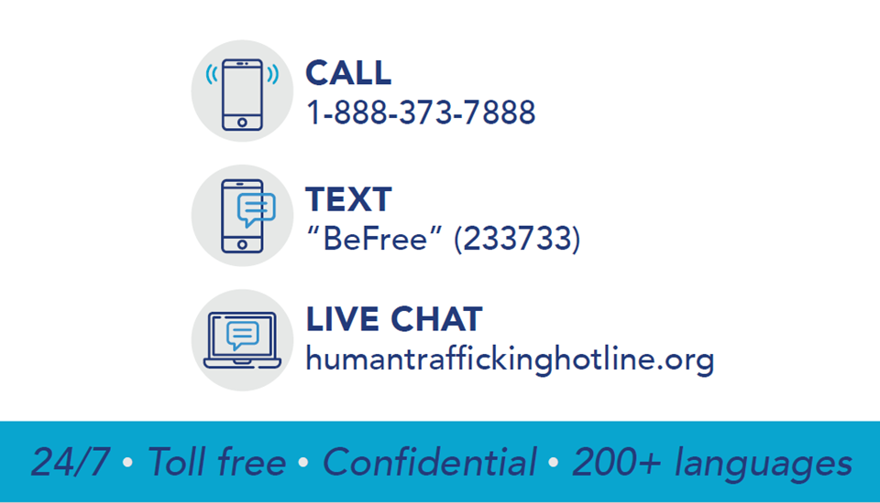
Thank You!
Notes:
Thank you for your participation. The National Human Trafficking Hotline is available 24/7, 365 days a year in English and Spanish and with additional languages via interpreter. The hotline is available through webchat, phone or sms.

Slide 27
January 2022
For questions, please contact your State Monitor Advocate or ETA Regional Monitor Advocate
Contact Information for Monitor Advocates is available at:
        https://www.dol.gov/agencies/eta/agriculture/monitor-advocate-system/contact
ETA Regulations for the Employment Service and Employment-Related Law Complaint System, including Apparent Violations
20 CFR 658 Subpart E
Notes:
Timmy Dudley: Thank you, Ted, for this great information.
If you have any questions regarding the content of this webcast or how State Workforce Agency staff should respond to potential trafficking situations, please contact your State Monitor Advocate or ETA Regional Monitor Advocate, using the contact information available through the link on this slide.
Please remember that whenever a State Workforce Agency, Employment Service office employee, or outreach staff observes, has reason to believe, or is in receipt of information regarding suspected labor trafficking, they must document the suspected violation and refer the information to the Employment Service Office Manager, as an apparent violation. Additionally, all complaints must be documented and processed according to ETA regulations for the Employment Service and Employment-Related Law Complaint System. Links to the applicable ETA regulations are provided on this slide. For specific guidance on how to document and refer Apparent Violations and Complaints, please consult your state’s State Monitor Advocate or your ETA Regional Monitor Advocate.
We appreciate your time and your important work to identify and process Apparent Violations and Complaints involving potential labor trafficking. Thank you.

