Slide 1

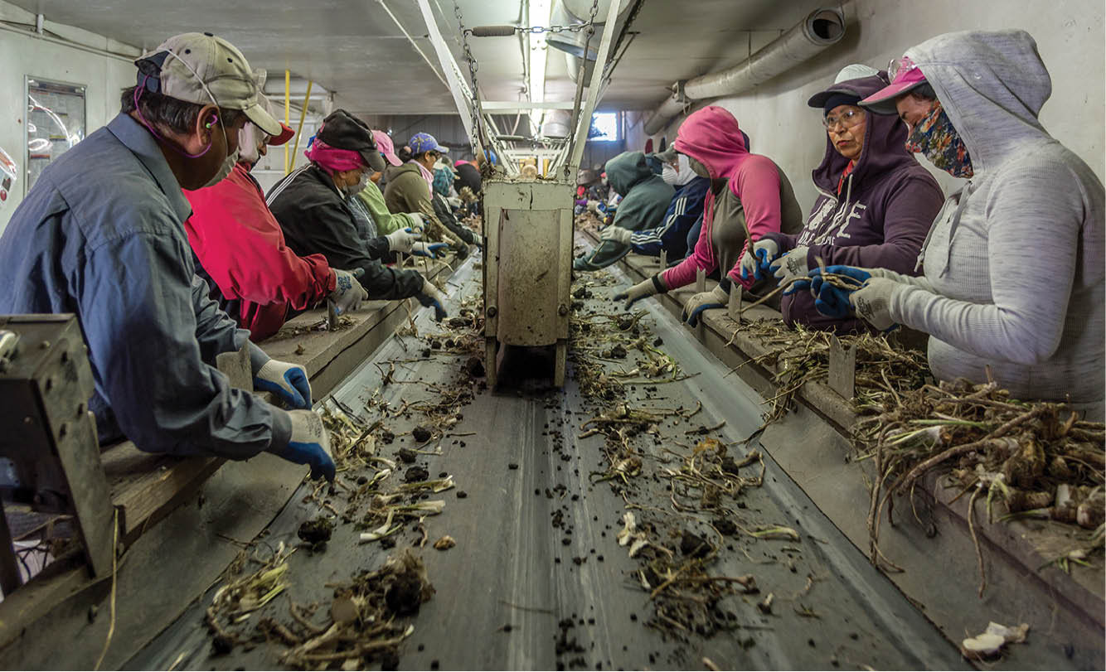
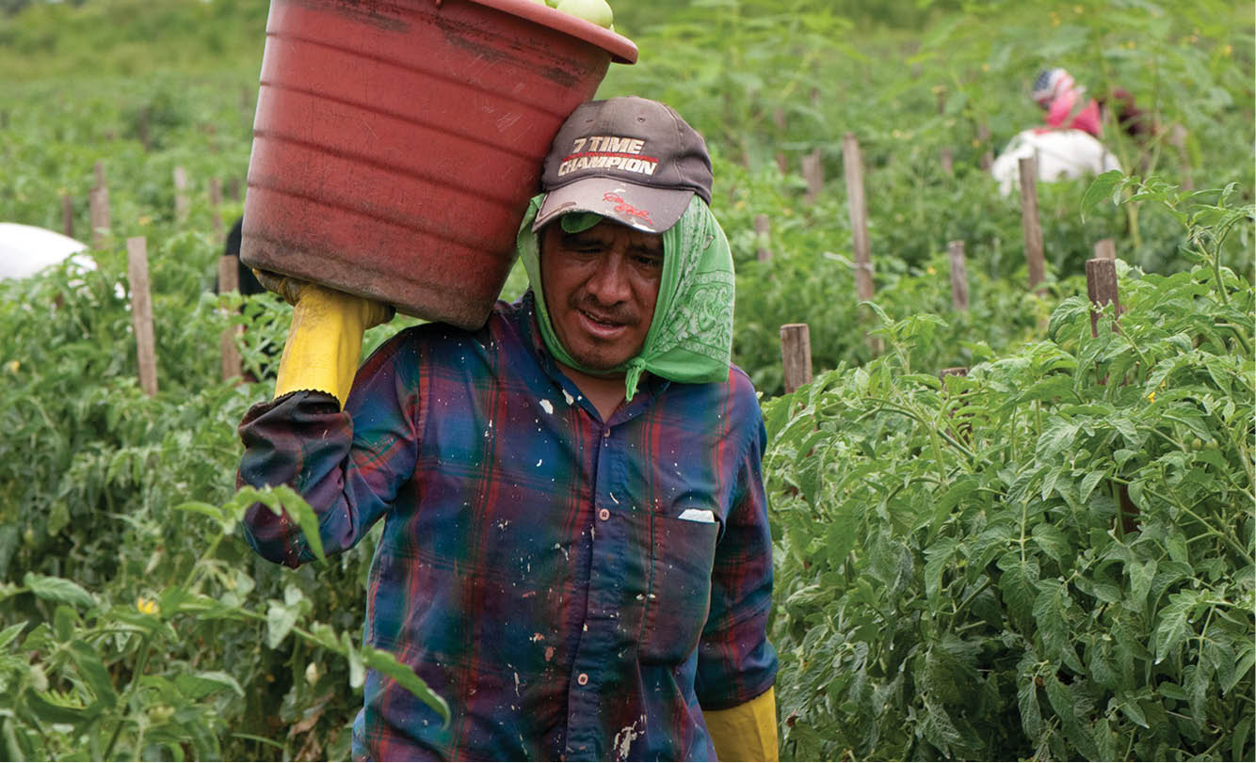
Prospective Applicant Webcast for 2024 Funding Opportunity Announcement: Career Services and Training Grants
National Farmworker
Jobs Program
FOA-ETA-24-15
The United States Department of Labor, Employment and Training Administration

Slide 2
Objectives
Program Purpose
Project Design
WIOA Performance Indicators and Additional Performance Indicators
Award Information
Eligibility for Applicants
Application Submission Requirements
Application Review Information

Slide 3
Program Purpose
Strengthen the ability of migrant and seasonal farmworkers and their dependents to acquire necessary skills to either stabilize or advance in their agricultural jobs or obtain employment in new industries.
Facilitate the delivery of workforce solutions that are responsive to the needs of workers and employers of one to three targeted sector(s).
Provide quality career services and training opportunities that lead to industry-recognized credentials and good jobs in agriculture and non-agriculture sectors to eligible migrant and seasonal farmworkers and their dependents.

Slide 4
Eligible participants
Eligible participants include adults, ages 18 and older, and youth, ages 14-24.
Participants may receive services as an eligible seasonal farmworker adult, eligible migrant farmworker adult, and eligible migrant and seasonal farmworker youth, who are low-income and employed in farmwork, as determined via the procedures described in Training and Employment Guidance Letter No. 18-16 Change 1 or in successive guidance.
Additionally, participants may receive services as a dependent adult of eligible migrant and seasonal farmworker or a dependent youth of an eligible migrant and seasonal farmworker, as defined in 20 CFR 685.110.
Other key requirements for participants receiving services are described in the funding opportunity announcement.

Slide 5
Period of Performance
51 months:
Starts July 1, 2024, and ends September 30, 2028

Slide 6
Project Design
Responsive applications will fully integrate five core elements in their project design, which are:
Good Jobs Principles;
Worker-centered Sector-based Training and Employer Partnerships;
Other Strategic Partnerships;
Outreach, Enrollment, and Referral; and
Case Management.
Good Jobs Principles
Outreach, Enrollment and Referral

Slide 7
WIOA Performance INDICATORS
Applicants are not required to propose targets for WIOA performance indicators in their application for this funding opportunity announcement.
In general, in NFJP, grantees provide services to individuals as a reportable individual or a participant. Reportable individuals are not counted towards performance calculations and participants are counted towards performance calculations.

Slide 8
WIOA Performance indicators for Adult participants
If a grantee plans to enroll adult participants, the Department will establish goals for the following adult performance indicators:
NFJP Adult Measures:
Employment Rate - 2nd Quarter After Exit
Employment Rate - 4th Quarter After Exit
Median Earnings - 2nd Quarter After Exit
Credential Attainment: Percentage of those participants enrolled in an education or training program (excluding those in on-the-job training (OJT) and customized training) who attain a recognized postsecondary credential or a secondary school diploma or its recognized equivalent during participation in or within one year after exit.
Measurable Skill Gains: Percentage of participants who, during a program year, are in an education or training program that leads to a recognized postsecondary credential or employment and who are achieving measurable skill gains, defined as documented academic, technical, occupational, or other forms of progress, towards such a credential or employment; and
Effectiveness in Serving Employers: Percentage of participants who exit and are employed with the same employer in the second and fourth quarters after exit.

Slide 9
Wioa Performance indicators for youth participants
If a grantee plans to enroll youth participants, the Department will establish goals for the following youth performance indicators:
NFJP Youth Measures:
Education and Employment Rate - 2nd Quarter After Exit
Education and Employment Rate - 4th Quarter After Exit
Median Earnings - 2nd Quarter After Exit
Credential Attainment: The percentage of those participants enrolled in an education or training program (excluding those in on-the-job training (OJT) and customized training) who attain a recognized postsecondary credential or a secondary school diploma, or its recognized equivalent, during participation in or within one year after exit from the program.
Measurable Skill Gains: Percentage of program participants who, during a program year, are in an education or training program that leads to a recognized postsecondary credential or employment and who are achieving measurable skill gains, defined as documented academic, technical, occupational, or other forms of progress, toward such a credential or employment; and
Effectiveness in Serving Employers: Percentage of participants who exit and are employed with the same employer in the second and fourth quarters after exit.

Slide 10
Additional Performance Indicators
Under this Funding Opportunity Announcement, applicants are required to propose goals for additional performance indicators, which are:
  Outreach contacts;
  Participant enrollment levels; and
  Subset of performance indicators to measure progress towards achieving goals for a minimum of two good job principles.

Slide 11
Eligible applicants
To be eligible to receive an NFJP grant, an entity must have: 1) an understanding of the problems of eligible migrant and seasonal farmworkers, including their dependents; 2) a familiarity with the agricultural industries and the labor market needs of the proposed service area; and 3) the ability to demonstrate a capacity to administer and deliver effectively a diversified program of workforce investment activities, including youth workforce investment activities, and related assistance for eligible migrant and seasonal farmworkers.
The Department encourages education and training providers, advocacy organizations, labor or worker organizations, industry representatives, and organizations that provide services to farmworkers and other populations facing multiple barriers to employment to consider applying for this Announcement.

Slide 12
Applicant Categories
Category A
Category B
Category A Applicant: DOL intends to award at least 50 percent of the total available grant competition funding to applicants that received an NFJP award in the most recent competition cycle (program years 2020-2023).
Category B Applicant: DOL intends to award the remainder of the grant funds to other eligible applicants that did not receive an NFJP award in the most recent competition cycle (program years 2020-2023).

Slide 13
Award Information
Approximately $90 million will be used to fund approximately 50-75 grants.
  CA Allotment: DOL intends to award up to seven grants for CA. Each grant will be approximately $1 million to $8 million.
  AZ, FL, ID, IL, MI, NY, NC, OR, PR, TX, and WA Allotments: DOL intends to award a grant in each of these states, and may award up to two grants in any of these states. Each grant will be approximately $1 million to $4.9 million.
  AL, AR, CO, CT, DE, GA, HI, IA, IN, KS, KY, LA, MA, ME, MD, MN, MO, MS, MT, ND, NE, NH, NJ, NM, NV, OH, OK, PA, RI, SC, SD, TN, UT, VA, WV, VT, WI, and WY Allotments: DOL intends to award one grant for each state. Each grant will be approximately $70,000 to $1.9 million.
Under this funding opportunity announcement, in instances where the Department does not receive any competitive applications from eligible applicants in a given state, the Department will not reopen this competition to seek prospective applicants to provide services in that state.

Slide 14
Guidelines for minimum number of participants to be enrolled
Applicants must request grant funding that is commensurate with the scope and scale of the project proposed. To ensure requested grant funds are providing the greatest benefit and leading to quality services for all participants, applicants must propose minimum number of enrolled participants for program year 2024, July 1, 2024 – June 30, 2025, which are based on the amount of funds requested by the applicant. ​
The Department is encouraging applicants to consider these guidelines as well as other factors such as the proposed design of their program and services, including migrant and seasonal farmworkers’ and their dependents’ needs, essential supportive services that help participants successfully complete program, geographic location, industry demands, costs of career services and training, when determining the minimum number of enrolled participants.
If the proposed minimum number of participants to be enrolled is higher or lower than the guidelines, applicants must explain the difference and use available data to support their explanation (for example, when determining the minimum number of participants to be enrolled consider your estimated cost-per-participant range, the type of services that will be included in your proposed project design, costs for sector specific training, and the type of supportive services that participants need to successfully engage in the program and realize their career goals).

Slide 15
Other information
A. WEB-BASED RESOURCES
CareerOneStop portal
Service Locator function within the CareerOneStop
Directory of the nation's American Job Centers, also known as one-stop centers
Occupational Information Network (O*NET) Online
B. INDUSTRY COMPETENCY MODELS AND CAREER CLUSTERS
Competency Model Clearinghouse
C. WORKFORCEGPS RESOURCES
WorkforceGPS
Online tutorials, “Grant Applications 101: A Plain English Guide to ETA Competitive Grants,” and “Grants Application 101: Budgetary Forms - SF-424, 424A, 424B, and Budget Narrative”
Workforce System Strategies resources
Grant application and Management portal
NFJP resources available on the Agricultural Connection community of practice
D. SKILLSCOMMONS RESOURCES
SkillsCommons

Slide 16
Content and Form of Application Submission
SF-424 Application For Federal Assistance
Project Budget (SF-424A and Budget Narrative)
Project Narrative
Attachments to the Project Narrative

Slide 17
SF-424 and Project Budget
SF-424 Application For Federal Assistance:
  Must contain the Unique Entity Identifier (UEI)
  Must register with System for Award Management (SAM) at https://www.sam.gov
  Must complete Field 14, Areas Affected by Project.
  Project Budget:
  SF-424A: Budget Information Form
  Budget Narrative

Slide 18
Project Narrative
Guidelines are found in Section IV.B.3 of the Funding Opportunity Announcement.
Limited to 25 double-spaced, single-sided 8.5 x 11-inch pages with Times New Roman 12-point text font and 1-inch margins. You must number the Project Narrative beginning with page number 1.
Evaluated using the evaluation criteria explained in Section IV.B.3. and summarized in Section V.A.

Slide 19
Attachments to the Project Narrative
In addition to the Project Narrative, applicants must submit attachments.
Must be clearly labeled as Attachments.
Attachments listed in Section IV.B.4 of the funding opportunity announcement are excluded from the page limit.
No additional materials will be considered.
See Section IV.B.4 for information on valid attachment file names.

Slide 20
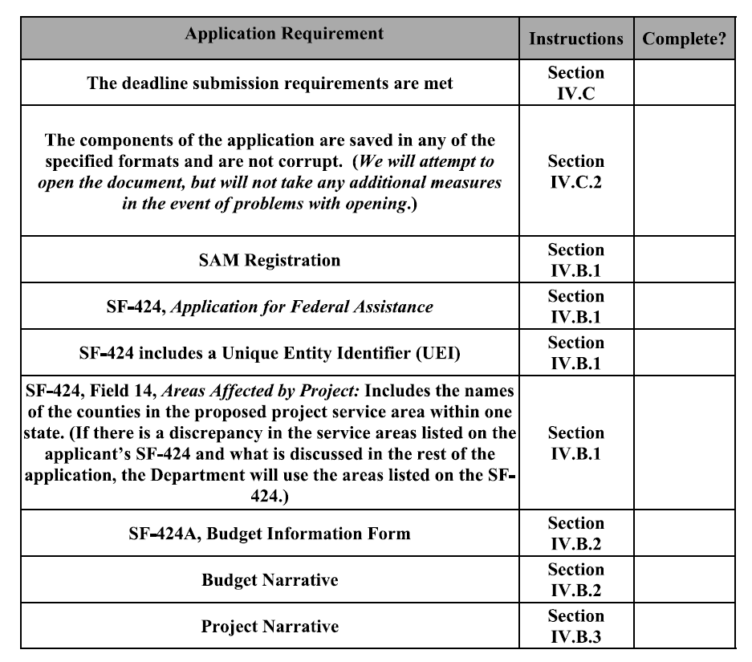
Application Screening Criteria

Slide 21
Evaluation Criteria
Criterion | Points Maximum
Statement of Need | 10 Points Total
2. Project Design | 40 Points Total
3. Organizational, Administrative, and Fiscal Capacity | 24 Points Total
4A. Past Performance – Category A Only | 18 Points Total
4B. Past Performance – Category B Only | 18 Points Total
Budget and Budget Justification | 8 Points Total
Total | 100

Slide 22
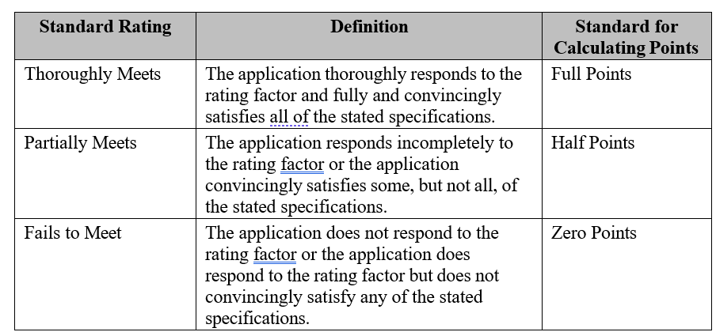
Evaluation Criteria cont.

Slide 23
APPLICATION Submission
Funding Opportunity Announcement Closing Date is May 3, 2024.
You must submit your application electronically on https://www.grants.gov no later than 11:59 p.m. Eastern Time on the closing date.
No applications submitted in hardcopy by mail or hand delivery (including overnight delivery) will be accepted for this funding opportunity.

Slide 24
Questions during the application process
For Questions on the Funding Opportunity Announcement:
  Email NFJP.OGM@dol.gov and reference FOA-ETA-24-15 in the subject line.
For Questions and Help Regarding Application Submission Difficulties in Grants.gov:
Call: 1-800-518-4726 or 606-545-5035 to speak to a Customer Support Representative
Email: support@grants.gov
Grants.gov Contact Center is open 24 hours a day, 7 days a week but closed on federal holidays.
Technical Questions - contact Tiffany Peters, Grants Management Specialist, Office of Grants Management, at Peters.Tiffany.A@dol.gov, along with question(s), include a contact name.

Slide 25
For More Information
Questions: NFJP.OGM@dol.gov
  Grants Management Specialist, OGM
    U.S. Department of Labor

Slide 26

Thank You

