Slide 1
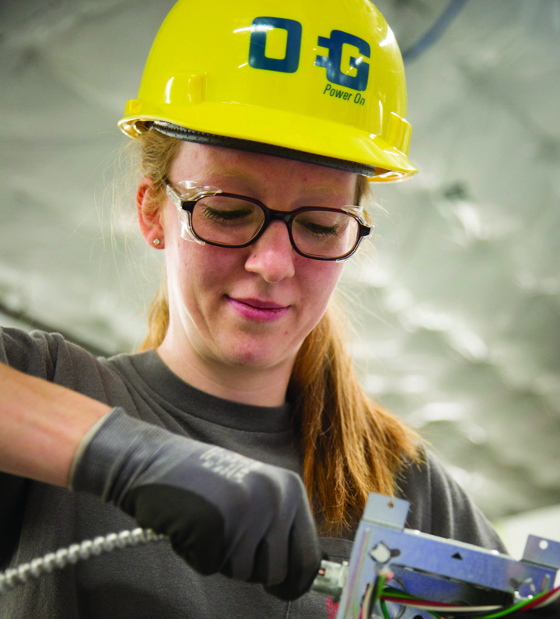
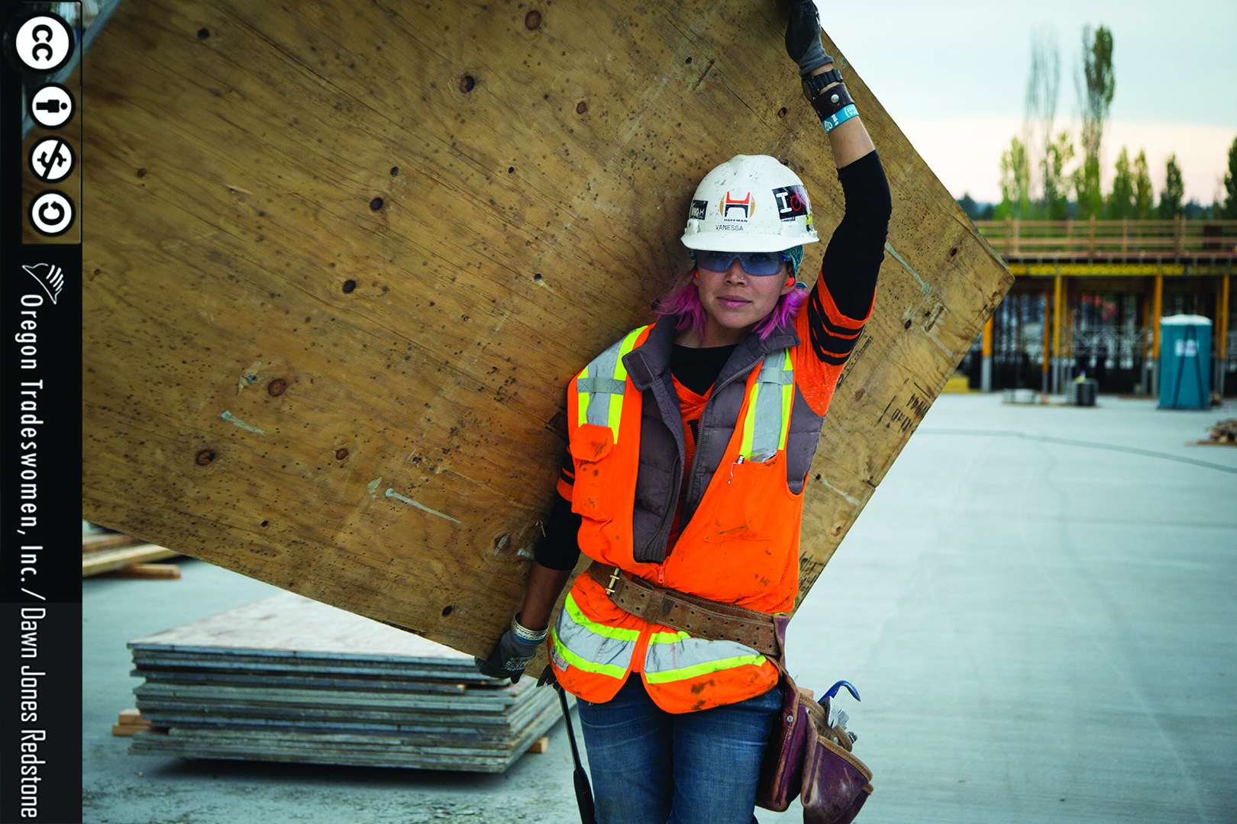
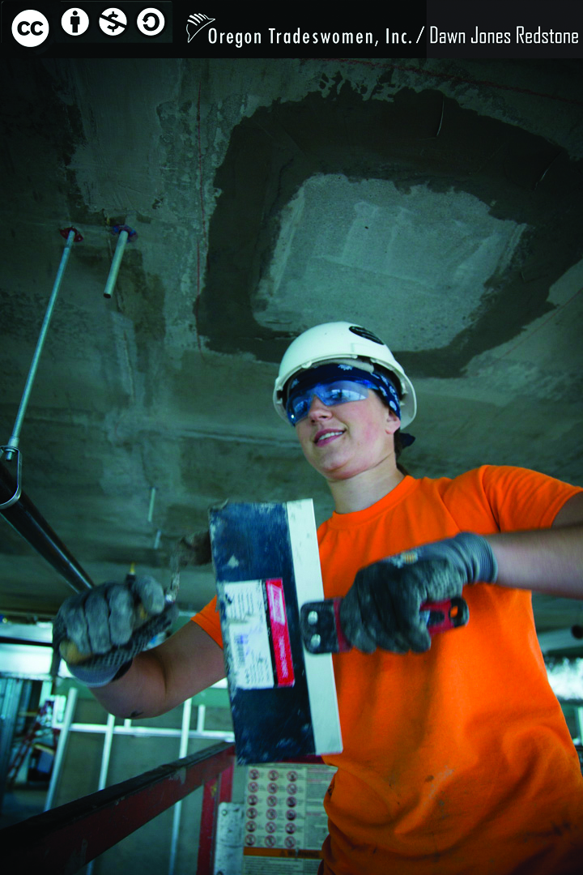


WOMEN
Earn Good Money With
APPRENTICESHIP
Women, for employment and training for high skills and high pay jobs, considering joining
Plumbers Local Union #123
OPEN HOUSE | 09.27.2018 | Saturday | 4:00 PM
Community Building | 215 Andy Street
Sioux Falls | South Dakota
www.ua.org/women | 410-269-2000
Notes:
Font option is Impact. 3 Picture design.

Slide 2
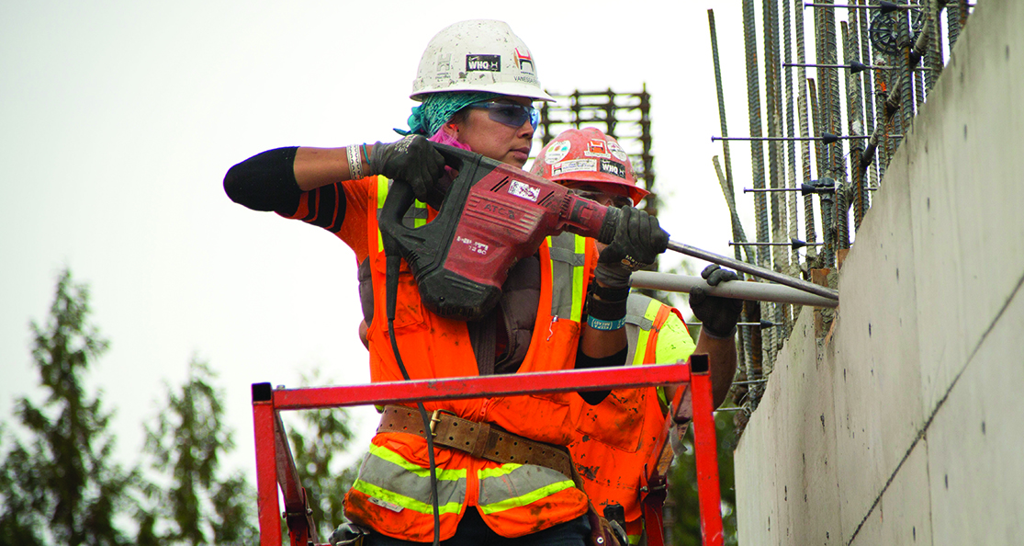
WOMEN
APPLY NOW!
Women, for employment and training for high skills and high pay jobs, considering joining
Plumbers Local Union #123
OPEN HOUSE | 09.27.2018 | Saturday | 4:00 PM
Community Building | 215 Andy Street
Sioux Falls | South Dakota
www.ua.org/women | 410-269-2000
Notes:
Design – Font option is Calibri – One large image

Slide 3
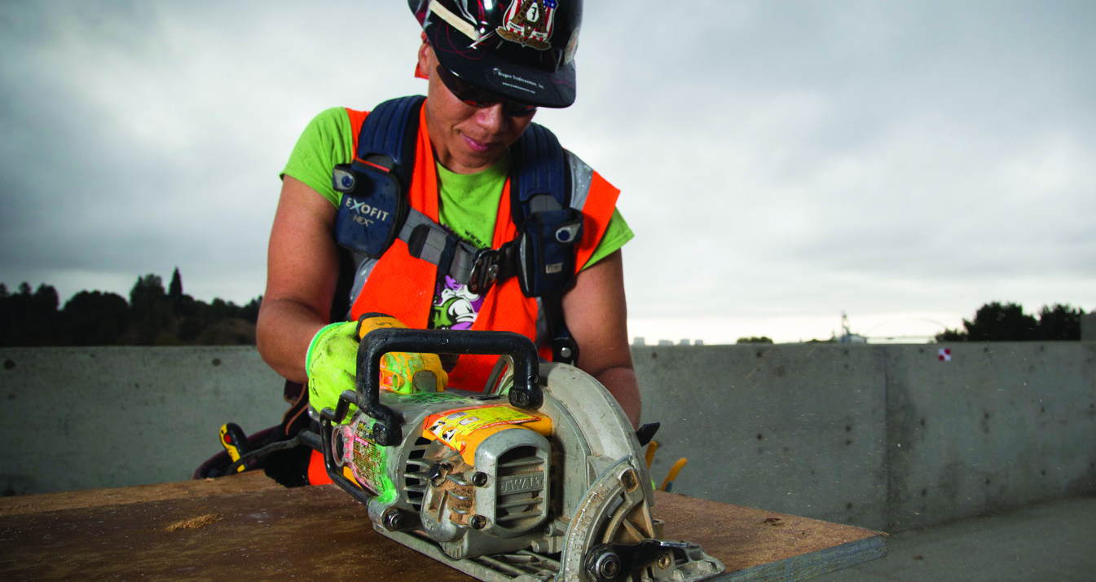
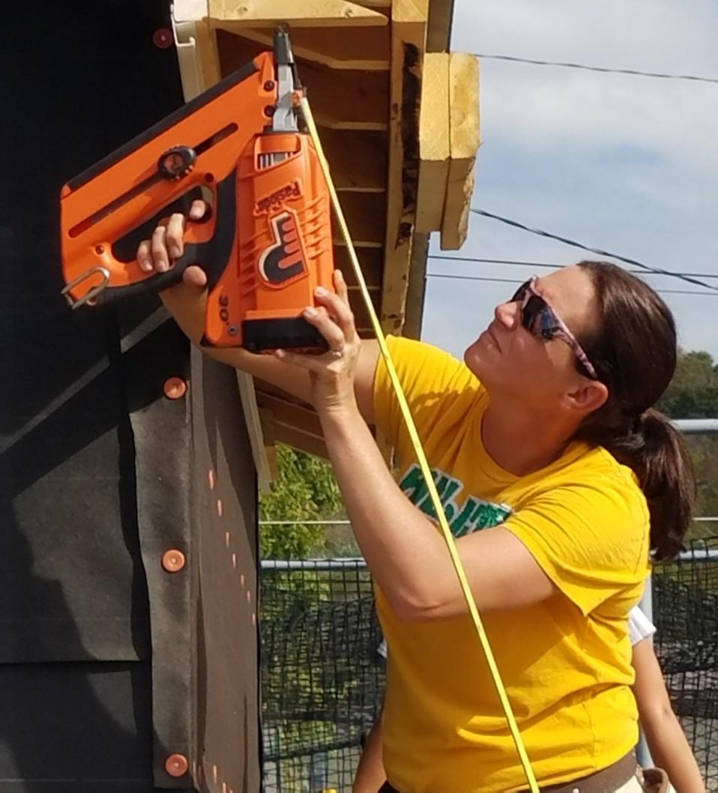
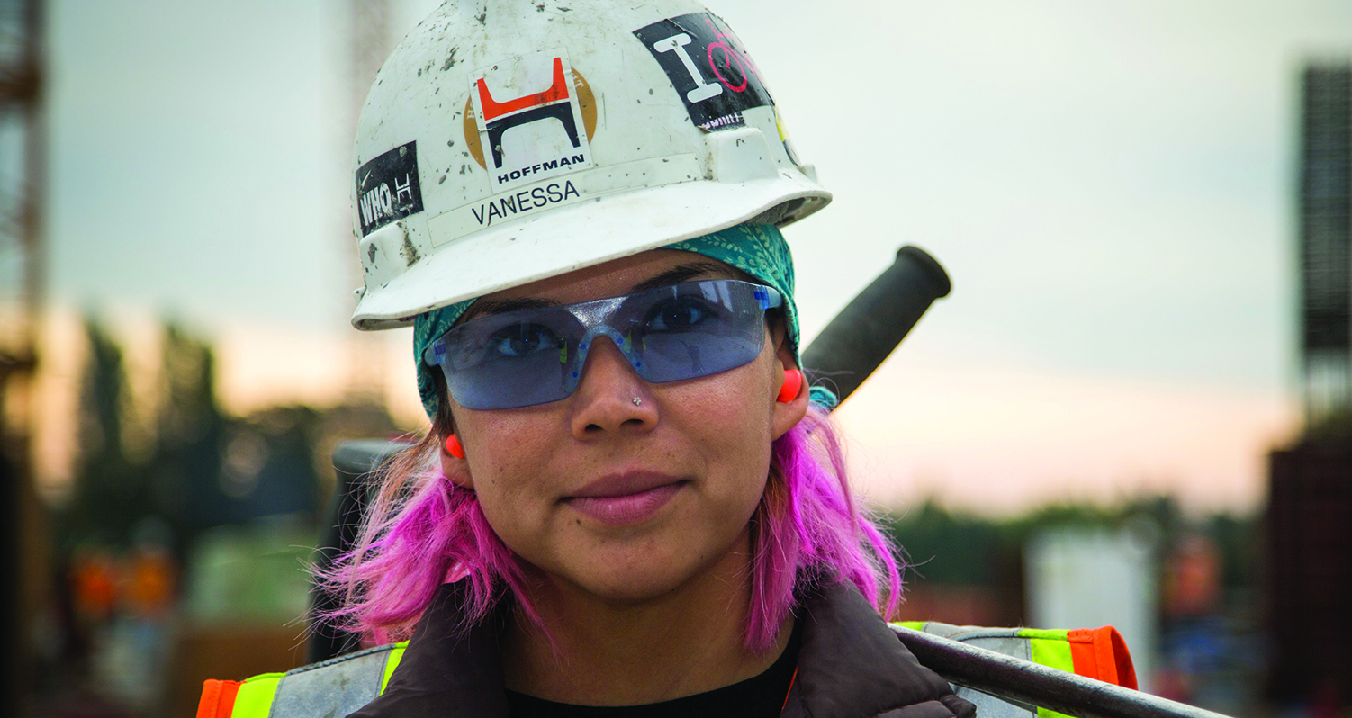
Notes:
Collection of sized images a user could “plug and play” in their design.

Slide 4
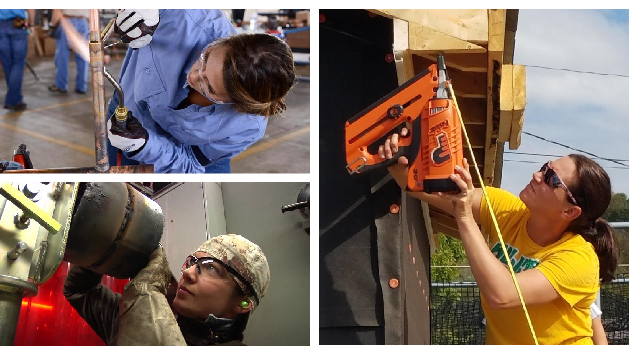




This recruitment flyer template tool was developed by West Virginia Women Work, Inc. and was made possible by the U.S. Department of Labor Equity Partners Initiative contract with Chicago Women in Trades. Photos courtesy of Oregon Tradeswomen, Inc.

