Slide 1
Rural healthcare and One Workforce technical assistance support
Kickoff Meeting
October 26, 2022

Slide 2

Recording Notice
American Institutes for Research (AIR) allows for the recording of audio, visuals, participants, and other information sent, verbalized, or utilized during business related meetings. By joining a meeting, you automatically consent to such recordings. Any participant who prefers to participate via audio only should disable their video camera so only their audio will be captured. Video and/or audio recordings of any AIR session shall not be transmitted to an external third party without AIR’s permission.

Slide 3
Welcome Grantees and TA Team!
Introduce Yourself in the Chat

Slide 4
AGENDA
Welcome Grantees!
Rural Healthcare & One Workforce TA
TA Team Introductions
TA Activities
TA Needs & Priorities
Next Steps

Slide 5

Department of Labor
Division of Strategic Investments
Welcome
TA to Date
Introduce TA Team

Slide 6
TA Team

Slide 7
Project Team
Project Management
Jen Pirtle
Monica Melville
One Workforce
Task Lead – Wendy Russell
Analyst – Margaret Lamb
Rural Healthcare
Task Lead – Brittany Lenertz
Analyst – coming soon
Performance
Task Lead – Jessie Oettinger
Analyst – Ben Mahrer & Support
Analyst – Wes Peterson
Amanda Ahlstrand
Lynn Bajorek
Erika Humphrey
Vinz Koller
Christy Montgomery
Dallas Oberlee
Timothy Putnam
Joe Quick
Gretchen Sullivan
Kristin Wolff
Others, as necessary
Coaches & SMEs

Slide 8

One Workforce Coaches
Lynn Bajorek
City of Refuge, Inc.
Christy Montgomery
Capital Workforce Partners
Wendy Russell
Arizona Board of Regents on behalf of Arizona State University
Calumet Area Industrial Commission
Erika Humphrey
Kristin Wolff
City and County of Denver
Delaware DOL, Employment & Training
WDB of Herkimer, Madison and Oneida Counties
Clark State Community College
Grand Rapids Community College
Trustees of Clark University
United Auto Workers - Labor Employment and Training Corporation
Southeast Michigan Community Alliance
Pima County
Dallas College
Inner City Fund, Incorporated, LLC
Jobs for the Future, Inc.
Workforce Alliance of South Central Kansas, Inc.
United Migrant Opportunity Services, Inc.

Slide 9

Rural Healthcare Coaches
Robin Gwathney
CommunityHealth IT (FL)
Dallas Oberlee
Alaska Primary Care Association
Joe Quick
California Rural Indian Health Board Inc.
Gretchen Sullivan
Governor's Office of Workforce Innovation (NV)
Ohio Area 7 Consortium of CEOs
WDB of Herkimer, Madison and Oneida Counties (NY)
Coastal Counties Workforce, Inc. (ME)
Colorado Center for Nursing Excellence
Northwest Wisconsin Workforce Investment Board, Inc.
Michigan LEO
Western Colorado Area Health Education Center
Eastern Kentucky Concentrated Employment Program, Inc.
Pee Dee Regional Council of Governments (SC)
Tecumseh Area Partnership, Inc. (Region 4 WDB) (IN)
Mary Hitchcock Memorial Hospital (NH)
West River Area Health Education Center (SD)
Workforce Solutions Rural Capital Area (TX)

Slide 10

Technical assistance
Activities

Slide 11
Technical assistance Approach and
Activities
Universal
Targeted
Intensive
Individual
As needed
Small
Groups
TA Supports
Frequency
Ongoing
Whole
Group
Ongoing

Slide 12
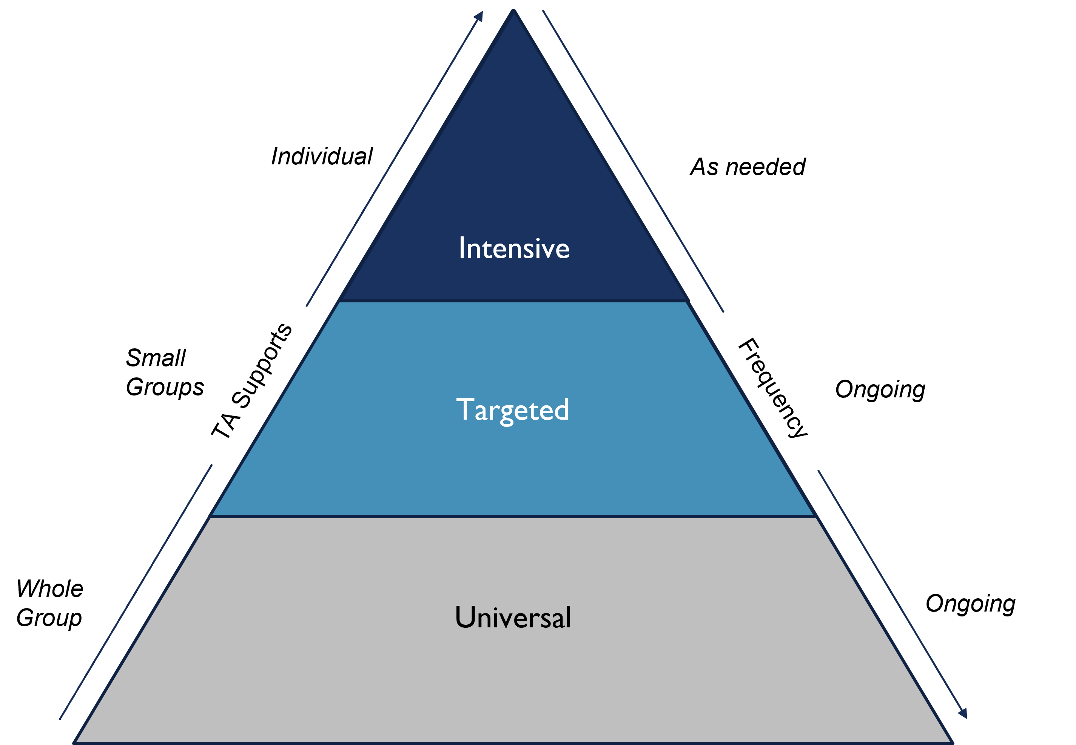
Universal TA
Available to a broad audience to raise awareness or knowledge of a particular subject matter area and/or broad need
Large Groups
Ongoing

Slide 13
Examples – Universal TA
Community of Practice
Webinars
Fact Sheets
FAQs

Slide 14
Targeted TA
Focused on a subset of grantees with common interests and/or needs that will affect success
Small Groups
Ongoing

Slide 15
Examples – Targeted TA
Cohorts
Workshops
Peer-to-Peer Calls
Handbooks

Slide 16
Intensive TA
Focused on one-on-one, individualized TA support to address a grantee-based specific need
As needed

Slide 17
Examples – Individual TA
Site Visits
Individual Coaching
Connect SMEs & Peers

Slide 18
Poll: WHAT TA tools do you like/want?
  Community of Practice
  Fact Sheets
  FAQs
  Webinars
  Peer Cohort Groups
  Site Visits
  Bring in SMEs to Present/Discuss Challenges and Promising Practices
  Peer-to-Peer Calls/Meetings
  Individual Coaching
  Group Coaching
  Other?

Slide 19

Technical Assistance
Needs & Priorities
What we Have Heard...

Slide 20
Performance Reporting
WIPS
(Submission Platform)
QNR
QPR
Reporting Content TA – guidance and assistance on what goes into quarterly narrative and performance reports
Reporting Mechanics TA – Assistance, strategies and best practices for successful WIPS submission and certification

Slide 21
One Workforce Challenges
Grant administration
Participant recruitment
Employer/partner engagement
Participant job placement

Slide 22
Rural Healthcare Challenges
Participants completing education and training activities and receiving a credential
Ongoing participant engagement
Obtaining/advancing in employment
Grantee staff turnover

Slide 23
Poll: What topics do you want to learn more about?
Participant Outreach & Recruitment
Participant Engagement
Reporting (Performance, Fiscal, or Narrative)
Business/Employer Engagement
Partner Engagement
Project/Grant Staff Turnover
Grant Sustainability
Other?

Slide 24
Next steps
Coaches Connect with Grantees (Needs Assessment)
TA Plans
TA Activities

Slide 25


Questions?

Slide 26
Thank you!

Slide 27



About the Technical Assistance Team
The American Institutes for Research (AIR) completed this project with federal funds, under contract number 1605C2-21-A-0008 H-1B Technical Assistance, from the U.S. Department of Labor, Employment and Training Administration. The contents of this publication do not necessarily reflect the views or policies of the Department of Labor, nor does mention of trade names, commercial products, or organizations imply endorsement by the U.S. Government. AIR® is nonpartisan, not-for-profit organization that conducts behavioral and social science research and delivers technical assistance to solve some of the most urgent challenges in the U.S. and around the world. AIR is partnered with Social Policy Research Associates (SPR) and Performance Excellence Partners (PEP) on this TA project. SPR has unparalleled knowledge and experience through supporting the public workforce system’s performance accountability structures and process and PEP is a small business that specializes in helping federal agencies and their programs become more operationally effective.

