Slide 1














Tracking and Participant Engagement Tips
Click on each icon for a tip you can use to enhance your program’s tracking and follow-up services.

Slide 2


Facebook
Create an organizational Facebook page and invite participants to contribute updates and useful content.
To see how Project Quest in San Antonio is using Facebook, visit their website and click on their Facebook link:
http://www.questsa.org/
Click the home key to return to the main menu.

Slide 3

LinkedIn
Create an invitation-only LinkedIn group for program participants and invite them to contribute updates and employment leads.
To learn how, click on this link to get started:
https://help.linkedin.com/app/answers/detail/a_id/1164
To see how Capital Area Michigan Works! uses LinkedIn to stay in touch with participants and employers, click on this link:
https://www.linkedin.com/company/289500
Click the home key to return to the main menu.

Slide 4

Graduations
Whenever you hold a celebratory event, be sure to issue a press release and invite reporters to attend. For tips on writing a press release, click on this link:
https://etagrantees.workforce3one.org/view/2001411237898750488/info
For a template you can use to write a press release for a graduation, please click on the image to the left.
Hold a graduation for your participants and invite their employers their families, and their friends to the celebration.
Click the home key to return to the main menu.

Slide 5

Click the home key to return to the main menu.

Slide 6
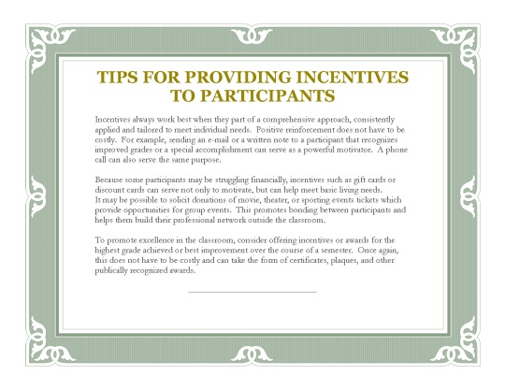
Incentives
Everyone likes positive reinforcement and even small gifts can have an enormous motivational impact upon participants.
For some tips on incentives, please click on the image of the certificate.
While grant funds cannot be used for incentives, it may be possible to solicit donations from local businesses and use these to provide participants with positive reinforcement for completing milestones.
Click the home key to return to the main menu.

Slide 7
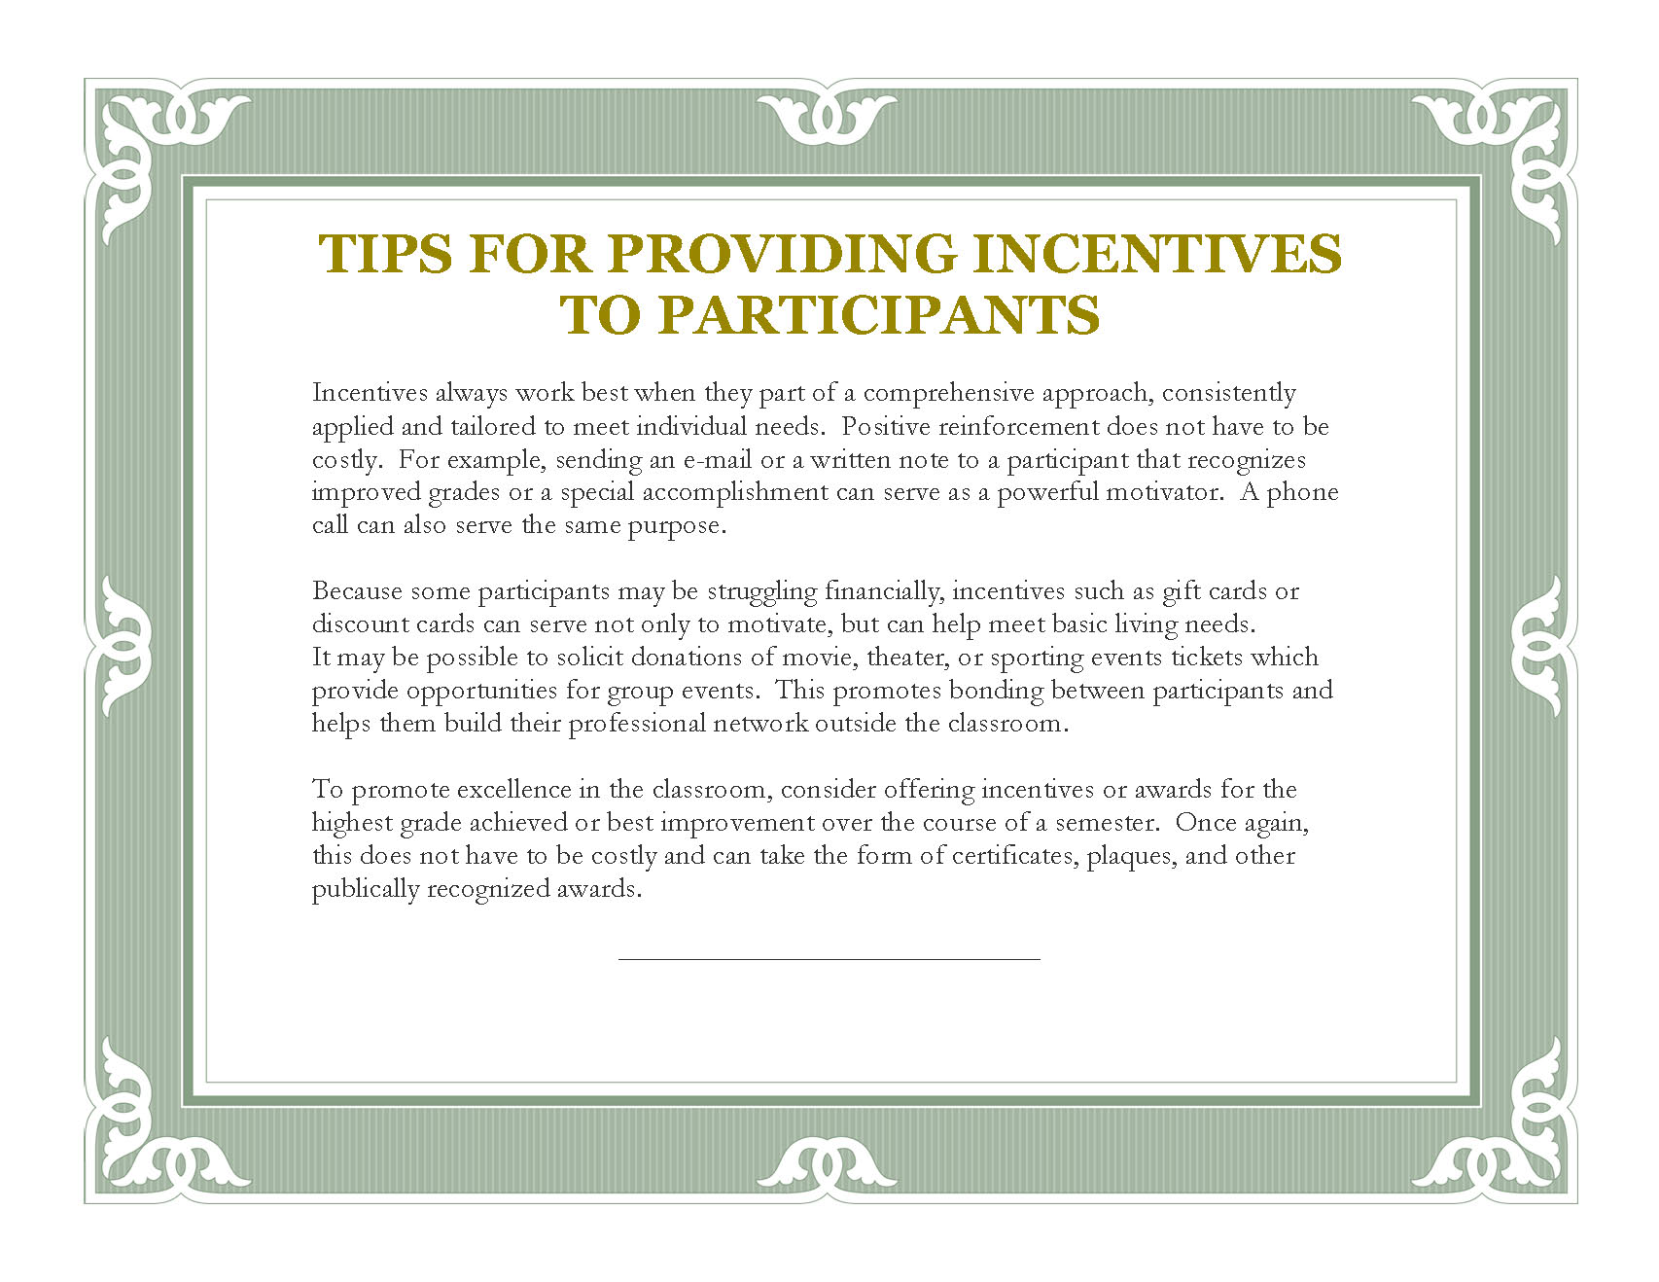
Click the home key to return to the main menu.

Slide 8
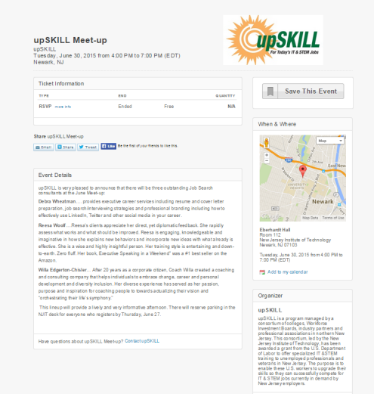
Meetup and Eventbrite
Use Meetup or Eventbrite to organize social or networking gatherings of your program’s participants.
To see how Eventbrite is being used by the New Jersey Institute of Technology to organize networking gatherings of their participants, click on the image of the invitation to the left.
Click the home key to return to the main menu.

Slide 9

Click the home key to return to the main menu.

Slide 10
Survey Monkey
Use Survey Monkey to get feedback from participants and keep tabs on their progress.
To learn how to use Survey Monkey, visit their website:
https://www.surveymonkey.com/mp/take-a-tour/?ut_source=header
Click the home key to return to the main menu.

Slide 11
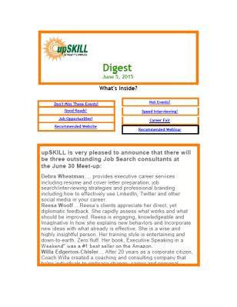
Newsletter
Produce an online newsletter that provides your participants with job hunting tips.
To see excerpts from an online newsletter that is distributed via e-mail by the upSKILL program of the New Jersey Institute of Technology, click on the image of the newsletter to the left.
Click the home key to return to the main menu.

Slide 12
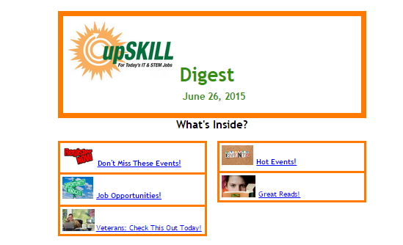
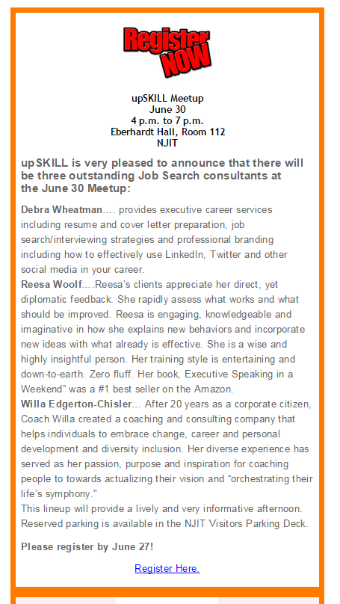
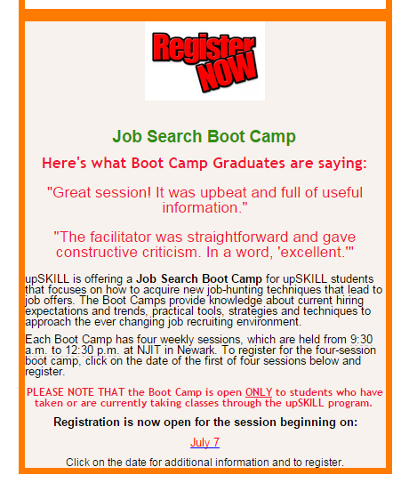

Click the home key to return to the main menu.

Slide 13
Job Clubs
Set up a job club for your participants and schedule meetings on a weekly basis.
For tips on starting a job club, click on the following link:
https://etagrantees.workforce3one.org/view/2001407734921555389/info
Click the home key to return to the main menu.

Slide 14
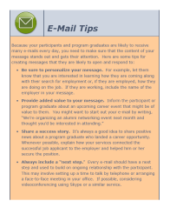
E-Mail and Snail Mail
Use e-mail and snail mail to stay in touch with participants.
While e-mails are easy and efficient, don’t underestimate the power of snail mail. Consider sending participants birthday wishes or congratulatory hand-written notes.
For guidance on how to make your follow-up e-mails more effective, click on the tip sheet to the left.
Click the home key to return to the main menu.

Slide 15
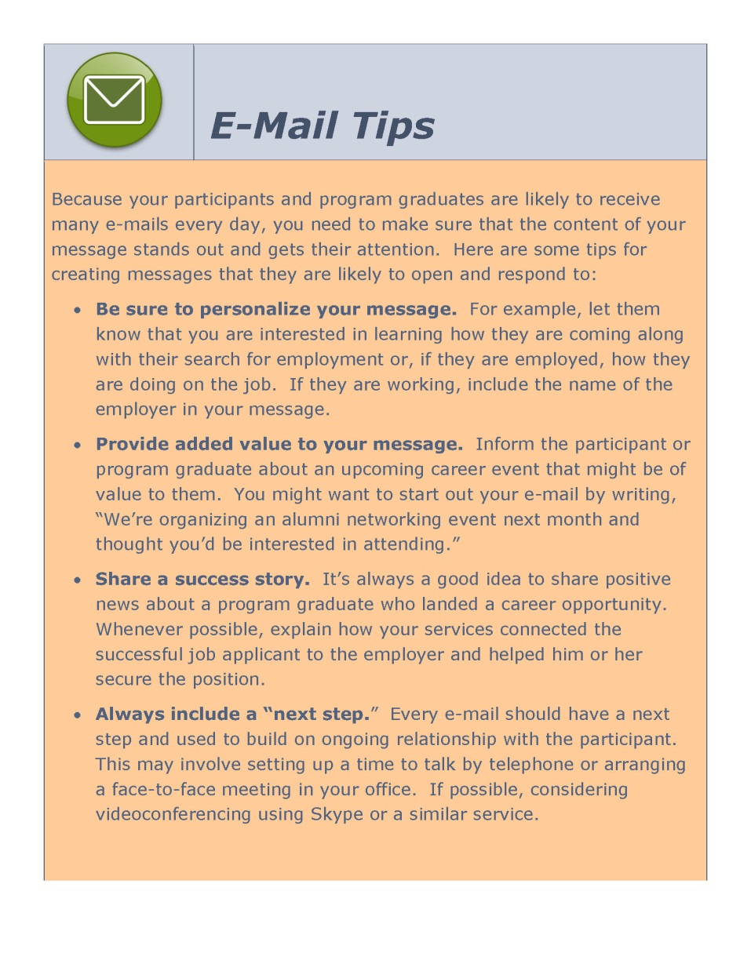
Click the home key to return to the main menu.

Slide 16
Mentors
Match participants to mentors who can provide them with career guidance and support.
For guidance on setting up a mentor program, click on this link:
http://www.mentoring.org/start_a_program
Click the home key to return to the main menu.

Slide 17
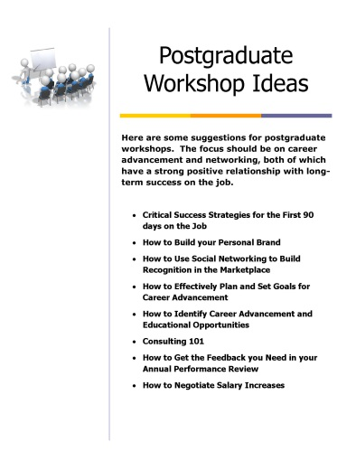
Workshops
Organize and deliver workshops that can provide career advancement guidance to program graduates.
One of the best ways to ensure long-term success is to help participants develop a career advancement plan. Postgraduate workshops can be used to facilitate this process.
For some suggestions concerning postgraduate workshops, please click on the Postgraduate Workshop Ideas tip sheet.
Click the home key to return to the main menu.

Slide 18

Click the home key to return to the main menu.

Slide 19
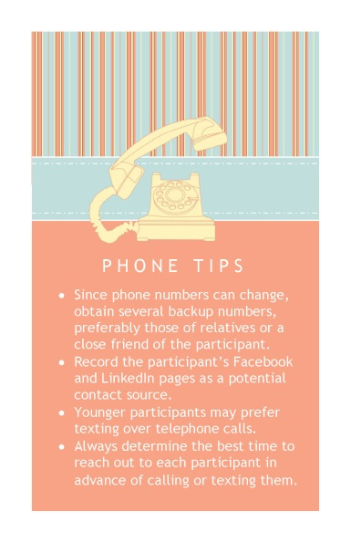
Telephone and Texting
Give them a call at a time that is convenient to them. Consider texting if they prefer that mode of communication.
Reaching out by telephone or texting is the foundation for all tracking and follow-up efforts. For some tips on using this strategy, click on the Phone Tips image to the left.
Click the home key to return to the main menu.

Slide 20

Click the home key to return to the main menu.

