Slide 1
Federal Systems Conveners
Virtual Grantee Convening
October 25 – 27, 2022
Jenn Smith, Division of Strategic Investments, ETA/USDOL (Moderator)
Robin Fernkas, Office of Workforce Investment, ETA/USDOL
Sara Hastings, Division of Youth Services, ETA/USDOL
Douglas Howell, Office of Apprenticeship, USDOL

Slide 2
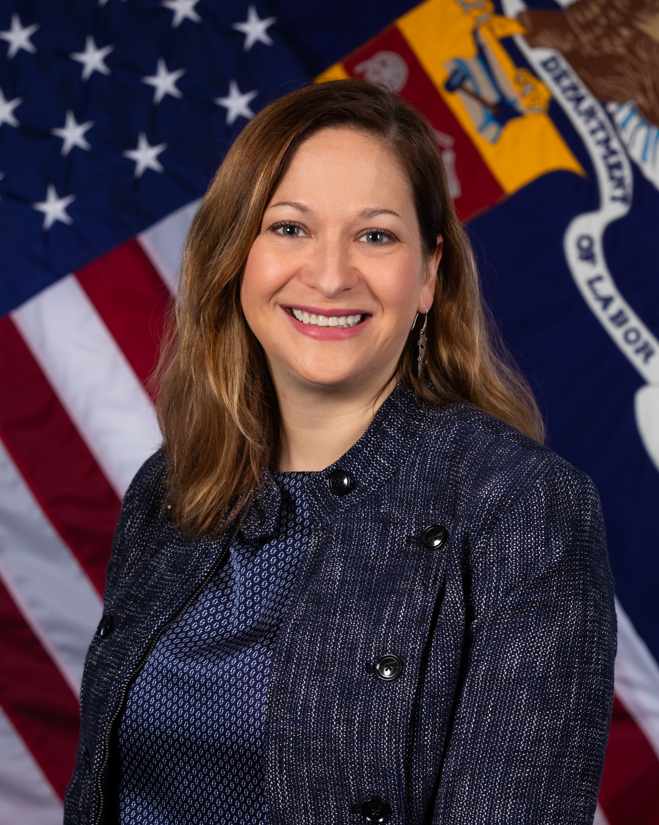
Moderator
Jenn Smith
Division Chief, Division of Strategic Investments
Office of Workforce Investment
US Department of Labor, Employment and Training Administration
smith.jenn@dol.gov

Slide 3
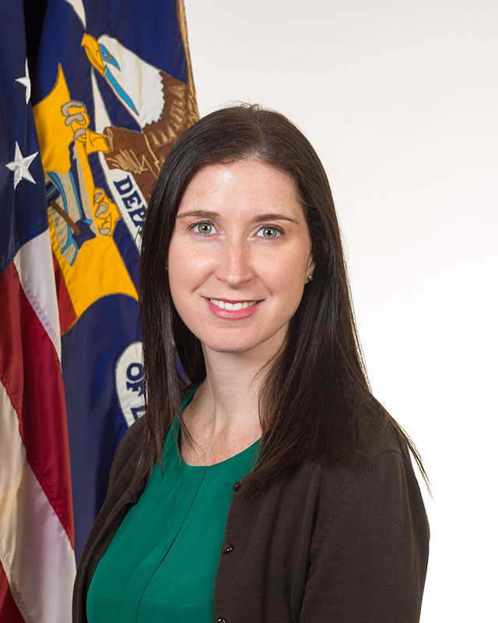
Performance Partnership Pilots for Disconnected Youth (P3)
Sara Hastings
Unit Chief, Division of Youth Services
Office of Workforce Investment
US Department of Labor, Employment and Training Administration
Hastings.sara@dol.gov

Slide 4
Performance Partnership Pilots for Disconnected Youth (P3)
P3 authorized in the Consolidated Appropriations Act of 2014 and reauthorized in each subsequent year’s appropriations act
P3 provides flexibilities to awarded pilots: Ability to combine funding of discretionary programs from across Federal agencies participating in P3
Waivers from those programs’ requirements
The goal of P3: to improve coordination and strengthen local systems in an effort to improve outcomes for disconnected (opportunity) youth

Slide 5
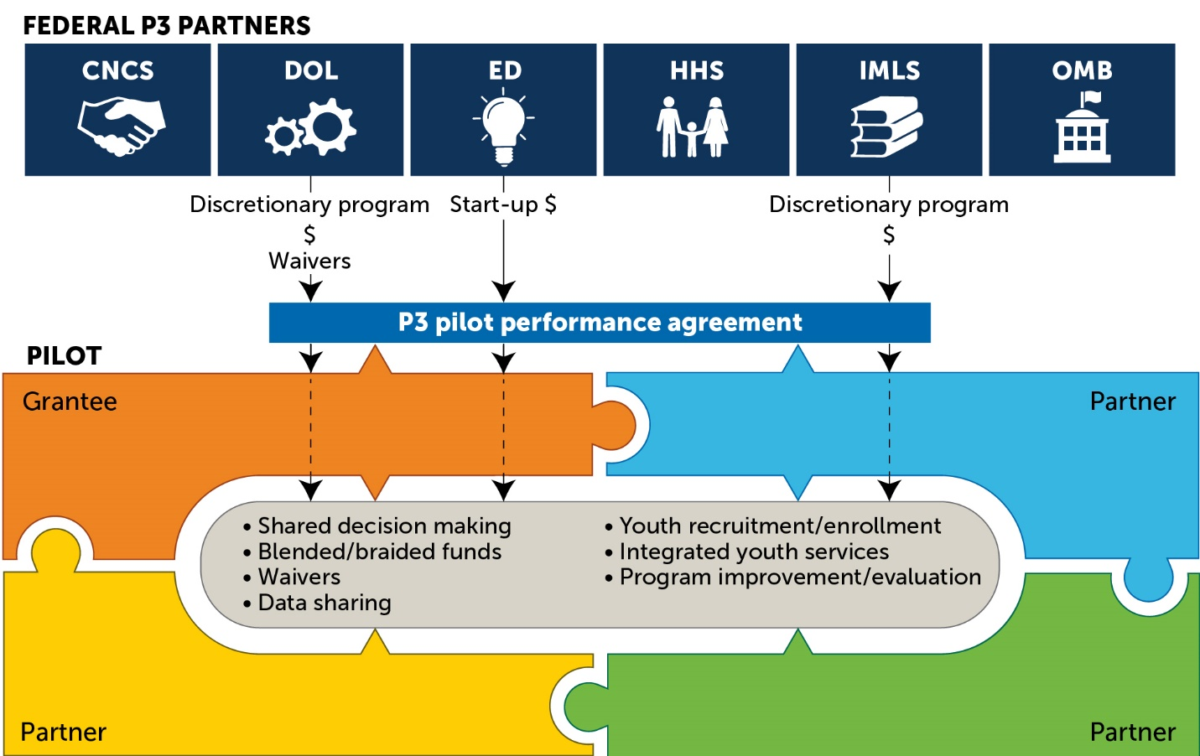
Illustrative Cohort 1 P3 pilot
Grantees can pool funds across discretionary programs and obtain waivers to programmatic requirements to reduce barriers to providing effective services for disconnected youth.

Slide 6
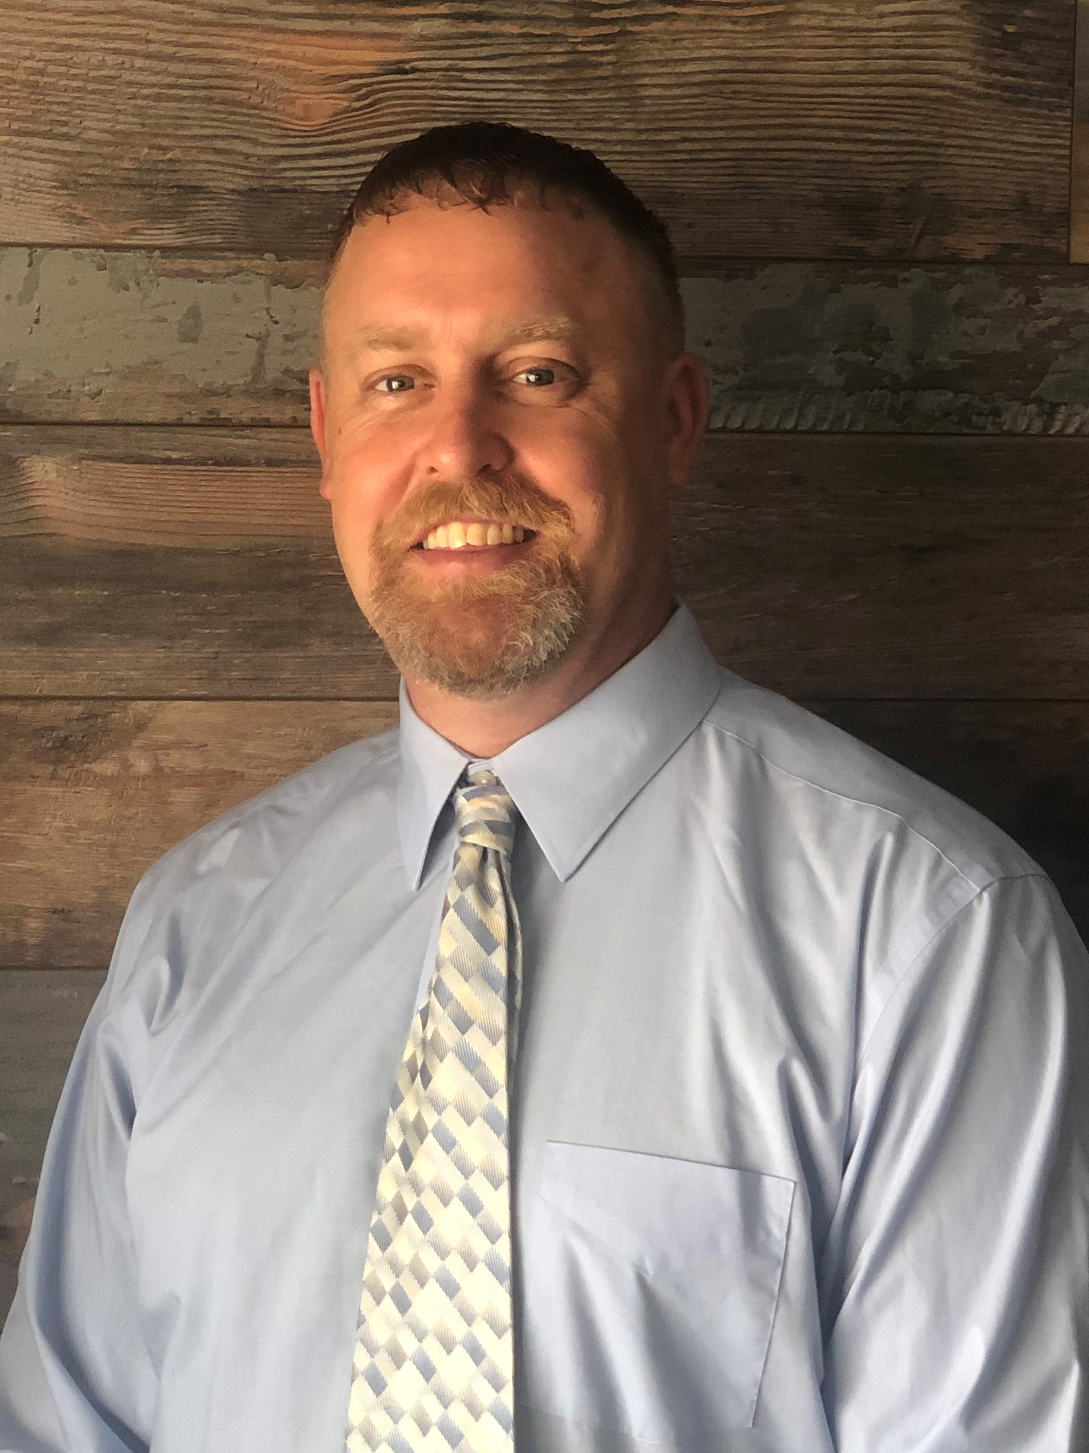
120-Day Cybersecurity Apprenticeship Sprint
Douglas Howell
California State Director
Office of Apprenticeship
US Department of Labor, Employment and Training Administration
Howell.Douglas@dol.gov

Slide 7
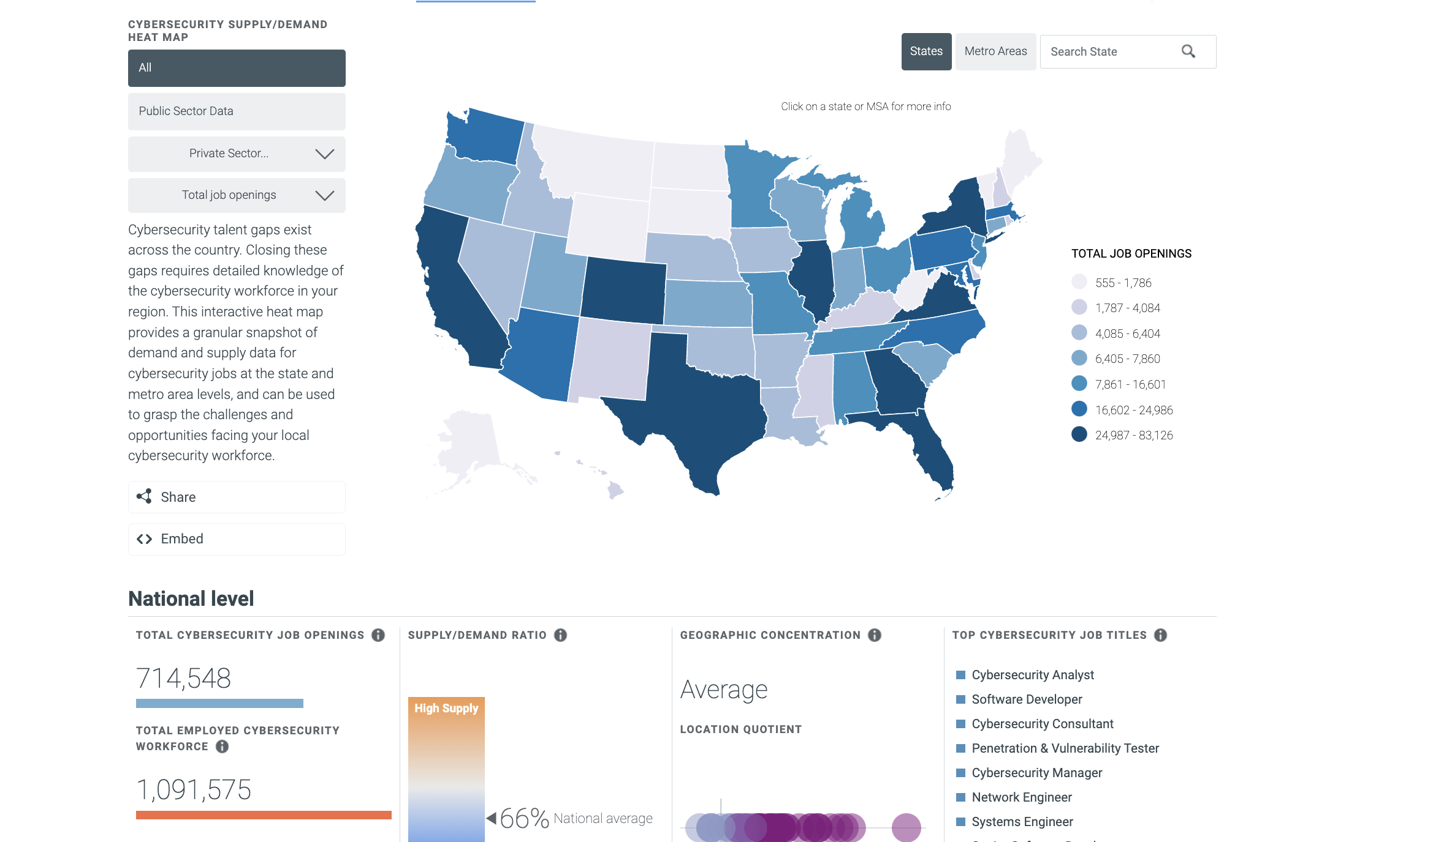
Addressing Cybersecurity Industry Issues with Apprenticeship
Rapidly growing talent shortage
  Over 700,000 open
  positions nationally

Slide 8

Cyber Sprint Goals
Increase
Increase Awareness of successful Cyber RA programs
Advance
Advance DEIA in Cyber field through RA
Educate
Educate public on accelerated approach model
Connect
Connect Career Seekers to cyber RA programs
Recruit
Recruit employers to explore RA

Slide 9
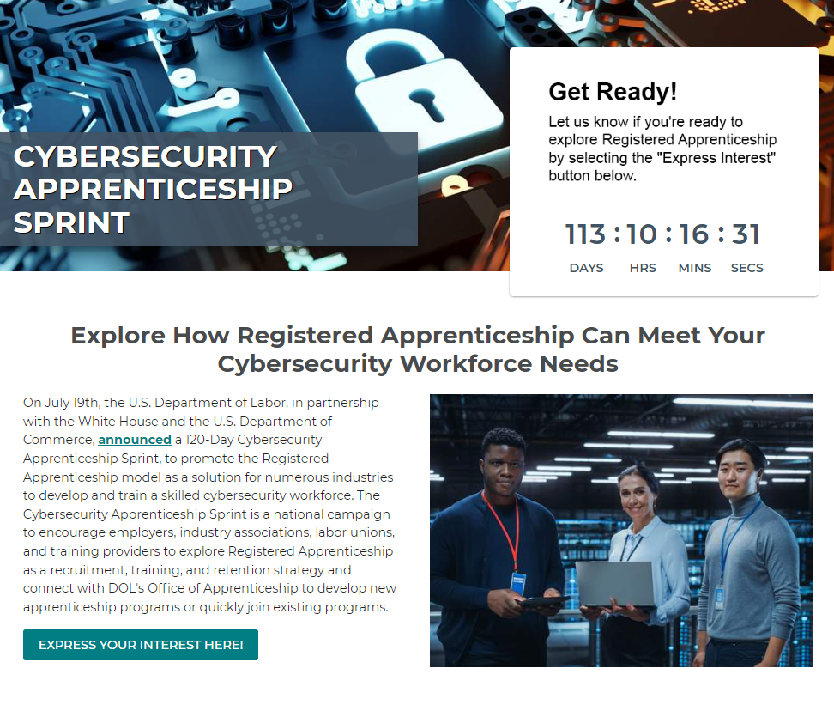
Cybersecurity Sprint Resources
Department of Labor and Commerce Joint Press Release
Cybersecurity Apprenticeship Sprint Website
  Express Interest Form
  NICE Program Finder
  Curriculum Resources
CybersecurityApprenticeship@dol.gov

Slide 10
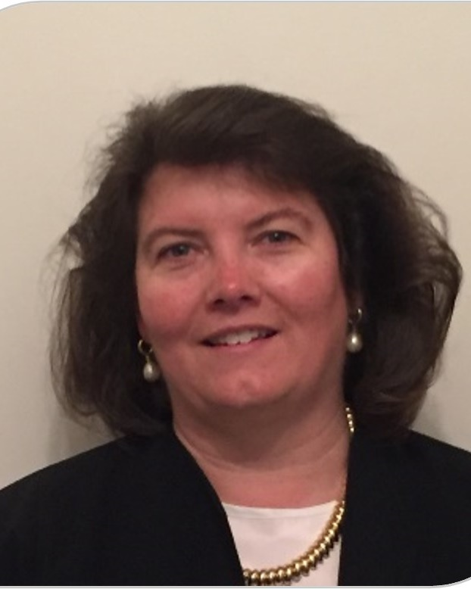
Career Pathways
Robin Fernkas
Deputy Administrator,
Office of Workforce Investment
US Department of Labor, Employment and Training Administration
Fernkas.Robin@dol.gov

Slide 11

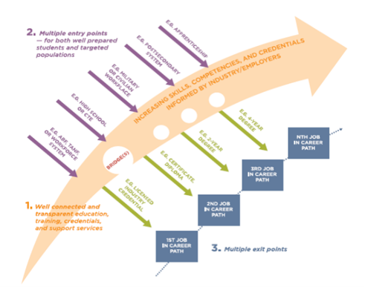
Career Pathways Operate At Many Levels

Slide 12
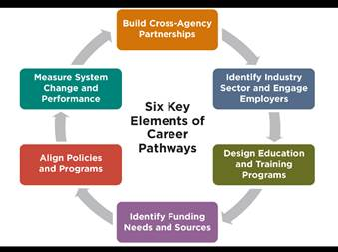
Career Pathways Framework

Slide 13

United States Federal Agency
Career Pathways Resources and Tools

Slide 14
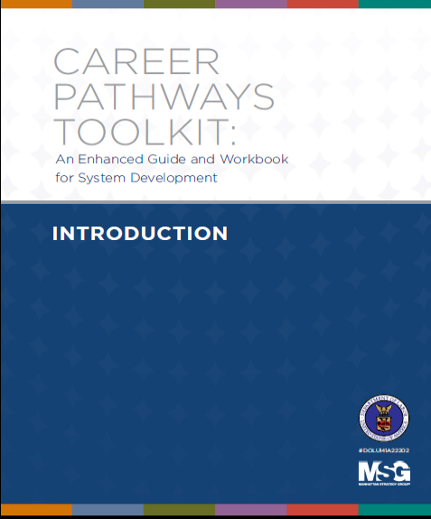
Enhanced Guide and Workbook
Updated with WIOA References
Enhanced Content:
  Examples
  Action Steps
  Tools
  Available at:
  www.careerpathways.workforcegps.org

Slide 15
Lessons from the work
Sustaining the systems change efforts can require explicit goals and planning, a strong commitment from leadership, and partners’ willingness to innovate
Emphasis from Federal Government on systems change could encourage these efforts in support of local communities (Set the Tone!)
Considerable technical assistance and planning time is needed to support efforts to capitalize on flexibilities (Coordination/collaboration takes time but is invaluable!)
Important to ask the questions: Where do we want to go and what’s in our way of getting there?

Slide 16

Identifying and Addressing Barriers to Program Implementation:
A Tool for Community Reflection

Slide 17
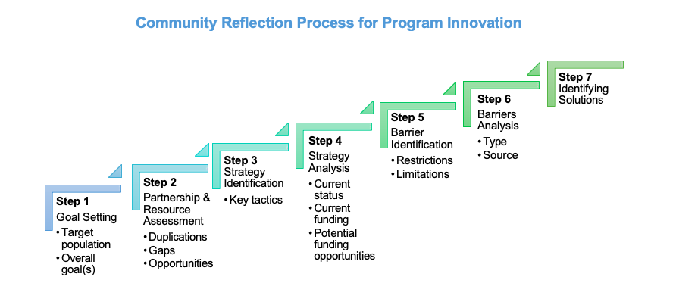
Identifying and Addressing Barriers to Program Implementation (youth.gov): https://youth.gov/sites/default/files/Implementation-Barriers-Tool-JFF-FYI.pdf

Slide 18
Thank you!

