Slide 1
What’s Important When You’re Engaged in Community College Systems Change?
Virtual Grantee Convening
October 25 – 27, 2022

Slide 2
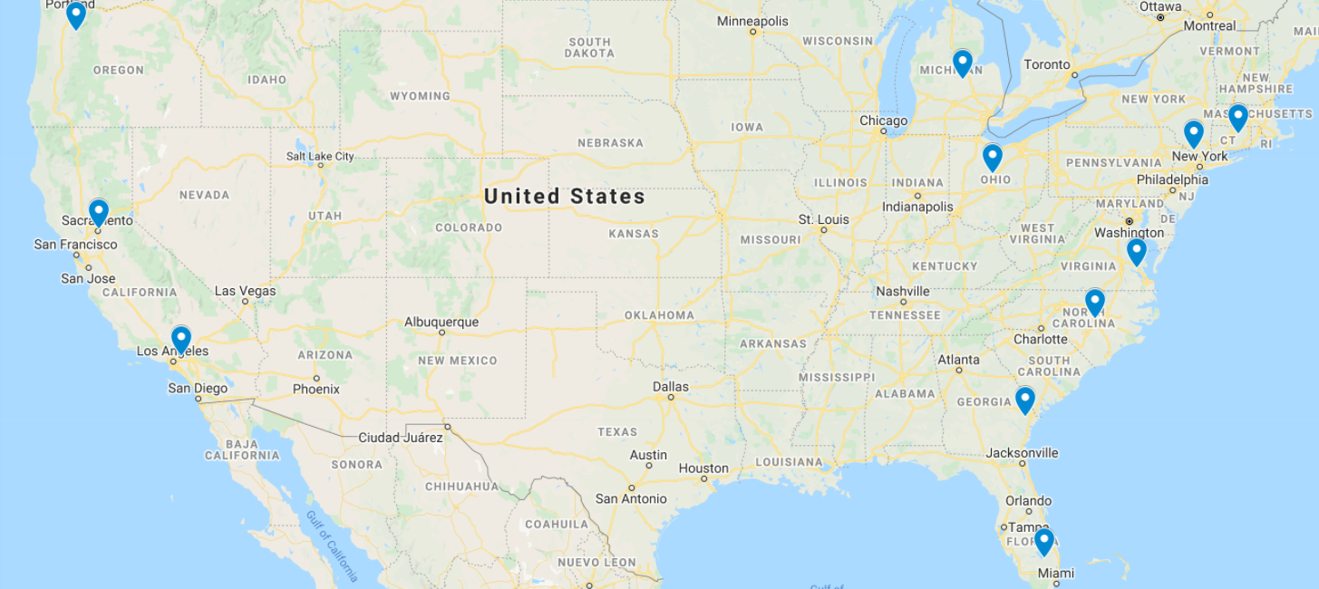
SCC Grants across the United States
Mt. Hood Community College (OR)
Grand Rapids Community College (MI)
Norwalk Community College (CT)
West River Area Health Education Center
Michigan Department of Labor and Economic Opportunity
Workforce Development Board of Herkimer, Madison and Oneida Counties
Queensborough Community College (NY)
Tecumseh Area Partnership, Inc., dba Region 4 Workforce Board
Western Colorado Area Health Education Center
Colorado Center for Nursing Excellence
Northwest State Community College (OH)
Ohio Area 7 Consortium of Chief Elected Officials
California Rural Indian Health Board
American River College (CA)
Governor's Office of Workforce Innovation
Eastern Kentucky Concentrated Employment Program, Inc.
Virginia Peninsula Community College (VA)
Forsyth Technical Community College (NC)
Pee Dee Regional Council of Governments
Long Beach City College (CA)
Workforce Solutions Rural Capital Area
Savannah Technical College (GA)
CommunityHealth IT
Broward College (FL)
Notes:
Robin
And here is a map showing where SCC grantees are located across the country.
[They cover ten states: California, Connecticut, Florida, Georgia, Michigan, North Carolina, New York, Ohio, Oregon, and Virginia. Two grants are located in California, one in northern and the other in southern California.]
Now I’ll turn it over to Eugenie Agia, the SCC Grant Lead, to walk you through more details about this program.

Slide 3
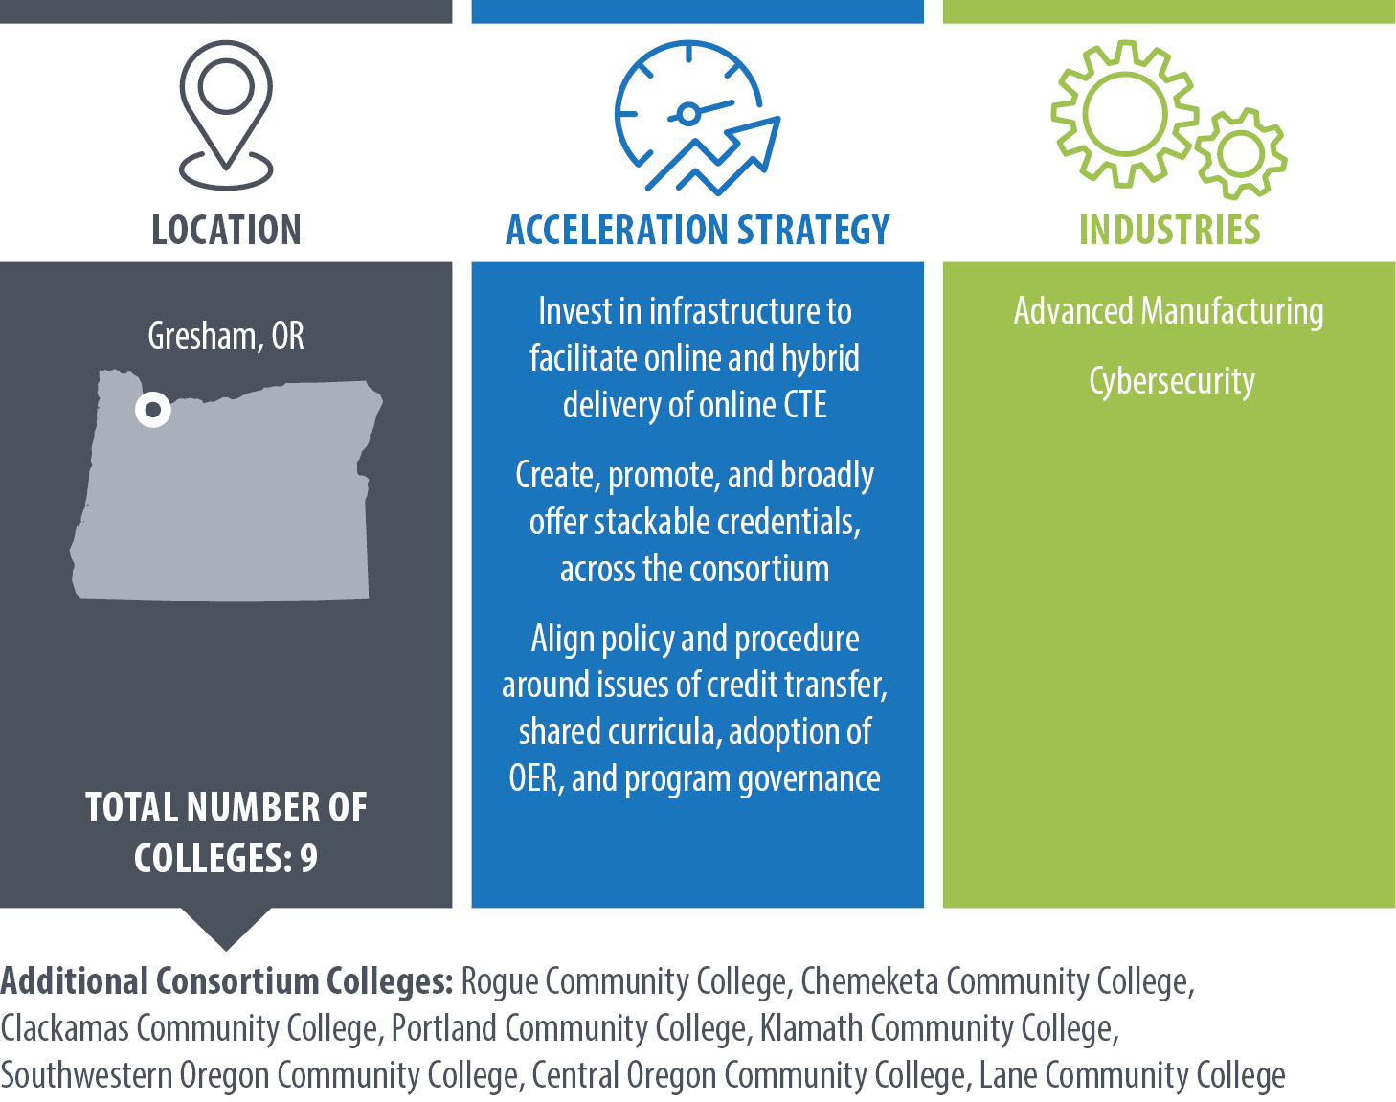
Mt. Hood Community College

Slide 4

USDOL Strengthening Community Colleges Training Grant – Jenni Newby, Consortium Director

Slide 5
Collaboration Lessons
Consortium collaboration for systems change requires:
Commitment/Engagement from college leadership
  Support for and prioritization of the work
The right stakeholders at the table
  Energy, enthusiasm, and authority
Pivot when needed
USDOL Strengthening Community Colleges Training Grant

Slide 6
Collaboration Strategies/Changes Implemented
Reflect, regroup, and revise (Pivot)
  Reflect, seek input, and revise collaboration approaches
  Example: Review grant committee membership, review and revise committee mission, vision and update action items
Find ways to engage and inform consortium college leadership
USDOL Strengthening Community Colleges Training Grant

Slide 7
Questions?
Jenni Newby, SCC Grant Consortium Director
jenni.newby@mhcc.edu
USDOL Strengthening Community Colleges Training Grant

Slide 8
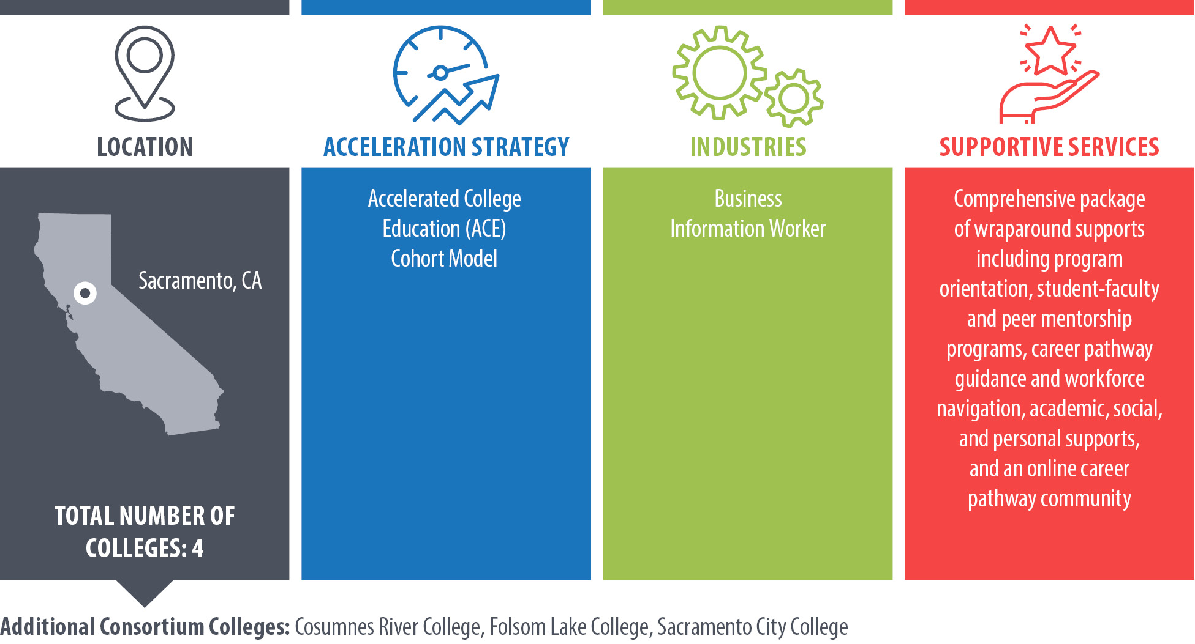
American River College
(Los Rios Community College District)

Slide 9
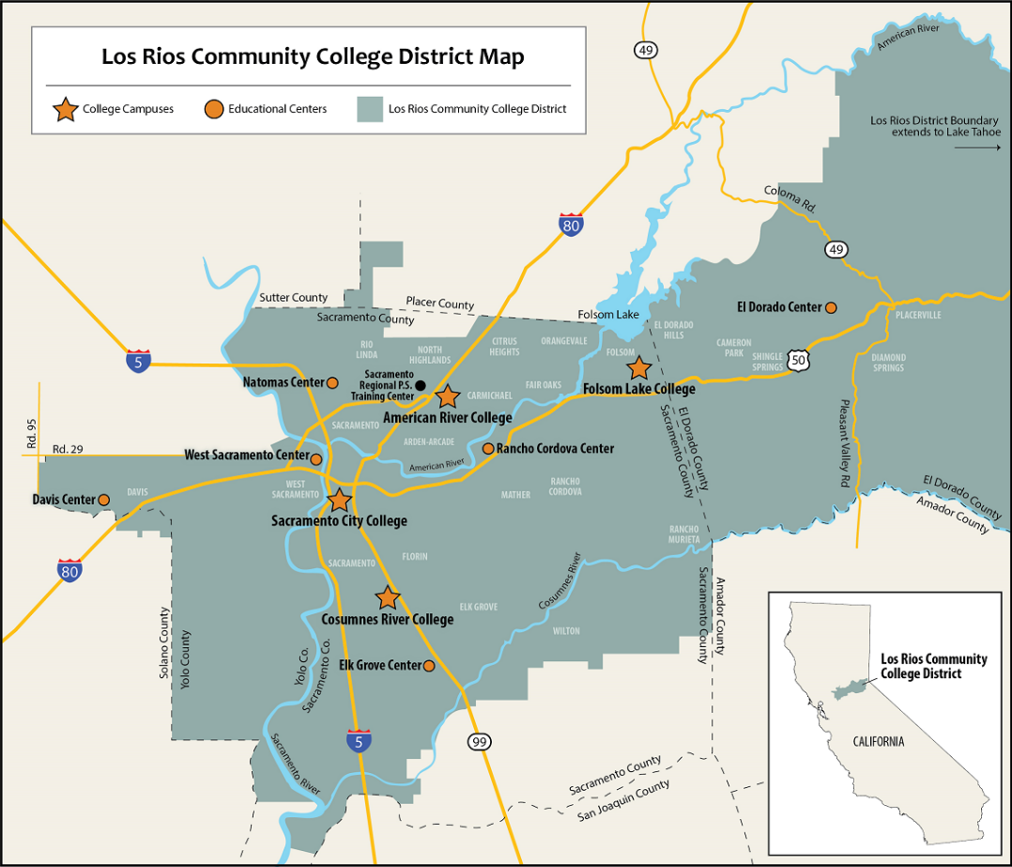
Collaboration embedded as a strategic approach
Consortium grantee
  Four colleges
  WIOA connections
  Employers
  Regional conveners
  SMEs
  Parallel initiatives w/ complimentary goals
  Public-sector focus
Notes:
Three overarching/phased goals:
Make necessary connections between appropriate internal and external stakeholders to inform approach, solicit input, build trust, ID project champions
Train target populations of job seekers
Develop clear on-ramps to living-wage public sector career opportunities

Slide 10
Systems change spotlight
Data-informed implementation
  Curriculum refresh
  Proactive + regular engagement
  Addressing & dispelling tropes
Josef Preciado,
Project Director
  preciaj@arc.losrios.edu
  +1 (916) 484-8365
Notes:
Well established record of academic programming coordination, but collaboration across LRCCD colleges is new.
Important to address the “elephants” in order to:
Expose and deconstruct challenges piece by piece
Articulate real and perceived issues among/between partners and operational systems
Identify institutional & organizational capacity for change

Slide 11
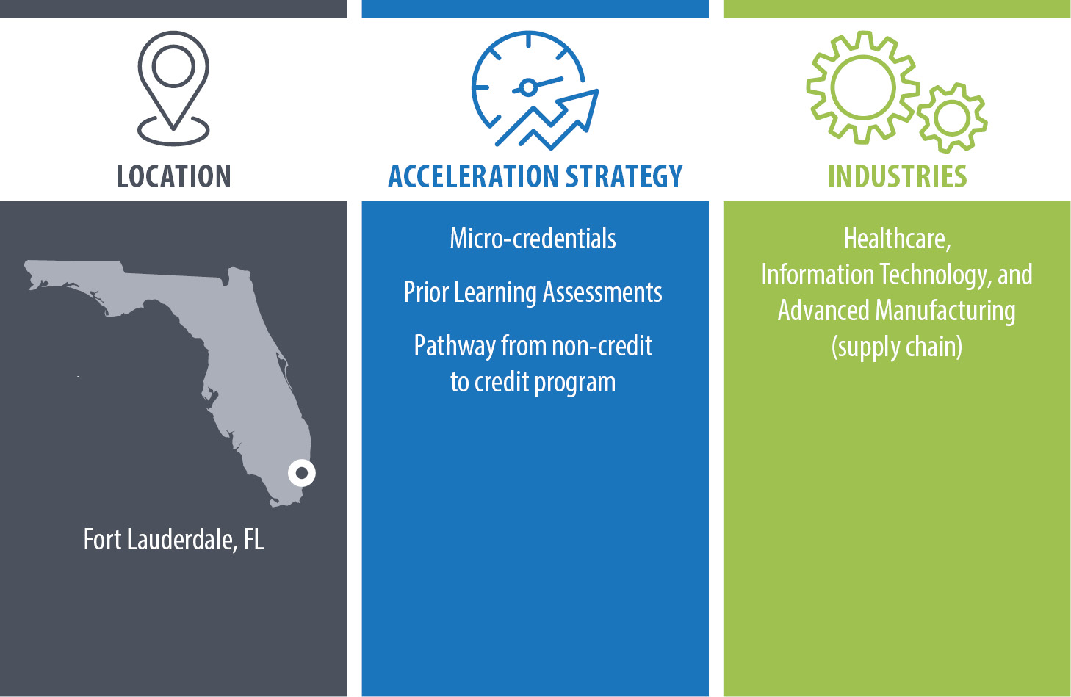
Broward College

Slide 12
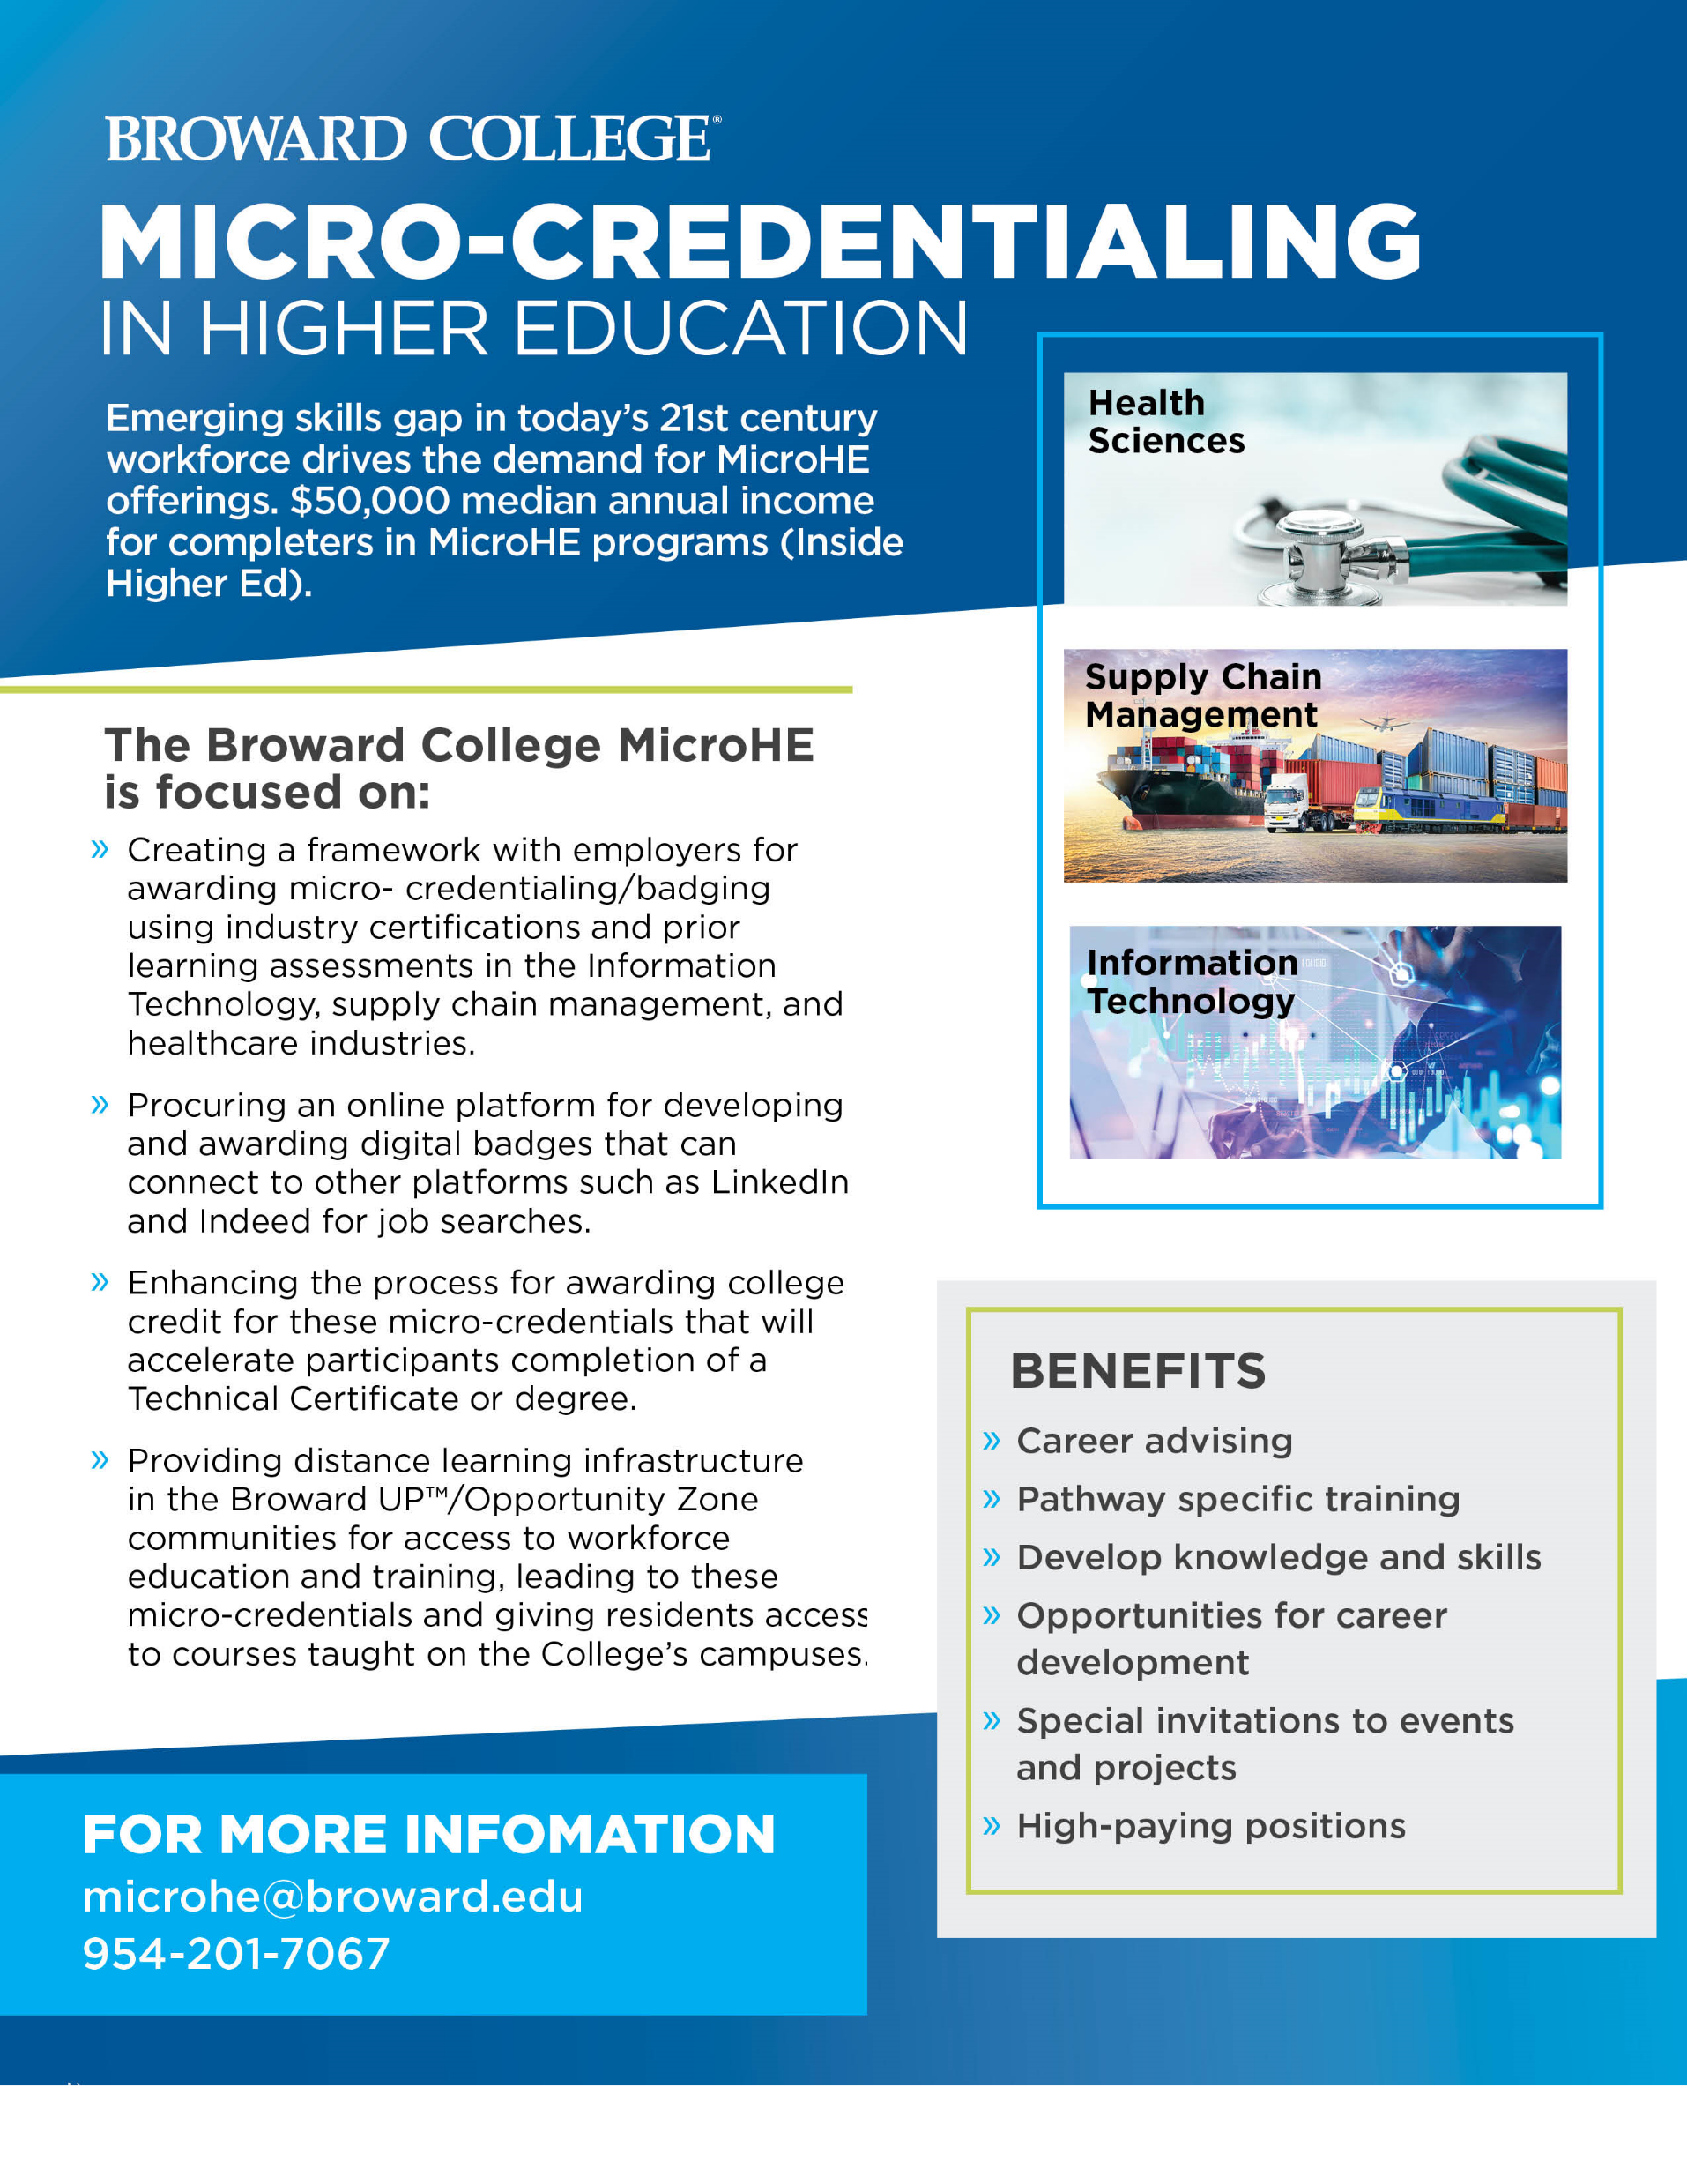
Introduction to MicroHE
The U.S. Department of Labor's Strengthening Community College Training Grants program has awarded Broward College a grant of almost $1.7 million. Broward College received one of eleven grants awarded to community colleges across the nation and the only grant awarded in Florida.
Micro-credentials are short term courses of training in a particular field or an area that allows students to gain qualifications or expertise through certifications that can be completed in a short period.
Dr. Candice Maharaj
Director, MicroHE

Slide 13
Framework and Online Platform
FRAMEWORK
Creating a framework with employers for awarding micro- credentialing/badging using industry certifications and prior learning assessments in the Information Technology, supply chain management, and healthcare industries.
ONLINE
PLATFORM
Procuring an online platform for developing and awarding digital badges that can connect to other platforms such as LinkedIn and Indeed for job searches.

Slide 14


College Credit and Broward UP
College Credit: Enhancing the process for awarding college credit for these micro-credentials that will accelerate participants completion of a Technical Certificate or degree.
Broward UP: Providing distance learning infrastructure in the Broward UP/Opportunity Zone communities for access to workforce education and training, leading to these micro-credentials and giving residents access to courses taught on the College’s campuses.

Slide 15
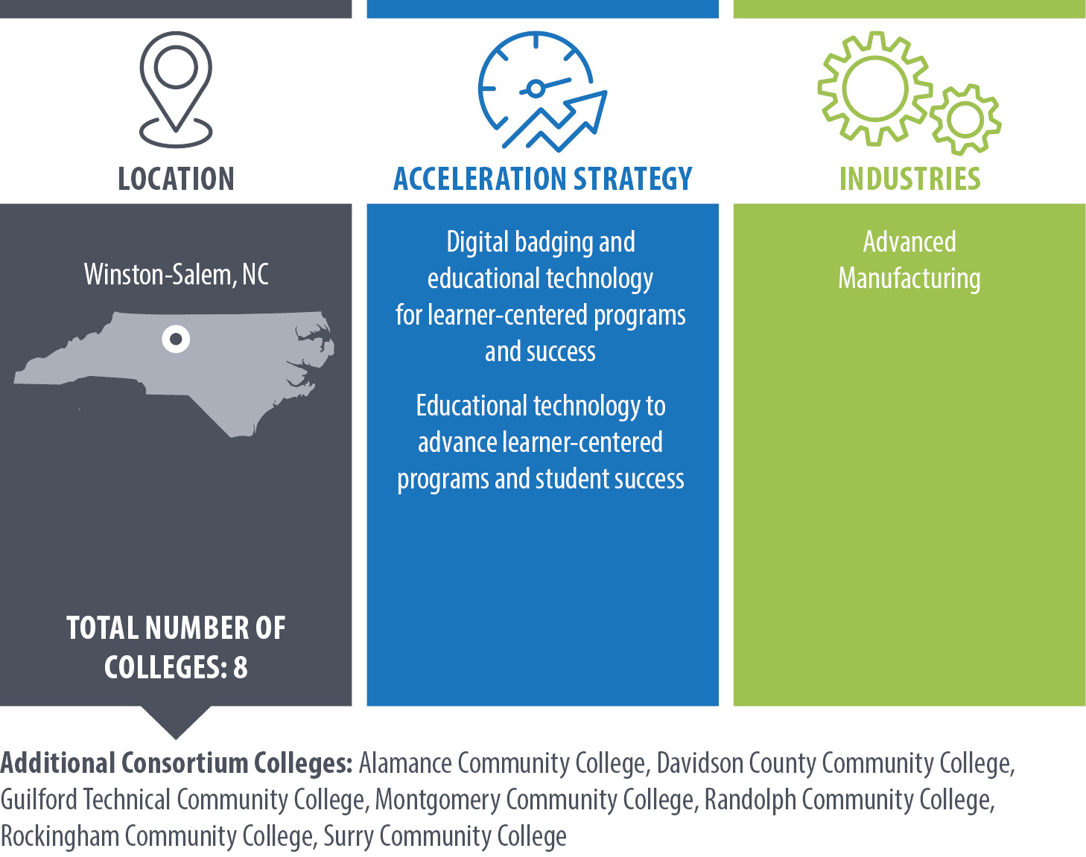
Forsyth Technical Community College

Slide 16
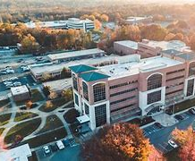

Aligning the Workforce and Education System for Manufacturing (AWESM)
AWESM is a $5,000,000 project funded by the DOL-ETA.

Slide 17
Vision Statement
Aligning regional technical education to deliver tomorrow’s advanced manufacturing workforce

Slide 18


Consortia of 8 Community Colleges
BILT
Close the gaps
Graduates who are skilled and ready for today’s workforce

Slide 19

AWESM BILT KSA Definition
(K)Knowledge + (S)kills + (A)bilities
How do you verify the relevancy of your curriculum’s content?
Will today’s content be relevant tomorrow, next year, 5 years from now?
What type of equipment and tools will an entry level worker be required to use 3-5 years from now?

Slide 20
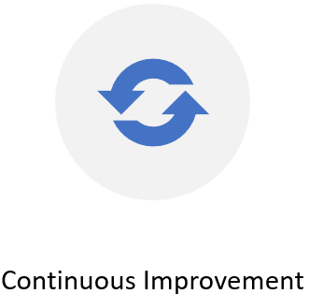
AWESM BILT KSA Implementation Timelines
Computer Integrated Machining (CIM) (2021 -2022)
Welding (2022 – 2023)
Mechatronics (2023 – 2024)
Industrial Systems Technology (2024 – 2025)

Slide 21
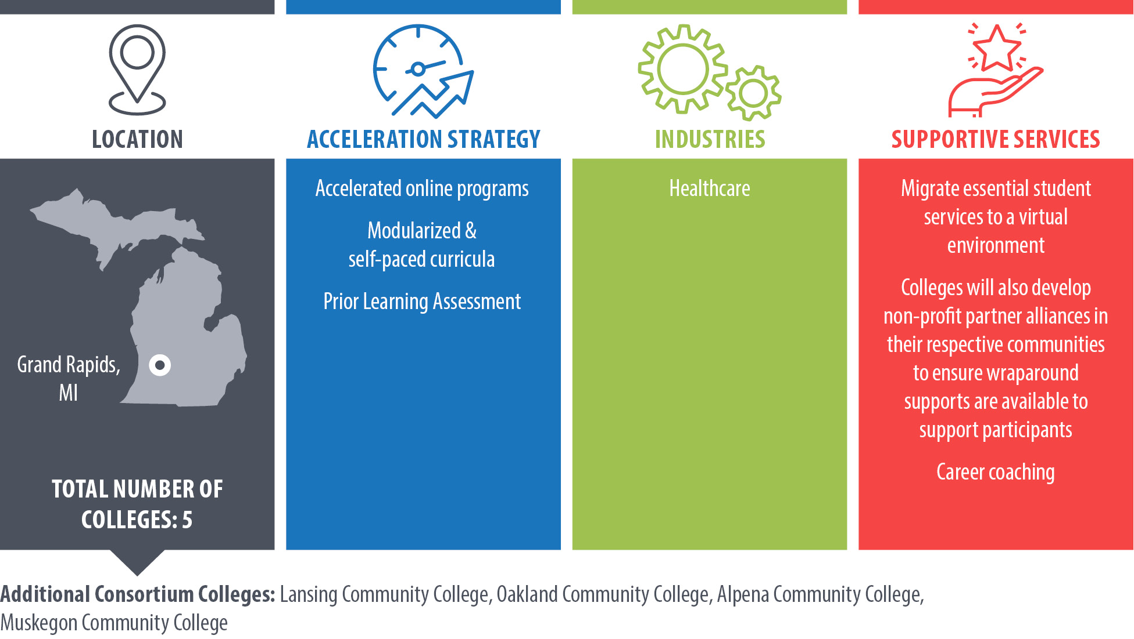
Grand Rapids Community College

Slide 22


grcc.edu/programs/job-workforce-training/mcahp-program
(616) 234-2542

Slide 23


Partners
Educational
Alpena Community College
Grand Rapids Community College
Lansing Community College
Muskegon Community College
Oakland Community College
Employers
Allegan County Mental Health Ascension Michigan
Cherry Health
Corewell Health
Holland Home
Holt Senior Care
Mary Free Bed Rehabilitation Hospital McLaren Greater Lansing
Mercy Health
U of M Health West
Northeast Michigan Community
Mental Health Authority
Sparrow Health System
Workforce Systems
Capital Area Michigan Works!
Oakland County Michigan Works!
Michigan Works! Northeast Consortium
West Michigan Works!

Slide 24


Highlights
West Michigan Works!
Healthcare employers willing to take risks
Community Partners
New Apprenticeships
  Low Numbers & High demand by employers
Consortium Model
  online classroom and
apprenticeship labs

Slide 25
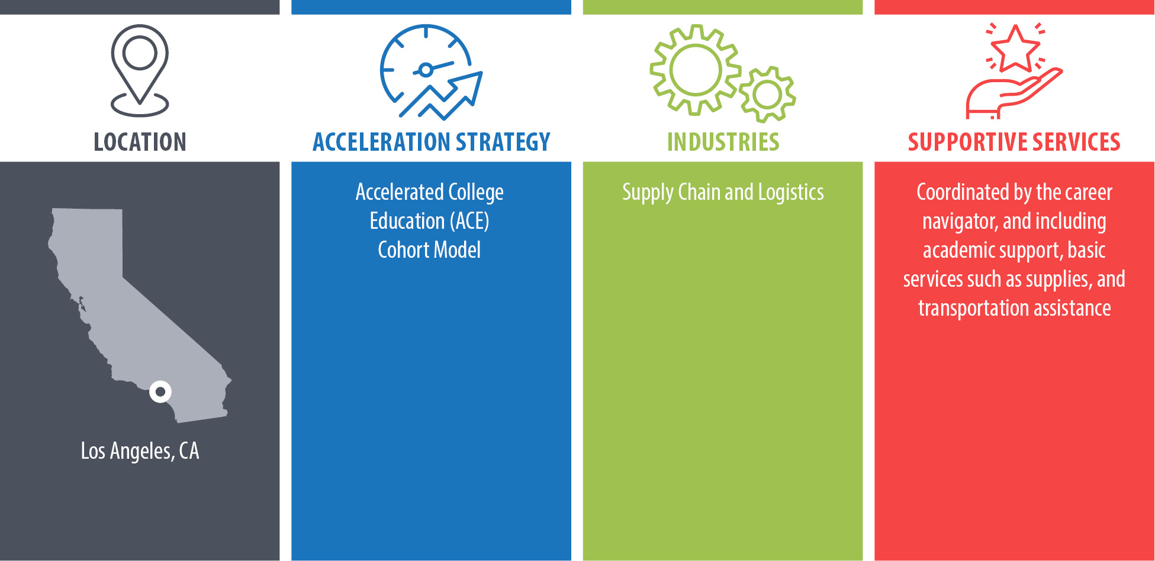
Long Beach City College

Slide 26
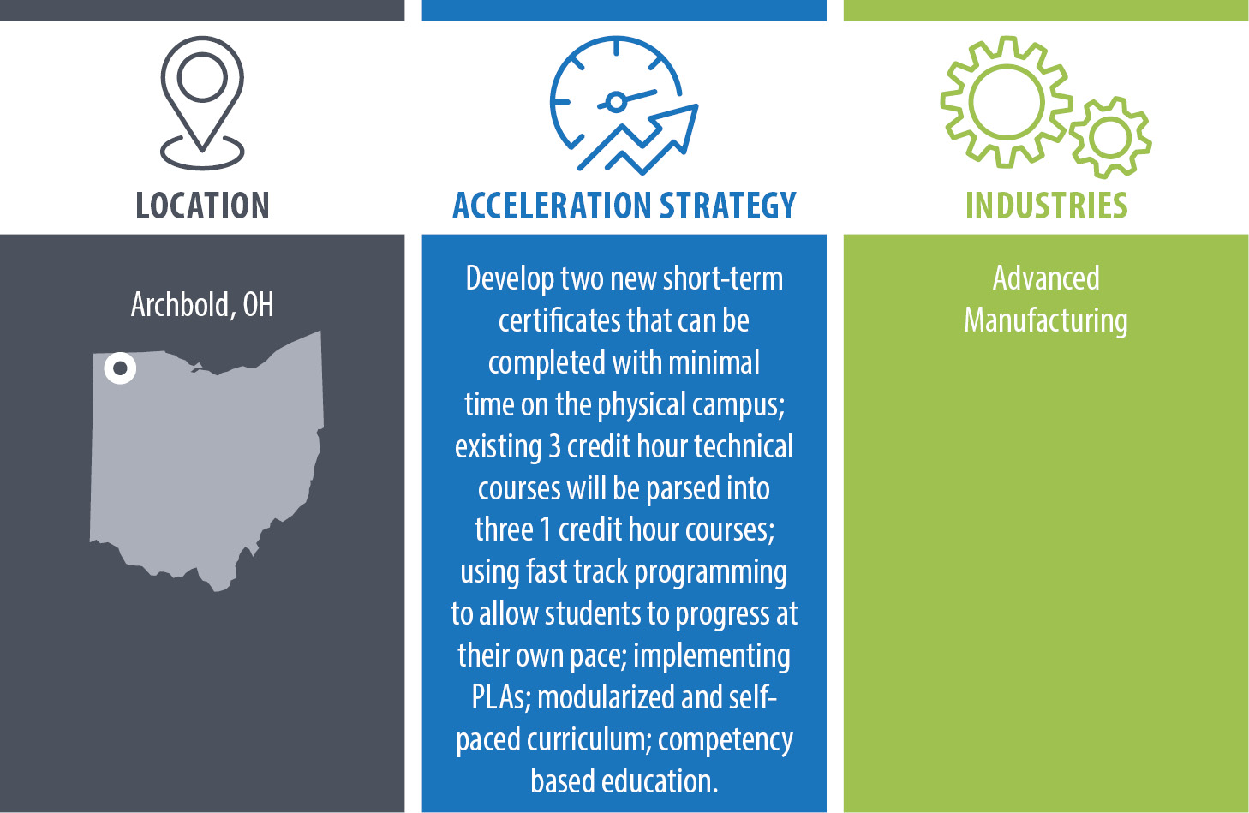
Northwest State Community College

Slide 27

Strategy/Lesson on Collaboration
Employer Engagement - “Make it about me!”
While group convenings have great value, we’ve found even greater involvement with 1-on-1 interactions
Each company/facility is unique and has specified challenges and needs
  Site visits - mutually beneficial
  Individualized approach with surveys to gauge interest in employee referral/involvement
  Puts NSCC “on the radar” at the company

Slide 28
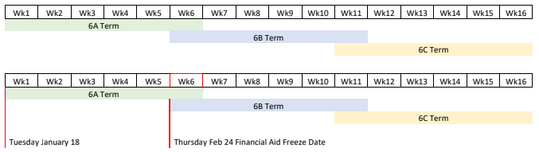
Systems Change to Support Collaboration
Internal Operations - 6 Week Parts of Term
Identified a difficulty accommodating both the “self paced” nature of the programming and working within the administrative structure of the college (Registrar, Financial Aid, Institutional Schedule, LMS)
Utilized interdepartmental collaboration and research
Solution = new 6 week part of term
  Accommodates the grant, requirements of the various departments

Slide 29
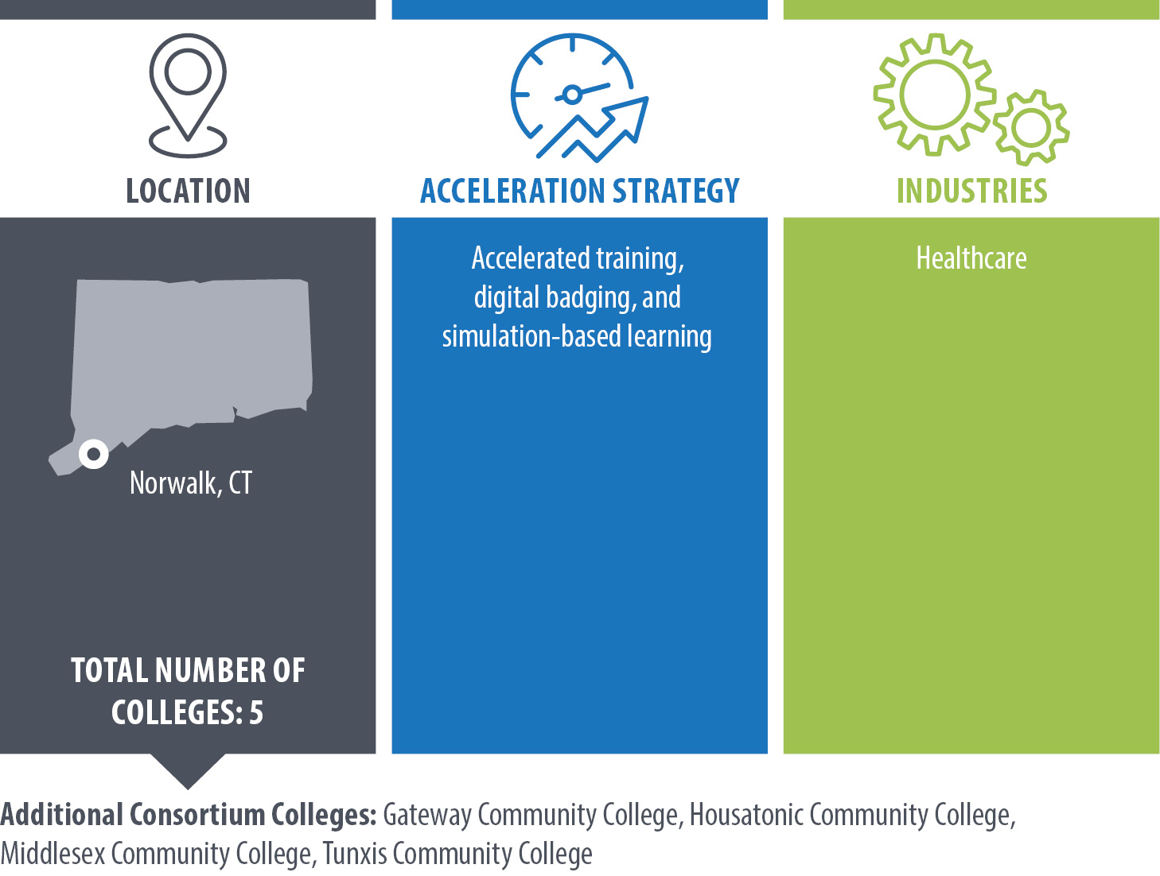
Norwalk Community College
(Connecticut State Community College)

Slide 30
Using a Memo of Agreement as
a Strategic Tool to Build Collaboration
Roles and Responsibilities
Clarified team’s purpose
Commitments
Across both organizations it helped us to negotiate, prioritize and agree on commitments
Collaborative Approach
Responsibility
Defined the “who, what, where, when and how’s” of the partnership
Identify and review Key Performance Indicators
Focused us on how each of our organizations could help each other reach common goals
Share progress, experiences, changes, challenges, etc. based on Memo of Agreement.
Determine opportunities to pursue
“We are in this together”
Monthly meetings with agenda and minutes
Problem solve
Laying the groundwork for successful collaboration
Shared Ownership

Slide 31
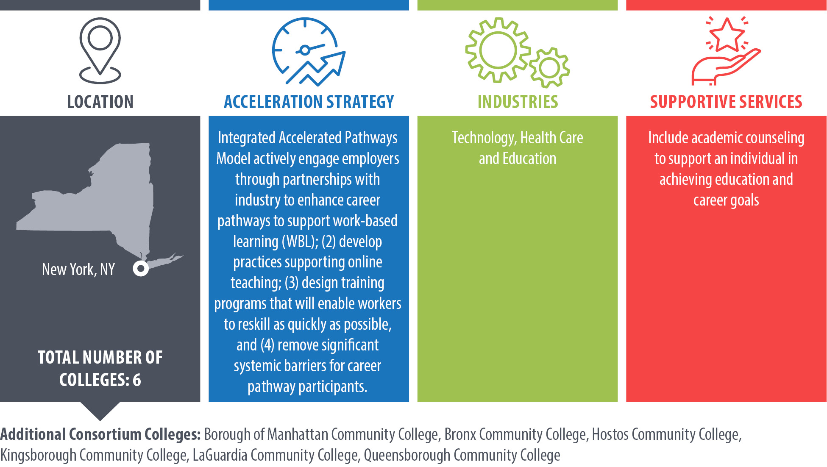
Queensborough Community College
(Research Foundation CUNY)

Slide 32
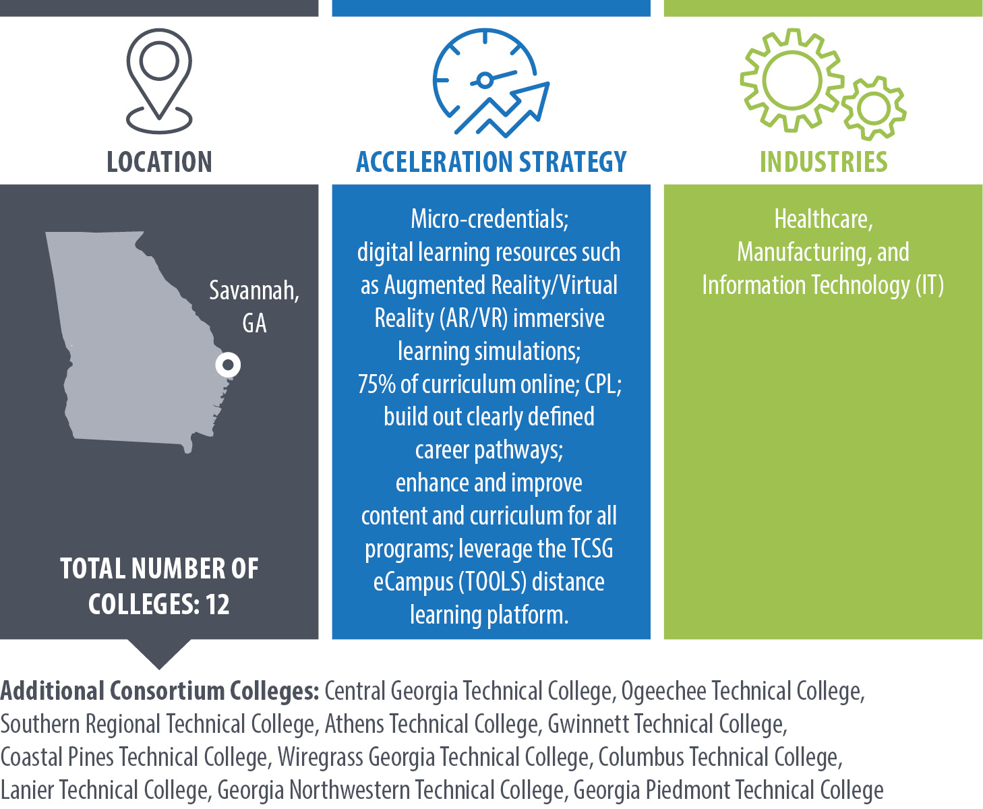
Savannah Technical College
(Technical College System of Georgia)

Slide 33

The Future is NOW
Keith Fletcher, Executive Director

Slide 34


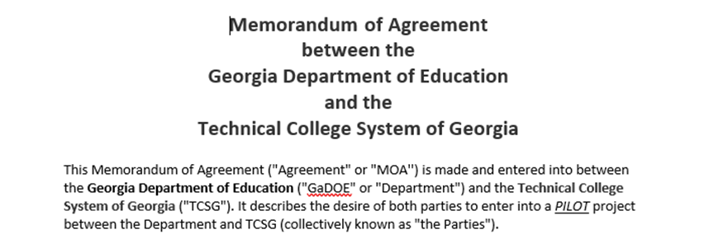
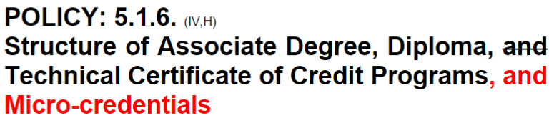
Systems impact
State Board Policy Change

Slide 35






Degree
Micro-credential
Diploma
Certificate
Micro-credential

Slide 36
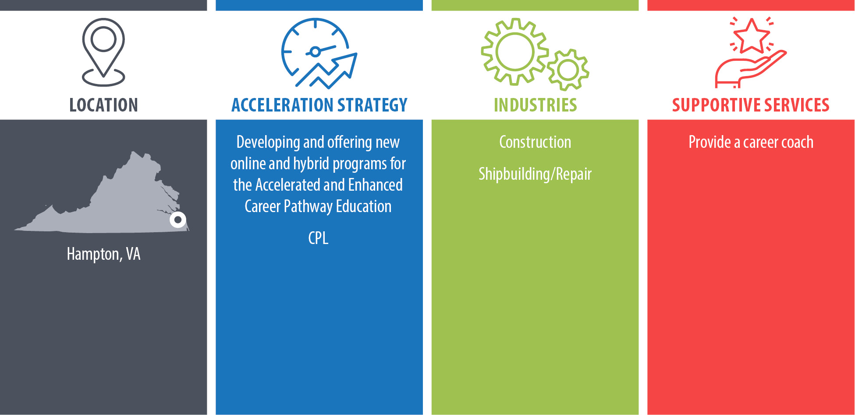
Virginia Peninsula Community College

Slide 37
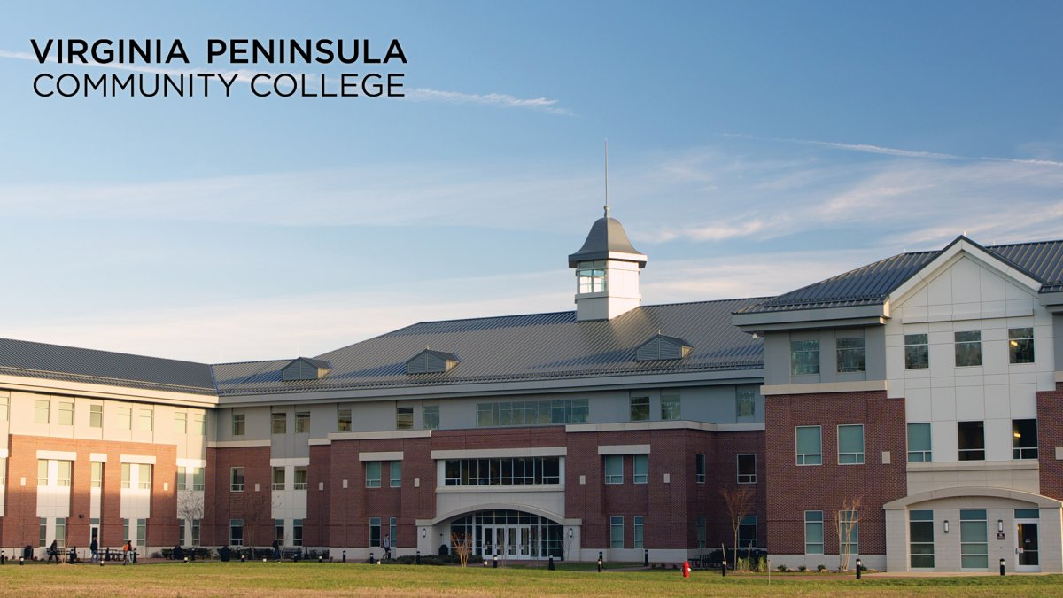
Accelerating and Enhancing Career Education Programs (AECE) Initiative
October 25, 2022
Accelerating and Enhancing Career Education Programs (AECE) is a $2,050,925 project; $1,686,258 (82%) funded through a Federal USDOL-ETA grant and $364,667(18%) through non-federal resources.

Slide 38
Accelerating & Enhancing Career Education Programs (AECE)
With funding support from the U.S. Department of Labor’s Strengthening Community College Initiative, Virginia Peninsula Community College has increased programming and online instructional capacity to prepare students for careers in shipbuilding, ship repair, construction, and manufacturing occupations. Programs offer students the opportunity obtain Industry Certifications, Career Studies Certificates, or an Associate of Applied Science Degree
Academic Programs | Workforce Training
Computer Aided Drafting & Design | Welding (AWS)
Electronic Engineering Technology | Computer Numerical Controls Machining (NIMS)
Heating, Ventilation, Air Conditioning & Refrigeration | Carpentry (NCCER)
Precision Machining Computer Numerical Controls | Masonry (NCCER)

Slide 39
AECE-Partner Categories
Partnering Categories
Advisory Partner
-Serves on program advisory board
-Provides ad-hoc advising but not on an advisory board
Hands-On Partner
-Collaborates on skill profiles for specific jobs
-Collaborates with IHE’s regionally to create career pathways
Examples: transfer program updates/enhancements; industry trends requiring new types of jobs and curriculums to support them at community colleges and universities
Strategic Partner
-Provides work-based learning opportunities
-Makes hiring commitments
-Contributes tuition cost coverage for incumbents, or scholarships
-Contributes in-kind resources
Actions for Cultivating Deeper Involvement
Working with Institutional Advancement staff to ensure AECE partners are invited to college events.
Working with the Vice President of Institutional Advancement and Director of Development to individualize partner-donor cultivation approaches
Establishing a Work Based Learning Advisory Board to include AECE partners
Leveraging other grant projects that involve AECE partners and can support recruiting new ones.
Increasing employer partnerships through new Manufacturing & Trades Advisory Board
Expanding partnership with school systems of Williamsburg /James City County/ York County/ City of Hampton/ City of Newport News/Poquoson
Strengthening regional workforce development system with support of the Hampton Roads Workforce Council

Slide 40
Thank you!

