Slide 1
ASE, SAE 2020, SAEEI Grantee Business Engagement Boot Camp
Kick-Off Webinar
September 29, 2021

Slide 2

Your Moderator
Gina Wells
  Apprenticeship Expansion Subject Matter Expert
    Maher & Maher

Slide 3
Today’s Agenda
Welcome and Overview
Introductions
Boot Camp Overview and Logistics
Building your Apprenticeship Business Outreach Skills
Questions
Wrap-up and Next Steps

Slide 4
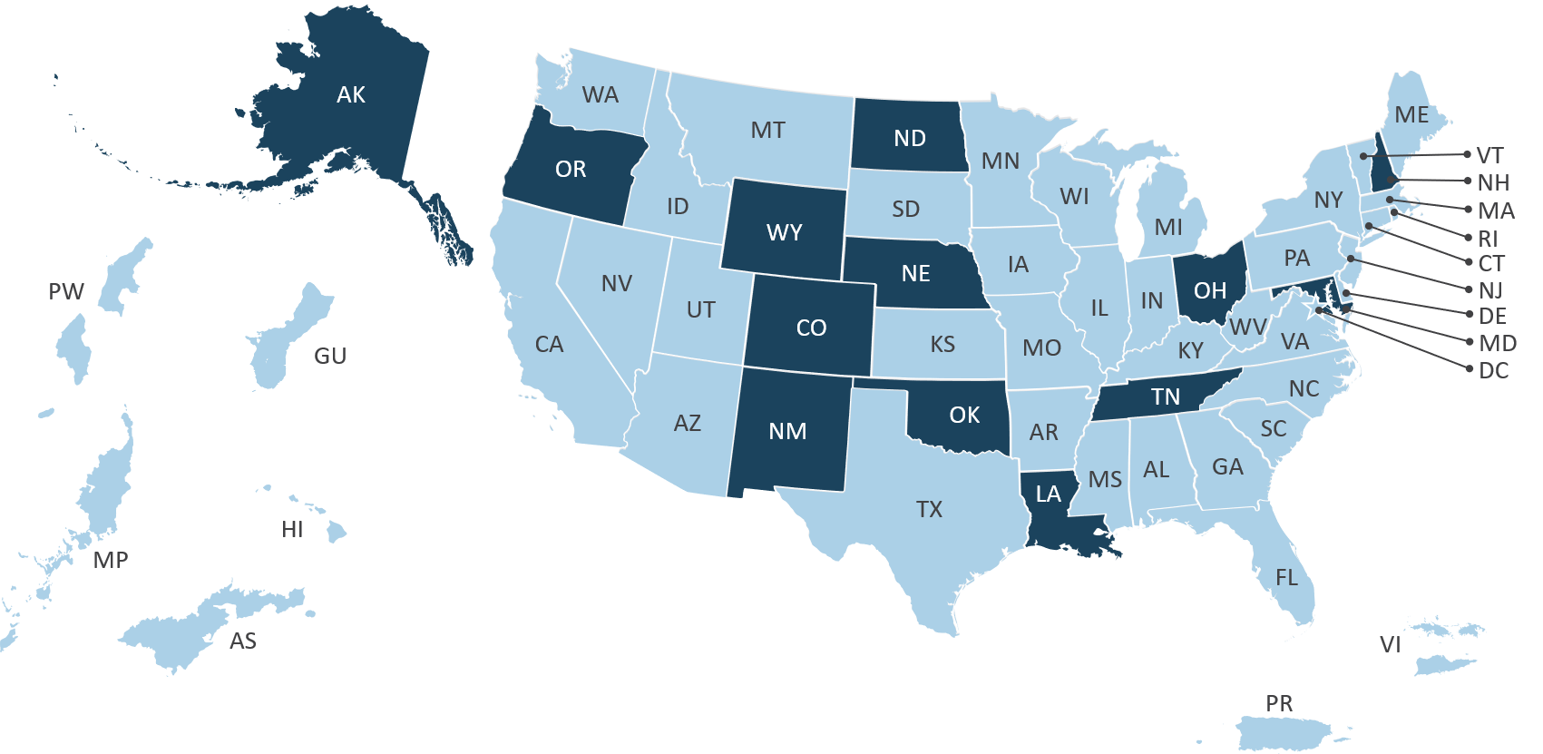
Welcome Bootcamp Participants!

Slide 5

Boot Camp Overview
Our Goal: Develop your skills as an Apprenticeship Business Consultant
4 Phases of the Boot Camp
  Orientation Call with Maher Team
  Today's training
  Two coaching calls
  Putting your skills to use
Questions? Contact Megan Scott: Mescott@air.org
Notes:
Goal: Develop your skills as an “apprenticeship consultant” by teaching you strategies to identify and reach out to businesses; prepare for your first conversation; use a consultative sales approach; and help businesses get started on developing an apprenticeship program.
What to Expect Today: Gerry Ghazi will teach you specific skills and strategies for identifying businesses, crafting a marketing and engagement strategy, and preparing for and holding successful kick-off and follow-up conversations with businesses.
What to Expect on Your Two Coaching Calls: Gerry will help you apply what you’ve learned to the specific industries and businesses you’re working with and coach you through specific challenges you’re facing.
Schedule: All coaching calls will be completed by July 17, 2020.
Questions? Contact Layli Oliver: loliver@Mahernet.com

Slide 6

Boot Camp Logistics
Sign up for your coaching calls: Follow the links provided in your welcome email.
Schedule: All coaching calls will be completed by December 10, 2021.
Questions? Contact Emily Bzdega ebzdega@air.org

Slide 7

Our Boot Camp Rules
Have fun! ☺
You get out what you put in.
Jump in with any questions at anytime.

Slide 8



Meet the Coaches
Amy Beller
  Business Engagement Coach
Chris Magyar
  Business Engagement Coach
Megan Scott
  Business Engagement Coach

Slide 9

Today’s Reality – Let’s Hear From You
How have current events impacted your apprenticeship business engagement work?
What challenges and/or opportunities do you want to tackle during the boot camp?

Slide 10

Apprenticeship as a Business Solution
The Mindsets
Apprenticeship is a workforce development tool.
Registered Apprenticeship is a formalized approach to what businesses already do, but ensures them better results.
Your apprenticeship pitch is only as good as the apprenticeship program you can deliver.

Slide 11
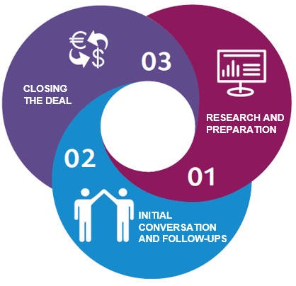
Three Phases of Business Engagement in RA

Slide 12
Phase 1: Research and Preparation
Recognize the business pain points Apprenticeship addresses.
Use research to identify businesses.
Prepare for your first conversation.

Slide 13

Recognize Challenges
Challenge
Indicator
Skill gaps in hiring
Development of existing talent
Attracting and retaining talent
Retiring workforce
Advancing technology
Job posting open for a long time
Businesses post openings for mid-level positions
Jobs are constantly posted and reposted
Industry reports indicate short-to-mid-range retirements
The business expresses interest in customized or technical training

Slide 14

Use Research to Identify Businesses
Identify important and growing industry sectors in your regional economy.
Look for businesses with openings that indicate the challenges we discussed.
Review job descriptions.
Keep track of what you learn.
learn

Slide 15
Understand What You’re Offering Businesses
Set forth the ROI involved with RA.
Consider new support that may be available through grants and economic recovery packages.
Compare traditional vs. RA hiring models.
Value built into
the RA program
Additional value your state/region may add
  Stepped up wages vs. full wages
  Increased retention
  Provides a repeatable, organized framework for recruitment, hiring, onboarding, and advancement
  Tax credits, workforce development grants, WIOA ITAs and OJTs
  State / federal subsidies
  Shared recruitment costs/ hiring incentives

Slide 16
Phase 2: Building Relationships
Validate Pain Points and Learn the Business’ Culture.
Introduce Apprenticeship in the Context of Existing Business Practices.
Build Trust.

Slide 17

Validate Pain Points and Learn the Business’ Culture
Start with a problem statement – not a solution.
Ask questions, seek to understand.
How have they solved their challenge? (recruitment, on-boarding, internal training, mentoring, etc.)

Slide 18










Relate Registered Apprenticeships to What Businesses Already Do
Businesses need and hire/promote staff
Business
Involvement
❶
❷
On-boarding of new staff to fill knowledge gaps
National
Occupational
Credential
Promote staff into new levels or positions
(confer new job titles)
Related
Instruction
❺
❸
Rewards
for Skill
Gains
Structured
On-the-Job
Training
Support new staff after hire – with mentoring
Conduct performance reviews and reward with merit-based increases
❹

Slide 19
Speak Their Language
Apprenticeship Speak
Business Speak
Outreach & Selection
Work Processes / Competencies
Related Technical Instruction
On the Job Learning (OJL)
Stepped-up Wages
Certificate of Completion
Recruitment & Interviewing
Job Descriptions / Position Responsibilities
Internal/External Training
Education or On-boarding
Mentoring / Supervision of Work Performance Reviews
Merit-Based Increases
Performance Increases
Position / Title Change

Slide 20
Understand what you’re offering businesses (2)
Set forth the ROI involved with RA.
Compare traditional vs. RA hiring models.
Value built into
the RA program
Additional value your state/region may add
  Stepped up wages vs. full wages
  Increased retention
  Provides a repeatable, organized framework for recruitment, hiring, onboarding, and advancement
  Tax credits, workforce development grants, WIOA ITAs and OJTs
  State / federal subsidies
  Shared recruitment costs/ hiring incentives

Slide 21
Follow Up
Building on A Successful First Conversation
Leave the first meeting understanding employer pain points.
Always set up for next conversation with take-aways and next meeting scheduled.
Understand that there will be multiple future calls with different audiences.
Create an incentive for meeting with you again.

Slide 22
Build Trust
Provide examples of how others’ businesses have used apprenticeship for the target occupation.
Offer opportunities to connect with peers using apprenticeship.
Create an apprenticeship solution proposal.
Provide a rough return-on-investment calculation.

Slide 23

Phase 3: Getting to Commitment
Address concerns.
Build organizational buy-in.
Bring the right partners to the table.

Slide 24

Closing the Deal
Get a commitment in writing to
participate in Registered Apprenticeship.
Work through Appendix A.
(Work Processes and Related
Technical Instruction Outline)
Show them value with each interaction.
Offer them registration alternatives using an intermediary.

Slide 25
Public Health Challenges and the Current Economy
Focus on occupations with greatest demand now and three months from now.
Work with intermediary sponsors to ensure fast returns and low business investment in program creation.
Use sector strategies to focus on a specific industry or cluster of occupations and employers
Engage existing sponsors in business-to-business conversation.
Focus on apprenticeship as a long-term strategy they can build now and use to recruit later.

Slide 26

Apprenticeship Business Engagement Tools
Resource Guide: A Targeted Approach to Apprenticeship Business Engagement
Talking to Businesses About Apprenticeship
Apprenticeship Business Engagement Strategies in Action
All are available at the: Apprenticeship Community of Practice

Slide 27
Questions & Discussion

Slide 28

Wrap Up and Next Steps
Anyone who has not done so, should schedule coaching calls and accept calendar appointments.
Think about specific businesses you want to work with, or businesses you’ve talked to in the past that didn’t work out. Come to your first call prepared to share this list.
Plan on some homework between calls.

Slide 29
Contact Us:
For additional questions, please contact:
Megan Scott
Mescott@air.org
Emily Bzdega
Ebzdega@air.org

