Slide 1

H-1B Apprenticeships:
Closing the Skills Gap Program Grants
Management and Technical Assistance
Employer Engagement Strategies Part Two
August 31, 2021 • 2:00 PM – 3:00 PM EDT
Notes:
Opening: Tori

Slide 2
While others sign on, let us know who is on the call.
Name
Grant Name/Organization
Location
Anyone listening today with you?
After hearing strategies during the Employer Engagement Session Part 1 on July 8 –
  What are strategies you have implemented or are planning to implement to support your Closing the Skills Gap grant project activities?
Notes:
Lisa/Erin/Tori-conduct through Chat

Slide 3
Welcome and Opening
Notes:
Tori

Slide 4
Agenda CSG Strategies for Employer Engagement Part Two
Welcome and Opening...........……………..................[2:00 – 2:05] ​
Introduction of Speakers…………………………….…… [2:05 – 2:08]​
Strategies for Business Engagement..……………….[2:08 – 2:40] ​
Q&A…………………………………………………………………[2:40 – 2:55]
Closing…………………………………………………………….[2:55 – 3:00]
Notes:
Tori

Slide 5






Today's Speakers
Lisa Rice, Safal Partners
CSG Project Manager,
Lead TA Coach
Erin Duckett, CSG TA Coach
Safal Partners/Maher & Maher
Notes:
Tori
Lisa Rice is a Project Manager with Safal Partners. Lisa is the Project Manager and Lead TA Coach for this project with DSI. She also supports other apprenticeship work at Safal including the Registered Apprenticeship in Cybersecurity Expansion contract and the RA Technical Assistance Center of Excellence grant. Lisa has over 20 years of experience in workforce development including as the former CEO of CareerSource Brevard in Melbourne, FL.
Erin Duckett is a Senior Analyst with Maher & Maher and is a CSG Coach and subject matter expert. At Maher, her work focuses on apprenticeship initiatives, including supporting state and U.S. territory grantees with TA efforts for apprenticeship expansion. Erin works on several other projects helping states and regions implement, showcase, and highlight workforce development initiatives and sector strategies.

Slide 6
Review:
Strategies for Business Engagement Part 1
Notes:
Lisa

Slide 7

Why Apply a Process to Business Engagement?
Establish Trust
Add Value
Differentiate Yourself
Become a SME
Notes:
Lisa – short review from session 1

Slide 8
Business Engagement Process
Business Engagement Process Steps
Identify Opportunities and Plan
Discover & Present Capabilities
Deliver Value & Results
Maintain & Grow the Relationship
Notes:
Lisa - short review from session 1
The foundation for all of this is consultative sales…
Put into the chat – Do you feel you are in a sales role? Why or why not?
These 4 steps are all part of the business engagement process. We will be going through the first two in more depth. And all of this is based on consultative sales. So let’s just visit that piece first…

Slide 9

What is a Consultative Sales Approach?
Focused on the customer
Solution-based selling
Notes:
Lisa- short review from session 1
Click - The consultative sales process is focused on the experience that the business customer feels and sees during their interactions with you. It’s about the how you find ways to provide them with value and make it all about them. Not your product, your business, or your numbers.
Click - Sometimes this is also referred to as solution-based selling.
Solution selling is a sales methodology. Rather than just promoting an existing product, the salesperson focuses on the customer's pain point(s) and addresses the issue(s) with his or her offerings (product and services)
Great, now that we have our first piece about consultative sales, let’s see how both it and the business engagement process start out.

Slide 10
Business Engagement in Apprenticeship
Notes:
Erin facilitate

Slide 11
Outreach and Business Engagement
As an employer-driven model, successful and sustained apprenticeship expansion demands effective business engagement strategies.
Helpful strategies employed by states are:
  increasing awareness-building activities
  putting in place policies and practices increase business demand for apprenticeship.

Slide 12

Mindsets of Apprenticeship Business Engagement
Apprenticeship is a workforce development tool.
Registered Apprenticeship is a formalized approach that enhances existing business practices.
Your apprenticeship pitch is only as good as the apprenticeship program that is created.

Slide 13
Look for Businesses with Challenges Well-Suited to an Apprenticeship Solution
Challenge
Indicator
Skill gaps in hiring
Development of existing talent
Ability to recruit and retain talent
Aging and retiring workforce
Advancing technology
Job postings open for a long time
Business post openings for mid-level positions
Job openings posted and reposted constantly
Industry reports indicate short-to-mid-range retirements
Business expresses interest in customized or technical training

Slide 14
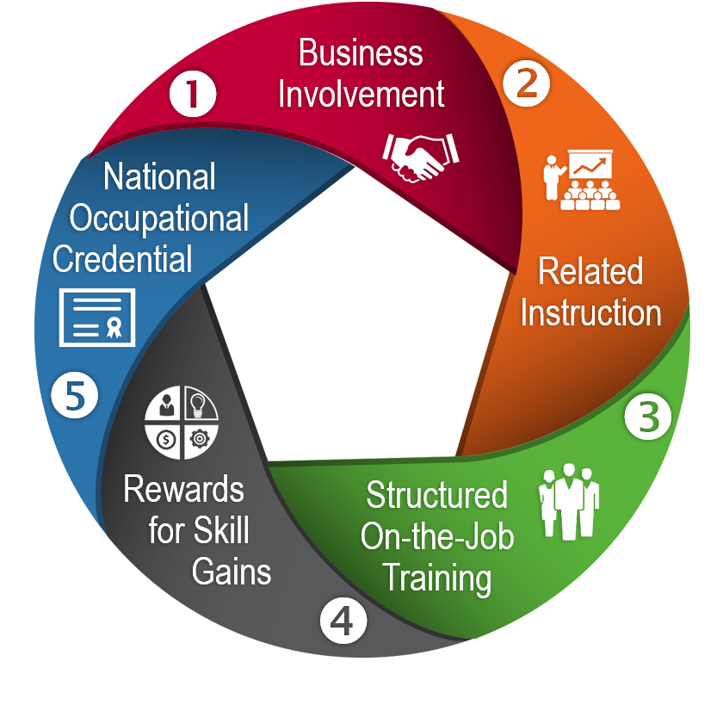
Relate Registered Apprenticeships to What Businesses Already Do
Businesses need and hire/promote staff
On-boarding of new staff to fill knowledge gaps
Promote staff into new levels or positions
(confer new job titles)
Support new staff after hire – with mentoring
Conduct performance reviews and reward with merit-based increases

Slide 15
Build Trust
Provide examples of how other businesses have used registered apprenticeships for the target occupation.
Offer opportunities to connect with peer businesses using apprenticeship.
Create an apprenticeship solution proposal.
Provide a rough return-on-investment (ROI) calculation.

Slide 16

Enable Commitment
Address Concerns
Build Organizational Buy-in
Bring the Right Partners to the Table

Slide 17
Sharing and Discussion
What strategies have been particularly effective in engaging business on apprenticeship?
What has been challenging in selling the apprenticeship model? What challenges have you faced about registered apprenticeship?
What kind of language do you use when speaking with businesses?
What strategies have worked for you?

Slide 18

Speak Their Language
Apprenticeship Speak
Business Speak
Outreach & Selection
Work Processes / Competencies
Related Technical Instruction
On the Job Learning (OJL)
Stepped-up Wages/Wage Increases
Certificate of Completion
Recruitment & Interviewing
Job Descriptions / Position Responsibilities
Internal/External Training
Education or On-boarding
Mentoring/Supervision of Work
Performance Reviews
Merit-Based Increases
Performance Increases
Position / Title Change

Slide 19
Role Play – Selling Apprenticeships
Apprenticeship Speak
Business Speak
Outreach & Selection
Work Processes / Competencies
Related Technical Instruction
On the Job Learning (OJL)
Stepped-up Wages/Wage Increases
Certificate of Completion
Recruitment & Interviewing
Job Descriptions / Position Responsibilities
Internal/External Training
Education or On-boarding
Mentoring/Supervision of Work
Performance Reviews
Merit-Based Increases
Performance Increases
Position / Title Change
Notes:
For this role-playing activity. We will call on 4 people in the audience. Two to play the role of an employer, two to play the role of an educator/business services staff trying to convince the employer to participate in an apprenticeship.
30 second pitch and 30 second response. What language do you use? What language do you avoid? How do you approach the employer?
Ask each group to go, Lisa and Erin comment after each one.
After – Erin will stress again how the 5 elements of apprenticeship relate to practices that employers already do. Slide 14.

Slide 20
Discussion:
Questions from Part 1
Notes:
Erin facilitate

Slide 21
Outstanding Questions
How do you approach businesses that want to pay lower wages?
How do you help businesses not feel like control is being taken away from them?
How do you help businesses understand braided funding?
How do you secure commitment from businesses after the initial meeting?

Slide 22

Q&A
Please unmute or type your questions in the chat!
Notes:
Tori facilitate – 10 minutes

Slide 23

Poll
What new tools and/or insights did you gain today about business engagement?
  Open text in chat
Notes:
Erin - Polls in Teams
Tori will run poll and Erin will ask question, review answers.

Slide 24
Poll
Poll
What other topics do you want addressed in future workshops?
  Grant management best practices
  Industry specific webinars
  Registered apprenticeship process
  Participant engagement
  Other (type in chat)
Notes:
Erin - Polls in Teams
Tori will run poll and Erin will ask question, review answers.

Slide 25





Resources
Discover Apprenticeships
www.Apprenticeship.gov
Apprenticeship Business Engagement Tools https://apprenticeship.workforcegps.org/resources/2018/05/11/17/01/Apprenticeship-Business-Engagement-Tools
National Governors Association Policy Examples https://www.nga.org/futureworkforce/policies/employer-engagement/
Apprenticeships: Closing the Skills Gap Community of Practice
Coming Soon!
Business Engagement Collaborative
https://businessengagement.workforcegps.org/
Notes:
Erin enter resources and go through them with the group.

Slide 26

Key Dates to Get on Your Calendar
Industry Forum September 16, 2021
Participant Engagement September 28, 2021
Peer Affinity Group Calls ongoing
CSG Newsletter September 2021
Notes:
Tori

Slide 27
Remember to…
Set up time with your coach
Share your successes and challenges with your coach
Ask for any TA you need
Register for a WorkforceGPS account
  https://www.workforcegps.org/
  Select the My Workforce GPS tab and the Join Workforce GPS dropdown link.
Notes:
Tori

Slide 28
Contact us anytime by reach out to your TA coach or send an email to
ClosingSkillsGap@dol.gov
Notes:
Tori

