Slide 1

H-1B Apprenticeships:
Closing the Skills Gap Program Grants
Management and Technical Assistance
Meeting the Challenges of Postsecondary Partnerships
November 18, 2021 • 1:00 PM – 2:30 PM EDT
Notes:
Opening: Tori

Slide 2
While others sign on, let us know who is on the call.
Name
Grant Name/Organization
Location
Anyone listening today with you?
What are strategies you have implemented or are planning to implement to support your Closing the Skills Gap grant project activities?

Slide 3
Agenda CSG Meeting the Challenges of Postsecondary Partnerships
Welcome and Opening...........……………..................[1:00 – 1:05] ​
Introduction of Speakers………………………………..[1:05 – 1:10]​
Strategies for Partnership Engagement..……….…….[1:10 – 1:50] ​
Q&A……………………………………………………….[1:50 – 2:15]
Closing…………………………………………………….[2:15 – 2:30]

Slide 4

Opening Remarks

Slide 5
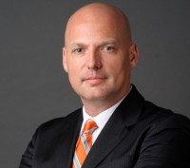
Panel Moderator
Christian Lagarde, PhD
Coach/SME
Safal Partners

Slide 6
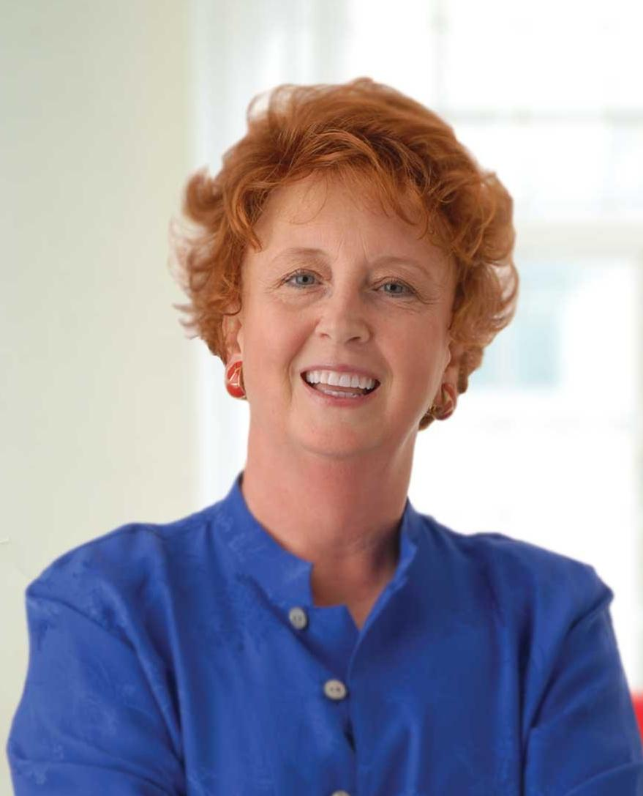
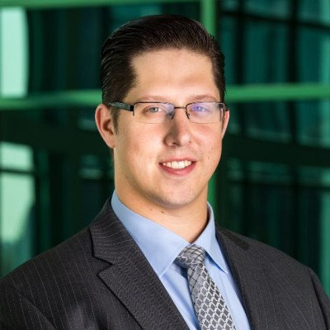
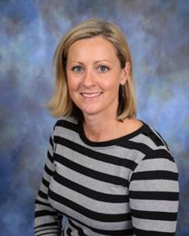
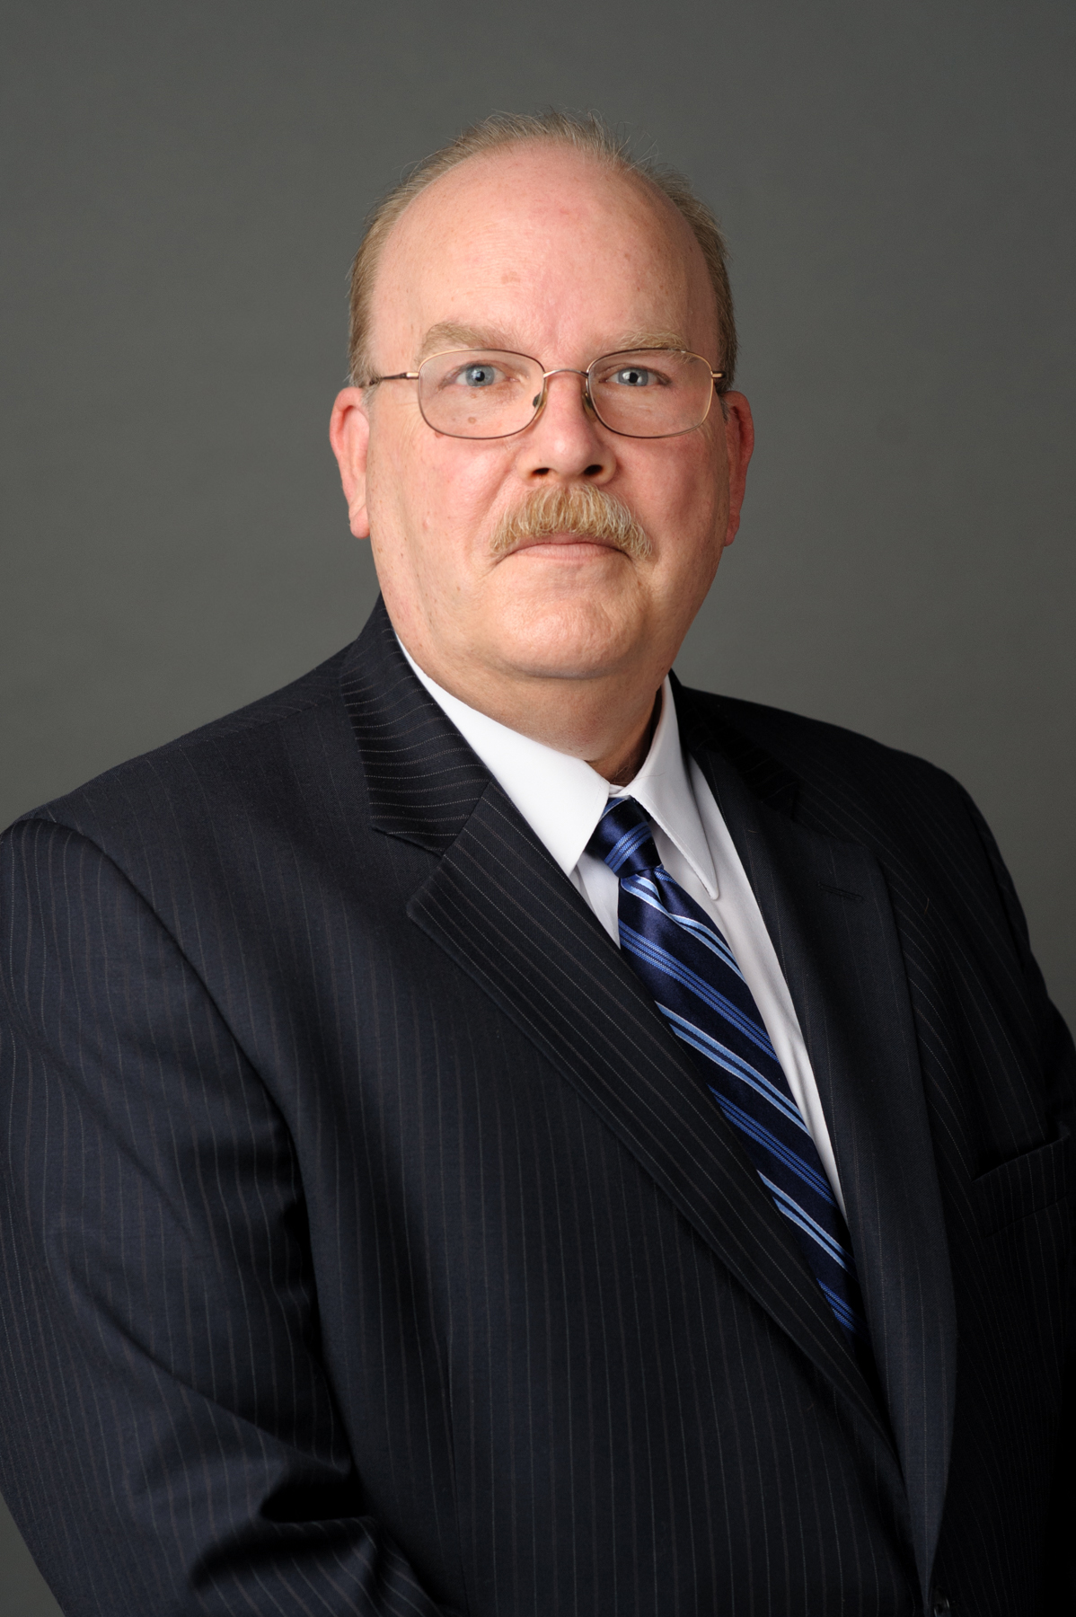
Presentation Speakers
Rebecca Lake, EdD
Apprenticeship Consultant,
Rebecca Lake Consulting
Callan Eschenburg,
Apprentice Expansion Specialist,
Michigan Department of Labor and Economic Opportunity
Megan Graves,
Project Director,
IIoTAE-Ivy Tech Community College
John Dyer,
Associate Vice President, Workforce Development, Workforce and Economic Development, American Association of Community Colleges

Slide 7
Strategies for Partnership Engagement

Slide 8

Faculty and Administration Buy-In
How is faculty and administrative “buy-in” to apprenticeships best achieved?

Slide 9

Academic Standards
What are faculty members’ chief concerns about apprenticeship—such as dilution of academic standards or rigor, or threats to accreditation—and how can they be addressed?

Slide 10

Curriculum
What are the most effective models of developing and delivering curriculum for apprenticeships that align with employers’ and apprentices’ needs?

Slide 11
Institutional Change
Policies and Culture
Champions
What needs to change in institutional policies and culture to facilitate successful apprenticeship programs?
How have apprenticeship “champions” in IHEs promoted change successfully?

Slide 12
Challenges and Successes
Partnerships
Employer Concerns
What are the elements of a successful industry/IHE partnership?
What are employer partners’ chief concerns with postsecondary partners, and how are they best addressed?

Slide 13
Ivy Tech Community College
“Case Study”

Slide 14

Q&A
Please unmute or type your questions in the chat!

Slide 15

Tools and Insights?
What new tools and/or insights did you gain today about post-secondary partnerships?

Slide 16

Future Topics?
What other topics do you want addressed in future workshops?
  Grant management best practices
  Industry specific webinars
  Registered apprenticeship process
  Participant engagement
  Other (type in chat)

Slide 17

Key Date to Get on Your Calendar
November 30th 1-2pm EDT NAW Lessons Learned

Slide 18
Remember to…
Set up time with your coach
Share your successes and challenges with your coach
Ask for any TA you need
Register for a WorkforceGPS account
  https://www.workforcegps.org/
  Select the My Workforce GPS tab and the Join Workforce GPS dropdown link.

Slide 19
Contact us anytime by reach out to your TA coach or send an email to
ClosingSkillsGap@dol.gov

