Slide 1
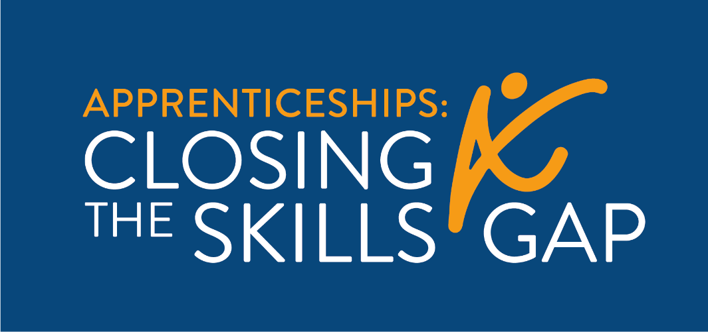
H-1B Apprenticeships:
Closing the Skills Gap
Program Grants Management and Technical Assistance
Manufacturing Industry Forum
Sept 23, 2021 • 1:00 PM – 2:00 PM EDT
Notes:
Matt

Slide 2
While others sign on, let us know who is on the call...
Name
Grant Name/Organization
Location
What types of manufacturers do you work with?
Notes:
Matt

Slide 3
Welcome!
Notes:
Matt, intro Ayreen

Slide 4
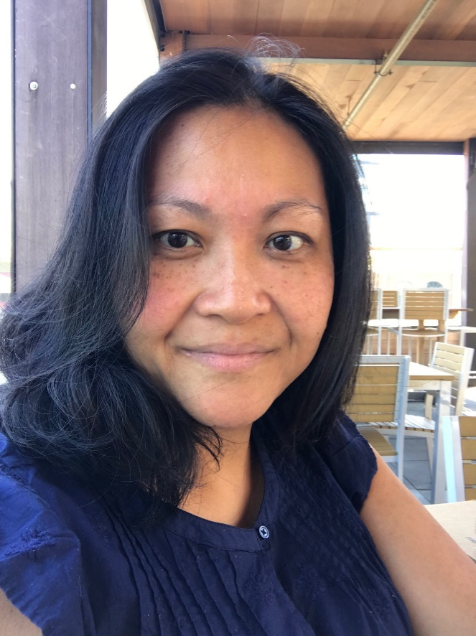
Today’s Host
Ayreen Cadwallader
USDOL, Employment & Training Administration
Division of Strategic Investments
Notes:
Ayreen
Ayreen’s welcome….

Slide 5
Agenda: Manufacturing Industry Forum
Welcome and Introductions..…………….............................[1:00 – 1:05] ​
Manufacturing Industry Panel…………………………….……….. [1:05 – 1:40]​
Grantee Debrief and Discussion…………………………………… [1:40 – 1:55]
Closing………………………………………………………………………….[1:55 – 2:00]
Notes:
Tori

Slide 6
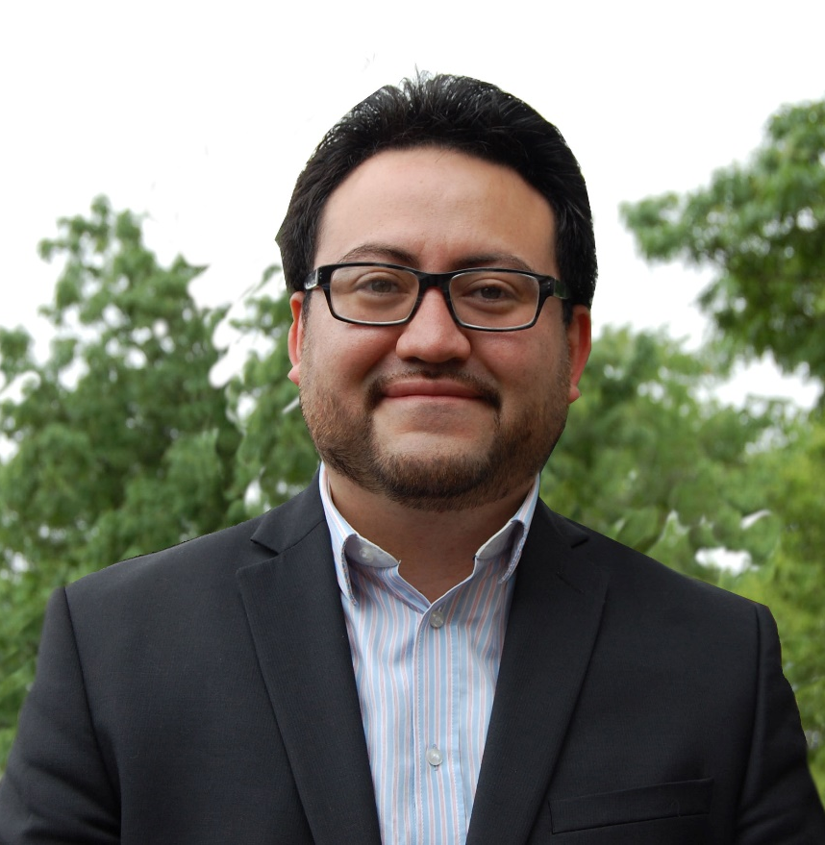
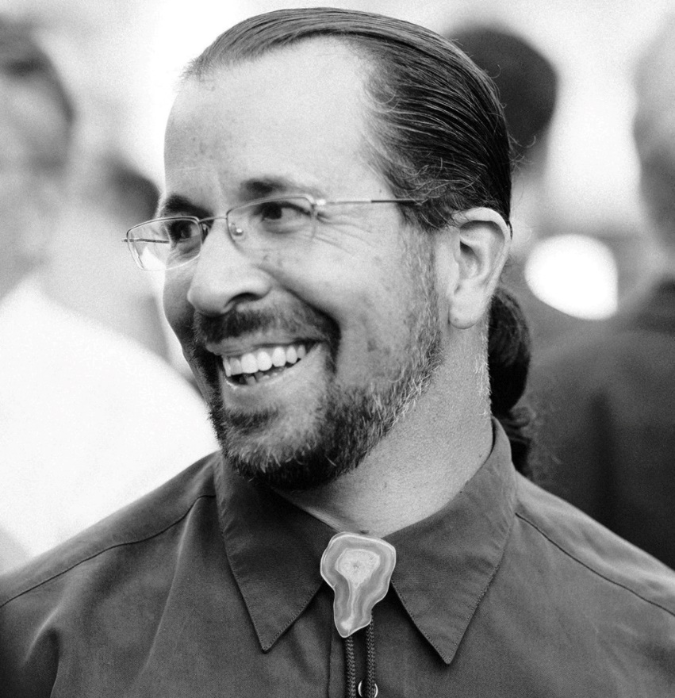
Today’s Panelists
Bryan Sanchinell
Senior Director of Workforce Products National Institute for Innovation and Technology
Robert Weinman
Director of Workforce Innovation
National Institute for Innovation and Technology
Notes:
Matt
Bryan is an accomplished workforce development professional with focused experience in learning development, organizational and change management. A 10+ year proven track record of launching, implementing, and evaluating programs to up-skill underrepresented communities and underemployed workers within an industry association, community-based organizations, and Higher Ed. Sectoral experience in Advanced Manufacturing, Design Tech, Transportation, Culinary Arts, and Office Services.
Robert is an innovator in Professional and Workforce Development programs and strategies with over twenty years of experience between industry and education to develop skilled, values-driven individuals in the workplace. His experience includes developing and supporting complete workforce strategies such as Project Management, Instructional Design & Delivery Collaboration & Partnerships and Skills Gap Assessment & Analysis.

Slide 7
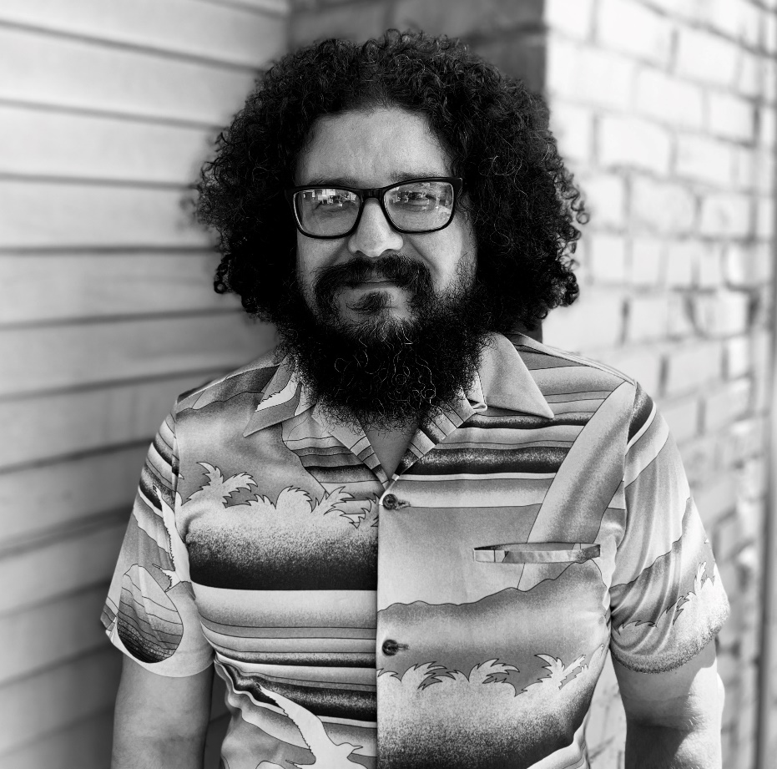
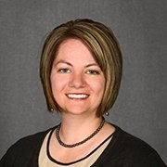
Today’s Panelists
George Colón
Director of Workforce and Youth Programs
SF Made
Megan Chase
Capital Delivery Leader
Owens Corning
Notes:
Matt
George Colón is a Workforce professional based in Oakland, CA. George has 12 years of business advising experience, with the last 5 years focused on advising around diversity, equity, inclusion, and how to support the success of a more diverse workforce. In addition to advising businesses, George has also spent the last 4 years working directly with the reentry population, other overlooked/underserved populations, and the nonprofit workforce organizations that support them. George’s work has allowed him to build lasting and valuable connections between these entities and individuals, helping to secure jobs, training, and talent pipelines. As such, George has an informed perspective of both sides, and works to develop well rounded, progressive outcomes. George’s position at SFMade continues his trajectory, in both experience and passion.
Megan Chase currently leads the Advanced Manufacturing Capital Delivery Project Services team at Owens Corning, providing the Composites business with Project Management, Safety & Construction Management, and Mechanical Utilities resources and problem solving on large capital projects. In addition to her day job Megan dabbles in Insulation Capital Delivery support, training folks on Project Management tools & best practices, and co-leading the Women in Operations employee resource group to help unleash the talent of some of our unsung heroes in Operations. Prior to joining OC in 2018, Megan held Engineering and HR leadership roles at Whirlpool Corporation. Megan has a BSE in Mechanical Engineering from the University of Michigan and an MBA from Michigan State University.

Slide 8
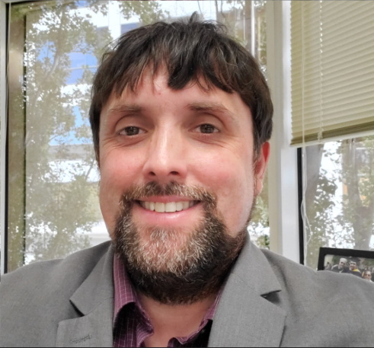
Panel Moderator
Matthew A. Poland
Project Coordinator, CSG Technical Assistance
Safal Partners
Notes:
Matt

Slide 9
Panel
Discussion
Notes:
Matt - we’ll take down the slides here and focus on cameras of panel
Questions for the panel:
Please share your name, title, company/organization and what subsector of manufacturing you represent (e.g. computer and electronics, metal fabrication, food processing, etc.)
What is something interesting about your area of manufacturing that most people probably don’t know?
Can you share your top two challenges right now? What is it that makes these issues difficult to address?
Manufacturers: Have you automated any parts of your operation or do you plan to? What were the results or what do you anticipate will happen?
Industry experts: how has automation impacted the industry in the last year? What do you think we’ll see going forward in this space?
Manufacturers: What are your current recruitment and talent development strategies?
Industry experts: have the manufacturers you work with brought forward needs or best practices related to talent development?
Q+A from audience
Q+A from panelists to apprenticeship experts in the audience (CSG grantees)

Slide 10
Grantee Debrief and
Discussion
Notes:
Matt – bring the slides back up

Slide 11
Discussion Questions:
What is something new that you learned about manufacturers today?
Is there something that surprised you or is different that what you thought before listening to the panel?
How have you found manufacturers to be unique among other types of employers?
What are some challenges in working with them or understanding their needs?
Do you have any ideas or tips to share with fellow grantees in better understanding the industry and working with them on apprenticeships?
How would you like to share news, information and ideas among one another related to the manufacturing industry?
Notes:
Matt

Slide 12
Contact us anytime by reaching out to your TA coach or sending an email to
ClosingSkillsGap@dol.gov
Notes:
Matt

Slide 13
Thank you!
Notes:
Matt

