Slide 1
2026 Peer-to-Peer Virtual Intensive: Day 2

Slide 2

Today’s Moderator
Zodie Makonnen
Grant Program Lead, Workforce Analyst
Division of Strategic Investments,
US Department of Labor - Employment and Training Administration

Slide 3
Purpose, Agreements, & Introductions
Purpose: Set your project up for success through focused time with your team, peers, and federal partners.
Community Agreements
When you’re speaking, please turn on your camera
Add all questions to the Q & A section.
Respect your colleagues’ views –especially when you don’t agree
Participate!

Slide 4
Day Two: Part 2 Agenda
3 – 3:20 PM
Essential Steps for a Smooth Federal Grant Closeout
  Mark McEnery and Avery Malone, DOL - Office of Grants Management
3:20 - 3:50 PM
Hospitality Grantee Spotlights:
  Employ Milwaukee, Inc
  Hospitality Industry Training and Education Fund
  Seattle-King County Workforce Development Council
3:50 – 4:15 PM
Grant Management TA: Grants Management Wrap Up
  Presenter: Ingrid Schonfield, DOL- ETA
4:15 - 4:30 PM Closing
Notes:
Zodie

Slide 5
Essential Steps for a Smooth Federal Grant Closeout

Slide 6
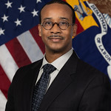
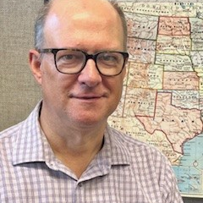
Presenters(2)
Avery Malone
Mark McEnery
Supervisory, Grant Management Specialist
Grants Management Specialist
US Department of Labor - Employment and Training Administration
US Department of Labor - Employment and Training Administration

Slide 7
Closeout Process Basics
Closeout Phase – End of the Grant Lifecycle
Initial Closeout Notification
Closeout Documentation Submission (120-days)
Closeout Review and Analysis
Final Payment or funding returns
Processing of award closure
Final Closeout Notification

Slide 8
Closeout Solutions
Unresponsive grant recipient – Be Responsive!
Request for late payment draws – PMS Account Open 90-days
Administrative rate misunderstanding - Understand Requirements
SF424A budget forms – Most Recently Approved
Indirect Cost – Negotiated Indirect Cost Rate Agreement (NICRA)
Excessive cost category budget overruns – 10% Flexibility
Staff turnover – Ensure Closeout Systems Access

Slide 9
Contact Us
Mark McEnery – Grant Officer
mcenery.mark.j@dol.gov
Avery Malone – Grant Officer
Malone.avery@dol.gov

Slide 10
Hospitality Grantee Spotlight Presentations)
Employ Milwaukee, Inc
Hospitality Industry Training and Education Fund
Seattle-King County Workforce Development Council

Slide 11
Employ Milwaukee (MKE)

Slide 12

ServeMKE: Quality Jobs for Hospitality Workers
Critical
Sectors
Round 1: Tier 2
Hospitality
Location: Milwaukee County
Top 3 project goals & progress to date
  Elevate the standards of job quality within Milwaukee’s hospitality sector.​
  Support 400 participants throughout the project’s duration.​
  Provide participants with valuable industry recognized training and credentials, such as Technical Diplomas for Culinary Assistant and Special Event Management, Associate Degrees in Hospitality Management and Culinary Arts, and entry level positions in food service and hospitality.​
Programmatic
Performance
Job
Grant Management
Quality

Slide 13
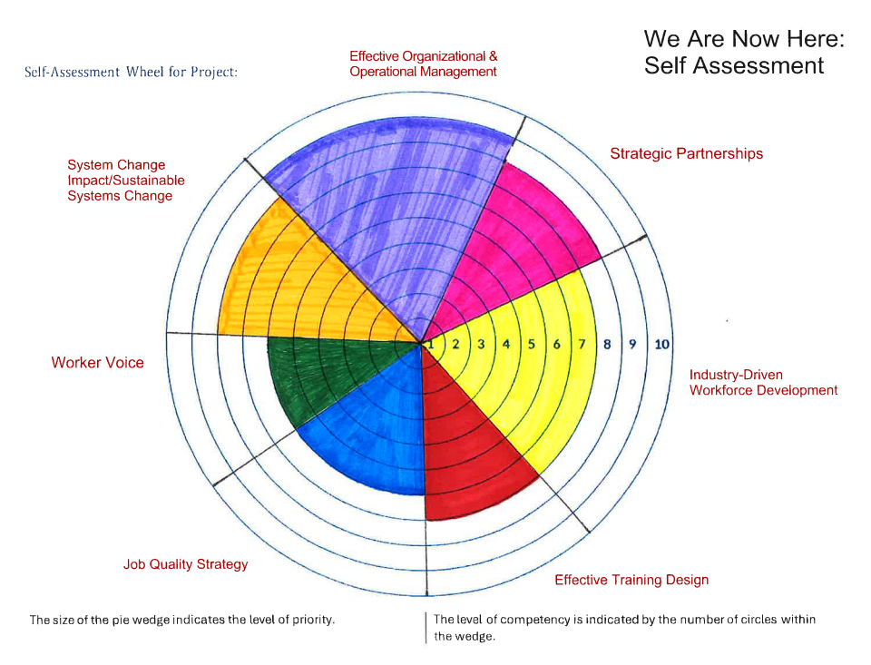
Employ MKE: Success Indicators 2024
Self-Assessment Results
Organizational/
Operational Management
Strategic Partnerships
Systems Change Impact
Sustainable Systems Change
Worker Voice
Industry-Driven Workforce Development
Job Quality Strategy
Effective Training Design

Slide 14
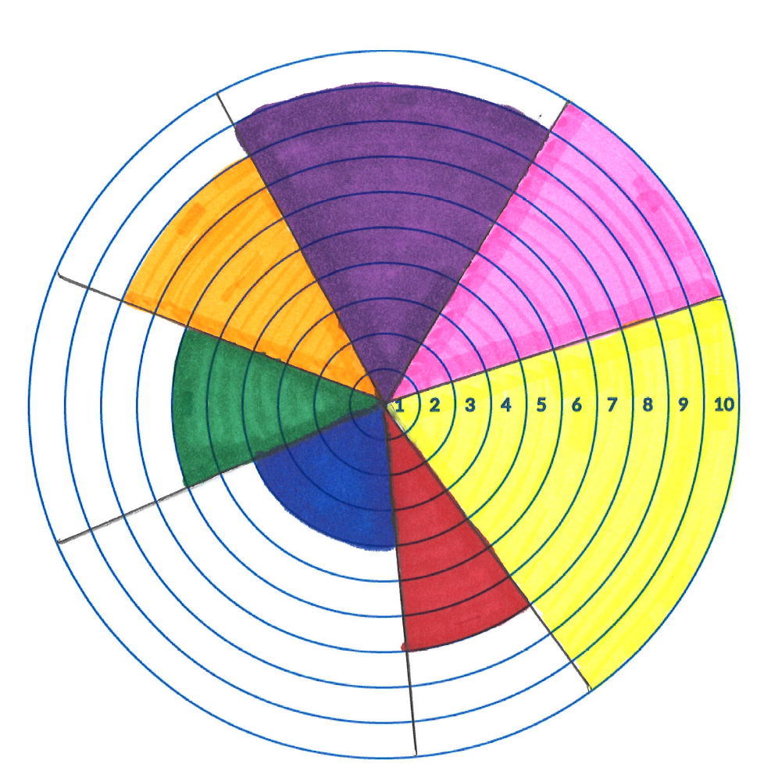
Employ MKE: Success Indicators Feb 2026 Self-Assessment Results
Effective Organizational
& Operational Management
System Change
Impact/Sustainable
Strategic Partnerships
Worker Voice
Industry-Driven
Workforce Development
Job Quality Strategy
Effective Training Design

Slide 15
Employ MKE: Experts in/Seeking Expertise In
We’re experts in…
Connecting with employers and creating PWE opportunities.
Expanding and creating training options for employer partners.
Serving unique demographics in obtaining various trainings and employment.
We’re seeking expertise in…
Tips in screening out those who are serious about obtaining employment after training as opposed to those who obtain the title/certificate and do not anticipate moving forward with finding employment.

Slide 16
Employ MKE: What’s Next?
Critical
Sectors
Programmatic
Hosting career/job-readiness workshops
Increasing employment metrics
Performance
WIOA
Grant Management
CARE

Slide 17
Thank You!(3)
Anneliese Robinson, Program Specialist
Employ Milwaukee

Slide 18
Hospitality Training Academy

Slide 19
Hospitality Culinary Registered Apprenticeship Replication Project
Round 1: Tier 2 Implementation Grant
Hospitality Industry
  Phoenix, Chicago, Baltimore, Philadelphia and New York
Focused on addressing challenges of
  Transforming low-wage Line Cook jobs into good union jobs with family sustaining wages and benefits
  Increasing access to good union jobs for historically marginalized and under-represented populations
Top 3 project goals
  Improve job quality for Cooks by expanding Chicago’s program, and replicating HTA’s program in Phoenix, Baltimore, Philadelphia and New York
  Train 273 participants in the skills needed to be hired by employers that have entered into Collective Bargaining Agreements (CBA) with local labor unions
  Place participants in good family sustaining jobs protected by CBAs.

Slide 20
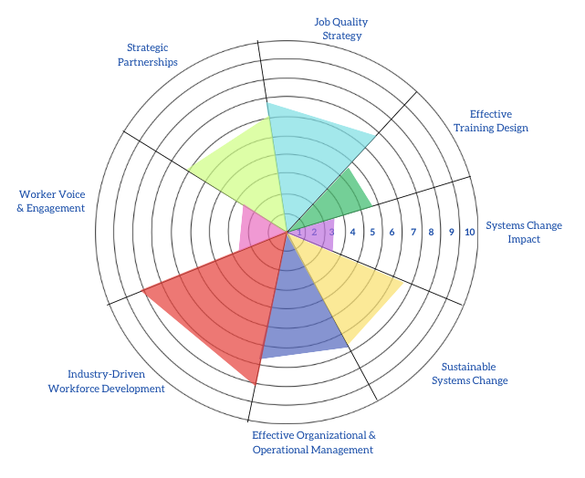
Hospitality Training Academy: Success Indicators 2024 Self-Assessment Results

Slide 21
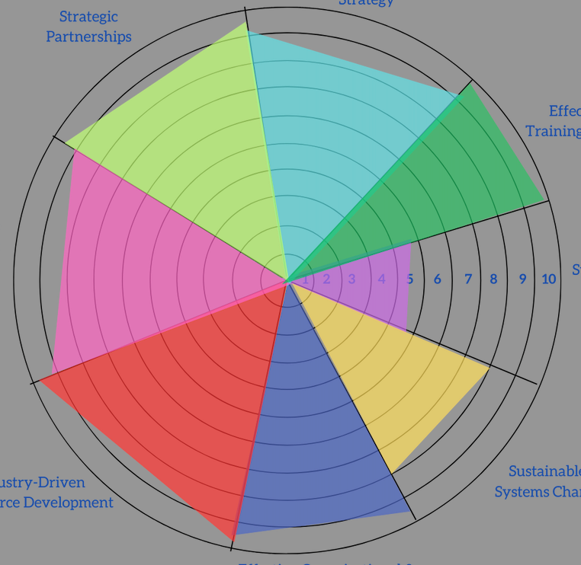
Hospitality Training Academy: Success Indicators Feb 2026
Self-Assessment Results
Job Quality Strategy
Strategic Partnerships
Effective Training Design
Worker Voice & Engagement
Systems Change Impact
Sustainable Systems Change
Industry-Driven Workforce Development
Organizational/
Operational Management

Slide 22
Hospitality Training Academy: Experts in/Seeking Expertise In
We’re experts in…
Industry Subject Matter Experts
Strong Labor–Management Relationships
Established Connections with Workforce Development Agencies and National Partnerships
We’re seeking expertise in…
Systematic and Policy Change: While some states recognize U.S. DOL Approved RAP standards and allow reciprocity without additional approvals, other states require programs to undergo a full, duplicative approval process, creating unnecessary barriers to expansion and replication.

Slide 23
Hospitality Training Academy: What’s Next?
Critical
Sectors
Scaling the apprenticeship model through National DOL Registered Apprenticeship Programs (RAPs), beginning with expansion into states such as Florida (Miami) and Washington DC.
Creating a Registered Pre-Apprenticeship on-ramp (Prep Cook) to the RA Line Cook program.
Expanding additional Registered Apprenticeship Programs (RAPs) across multiple states.
Programmatic
Performance
WIOA
Grant Management
CARE

Slide 24
Thank You!(4)
Adrineh Terantonians,
Deputy Director of Programs
​Hospitality Training Academy​

Slide 25
Workforce Development Council of Seattle-King County

Slide 26
Workforce Development Council (WDC) of Seattle-King County: Project Overview
Round 2: Tier 2
Industry Focus: Hospitality
Geographic focus area: Seattle-King County
Top 3 project goals & Progress to date:
  Train and place workers (Community Pathways to Grocery Careers)
    Goal: 180 trained, 135 graduated, 40 placed
    Progress: 50 trained, 45 graduated, 10 placed in jobs (7 in industry)
  Engage employers in workplace wellbeing assessment and training program, job fairs, and through CPGC
    Goal: 100 employers engaged across all activities
    Progress: 50 employers (some in multiple ways)
  Conduct career fairs to engage employers and support career pathway development
    Goal: 4-5 over course of the grant
    Progress: 2 hosted (1 in July 2025, 1 on Feb 25, 2026), plus project team has sent employers to partner events

Slide 27
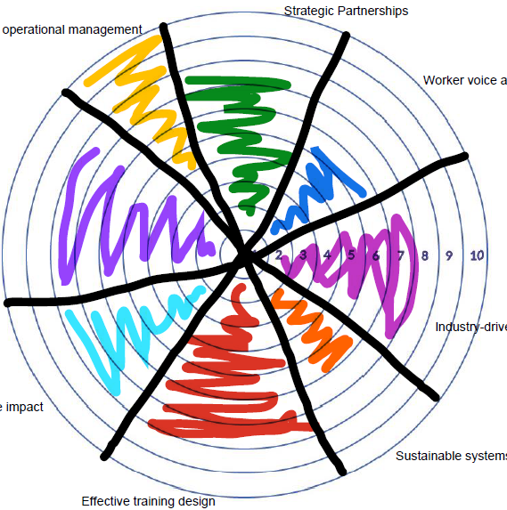
WDC Sea-King: Success Indicators
Feb 2026 Self-Assessment Results
Effective Organizational
& Operational Management
Strategic Partnerships
Worker Voice
Job Quality Strategy
Industry-Driven
Workforce Development
System Change
Impact
Sustainable Systems Change
Effective Training Design

Slide 28
WDC Seak-King: Experts in/Seeking Expertise In
We’re experts in…
Engaging employers with whom we have existing relationships
Facilitating cohort-style workshops with businesses about job quality
Training workers through the CPGC program
We’re seeking expertise in…
Ways to increase worker response to the workplace wellbeing assessments
Tips for increasing engagement with and commitments from employers with whom we do not have a relationship
Industry job quality expertise specifically to improve training offerings

Slide 29
WDC Sea-King: What’s Next?
Workplace wellbeing-assessment & training program:
  Completed mid-grant check to adjust in response to employer feedback—key takeaways include:
    Emphasize cohort-style trainings (rather than the employee survey) as core value proposition
    Explore supplementary trainings on specific business interest (i.e. management training, benefits, benefits navigation, etc.)
    Plan for sustainability beyond grant period
CPGC: Continue delivering cohorts and placing workers, explore options to deliver programming for veterans
Career fairs:
  Host 2/25/26 hospitality-focused job fair
  Schedule Fall 2026 job fair

Slide 30
Thank You! (5)
Tessa McClellan,
Director of Industry Strategies
Workforce Development Council of Seattle-King County

Slide 31
Grant Management TA: Finishing Strong - Grant Wrap Up

Slide 32
Grant Wrap-up vs. Grant Closeout
Wrap-up is the final phase of activities during a grant’s performance period.
Closeout is the period after the end of the grant performance period.

Slide 33
Grant Wrap-Up Areas for Consideration
Final quarterly financial and performance reports
Participant services (for Tier 2)
Partnerships
Sustainability
Staffing needs
Leaving a legacy

Slide 34
Final Financial and Performance Reports
Financial reports
Include all subawards
Use US DOL’s online reporting system
Performance reports
Ensure participant data are current
Follow US DOL guidance re final data submission
  report only grant-funded activities
  outcomes that occur after the grant’s end date must not be included in the final data file.
Use guidance for final narrative report (QNR):
  Summarize your grant’s progress and achievements over the entire grant period
Review DOL’s guidance on record retention:
  Federal guidelines require grantees to maintain all records pertaining to grant activities for at least three years from the date of submission of the final expenditure report.

Slide 35
Participant Services
Determine how many individuals can still be trained based on available funds and the length and cost of training.
Develop and implement a transition plan for serving currently enrolled participants after your Critical Sectors grant ends.
Ask participants to share stories of their grant-inspired accomplishments and include these stories in your Critical Sectors final quarterly narrative report - and integrate them into your project’s success stories!

Slide 36
Partnerships
Decide when and how to share your plan and timelines for the end of the Critical Sectors program with partner agencies, including the end of new participant enrollment and outcome data collection.
Determine who will be informed at partner agencies.
With your partners evaluate grant successes, failures, challenges, promising practices, and lessons learned.
Gauge the level of each partner’s commitment to sustaining some or all elements of the grant’s activities post closeout.

Slide 37
Sustainability
For each activity or service that will continue after the end of your Critical Sectors grant, identify timelines, responsible staff and partners, and resource requirements.
Review alternatives, if appropriate, to terminating services or activities.
Develop a plan to effectively phase-out services and activities that will end on the last day of the grant.

Slide 38
Staffing Needs
Make sure that your Critical Sectors team is aware that the grant is ending and share plans for sustaining or ending grant activities and services. Transparency is key!
Identify which staff are needed to close out your grant. Cross-train Critical Sectors team members and develop plans for transitioning them to other programs.
Celebrate your Critical Sectors team’s accomplishments! Build staff enthusiasm for wrapping up grant activities and moving on to new initiatives.

Slide 39
Leaving a Legacy
Thank partners, community members and leaders for supporting Critical Sectors, and make sure they know whom to contact if they have questions about the project or need support in the future.
Gather information from partners and participants on the grant’s impact (data and statistics along with narrative information) to include in your final report.
Present your participants’ successes, performance data, and community impact to the groups your project serves and those in positions to support your work.

Slide 40
New Resource
Critical Sectors Wrap Up Checklist
The detailed checklist can be found within the Critical Sectors Community on WorkforceGPS.

Slide 41
Closing Remarks
Critical
Sectors
Programmatic
Performance
Job
Grant Management
Quality

Slide 42

All Sessions: Next Steps
From yesterday Performance Technical Assistance - Measuring Success to Tell Your Story session:
  By March 18, 2026, email your Critical Sectors project’s Success Story that highlights its impact.
From today’s Technical Assistance: Sustainability 101 session:
  Review the Sustainability Checklist and prepare to discussion your status in upcoming peer to peer sessions.
Round 2: Tier 1 Grantees:
  Be on the lookout for an email from the Closeout Team

Slide 43

Thank you for participating!
Contact the Critical Sectors Program Office at Criticalsectors@dol.gov
To anonymously ask questions of - or give feedback to the Critical Sectors Program Office team, complete our form.
The next P2P is Thursday, March 19th at 2 PM ET.

Slide 44
Thank You!(6)
Connect with us on the Critical Sectors Community on WorkforceGPS.

